Slide 1

Texas Demographic Trends and Characteristics
Texas Transportation Forum
January 30, 2023
Austin, Texas

Slide 2
States with Most Population Growth, 2010 to 2020
 | 2010 Population | 2020 Population | Numeric Change 2010-2020 | Percent Change 2010-2020
United States | 308,745,538 | 331,449,281 | 22,703,743 | 7.4%
Texas | 25,145,561 | 29,145,505 | 3,999,944 | 15.9%
Florida | 18,801,310 | 21,538,187 | 2,736,877 | 14.6%
California | 37,253,956 | 39,538,223 | 2,284,267 | 6.1%
Georgia | 9,687,653 | 10,711,908 | 1,024,255 | 10.6%
Washington | 6,724,540 | 7,705,281 | 980,741 | 14.6%
North Carolina | 9,535,483 | 10,439,388 | 903,905 | 9.5%
New York | 19,378,102 | 20,201,249 | 823,147 | 4.2%
Arizona | 6,392,017 | 7,151,502 | 759,485 | 11.9%
Colorado | 5,029,196 | 5,773,714 | 744,518 | 14.8%
Virginia | 8,001,024 | 8,631,393 | 630,369 | 7.9%
Tennessee | 6,346,105 | 6,910,840 | 564,735 | 8.9%
Utah | 2,763,885 | 3,271,616 | 507,731 | 18.4%
SOURCE: US Census Bureau 2010 and 2020 Census Count and 2021 Population Estimates

Slide 3
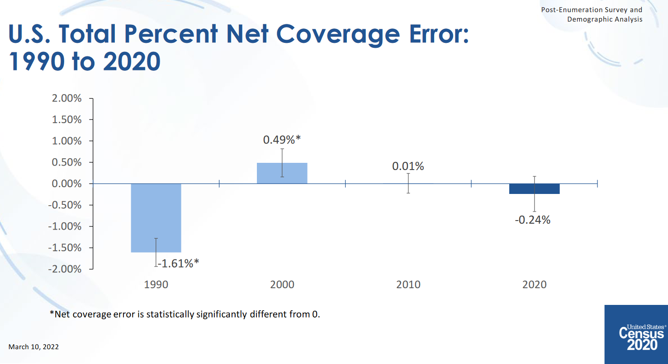

Slide 4
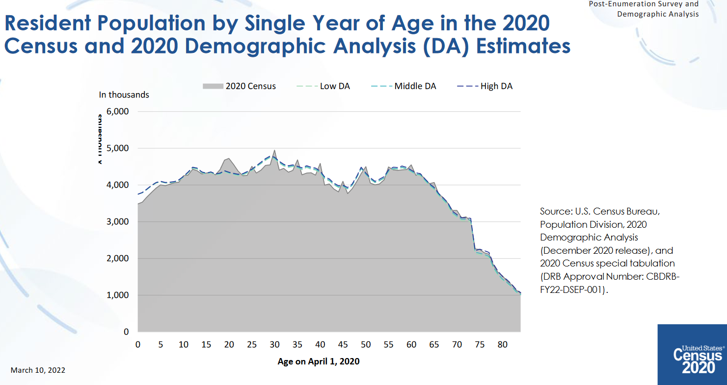

Slide 5
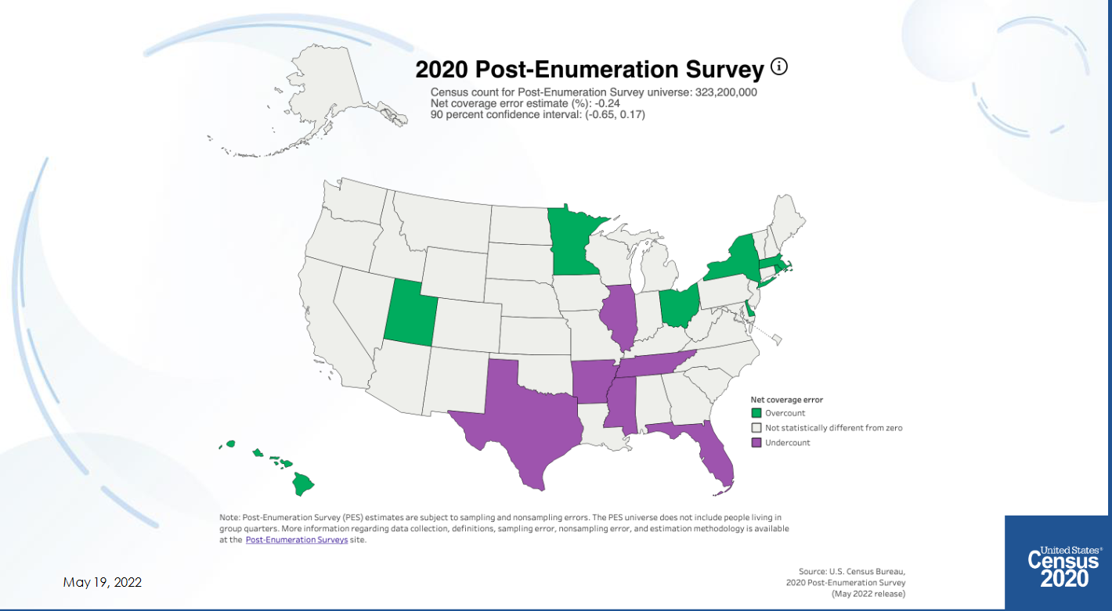

Slide 6
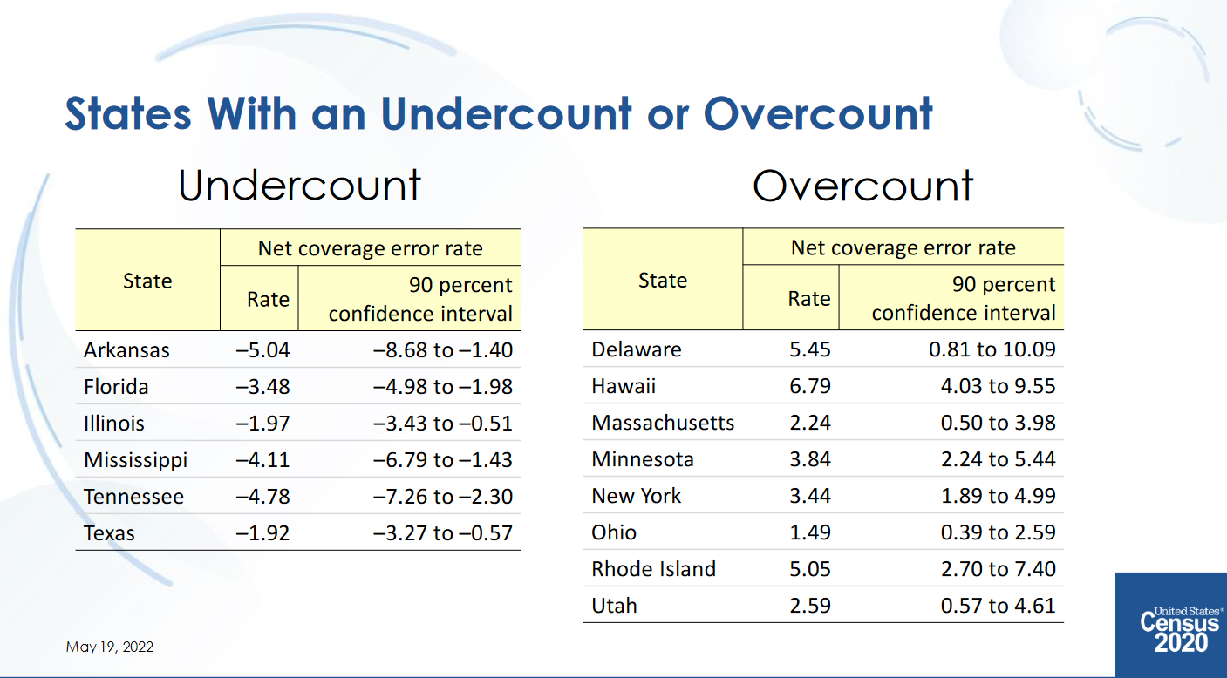
Texas had an undercount of -0.97 in 2010 (not statistically different from 0)

Slide 7
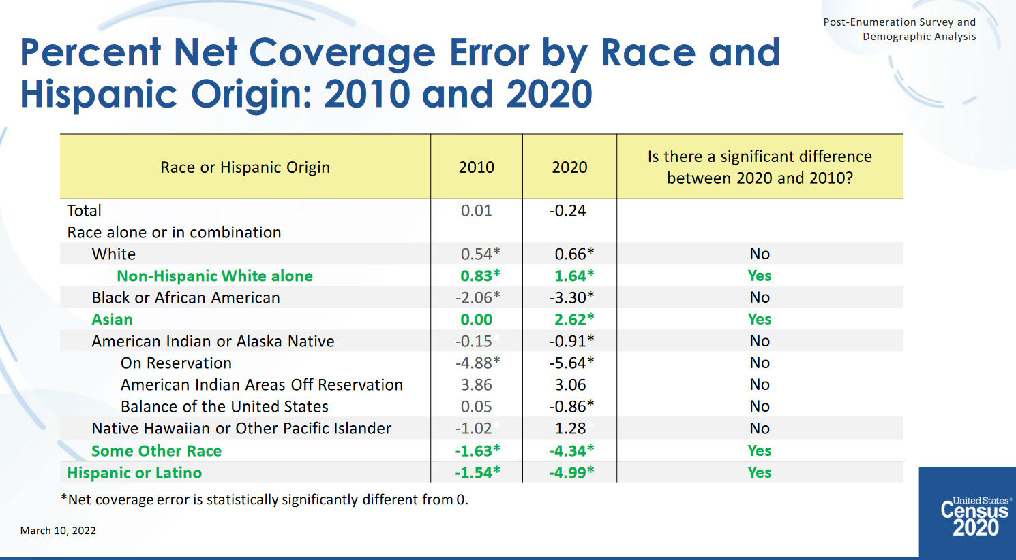

Slide 8

Census Bureau’s Commitment to Data Stewardship
Data stewardship is central to the Census Bureau’s mission to produce high-quality statistics about the people and economy of the United States.
The Census Bureau’s commitment to protect the privacy of respondents and the confidentiality of their data is both a legal obligation and a core component of Census Bureau institutional culture.
2020CENSUS.GOV

Slide 9
The Census Bureau’s Privacy Protections Over Time
Throughout its history, the Census Bureau has been at the forefront of the design and implementation of statistical methods to safeguard respondent data.
Over the decades, as we have increased the number and detail of the data products we release, so too have we improved the statistical techniques we use to protect those data.
Stopped publishing small area data
Whole-table suppression
Data swapping
Formal Privacy
1930
1970
1990
2020

Slide 10
2010 Demonstration Products
Census Bureau has released a set of data products that demonstrate the computational capabilities of the DAS. The current version of the DAS was run on the 2010 internal data to produce two products:
- PL 94-171
- Demographic and Housing Characteristics File (selected tables)
Allows data users to assess the impacts of the DAS implementation.
Uses Privacy-Loss Budget of ε=6 (ε=4 for person records, ε=2 for household records)
Available at: https://www.census.gov/programs-surveys/decennial-census/2020- census/planning-management/2020-census-data-products/2010-demonstration- data-products.html

Slide 11
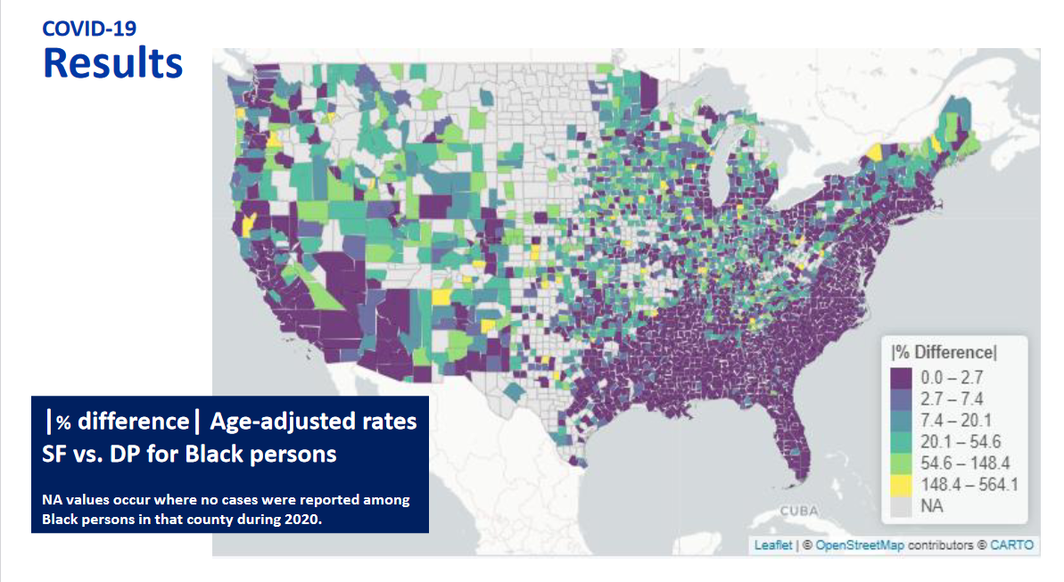

Slide 12
Minority population drove growth in Texas between 2010-2020
3,999,944 new Texans
95.3% attributable to growth of minority populations
Source: US Census Bureau, 2010 and 2020 Census, P.L. 94-171 Redistricting Files

Slide 13
Estimated Racial/Ethnic Composition of Texas Population, 2021
Source: U.S. Census Bureau, American Community Survey, 2021

Slide 14
States with Most Population Growth, 2020 to 2022
Geographic Area | Population Estimate (as of July 1)
 | 2020 | 2021 | 2022 | Change 21-22 | Rank Change 21-22 | Pct. Change 21-22 | Rank Pct. Change 21-22
United States | 331,511,512 | 332,031,554 | 333,287,557 | 1,256,003 |  | 0.4%
Texas | 29,232,474 | 29,558,864 | 30,029,572 | 470,708 | 1 | 1.6% | 4
Florida | 21,589,602 | 21,828,069 | 22,244,823 | 416,754 | 2 | 1.9% | 1
North Carolina | 10,449,445 | 10,565,885 | 10,698,973 | 133,088 | 3 | 1.3% | 9
Georgia | 10,729,828 | 10,788,029 | 10,912,876 | 124,847 | 4 | 1.2% | 12
Arizona | 7,179,943 | 7,264,877 | 7,359,197 | 94,320 | 5 | 1.3% | 8
South Carolina | 5,131,848 | 5,193,266 | 5,282,634 | 89,368 | 6 | 1.7% | 3
Tennessee | 6,925,619 | 6,968,351 | 7,051,339 | 82,988 | 7 | 1.2% | 11
Washington | 7,724,031 | 7,740,745 | 7,785,786 | 45,041 | 8 | 0.6% | 16
Utah | 3,283,785 | 3,339,113 | 3,380,800 | 41,687 | 9 | 1.2% | 10
Idaho | 1,849,202 | 1,904,314 | 1,939,033 | 34,719 | 10 | 1.8% | 2
’20-’21 -> 902
new Texans per day
’21-’22 -> 1,290 new Texans per day

Slide 15
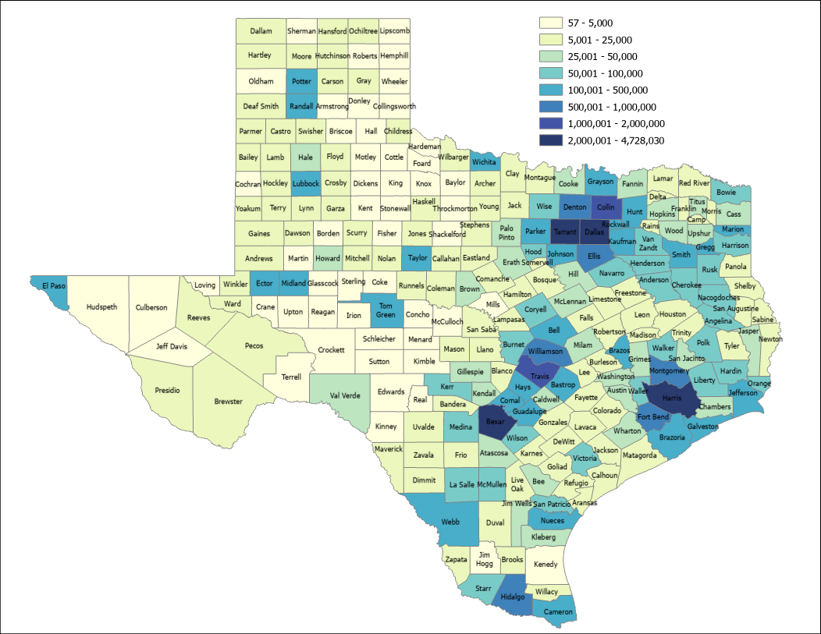

2021 Estimated Population, Texas Counties
89.4%
Source: US Census Bureau, 2021 Population Estimates

Slide 16
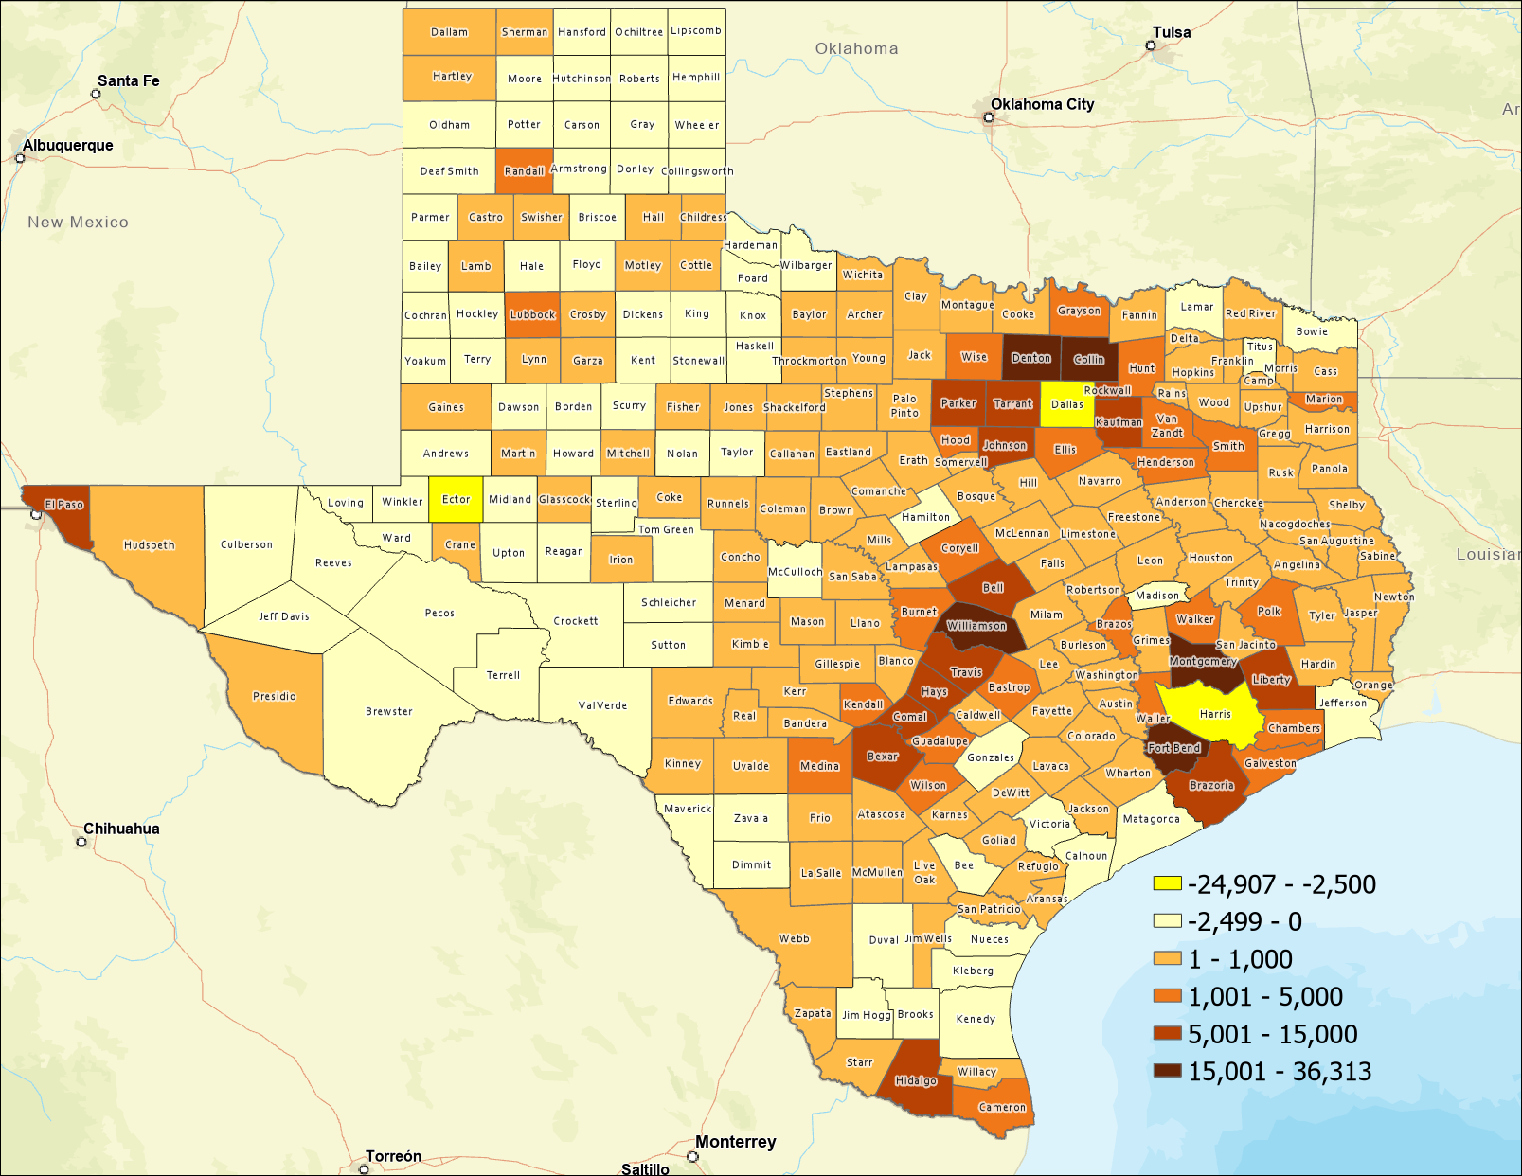
Estimated Numeric Change, Texas Counties, 2020-2021
82 Counties Lost Population
SOURCE: US Census Bureau, Population Estimates, 2021 Vintage

Slide 17
Top Counties for Numeric Growth in Texas, 2020-2021
County | US Rank | 2021 Population Estimate | Population Change 2020-2021 | Percent of Change from Natural Increase | Percent of Change from International Migration | Percent of Change from Domestic Migration
Collin | 2 | 1,109,462 | 36,313 | 13.2% | 4.4% | 82.4%
Fort Bend | 4 | 858,527 | 29,895 | 12.6% | 5.6% | 81.8%
Williamson | 5 | 643,026 | 27,760 | 9.2% | 1.3% | 89.5%
Denton | 6 | 941,647 | 27,747 | 14.8% | 2.6% | 82.6%
Montgomery | 8 | 648,886 | 23,948 | 7.7% | 1.9% | 90.4%
Bexar | 17 | 2,028,236 | 14,184 | 59.1% | 6.6% | 34.2%
Tarrant | 23 | 2,126,477 | 11,768 | 82.5% | 15.6% | 1.9%
Hays | 24 | 255,397 | 11,588 | 8.5% | 1.2% | 90.3%
Comal | 25 | 174,986 | 11,413 | 0.4% | 0.2% | 99.3%
Kaufman | 28 | 157,768 | 10,782 | 4.3% | 0.1% | 95.6%
Travis | 35 | 1,305,154 | 9,054 | 82.1% | 19.9% | -1.9%
Ellis | 44 | 202,678 | 8,406 | 5.2% | 0.1% | 94.6%
Source: US Census Bureau, 2021 Population Estimates

Slide 18
Top Counties for Percent Growth in Texas, 2020-2021*
County | US Rank | 2021 Population Estimate | Population Change 2020-2021 | Percent Population Change 2020-2021 | Percent of Population Change from Natural Increase | Percent of Population Change from International Migration | Percent of Population Change from Domestic Migration
Kaufman | 1 | 157,768 | 10,782 | 7.3% | 4.3% | 0.1% | 95.6%
Comal | 2 | 174,986 | 11,413 | 7.0% | 0.4% | 0.2% | 99.3%
Rockwall | 3 | 116,381 | 7,291 | 6.7% | 3.9% | 0.6% | 95.5%
Liberty | 4 | 97,621 | 5,270 | 5.7% | 3.7% | 0.1% | 96.2%
Parker | 9 | 156,764 | 7,332 | 4.9% | 0.9% | 0.6% | 98.6%
Hays | 10 | 255,397 | 11,588 | 4.8% | 8.5% | 1.2% | 90.3%
Williamson | 14 | 643,026 | 27,760 | 4.5% | 9.2% | 1.3% | 89.5%
Ellis | 17 | 202,678 | 8,406 | 4.3% | 5.2% | 0.1% | 94.6%
Waller | 19 | 59,781 | 2,432 | 4.2% | 9.3% | 0.4% | 90.3%
Bastrop | 20 | 102,058 | 4,075 | 4.2% | 3.4% | -0.3% | 97.0%
Wise | 22 | 71,714 | 2,848 | 4.1% | -1.4% | 0.1% | 101.2%
Montgomery | 25 | 648,886 | 23,948 | 3.8% | 7.7% | 1.9% | 90.4%
Johnson | 32 | 187,280 | 6,547 | 3.6% | 4.6% | 0.3% | 95.1%
Source: US Census Bureau, 2021 Population Estimates
*Among counties with populations of 50,000 or more in 2020

Slide 19
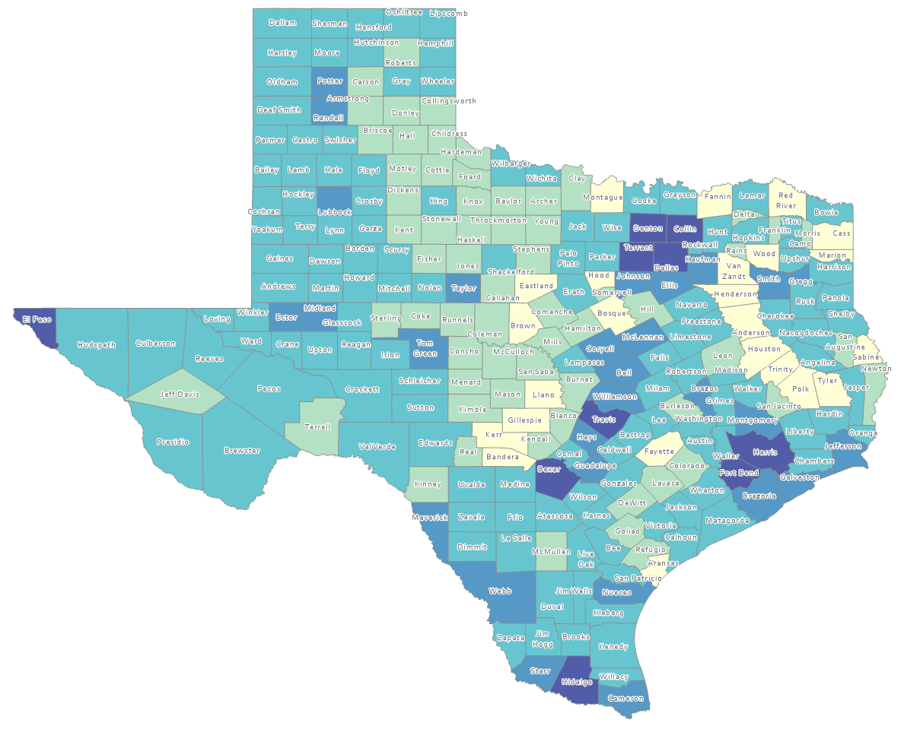
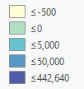
Estimated Natural Increase (Decrease), Texas Counties, 2010-2020
86 counties had natural decrease over the decade (1/3 of Texas’ counties)
Source: US Census Bureau, 2020 Population Estimates

Slide 20
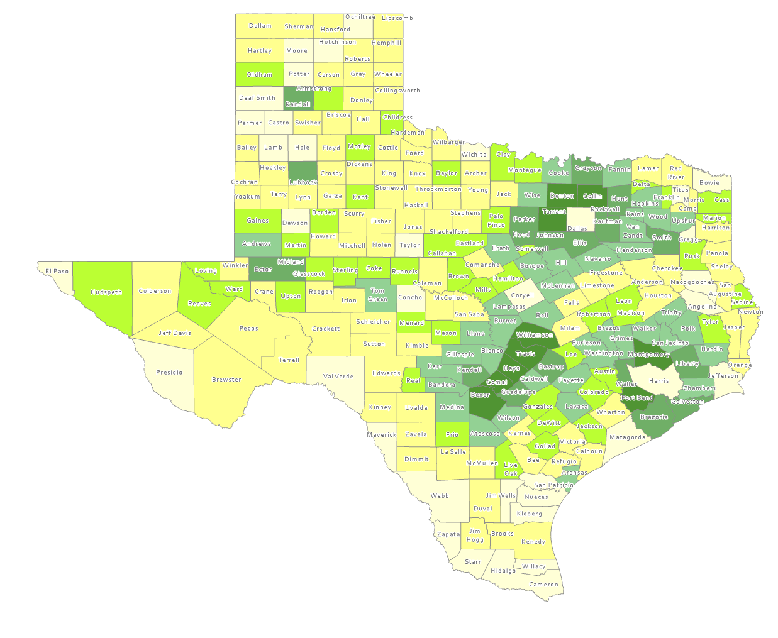
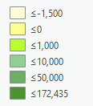
Estimated Population Change from Domestic Migration, Texas Counties, 2010-2020
More than half (134) of counties had net out domestic migration
Source: US Census Bureau, 2020 Population Estimates

Slide 21
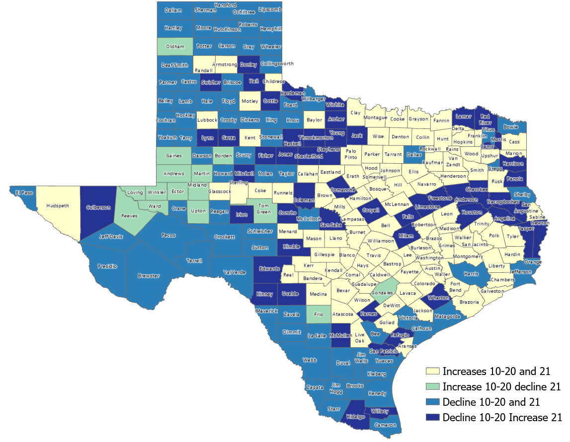
Estimated Change from Domestic Migration Comparing 2010-20 and 2020-21, Texas Counties
Number of Counties
106
15
79
54
Source: US Census Bureau, 2021 Population Estimates

Slide 22
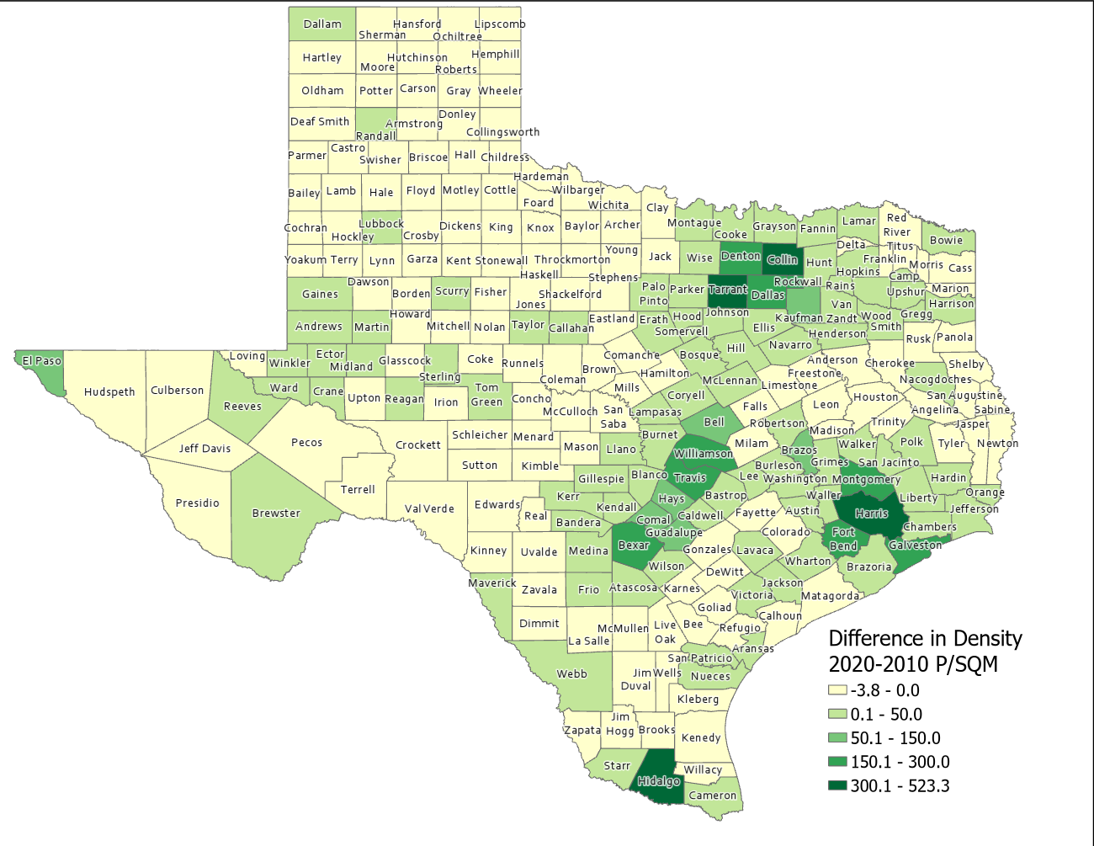
Difference in Population Density per Square Mile (2020-2010), Texas Counties
SOURCE: US Census Bureau, 2010 and 2020 Census, P.L. 94-171 Redistricting Files

Slide 23
Estimated Components of Population Change for Texas, 2010-2020, 2020-2021 and 2021-2022
2010 to 2020
2020 to 2021
2021 to 2022
SOURCE: U.S. Census Bureau. 2020 Evaluation Population Estimates and 2021 and 2022 Vintage Population Estimates

Slide 24
Estimated Domestic and International Migration for Texas, 2011-2022
SOURCE: U.S. Census Bureau. 2020 Evaluation Population Estimates and 2022 Vintage Population Estimates

Slide 25
Texas Birth Rates, 2007-2019
SOURCE: Centers for Disease Control and Prevention, National Center for Health Statistics.

Slide 26
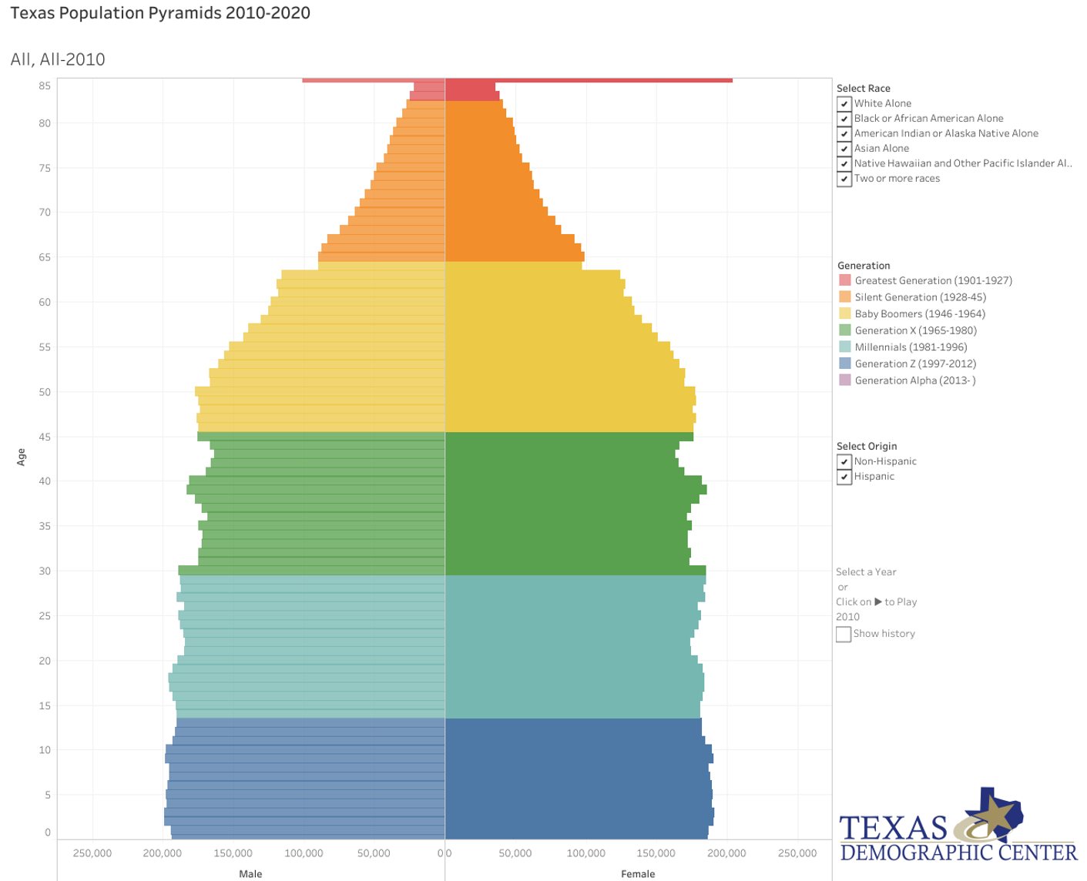
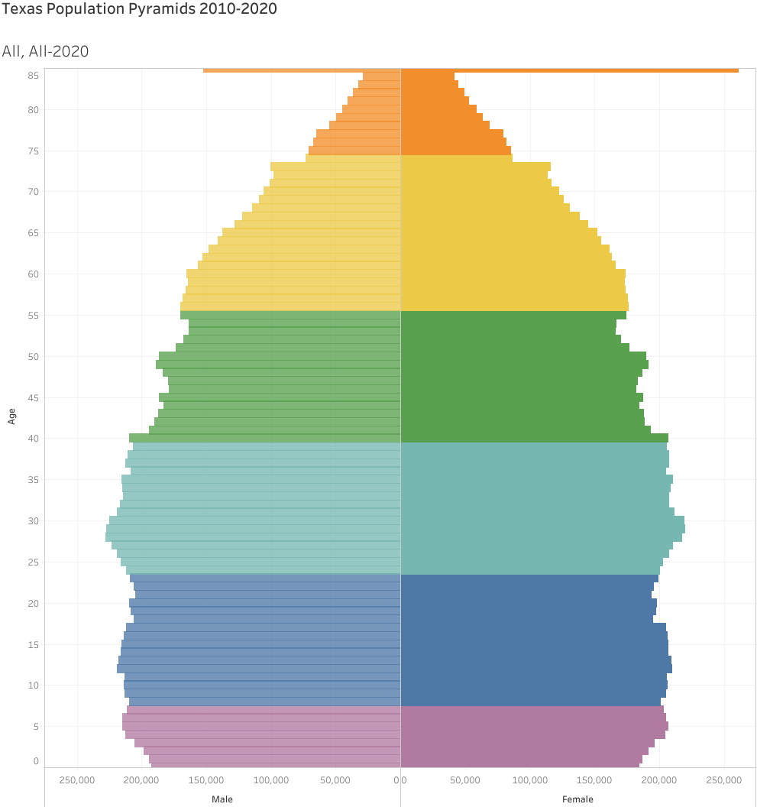
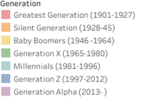
Generational Population Pyramids, Texas, 2010 and 2020
2010
2020
2010
2015
2020
Year of birth
SOURCE: U.S. Census Bureau. 2010 and 2020 Vintage Population Estimates

Slide 27
Estimated Net Domestic Migrants Between Texas and Other States, 2010-2019
Source: U.S. Census Bureau, State-to-State Migration Flows, 2010-2019

Slide 28
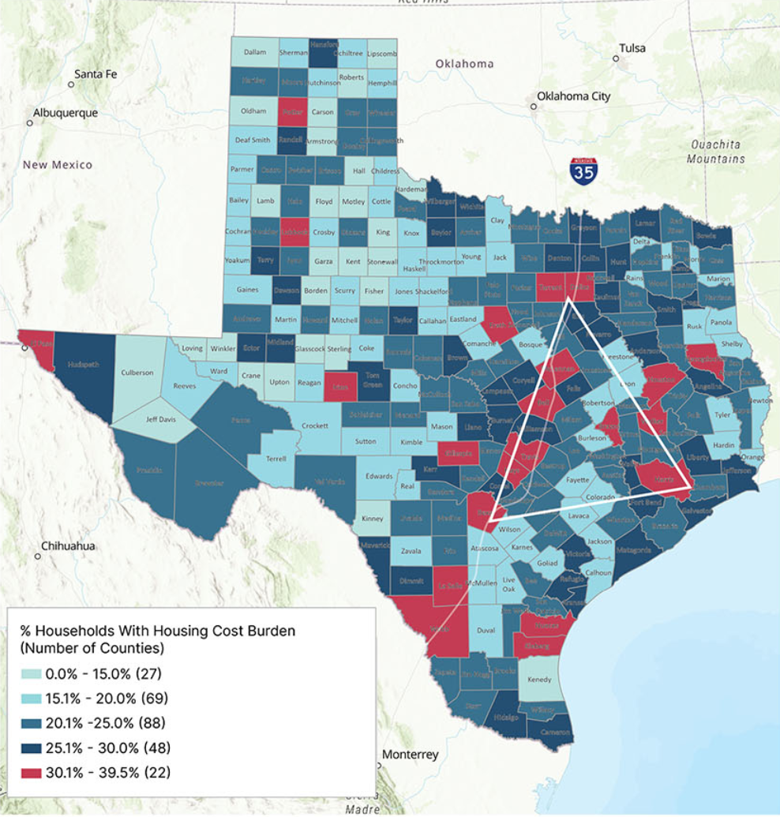
Housing Cost Burden in Texas, 2017-2021

Slide 29
Projected Population Growth in Texas, 2010-2060
SOURCE: Texas Demographic Center, Vintage 2022 and 2018 Population Projections

Slide 30
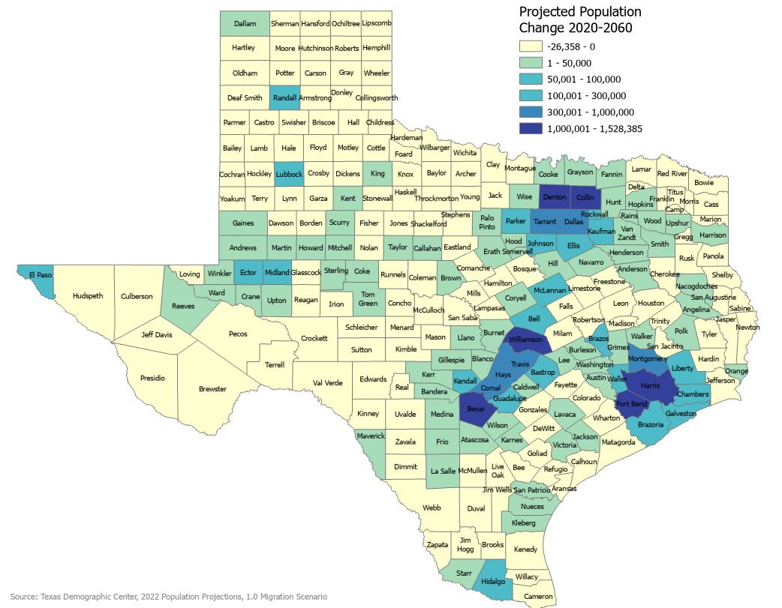
Projected Population Change, Texas Counties, 2020-2060

Slide 31
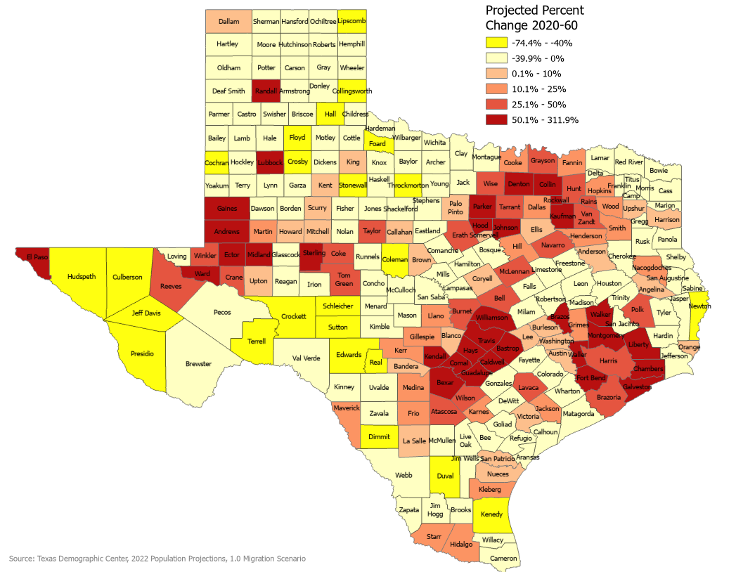
Projected Percent Population Change, Texas Counties, 2020-2060

Slide 32




Lloyd Potter, Ph.D.
(210) 458-6530
TDC@UTSA.edu
Demographics.Texas.gov
@TexasDemography

