Slide 1
Demographic Trends and Characteristics of Texas and Texas Counties
Texas House of Representatives
County Affairs Committee
March 1, 2023
Austin, Texas

Slide 2
States with Most Population Growth, 2010 to 2020
 | 2010 Population | 2020 Population | Numeric Change 2010-2020 | Percent Change 2010-2020
United States | 308,745,538 | 331,449,281 | 22,703,743 | 7.4%
Texas | 25,145,561 | 29,145,505 | 3,999,944 | 15.9%
Florida | 18,801,310 | 21,538,187 | 2,736,877 | 14.6%
California | 37,253,956 | 39,538,223 | 2,284,267 | 6.1%
Georgia | 9,687,653 | 10,711,908 | 1,024,255 | 10.6%
Washington | 6,724,540 | 7,705,281 | 980,741 | 14.6%
North Carolina | 9,535,483 | 10,439,388 | 903,905 | 9.5%
New York | 19,378,102 | 20,201,249 | 823,147 | 4.2%
Arizona | 6,392,017 | 7,151,502 | 759,485 | 11.9%
Colorado | 5,029,196 | 5,773,714 | 744,518 | 14.8%
Virginia | 8,001,024 | 8,631,393 | 630,369 | 7.9%
Tennessee | 6,346,105 | 6,910,840 | 564,735 | 8.9%
Utah | 2,763,885 | 3,271,616 | 507,731 | 18.4%
*
SOURCE: U.S. Census Bureau. 2010 and 2020 Census Count
* About 1,096 new Texans each day on average
Notes:
Texas grew more than any other state between the 2010 and 2020 Census and we are the second largest state. We added almost 4 million Texas over the decade and grew at a rate of almost 16 percent, faster than all but two states – Utah and Idaho – both substantially smaller than Texas. On average, Texas’ population added about 1,096 persons per day over last decade from the combination of more births than deaths and net in-migration.

Slide 3
Notes:
As you know, the 2020 Census was deployed during the COVID pandemic, leading to significant challenges. To assess the quality of the Census, the Census Bureau estimates the accuracy of the census count by state. Eight states are estimated to have over-count, and 4 states undercount. Texas is among the four estimated to have been undercounted.

Slide 4
Texas had an undercount of -0.97 in 2010 (not statistically different from 0)
Notes:
The undercount in Texas was estimated to be 1.92 percent. That equates to about 500,000 Texans missed in the 2020 Census.

Slide 5
States with the Most Population Growth, 2020 to 2022
Geographic Area | Population Estimate (as of July 1)
 | 2020 | 2021 | 2022 | Change 21-22 | Rank Change 21-22 | Pct. Change 21-22 | Rank Pct. Change 21-22
United States | 331,511,512 | 332,031,554 | 333,287,557 | 1,256,003 |  | 0.4%
Texas | 29,232,474 | 29,558,864 | 30,029,572 | 470,708 | 1 | 1.6% | 4
Florida | 21,589,602 | 21,828,069 | 22,244,823 | 416,754 | 2 | 1.9% | 1
North Carolina | 10,449,445 | 10,565,885 | 10,698,973 | 133,088 | 3 | 1.3% | 9
Georgia | 10,729,828 | 10,788,029 | 10,912,876 | 124,847 | 4 | 1.2% | 12
Arizona | 7,179,943 | 7,264,877 | 7,359,197 | 94,320 | 5 | 1.3% | 8
South Carolina | 5,131,848 | 5,193,266 | 5,282,634 | 89,368 | 6 | 1.7% | 3
Tennessee | 6,925,619 | 6,968,351 | 7,051,339 | 82,988 | 7 | 1.2% | 11
Washington | 7,724,031 | 7,740,745 | 7,785,786 | 45,041 | 8 | 0.6% | 16
Utah | 3,283,785 | 3,339,113 | 3,380,800 | 41,687 | 9 | 1.2% | 10
Idaho | 1,849,202 | 1,904,314 | 1,939,033 | 34,719 | 10 | 1.8% | 2
’20-’21 -> 902
new Texans per day
’21-’22 -> 1,290 new Texans per day
SOURCE: US Census Bureau, Population Estimates, 2021 and 2022 vintages
Notes:
Since the Census, Texas continues to grow more than any other state. Between 2021 and 2022, the most recent year for which we have estimates, Texas’ population exceeded 30 million and grew more than any other state adding over 470 thousand people. Texas continued to grow fast and grew faster than all but 3 other states. The COVID pandemic impacted Texas growth. Between 2020 and 2021, our population grew by only 902 persons per day on average. Oout growth more than recovered between 2021 and 2022, adding an average of almost 1,300 people per day.

Slide 6
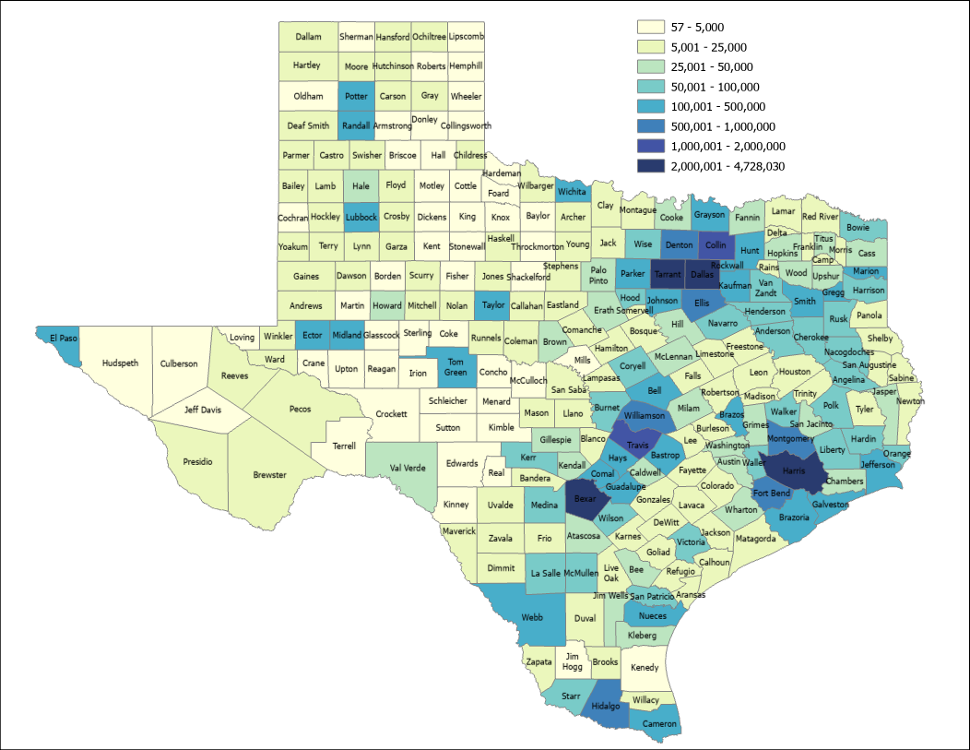
2021 Estimated Population, Texas Counties
89.4%
Source: US Census Bureau, 2021 Population Estimates
Notes:
2021 is the most recent year for which we have county-level estimates. When we look at the population distribution at the county level, we can see the population triangle anchored by San Antonio, Houston, and Dallas-Fort Worth. The population in counties along I-35 and east accounts for almost 90 percent of our total population. This highlights a dichotomy in population size and dynamics, with many of the rural counties in the west being sparsely populated. East of I-35 does have a significant number of sparsely populated counties as well, but it has some of the most populated counties in the country.

Slide 7
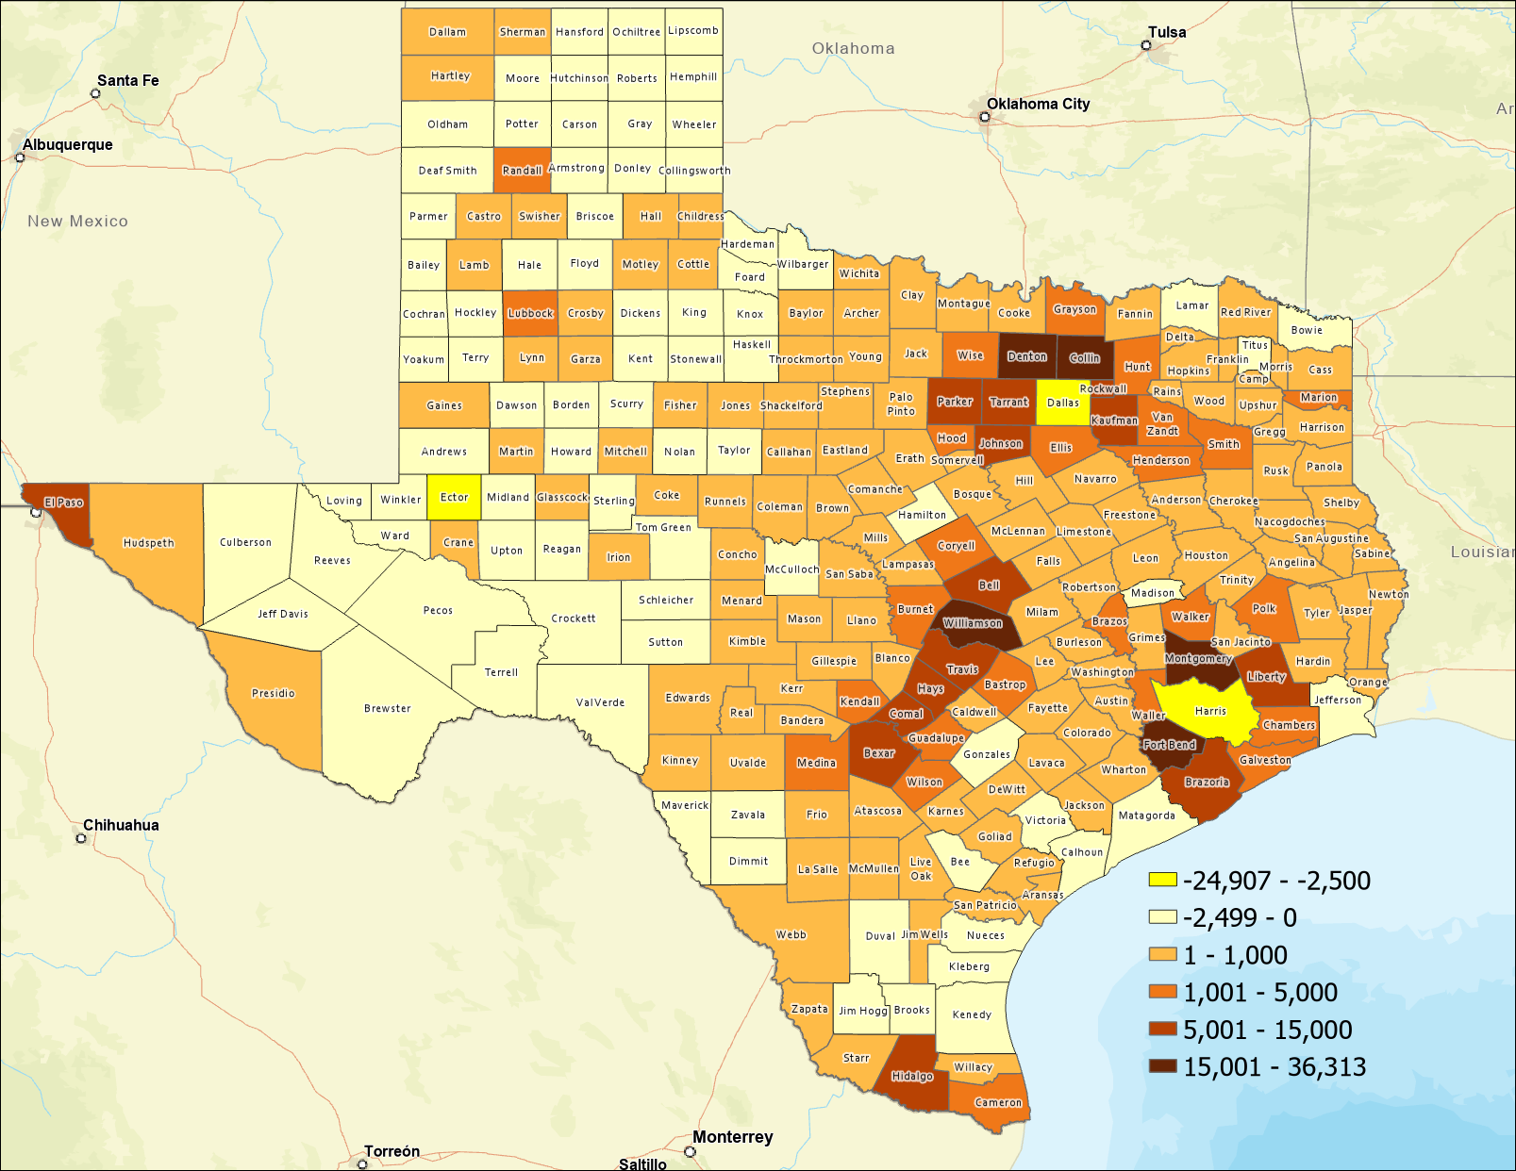
Estimated Numeric Change, Texas Counties, 2020-2021
82 Counties Lost Population
SOURCE: US Census Bureau, Population Estimates, 2021 Vintage
Notes:
Between 2020 and 2021, most of our counties experienced growth. Yet 82 counties lost population. These counties were mainly in west and south Texas. Suburban ring counties in the population triangle grew the most. Dallas and Harris counties lost population in this year after being among the most significant growing counties in the country for much of the last decade. This appears to be largely the result of net-out domestic migration combined with generally declining birth rates.

Slide 8
Top Counties for Numeric Growth in Texas, 2020-2021
County | US Rank | 2021 Population Estimate | Population Change 2020-2021 | Percent of Change from Natural Increase | Percent of Change from International Migration | Percent of Change from Domestic Migration
Collin | 2 | 1,109,462 | 36,313 | 13.2% | 4.4% | 82.4%
Fort Bend | 4 | 858,527 | 29,895 | 12.6% | 5.6% | 81.8%
Williamson | 5 | 643,026 | 27,760 | 9.2% | 1.3% | 89.5%
Denton | 6 | 941,647 | 27,747 | 14.8% | 2.6% | 82.6%
Montgomery | 8 | 648,886 | 23,948 | 7.7% | 1.9% | 90.4%
Bexar | 17 | 2,028,236 | 14,184 | 59.1% | 6.6% | 34.2%
Tarrant | 23 | 2,126,477 | 11,768 | 82.5% | 15.6% | 1.9%
Hays | 24 | 255,397 | 11,588 | 8.5% | 1.2% | 90.3%
Comal | 25 | 174,986 | 11,413 | 0.4% | 0.2% | 99.3%
Kaufman | 28 | 157,768 | 10,782 | 4.3% | 0.1% | 95.6%
Travis | 35 | 1,305,154 | 9,054 | 82.1% | 19.9% | -1.9%
Ellis | 44 | 202,678 | 8,406 | 5.2% | 0.1% | 94.6%
Source: US Census Bureau, 2021 Population Estimates
Notes:
This table presents the most significant growing counties in the State. Most of these are suburban counties, with Bexar (San Antonio), Tarrant (Forth Worth), and Travis (Austin) being the only urban core counties on this list. The population dynamics for these three urban core counties indicated that most of their growth is from natural increase (births-deaths). Also, note that Travis County had estimated net-out domestic migration for the first time. All of the other counties are growing from domestic migration.

Slide 9
Top Counties for Percent Growth in Texas, 2020-2021*
County | US Rank | 2021 Population Estimate | Population Change 2020-2021 | Percent Population Change 2020-2021 | Percent of Population Change from Natural Increase | Percent of Population Change from International Migration | Percent of Population Change from Domestic Migration
Kaufman | 1 | 157,768 | 10,782 | 7.3% | 4.3% | 0.1% | 95.6%
Comal | 2 | 174,986 | 11,413 | 7.0% | 0.4% | 0.2% | 99.3%
Rockwall | 3 | 116,381 | 7,291 | 6.7% | 3.9% | 0.6% | 95.5%
Liberty | 4 | 97,621 | 5,270 | 5.7% | 3.7% | 0.1% | 96.2%
Parker | 9 | 156,764 | 7,332 | 4.9% | 0.9% | 0.6% | 98.6%
Hays | 10 | 255,397 | 11,588 | 4.8% | 8.5% | 1.2% | 90.3%
Williamson | 14 | 643,026 | 27,760 | 4.5% | 9.2% | 1.3% | 89.5%
Ellis | 17 | 202,678 | 8,406 | 4.3% | 5.2% | 0.1% | 94.6%
Waller | 19 | 59,781 | 2,432 | 4.2% | 9.3% | 0.4% | 90.3%
Bastrop | 20 | 102,058 | 4,075 | 4.2% | 3.4% | -0.3% | 97.0%
Wise | 22 | 71,714 | 2,848 | 4.1% | -1.4% | 0.1% | 101.2%
Montgomery | 25 | 648,886 | 23,948 | 3.8% | 7.7% | 1.9% | 90.4%
Johnson | 32 | 187,280 | 6,547 | 3.6% | 4.6% | 0.3% | 95.1%
Source: US Census Bureau, 2021 Population Estimates
*Among counties with populations of 50,000 or more in 2020
Notes:
The fastest-growing counties are largely suburban ring counties that are growing from domestic migration. Growth from domestic migration put instant strain on infrastructure of areas affected. Each new household added to a county requires a housing unit, water, power, retail, places to work, possibly schools, and roads.

Slide 10
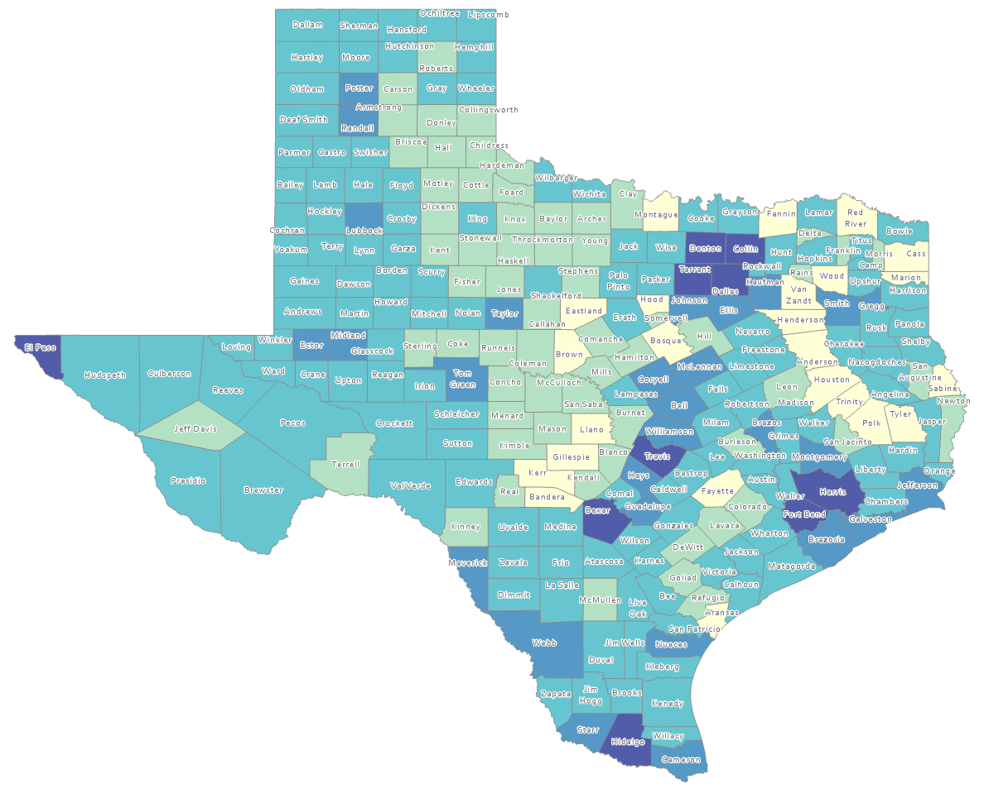
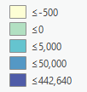
Estimated Natural Increase (Decrease), Texas Counties, 2010-2020
86 counties had natural decrease over the decade (1/3 of Texas’ counties)
Source: US Census Bureau, 2020 Population Estimates
Notes:
Many core and suburban ring counties had positive and significant natural increase last decade. Yet 86 of our counties had more deaths than births, These are largely rural counites in central west and east Texas. The population in these counties is aging and many of the young population move to more urban areas seeking post-secondary education and employement opportunity.

Slide 11
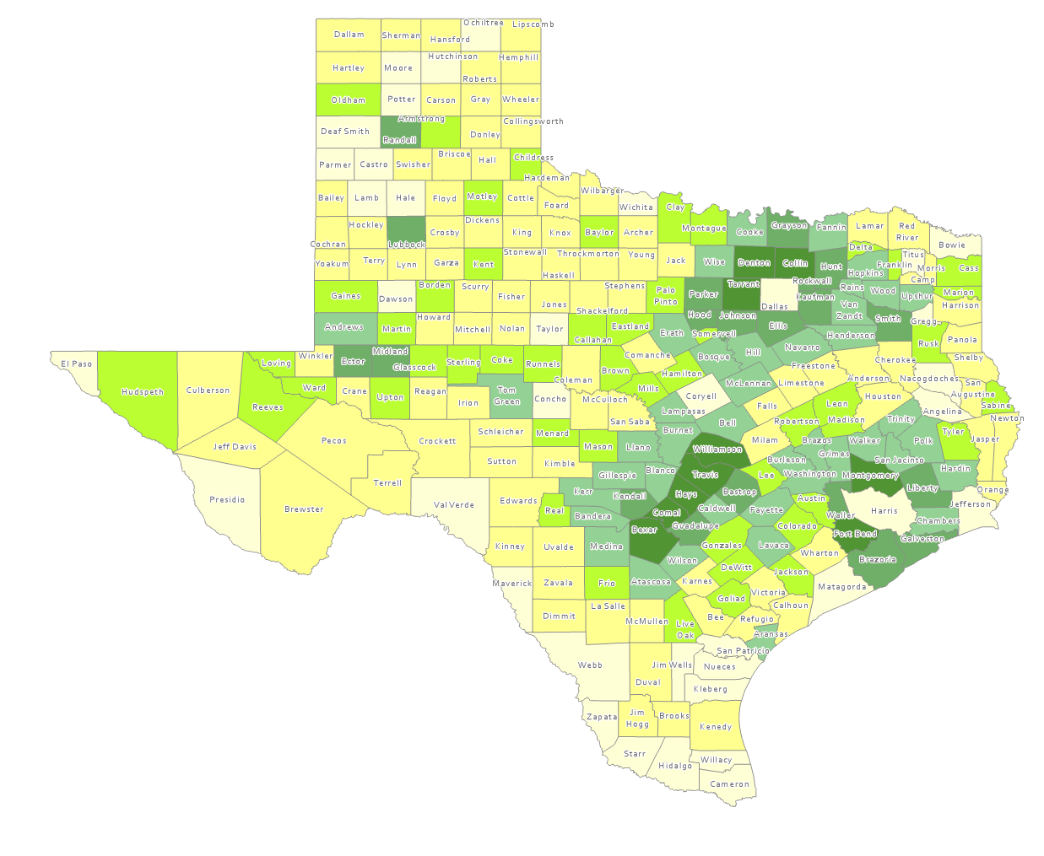
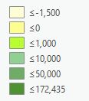
Estimated Population Change from Domestic Migration, Texas Counties, 2010-2020
More than half (134) of counties had net out domestic migration
Source: US Census Bureau, 2020 Population Estimates
Notes:
With the exception of Dallas and Harris Counties, metro areas around the urban cores had positive and significant net-in domestic migration last decade. Yet more than half of our counties had net-out domestic migration. Most of these counties loosing population from out migration are largely rural.

Slide 12
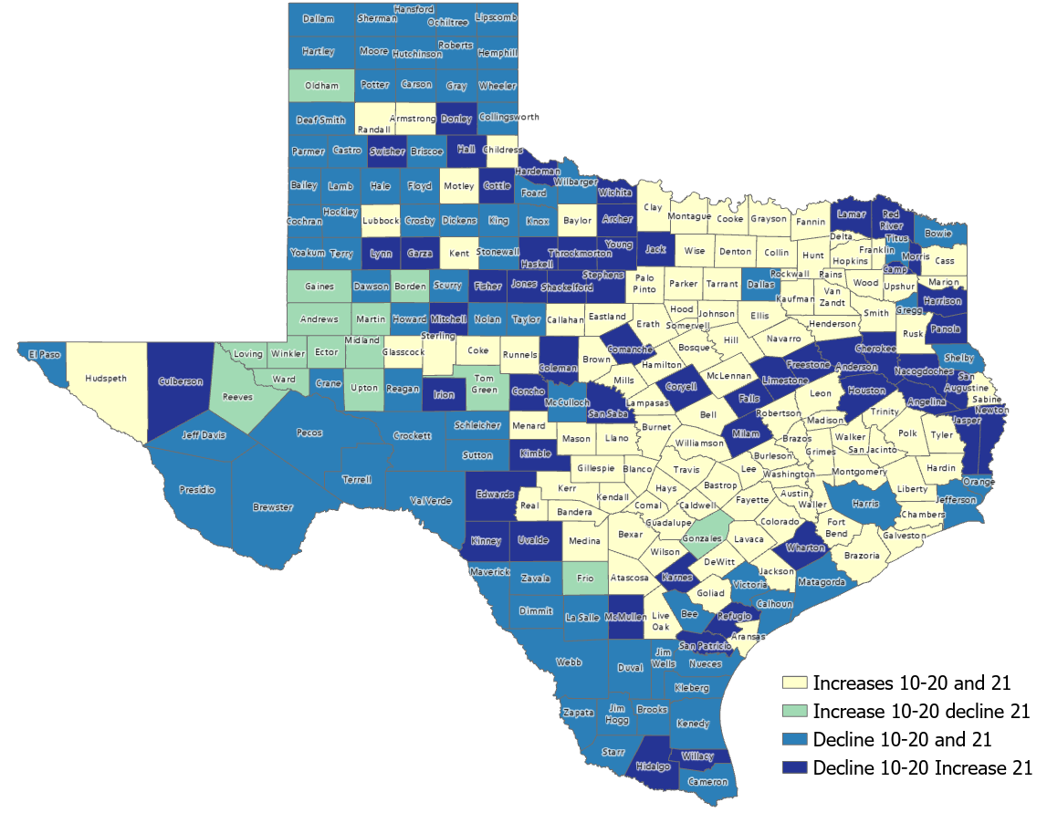
Estimated Change from Domestic Migration Comparing 2010-20 and 2020-21, Texas Counties
Number of Counties
106
15
79
54
Source: US Census Bureau, 2021 Population Estimates
Notes:
Between 2020 and 2021, during the height of the COVID pandemic, we noticed a turn-around of domestic migration for 54 counties. All of the dark blue counties had net out migration for all of last decade, but between 2020 and 2021, they experienced net in migration. We speculate that this may be people relocating to more rural places. We will monitor this closely when data are released for 2021-2022.

Slide 13
Minority population drove growth in Texas between 2010-2020
3,999,944 new Texans
95.3% attributable to growth of minority populations
Source: US Census Bureau, 2010 and 2020 Census, P.L. 94-171 Redistricting Files
Notes:
Last decade, our population growth was driven by the minority population, with almost half of our total growth driven by the Hispanic population.

Slide 14
Estimated Racial/Ethnic Composition of Texas Population, 2021
Source: U.S. Census Bureau, American Community Survey, 2021
Notes:
In 2021, the Hispanic population became the largest race/ethnic group in Texas now comprising over 40% of our population.

Slide 15
Estimated Net Domestic Migrants Between Texas and Other States, 2010-2019
Source: U.S. Census Bureau, State-to-State Migration Flows, 2010-2019
Notes:
Last decade, most of Texas’ domestic migrants came from California, Illinois, New York, and Florida.

Slide 16
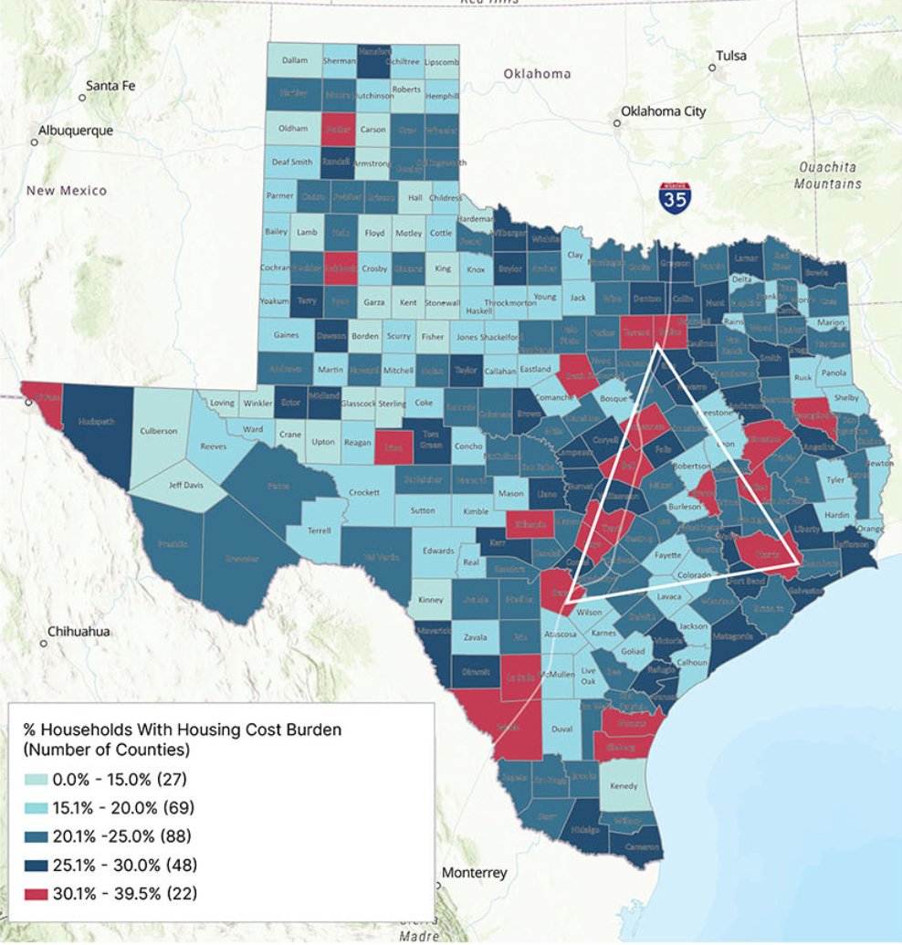
Housing Cost Burden in Texas, 2017-2021

Slide 17
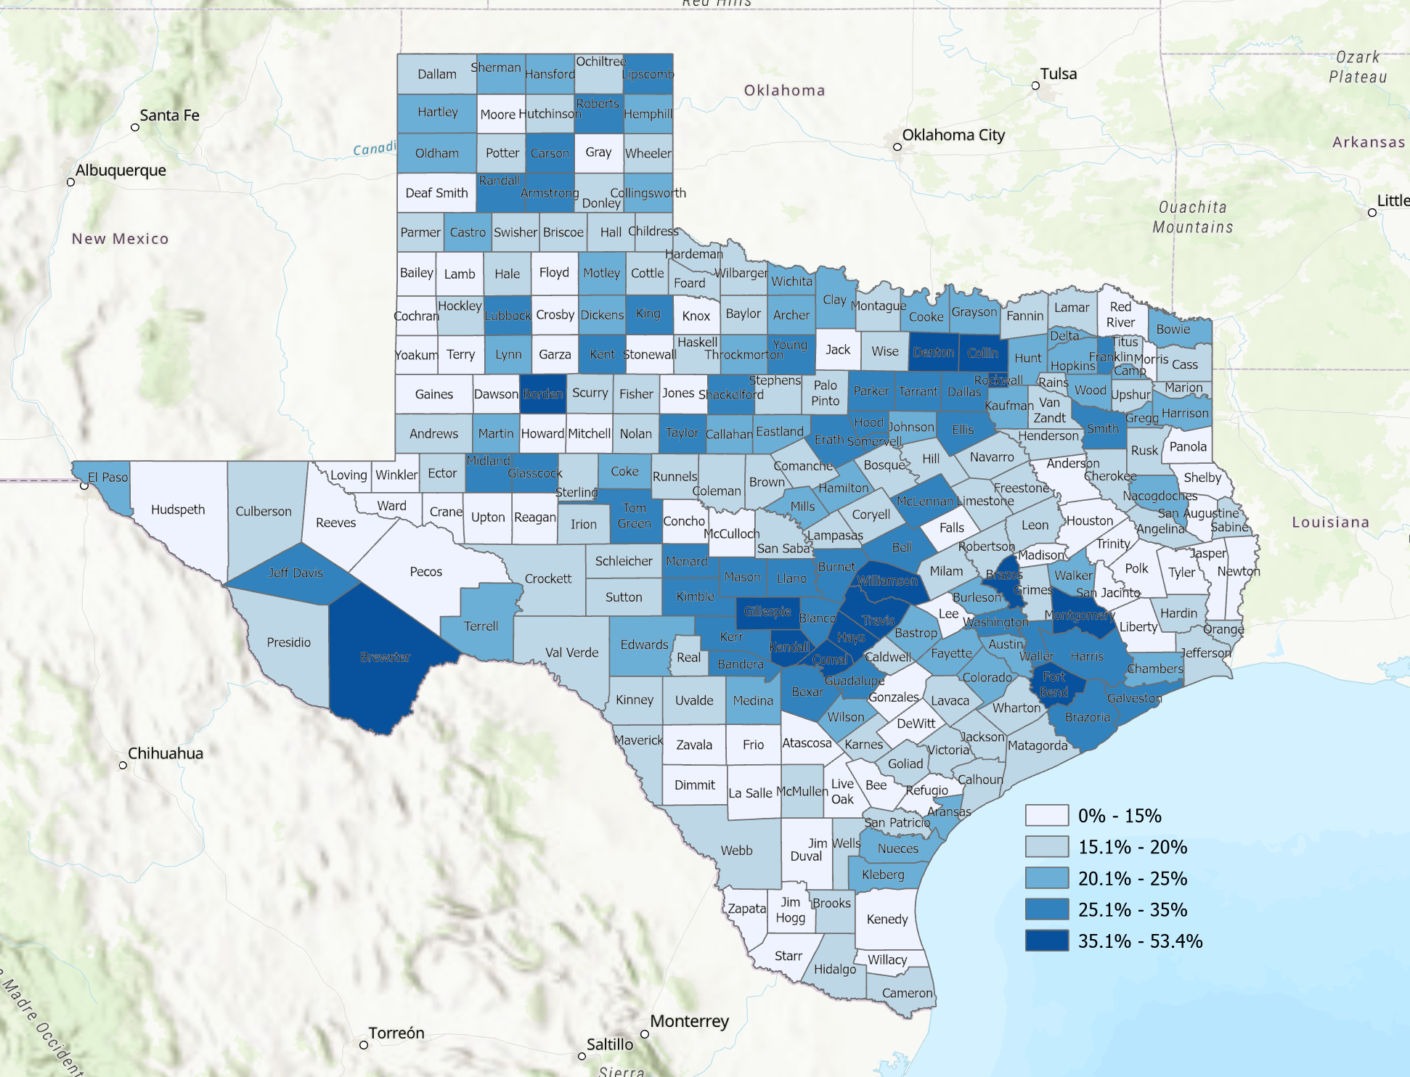
Percent of Adult Population with a Bachelor’s Degree or Higher, Texas Counties, 2017-2021
Source: US Census Bureau, American Community Survey, 5-Year Sample, 2017-2021
Notes:
Now shifting to look at population characteristics, we see that high percentages of adults have a bachelor’s degree or higher in the metro areas around the points of the population triangle. Rural areas, with some exceptions tend to have lower levels of educational attainment.

Slide 18
Educational Attainment of Persons Age 25 Years and Older by Race/Ethnicity, Texas, 2019
39.9%
70.1 %
Source: US Census Bureau, American Community Survey, 1-Year Sample, 2019
Notes:
Educational attainment varies significantly by race and ethnicity. Here we see the non-Hispanic white population having post-secondary education being over 70% while this is true for less than forty percent of Hispanics. This is significant for Texas because of the relatively rapid and significant growth of the Hispanic population.

Slide 19
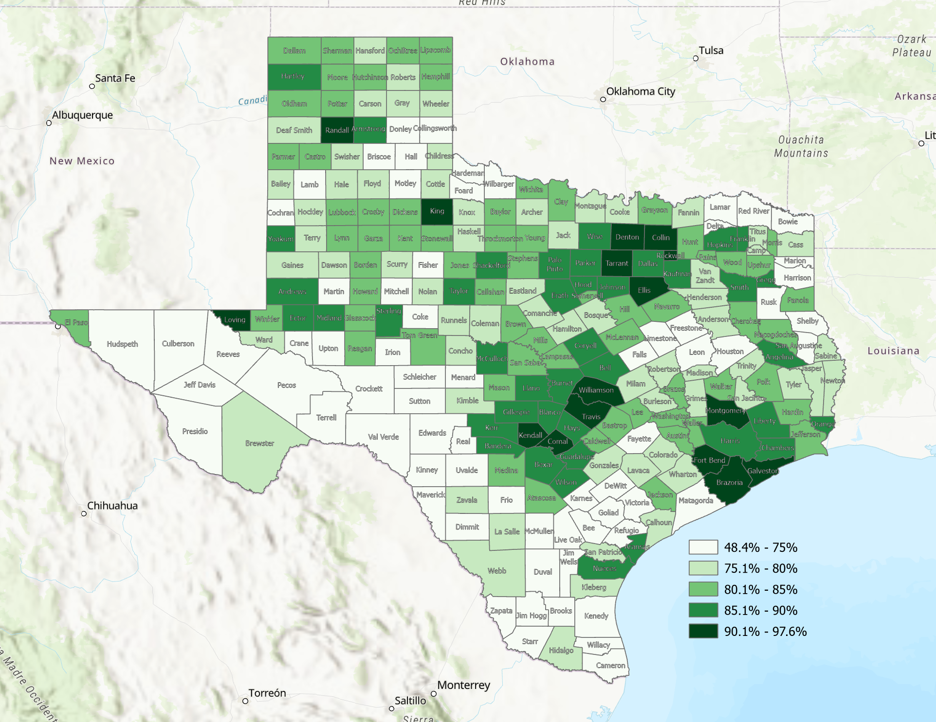
Percent of Households with Broadband Internet Subscription, Texas Counties, 2017-2021
Source: US Census Bureau, American Community Survey, 5-Year Sample, 2017-2021
Notes:
Texas is prioritizing expanding its internet infrastructure. When we look at the percentage of households with broadband subscriptions, we see high percentages in metro areas and much of south and southwest Texas, along with many rural counties across the State having limited access to the internat.

Slide 20
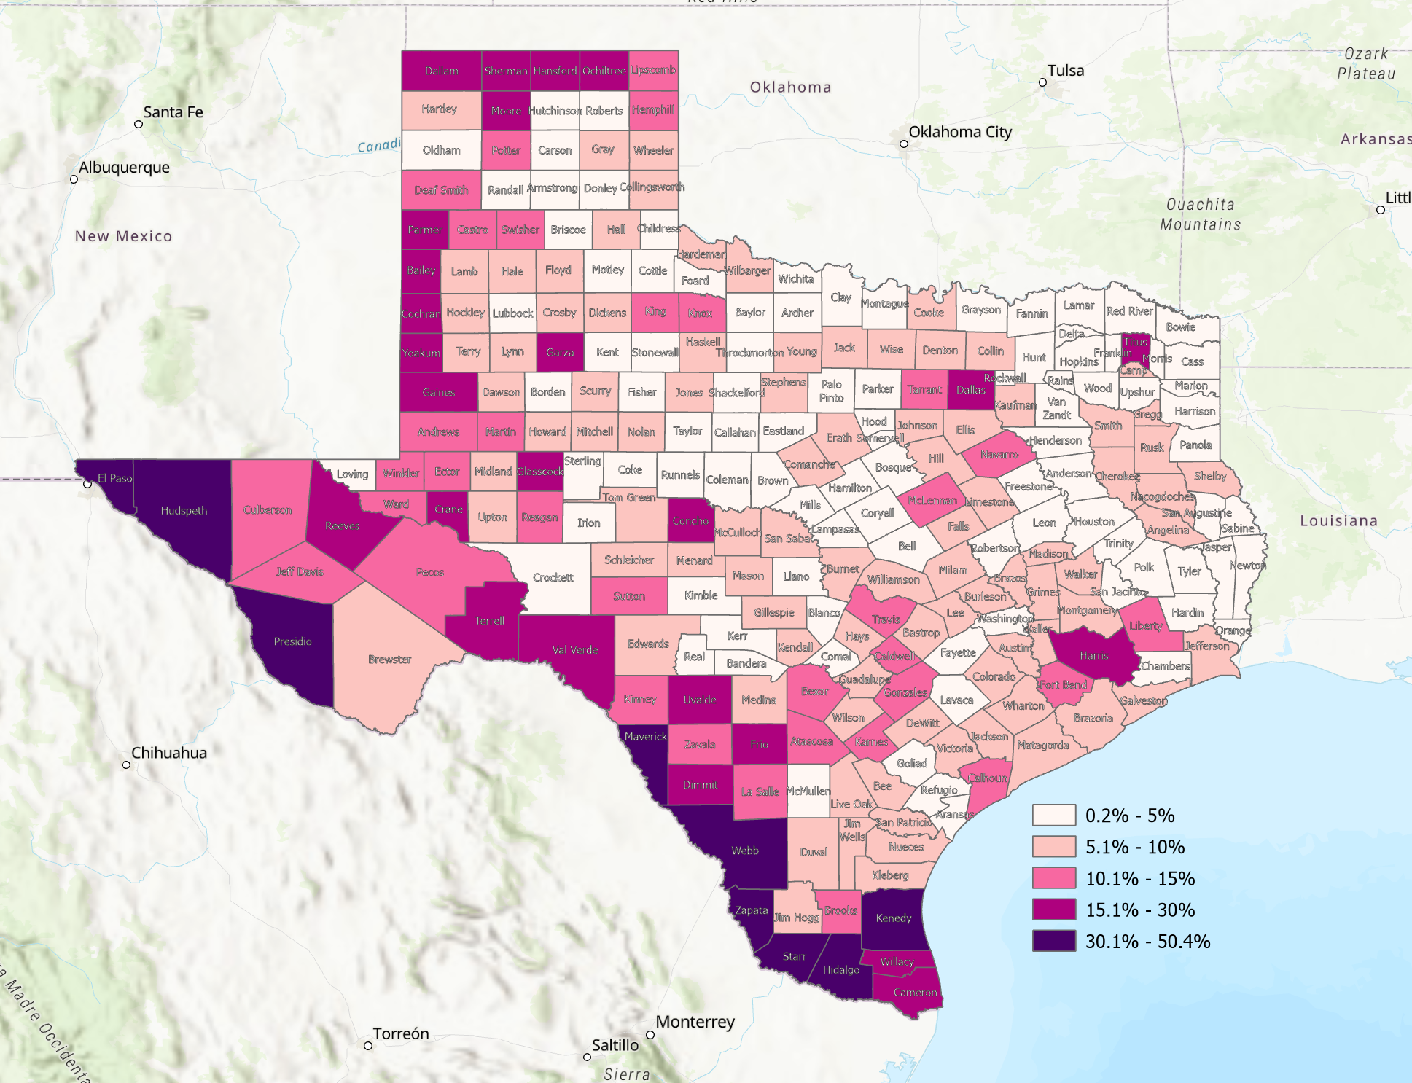
Percent of Persons Who Speak a Language Other than English and Speak English Less than Very Well,, Texas Counties, 2017-2021
Source: US Census Bureau, American Community Survey, 5-Year Sample, 2017-2021

Slide 21
Projected Population Growth in Texas, 2010-2060
SOURCE: Texas Demographic Center, Vintage 2022 and 2018 Population Projections
Notes:
The latest population projections from the Texas Demographic Center are lower than those we produced last decade. This is the result of substantial declines in birth rates over the last half of last decade. We also saw slowing of domestic migration for the second half of last decade. Even with slower projected growth, Texas is anticipated to continue to lead the nation in population growth, just at a slightly slower, and hopefully, more manageable pace.

Slide 22
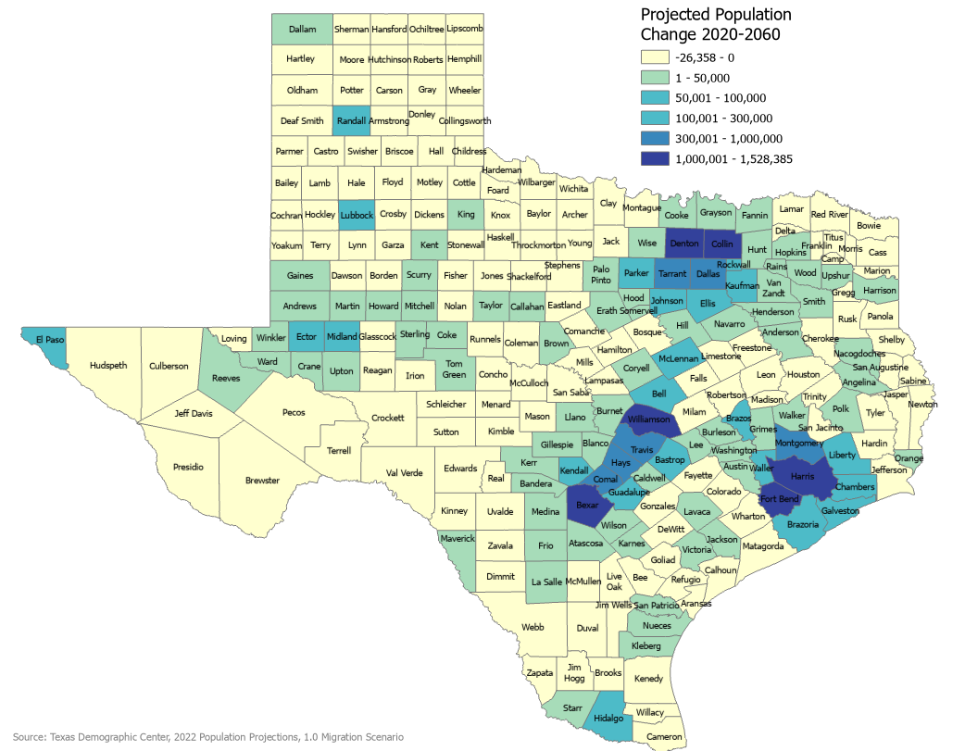
Projected Population Change, Texas Counties, 2020-2060
Notes:
Most of the projected growth is around and in the urban cores of the State. Many rural counties are projected to lose population.

Slide 23
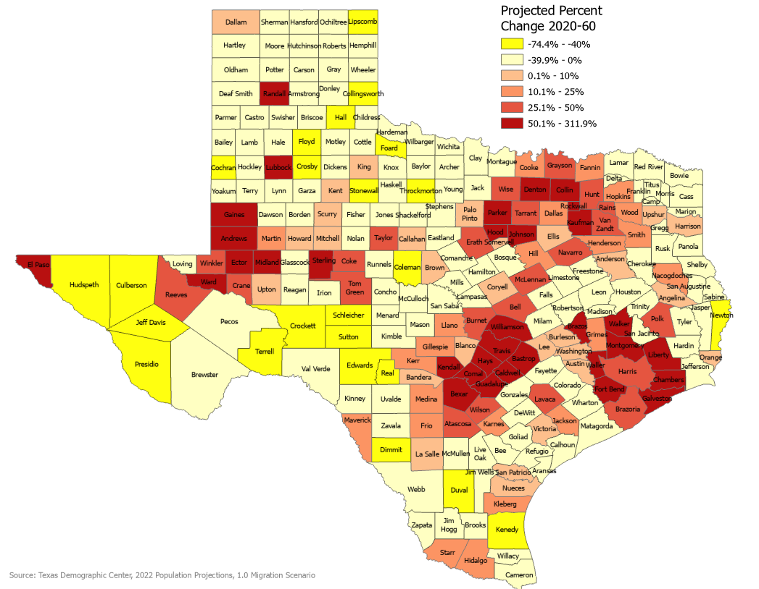
Projected Percent Population Change, Texas Counties, 2020-2060
Notes:
Our projections indicate that the fasted growing counties will be in the metro areas around the points of the population triangle. The Permean Basin is also projected to have fast growth.

Slide 24
Monica Cruz, Ph.D.
(210) 458-6543
TDC@UTSA.edu
Demographics.Texas.gov
@TexasDemography
Notes:
This concludes my testimony and I would be happy to attempt to address any questions you may have.

