Slide 1
Population Change and Higher Education in Texas
University of Texas System
Executive Officers and the Chancellor’s Administrative Council
March 2, 2023

Slide 2
States with Most Population Growth, 2010 to 2020
 | 2010 Population | 2020 Population | Numeric Change 2010-2020 | Percent Change 2010-2020
United States | 308,745,538 | 331,449,281 | 22,703,743 | 7.4%
Texas | 25,145,561 | 29,145,505 | 3,999,944 | 15.9%
Florida | 18,801,310 | 21,538,187 | 2,736,877 | 14.6%
California | 37,253,956 | 39,538,223 | 2,284,267 | 6.1%
Georgia | 9,687,653 | 10,711,908 | 1,024,255 | 10.6%
Washington | 6,724,540 | 7,705,281 | 980,741 | 14.6%
North Carolina | 9,535,483 | 10,439,388 | 903,905 | 9.5%
New York | 19,378,102 | 20,201,249 | 823,147 | 4.2%
Arizona | 6,392,017 | 7,151,502 | 759,485 | 11.9%
Colorado | 5,029,196 | 5,773,714 | 744,518 | 14.8%
Virginia | 8,001,024 | 8,631,393 | 630,369 | 7.9%
Tennessee | 6,346,105 | 6,910,840 | 564,735 | 8.9%
Utah | 2,763,885 | 3,271,616 | 507,731 | 18.4%
*
SOURCE: U.S. Census Bureau. 2010 and 2020 Census Count
* About 1,096 new Texans each day on average

Slide 4
Texas had an undercount of -0.97 in 2010 (not statistically different from 0)

Slide 6
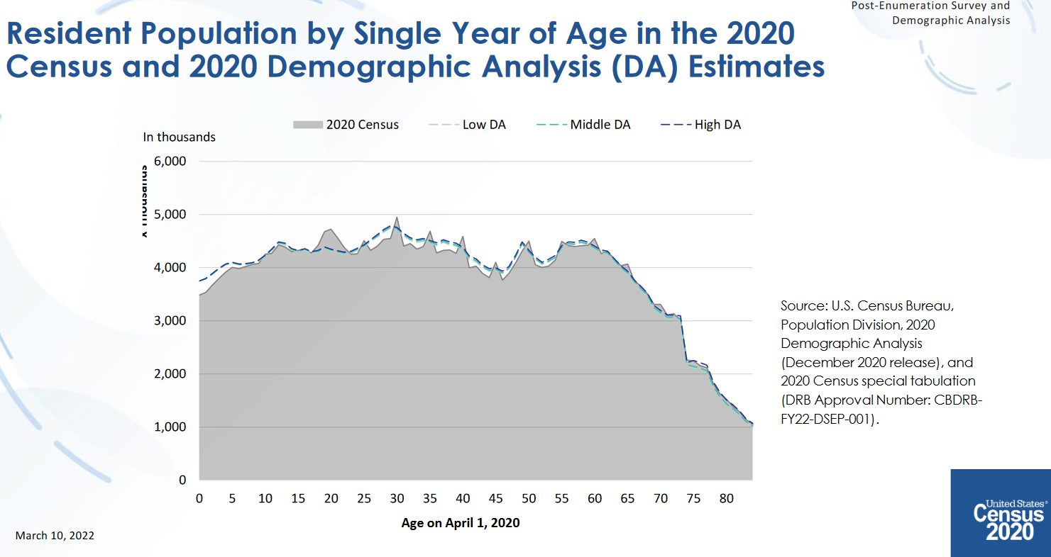

Slide 7
States with Most Population Growth, 2020 to 2022
Geographic Area | Population Estimate (as of July 1)
 | 2020 | 2021 | 2022 | Change 21-22 | Rank Change 21-22 | Pct. Change 21-22 | Rank Pct. Change 21-22
United States | 331,511,512 | 332,031,554 | 333,287,557 | 1,256,003 |  | 0.4%
Texas | 29,232,474 | 29,558,864 | 30,029,572 | 470,708 | 1 | 1.6% | 4
Florida | 21,589,602 | 21,828,069 | 22,244,823 | 416,754 | 2 | 1.9% | 1
North Carolina | 10,449,445 | 10,565,885 | 10,698,973 | 133,088 | 3 | 1.3% | 9
Georgia | 10,729,828 | 10,788,029 | 10,912,876 | 124,847 | 4 | 1.2% | 12
Arizona | 7,179,943 | 7,264,877 | 7,359,197 | 94,320 | 5 | 1.3% | 8
South Carolina | 5,131,848 | 5,193,266 | 5,282,634 | 89,368 | 6 | 1.7% | 3
Tennessee | 6,925,619 | 6,968,351 | 7,051,339 | 82,988 | 7 | 1.2% | 11
Washington | 7,724,031 | 7,740,745 | 7,785,786 | 45,041 | 8 | 0.6% | 16
Utah | 3,283,785 | 3,339,113 | 3,380,800 | 41,687 | 9 | 1.2% | 10
Idaho | 1,849,202 | 1,904,314 | 1,939,033 | 34,719 | 10 | 1.8% | 2
’20-’21 -> 902
new Texans per day
’21-’22 -> 1,290 new Texans per day
SOURCE: US Census Bureau, Population Estimates, 2021 and 2022 vintages

Slide 8
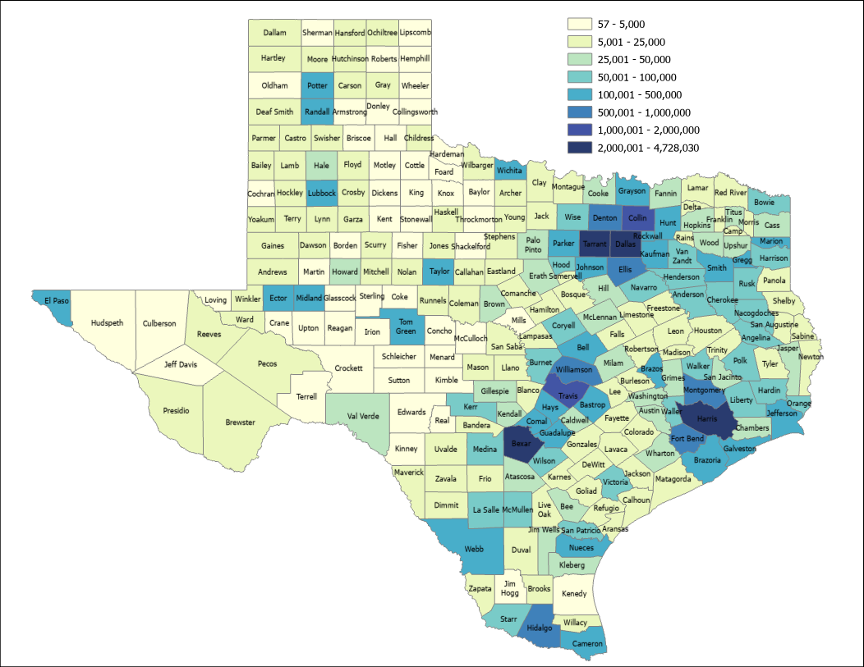
2021 Estimated Population, Texas Counties
89.4%
Source: US Census Bureau, 2021 Population Estimates

Slide 9
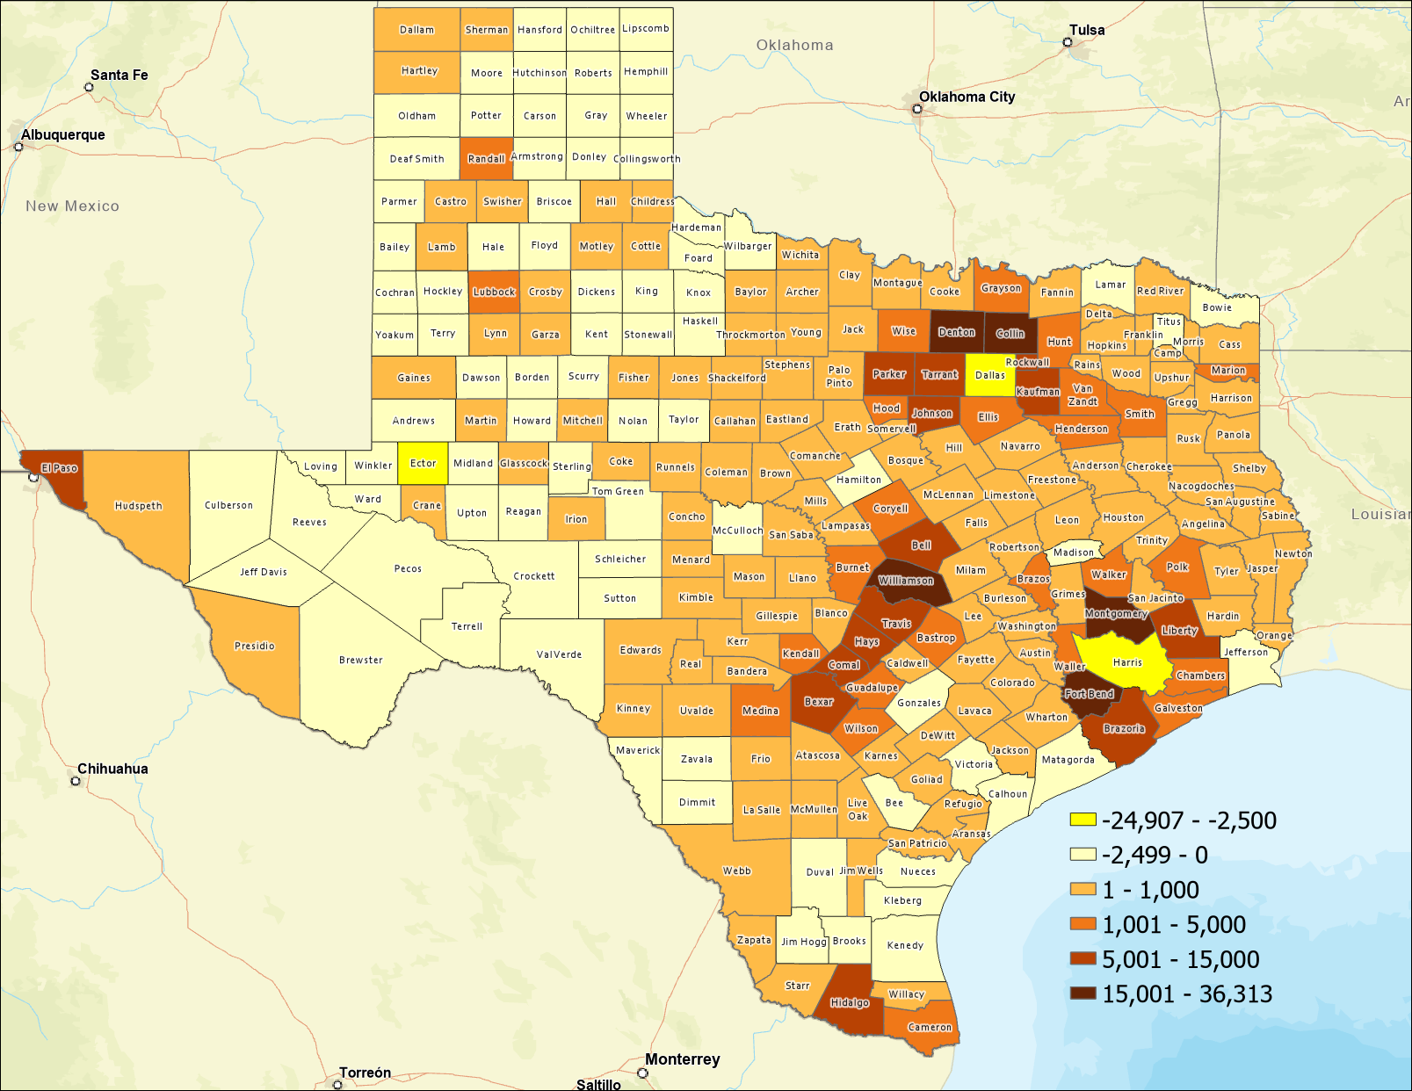
Estimated Numeric Change, Texas Counties, 2020-2021
82 (almost 1/3) of Texas counties lost population
SOURCE: US Census Bureau, Population Estimates, 2021 Vintage

Slide 10
Top Counties for Numeric Growth in Texas, 2020-2021
County | US Rank | 2021 Population Estimate | Population Change 2020-2021 | Percent of Change from Natural Increase | Percent of Change from International Migration | Percent of Change from Domestic Migration
Collin | 2 | 1,109,462 | 36,313 | 13.2% | 4.4% | 82.4%
Fort Bend | 4 | 858,527 | 29,895 | 12.6% | 5.6% | 81.8%
Williamson | 5 | 643,026 | 27,760 | 9.2% | 1.3% | 89.5%
Denton | 6 | 941,647 | 27,747 | 14.8% | 2.6% | 82.6%
Montgomery | 8 | 648,886 | 23,948 | 7.7% | 1.9% | 90.4%
Bexar | 17 | 2,028,236 | 14,184 | 59.1% | 6.6% | 34.2%
Tarrant | 23 | 2,126,477 | 11,768 | 82.5% | 15.6% | 1.9%
Hays | 24 | 255,397 | 11,588 | 8.5% | 1.2% | 90.3%
Comal | 25 | 174,986 | 11,413 | 0.4% | 0.2% | 99.3%
Kaufman | 28 | 157,768 | 10,782 | 4.3% | 0.1% | 95.6%
Travis | 35 | 1,305,154 | 9,054 | 82.1% | 19.9% | -1.9%
Ellis | 44 | 202,678 | 8,406 | 5.2% | 0.1% | 94.6%
Source: US Census Bureau, 2021 Population Estimates

Slide 11
Top Counties for Percent Growth in Texas, 2020-2021*
County | US Rank | 2021 Population Estimate | Population Change 2020-2021 | Percent Population Change 2020-2021 | Percent of Population Change from Natural Increase | Percent of Population Change from International Migration | Percent of Population Change from Domestic Migration
Kaufman | 1 | 157,768 | 10,782 | 7.3% | 4.3% | 0.1% | 95.6%
Comal | 2 | 174,986 | 11,413 | 7.0% | 0.4% | 0.2% | 99.3%
Rockwall | 3 | 116,381 | 7,291 | 6.7% | 3.9% | 0.6% | 95.5%
Liberty | 4 | 97,621 | 5,270 | 5.7% | 3.7% | 0.1% | 96.2%
Parker | 9 | 156,764 | 7,332 | 4.9% | 0.9% | 0.6% | 98.6%
Hays | 10 | 255,397 | 11,588 | 4.8% | 8.5% | 1.2% | 90.3%
Williamson | 14 | 643,026 | 27,760 | 4.5% | 9.2% | 1.3% | 89.5%
Ellis | 17 | 202,678 | 8,406 | 4.3% | 5.2% | 0.1% | 94.6%
Waller | 19 | 59,781 | 2,432 | 4.2% | 9.3% | 0.4% | 90.3%
Bastrop | 20 | 102,058 | 4,075 | 4.2% | 3.4% | -0.3% | 97.0%
Wise | 22 | 71,714 | 2,848 | 4.1% | -1.4% | 0.1% | 101.2%
Montgomery | 25 | 648,886 | 23,948 | 3.8% | 7.7% | 1.9% | 90.4%
Johnson | 32 | 187,280 | 6,547 | 3.6% | 4.6% | 0.3% | 95.1%
Source: US Census Bureau, 2021 Population Estimates
*Among counties with populations of 50,000 or more in 2020

Slide 12
Minority population drove growth in Texas between 2010-2020
3,999,944 new Texans
95.3% attributable to growth of minority populations
Source: US Census Bureau, 2010 and 2020 Census, P.L. 94-171 Redistricting Files

Slide 13
Estimated Racial/Ethnic Composition of Texas Population, 2021
Source: U.S. Census Bureau, American Community Survey, 2021

Slide 14
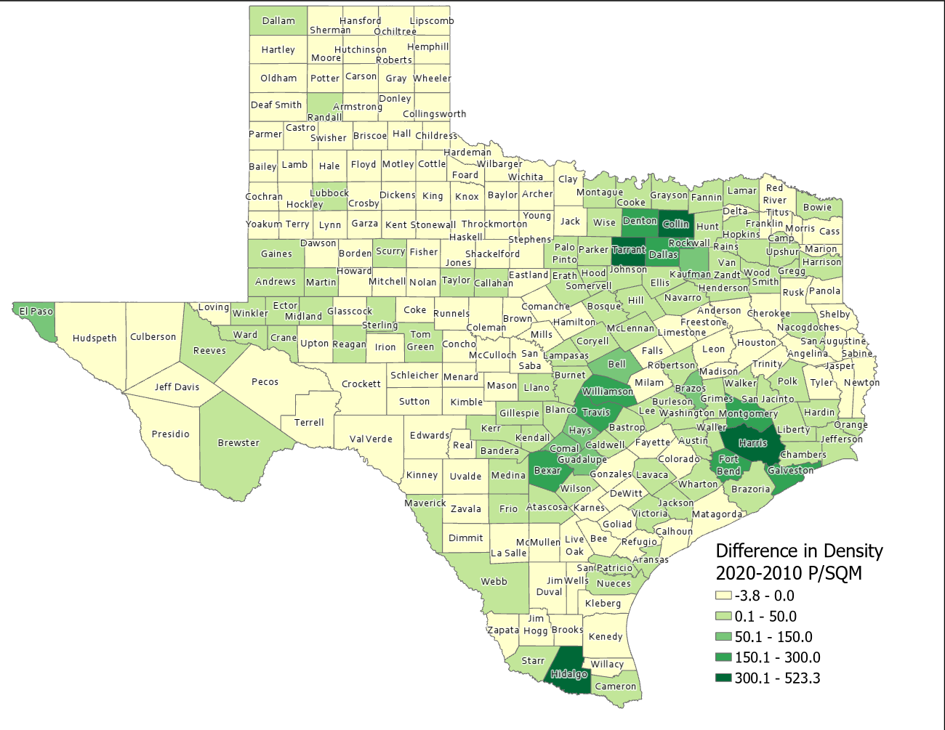
Difference in Population Density per Square Mile (2020-2010), Texas Counties
SOURCE: US Census Bureau, 2010 and 2020 Census, P.L. 94-171 Redistricting Files

Slide 15
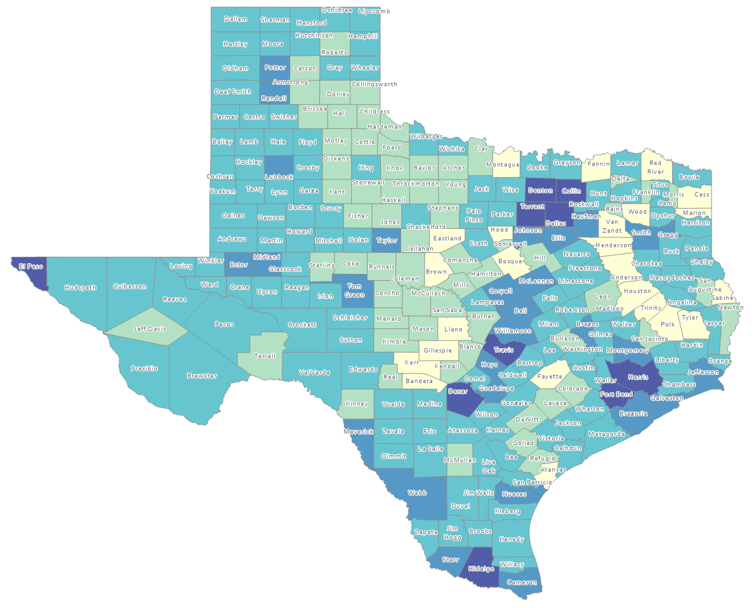
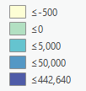
Estimated Natural Increase (Decrease), Texas Counties, 2010-2020
86 counties had natural decrease over the decade (1/3 of Texas’ counties)
Source: US Census Bureau, 2020 Population Estimates

Slide 16
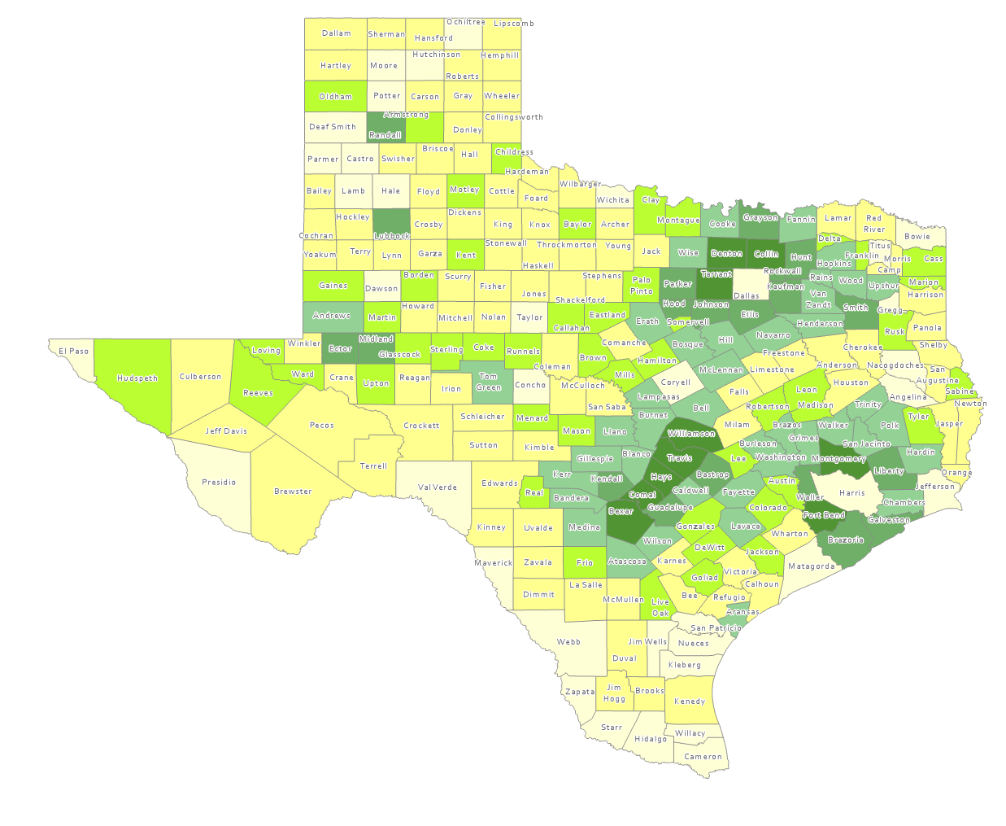
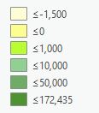
Estimated Population Change from Domestic Migration, Texas Counties, 2010-2020
More than half (134) of counties had net out domestic migration
Source: US Census Bureau, 2020 Population Estimates

Slide 17
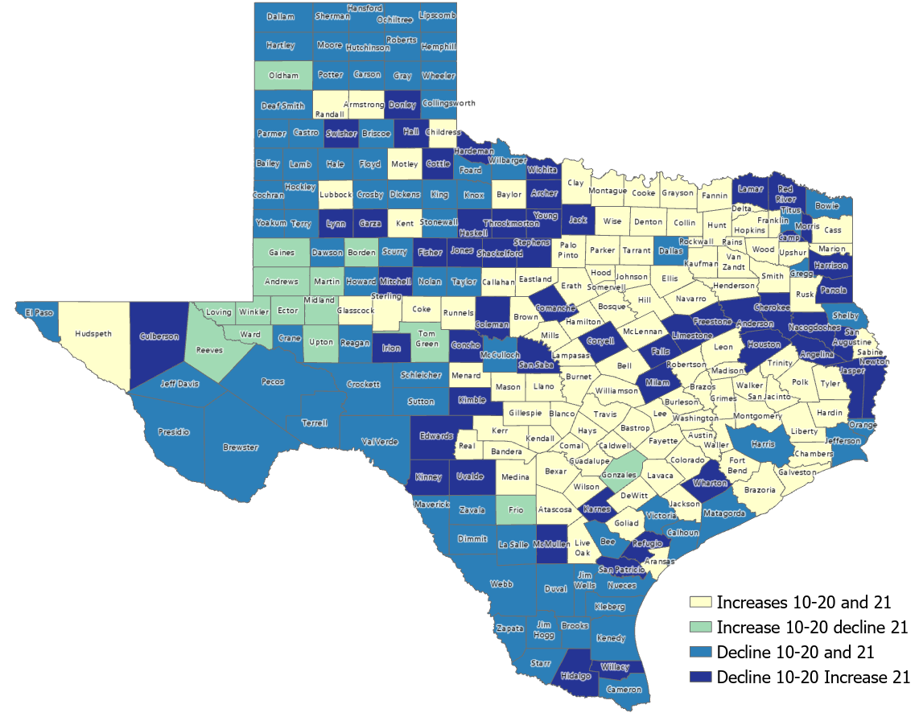
Estimated Change from Domestic Migration Comparing 2010-20 and 2020-21, Texas Counties
Number of Counties
106
15
79
54
Source: US Census Bureau, 2021 Population Estimates

Slide 18
Estimated Net Domestic Migrants Between Texas and Other States, 2010-2019
Source: U.S. Census Bureau, State-to-State Migration Flows, 2010-2019

Slide 19
Texas Birth Rates, 2007-2019
SOURCE: Centers for Disease Control and Prevention, National Center for Health Statistics.

Slide 20
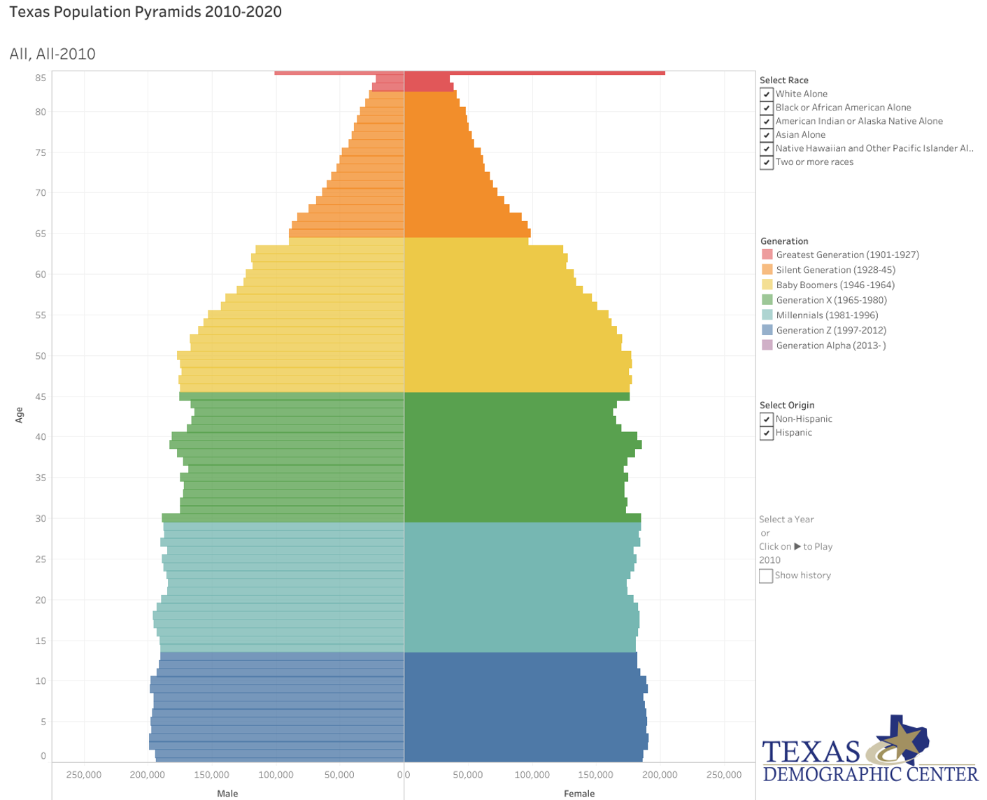
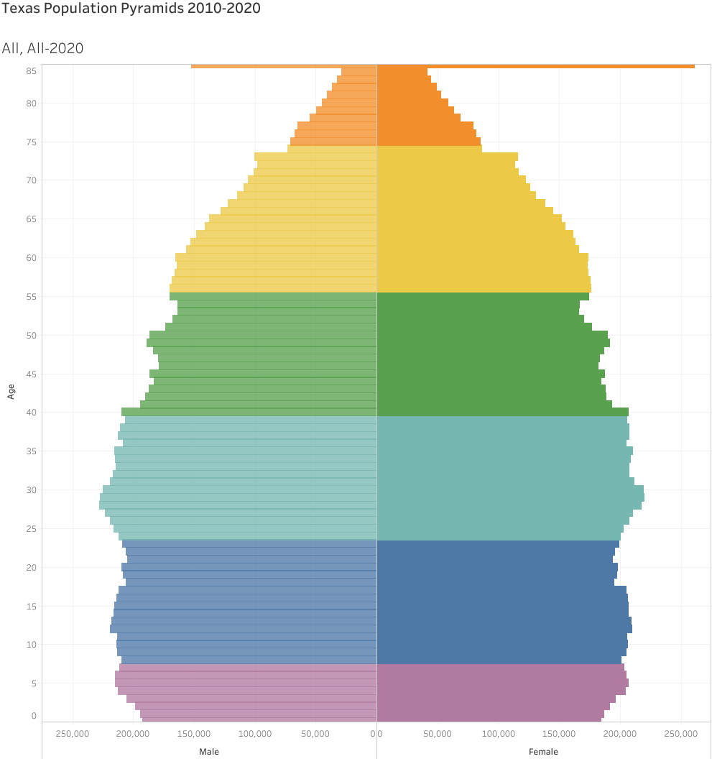
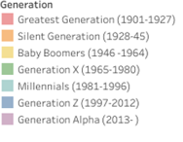
Generational Population Pyramids, Texas, 2010 and 2020
2010
2020
2010
2015
2020
Year of birth
SOURCE: U.S. Census Bureau. 2010 and 2020 Vintage Population Estimates

Slide 21
Educational Attainment of Persons Age 25 Years and Older by Race/Ethnicity, Texas, 2019
39.9%
70.1 %
Source: US Census Bureau, American Community Survey, 1-Year Sample, 2019

Slide 23
Estimated undergraduate college enrollment, Texas, 2010-2021
Source: U.S. Census Bureau, American Community Survey, 1-year sample, 2010=2021.
* ACS estimates not available for 2020 – this point represents an average of 2019 and 2021

Slide 24
Estimated graduate or professional enrollment, Texas, 2010-2021
*
Source: U.S. Census Bureau, American Community Survey, 1-year sample, 2010=2021.
* ACS estimates not available for 2020 – this point represents an average of 2019 and 2021

Slide 25
College and Graduate Enrollment by Race/Ethnicity, Texas, 2008-2019
Source: US Census Bureau, American Community Survey 1-Year Estimates, 2008-2019 and 2021
* ACS estimates not available for 2020 – this point represents an average of 2019 and 2021

Slide 26
Projected Population Growth in Texas, 2010-2060
SOURCE: Texas Demographic Center, Vintage 2022 and 2018 Population Projections

Slide 27
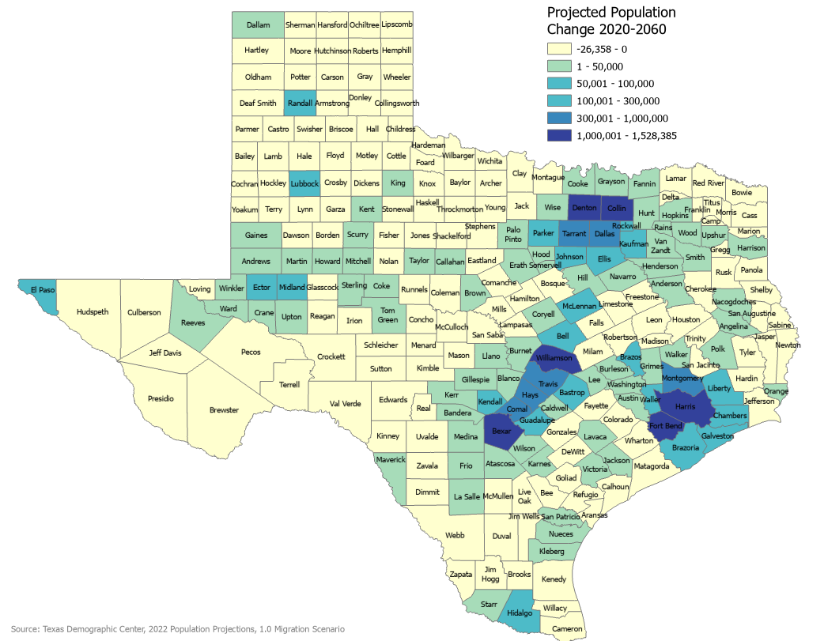
Projected Population Change, Texas Counties, 2020-2060

Slide 28
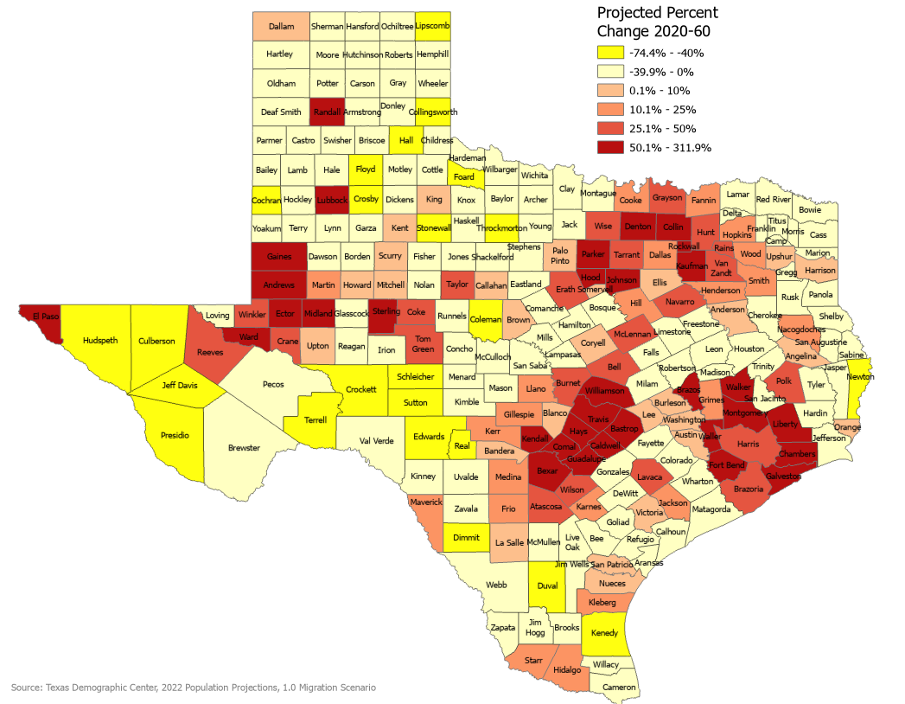
Projected Percent Population Change, Texas Counties, 2020-2060

Slide 29
Lloyd Potter, Ph.D.
(210) 458-6530
TDC@UTSA.edu
Demographics.Texas.gov
@TexasDemography

