Slide 1
Demographic Trends and Characteristics: Texas and South Texas Area
April 21, 2023
McAllen, Texas

Slide 2
States with Most Population Growth, 2010 to 2020
 | 2010 Population | 2020 Population | Numeric Change 2010-2020 | Percent Change 2010-2020
United States | 308,745,538 | 331,449,281 | 22,703,743 | 7.4%
Texas | 25,145,561 | 29,145,505 | 3,999,944 | 15.9%
Florida | 18,801,310 | 21,538,187 | 2,736,877 | 14.6%
California | 37,253,956 | 39,538,223 | 2,284,267 | 6.1%
Georgia | 9,687,653 | 10,711,908 | 1,024,255 | 10.6%
Washington | 6,724,540 | 7,705,281 | 980,741 | 14.6%
North Carolina | 9,535,483 | 10,439,388 | 903,905 | 9.5%
New York | 19,378,102 | 20,201,249 | 823,147 | 4.2%
Arizona | 6,392,017 | 7,151,502 | 759,485 | 11.9%
Colorado | 5,029,196 | 5,773,714 | 744,518 | 14.8%
Virginia | 8,001,024 | 8,631,393 | 630,369 | 7.9%
Tennessee | 6,346,105 | 6,910,840 | 564,735 | 8.9%
Utah | 2,763,885 | 3,271,616 | 507,731 | 18.4%
SOURCE: U.S. Census Bureau. 2010 and 2020 Census Count and 2021 Population Estimates

Slide 3
Texas had an undercount of -0.97 in 2010 (not statistically different from 0)

Slide 5
States with Most Population Growth, 2020 to 2022
Geographic Area | Population Estimate (as of July 1)
 | 2020 | 2021 | 2022 | Change 21-22 | Rank Change 21-22 | Pct. Change 21-22 | Rank Pct. Change 21-22
United States | 331,511,512 | 332,031,554 | 333,287,557 | 1,256,003 |  | 0.4%
Texas | 29,232,474 | 29,558,864 | 30,029,572 | 470,708 | 1 | 1.6% | 4
Florida | 21,589,602 | 21,828,069 | 22,244,823 | 416,754 | 2 | 1.9% | 1
North Carolina | 10,449,445 | 10,565,885 | 10,698,973 | 133,088 | 3 | 1.3% | 9
Georgia | 10,729,828 | 10,788,029 | 10,912,876 | 124,847 | 4 | 1.2% | 12
Arizona | 7,179,943 | 7,264,877 | 7,359,197 | 94,320 | 5 | 1.3% | 8
South Carolina | 5,131,848 | 5,193,266 | 5,282,634 | 89,368 | 6 | 1.7% | 3
Tennessee | 6,925,619 | 6,968,351 | 7,051,339 | 82,988 | 7 | 1.2% | 11
Washington | 7,724,031 | 7,740,745 | 7,785,786 | 45,041 | 8 | 0.6% | 16
Utah | 3,283,785 | 3,339,113 | 3,380,800 | 41,687 | 9 | 1.2% | 10
Idaho | 1,849,202 | 1,904,314 | 1,939,033 | 34,719 | 10 | 1.8% | 2
’20-’21 -> 902
new Texans per day
’21-’22 -> 1,290 new Texans per day
SOURCE: US Census Bureau, Population Estimates, 2021 and 2022 vintages

Slide 6
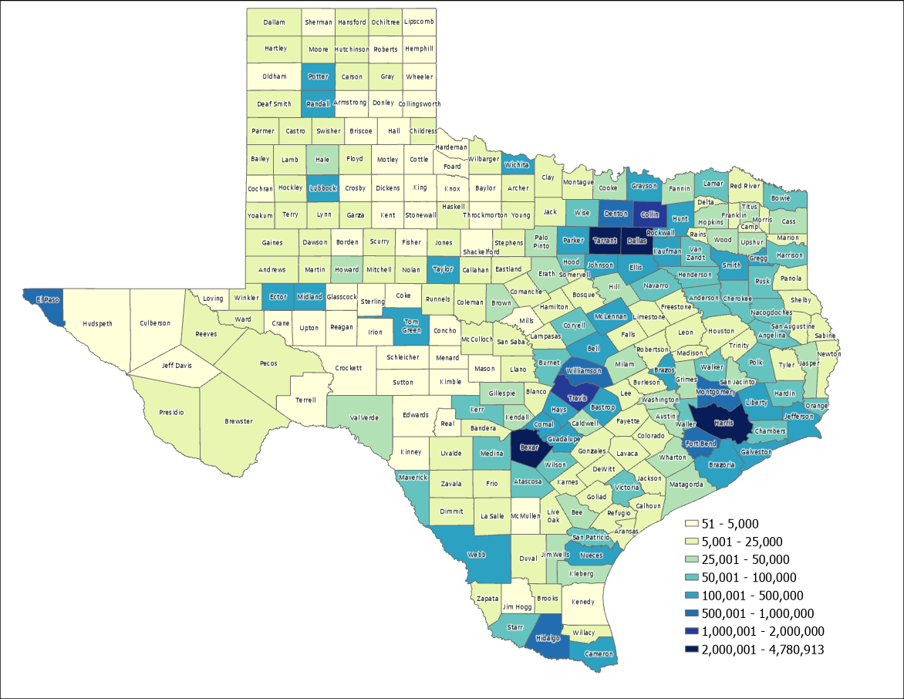
2022 Estimated Population, Texas Counties
87%
Source: US Census Bureau, 2022 Population Estimates

Slide 7
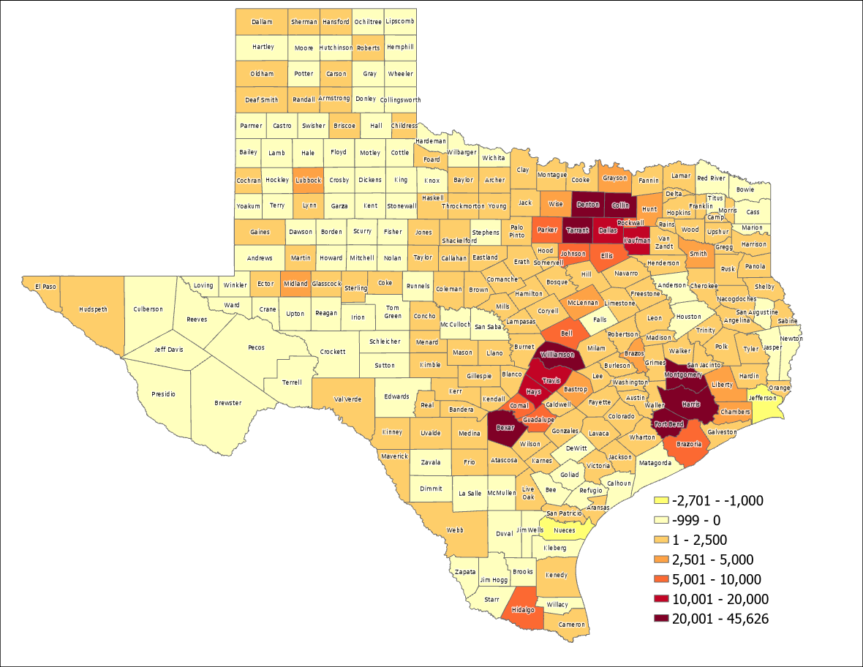
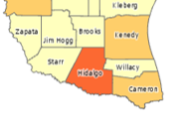
Estimated Numeric Change, Texas Counties, 2021-2022
95 of Texas counties lost population
SOURCE: US Census Bureau, Population Estimates, 2022 Vintage

Slide 8
Top Counties for Numeric Growth in Texas, 2021-2022
County | US Rank | 2022 Population Estimate | Population Change 2021-2022 | Percent of Change from Natural Increase | Percent of Change from International Migration | Percent of Change from Domestic Migration
Harris | 2 | 4,780,913 | 45,626 | 63.6% | 78.7% | -42.2%
Collin | 3 | 1,158,696 | 44,246 | 13.9% | 17.8% | 68.3%
Denton | 4 | 977,281 | 33,424 | 16.7% | 10.8% | 72.5%
Fort Bend | 7 | 889,146 | 29,022 | 15.3% | 23.1% | 61.6%
Bexar | 9 | 2,059,530 | 28,635 | 27.7% | 18.3% | 54.1%
Montgomery | 10 | 678,490 | 28,229 | 10.3% | 7.2% | 82.5%
Williamson | 12 | 671,418 | 26,967 | 13.6% | 8.0% | 78.4%
Tarrant | 13 | 2,154,595 | 25,193 | 39.6% | 32.0% | 28.3%
Travis | 20 | 1,326,436 | 17,892 | 47.4% | 39.8% | 12.9%
Kaufman | 29 | 172,366 | 14,150 | 6.0% | 1.1% | 92.9%
Hays | 36 | 269,225 | 13,160 | 11.1% | 3.7% | 85.3%
Dallas | 38 | 2,600,840 | 12,886 | 115.7% | 128.5% | -144.2%
Comal | 48 | 184,642 | 9,751 | 0.5% | 0.2% | 99.3%
Brazoria | 50 | 388,181 | 9,323 | 16.2% | 9.2% | 74.6%
Ellis | 52 | 212,182 | 9,075 | 8.8% | 1.8% | 89.3%
Parker | 53 | 165,834 | 8,868 | 2.7% | 1.3% | 96.0%
Source: US Census Bureau, 2022 Population Estimates

Slide 9
Top Counties for Percent Growth in Texas, 2021-2022*
County | US Rank | 2022 Population Estimate | Population Change 2021-2022 | Percent Population Change 2021-2022 | Percent of Population Change from Natural Increase | Percent of Population Change from International Migration | Percent of Population Change from Domestic Migration
Kaufman | 1 | 172,366 | 14,150 | 8.9% | 6.0% | 1.1% | 92.9%
Rockwall | 4 | 123,208 | 6,659 | 5.7% | 6.6% | 2.6% | 90.7%
Comal | 5 | 184,642 | 9,751 | 5.6% | 0.5% | 0.2% | 99.3%
Parker | 6 | 165,834 | 8,868 | 5.6% | 2.7% | 1.3% | 96.0%
Hays | 7 | 269,225 | 13,160 | 5.1% | 11.1% | 3.7% | 85.3%
Liberty | 12 | 101,992 | 4,610 | 4.7% | 0.7% | 2.9% | 96.4%
Williamson | 13 | 671,418 | 26,967 | 4.7% | 6.3% | 1.2% | 92.5%
Wise | 20 | 74,895 | 3,007 | 4.3% | 10.3% | 7.2% | 82.5%
Montgomery | 22 | 678,490 | 28,229 | 4.3% | 4.2% | 1.1% | 94.8%
Bastrop | 24 | 106,188 | 4,022 | 4.2% | 13.6% | 8.0% | 78.4%
Johnson | 27 | 195,506 | 8,064 | 4.2% | 0.8% | 1.9% | 97.3%
Waller | 31 | 61,894 | 2,420 | 4.1% | 10.5% | 3.4% | 86.1%
Hunt | 32 | 108,282 | 4,824 | 4.0% | 13.9% | 17.8% | 68.3%
Collin | 36 | 1,158,696 | 44,246 | 3.9% | 8.7% | 2.1% | 89.2%
Fort Bend | 46 | 889,146 | 29,022 | 3.4% | 15.3% | 23.1% | 61.6%
Source: US Census Bureau, 2022 Population Estimates
*Among counties with populations of 50,000 or more in 2021

Slide 10
Estimated Population and Change for Select Texas Counties, 2021-2022
County | 2022 Estimate | Change 2021-2022 | Percent Change 2021-2022 | Percent Natural Increase (decrease) | Percent International Migration | Percent Domestic Migration
Hidalgo | 888,367 | 7,734 | 0.9% | 85.5% | 21.3% | -6.8%
Cameron | 425,208 | 2,084 | 0.5% | 91.3% | 40.4% | -31.7%
Webb | 267,780 | 147 | 0.1% | 2392.7% | 994.8% | -3287.5%
Willacy | 20,143 | -147 | -0.7% | 8.3% | -2.1% | 93.8%
Starr | 65,728 | -244 | -0.4% | -175.2% | -12.4% | 287.6%
Zapata | 13,849 | -44 | -0.3% | -151.1% | -40.0% | 291.1%
Source: US Census Bureau, 2022 Population Estimates

Slide 11
Minority population drove growth in Texas between 2010-2020
3,999,944 new Texans
95.3% attributable to growth of minority populations
Source: US Census Bureau, 2010 and 2020 Census, P.L. 94-171 Redistricting Files
Note: there were changes in the capture and processing of race data changed between 2010 and 2020

Slide 12
Estimated Racial/Ethnic Composition of Texas Population, 2021
Source: U.S. Census Bureau, American Community Survey, 2021

Slide 13
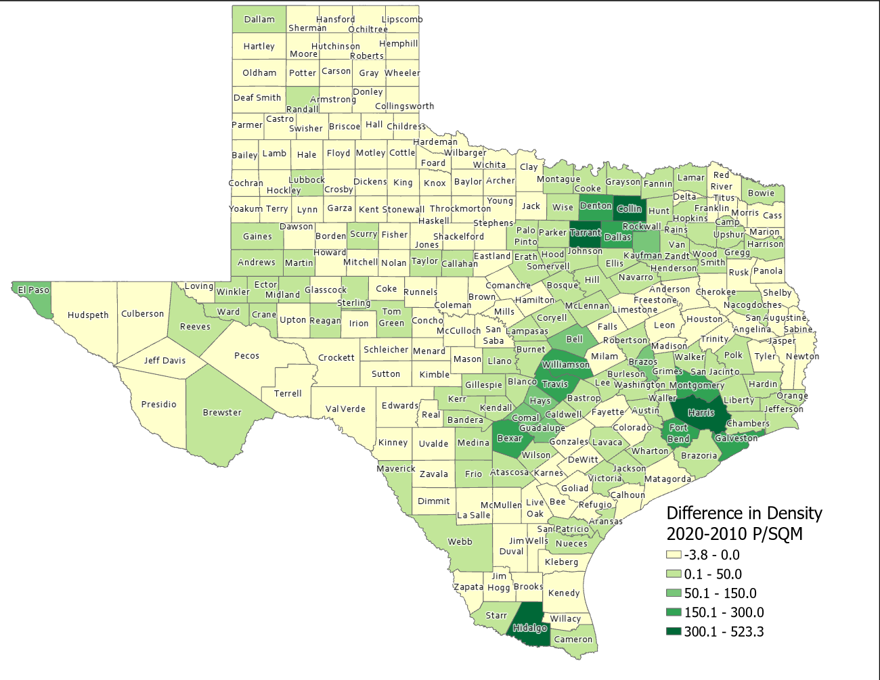
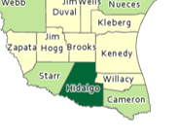
Difference in Population Density per Square Mile (2020-2010), Texas Counties
SOURCE: US Census Bureau, 2010 and 2020 Census, P.L. 94-171 Redistricting Files

Slide 14
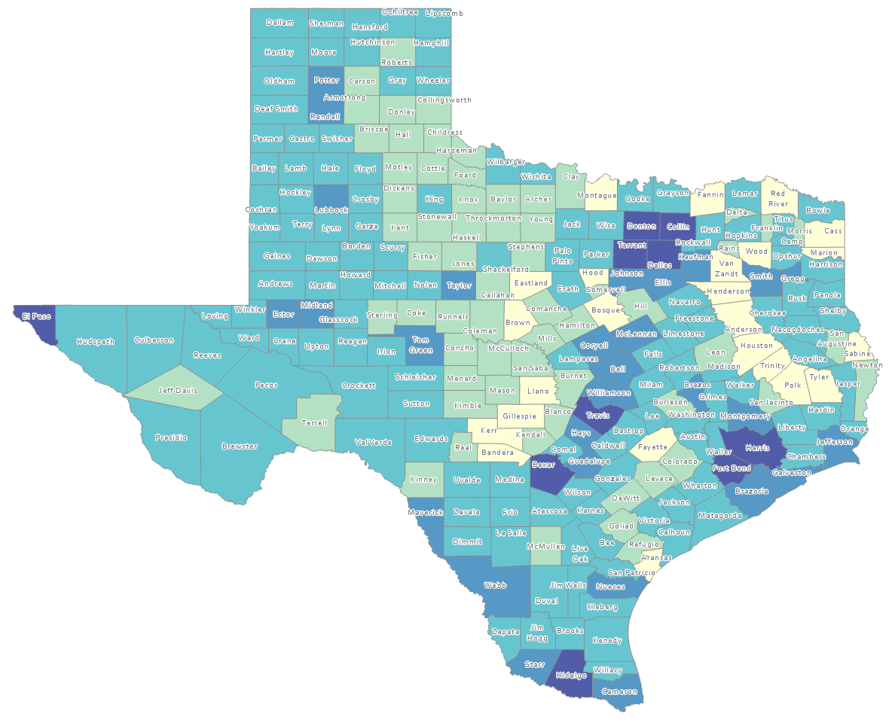
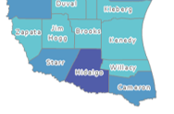
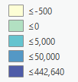
Estimated Natural Increase (Decrease), Texas Counties, 2010-2020
86 counties had natural decrease over the decade (1/3 of Texas’ counties)
Source: US Census Bureau, 2020 Population Estimates

Slide 15
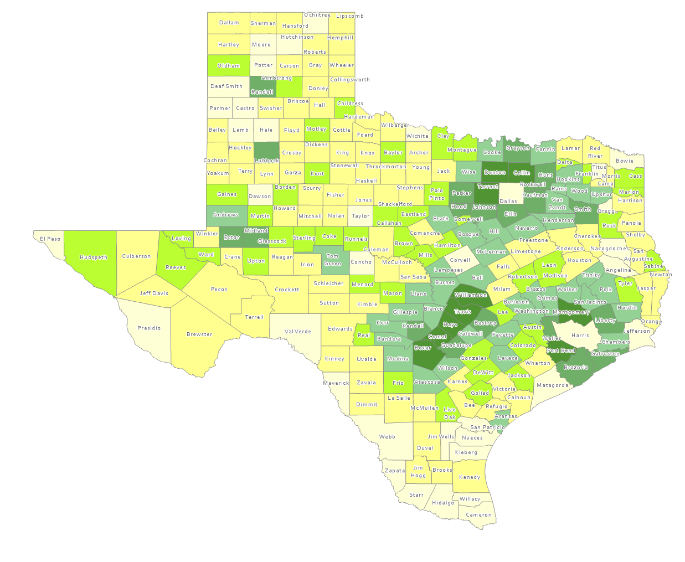
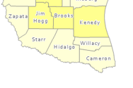
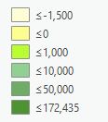
Estimated Population Change from Domestic Migration, Texas Counties, 2010-2020
More than half (134) of counties had net out domestic migration
Source: US Census Bureau, 2020 Population Estimates

Slide 16
Estimated Components of Population Change for Texas, 2010-2020 and 2020-2021, 2021-2022
2010 to 2020
2020 to 2021
2021 to 2022
326,390
470,708
SOURCE: U.S. Census Bureau. 2020 Evaluation Population Estimates and 2021 and 2022 Vintage Population Estimates

Slide 17
Estimated Domestic and International Migration for Texas, 2011-2021
SOURCE: U.S. Census Bureau. 2020 Evaluation Population Estimates and 2021 Vintage Population Estimates

Slide 18
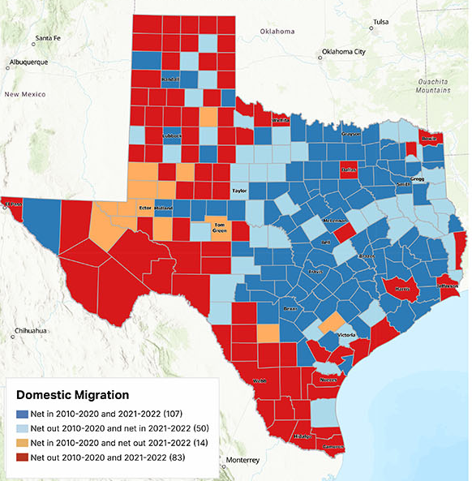
Estimated Change from Domestic Migration Comparing 2010-20 and 2021-22, Texas Counties
Source: US Census Bureau, 2022 Population Estimates

Slide 19
Texas Birth Rates, 2007-2019
SOURCE: Centers for Disease Control and Prevention, National Center for Health Statistics.

Slide 20
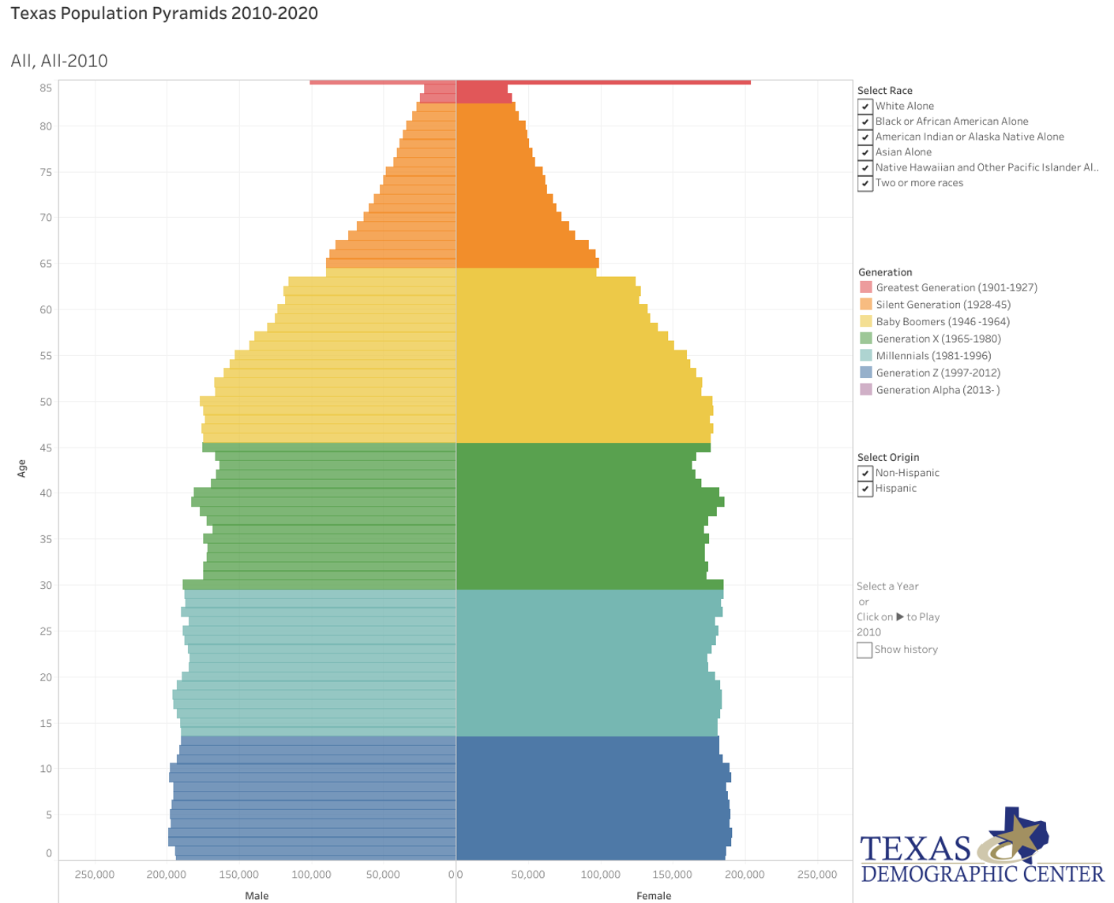
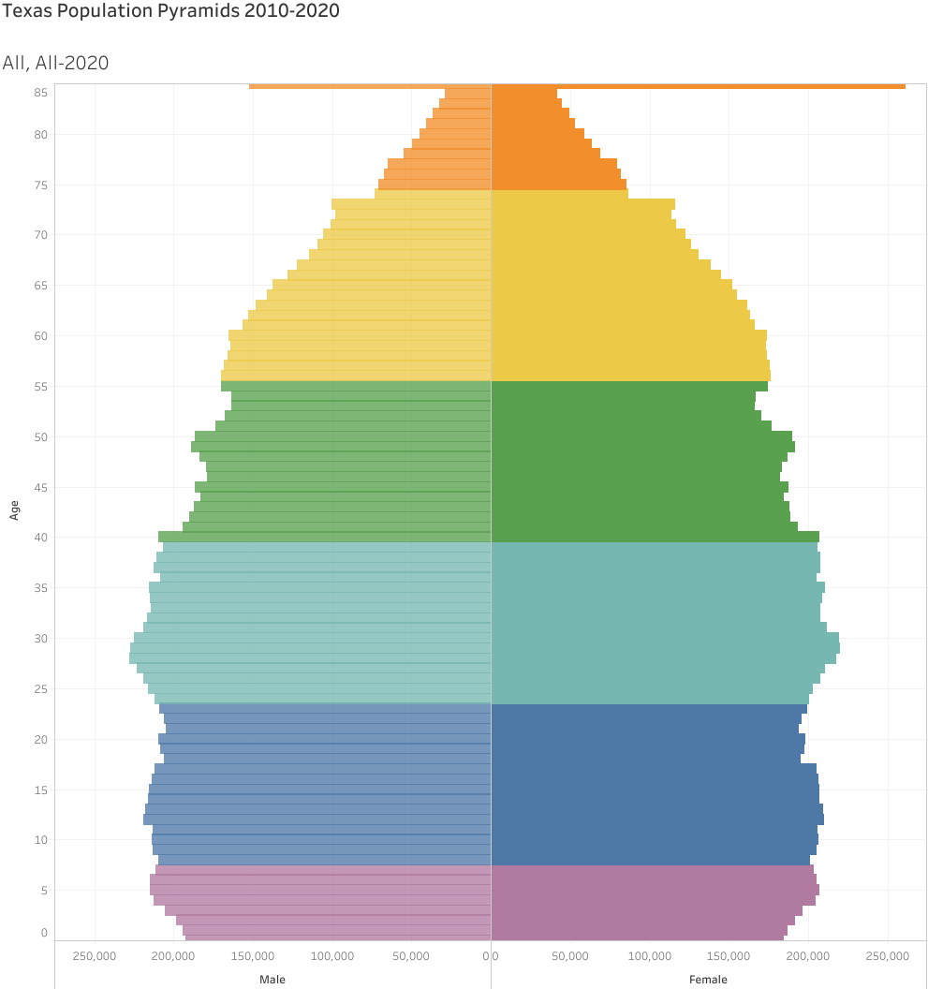
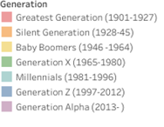
Generational Population Pyramids, Texas, 2010 and 2020
2010
2020
2010
2015
2020
Year of birth
SOURCE: U.S. Census Bureau. 2010 and 2020 Vintage Population Estimates

Slide 21
Estimated Net Domestic Migrants Between Texas and Other States, 2010-2019
Source: U.S. Census Bureau, State-to-State Migration Flows, 2010-2019

Slide 22
Percent of Civilian Labor Force by Occupation, Texas, 2007, 2017 and 2017-2017 Change
Source: US Census Bureau, American Community Survey, 1-Year Sample, 2007, 2017

Slide 23
Percent Distribution by Education Attainment of Texas Residents (Non-Migrants), Immigrants (international) and Net-Migrants (domestic) Aged 25 Years and Over, Texas, 2015-2019
SOURCE: US Census Bureau, American Community Survey, PUMS, 5-Year Samples, 2015-2019

Slide 24
Percent Distribution by Occupation of Non-Migrants (Texans) and Net-In Domestic Migrants Aged 25 Years and Over, Texas, 2006-2019
SOURCE: US Census Bureau, American Community Survey, 2006-2020

Slide 25
Change in Travel Time to Work, Texas, 2006-2010 and 2016-2020
SOURCE: US Census Bureau, 2010 and 2020 5-Year American Community Survey Summary File

Slide 26
Means of Transportation, Texas, 2011, 2019, 2021
SOURCE: US Census Bureau, 2011, 2019 and 2021 1-Year American Community Survey Summary File

Slide 27
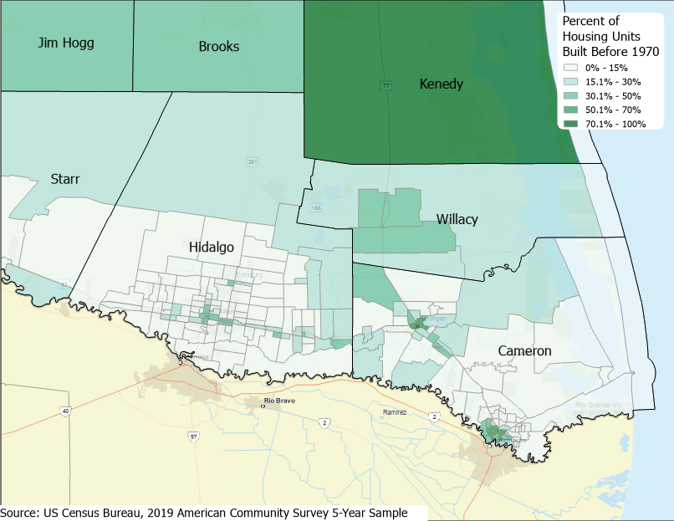
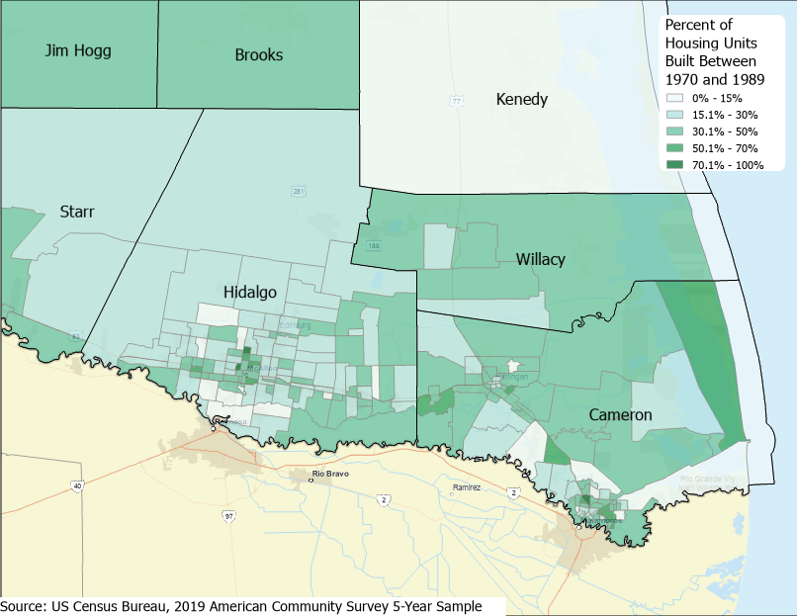
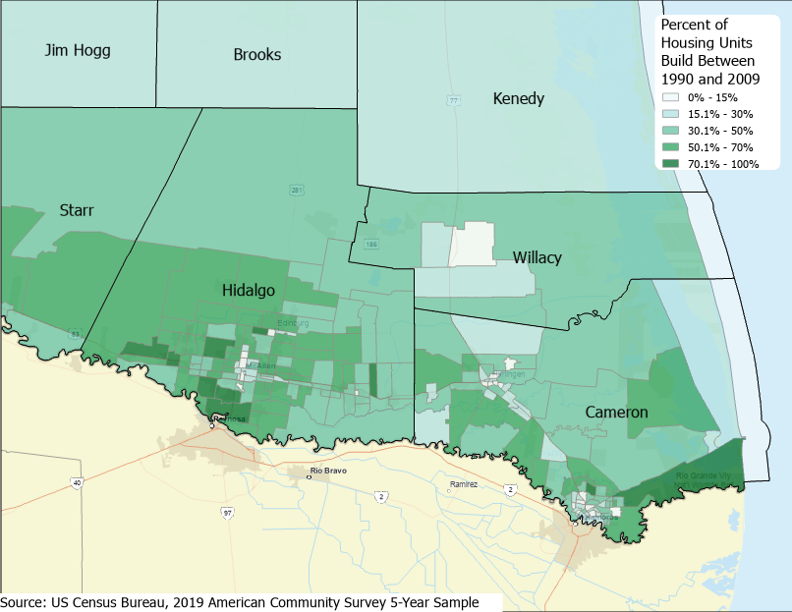
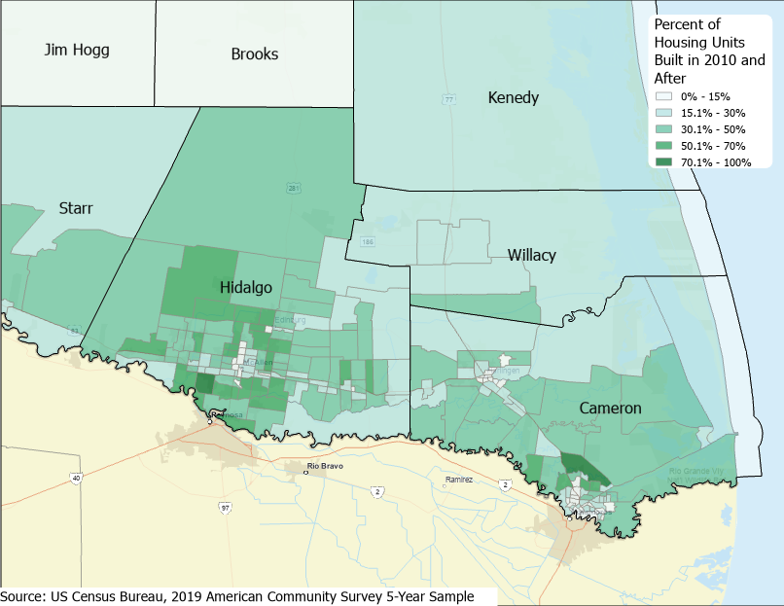
Percent of housing units build in different periods, Census Tracts, 2019
Before 1970
1970-1989
1990-2009
2010 and after

Slide 28
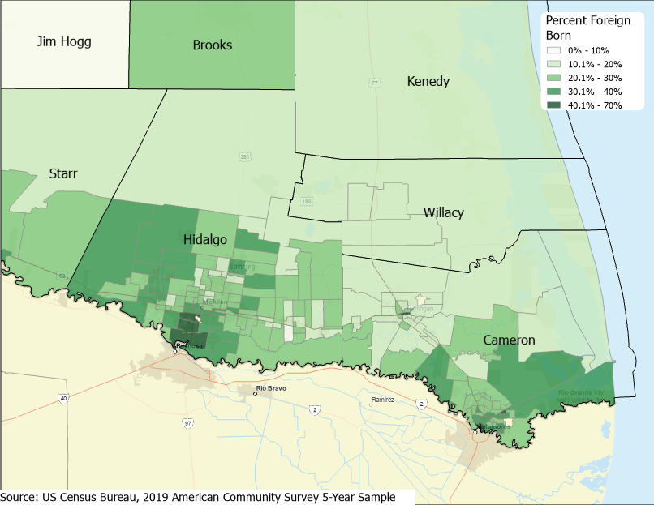

Slide 29
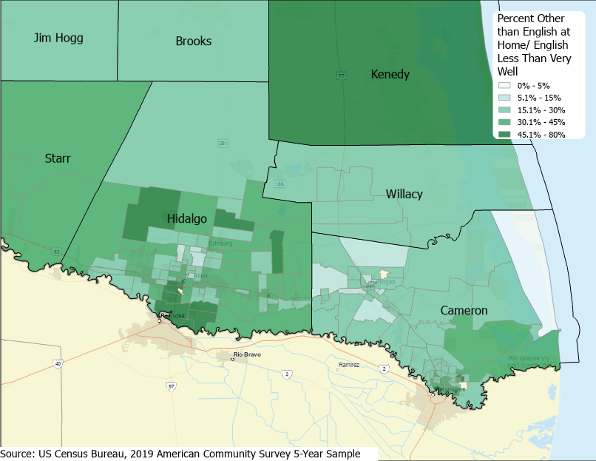

Slide 30
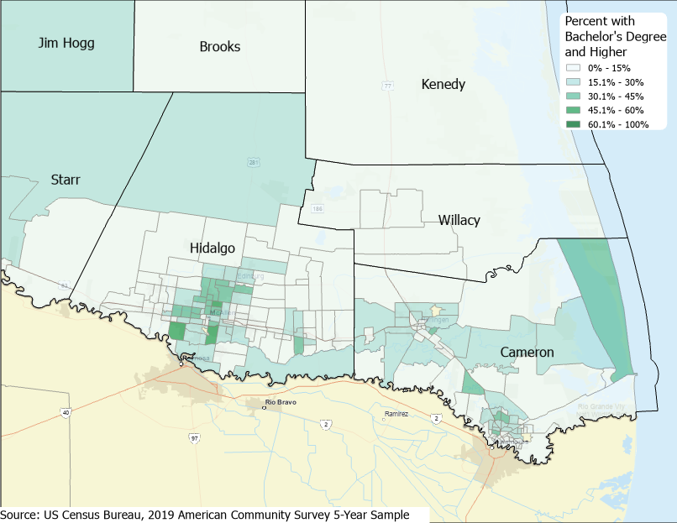
Estimated Percent of Population 25 Years and Older with a Bachelor’s Degree or Higher, Census Tracts, 2019

Slide 31
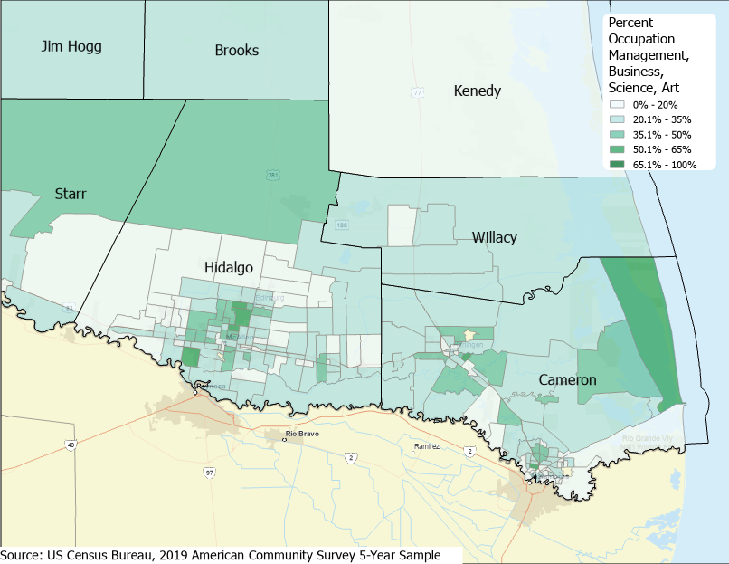
Estimated Percent of Labor Force in Management, Business, Science Occupations, Census Tracts, 2019

Slide 32
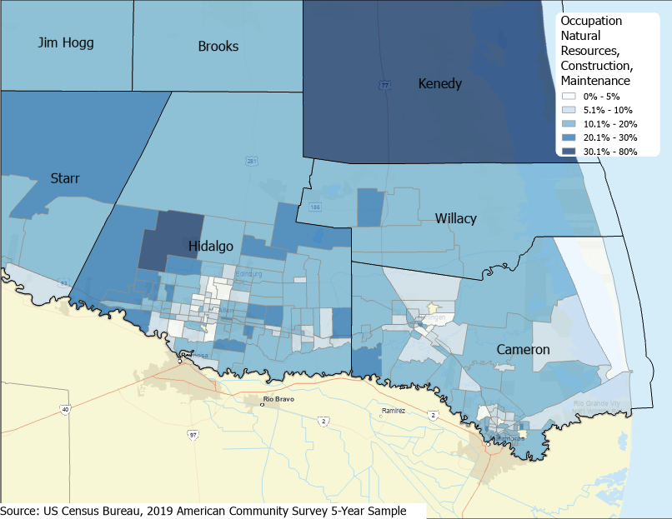
Estimated Percent of Labor Force in Construction and Maintenance Occupations, Census Tracts, 2019

Slide 33
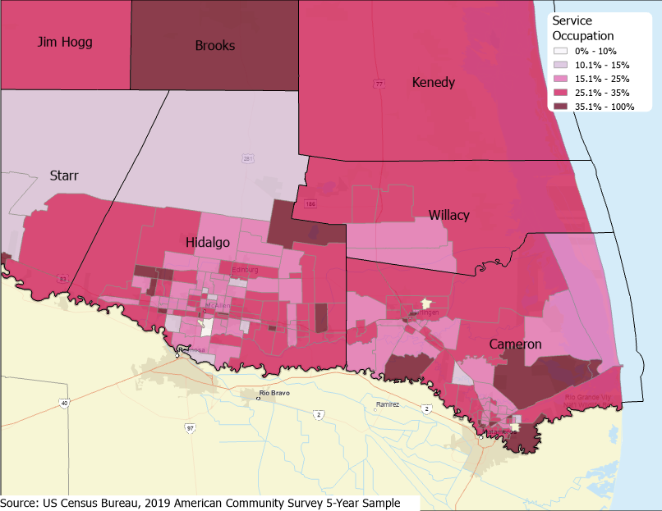
Estimated Percent of Labor Force in Service Occupations, Census Tracts, 2019

Slide 34
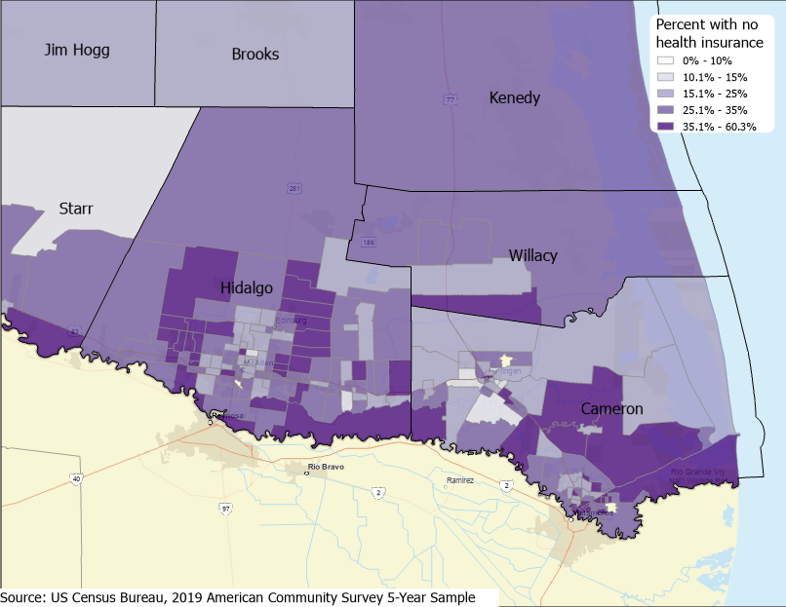
Estimated Percent of Population that does not have Health Insurance, Census Tracts, 2019

Slide 35
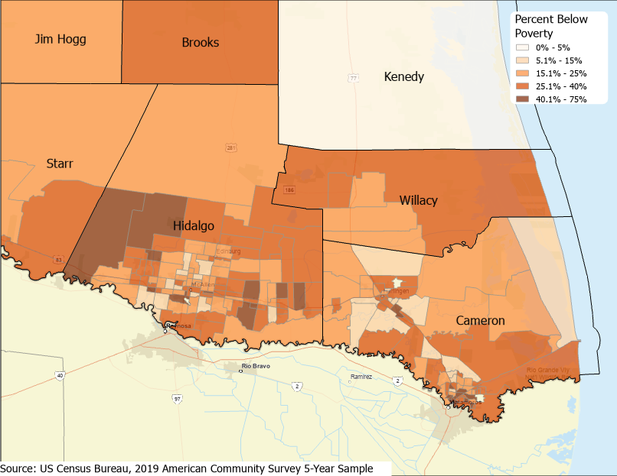
Estimated Percent of Population that is Living Below Poverty, Census Tracts, 2019

Slide 36
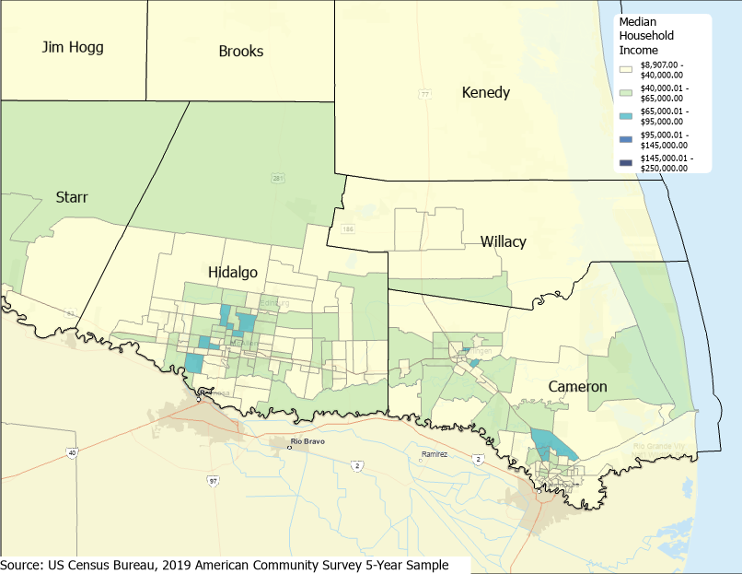
Estimated Median Household Income, Census Tracts, 2019

Slide 37
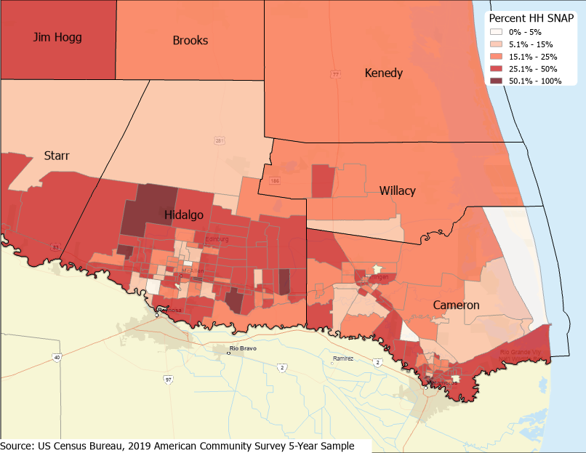
Estimated Percent of Population that Receive SNAP Benefits, Census Tracts, 2019

Slide 38
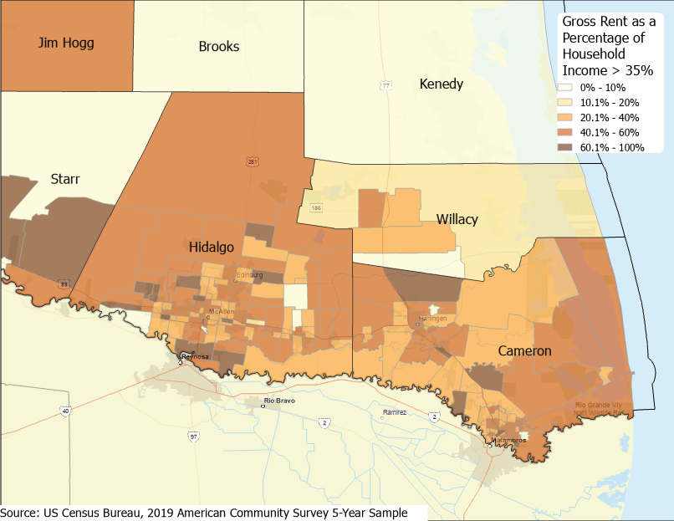
Estimated Percent of Renter Households with GRAPI Greater than 35%, Census Tracts, 2019

Slide 39
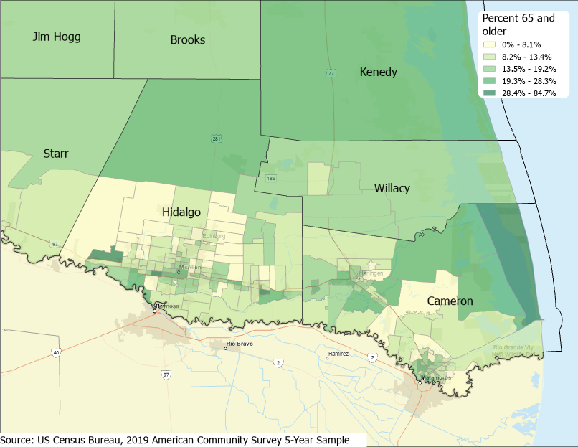
Estimated Percent of Population that is aged 65 Years and older, Census Tracts, 2019

Slide 40
Projected Population Growth in Texas, 2020-2060
SOURCE: Texas Demographic Center, Vintage 2022 and 2018 Population Projections

Slide 41
Projected Population for Select Counties, Texas, 2020-2060
Source: Texas Demographic Center 2022 Population Projections

Slide 42
Projected Population by Race and Ethnicity, Texas 2020-2050
Source: Texas Demographic Center 2018 Population Projections
Notes:
Population projections by race and ethnicity suggest that Latino’s are and will increasingly be the largest race/ethnic group. The number and percent who are non-Hispanic white are likely to decline. Non-Hispanic other are largely of Asian descent and they appear to be increasing rapidly, although the base number is small.

Slide 43
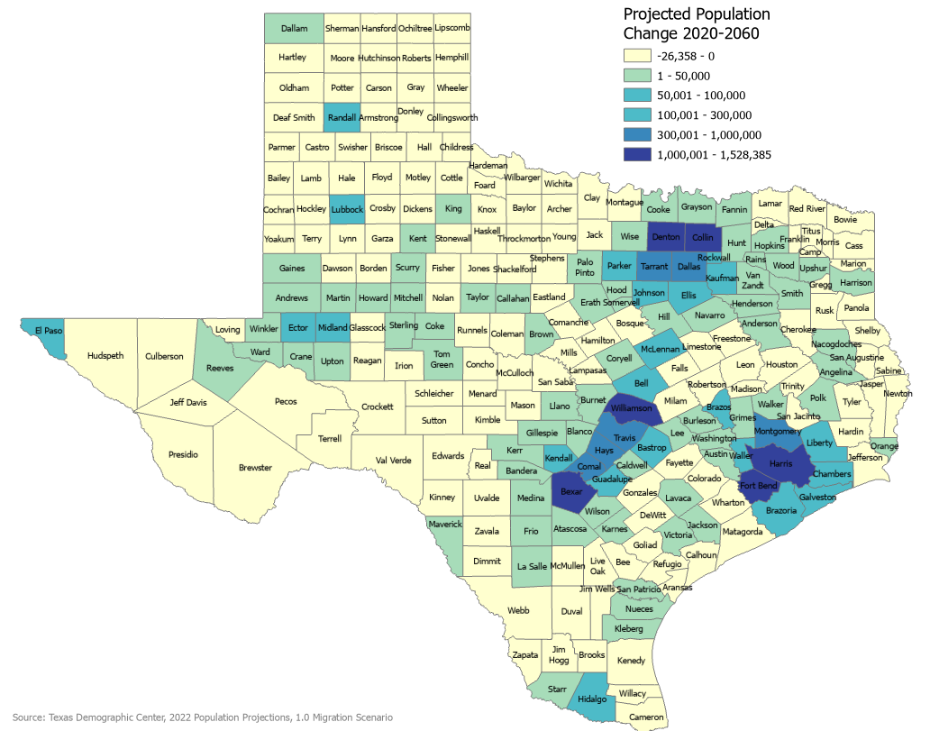
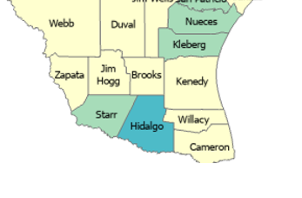
Projected Population Change, Texas Counties, 2020-2050

Slide 44
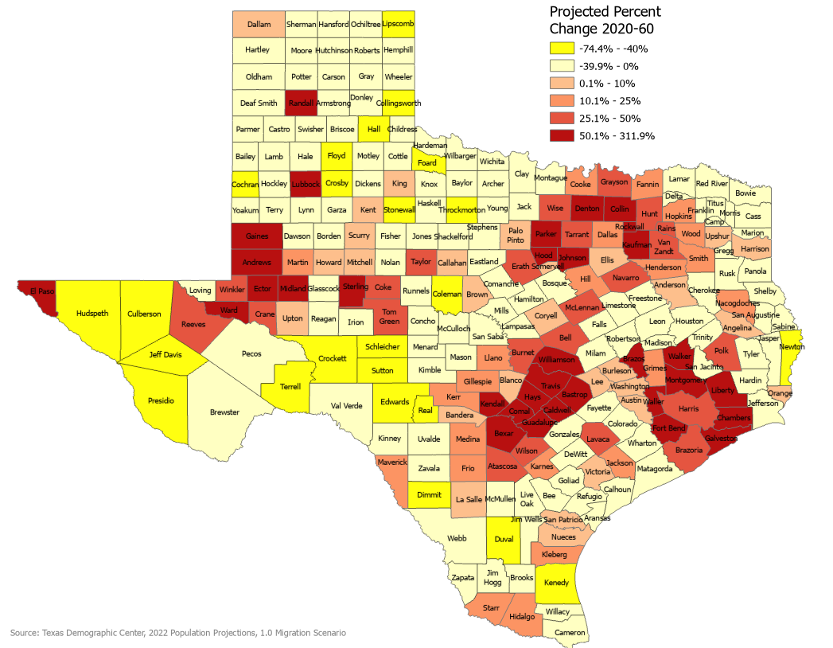
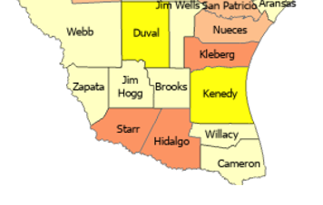
Projected Percent Population Change, Texas Counties, 2020-2050

Slide 45
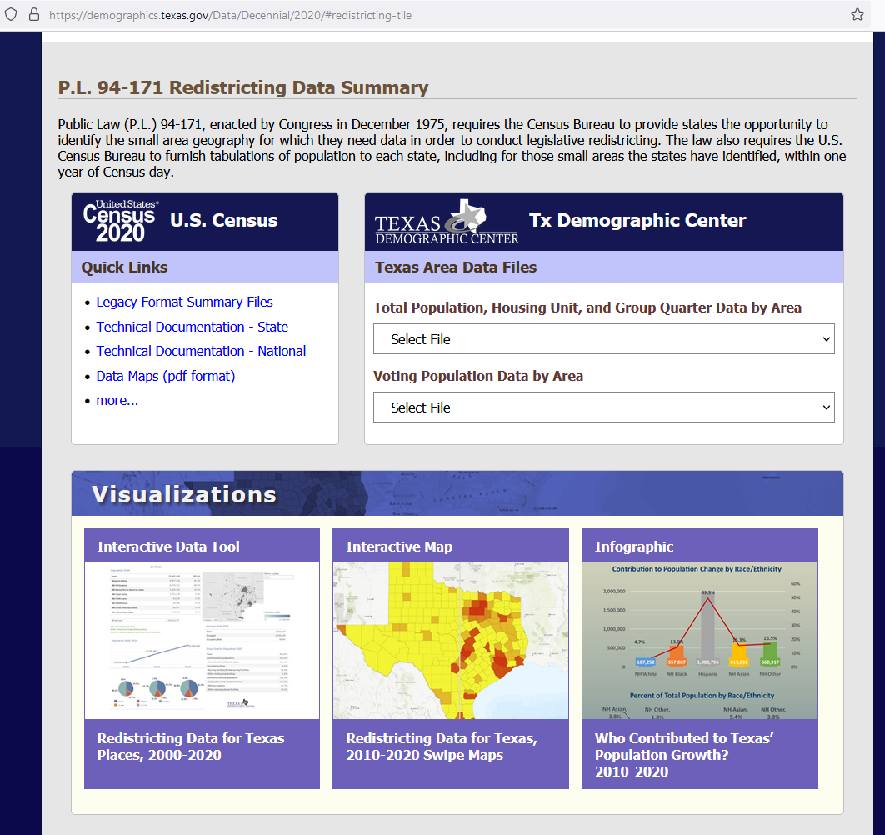
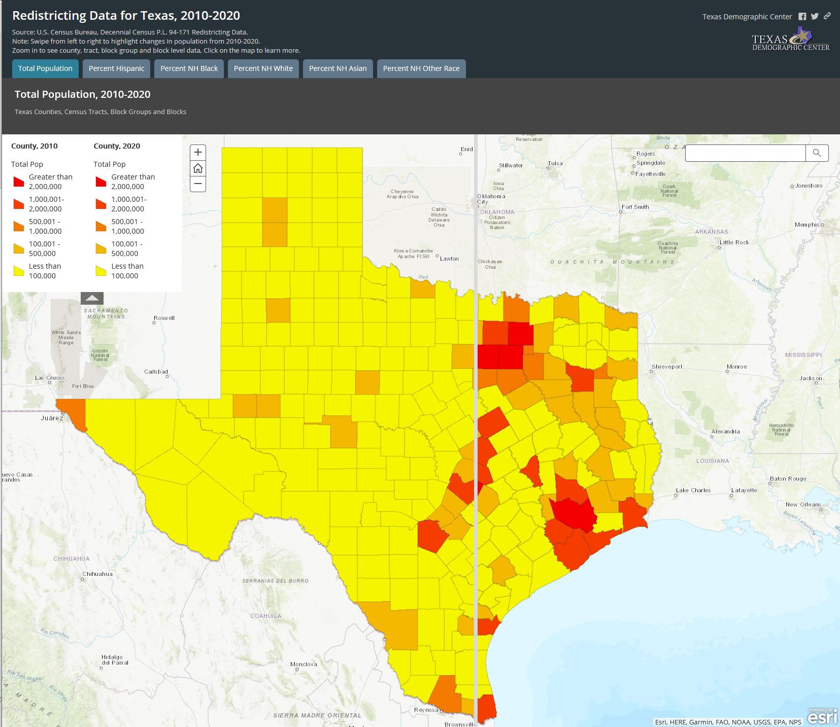
https://demographics.texas.gov/

Slide 46
Lloyd Potter, Ph.D.
(210) 458-6530
TDC@UTSA.edu
Demographics.Texas.gov
@TexasDemography

