Slide 1
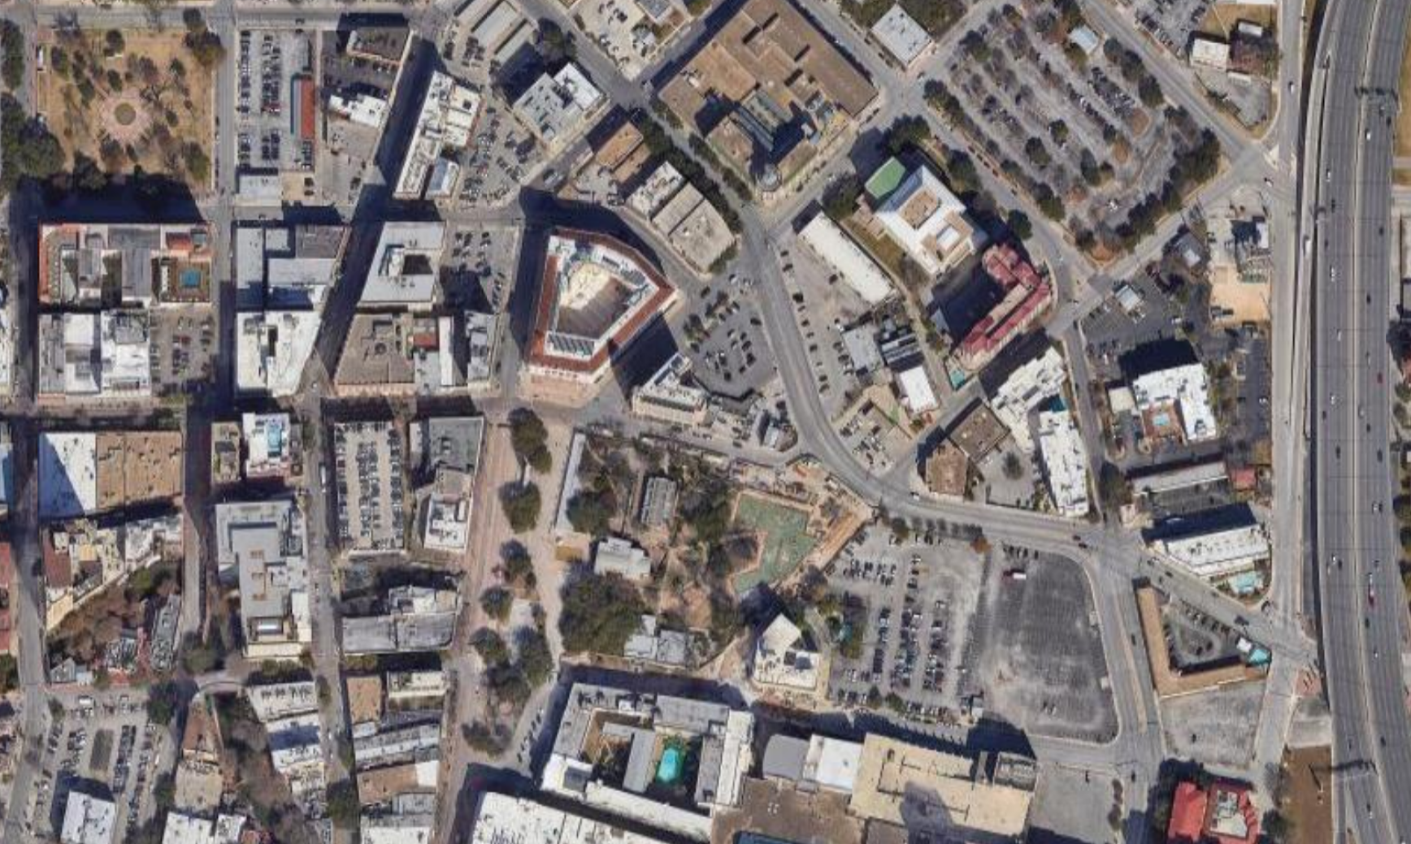
2020 Census Urban Areas: Considerations, Delineations, and Trends
Texas Demographic Conference
May 24, 2023
Urban Areas Team
Geography Division
U.S. Census Bureau

Slide 2
Overview
What, why, and how of the Census Bureau’s urban area (UA) delineation.
Key UA criteria changes from 2010 – 2020.
Key UA trends for the U.S. and Texas from 2010 – 2020.
Beyond 2020.

Slide 3
What, why, and how of the Census Bureau’s UA delineation

Slide 4
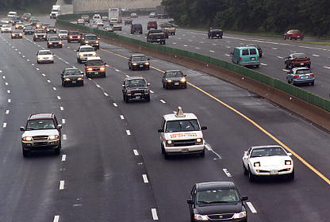


How does the Federal Government Define Urban and Rural?
It varies. There is no single “urban” or “rural” definition.
Tribal, federal, state, and local agencies and offices develop different urban and rural definitions depending on their programmatic needs and uses, including:
  allocating program funds,
  setting program standards, and
  implementing and measuring aspects of their programs.
Geographic Delineation
Agency/office criteria based on their programmatic needs
Urban or Rural definition used by the agency/office
+
=

Slide 5










How does the Federal Government Define Urban and Rural?

Slide 6



How does the Federal Government Define Urban and Rural?
Commonly used federal geographic delineation sources used by federal agencies in defining urban and rural:
Geographic Delineation | Unit of Geography | Primarily based on…
Census UAs and Rural Territory | Census Blocks | Housing unit and population counts and densities. Land use. Commuting.
Metropolitan and Micropolitan Statistical Areas (Core Based Statistical Areas) | Counties | Census UAs. Commuting.
Rural-Urban Commuting Areas (RUCA) | Census Tracts | Census UAs. Commuting.

Slide 7



Why does the Census Bureau delineate UAs?
The Census Bureau delineates UAs for statistical data tabulation, publication, and analysis.
However, the Census Bureau recognizes that many tribal, federal, state, and local governments define their program requirements based on the urban and rural delineation.
For this reason, the Census Bureau:
Invites all stakeholders to actively participate in reviewing and commenting on proposed updates to the UA criteria via the Federal Register Notice leading up to the Decennial Census.
Invites all stakeholders to ask questions. The Census Bureau works with tribal, federal, state, and local agencies as well as other stakeholders to ensure understanding of our classification.

Slide 8
What are Census UAs?
Urban Area
Population and Housing Unit Thresholds
Density Thresholds
Urban Land Use
Linking Development Across Landscapes
Splitting Large Agglomerations
Purpose: Delineation of geographical areas, identifying individual UAs and the rural portion of the nation, for the tabulation and presentation of statistical data.
Census Bureau UAs:
  Represent densely developed territory.
  Encompass residential, commercial, and other non-residential urban land uses.

Slide 9
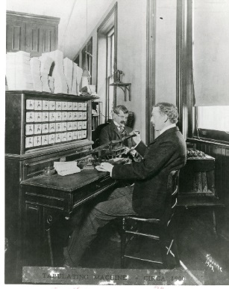
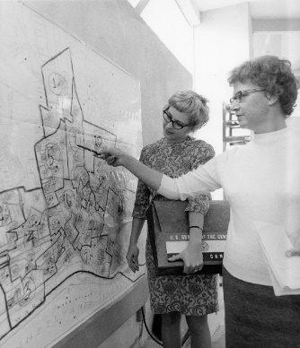

UA Delineation: Evolution Over Time
The history of UA delineation is marked by change and re-evaluation of the thresholds and criteria for delineating UAs after each decennial census.
The Census Bureau has delineated UAs since the late 1800s.
Modern UA concepts began with the 1950 Census to capture growing suburban development.
Census 2000 moved from primarily interactive to primarily automated process.
Concepts have been refined each decade as technology and data availability has improved our ability to evaluate the nature of “urban” and "rural" settlement.

Slide 10
UA Program Cycle
Publish UAs and UA products
Evaluate UAs and innovate
Develop proposed criteria and delineation methodology
Publish proposed criteria for comment
Publish final criteria and finalize methodology
Delineate UAs after Decennial Census
Data user comments and feedback
Census Bureau lessons learned and research
Availability of new data and technology
Data user comments and feedback

Slide 11
How are UAs Delineated?
The Census Bureau uses a nationally-consistent, objective approach, to create UAs and rural territory. These areas are designed to meet the needs of a broad range of analysts and users interested in the definition of and data for urban and rural communities for statistical purposes.
In 2020, the final delineation criteria were implemented using:
  Python-based delineation software.
  Census blocks and Decennial Census block-level housing unit and population data.
  Impervious surface, hydrography, and wetlands data.
    Sources: Census MAF/TIGER System, National Land Cover Dataset, and Coastal Change Analysis Program.
  Commuting data.
    Source: Longitudinal Employer-Household Dynamics Origin-Destination Employment Statistics (LODES).

Slide 12
UA Delineation Steps
1. Urban Core Formation
2. Hops and Jumps
3. Low-Density Fill
4. Nonresidential Territory
5. Enclaves
6. Indentations
11. UA Naming
7. Merging
8. Splitting
10. Final UA Review
9. UA Qualification
12

Slide 13
Step 1: Urban Core Formation
Eligible Block Areas
Housing Units per Square Mile Density
Impervious Surface
Group Quarters (GQ)
13

Slide 14
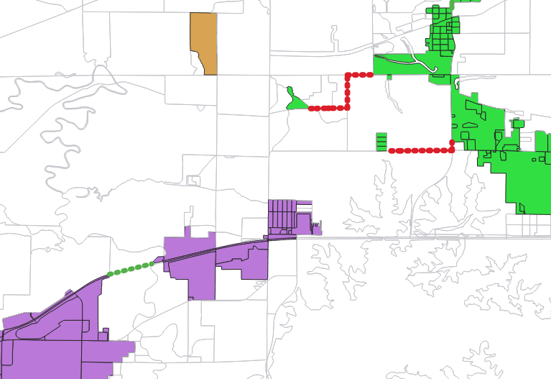
Step 2: Hops and Jumps
Connect noncontiguous urban territory through road connections.
Hops occur first.
  Maximum hop distance is 0.5 miles.
  Hops continue to propagate until there are no more qualified connections.
Jumps occur after hops are completed.
  Jump distance is between 0.5 and 1.5 miles.
  Jumps only occur once, then stop.
Jumps
Hop
14

Slide 15
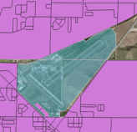
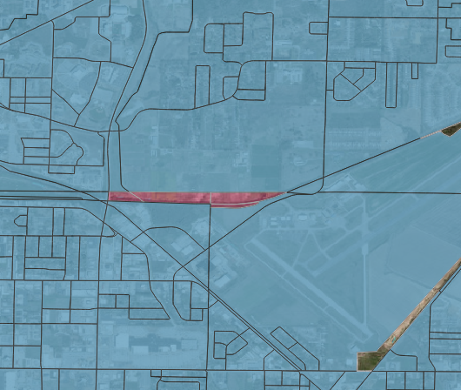
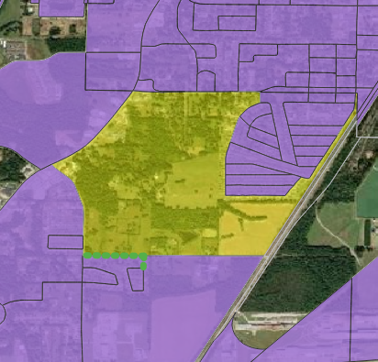
Steps 3-6: Adding territory
Adding blocks with low housing density and nonresidential urban land uses (e.g., airports, commercial and industrial parks on the edges of areas).
Filling enclaves.
Filling indentations.

Slide 16
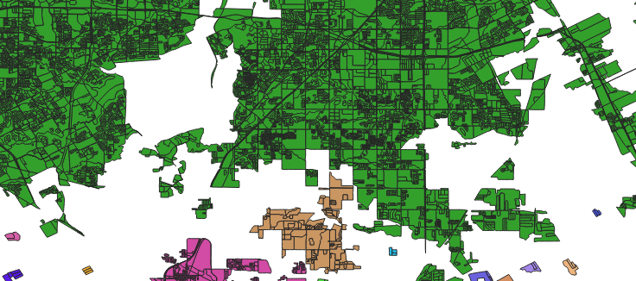
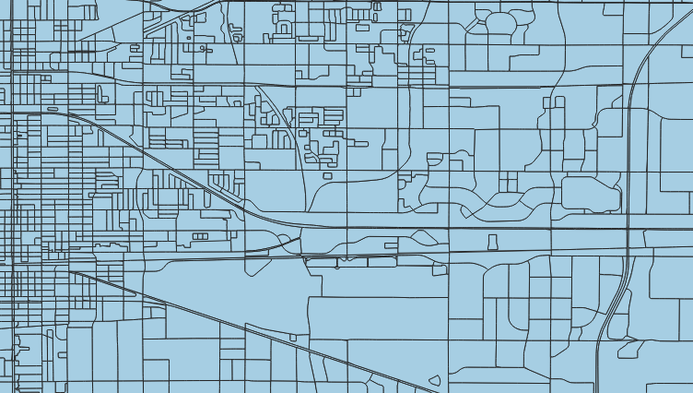
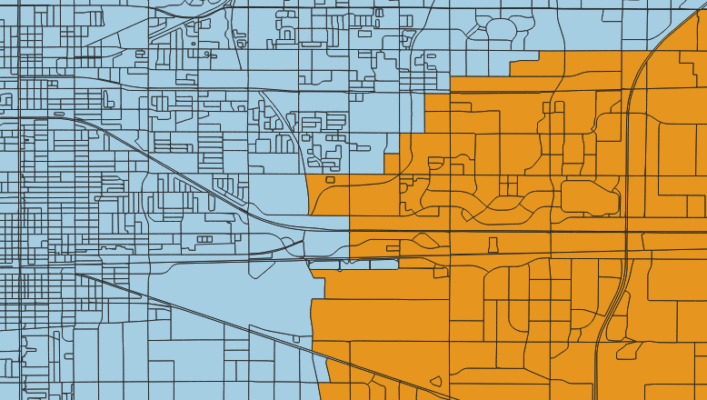
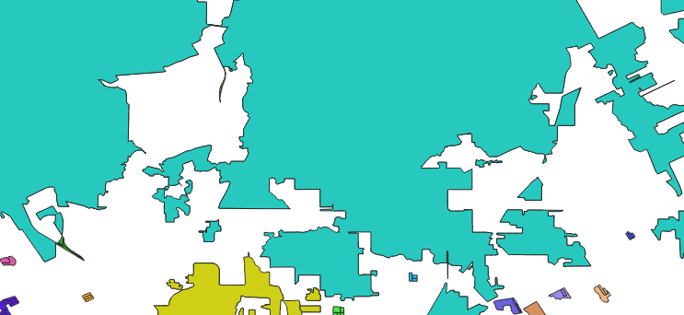
Step 7 and 8: Merging and Splitting
Merge eligibility: Areas that would not qualify as final UAs that are within 0.25 miles of qualifying areas.
Split eligibility: Separate UAs for the 2010 Census or areas connected via low-density fill (in step 4).
Split location: Determined using commuter data.
Pre-Merge
Pre-Split
Post-Merge
Post-Split
16

Slide 17
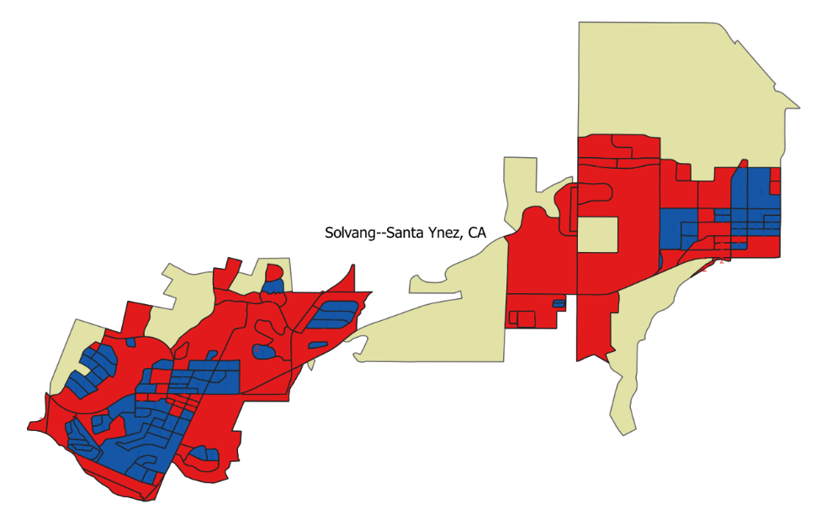
Step 9: Qualification
The area must contain:
A set of blocks with ≥ 500 housing units surrounding a core made up of at least one block with ≥ 1,275 housing units per square mile.
At least 5,000 people or at least 2,000 housing units.
This final UA contains 2 sets of qualifying cores (blue) with surrounding blocks (red).
The entire area (beige) has a total HU count of 4,330, and a total population of 10,295.
17

Slide 18

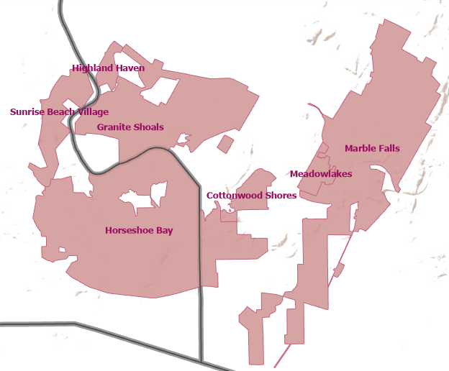
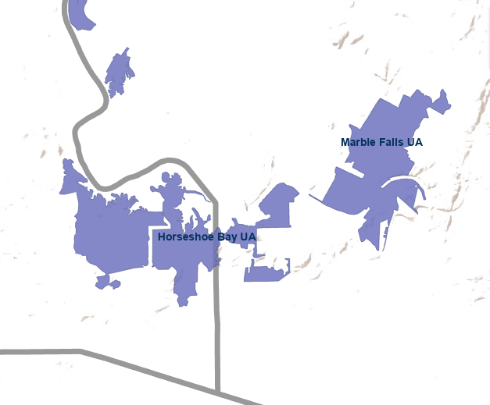
Step 10: Final Review and Naming
Census Bureau subject matter experts reviewed and added or removed individual blocks from the UA delineation where appropriate.
Incorporated Places
UAs
UAs are named primarily based on the most populous incorporated place(s) or census designated place(s) within the UA.
Add image

Slide 19
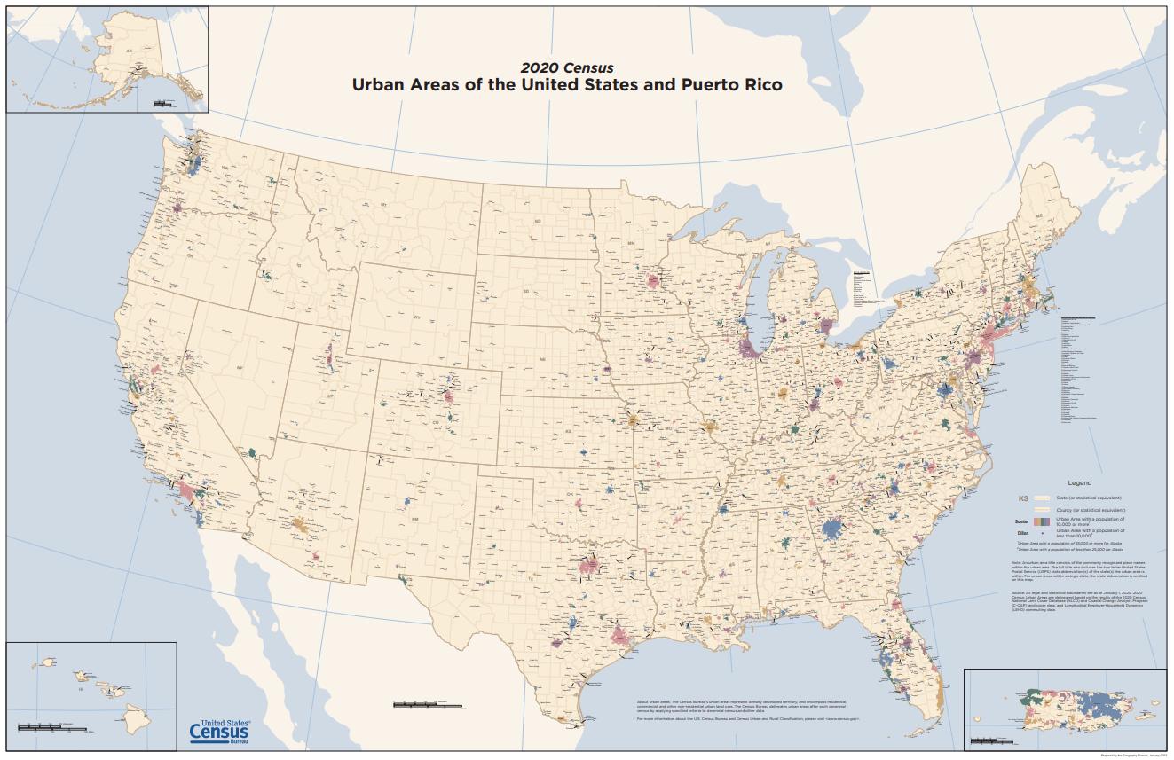
2020 Census UA Products
Urban and Rural Classification website:
Urban and Rural (census.gov)
TIGER/Line Shapefiles:
TIGER/Line Shapefiles (census.gov)
TIGERweb:
TIGERweb (census.gov)
Census Geocoder:
Census Geocoder

Slide 20
Key 2020 Census UA Criteria Changes

Slide 21
Origin of UA Criteria Changes
Publish UAs and UA products
Evaluate UAs and innovate
Develop proposed criteria and delineation methodology
Publish proposed criteria for comment
Publish final criteria and finalize methodology
Delineate UAs after Decennial Census
Data user comments and feedback
Census Bureau lessons learned and research
Availability of new data and technology
Data user comments and feedback

Slide 22

2020 Census UA Delineation Key Criteria Changes
  Minimum threshold for qualification as urban raised from at least 2,500 people in 2010 to at least 2,000 housing units or at least 5,000 people in 2020.
  Delineation based primarily on housing unit data at only the census block level instead of only population data at various geographic levels.
  Maximum jump distance reduced from 2.5 miles to 1.5 miles.
  Introduced the use of commuter data to determine where to split large urban agglomerations.
  No longer distinguish “urban areas” as “urbanized areas” or “urban clusters”.

Slide 23
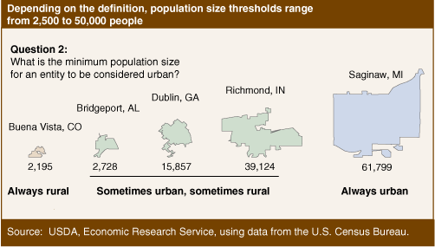
2020 Census UA Criteria Changes
Minimum threshold for qualification as urban raised from at least 2,500 people in 2010 to at least 2,000 housing units or at least 5,000 people in 2020.
2,500-person threshold had been in use since 1910.
  Prior to 1910 the thresholds fluctuated from 2,500 to 8,000.
Census Bureau’s threshold was the lowest in use in various agencies’ urban/rural definitions.
Rural stakeholders and analysts have questioned the continued validity of the 2,500-person threshold and have routinely asked if we would consider an increase.
Source: Cromartie and Bucholtz (2008), “Defining the ‘Rural’ in Rural America.”
USDA ERS - Defining the “Rural” in Rural America

Slide 24
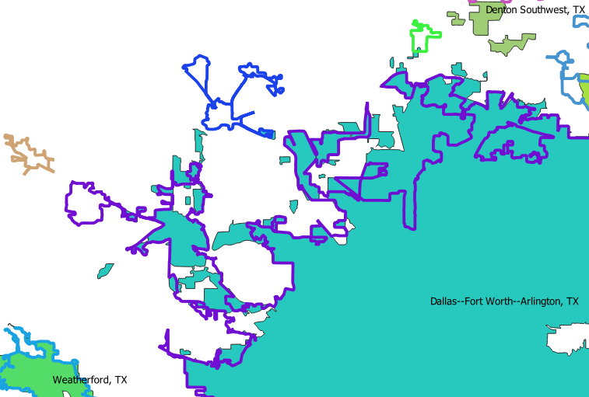
2020 Census UA Criteria Changes
Qualification Threshold Increase Example
2010 Census Urban Clusters of Springtown, TX, Pecan Acres, TX, and Justin, TX no longer qualify as 2020 Census UAs.
2020 Census UA Dallas--Fort Worth--Arlington, TX has expanded to a larger footprint.
Increase in noncontiguous portions of UAs.
Legend:
2020 UA (shaded and labeled)
2010 UA (outlined)

Slide 25
National Average:
200 housing units per square mile (HPSM) = 500 people per square mile (PPSM).
2020 Census UA Criteria Changes
Delineation based primarily on housing unit data at the census block level instead of population data.
More direct measure of developed landscape
Census block-level housing unit counts are invariant
Ability to update extent of UAs between censuses
425 housing units per square mile (HPSM) for initial cores
200 HPSM to fill in extent of UAs
1,275 HPSM to ensure each UA has a high-density nucleus

Slide 26
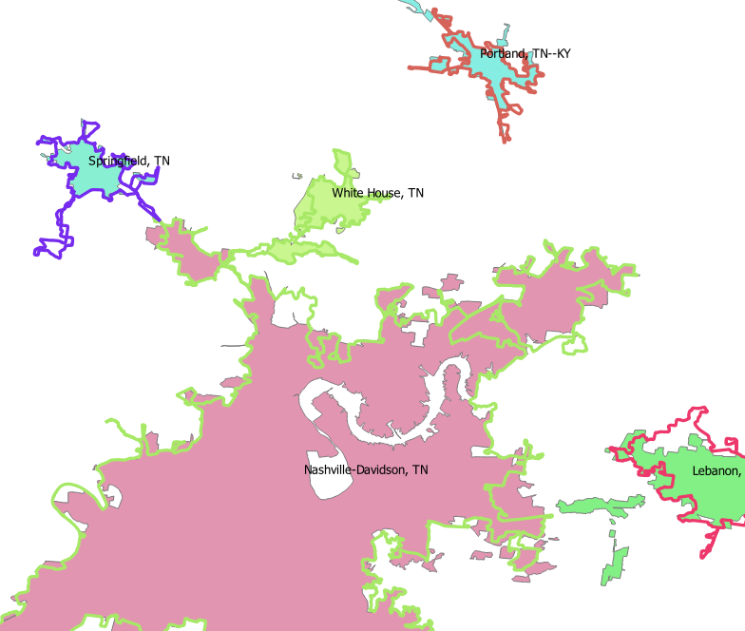
2020 Census UA Criteria Changes
2010 and 2020 UA Changes Example
Most 2020 Census UAs maintained a similar footprint to 2010 Census UAs with changes around the edges.
Legend:
2020 UA (shaded and labeled)
2010 UA (outlined)

Slide 27
2020 Census UA Criteria Changes
Max jump distance to noncontiguous territory reduced from 2.5 miles to 1.5 miles.
Criteria:
Maximum distance for “jumping” across low-density intervening territory reduced from 2.5 miles to 1.5 miles (return to the jump distance that was in effect from 1950 through 1990).
Does not include the intervening low-density “hop” and “jump” corridor blocks in the UA.
Impact:
Minimizes over-bounding caused by addition of impervious surface landcover in 2010.
Reduces the amount of land area within individual UAs. Provides a truer measurement of the extent of urbanization and urban sprawl.
More discrete UAs. Fewer connections to other UAs.
More noncontiguous UAs.

Slide 28
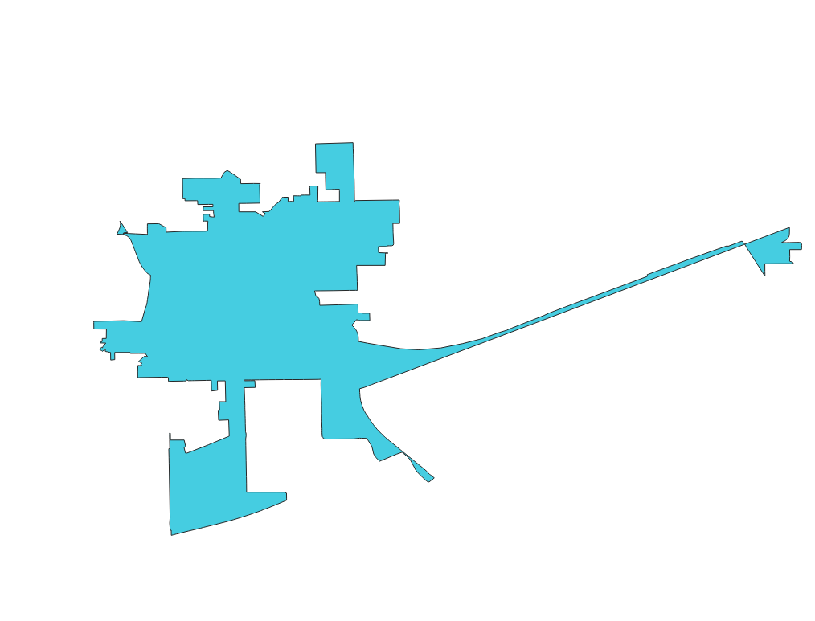
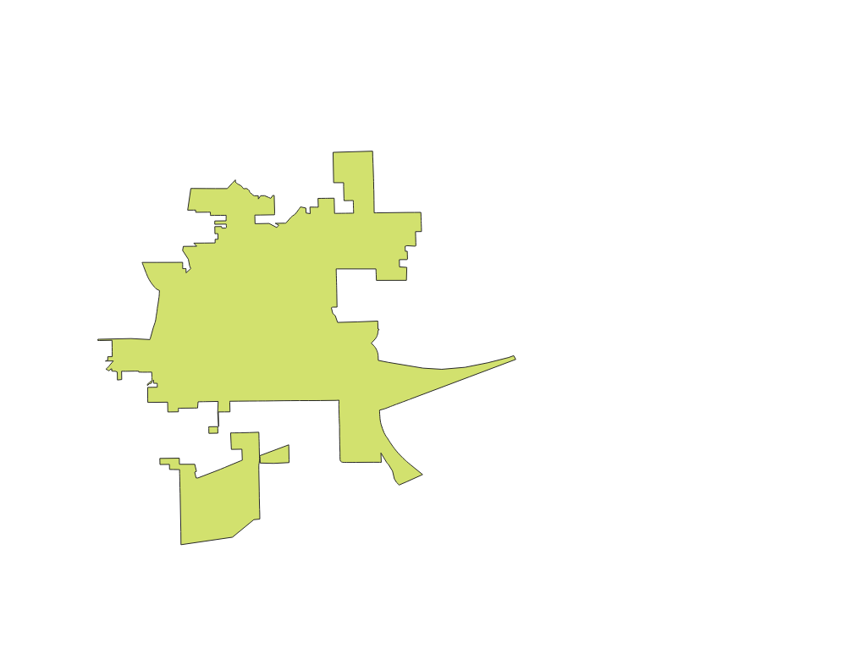
2020 Census UA Criteria Changes
Jump Distance and Intervening Low-Density Territory Example
2010 Census UA
2020 Census UA

Slide 29
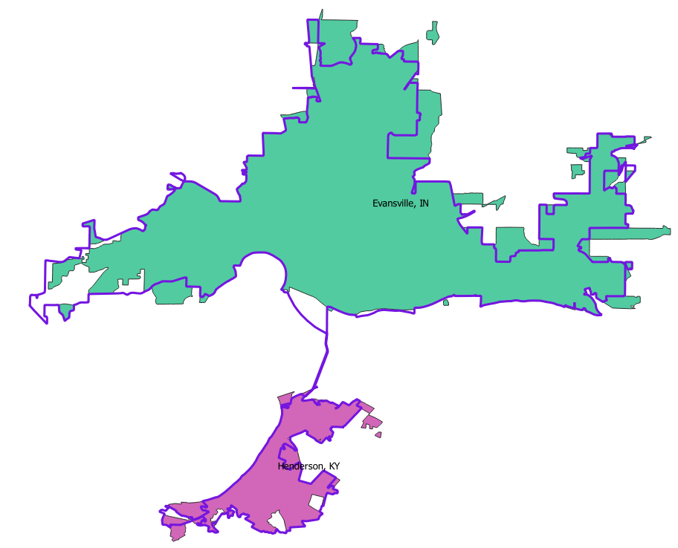
2020 Census UA Criteria Changes
Jump Distance Example
2010 Evansville, IN--KY UA became 2020 Evansville, IN UA and Henderson, KY UA.
Legend:
2020 UA (shaded and labeled)
2010 UA (outlined)

Slide 30
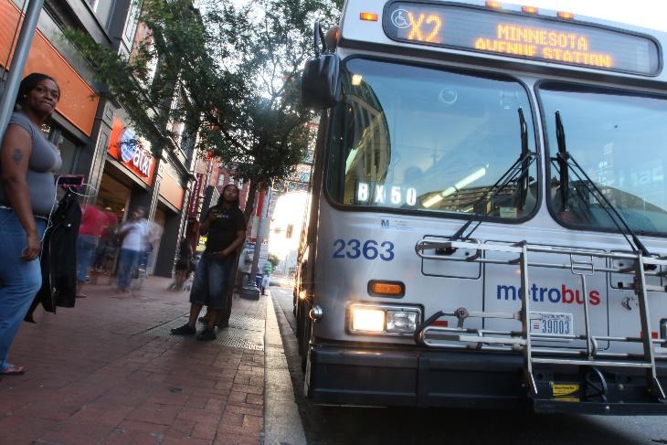
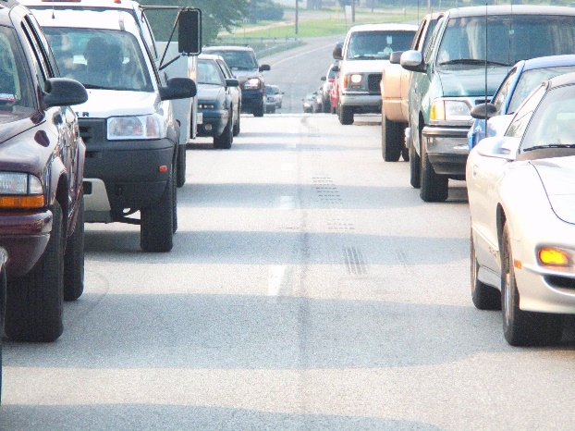

2020 Census UA Criteria Changes
Introduced the use of commuter data to determine where to split large urban agglomerations.
The delineation process results in large urban agglomerations encompassing multiple, individual UAs.
For 2020 we introduced commuting data (LODES dataset) to better determine where to split the urban agglomerations.

Slide 31
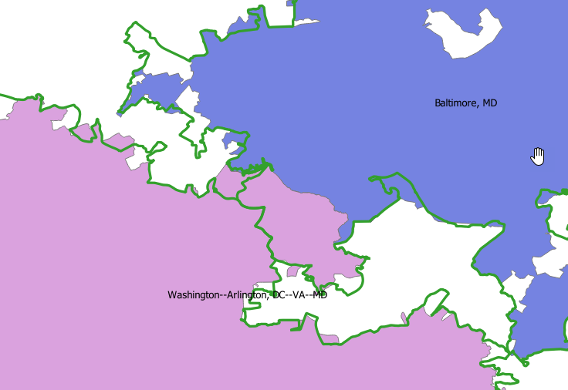
2020 Census UA Changes
Splitting Urban Agglomerations Example
2010 and 2020 Washington D.C. and Baltimore area UAs
Implementing the LODES commuter data shifts the Washington--Arlington, DC--VA--MD UA northeast.
Legend:
2020 UA (shaded and labeled)
2010 UA (outlined)

Slide 32
2020 Census UA Changes
No longer distinguish between “urbanized areas” and “urban clusters”. All qualifying territory will be considered “urban” by the Census Bureau.
The Census Bureau no longer distinguishes between urbanized areas of 50,000 or more population and urban clusters of less than 50,000 population.
  No clear scientific basis for use of 50,000 population as a threshold distinguishing different types of UAs.
  The decision to adopt 50,000 population as a threshold for urbanized areas starting for the 1950 Census seems to have been based primarily on operational concerns and data availability than rooted in economic data, central place theory, or the importance of a place in a particular area.
  UAs above or below 50,000 population can be similar in terms of economic activity.
  Still possible for data users and agencies to identify areas based on population.

Slide 33
Key urban area trends for the U.S. and Texas
(2010 – 2020)

Slide 34
Key 2020 UA Trends, As Compared to 2010 UAs
  Similar percent of population and housing units urban vs. rural.
  Decrease in total number of UAs; but an increase in the number of UAs ≥ 5,000 population.
  Decrease in many UAs’ size/land area; increase in population and housing density of UAs.
  Some 2010 UAs became two UAs in 2020.
  Some 2020 UAs include areas with of densely developed seasonal housing.
  Note: These are national-level trends, and trends vary by region and state.

Slide 35
Percent Population and Housing Units
 |  | 2010 |  | 2020
 |  | Percent Population | Percent Housing | Percent Population | Percent Housing
U.S.* | Urban | 81% | 79% | 80% | 79%
 | Rural | 19% | 21% | 20% | 21%
TX | Urban | 85% | 83% | 84% | 83%
 | Rural | 15% | 17% | 16% | 17%
Sources: 2010 and 2020 Tabulation Block TIGER/Line Shapefiles
*Data includes 50 States and District of Columbia. Does not include UAs located in Puerto Rico and Island Areas.

Slide 36
Decrease in Number of Discrete UAs?
 |  | All UAs |  |  | UAs ≥ 5,000 Population
 |  | 2010 Urban Areas | 2020 Urban Areas | Percent Change | 2010 Urban Areas | 2020 Urban Areas | Percent Change
U.S.* | Urban | 3,573 | 2,612 | -27% | 2,282 | 2,387 | 5%
 | Urbanized Area | 486 | NA |  | 486 | NA
 | Urban Cluster | 3,087 | NA |  | 1,796 | NA
TX | Urban | 306 | 195 | -36% | 186 | 189 | 2%
 | Urbanized Area | 34 | NA |  | 34 | NA
 | Urban Cluster | 272 | NA |  | 152 | NA
Sources: 2010 and 2020 state-sorted lists of urban areas on Urban and Rural (census.gov)
Primarily resulting from criteria changes: Minimum threshold for qualification as urban raised from at least 2,500 people in 2010 to at least 2,000 housing units or at least 5,000 people in 2020.
*Data includes 50 States and District of Columbia. Does not include UAs located in Puerto Rico and Island Areas.

Slide 37
Decrease in UA Size/Land Area; Increase in Population Density
 |  | 2010 Urban Areas | 2020 Urban Areas | Percent Change
U.S.* | Land Area (mi²) | 106,386 | 103,872 | -2%
 | Pop Density (people/mi²) | 2,343 | 2,552 | 9%
TX | Land Area (mi²) | 8,746 | 9,052 | 3%
PA | Pop Density (people/mi²) | 2,435 | 2,696 | 11%
Sources: 2010 and 2020 state-sorted lists of urban areas on Urban and Rural (census.gov)
Primarily resulting from criteria changes:
Max jump distance to noncontiguous territory reduced from 2.5 miles to 1.5 miles.
Move from tract-based to only block-based delineation.
*Data includes 50 States and District of Columbia. Does not include UAs located in Puerto Rico and Island Areas.

Slide 38
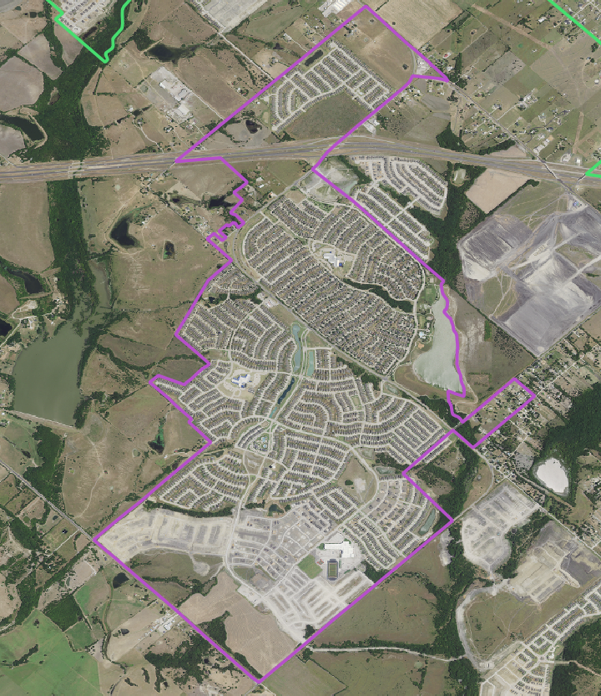
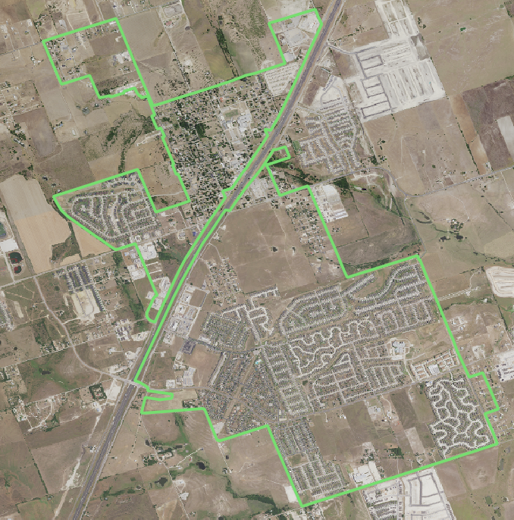
New 2020 UAs
Number of new UAs:
U.S.: 36
TX: 2
  Heartland, TX and Sonterra, TX.
  Planned communities.
  Created as census designated places (CDPs) for the 2020 Census.
Number of 2020 UAs that were part of a different or larger 2010 UA:
U.S.: 2,030
TX: 11
  10 2020 UAs were part of a larger 2010 UA.
  1 merged.
Heartland, TX
Sonterra, TX

Slide 39
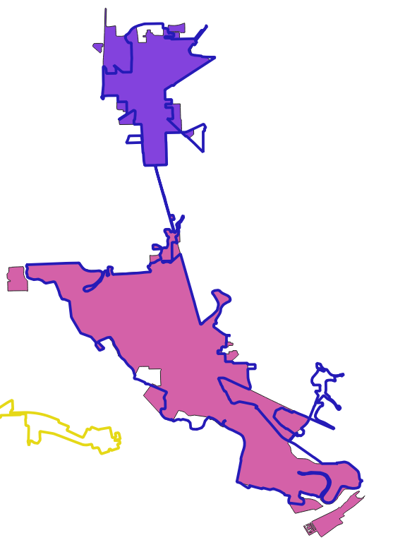
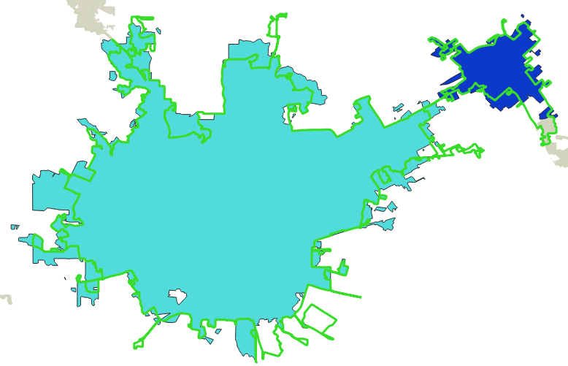
One 2010 UA Became Two 2020 UAs
2010 Lake Jackson--Angleton, TX
2010 San Antonio, TX
2020 Angleton, TX
2020 New Braunfels, TX
2020 San Antonio, TX
2020 Lake Jackson, TX
Legend:
2020 UA (shaded)
2010 UA (outlined)

Slide 40
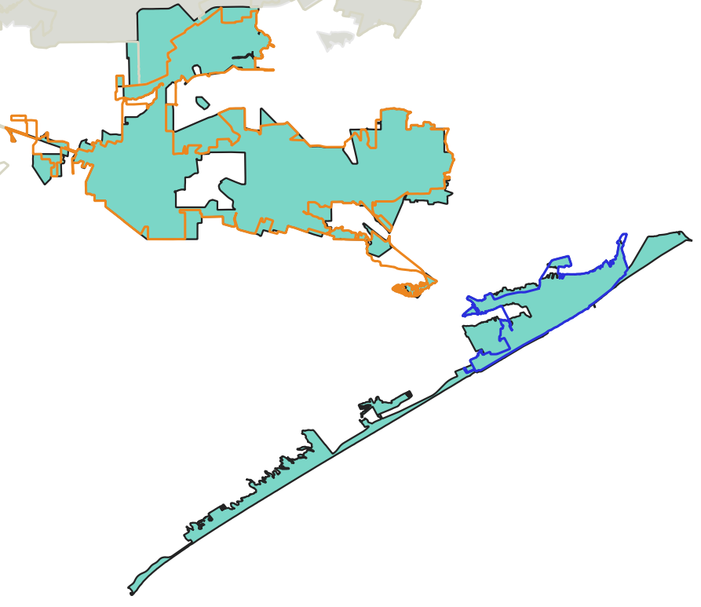
Two 2010 UAs Became one 2020 UA
2020 Galveston--Texas City, TX
2010 Texas City, TX
2010 Galveston TX
Legend:
2020 UA (shaded)
2010 UA (outlined)

Slide 41
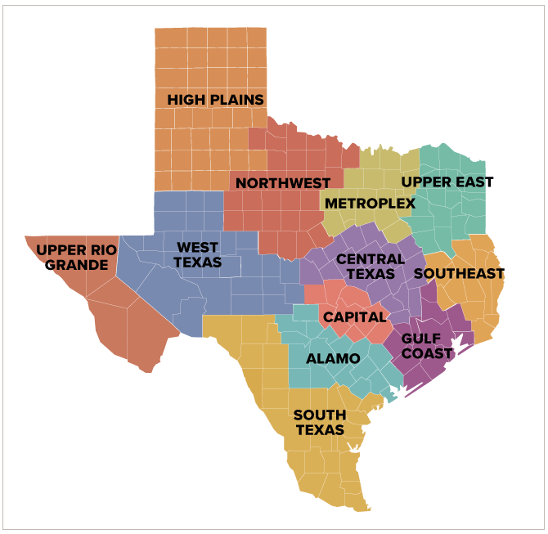
Texas Regions
Source: Texas Comptroller Economic Regions

Slide 42
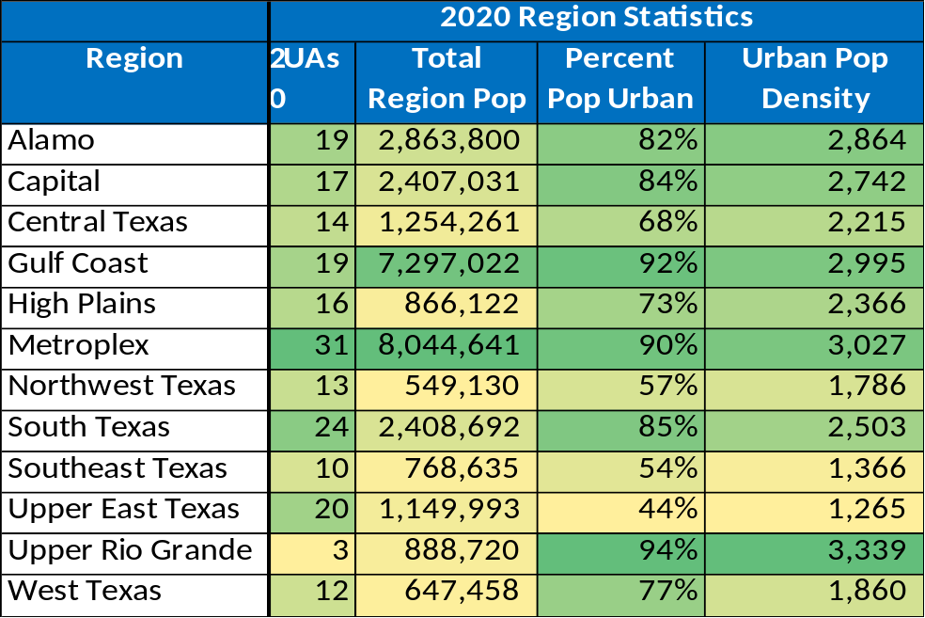
Texas Regions: Basic Statistics
Sources: Texas Comptroller Economic Regions; 2020 County, Tabulation Block, and Urban Area TIGER/Line Shapefiles

Slide 43
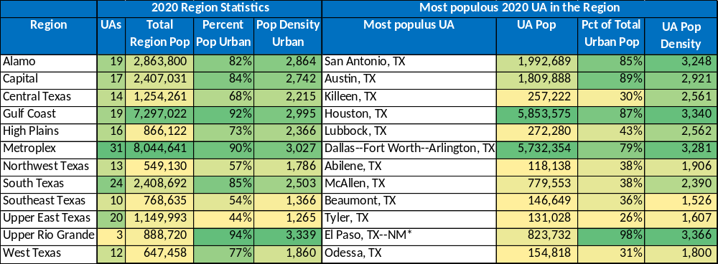
Texas Regions: Basic Statistics
Sources: Texas Comptroller Economic Regions; 2020 County, 2020 Tabulation Block, and 2020 Urban Area TIGER/Line Shapefiles; 2020 list of urban areas and state-sorted list of urban areas on Urban and Rural (census.gov)
*El Paso, TX--NM data represents the Texas portion of the UA.

Slide 44
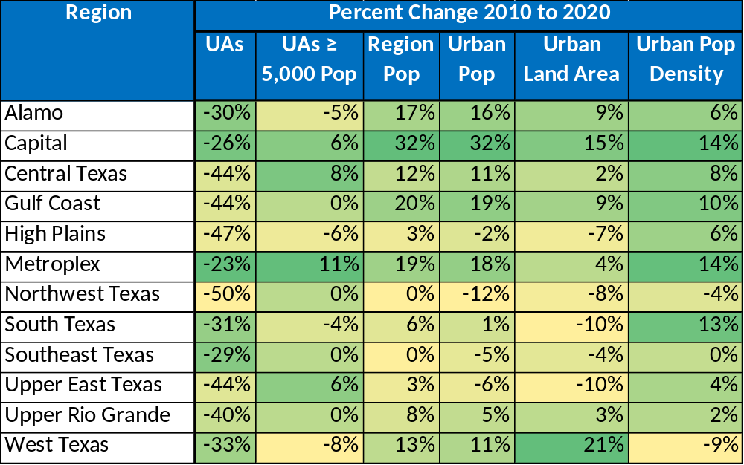
Sources: Texas Comptroller Economic Regions; 2010 and 2020 County, Tabulation Block, and Urban Area TIGER/Line Shapefiles; 2010 and 2020 lists of urban areas and state-sorted lists of urban areas on Urban and Rural (census.gov)
Texas Regions: Percent Change
2010 to 2020
\

Slide 45
Beyond 2020

Slide 46
Beyond 2020: Next Steps
  Demographic data published in the Demographic and Housing Characteristics File (DHC).
    Scheduled publication Summer 2023.
    Subjects: Age, sex, race, Hispanic or Latino origin, household type, family type, relationship to householder, group quarters population, housing occupancy, and housing tenure.
    Some tables are repeated by race and ethnicity.
  Continue working with stakeholders.
    The Census Bureau works with tribal, federal, state, and local agencies as well as other stakeholders to ensure understanding of our classification.
    There are different advantages and disadvantages to urban qualification based on each individual program or funding agency and often qualification for one program may equal a disadvantage in a different program for the same entity.

Slide 47
Beyond 2020: UA Criteria
Given data user feedback to date, the Census Bureau:
  Does not anticipate significant UA criteria changes.
  Will consider additional land use datasets to identify exempted territory.
    Datasets must be nationally-consistent and freely-available sources.

Slide 48
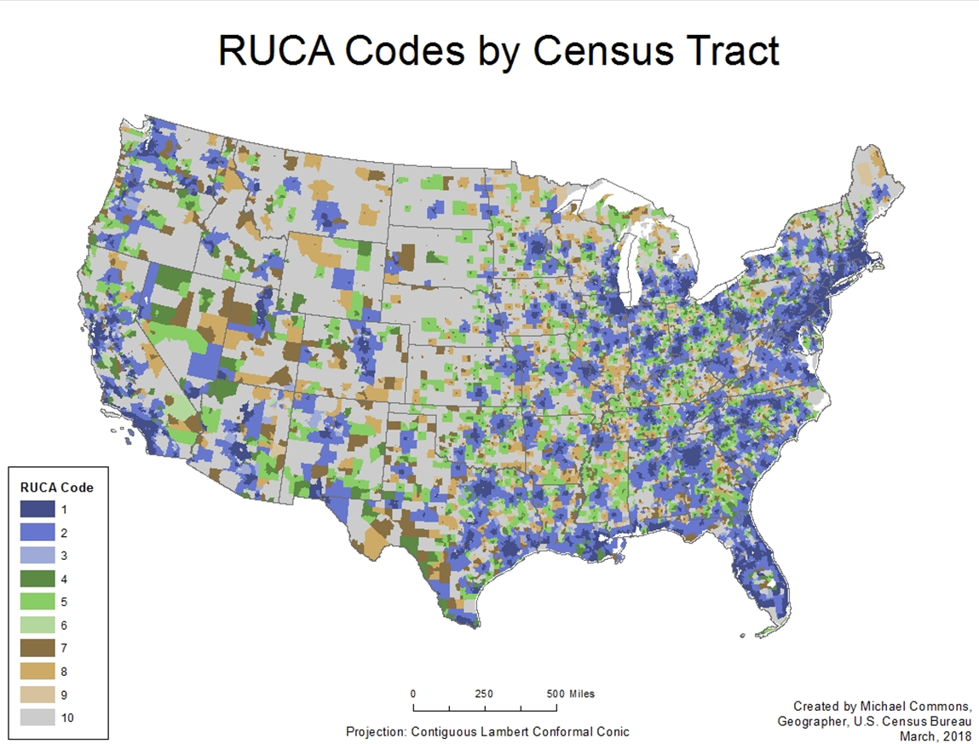
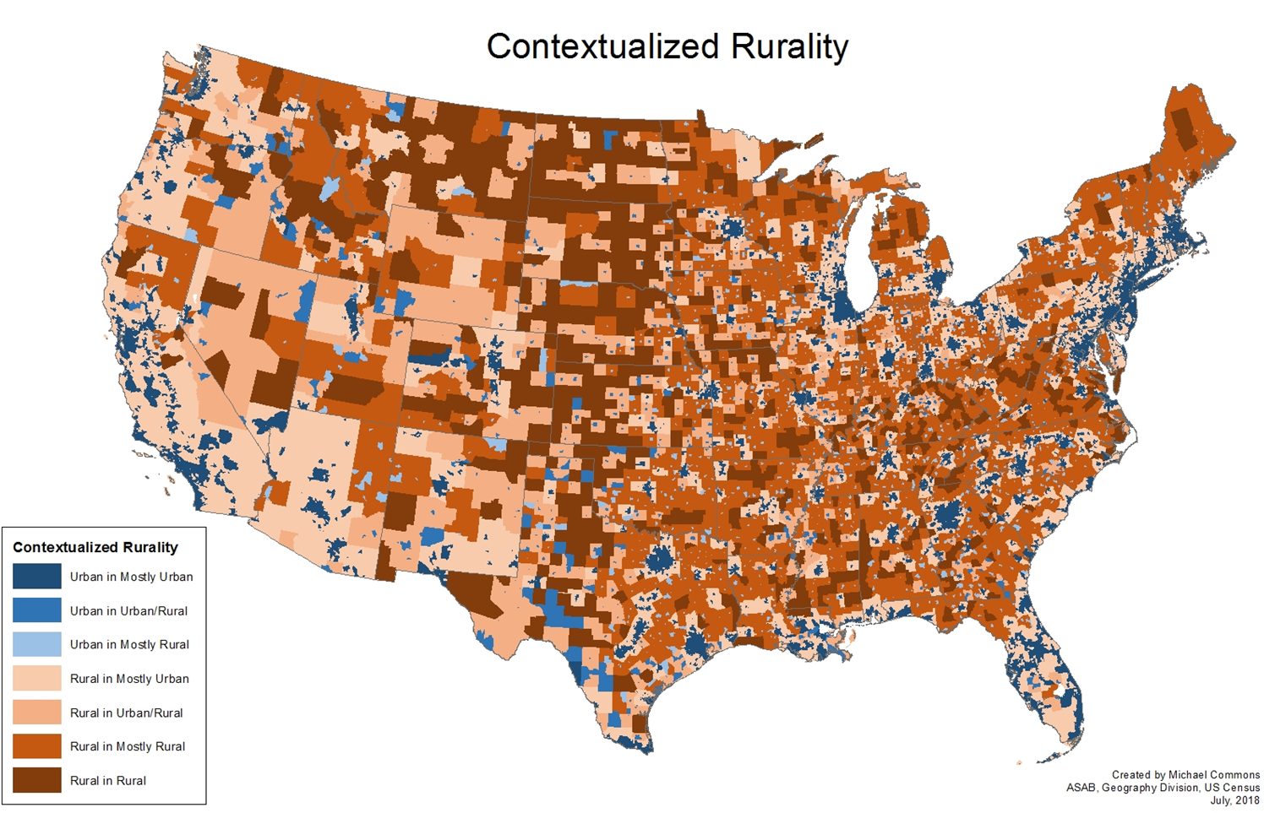
Beyond 2020: Investigating Urban-Rural Continuum
  Classifications tend to be dichotomous:
    Urban/Rural; Metropolitan/Nonmetropolitan.
    Rural and Nonmetropolitan are residual categories.
  Move towards additional categories:
    USDA Economic Research Service Rural-Urban Commuting Areas, Rural Urban Continuum Codes.
    National Center for Health Statistics County Classification.

Slide 49
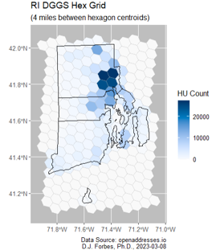
Beyond 2020: Investigating Grids
  Investigating UA delineation via grids:
    Census blocks and other census geographies vary in size.
    Possibility of a more uniform, close to equal geographic unit with less bias.

Slide 50
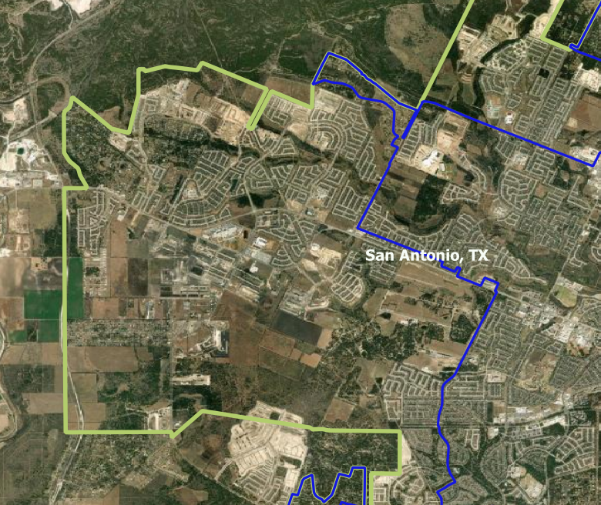
Beyond 2020: Additional Considerations
Post-2010 development on the west side of the San Antonio, TX UA.
    Continuum and grid-based delineation in addition to “traditional” UA delineation?
      Historical comparability.
      Agency reliance on Census Bureau UAs for programmatic uses.
    Intercensal updates
      Possibility post-2020 delineation since 2020 UAs are housing unit-based.
      Options:
        Additive update (most likely), e.g., “add urban” to the current delineation where development occurs.
        Complete re-delineation.
Legend:
2020 UA Boundary
2010 UA Boundary

Slide 51
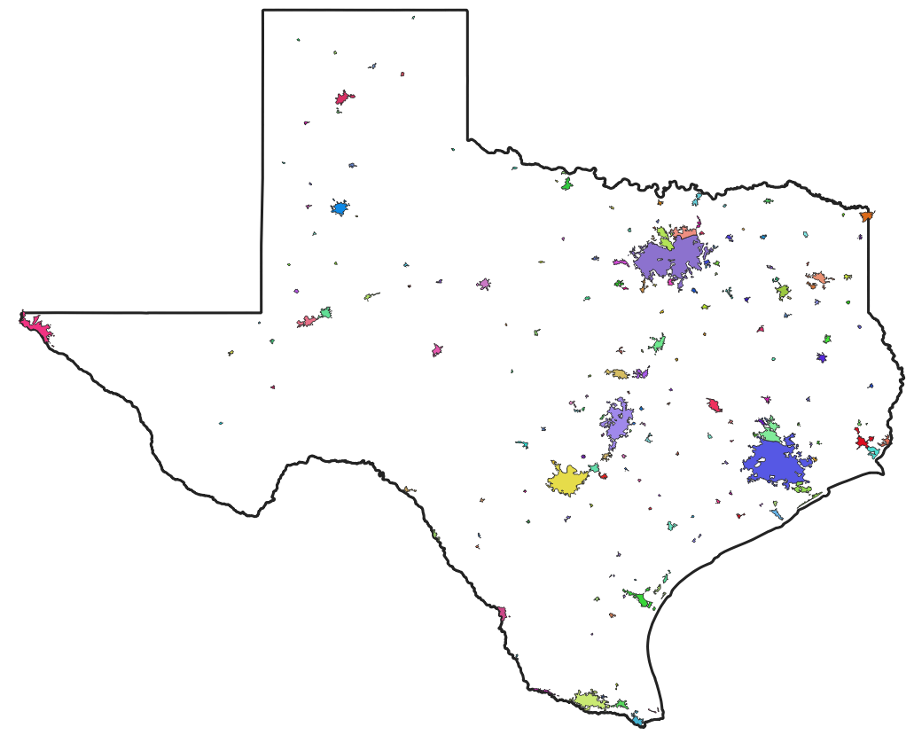
Texas 2020 UAs
51

Slide 52
Questions?
U.S. Census Bureau
Geography Division
https://www.census.gov/programs-surveys/geography/guidance/geo-areas/urban-rural.html
2020 Census UA Team: geo.urban@census.gov

