Slide 1
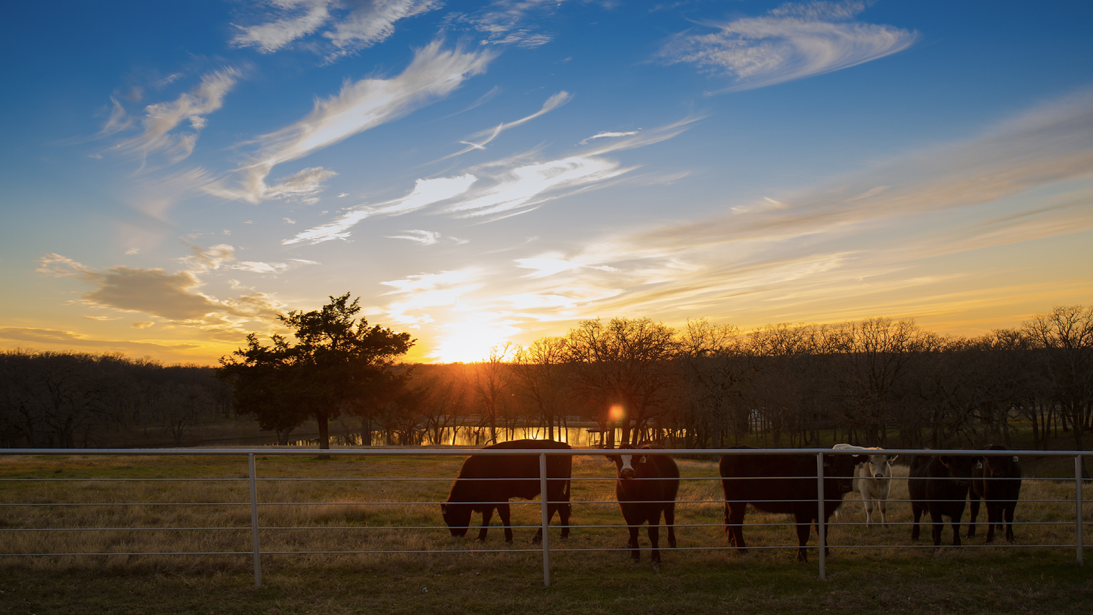

2020 U.S. Census Undercount
ENGAGING TEXAS COMMUNITIES FOR STRONGER DATA
Dr. Francisco Castellanos-Sosa and Regina Nippert
May 24, 2023
2023 Texas Demographic Conference

Slide 2
Today’s Agenda
1) Who we are
2) Census data accuracy and why it matters
3) Challenges to collecting and accessing accurate data
Challenge 1: Understanding the 2020 Census undercount
Challenge 2: Improving self-response rates
4) Increasing self-response rates to amplify the Bureau’s activities in historically-undercounted communities (HUCs)
5) Engaging undercounted communities in the research process

Slide 3
Let’s meet us!

Slide 4


What industry does your organization represent?
ⓘ Start presenting to display the poll results on this slide.

Slide 5
About the
Texas Census Institute
Notes:
Establish TxCI credibility and purpose

Slide 6



The Texas Census Institute (TxCI) provides independent, non-partisan, data-driven census policy and program guidance that encourages census participation so all Texans can enjoy a great quality of life.
REGIONAL
PARTNERSHIPS
RESEARCH
EDUCATION

Slide 7
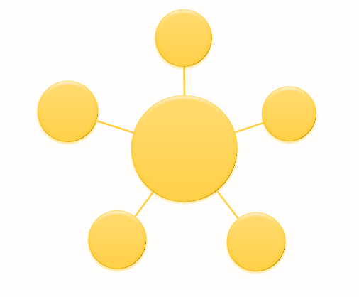
TxCI is a hub for Texas. Together with regional partners and other stakeholders, we:
Augment data collection activities,
Help ensure data accuracy,
Expand data access and granularity, and
Help ensure better lives for all Texans.

Slide 8
Census data accuracy and
why it matters
Notes:
Dr. Potter talked about the undercount earlier in population terms. Texas is growing fast, our physical infrastructure is aging, our technology infrastructure is still spotty in places, and our ability to provide human services like education and health care is inadequate. Texans need accurate data to plan for growth and we need our full share of federal dollars in order to accomplish it.

Slide 9

Nationwide, the census impacts:
Money
Influences roughly $1.5 trillion in federal funds
Influence
Determines apportionment and district boundaries
Planning & Research
Identifies local needs and evaluates impact
Advocacy
Addresses policy gaps for underserved populations
Sources:
POGO (2020) (Retrieved from https://www.pogo.org/analysis/2020/03/the-importance-of-the-2020-census-explained-in-dollars-and-cents)
U.S. Census Bureau (2021) (Retrieved from https://www.census.gov/data/tables/2020/dec/2020-apportionment-data.html)

Slide 10
The decennial census helps Congress to distribute billions of dollars in federal funding, grants and support for:
  schools,
  hospitals,
  roads,
  public works and infrastructure, and
  other projects.
Notes:
EXAMPLES ( $ and PROGRAMS)
School buildings, teacher salaries, school breakfasts, etc.

Slide 11
The annual American Community Survey (ACS) supports near-term data-driven decision making for:
businesses and corporations,
preK-12 school systems,
colleges and universities,
state and local governments,
faith communities,
nonprofits,
researchers, and the
public sector.

Slide 12
Key Takeaway
1
Counting people accurately is essential for planning, economic stability and political representation.
Accurate data are vital tools for maintaining a thriving Texas.
Notes:
Specifics from one of the regions (Houston/Gulf Coast)

Slide 13
Challenges to accessing
and collecting accurate data
Challenge 1: Understanding the scope and location of the 2020 Census undercount
Challenge 2: Declining self-response rates
Notes:
Dr. Potter talked about the undercount earlier in population terms. Texas is growing fast, our physical infrastructure is aging, our technology infrastructure is still spotty in places, and our ability to provide human services like education and health care is inadequate. Texans need accurate data to plan for growth and we need our full share of federal dollars in order to accomplish it.

Slide 14
Challenge 1: Understanding the
scope, location, and impact of the 2020 Census undercount in Texas
Notes:
Dr. Potter talked about the undercount earlier in population terms. Texas is growing fast, our physical infrastructure is aging, our technology infrastructure is still spotty in places, and our ability to provide human services like education and health care is inadequate. Texans need accurate data to plan for growth and we need our full share of federal dollars in order to accomplish it.

Slide 15
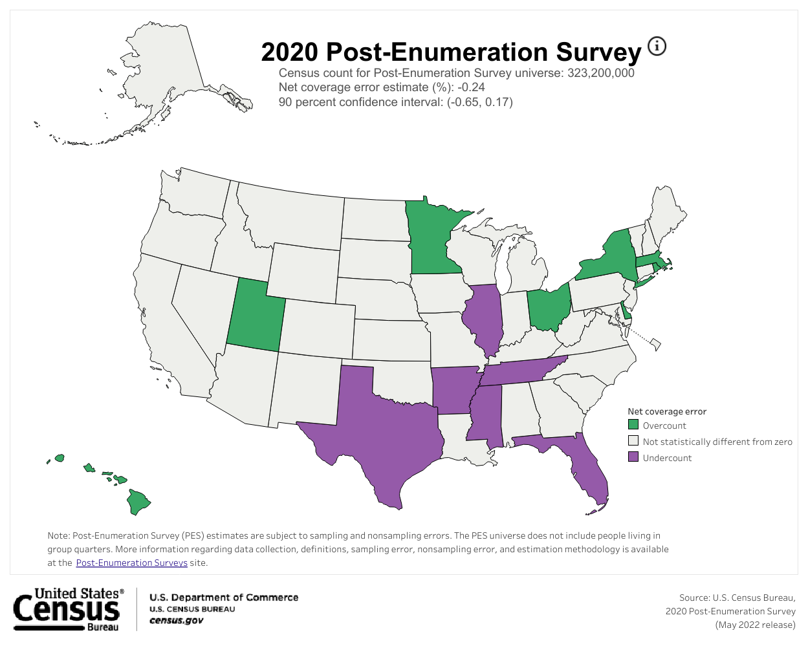
Texas Census Count for PES
28,540,000
Texas Undercount (Net Coverage Error)
-1.92%
Texas Undercount (Population)
547,968
Texas 90% Confidence Interval
(-3.27, -0.57)
Source: U.S. Census Bureau (2022) (Retrieved from https://www.census.gov/library/visualizations/interactive/2020-post-enumeration-survey.html).

Slide 16
In the 2020 Census, 547,968 Texas residents were undercounted.
Source: U.S. Census Bureau (2022) (Retrieved from https://www.census.gov/library/visualizations/interactive/2020-post-enumeration-survey.html).

Slide 17
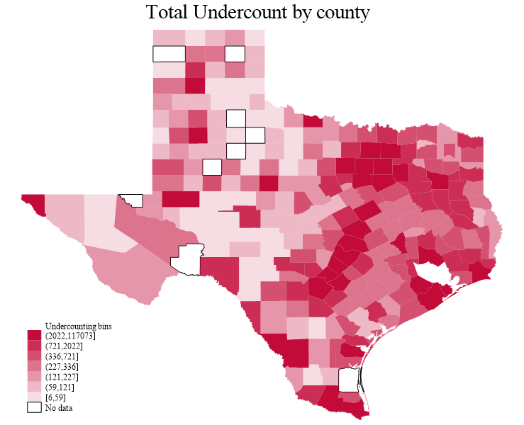
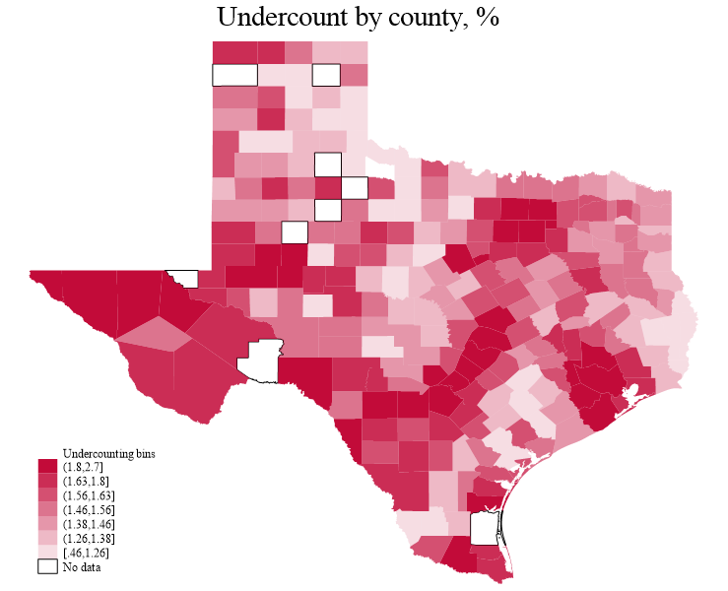
The undercount in Texas counties
Figure 1 Undercount in Texas counties
Source: Castellanos-Sosa (2022) (Retrieved from https://texascensus.org/undercounting-and-overcounting-texas-counties-population/)
Note: There is no information for the following nine counties regarding Cohesiveness by clustering and Volunteering: Borden, Hartley, Kenedy, Kent, King, Loving, Motley, Roberts, and Terrel.

Slide 18
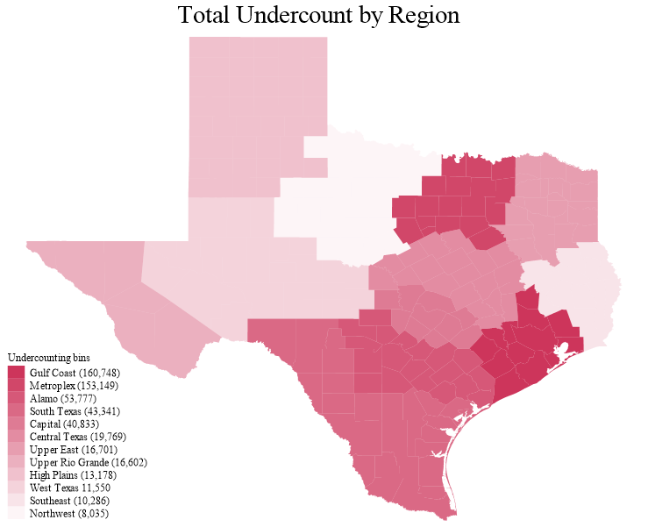
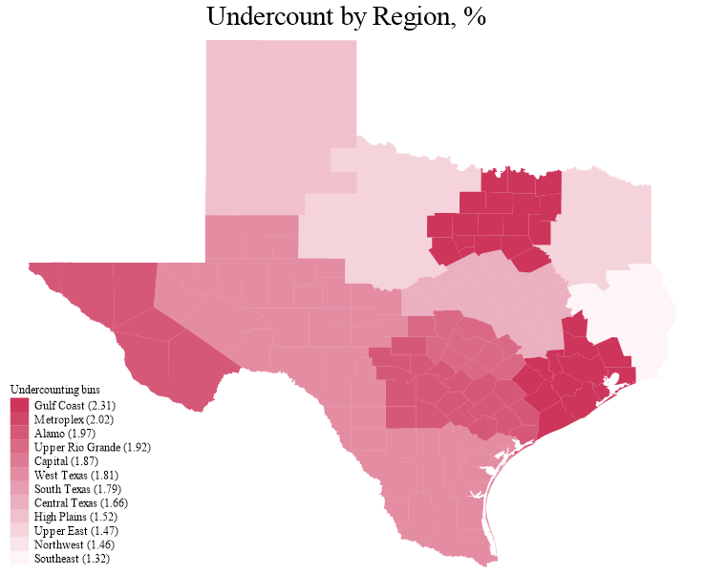
The undercount in Texas regions
Figure 2 Undercount in Texas regions
Source: Castellanos-Sosa (2022) (Retrieved from https://texascensus.org/undercounting-and-overcounting-texas-counties-population/)
Note: There is no information for the following nine counties regarding Cohesiveness by clustering and Volunteering: Borden, Hartley, Kenedy, Kent, King, Loving, Motley, Roberts, and Terrel.

Slide 19
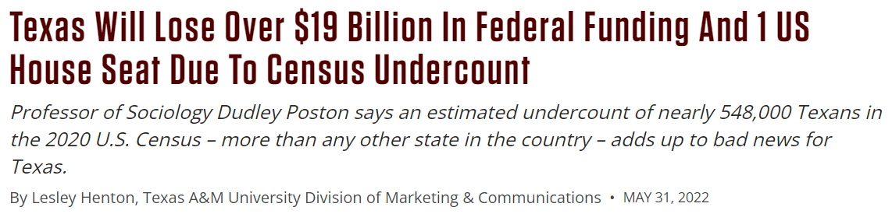
Texas losses due to undercount
Source: Texas A&M Today (2022) (Retrieved from https://today.tamu.edu/2022/05/31/texas-will-lose-over-19-billion-in-federal-funding-and-1-us-house-seat-due-to-census-undercount/)
Notes:
$19-27B

Slide 20
Texas losses due to undercount
Between 2021 and 2030, the Perryman Group estimates the 2020 Census undercount will cost Texas:
$59.0 billion in gross product, and
641,624 in job-years
Source: Perryman Group (2022) (Retrieved from https://www.perrymangroup.com/publications/brief/2022/6/3/the-economic-impact-of-the-texas-census-undercount/)
Notes:
take off first bullet

Slide 21
Impact: Regional Food Bank
“The need we are seeing is much larger than the numbers would indicate. As a result our funding need is significantly greater than what we budgeted based on the data we had.”
Source: North Texas Food Bank

Slide 22
Key Takeaway
2
Texas experienced a half-million+ person undercount in the 2020 Census, resulting in loss of income and representation.
All Texans have a strong vested interest in a more accurate 2030 Census.
Notes:
Specifics from one of the regions (Houston/Gulf Coast)

Slide 23

How does your organization rely on census data for planning or funding?
ⓘ Start presenting to display the poll results on this slide.
Notes:
Does your organization rely upon census data? How might the undercount be impacting you? Your region?

Slide 24
Challenge #2: Improving
self-response rates in historically undercounted communities

Slide 25

How informed are you about
how the Census Bureau calculates the undercount?
ⓘ Start presenting to display the poll results on this slide.

Slide 26
How does the Bureau calculate the undercount and why do self-response rates matter?

Slide 27
The U.S. Census Bureau assesses the accuracy of its decennial census in two primary ways:
Post-Enumeration Survey (PES), and
Demographic Analysis (DA).

Slide 28
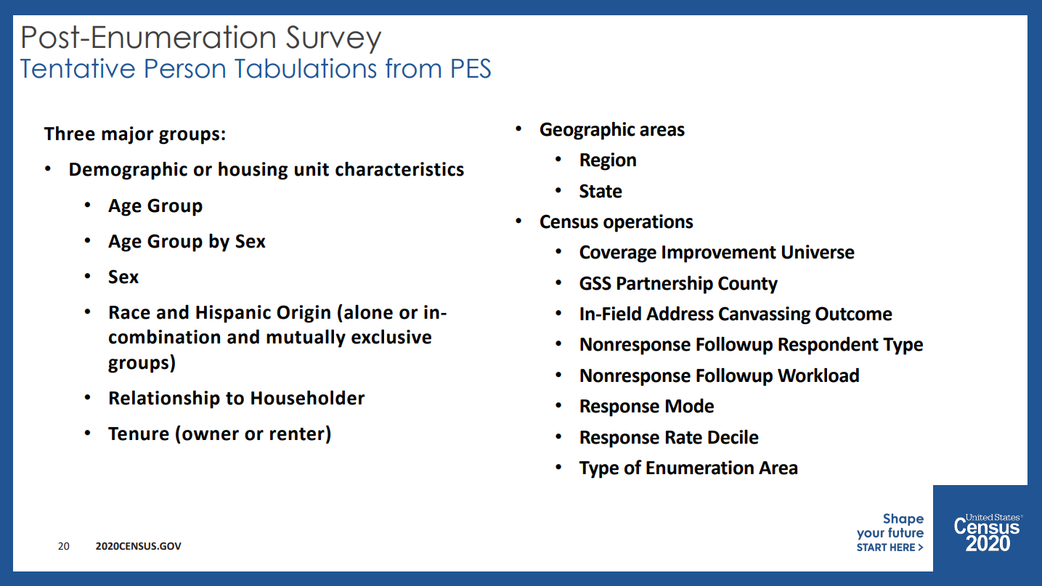
Post-Enumeration Surveys
Source: U.S. Census Bureau (2021) (Retrieved from https://www2.census.gov/about/partners/cac/nac/meetings/2021-05/presentation-post-enumeration-survey-overview.pdf)

Slide 29
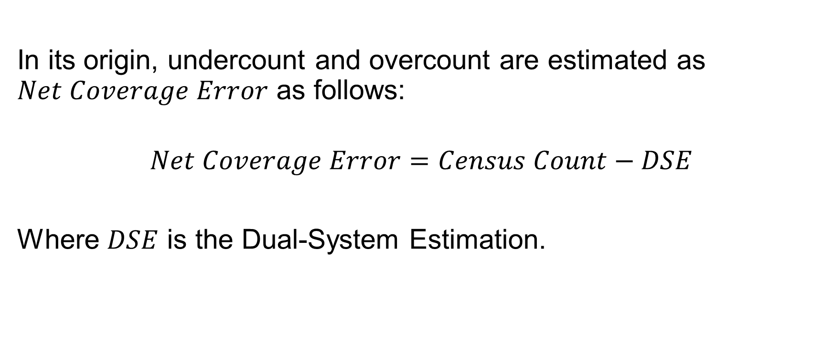
Source: U.S. Census Bureau (2022) (Retrieved from https://www2.census.gov/programs-surveys/decennial/coverage-measurement/pes/2020-pes-estimation-design.pdf)

Slide 30
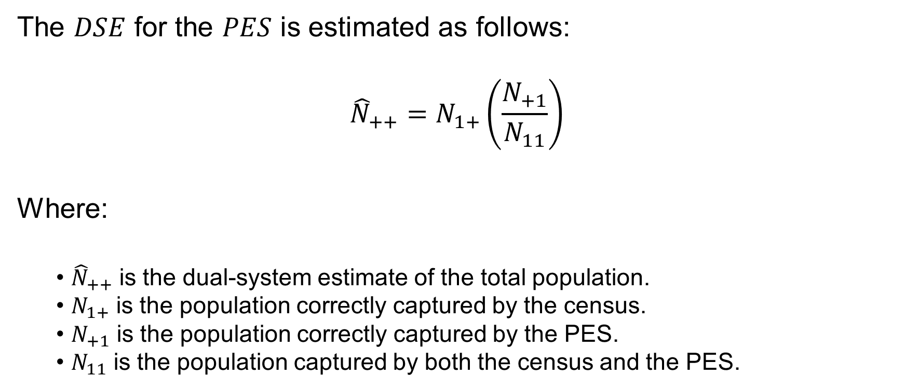
Source: U.S. Census Bureau (2022) (Retrieved from https://www2.census.gov/programs-surveys/decennial/coverage-measurement/pes/2020-pes-estimation-design.pdf)

Slide 31
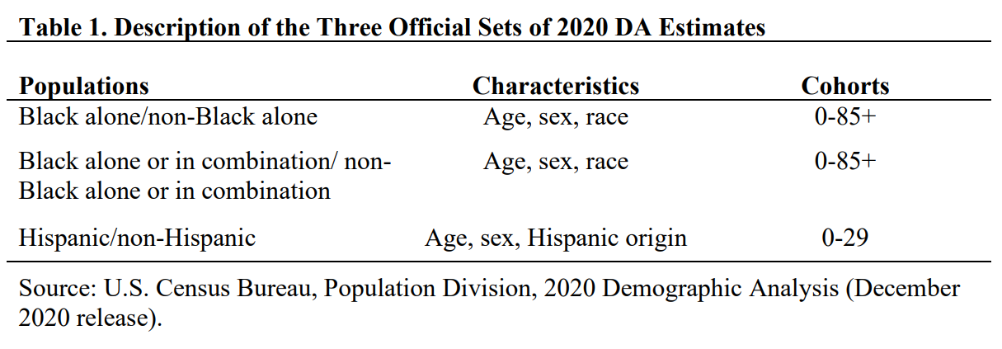
Demographic Analysis
Source: U.S. Census Bureau (2020) (Retrieved from https://www2.census.gov/programs-surveys/popest/technical-documentation/methodology/2020da_methodology.pdf)

Slide 32
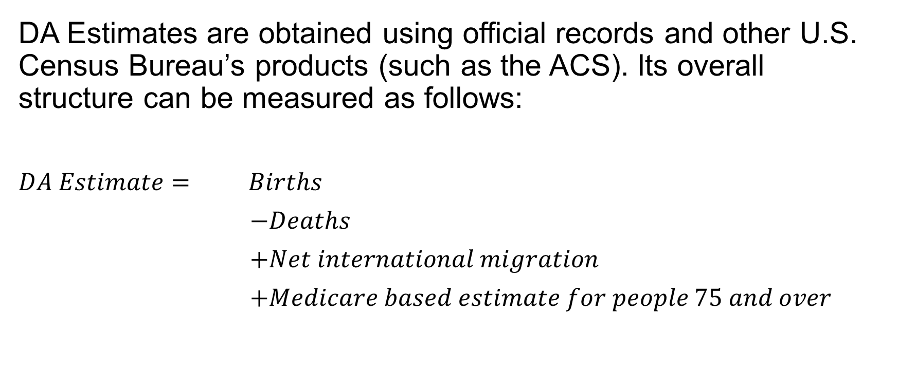
Source: U.S. Census Bureau (2020) (https://www2.census.gov/programs-surveys/popest/technical-documentation/methodology/2020da_methodology.pdf)

Slide 33
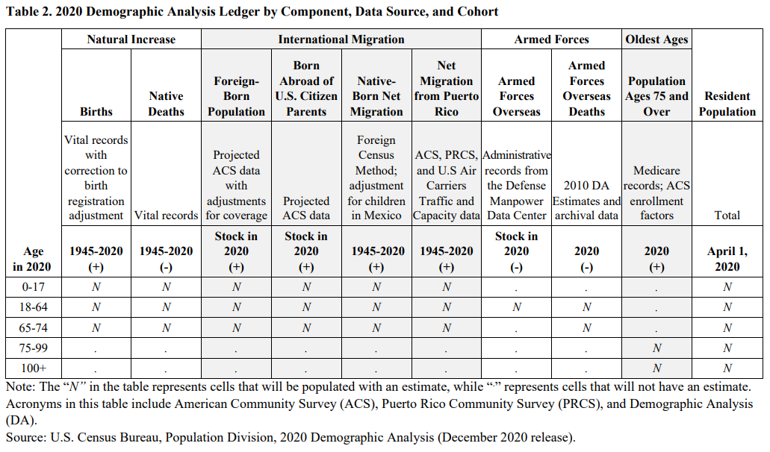
Source: U.S. Census Bureau (2020) (https://www2.census.gov/programs-surveys/popest/technical-documentation/methodology/2020da_methodology.pdf)

Slide 34
Post-Enumeration Surveys and Demographic Analysis both use individual or “self-response” as their primary source of data.
The Bureau identifies communities where self-response rates are low as “historically undercounted” communities.
Historically undercounted communities’ self-response rates, despite enumeration, remain persistently lower than self-response rates in other communities.

Slide 35
What do the data tell us about self-response rates?

Slide 36
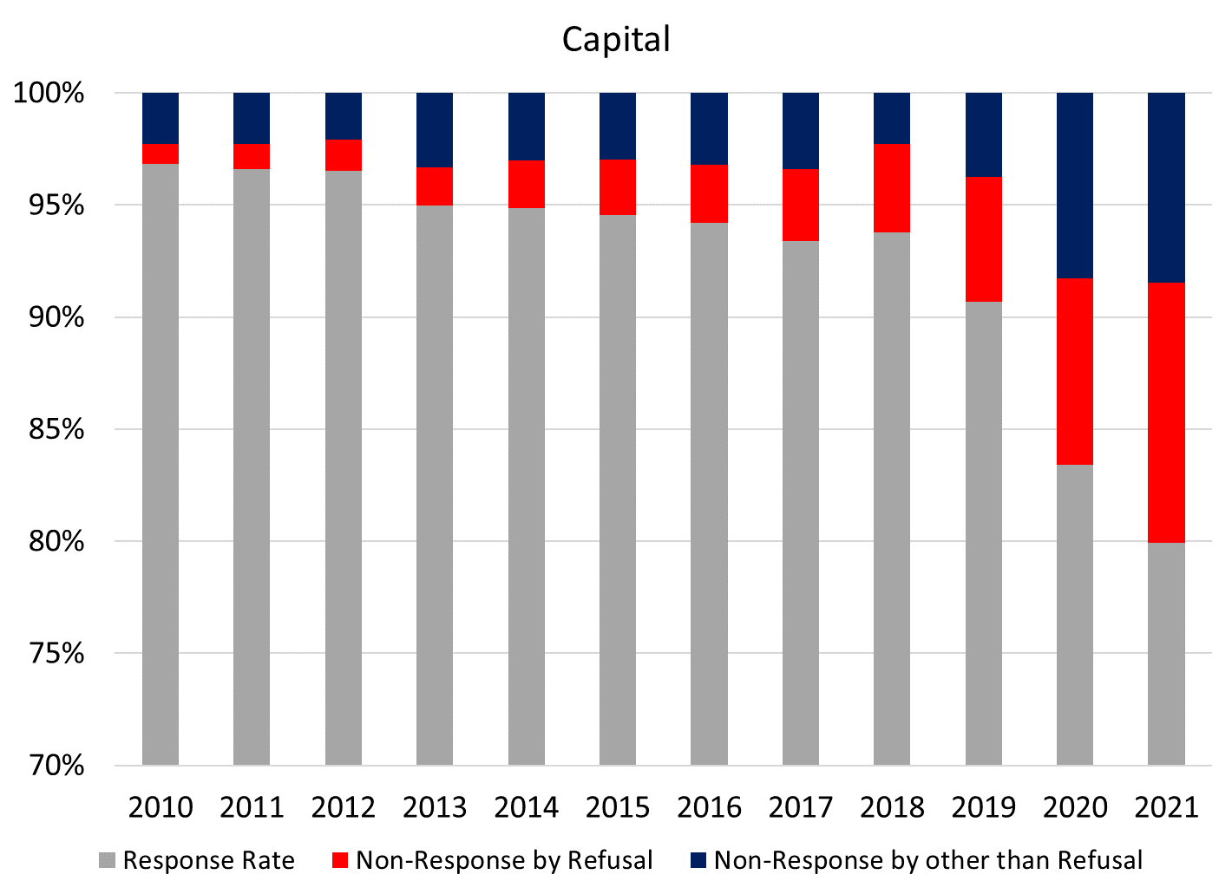
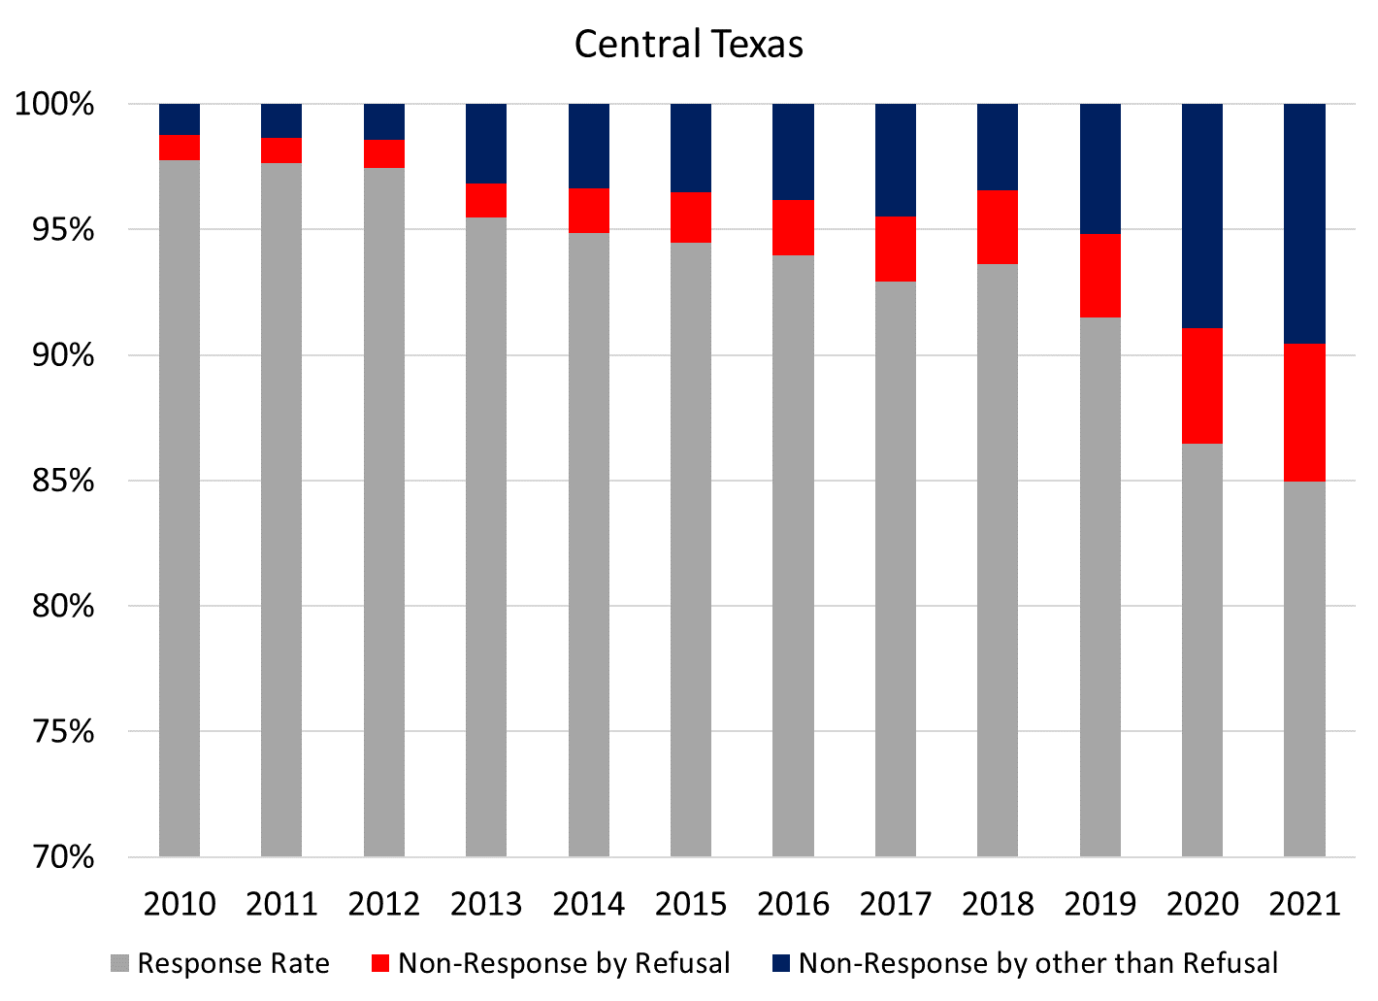
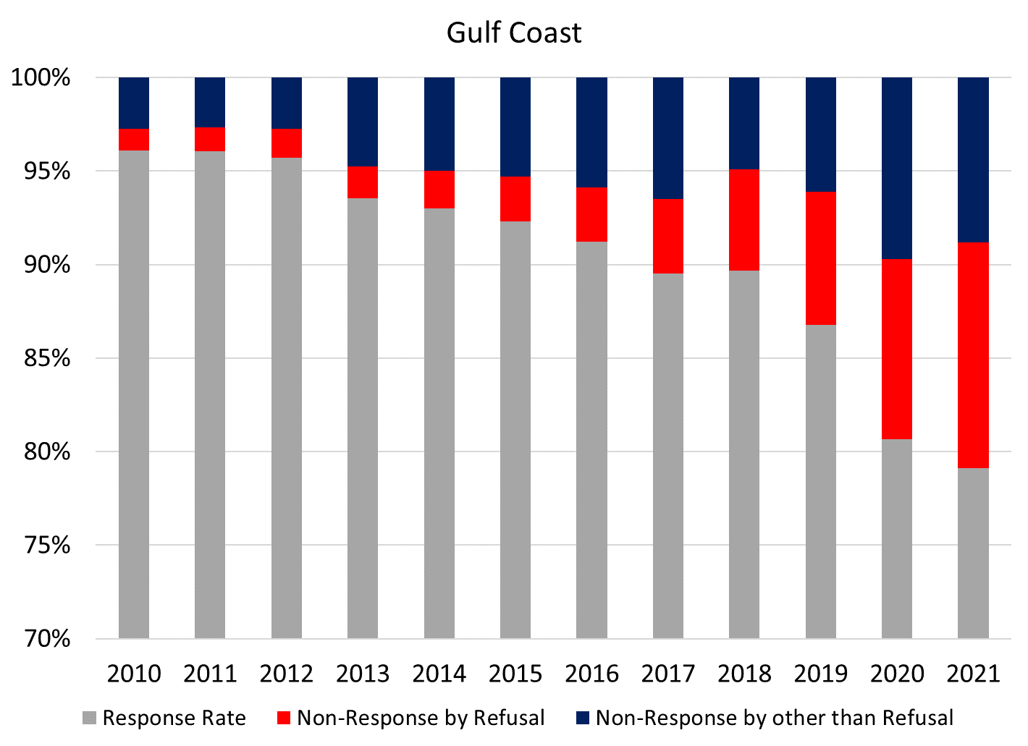
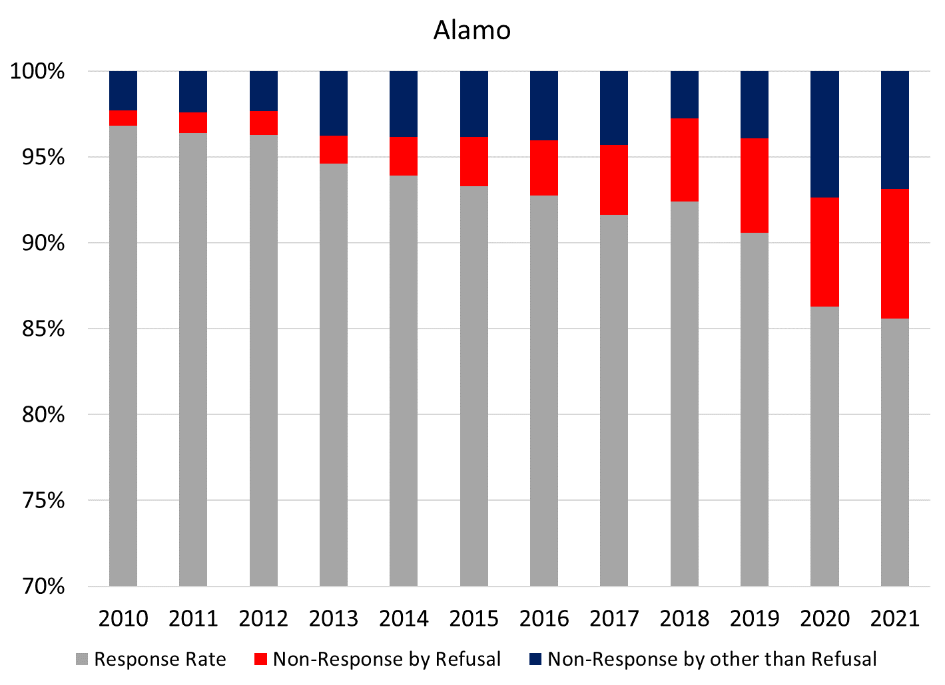
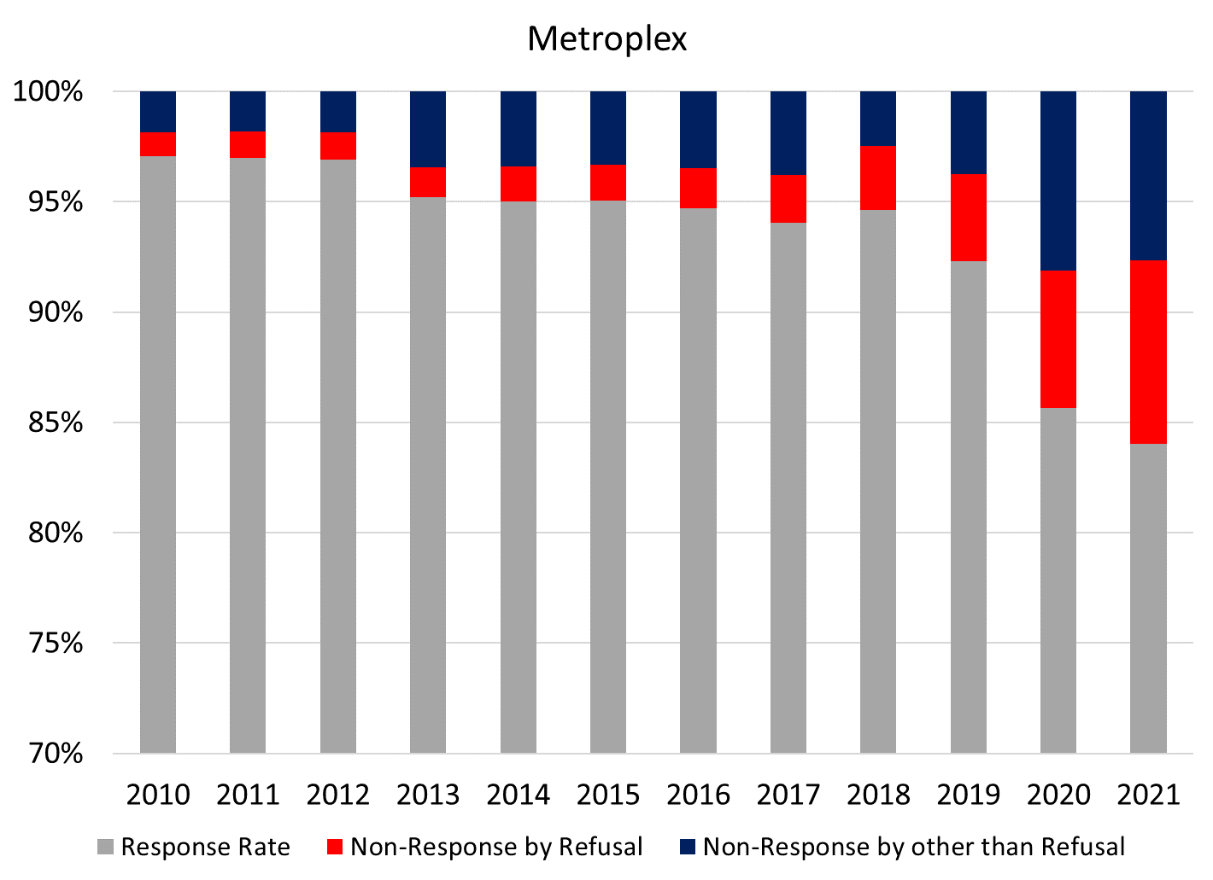
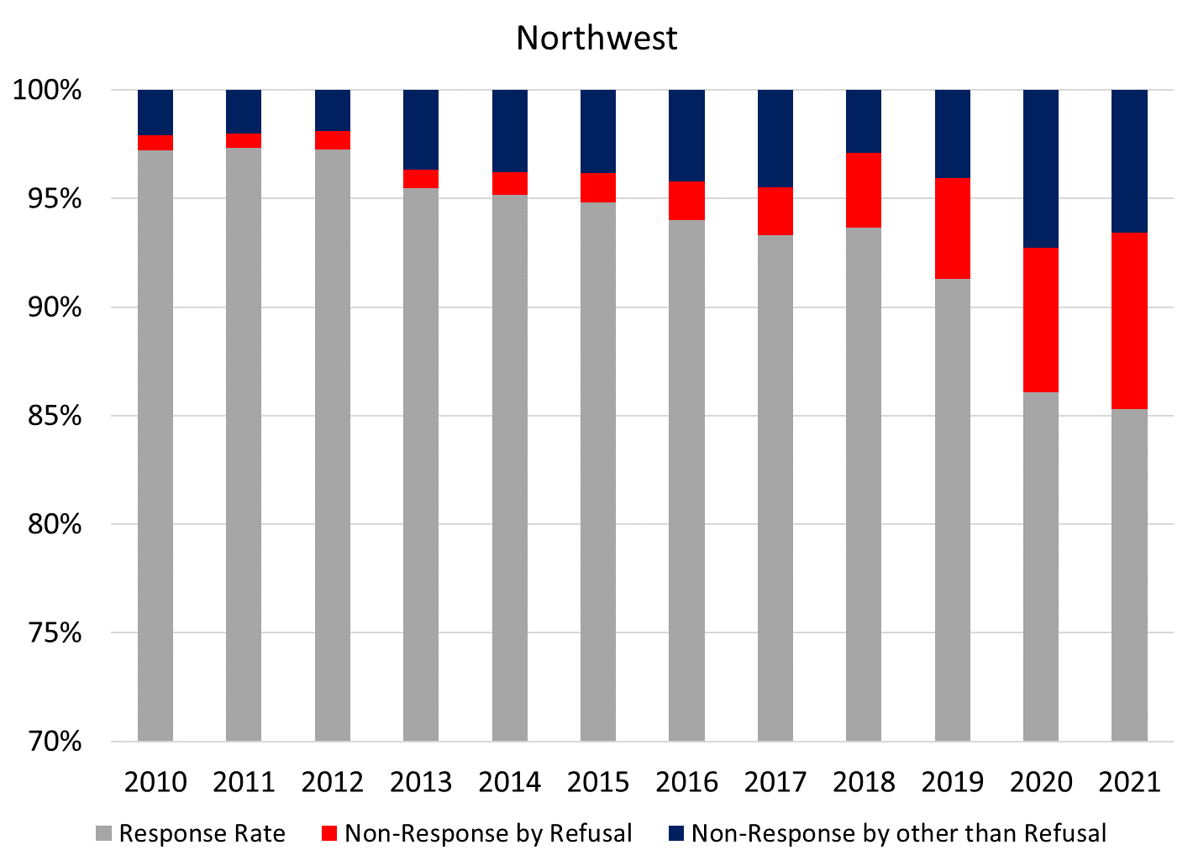
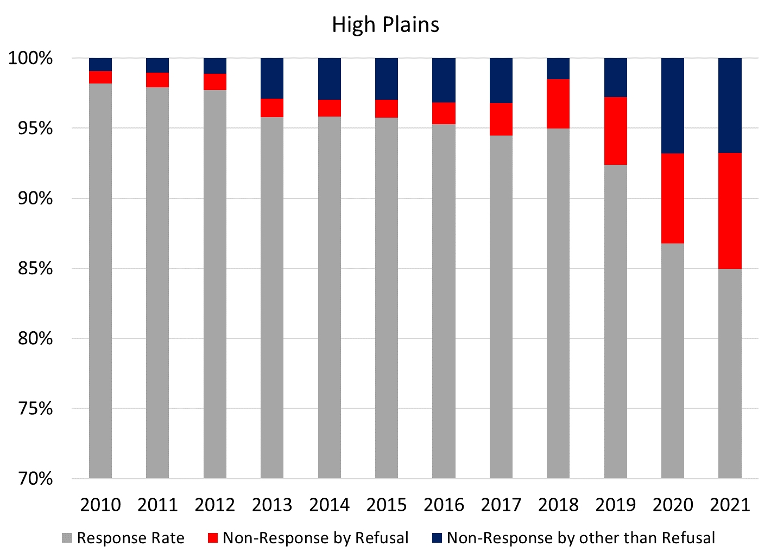
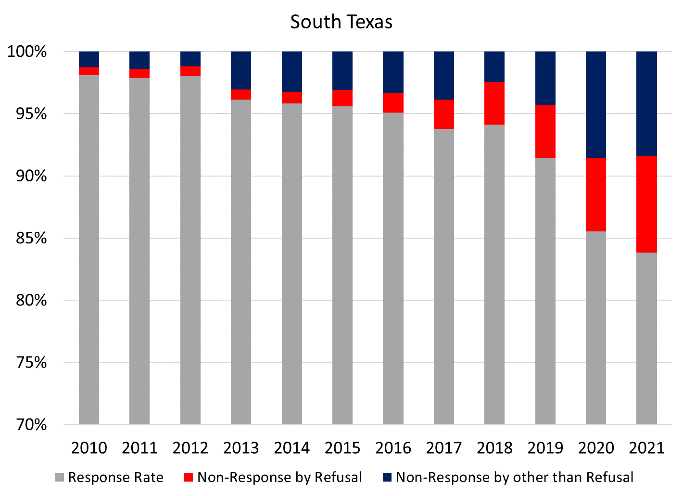
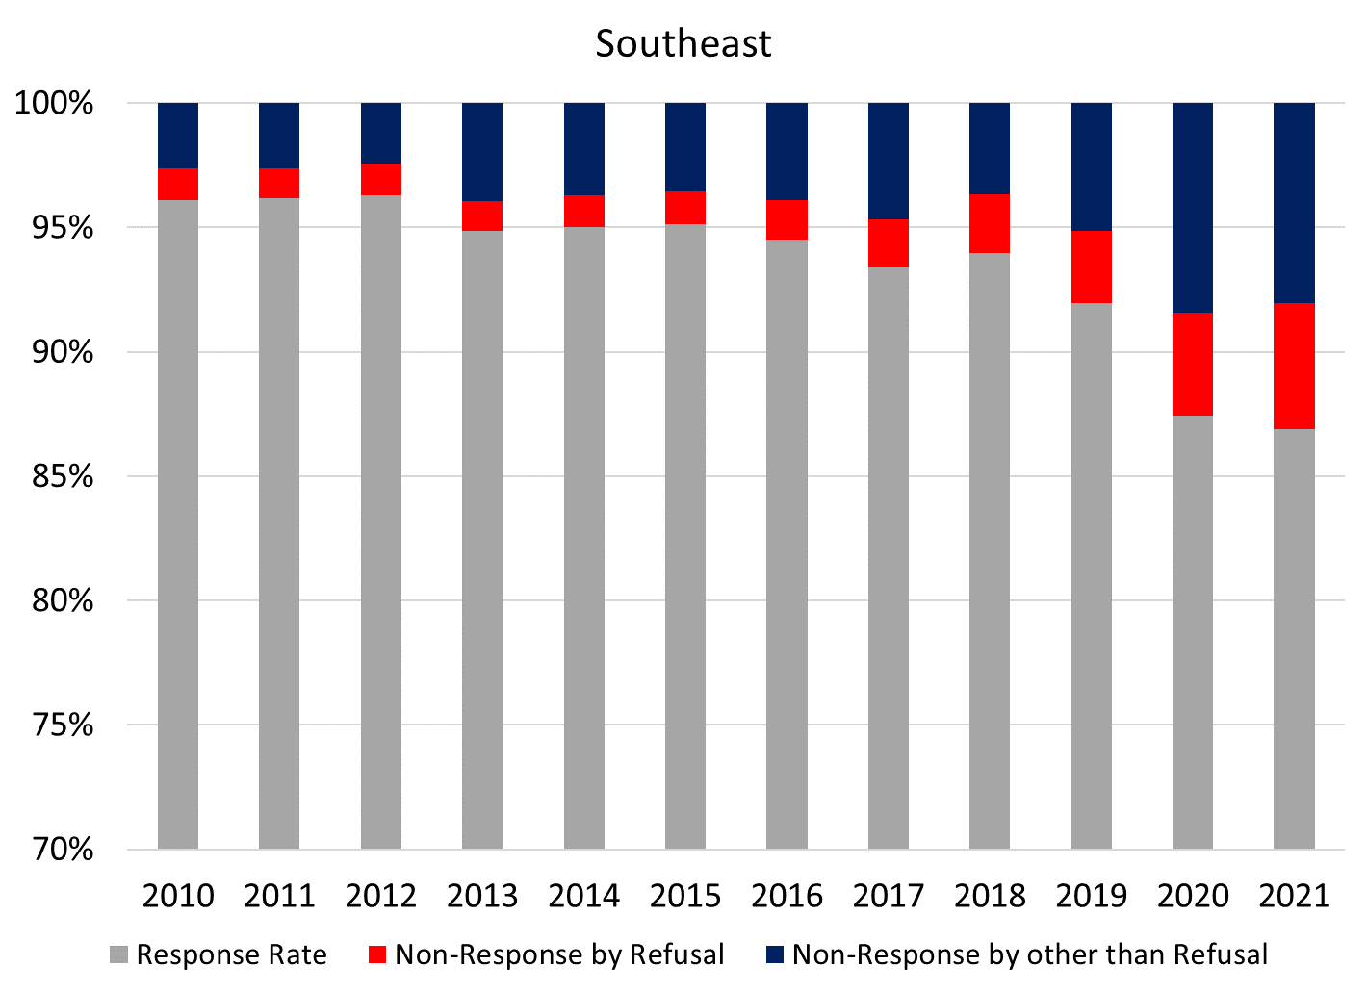
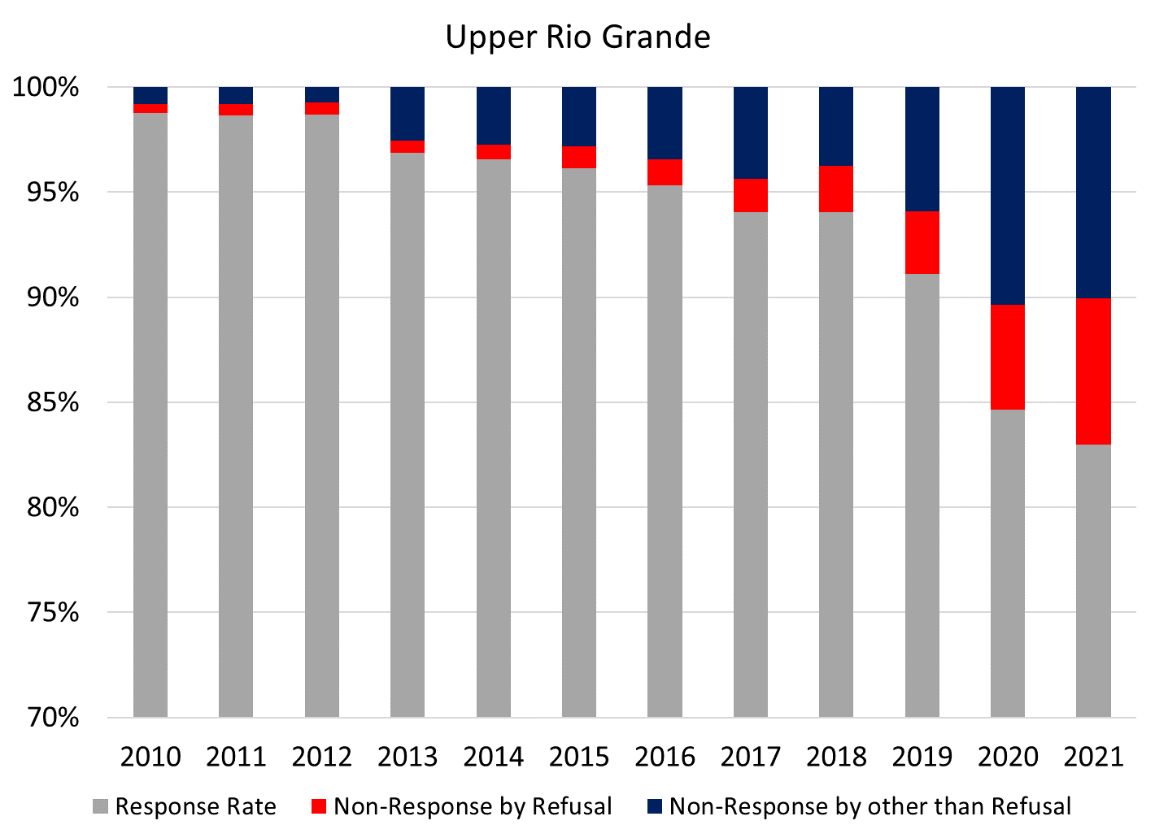
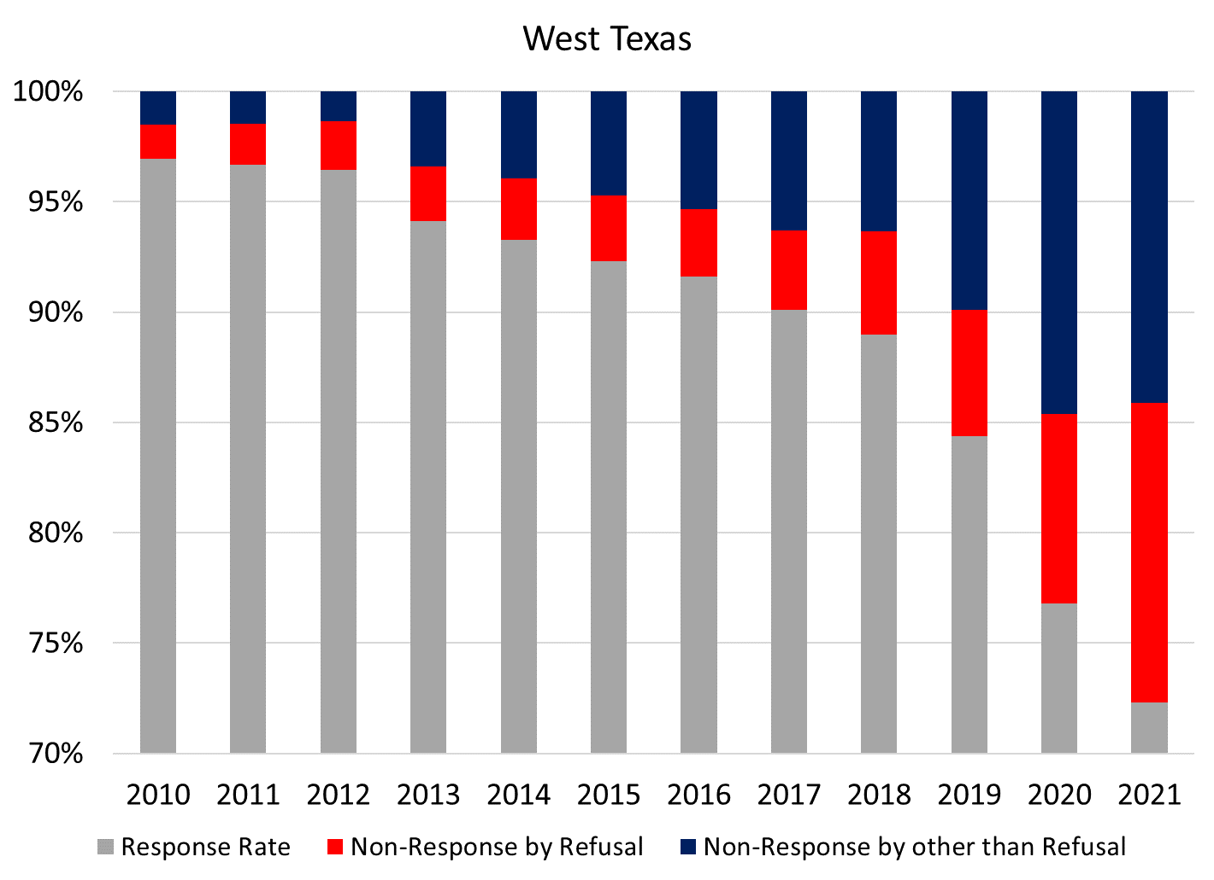
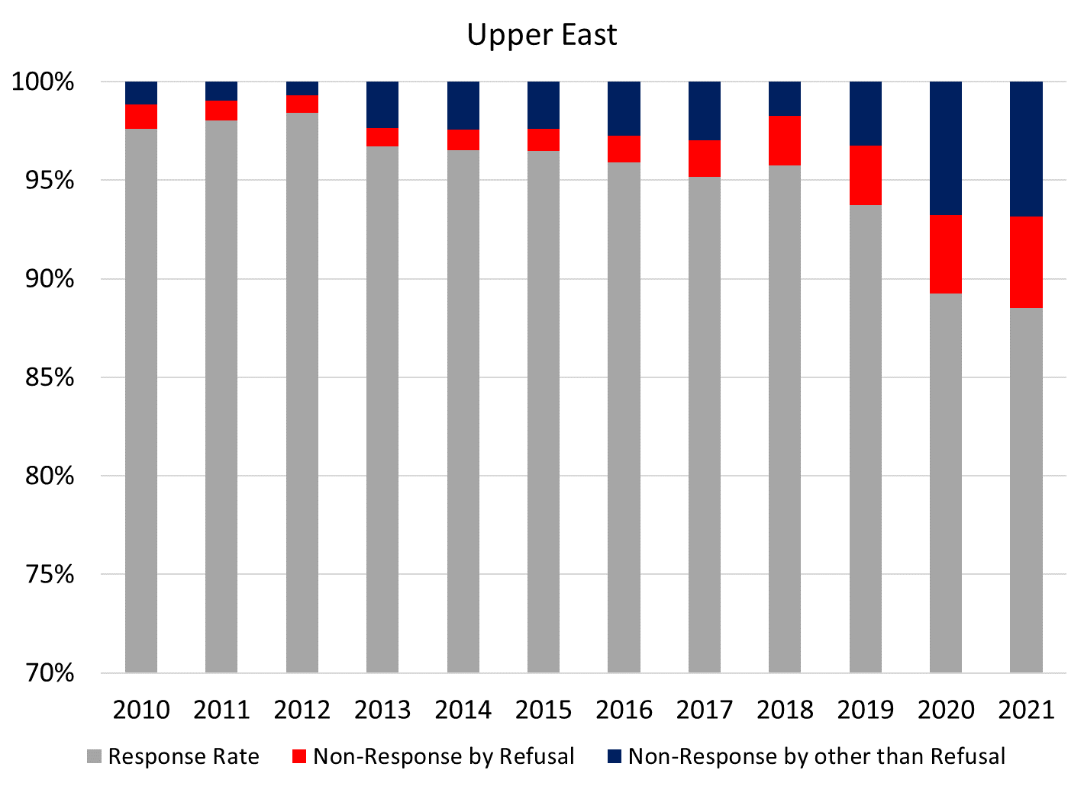
Notes:
Discuss TxCI’s first research paper, our methodology and the undercount predictors and indicators. Reiterate importance of self-response and challenges in getting a complete count in historically undercounted communities.

Slide 37
Impact: Early childhood care and education
Two primary drivers determine K-12 academic outcomes: the mother’s education level and access to quality early childhood education.
In Harris and Hidalgo counties low self-response rates in 2010 reduced funding for Head Start so that it could only serve <25% of the need. In 2020 there was an even more dramatic drop. Children and families have been deprived of essential early childhood care for over a decade.
Source: Texas Tribune 2019 (Retrieved from https://www.texastribune.org/2019/08/27/Texas-census-2020-efforts-turn-to-schools-prevent-undercount/)
Notes:
Discuss TxCI’s second research paper, our methodology and the impact of the undercount on Texas children. Reiterate importance of self-response and challenges in getting a complete count in historically undercounted communities.

Slide 38
What are some potential determinants of undercount that could help increase self-response rates?

Slide 39
Potential determinants of undercount and overcount
Personal
Social capital
Social exchange
Geographical
Easiness to reach
Accuracy in Master Address File
Census Features
Marketing strategies
Internet / Technology accessibility
Source: Castellanos-Sosa (2022) (Retrieved from https://texascensus.org/undercounting-and-overcounting-texas-counties-population/)
Notes:
Poverty? Citizenship status? Race and ethnicity?
“Counting the hard to count in a census”

Slide 40
Key Takeaway
3
Higher self-response rates are key to increasing census accuracy.
Texas’ undercount and loss of resources would be lower if self-response rates were higher.
Notes:
Make second point better

Slide 41

How might your organization contribute to
census data accuracy?
Money
Influences roughly $1.5 trillion in federal funds
Influence
Determines apportionment and district boundaries
Planning & Research
Identifies local needs and evaluates impact
Advocacy
Addresses policy gaps for underserved populations
Sources:
POGO (2020) (Retrieved from https://www.pogo.org/analysis/2020/03/the-importance-of-the-2020-census-explained-in-dollars-and-cents)
U.S. Census Bureau (2021) (Retrieved from https://www.census.gov/data/tables/2020/dec/2020-apportionment-data.html)

Slide 42
Amplifying the US Census Bureau’s activities in historically undercounted communities
Notes:
How TxCI is approaching the challenge of amplifying the US Census Bureau’s activities in Texas.

Slide 43
What do we know about historically undercounted communities?

Slide 44
Historically undercounted communities are those for whom a real or perceived barrier exists for full and representative inclusion in the data collection process.
Some examples of common historically undercounted populations include people experiencing homelessness, historically marginalized groups, and nomadic peoples.
Historically undercounted populations in Texas are concentrated in the Gulf Coast, High Plains, West Texas, South Texas, and Upper Rio Grande regions of Texas.
Source: U.S. Census Bureau (2019) (Retrieved from https://www.census.gov/content/dam/Census/library/working-papers/2019/demo/historically undercounted-Populations-Brief.pdf)
and Hard to Count (2020) (Retrieved from https://www.censushardtocountmaps2020.us/img/mappdfs/Texas.pdf)

Slide 45
In the 2020 Census, 547,968 Texas residents
were uncounted.
There is a strong correlation between the undercount, individual self-response rates, and poverty and poverty-related challenges.
Source: US Census Bureau 2020 Census; US Census Bureau (2020)(Retrieved from https://www.census.gov/content/dam/Census/library/factsheets/2020/dec/mission-count-everyone/mission-count-everyone.pdf)
Notes:
Understanding WHY a person is hard to count allows TxCI and others to craft strategies for a more accurate count.Texas is home to 29,145,505, and one in four of the people who call Texas home live in historically undercounted communities. This means that roughly 7 million Texans are considered hard to count.

Slide 46
Historically undercounted Texans
14.7% of Texans live below the poverty line.
20% of Texans live just above the poverty line.
30% of Texas households are renters.
5% of households with children under 18 are single-parent homes.
Approximately 8% of households in Texas are LEP.
17% of the state population was born outside of the US.
Texas has the second largest Hispanic and African American populations in the US and the third largest Asian population.
Minority populations, especially Hispanic children, are least likely to be counted.
Source: US Census Bureau 2020 Census; US Census Bureau (2020) (Retrieved from https://www.census.gov/content/dam/Census/library/factsheets/2020/dec/mission-count-everyone/mission-count-everyone.pdf)
Notes:
Understanding WHY a person is hard to count allows TxCI and others to craft strategies for a more accurate count.Texas is home to 29,145,505, and one in four of the people who call Texas home live in historically undercounted communities. This means that roughly 7 million Texans are considered hard to count.

Slide 47
Key Takeaway
4
Inaccurate data can have a compounding effect in communities where census-based resources are most needed.
Notes:
Make second point better

Slide 48
How might Texas counteract low self-response rates in historically undercounted communities?

Slide 49
Counteracting low self-response rates
Measures to counteract low self-response rates include:
Community organizing (early and broadly)
Accessibility (language, media, broadband, ease)
Trust (trusted intermediaries, face-to-face interactions, census data security)
Messaging (every person matters, census benefits to children and families, money back to communities)
Source: Census 2020 Campaign: Final Measurement Report - California’s 15 Hardest-to-Count Populations; Social Quest, Inc (2020), Retrieved from https://census.ca.gov/wp-content/uploads/sites/4/2021/05/Report_CCCO_historically undercounted-Campaign_Final-Assessment_Dec2020_full_1.pdf
Notes:
During the 2020 Census, several states identified measures to counteract impediments to self-response rates and achieve a more accurate count in historically undercounted communities.

Slide 50
Engaging undercounted communities in the research process
Notes:
Today we are sharing strategies communities can take to counteract low self-response rates among their historically undercounted neighbors. These strategies come from the fields of community psychology, health care, and community development. They are sometime studied collectively as community-based participatory research. The CBPR focus emerged from an approach to data collection in the health-care industry and is a course of study at respected centers of learning such as UC Boulder, Duke University, and UNC.

Slide 51
Goal: Equitable data flows = better data
Equitable data flows:
avoid valuing only the dominant culture
broaden access to community-level data
support sharing control of collected data, and
use data collection as an opportunity to change practices.
Source: Detroit Urban Resource Center (Retrieved from https://detroiturc.org/programs-expertise/cbpr-partnership-academy)
Notes:
Data use practices that avoid valuing only the dominant culture over multi-cultural processes
Information flows which broaden access to community-level data beyond researchers and scholars
Relationships and power dynamics between data gatherers and individuals and communities being scrutinized that support sharing control of collected data, and
Mental models which use data collection as an opportunity to change practices, rather than reinforce current behaviors.

Slide 52
Method: Community Based Participatory Research introduces two-way data flows into the census conversation
Data gathering from historically undercounted communities
Media campaigns to share importance
Trusted intermediaries to secure participation
Importance of complete (accurate) count
Data sharing with historically undercounted communities
Engagement and activation
Data-driven decision making
Funding for targeted vital resources

Slide 53
Strategy: Essential elements
Translate and disseminate research findings
Understand community strengths and dynamics
Maintain, sustain and evaluate community partnerships
Gather feedback and interpret research findings
Identify priority issues and research questions
Design/conduct etiological and/or policy research

Slide 54
Outcome: Accurate data, greater impact
Benefits community participants, practitioners, and researchers alike.
Creates bridges between scientists and communities, through the use of shared knowledge and valuable experiences.
Ensures culturally appropriate measurement instruments making projects more effective and efficient.
Enhances both the quantity and the quality of data collected.
“The ultimate benefit is a deeper understanding of a community's unique circumstances, and a more accurate framework for testing and adapting best practices to the community's needs.”
Source: Vishwanathan, M (2004) et al, Community‐Based Participatory Research: Assessing the Evidence: Summary; National Library of Medicine.
Notes:
Done properly, CBPR benefits community participants, health care practitioners, and researchers alike. CBPR creates bridges between scientists and communities, through the use of shared knowledge and valuable experiences.
This collaboration further lends itself to the development of culturally appropriate measurement instruments, thus making projects more effective and efficient.
CBPR establishes a mutual trust that enhances both the quantity and the quality of data collected.The ultimate benefit to emerge from such collaborations is a deeper understanding of a community's unique circumstances, and a more accurate framework for testing and adapting best practices to the community's needs.

Slide 55
Key Takeaway
5
The private (social) sector has an essential role in ensuring the U.S. Census Bureau collects and provides strong and accurate data through community engagement in gathering and disseminating data.

Slide 56
Your contribution to census data accuracy
Money
Influences roughly $1.5 trillion in federal funds
Influence
Determines apportionment and district boundaries
Planning & Research
Identifies local needs and evaluates impact
Advocacy
Addresses policy gaps for underserved populations
Sources:
POGO (2020) (Retrieved from https://www.pogo.org/analysis/2020/03/the-importance-of-the-2020-census-explained-in-dollars-and-cents)
U.S. Census Bureau (2021) (Retrieved from https://www.census.gov/data/tables/2020/dec/2020-apportionment-data.html)

Slide 57
How might you begin to engage with community-based organizations and local leaders as valued data collectors and contributors who will help support a complete count?
ⓘ Start presenting to display the poll results on this slide.

Slide 58
Key Takeaway
6
The social sector’s role must include engaging historically undercounted communities in all aspects of the 2030 Census.

Slide 59
Questions? We’d love your ideas on how we can work together.

Slide 60
Key Takeaway
1
Counting people accurately is essential for planning, economic stability and political representation.
Accurate data are vital tools for maintaining a thriving Texas.
Notes:
Specifics from one of the regions (Houston/Gulf Coast)

Slide 61
Key Takeaway
2
Texas experienced a half-million+ person undercount in the 2020 Census, resulting in loss of income and representation.
All Texans have a strong vested interest in a more accurate 2030 Census.
Notes:
Specifics from one of the regions (Houston/Gulf Coast)

Slide 62
Key Takeaway
3
Higher self-response rates are key to increasing census accuracy.
Texas’ undercount and loss of resources would be lower if self-response rates were higher.
Notes:
Make second point better

Slide 63
Key Takeaway
4
Inaccurate data can have a compounding effect in communities where census-based resources are most needed.
Notes:
Make second point better

Slide 64
Key Takeaway
5
The private (social) sector has an essential role in ensuring the U.S. Census Bureau collects and provides strong and accurate data through community engagement in gathering and disseminating data.

Slide 65
Contact us!
Angela Broyles
Founding Executive Director
angela@texascensus.org
Francisco A. Castellanos-Sosa
Senior Research Associate
francisco@texascensus.org
Regina Nippert
Human-Centered Design Strategist
regina@texascensus.org
texascensus.org

Slide 66

Partner with Us!
texascensus.org

Slide 67

Approach: Collaborative research
Abraham Wandersman et al, “Bridging the gap between prevention research and practice: the interactive systems framework for dissemination and implementation” (2008)
Nora Wallerstein and Bonnie Duran, Community-Based Participatory Research for Health: Advancing Social and Health Equity (2017)
Notes:
Other sciences, in particular health care and community psychology have developed methodologies that are useful to us as we seek to address inaccuracies due to low self-response rates.

