Slide 1
Disclosure Avoidance and the 2020 Census Demographic and Housing Characteristics (DHC) File
Michael Hawes
Senior Survey Statistician for Scientific Communication
Research and Methodology Directorate
U.S. Census Bureau
May 24, 2023
Any viewpoints or opinions expressed in this presentation are entirely the author’s own and do not represent the viewpoints or opinions of the U.S. Census Bureau

Slide 2
2020 Census Data Products
Released
  Demographic Profile
  Demographic and Housing Characteristics File (DHC)
  May 25, 2023
Future Effort
  Apportionment
  Public Use Microdata File
April 26, 2021
  Special Tabulations
  Congressional District Summary Files
  Planned August 2023
  Detailed DHC-A
  Planned September 2023
  Detailed DHC-B
  Release Date TBD
  Supplemental DHC (S-DHC)
  Release Date TBD
  Redistricting File
  (Public Law 94-171)
August 12, 2021
September 16, 2021
More information about the products is available on the About 2020 Census Data Products webpage.
Notes:
First, just a reminder to orient us among the 2020 Census data products. Today, I’ll talk about the DHC; the Demo Profile is basically treated as part of it. They will be released together in May.
The next product after that is the Detailed DHC-A. That is the product that will have the detailed groups so many people have been waiting on – like Mexican, Navajo Nation, Chinese, etc.

Slide 3
Apportionment Release
  Apportionment is the process of dividing the 435 memberships, or seats, in the U.S. House of Representatives among the 50 states. At the conclusion of each decennial census, the results are used to calculate the number of seats to which each state is entitled.
  Results were released on April 26, 2021
  Subjects include:
  Geography: 50 states, the District of Columbia (DC), and Puerto Rico
  Disclosure avoidance: Results do not undergo disclosure avoidance
  Resident population
  Overseas population
  Apportionment population
Notes:
Apportionment was already released, and it provides the total population counts for the states.
It does not undergo disclosure avoidance.

Slide 4
Redistricting File (Public Law 94-171)
  Public Law 94-171 directs the Census Bureau to provide data to the governors and legislative leadership in each of the 50 states for redistricting purposes. This product is the first file released that includes demographic and housing characteristics.
  Results were released on August 12, 2021 (Summary Files) and September 16, 2021 (data.census.gov)
  Subjects include:
  Lowest level of geography: Census Block
  Disclosure avoidance: Differentially private TopDown Algorithm (TDA)
  Voting age
  Race
  Hispanic or Latino origin
  Housing occupancy
  Group quarters (GQ) population by major GQ type
Notes:
The Redistricting file was also already released.
It includes 6 tables – housing occupancy, race and Hispanic or Latino origin by total population and people 18 years and over, and major group quarters population
The Redistricting File, Demographic Profile, and DHC will all be protected using the TopDown Algorithm or TDA.
They will all be consistent with each other.

Slide 5
Demographic Profile
  This product will provide select demographic and housing characteristics about local communities in a streamlined, easy to use format.
  Expected release date: May 25, 2023
  Subjects include:
  Lowest level of geography: Tract
  Disclosure avoidance: Differentially private TDA
  Sex by 5-year age groups
  Median age by sex
  Race
  Hispanic or Latino origin
  Relationship to householder
  GQ population
  Household type
  Housing occupancy
  Housing tenure
Notes:
The Demographic Profile provides a snapshot of many characteristics in one table – to provide an overview of a community.
For the Demo Profile, we are currently in production and conducting quality assurance checks.

Slide 6
Demographic and Housing Characteristics File (DHC)
  The DHC will include many of the demographic and housing tables previously included in 2010 Summary File 1 (2010 SF1). Some tables are repeated by race and ethnicity.
  Expected release date: May 25, 2023
  Subjects include:
  Lowest level of geography: Varies with many tables at Census Block
  Disclosure avoidance: Differentially private TDA
  Sex by single year-of-age
  Hispanic or Latino origin of householder by race of householder
  GQ population by sex by age
  Relationship by age for population under 18 years
  Household type by relationship and presence of people of specific ages
  Multigenerational households
  Family type by presence of children
  Tenure by household size
  Tenure by household type by age of householder
  Vacancy Status
Notes:
The DHC is the most extensive data product because it contains the most amount of tables.
The topics listed are not exhaustive, but shows how DHC gets more detailed than Redistricting and Demo Profile
For the DHC, we are currently in production and conducting quality assurance checks.
Your feedback on this product was vital as we developed the disclosure avoidance system.
Today’s presentation focuses on the Redistricting, Demo Profile, and DHC data products, but I wanted to quickly go over the remaining data products as a reminder.

Slide 7
Detailed Demographic and Housing Characteristics File A (Detailed DHC-A)
  Detailed DHC-A includes population counts repeated by approximately 370 detailed racial and ethnic groups and 1,200 detailed American Indian and Alaska Native (AIAN) tribal and village population groups
  Expected release date: Sept 2023
  Subjects are repeated by detailed racial and ethnic groups:
  Proposed levels of geography: Nation, State, County, Tract, Place, AIANNH areas
  Disclosure avoidance: Differentially private SafeTab-P algorithm
  Total population
  Sex by Age for Selected Age Categories
Notes:
Unlike Redistricting, Demo Profile, and DHC which are protected by the TopDown Algorithm, the remaining data products have their own algorithm
Although, they are still protected by differential privacy.
Detailed DHC-A includes total population and sex by age for approximately 370 detailed racial and ethnic groups and 1,200 detailed American Indian and Alaska Native (AIAN) tribal and village population groups
These tables are available for nation, State, County, Tract, Place, AIANNH areas
We recently requested feedback on this product via the Proof of Concept, and we are currently assessing that feedback prior to entering the production development cycle.
Roberto will dive into this product a little more.

Slide 8
Detailed Demographic and Housing Characteristics File B (Detailed DHC-B)
  Detailed DHC-B includes household counts repeated by approximately 370 detailed racial and ethnic groups and 1,200 detailed American Indian and Alaska Native (AIAN) tribal and village population groups
  Expected release date: TBD
  Subjects are repeated by detailed racial and ethnic groups:
  Proposed levels of geography: Nation, State, County, Tract, Place, AIANNH areas
  Disclosure avoidance: Differentially private SafeTab-H algorithm
  Household Type
  Tenure
Notes:
Detailed DHC-B includes Household Type and Tenure, and these tables are also repeated for approximately 370 detailed racial and ethnic groups and 1,200 detailed American Indian and Alaska Native (AIAN) tribal and village population groups
Although Detailed DHC-B is protected by a different algorithm than Detailed DHC-A, we are trying to keep them as similar as possible.
For example, we are proposing the same geographies for Detailed DHC-B as Detailed DHC-A.
We are currently developing and testing the disclosure avoidance for this data product, and we are planning a Proof of Concept product – similar to Detailed DHC-A -- in the future.

Slide 9
Background on Confidentiality Protections for the 2020 Census Data Products

Slide 10

Keeping the Public’s Trust: Title 13
“To stimulate public cooperation necessary for an accurate census…Congress has provided assurances that information furnished by individuals is to be treated as confidential. Title 13 U.S.C. §§ 8(b) and 9(a) explicitly provide for nondisclosure of certain census data, and no discretion is provided to the Census Bureau on whether or not to disclose such data…” (U.S. Supreme Court, Baldrige v. Shapiro, 1982)
To safeguard the public’s confidential census responses, the Census Bureau has long employed a variety of statistical techniques to mitigate disclosure risk in our published data products.
Notes:
Conducting a quality census hinges on the voluntary participation of the American public. Securing that participation requires that the public trust us to properly safeguard their data. To that end, Congress enacted strong confidentiality protections for the Census in sections 8(b) and 9(a) of Title 13.
The U.S. Supreme Court has affirmed that the Census Bureau has no discretion in adhering to these legal obligations. So, to safeguard the public’s confidential census responses, we have long employed a variety of statistical techniques to mitigate the risk of disclosure in the data that we publish.

Slide 11

Disclosure Avoidance for Past Censuses
1970-1980 Censuses
1990-2010 Censuses
50 | 528 | 798
314 | 320 | 794
191 | 581 | 430
137 | 941 | 189
931 | 20 | 605
201 | 250 | 592
351 | 124 | 590
668 | 178 | 779
91 | 8 | 159
809 | 112 | 811
518 | 424 | 955
989 | 352 | 765
237 | 411 | 686
77 | 820 | 590
SUPPRESSION
SWAPPING
Notes:
Those statistical safeguards, known as “statistical disclosure limitation” or more colloquially at the Census Bureau as “Disclosure Avoidance” have taken different forms over the decades. For the 1970 and 1980 Censuses, for example, we used a method known as suppression where table cells, or even entire tables were redacted if they did not meet certain underlying population size thresholds. As you can imagine, this resulted in a large amount of missing data, particularly for lower level geographies, or for smaller populations. (I call this the “swiss cheese effect”) As you can imagine, this had an obvious detrimental impact on numerous important uses of census data. Consequently, for the 1990 Census, we moved away from suppression and began injecting noise into some census tabulations instead, through a process known as record swapping. For the 2000 and 2010 Censuses, this noise injection was enhanced to cover more demographic characteristics across the suite of published census tabulations. Unlike its predecessor, however, the impact of swapping on census data was largely opaque to our data users, both because there were no longer obvious holes in the data as we had from suppression, but also because the effectiveness of swapping as a noise injection safeguard hinged at least in part on the public being unaware of its magnitude or scope.

Slide 12

The Ever-rising Risk of Disclosure
Any data release carries some risk of disclosure.
Improvements in computing power and the explosion of third-party data mean that disclosure risk has increased significantly.
Protecting confidentiality means adapting and responding to these increasing threats
Notes:
The challenge, however, is that disclosure risk is not static. Much like IT security and hacking threats, statistical agencies have to contend with a constantly changing environment where existing threats increase, and new risks arise on a continuous basis. Two of the most vexing of these evolving threats come from the explosion of third-party data sources that can be used as part of an attack on published statistical data, and the ever increasing power of computers and optimization algorithms that can leverage these data in such an attack.

Slide 13
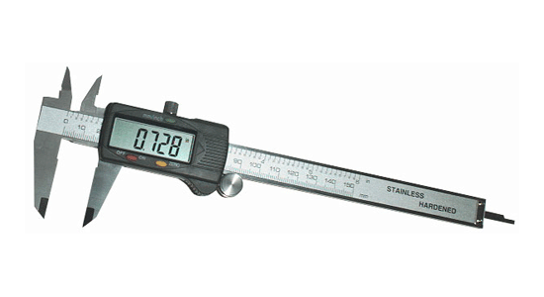
Disclosure Avoidance for the 2020 Census
The 2020 Census improves on the noise injection methods of the 1990-2010 Censuses by employing a mathematical framework known as Differential Privacy (DP) to assess and quantify disclosure risk and confidentiality protection.
Every individual that is reflected in a particular statistic contributes towards that statistic’s value.
Every statistic that you publish “leaks” a small amount of private information.
DP as a framework allows you to assess each individual’s contribution to the statistic, and to inject a precise amount of noise into the statistic to limit how much information about them will leak.
Notes:
So, with the knowledge that disclosure risks from reconstruction-abetted attacks are concerning, the Census Bureau decided to enhance our methods of noise injection for the 2020 Census, moving away from the swapping mechanism used in the past and adopting an approach based on the mathematical framework known as Differential Privacy. DP allows for quantification of disclosure risk and confidentiality protection in ways that prior methods do not.
Every individual that is reflected in a particular statistic contributes towards that statistic’s value.
Every statistic that you publish “leaks” a small amount of private information.
DP as a framework allows you to assess each individual’s contribution to the statistic, and to measure (and thus, limit) how much information about them will leak.

Slide 14








The 2020 Census Disclosure Avoidance System (DAS)
TopDown Algorithm
(TDA)
SafeTab
PHSafe
Produces privacy-protected microdata (Microdata Detail File) that is ingested by Decennial tabulation system
Produce privacy-protected tabulations
Detailed DHC-A
Detailed DHC-B
Supplemental DHC
Redistricting Data (P.L. 94-171) Summary File
Demographic Profile
Demographic and Housing Characteristics File (DHC)
Congressional District Summary Files
Notes:
Now, there is no single way to implement DP. DP is merely the accounting system you use to measure and track disclosure risk across all of your releases. Thus, we have employed a variety of differentially private algorithms to protect the different data products that comprise the 2020 Census. For today’s discussion, we’re going to focus on the TopDown Algorithm, or TDA, which we used for the 2020 PL 94-171 redistricting data that were published last fall, and that we will be using for the 2020 demographic profiles and DHC.

Slide 15
The TopDown Algorithm
Input Microdata (CEF) & Tabulation Geographic Reference File (Tab GRF-C)
Noisy Measurements
Post-processing
Conversion to Histogram*
Conversion to Microdata (MDF)
*A histogram, in this context, is a tabular representation of the microdata with counts of records for each possible combination of values for each attribute in the microdata.
For complete details see: Abowd, J., Ashmead, R., Cumings-Menon, R., Garfinkel, S., Heineck, M., Heiss, C., Johns, R., Kifer, D., Leclerc, P., Machanavajjhala, A., Moran, B., Sexton, W., Spence, M., & Zhuravlev, P. (2022). The 2020 Census Disclosure Avoidance System TopDown Algorithm. Harvard Data Science Review. (June) https://doi.org/10.1162/99608f92.529e3cb9
Notes:
At a high level, the TDA follows a five step process…

Slide 16
The TopDown Algorithm
At each geographic level:
United States
States
[…]
Census Blocks
Invariants*
Noisy Measurements
Internally consistent histogram
Constraints**
*Invariants are counts to which no noise is added.
**Constraints are consistency and reasonableness rules the post-processing must impose.
The Geographic Hierarchy
Notes:
So, during the noisy measurements step of the algorithm, the TDA takes a massive number of noisy measurements of the confidential data, injecting a small amount of noise into each of those results. But, those noisy measurements provide many different answers for the same question, and because the noise is injected independently, those results will differ from each other (i.e., the number of males and females in a geography summed together, may not equal the value for the total population of that geography). Thus, the TDA then post-processes those noisy measurements into an internally and hierarchally consistent set of results, incorporating any corresponding invariants and constraints into the process.
It does this, as the name suggests, in a top-down fashion, starting at the level of the entire US, and moving sequentially down each geographic level of the hierarchy until it gets down to the block level.
At each level, the results and totals from the level above are added to the constraints…as were the PL data that have previously released.

Slide 17
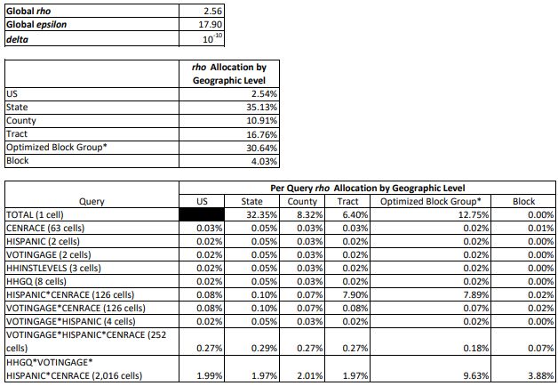
Queries and Privacy-loss Budget Allocation
Production settings for the 2020 Census Redistricting Data (P.L. 94-171) Summary File
(Persons tables P1-P5)

Slide 18
2010 Demonstration Data

Slide 19
Components of the 2010 Demonstration Data
Products Suite – Redistricting and Demographic and Housing
Characteristics File – Production Settings (2023-04-03) (2010 DDPS)
(2010 Census data processed through the 2020 DAS at production settings)
2010 DDPS Fact Sheet
Detailed Summary Metrics (and Metrics Overview)
Privacy-Protected Microdata File (PPMF)
DHC Tabulations (via IPUMS)
Privacy-loss Budget (PLB) Allocations
Noisy Measurement File (NMF)

Slide 20
Fitness-for-Use: Detailed Summary Metrics
  One way to understand the anticipated fitness of use – Detailed Summary Metrics, which compare tabulations from 2010 Census data run through Disclosure Avoidance System (DAS) to published 2010 data.
  These comparisons (e.g., absolute value of difference) are averaged across geographies in a geographic level (e.g., counties) to create estimates of accuracy (e.g., Mean Absolute Error or MAE) or bias or to count large outliers.
  We can use these metrics to think about the fitness-for-use of 2020 DHC data, since the same software and settings are used to produce those.

Slide 21
Fitness-for-Use: Detailed Summary Metrics
  Have released 9 versions of Detailed Summary Metrics that show how the DAS and its parameter settings have evolved over time due to internal and external feedback on use cases and data user needs.
  This release showcases improvements that were made between the last demonstration data release (August 2022) and the final code settings for the production run in November 2022.
  Based on these 2010 evaluations, there are acuracy improvements for:
      Householder race
      Presence and age of own children
      Relationship to householder
      Single year of age for children for counties and school districts
      Age for persons in group quarters
      Same-sex married and unmarried partners

Slide 22
Highlights from the Detailed Summary Metrics
    Looking beyond average error (MAE/MAPE):
        95th Percentile Absolute Error
        95th Percentile Absolute Percent Error
    Comparing to average populations to provide context
    Acceptable errors even for the 95th percentile case
95% of geographies are off by this much (or less).
Tenure Numbers are: 2022-08-25 / 2023-04-03 Universe: Occupied Housing Units. Geography: Census Tract
 | Mean Population | Mean Absolute Error (MAE) | 95th Percentile Absolute Error (95th AE) | Mean Absolute Percent Error (MAPE) | 95th Percentile Absolute Percent Error (95th APE)
Owned with a mortgage | 725 | 1.65 / 2.04 | 4.00 / 5.00 | 1% / 1% | 1% / 1%
Owned free and clear | 315 | 1.65 / 2.05 | 4.00 / 5.00 | 2% / 2% | 4% / 5%
Renter-occupied | 528 | 1.66 / 2.04 | 4.00 / 5.00 | 1% / 1% | 3% / 3%
CBDRB-FY22-DSEP-004
CBDRB-FY22-DSEP-004

Slide 23
Updated Metrics on 2010 DDPS Accuracy
Coupled Household Type Numbers are: 2022-08-25 / 2023-04-03 Universe: Households. Geography: County
 | Mean Population | MAE | 95th AE | MAPE | 95th APE
Opposite-sex married couple household | 17,980 | 5.83/ 4.58 | 15 / 12 | 0% / 0% | 1% / 1%
Same-sex married couple household | 111 | 3.62/ 2.38 | 9 / 6 | 21% / 15% | 80% / 60%
Opposite-sex unmarried partner household | 2,177 | 5.12 / 3.68 | 13 / 10 | 2% / 1% | 8% / 6%
Same-sex unmarried partner household | 176 | 3.61 / 2.29 | 10 / 6 | 33% / 24% | 200% / 100%
CBDRB-FY22-DSEP-004
CBDRB-FY22-DSEP-004

Slide 24
Tenure By Race of Householder 2022-08-25 / 2023-04-03 Universe: Occupied Housing Units. Geography: County
 | Mean Population | MAE | 95th AE | MAPE | 95th APE
Owner occupied
White alone | 20,187 | 83.61 / 5.54 | 258 / 15 | 2% / 0% | 5% / 1%
Black or African American alone | 1,992 | 48.09 / 4.10 | 157 / 12 | 238% / 32% | 1,200% / 200%
American Indian and Alaska Native alone | 162 | 18.08 / 3.45 | 60 / 10 | 81% / 23% | 300% / 100%
Asian alone | 856 | 31.60 / 2.96 | 112 / 9 | 227% / 35% | 948% / 200%
Native Hawaiian and Other Pacific Islander alone | 20 | 5.10 / 1.51 | 18 / 5 | 128% / 65% | 400% / 200%
Some Other Race alone | 629 | 15.29 / 3.13 | 53 / 8 | 66% / 26% | 270% / 117%
Two or More Races | 332 | 19.37 / 3.38 | 63 / 9 | 47% / 12% | 188% / 44%
Renter occupied
White alone | 8,370 | 57.34 / 4.59 | 179 / 12 | 3% / 0% | 11% / 2%
Black or African American alone | 2,504 | 33.81 / 3.43 | 102 / 9 | 167% / 28% | 800% / 200%
American Indian and Alaska Native alone | 137 | 14.67 / 3.06 | 54 / 8 | 90% / 29% | 375% / 140%
Asian alone | 618 | 17.62 / 2.41 | 62 / 7 | 164% / 38% | 700% / 200%
Native Hawaiian and Other Pacific Islander alone | 26 | 6.61 / 1.53 | 27 / 5 | 146% / 66% | 400% / 200%
Some Other Race alone | 936 | 12.75 / 3.04 | 44 / 8 | 46% / 21% | 200% / 100%
Two or More Races | 368 | 16.26 / 3.08 | 54 / 8 | 55% / 16% | 214% / 62%
CBDRB-FY22-DSEP-004
CBDRB-FY22-DSEP-004

Slide 25
Single Year of Age for Ages 0-15 2022-08-25 / 2023-04-03 Universe: Persons. Geography: County
 | Mean Population | MAE | 95th AE | MAPE | 95th APE
Under 1 year old | 1,255 | 14.62 / 5.58 | 42 / 14 | 6% / 3% | 25% / 14%
1 year old | 1,266 | 14.93 / 5.47 | 44 / 14 | 6% / 4% | 22% / 14%
2 years old | 1,304 | 14.56 / 5.47 | 42 / 13 | 6% / 3% | 22% / 13%
3 years old | 1,311 | 13.15 / 5.96 | 38 / 14 | 6% / 4% | 20% / 14%
4 years old | 1,293 | 13.20 / 6.15 | 37 / 15 | 6% / 4% | 21% / 15%
5 years old | 1,291 | 16.50 / 5.93 | 50 / 14 | 7% / 4% | 23% / 14%
6 years old | 1,294 | 16.47 / 5.96 | 51 / 15 | 7% / 4% | 25% / 14%
7 years old | 1,282 | 16.42 / 6.10 | 47 / 15 | 7% / 4% | 24% / 15%
8 years old | 1,287 | 17.07 / 5.93 | 48 / 15 | 7% / 4% | 24% / 14%
9 years old | 1,320 | 17.01 / 5.98 | 49 / 15 | 7% / 4% | 24% / 14%
10 years old | 1,328 | 16.69 / 6.06 | 49 / 16 | 7% / 3% | 24% / 13%
11 years old | 1,309 | 16.55 / 6.02 | 46 / 16 | 7% / 3% | 23% / 13%
12 years old | 1,306 | 16.88 / 5.92 | 50 / 15 | 7% / 3% | 25% / 13%
13 years old | 1,310 | 16.82 / 6.02 | 48 / 15 | 7% / 4% | 24% / 13%
14 years old | 1,325 | 16.87 / 6.11 | 49 / 16 | 7% / 4% | 23% / 13%
15 years old | 1,350 | 5.11 / 3.98 | 13 / 11 | 3% / 2% | 11% / 8%
CBDRB-FY22-DSEP-004
CBDRB-FY22-DSEP-004

Slide 26
Noisy Measurement Files (NMFs), Privacy-Protected Microdata Files (PPMFs), Published Tabulations
Redistricting Noisy Measurement File
(privacy-protected tabulations, w/o enforced consistency)
Redistricting MDF/PPMF
(privacy-protected microdata)
Published Redistricting Tabulations
(privacy-protected tabulations. with consistency)
Post-Processing
Tabulation
Queries
Census Edited File - CEF (confidential microdata)
Noise
Constraints
DHC
Noisy Measurement File
(privacy-protected tabulations, w/o enforced consistency)
DHC
MDF/PPMF
(privacy-protected microdata)
Published DHC Tabulations
(privacy-protected tabulations. with consistency)
Queries
Tabulation
Post-Processing

Slide 27
2010 DDPS NMFs, PPMF, Tabulations
Redistricting Noisy Measurement File
(privacy-protected tabulations, w/o enforced consistency)
Redistricting PPMFs
(privacy-protected microdata)
Published Redistricting Tabulations
(privacy-protected tabulations. with consistency)
Post-Processing
Tabulation
Queries
Census Edited File - CEF (confidential microdata)
Noise
Included in DHC PPMF
Edits and Constraints
DHC
Noisy Measurement File
(privacy-protected tabulations, w/o enforced consistency)
DHC
PPMF
(privacy-protected microdata)
Published DHC Tabulations
(privacy-protected tabulations. with consistency)
Queries
Tabulation
Post-Processing
To be released in June 2023
Released via IPUMS

Slide 28

Should I Use the NMF, the PPMF, or the Tabulations?
There are two sources of error in the published statistics (PPMF and Tabulations):
Differentially private noise
Unbiased
Known distribution
Reflected in the noisy measurements
Post-processing
Data dependent
  While the nonnegativity requirement decreases error in the detailed cell counts, it also introduces a positive bias in small counts and an offsetting negative bias in large counts.
  TDA also reduces the amount of error for many statistics relative to their corresponding noisy measurements.
Block-level statistics will often have a lower expected variation than you would expect based solely on the amount of PLB assigned to that query at the block level.

Slide 29
Should I Use the NMF, the PPMF, or the Tabulations?
2020 Census Redistricting and DHC Tabulations
2020 Census PPMF
2020 Census NMF
Official 2020 Census Statistics
Higher Accuracy (feature of TDA)
Consistent with published tabulations
Useful for special tabulations and microdata analysis
100% microdata file
Can be used to produce unbiased estimates and confidence intervals
Research product
Can be used to evaluate alternate post-processing mechanisms
Does include bias due to post-processing

Slide 30
New Resources for Data Users

Slide 31
Reader-Friendly Disclosure Avoidance Briefs
Disclosure Avoidance and the 2020 Redistricting Data
Why the Census Bureau Chose Differential Privacy
Disclosure Avoidance and the 2020 Census: How the TopDown Algorithm Works
More resources are in development, as well as additional specific guidance and training for using the 2020 Census data.

Slide 32
Coming Soon
Guidance and examples on how to use the NMF to calculate unbiased estimates and confidence intervals.
Subscribe to our newsletter to receive the announcement and related webinar info.

Slide 33
Questions?
Or send them to 2020DAS@census.gov

Slide 34
Supplemental Slides

Slide 35
About the Detailed DHC-A
Subjects repeated by approximately 370 detailed racial and ethnic groups and 1,200 detailed American Indian and Alaska Native (AIAN) tribes and villages:
      Total population
      Sex by age for selected age categories
      Geographic levels included:
      Nation
      State
      County
      Tracts
      Places
      American Indian/Alaska Native/Hawaiian Home Land (AIANNH) areas
      Planned for release in September 2023
Notes:
The Detailed DHC-A will provide population counts and sex and age statistics for
approximately 370 detailed racial and ethnic groups and approximately
1,200 American Indian and Alaska Native tribes and villages.
Population counts for detailed American Indian and Alaska tribes and villages, ​
such as the Navajo Nation, the Lumbee Tribe of North Carolina,
the Arctic Slope Corporation, and the Native Village of Fort Yukon,
will be available in the Detailed DHC-A
​
This product will also provide statistics on sex by age for selected age categories
for detailed American Indian and Alaska Native ​
tribes and villages that meet certain population thresholds.​
​
This product will include data for the
nation, states, counties, tracts, places, and
American Indian, Alaska Native, and Hawaiian Home Land Areas.
The Detailed DHC-A is now planned for release in September 2023 in order for us to address a
confusing issue where geographies with the same boundaries that appear in multiple summary levels
had different counts.
For example, previously Washington DC would have different counts
for the state and county levels, which we think would be confusing for data users.
We are implementing a post-processing fix to ensure these counts are now the same.
**********************************************************************
​IF ASKED: AIANNH Areas include
legal entities:
federally recognized American Indian reservations and off-reservation trust land areas,
the tribal subdivisions that can divide these entities,
state-recognized American Indian reservations,
Alaska Native Regional Corporations, and Hawaiian home lands
and statistical entities:
Alaska Native village statistical areas,
Oklahoma tribal statistical areas,
tribal designated statistical areas, and
state designated tribal statistical areas).

Slide 36
Using Adaptive Design to Produce the Detailed DHC-A
Population groups that are pre-set to receive total population count only
Total Population Only
Detailed groups with a national population count less than 50 in the 2010 Census are pre-set to receive total population only in the Detailed DHC-A.
36
Notes:
The Detailed DHC-A uses an adaptive design that
allows us to provide more detailed statistics for
tribes and villages with larger populations,
while at the same time ensuring sufficient confidentiality protections.
Let’s walk through what that means.
For some pre-determined population groups, adaptive design will not be used.
Based on data from the 2010 Census,​
we anticipate that some groups will be too small to receive a sex by age table.
Detailed tribes and villages with a population smaller than 50 in the 2010 Census
are pre-set to receive total population only.
This is determined in advance
and allows us to spend more privacy loss budget
to produce the total population counts for these small populations.
For these groups, a noise infused total population count
will always be calculated,
but no sex and age statistics will be available.

Slide 37
Using Adaptive Design to Produce the Detailed DHC-A
Total Population Only
Population groups that had a national population count of at least 50 in the 2010 Census are eligible to go through this adaptive design.
Total Population
and
Sex by Age table (4 categories)
Calculate the noise infused total population and compare it to pre-determined population thresholds for the sex by age tables
Population groups that are pre-set to be eligible for adaptivity
Total Population
and
Sex by Age table (9 categories)
Total Population
and
Sex by Age table (23 categories)
Notes:
For all other population groups, ​
that is groups that had a population greater than 50 in the 2010 Census, ​
and groups that we did not collect data for in the 2010 Census,​
they are eligible to go through the adaptive design. ​
First, we calculate a noise infused total population count
for each population group using a small portion of the privacy-loss budget.
Second, we determine if the population group meets the threshold
to produce a total population count only or one of the three possible sex by age tables.
These tables have 4 age categories, 9 age categories, and 23 age categories all crossed by sex.
Finally, we use the remainder of the privacy loss budget
to calculate the sex by age data, when applicable.
This process is repeated for each combination of geography and race or ethnic group.

Slide 38
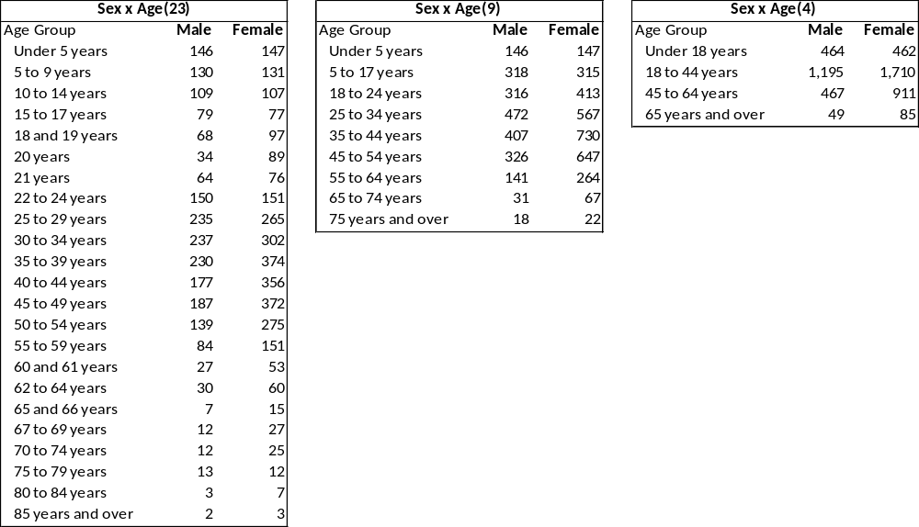
Sex by Age
23 categories
Sex by Age
9 categories
Sex by Age
4 categories
Note: These are fictitious data for illustration purposes.
Notes:
The amount of sex by age data a population group receives will be
based on a combination of population thresholds and the level of geography.
If a group meets population thresholds to receive age and sex data,
they will receive one of three possible tables:
a table with 4 age categories,
a table with 9 age categories,
or a table with 23 age categories.
This approach will allow us to produce more data for populations
based on their size within a geographic area.

Slide 39
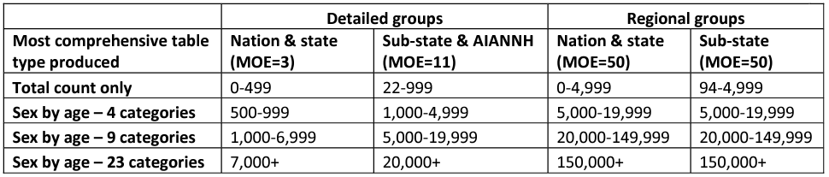
Detailed DHC-A Minimum Noise Infused Population Counts and Margins of Error (MOE) by Geography
Note: The listed population thresholds are applied to the population counts after they have been processed by the approved differential privacy mechanism.
Note: MOE refers to the margin of error
Notes:
Back in 2010, the 2010 Summary File 2 and American Indian and Alaska Native Summary File used a
single population threshold of 100 for every table and every geographic area.
In the proof of concept for the Detailed DHC-A, multiple population thresholds are used to
determine the amount of data a population group receives.
The population thresholds for all groups to receive a population count at all levels of geography are less than 100.
We heard from data users that population counts were critical,
so we prioritized providing accurate population counts for detailed race and
ethnicity groups and AIAN tribes and villages in this product.
This table shows the minimum population counts, or thresholds, required for detailed groups,
such as Iranian, Japanese, or Peruvian, and regional groups, such as Middle Eastern and North African, East Asian, or South American,
to receive each type of data different levels of geography in the proof of concept.
For data to be published, a group must meet these minimum population counts within a specific geographic area.
For example, a detailed group, such as Haitian alone, must have a noisy population count
Over 7000 at the state or national level to receive a sex by age table with 23 age categories and a total population count.
At lower levels of geography, which includes counties, tracts, places, and AIANNH areas,
adaptive design works the same way as at the national and state levels,
but different minimum population counts, or thresholds, are used.
Detailed groups with noise infused populations of less than 22 and regional groups with noise infused populations of less than 95
in these geographic areas will not have data published for that geography.
Utilizing the population thresholds of 22 and 95 are improvements for 2020 compared to back in 2010,
when groups needed to meet a minimum population count of 100 to have published counts at any given geography level.
The margin of error, meaning how different the count is from the true, enumerated count,
for detailed groups that receive a total only and individual age by sex counts at ​
the national and state levels in the proof of concept is 3.​
At sub-state and AIANNH areas, the margin of error is 11.
For regional groups, the margin of error is 50 at all levels of geography.
*************************************************
If asked:
We conducted extensive research using both 2010 decennial data and 2019 ACS 5-year estimates to reach these thresholds, evaluating the sparseness of different size groups at different levels of geography and in different tables. We also assessed population thresholds used in current ACS data products and previous decennial data products. The minimum population thresholds help ensure data quality in the final product. Additionally, the population thresholds for groups to receive a total population count at all levels of geography is lower in the Proof of Concept than in the 2010 Census SF2 and AIANSF, where groups needed a minimum population count of 100 to have published counts at any given geographic level.

