Slide 1


State of the State: Texas Demographic Trends and Characteristics
May 23, 2023 | Austin, Texas

Slide 2
States with Most Population Growth, 2010 to 2020
 | 2010 Population | 2020 Population | Numeric Change 2010-2020 | Percent Change 2010-2020
United States | 308,745,538 | 331,449,281 | 22,703,743 | 7.4%
Texas | 25,145,561 | 29,145,505 | 3,999,944 | 15.9%
Florida | 18,801,310 | 21,538,187 | 2,736,877 | 14.6%
California | 37,253,956 | 39,538,223 | 2,284,267 | 6.1%
Georgia | 9,687,653 | 10,711,908 | 1,024,255 | 10.6%
Washington | 6,724,540 | 7,705,281 | 980,741 | 14.6%
North Carolina | 9,535,483 | 10,439,388 | 903,905 | 9.5%
New York | 19,378,102 | 20,201,249 | 823,147 | 4.2%
Arizona | 6,392,017 | 7,151,502 | 759,485 | 11.9%
Colorado | 5,029,196 | 5,773,714 | 744,518 | 14.8%
Virginia | 8,001,024 | 8,631,393 | 630,369 | 7.9%
Tennessee | 6,346,105 | 6,910,840 | 564,735 | 8.9%
Utah | 2,763,885 | 3,271,616 | 507,731 | 18.4%
SOURCE: U.S. Census Bureau. 2010 and 2020 Census Count and 2021 Population Estimates

Slide 3
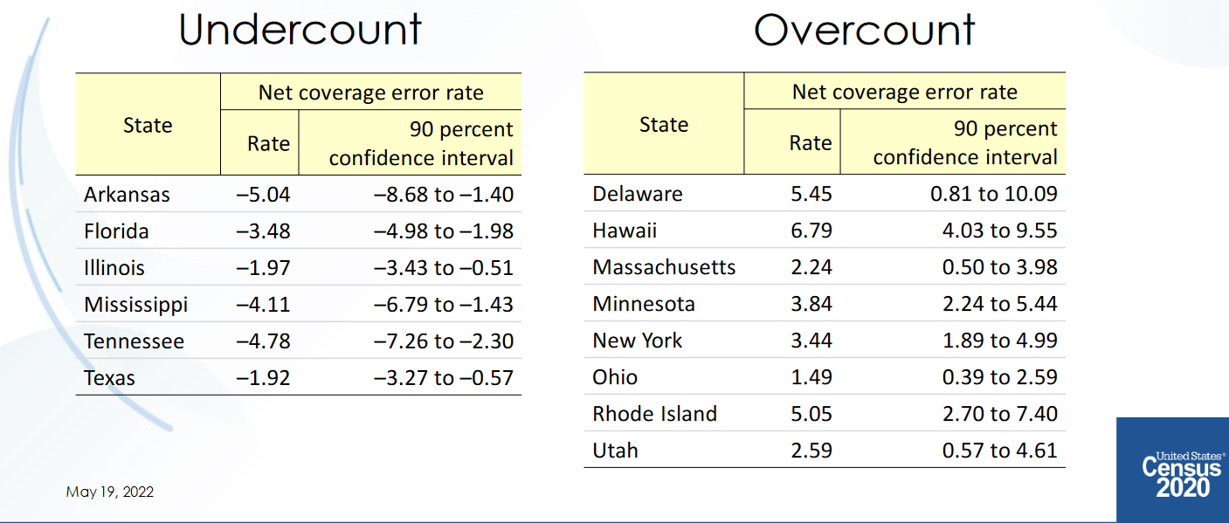
States with an Undercount or Overcount
Texas had an undercount of -0.97 in 2010 (not statistically different from 0)

Slide 4
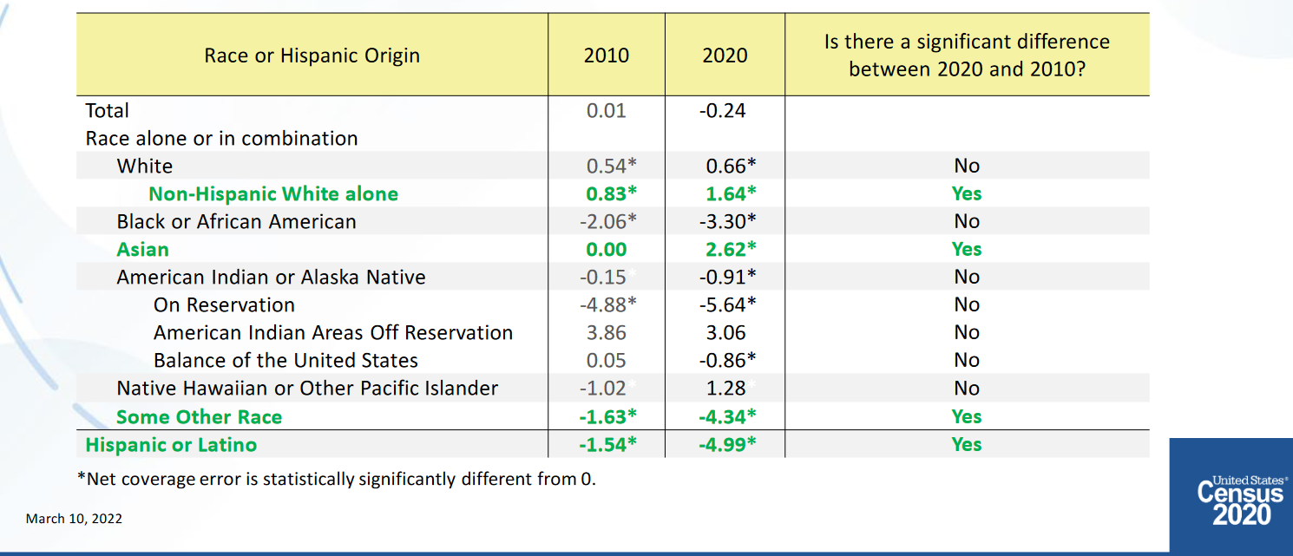
Percent Net Coverage Error by Race and Hispanic Origin: 2010-2020
Post-Enumeration Survey and Demographic Analysis

Slide 5
States with Most Population Growth, 2020 to 2022
Geographic Area | Population Estimate (as of July 1)
 | 2020 | 2021 | 2022 | Change 21-22 | Rank Change 21-22 | Pct. Change 21-22 | Rank Pct. Change 21-22
United States | 331,511,512 | 332,031,554 | 333,287,557 | 1,256,003 |  | 0.4%
Texas | 29,232,474 | 29,558,864 | 30,029,572 | 470,708 | 1 | 1.6% | 4
Florida | 21,589,602 | 21,828,069 | 22,244,823 | 416,754 | 2 | 1.9% | 1
North Carolina | 10,449,445 | 10,565,885 | 10,698,973 | 133,088 | 3 | 1.3% | 9
Georgia | 10,729,828 | 10,788,029 | 10,912,876 | 124,847 | 4 | 1.2% | 12
Arizona | 7,179,943 | 7,264,877 | 7,359,197 | 94,320 | 5 | 1.3% | 8
South Carolina | 5,131,848 | 5,193,266 | 5,282,634 | 89,368 | 6 | 1.7% | 3
Tennessee | 6,925,619 | 6,968,351 | 7,051,339 | 82,988 | 7 | 1.2% | 11
Washington | 7,724,031 | 7,740,745 | 7,785,786 | 45,041 | 8 | 0.6% | 16
Utah | 3,283,785 | 3,339,113 | 3,380,800 | 41,687 | 9 | 1.2% | 10
Idaho | 1,849,202 | 1,904,314 | 1,939,033 | 34,719 | 10 | 1.8% | 2
’20-’21 -> 902 of new Texans per day
’21-’22 -> 1,290 new Texans per day
SOURCE: US Census Bureau, Population Estimates, 2021 and 2022 vintages

Slide 6
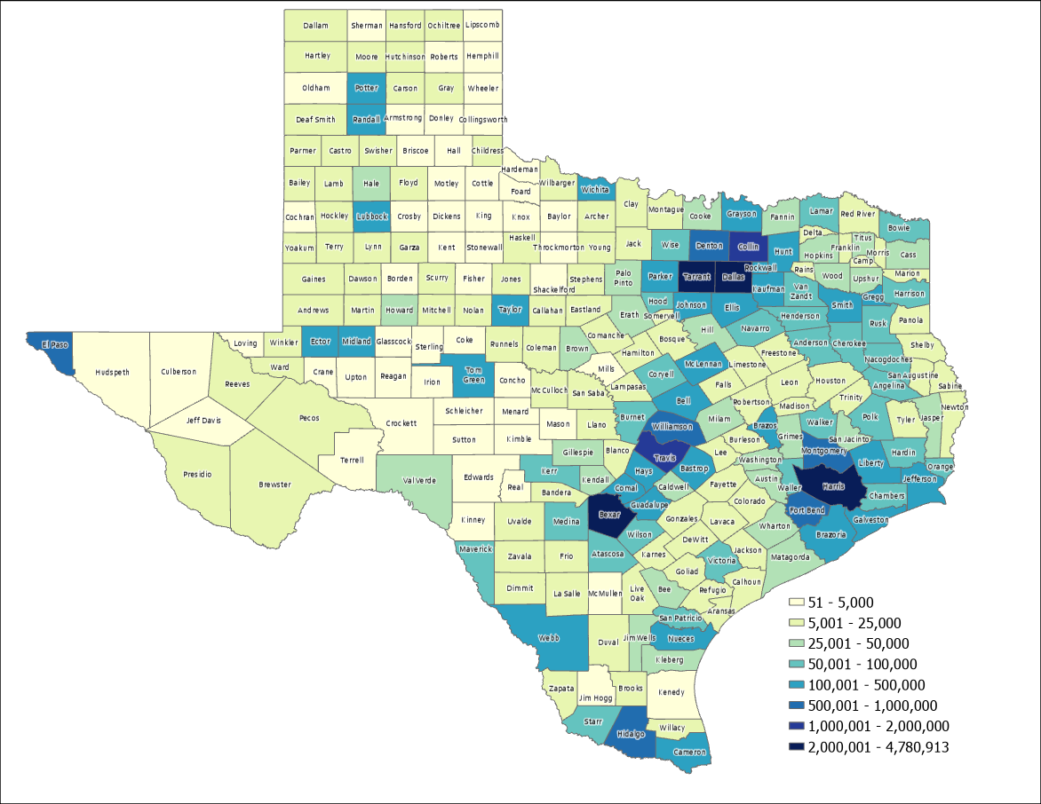

2022 Estimated Population, Texas Counties
87%
Source: US Census Bureau, 2022 Population Estimates

Slide 7
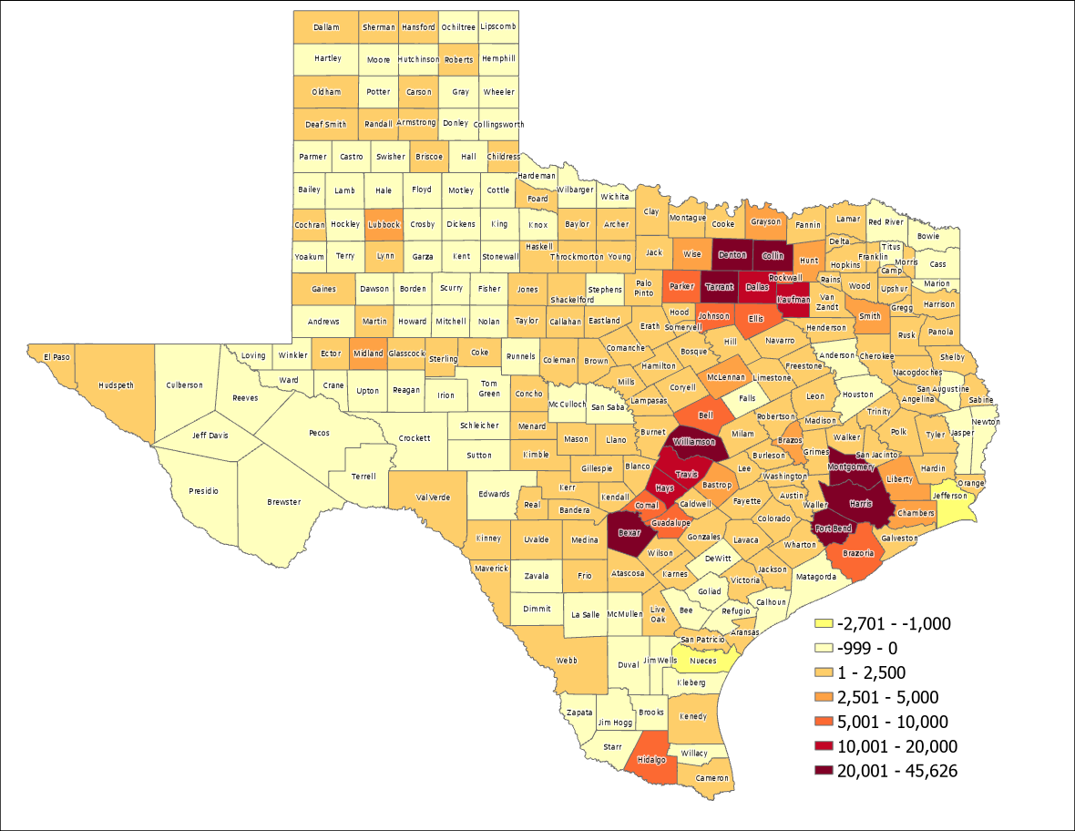

Estimated Numeric Change, Texas Counties, 2021-2022
95 of Texas counties lost population
SOURCE: US Census Bureau, Population Estimates, 2022 Vintage

Slide 8
Top Counties for Numeric Growth in Texas, 2021-2022
County | US Rank | 2022 Population Estimate | Population Change 2021-2022 | Percent of Change from Natural Increase | Percent of Change from International Migration | Percent of Change from Domestic Migration
Harris | 2 | 4,780,913 | 45,626 | 63.6% | 78.7% | -42.2%
Collin | 3 | 1,158,696 | 44,246 | 13.9% | 17.8% | 68.3%
Denton | 4 | 977,281 | 33,424 | 16.7% | 10.8% | 72.5%
Fort Bend | 7 | 889,146 | 29,022 | 15.3% | 23.1% | 61.6%
Bexar | 9 | 2,059,530 | 28,635 | 27.7% | 18.3% | 54.1%
Montgomery | 10 | 678,490 | 28,229 | 10.3% | 7.2% | 82.5%
Williamson | 12 | 671,418 | 26,967 | 13.6% | 8.0% | 78.4%
Tarrant | 13 | 2,154,595 | 25,193 | 39.6% | 32.0% | 28.3%
Travis | 20 | 1,326,436 | 17,892 | 47.4% | 39.8% | 12.9%
Kaufman | 29 | 172,366 | 14,150 | 6.0% | 1.1% | 92.9%
Hays | 36 | 269,225 | 13,160 | 11.1% | 3.7% | 85.3%
Dallas | 38 | 2,600,840 | 12,886 | 115.7% | 128.5% | -144.2%
Comal | 48 | 184,642 | 9,751 | 0.5% | 0.2% | 99.3%
Brazoria | 50 | 388,181 | 9,323 | 16.2% | 9.2% | 74.6%
Ellis | 52 | 212,182 | 9,075 | 8.8% | 1.8% | 89.3%
Parker | 53 | 165,834 | 8,868 | 2.7% | 1.3% | 96.0%
Source: US Census Bureau, 2022 Population Estimates

Slide 9
Top Counties for Percent Growth in Texas, 2021-2022*
County | US Rank | 2022 Population Estimate | Population Change 2021-2022 | Percent Population Change 2021-2022 | Percent of Population Change from Natural Increase | Percent of Population Change from International Migration | Percent of Population Change from Domestic Migration
Kaufman | 1 | 172,366 | 14,150 | 8.9% | 6.0% | 1.1% | 92.9%
Rockwall | 4 | 123,208 | 6,659 | 5.7% | 6.6% | 2.6% | 90.7%
Comal | 5 | 184,642 | 9,751 | 5.6% | 0.5% | 0.2% | 99.3%
Parker | 6 | 165,834 | 8,868 | 5.6% | 2.7% | 1.3% | 96.0%
Hays | 7 | 269,225 | 13,160 | 5.1% | 11.1% | 3.7% | 85.3%
Liberty | 12 | 101,992 | 4,610 | 4.7% | 0.7% | 2.9% | 96.4%
Williamson | 13 | 671,418 | 26,967 | 4.7% | 6.3% | 1.2% | 92.5%
Wise | 20 | 74,895 | 3,007 | 4.3% | 10.3% | 7.2% | 82.5%
Montgomery | 22 | 678,490 | 28,229 | 4.3% | 4.2% | 1.1% | 94.8%
Bastrop | 24 | 106,188 | 4,022 | 4.2% | 13.6% | 8.0% | 78.4%
Johnson | 27 | 195,506 | 8,064 | 4.2% | 0.8% | 1.9% | 97.3%
Waller | 31 | 61,894 | 2,420 | 4.1% | 10.5% | 3.4% | 86.1%
Hunt | 32 | 108,282 | 4,824 | 4.0% | 13.9% | 17.8% | 68.3%
Collin | 36 | 1,158,696 | 44,246 | 3.9% | 8.7% | 2.1% | 89.2%
Fort Bend | 46 | 889,146 | 29,022 | 3.4% | 15.3% | 23.1% | 61.6%
Source: US Census Bureau, 2022 Population Estimates
*Among counties with populations of 50,000 or more in 2021

Slide 10
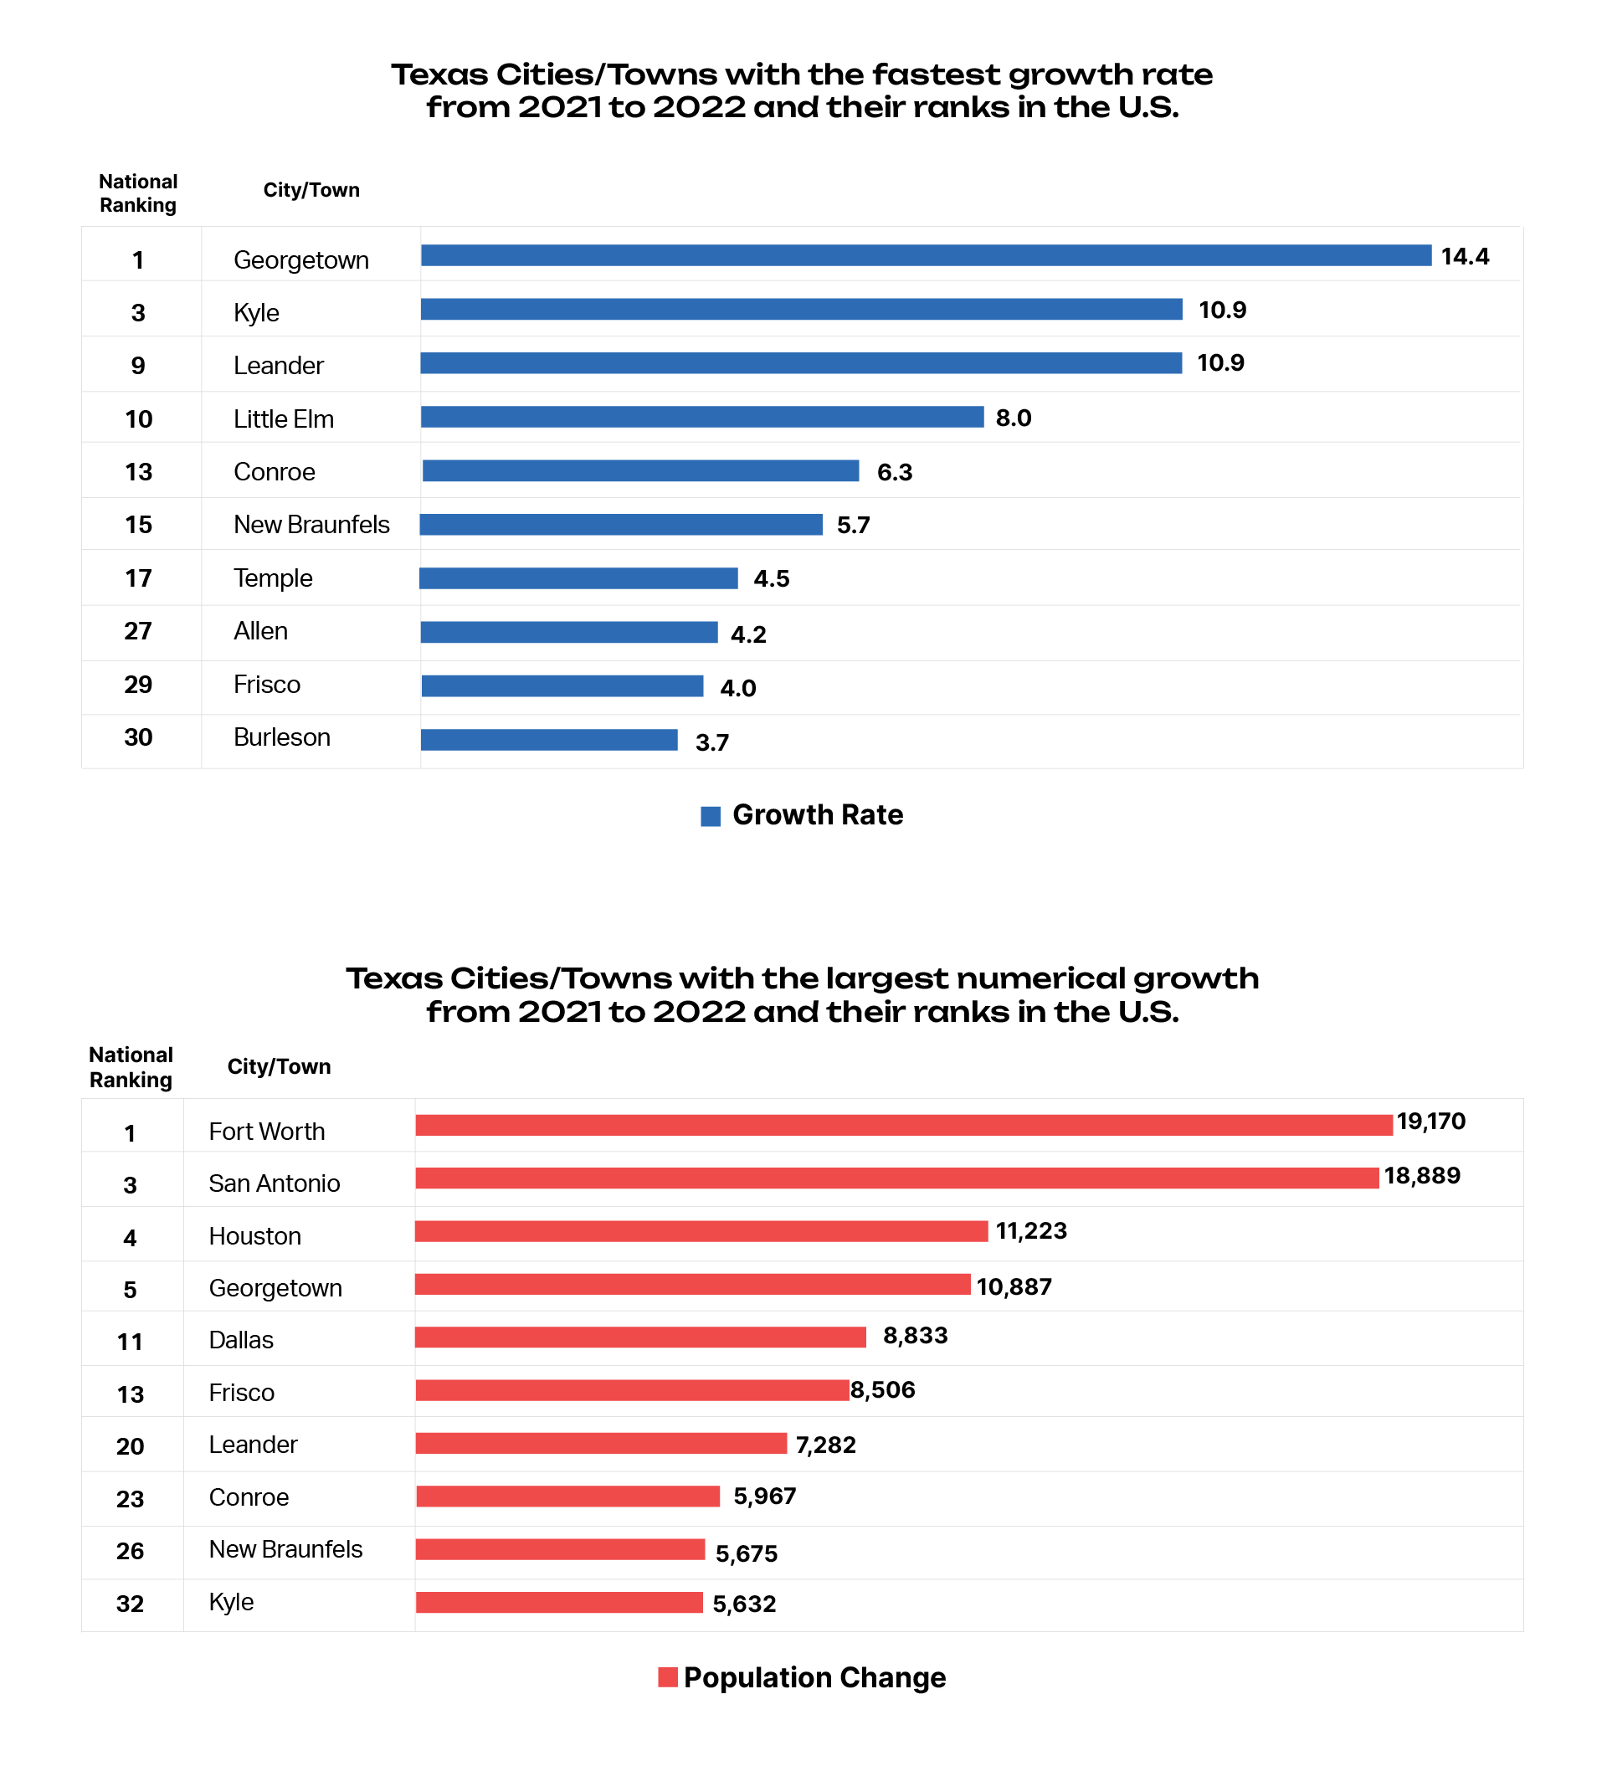
Top Places for Numeric Growth, 2021-2022
Source: US Census Bureau, 2022 Population Estimates

Slide 11
Top Places for Percent Growth, 2021-2022
Source: US Census Bureau, 2022 Population Estimates

Slide 12
Minority population drove growth in Texas between 2010-2020
3,999,944 new Texans
95.3% attributable to growth of minority populations
Source: US Census Bureau, 2010 and 2020 Census, P.L. 94-171 Redistricting Files
Note: there were changes in the capture and processing of race data changed between 2010 and 2020

Slide 13
Estimated Racial/Ethnic Composition of Texas Population, 2021
Source: U.S. Census Bureau, American Community Survey, 1-year sample, 2021

Slide 14
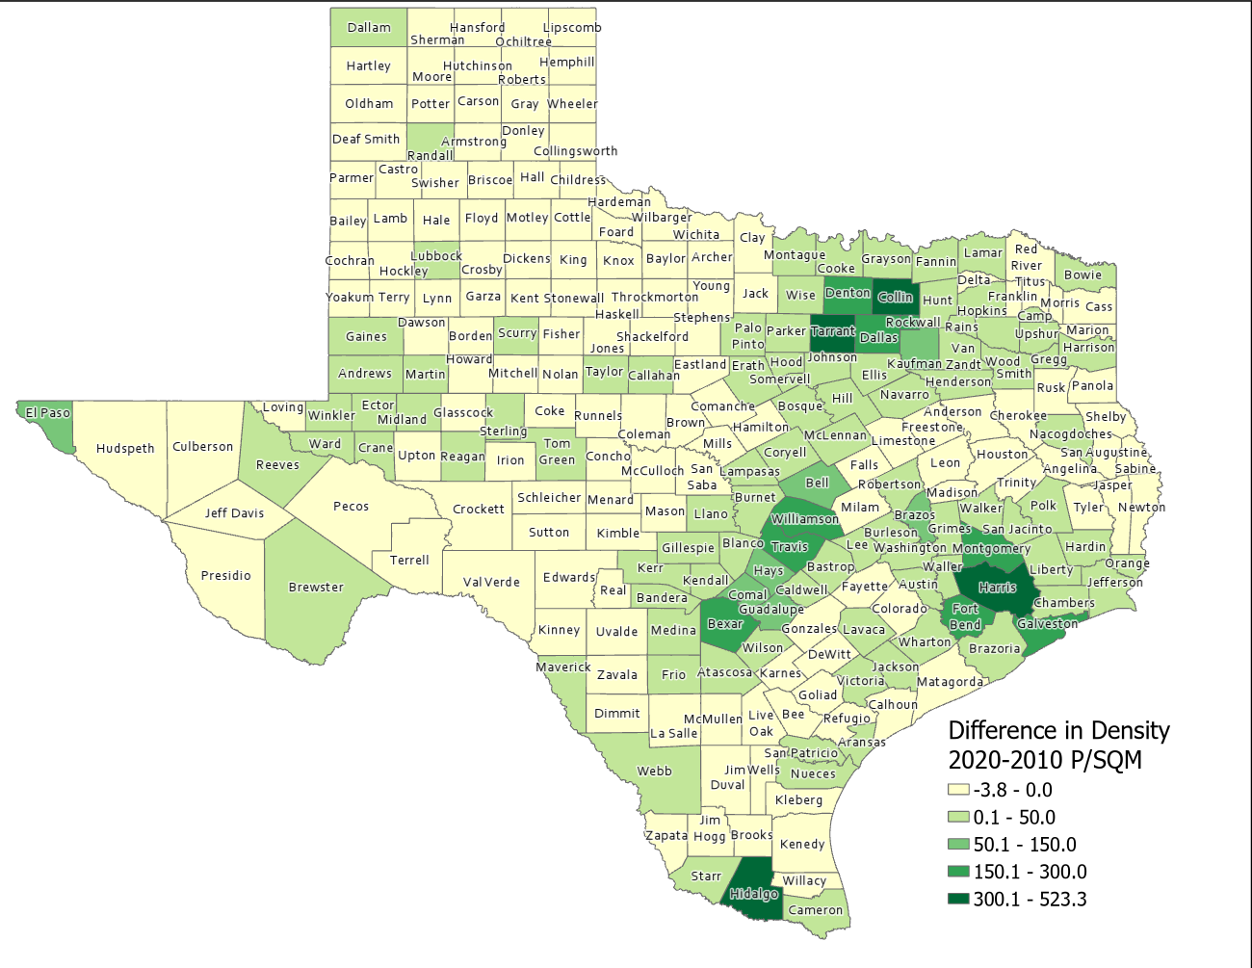
Difference in Population Density per Square Mile (2020-2010), Texas Counties
SOURCE: US Census Bureau, 2010 and 2020 Census, P.L. 94-171 Redistricting Files

Slide 15
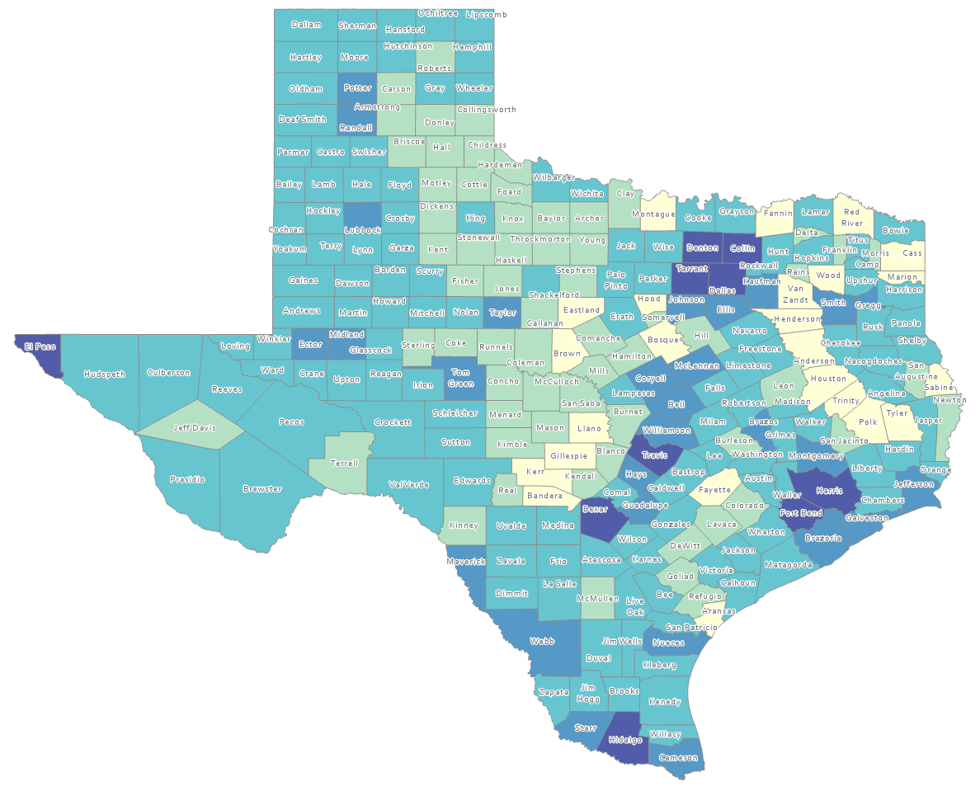
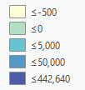
Estimated Natural Increase (Decrease), Texas Counties, 2010-2020
86 counties had natural decrease over the decade (1/3 of Texas’ counties)
Source: US Census Bureau, 2020 Population Estimates

Slide 16
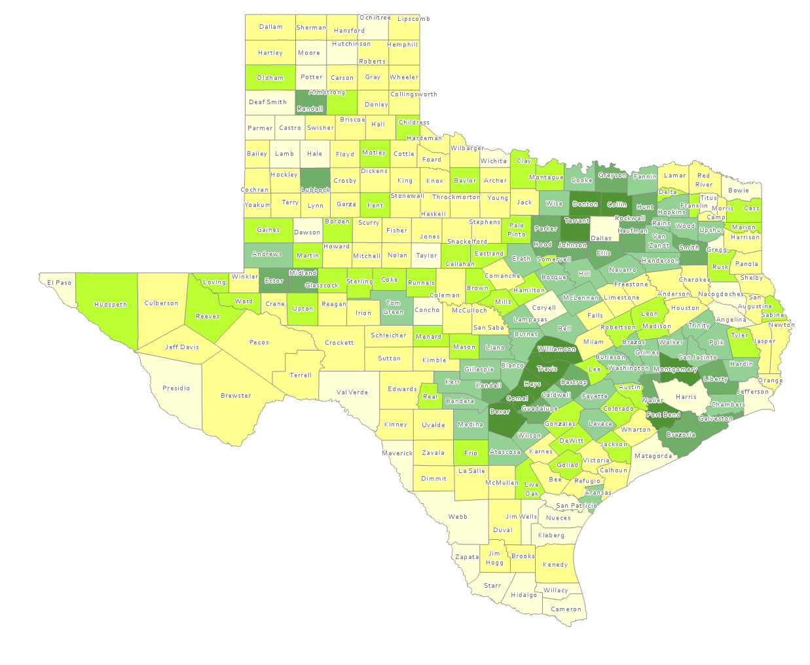
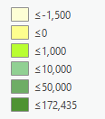
Estimated Population Change from Domestic Migration, Texas Counties, 2010-2020
More than half (134) of counties had net out domestic migration
Source: US Census Bureau, 2020 Population Estimates

Slide 17
Estimated Components of Population Change for Texas, 2010-2020 and 2020-2021, 2021-2022
2010 to 2020
2020 to 2021
2021 to 2022
326,390
470,708
SOURCE: U.S. Census Bureau. 2020 Evaluation Population Estimates and 2021 and 2022 Vintage Population Estimates

Slide 18
Estimated Domestic and International Migration for Texas, 2011-2022
SOURCE: U.S. Census Bureau. 2020 Evaluation Population Estimates and 2022 Vintage Population Estimates

Slide 19
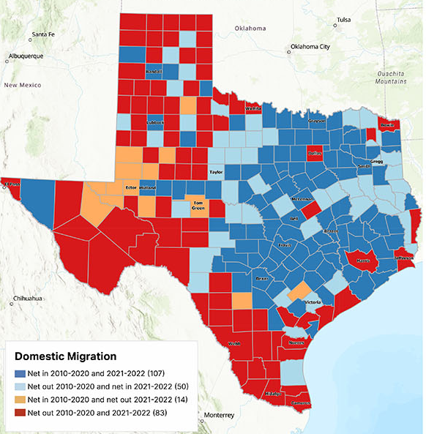
Estimated Change from Domestic Migration Comparing 2010-2020 and 2021-2022, Texas Counties
Source: US Census Bureau, 2022 Population Estimates

Slide 20
Texas Birth Rates, 2007-2019
SOURCE: Centers for Disease Control and Prevention, National Center for Health Statistics.

Slide 21
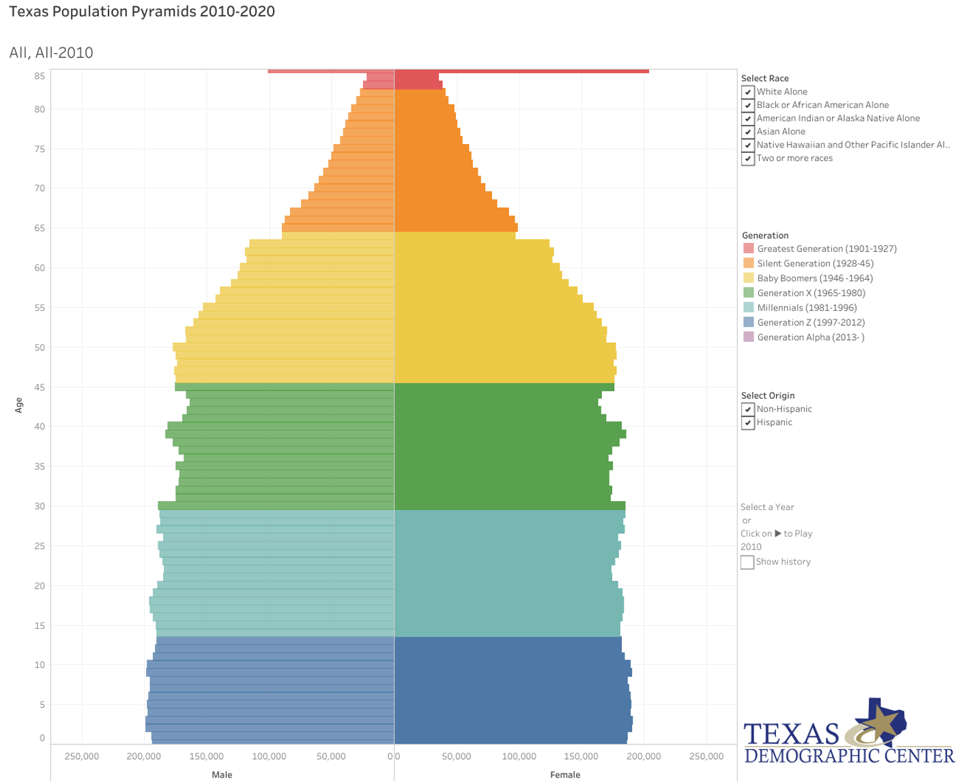
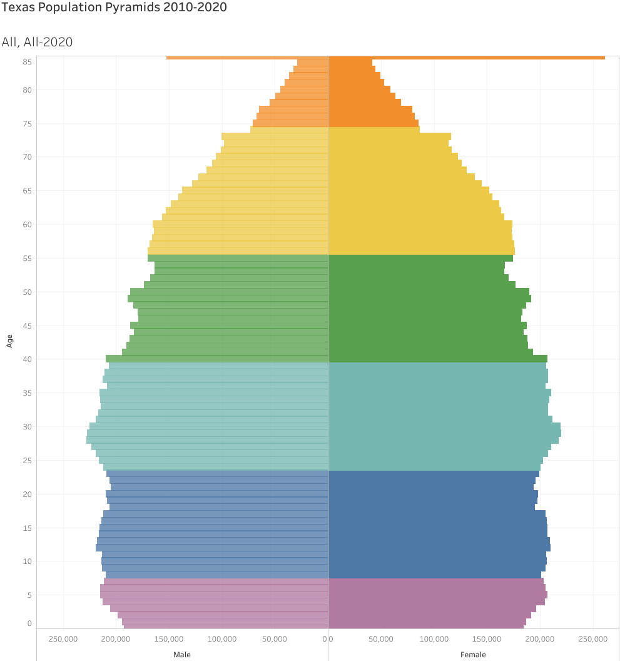
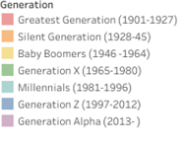
Generational Population Pyramids, Texas, 2010-2020
2010
2020
2010
2015
2020
Year of birth
SOURCE: U.S. Census Bureau. 2010 and 2020 Vintage Population Estimates

Slide 22
Estimated Net Domestic Migrants Between Texas and Other States, 2010-2019
Source: U.S. Census Bureau, State-to-State Migration Flows, 2010-2019

Slide 23

Percent Distribution by Education Attainment of Texas Residents (Non-Migrants), Immigrants (International) and Net-Migrants (Domestic) Aged 25 Years and Over, Texas, 2015-2019
SOURCE: US Census Bureau, American Community Survey, PUMS, 5-Year Samples, 2015-2019

Slide 24
Percent Distribution by Occupation of Non-Migrants (Texans) and Net-In Domestic Migrants Aged 25 Years and Over, Texas, 2006-2019
SOURCE: US Census Bureau, American Community Survey, 2006-2020

Slide 25
Percent of Civilian Labor Force by Occupation, Texas, 2011, 2021 and 2011-2012 Change
Source: US Census Bureau, American Community Survey, 1-Year Sample, 2011, 2021

Slide 26
Educational Attainment of Adults Aged 25 Years and Older by Race and Ethnicity, Texas, 2021
Source: US Census Bureau, American Community Survey, 1-Year Sample, 2021

Slide 27
Change in Educational Attainment of Adults Aged 25 Years and Older by Race and Ethnicity, Texas, 2011-2021
Source: US Census Bureau, American Community Survey, 1-Year Sample, 2011 and 2021

Slide 28
Change in Travel Time to Work, Texas, 2006-2010 and 2016-2020
SOURCE: US Census Bureau, 2010 and 2020 5-Year American Community Survey Summary File

Slide 29
Means of Transportation, Texas, 2011, 2019, 2021
SOURCE: US Census Bureau, 2011, 2019 and 2021 1-Year American Community Survey Summary File

Slide 30
Projected Population Growth in Texas, 2020-2060
SOURCE: Texas Demographic Center, Vintage 2022 and 2018 Population Projections

Slide 31
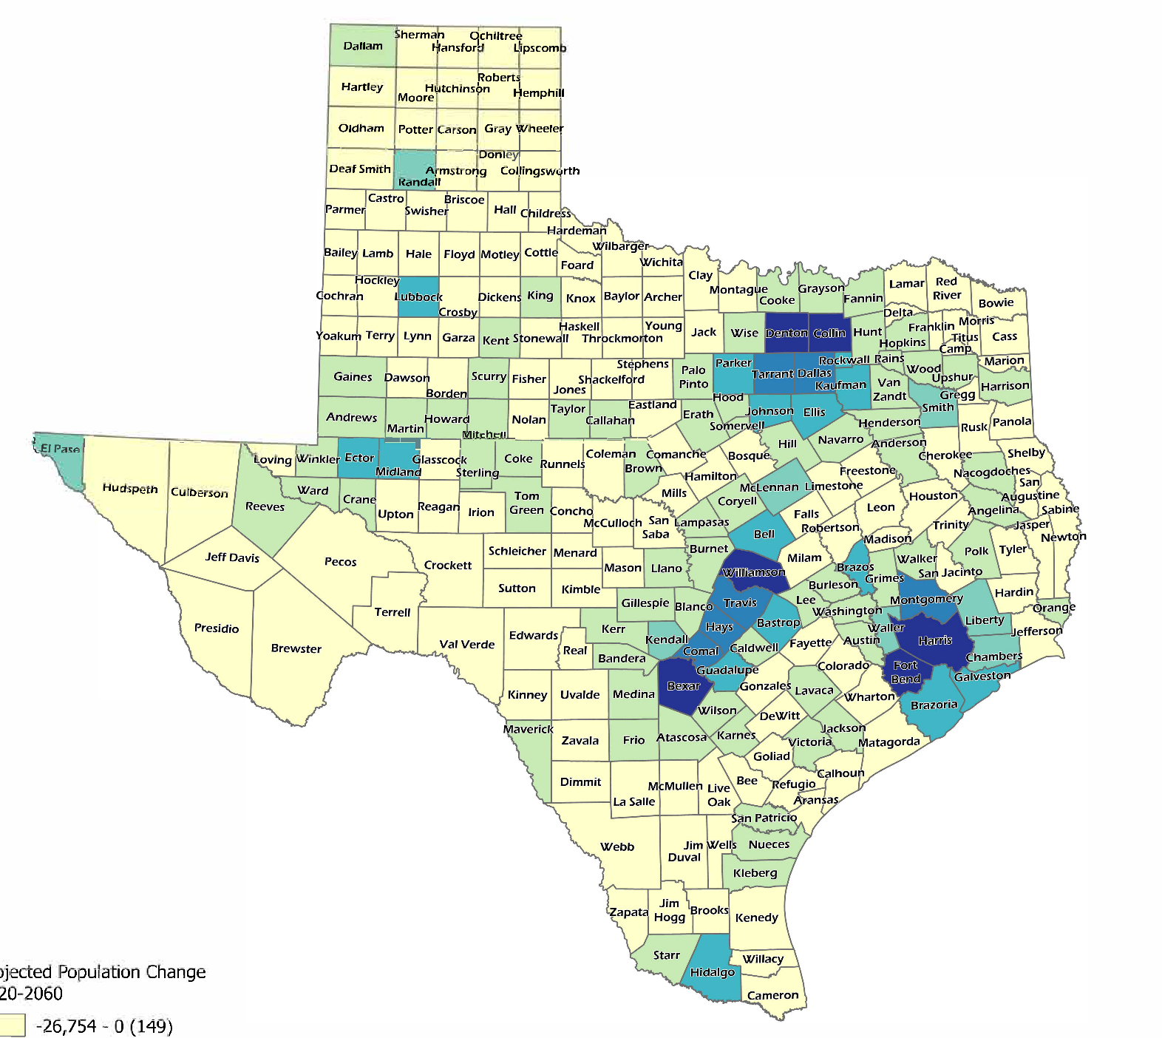

Projected Population Change, Texas Counties, 2020-2060
SOURCE: Texas Demographic Center, Vintage 2022 Population Projections

Slide 32
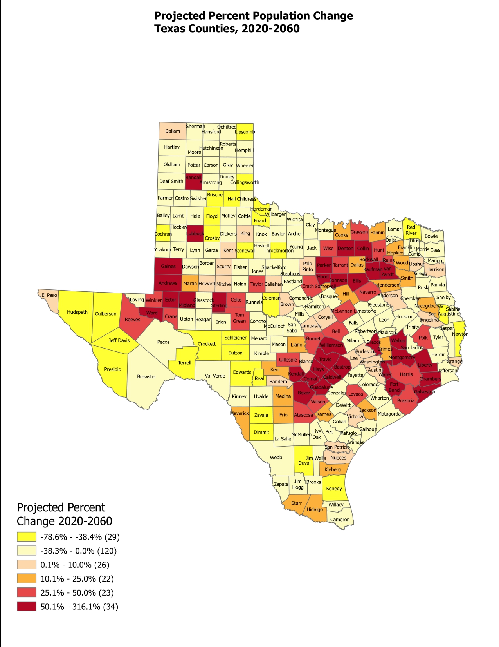
Projected Percent Population Change, Texas Counties, 2020-2060
SOURCE: Texas Demographic Center, Vintage 2022 Population Projections

Slide 33
Projected Population by Race and Ethnicity, Texas, 2020-2050
Source: Texas Demographic Center 2018 Population Projections
Notes:
Population projections by race and ethnicity suggest that Latino’s are and will increasingly be the largest race/ethnic group. The number and percent who are non-Hispanic white are likely to decline. Non-Hispanic other are largely of Asian descent and they appear to be increasing rapidly, although the base number is small.

Slide 34


Visit our website
demographics.texas.gov/

Slide 35
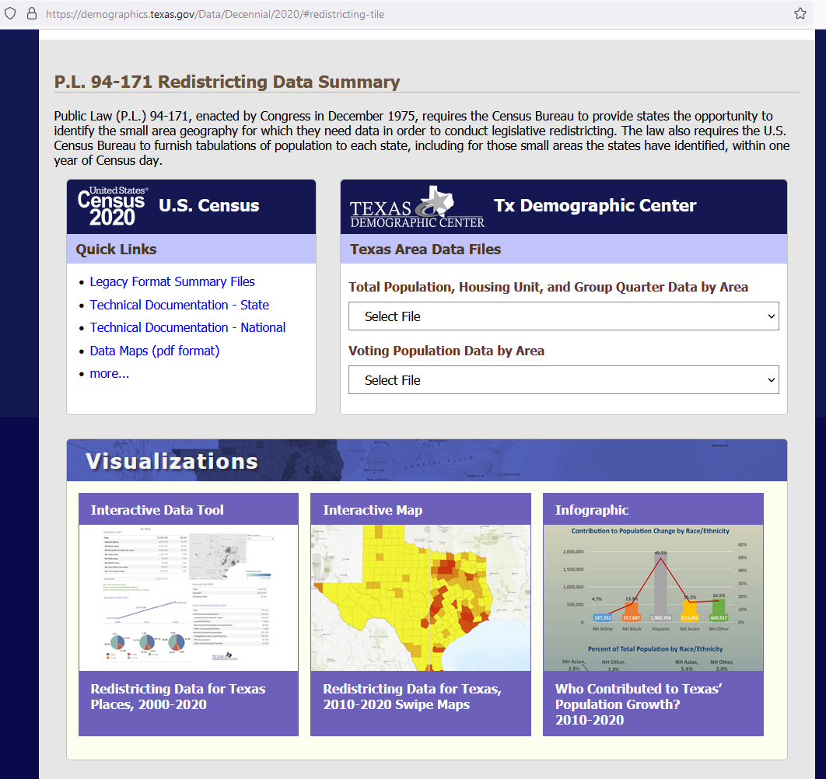
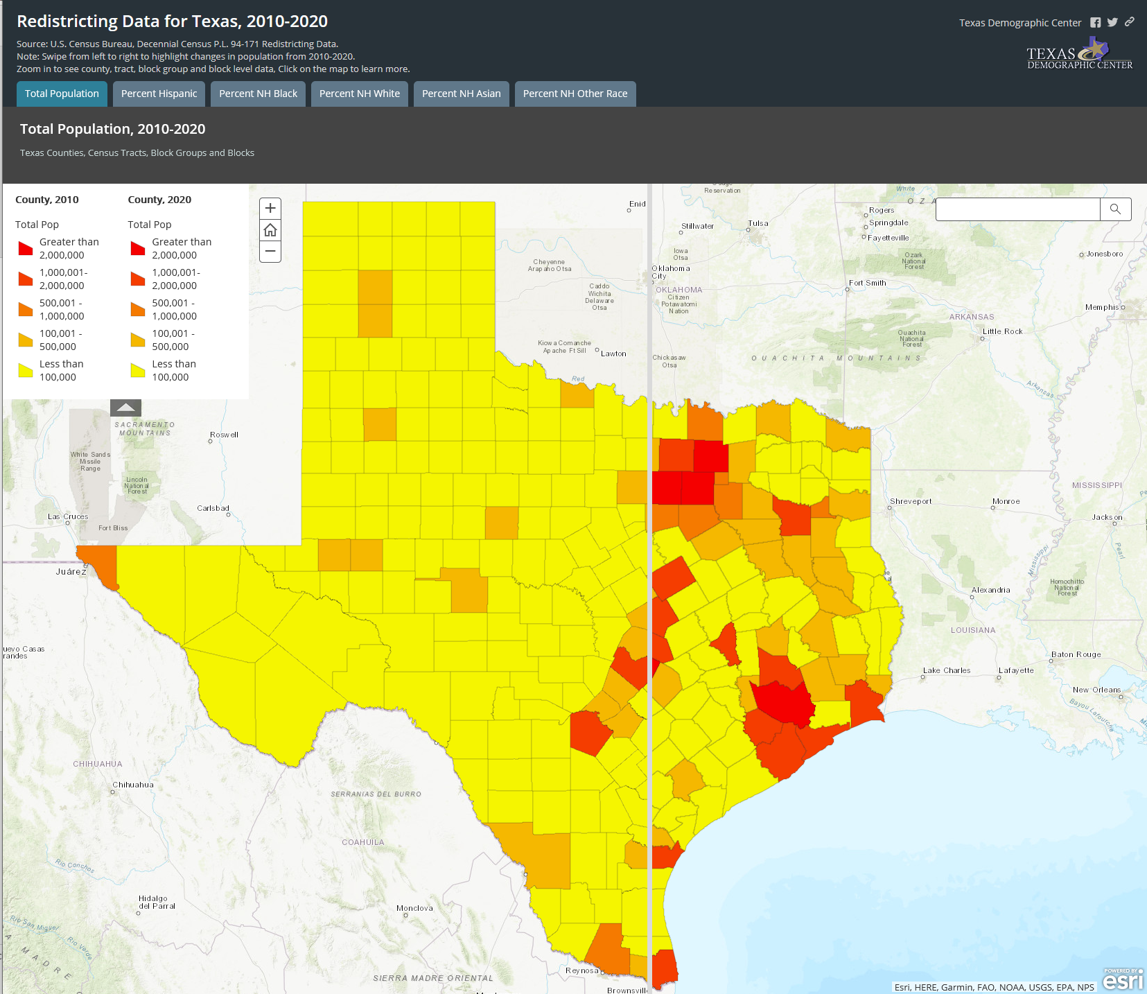
Interactive Maps
demographics.texas.gov/

Slide 36
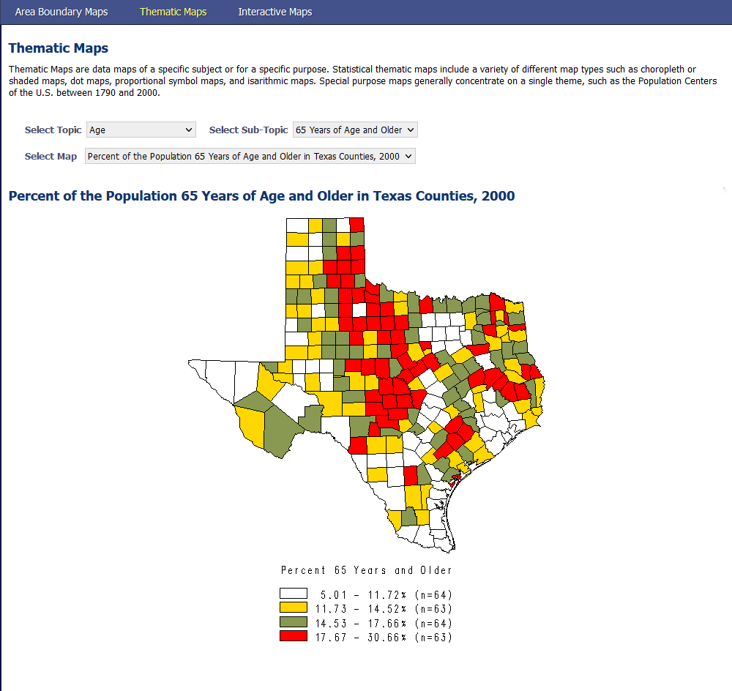
Thematic Maps
demographics.texas.gov/

Slide 37




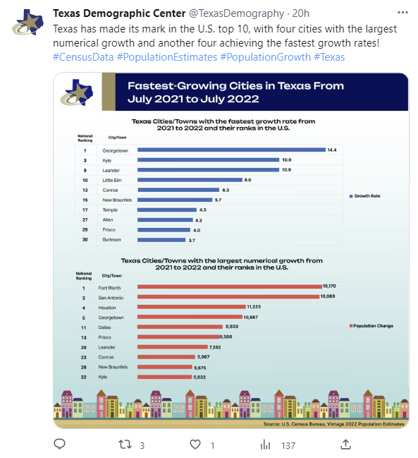
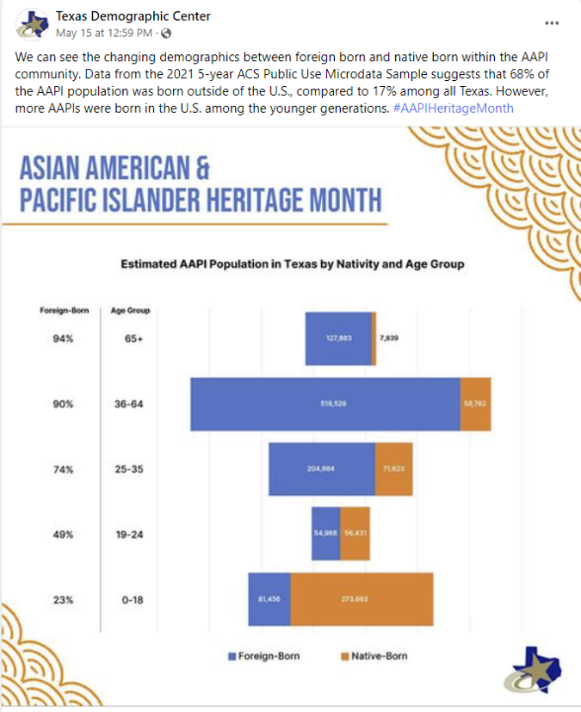


Texas Demographic Center Social Media
@TexasDemography
Texas Demographic Center
texasdemographiccenter
Texas Demographic Center

Slide 38





Lloyd Potter, Ph.D.
(210) 458-6530
TDC@UTSA.edu
Demographics.Texas.gov
@TexasDemography

