Slide 1



Estimates and Projections for Texas
By Helen You
Texas Demographic Conference
May 24, 2023 | Austin, Texas

Slide 2
Texas Demographic Center Population Estimates Program
Required by Texas Law to produce population estimates for the State and its counties and places every year.
TDC surveys, Administrative data and public data are used; Data collection ends on June 1, preliminary estimates out in September and final released in October.
Three methods are used: Component Method II, Ratio Correlation and Housing Unit;
County Estimates are controlled to the Census Bureau State Population Estimates; Place Estimates are controlled to TDC County Estimates.
Controlled Estimates from the three methods are evaluated against estimates from other sources, mainly those from the Census Bureau, and historical trends to make the final TDC estimates

Slide 3
Three Methods are used in the TDC population Estimates
Component Method II
  Population_{(t+k)} = Population_{t}
  + Natrual Increase_{t} (Births_{t} – Deaths_{t} )
  + Net Migrants_{t} (In-mig_{t} – Out-mig_{t})
  Vital statistics data, school enrollment, medicare data, GQ
Housing Unit
  Population(t+k) = Population + New Housing Units * HH size
  Building permit data, annexation & boundary data, GQ
Ratio Correlation
  Regression method using symptomatic indicators
  Birth, death, voter registration, vehicle registration, housing unit
Group Quarter Population
  Dorms, prisons, military barracks, nursing homes…

Slide 4
“Symptomatic Indicators” are Powerful Predictors of Population
Mostly stable overtime
High Correlations
 | State Ratios Enrollment/Population | County Correlation Population&Enrollment
Vehicle Registration
2010 | 0.862 | 0.998
2020 | 0.826 | 0.997
Voter Registration
2010 | 0.515 | 0.997
2020 | 0.553 | 0.998
School Enrollment (2nd-8th Grade)
2010 | 0.120 | 0.996
2020 | 0.110 | 0.994
Medicare Enrollment
2010 | 0.099 | 0.993
2020 | 0.126 | 0.995

Slide 5
TDC Building Permit Survey
1,214

Slide 6
Comparing TDC 2020 Estimates with the Decennial Census, State of Texas
 | Census 2020 | CB Estimates | Housing Unit | Ratio Correlation | Component Method II
Population | 29,145,505 | 29,360,759 | 29,034,349 | 29,373,713 | 30,998,108
Numeric Difference |  | 215,254 | -111,156 | 228,208 | 1,852,603
Percent Difference |  | 0.74 | -0.38 | 0.79 | 6.31

Slide 7
Summary Measures of Estimation Errors, CB 2020 and TDC 2020
 | CBEst | HousingUnit_TDC_2020 | RatioCorrelation | ComponentMethodII
Bias_Measurements
Mean_Error | 847 | -438 | 898 | 7,294
Median_Error | 348 | 530 | 1,040 | 1,476
MALPE(%) | 4.4 | 7.7 | 8.8 | 9.6
% Positive | 76.0 | 76.0 | 85.4 | 83.9
Median_ALPE (%) | 2.3 | 5.1 | 7.5 | 8.6
Trimmed_mean (5%) | 3.2 | 6.0 | 8.1 | 9.0
Index of Misallocation | 0.56 | 1.59 | 1.83 | 3.14
Accuracy_Measurements
Mean_Absolute_Error | 1,557 | 3,576 | 4,108 | 8,123
Median_Absolute_Error | 451 | 897 | 1,337 | 1,615
MAPE (%) | 5.5 | 9.5 | 9.7 | 11.9
Median_APE (%) | 3.2 | 6.1 | 7.7 | 9.3
RMSPE (%) | 13.7 | 18.8 | 13.2 | 16.2
GMAPE (%) | 2.5 | 5.1 | 5.9 | 7.7
Trimmed_APE_mean (5%) | 4.1 | 7.4 | 8.7 | 10.6
Note: Selected measures and their calculations guided by Swanson, D and Tayman, J, 2012, Subnational Population Estimates

Slide 8
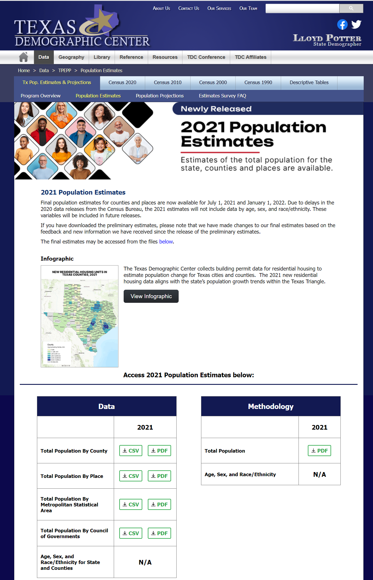
Access TDC Estimates Data, V2018 and V2022
Customized table tool available fall 2023 when new estimates are available
Source: Texas Demographic. https://idser.maps.arcgis.com/apps/MapSeries/index.html?appid=88493fab762141d7b5a28d3430ab1ca8

Slide 9
Comparing TDC and Census Bureau Population Estimates
Timeline
  CB: estimates for July of the previous year from December to June:
  TDC: estimates for July of previous year and January of current year in early October.
The input data
  CB: some input data are projected;
  TDC: up-to-date data.
Methodology.
  CB: the cohort component method, a more “direct” method; access to individual level administrative data; migration estimates likely more accurate;
  TDC: a combination of three methods (cohort component, ratio-correlation, and housing unit method); compare with Census Bureau estimates.
  Data Available
  CB: July Estimates for previous year; components of Change;
  TDC: July Estimates for previous year and January estimates for Current year.
  Interactions with the local government.
  CB: collaboration with TDC; the challenge program;
  TDC: collect data from state agencies and local governments; preliminary sent to local governments for review.
Which time frame fits you better?
Is consistency an issue?
Use caution when comparing estimates from different sources and decades.

Slide 10
Texas Demographic Center Population Projections Program
Required by Texas Law to produce population projections for the State and its counties every other year. Release in fall. Available by:
  Single year of age;
  Male and Female;
  NH White, NH Black, Hispanics, NH Asian and NH Other;
  Single year, 40 years out in the future from the base year.
Cohort Survival method is used to account for trends in fertility, mortality and migration.
State and County projections are produced separately. County projections are controlled so that they add up to the state projections.

Slide 11
TDC Population Projection Illustration
Population 2020 (Ages 0 to 95+)
DEATHS
[= Base Population * Projected Death Rates]
+ NET MIGRANTS
[= Base Population * Constant Migration Rates]
Population 2021 (Ages 1 to 95+)
+ BIRTHS
[= Women 15 -49 * Projected Fertility rates (ASFR)
Population 2021 (Ages 0 to 95+)
Population 2021 (Ages 0)

Slide 12
Projected Population Growth in Texas with Various Migration Scenarios
Census Count | TDC Projection | % Dif | PES shows Under Count
29,145,505 | 29,677,668 | 1.8% | 1.9%
SOURCE: Texas Demographic Center, Vintage 2014 and 2018, 2022 Population Projections

Slide 13
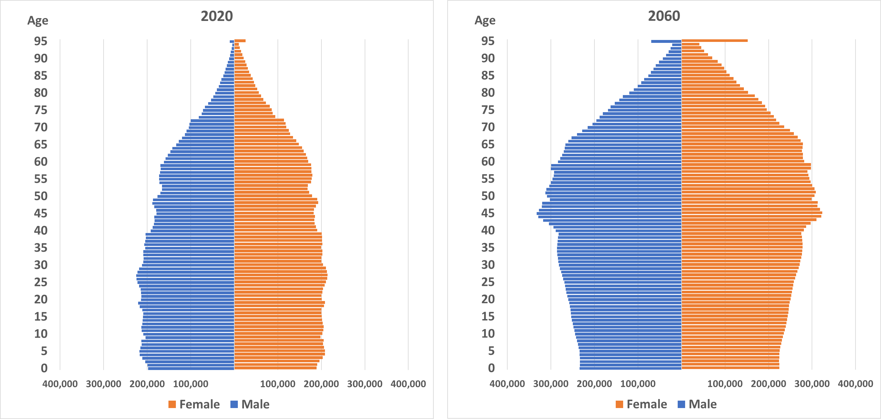
Projected Population by Age and Sex, Texas, 2020-2060
Source: Texas Demographic Center Vintage 2022 Population Projections

Slide 14
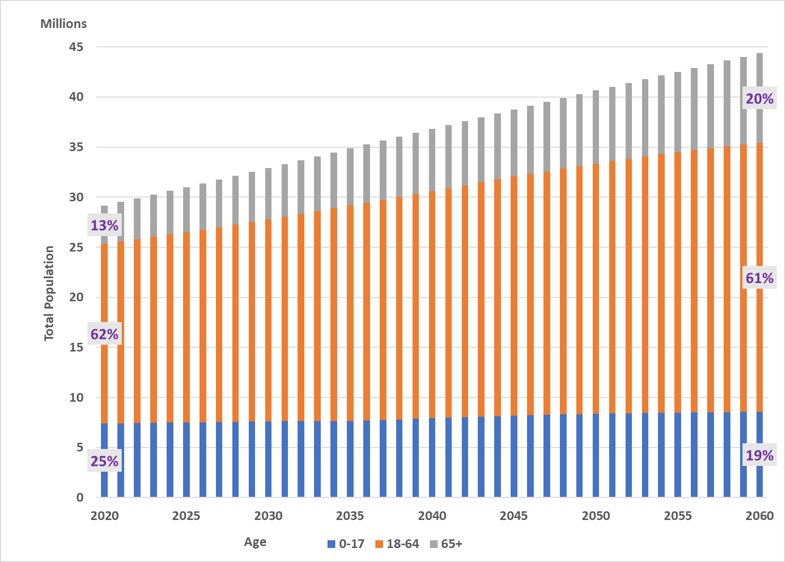
Projected Population Composition, Texas, 2020-2060
Source: Texas Demographic Center Vintage 2022 Population Projections

Slide 15
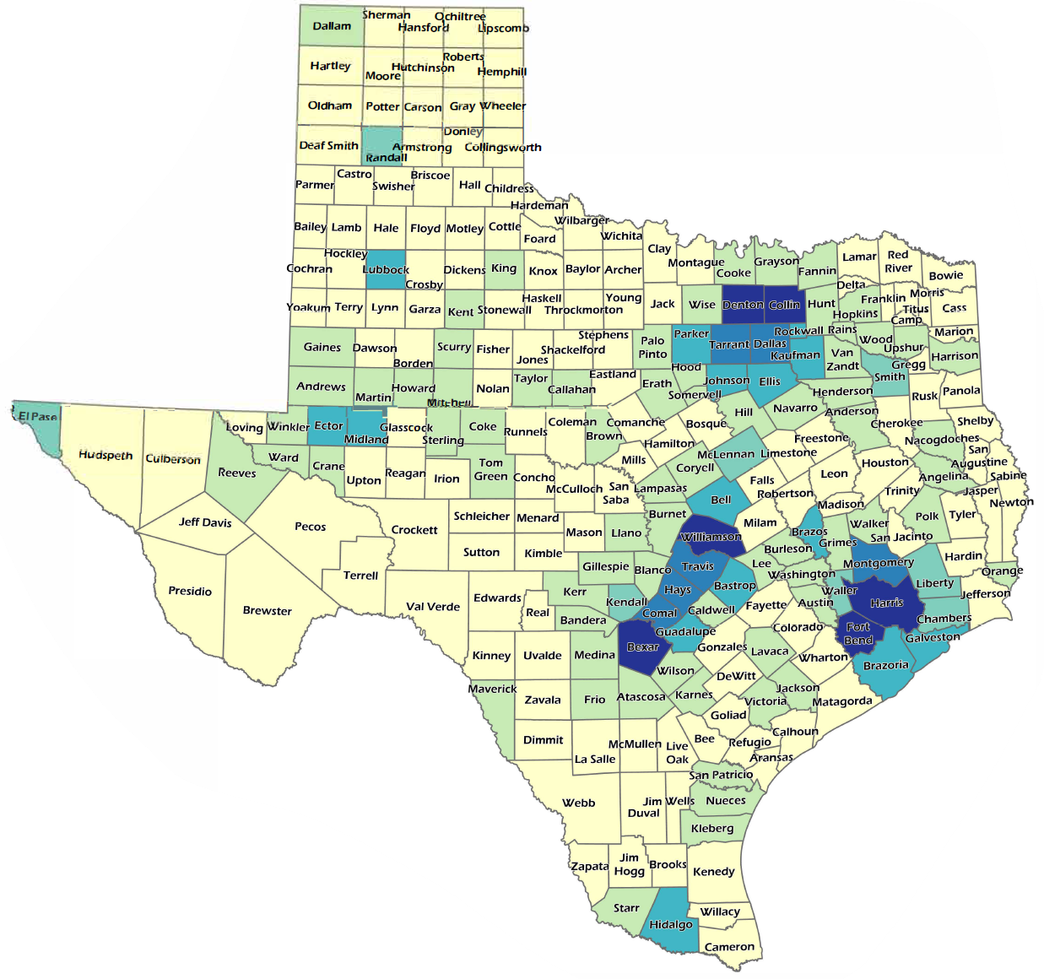
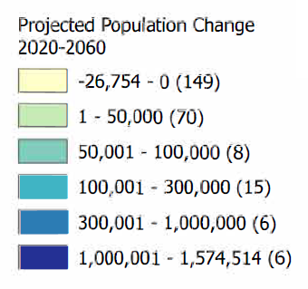
Projected Population Change, Texas Counties, 2020-2060

Slide 16
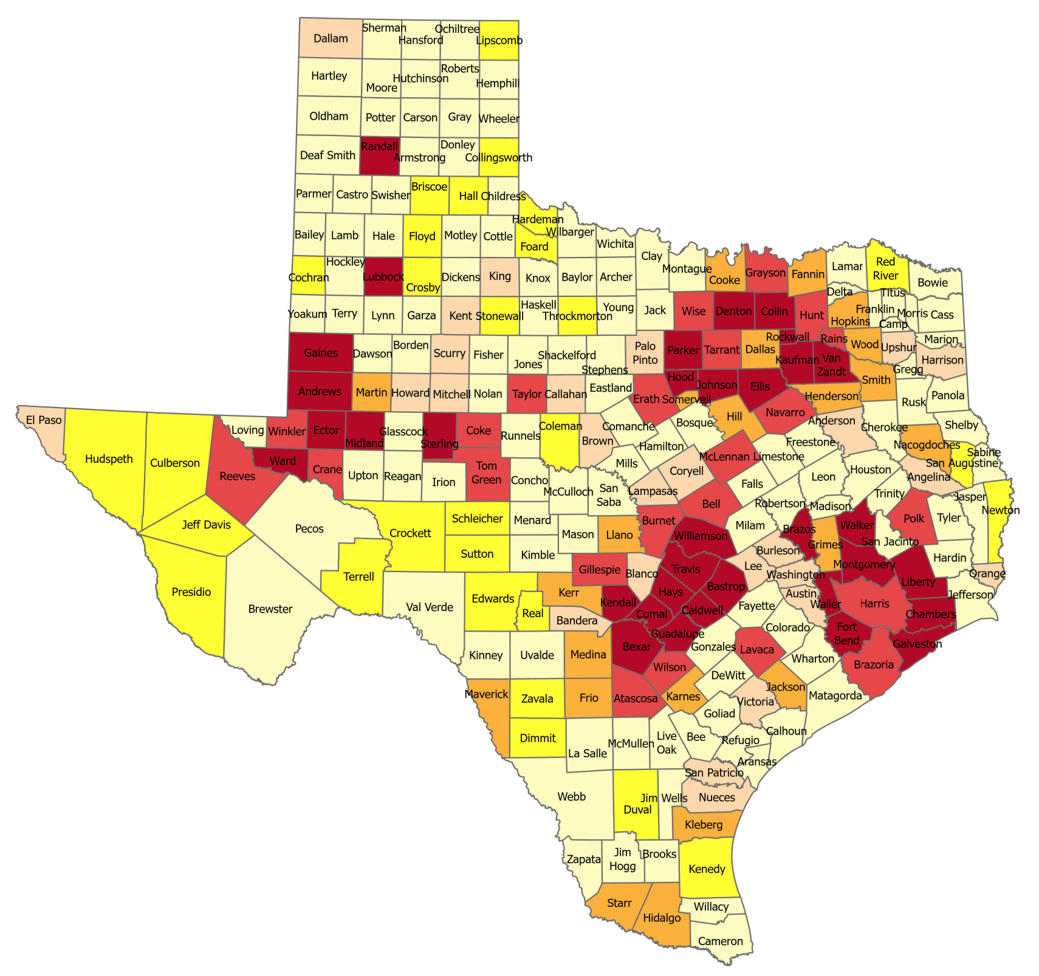
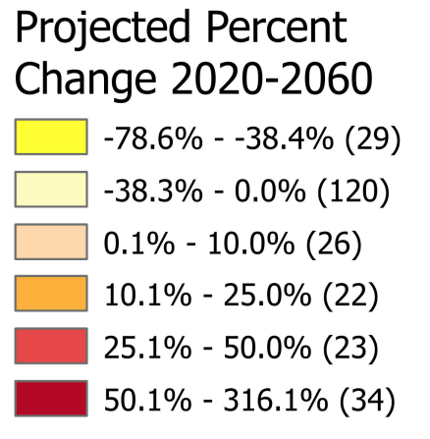
Projected Percent Population Change, Texas Counties, 2020-2060

Slide 17
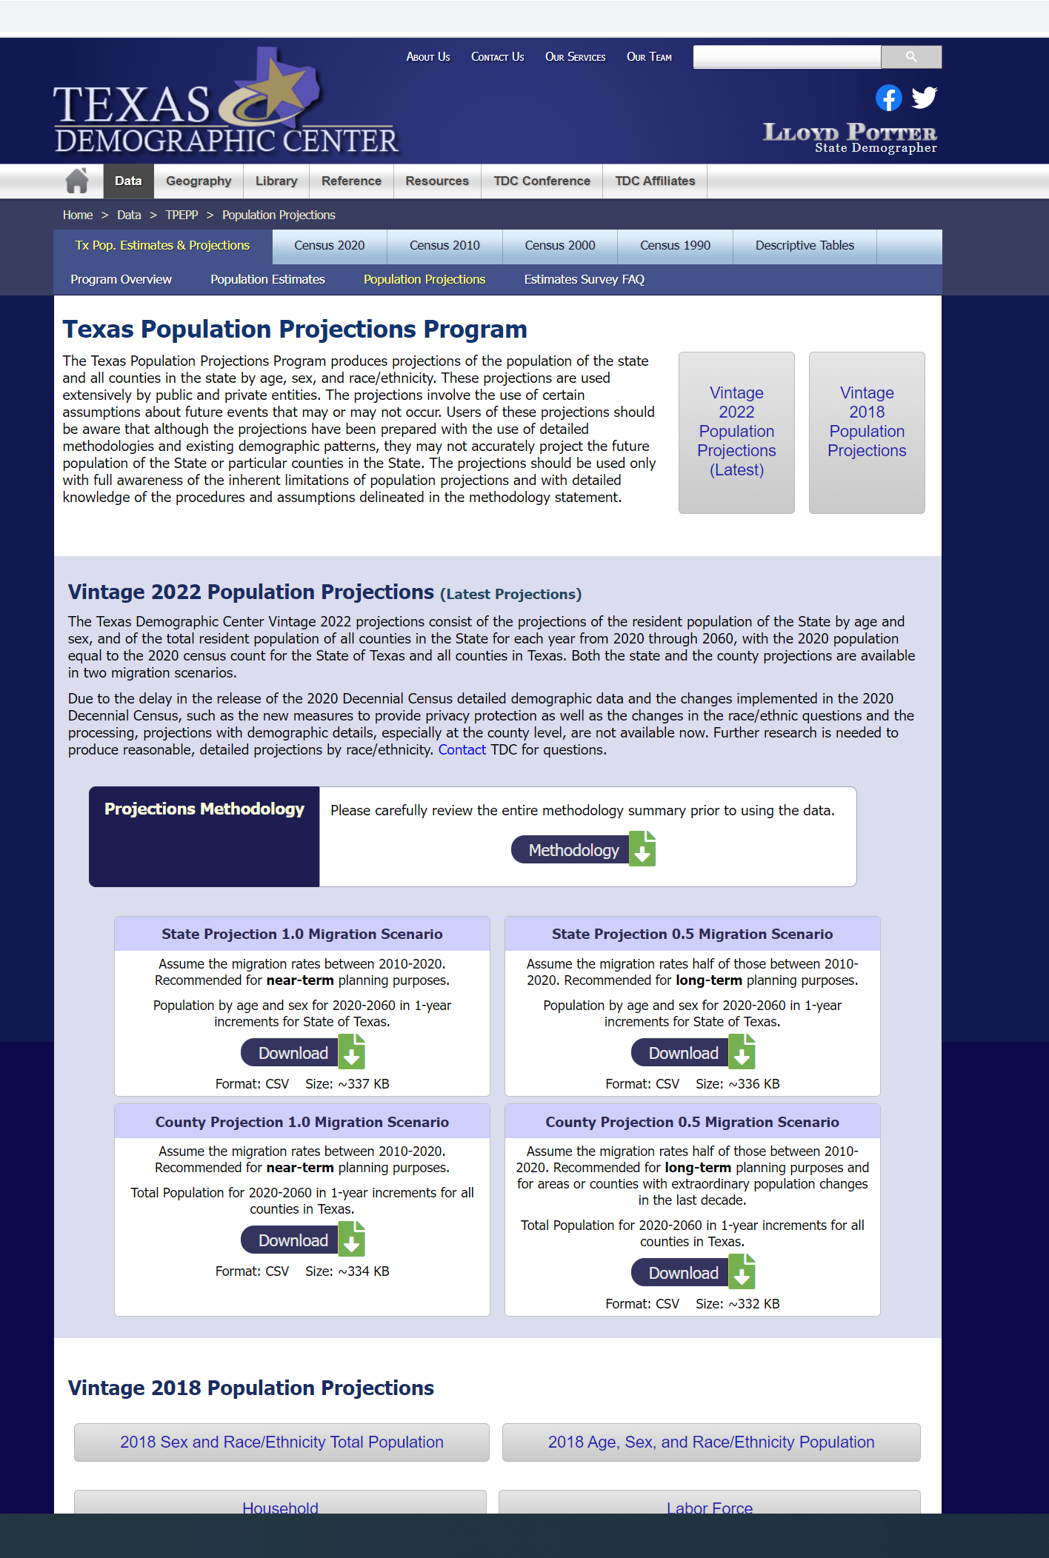
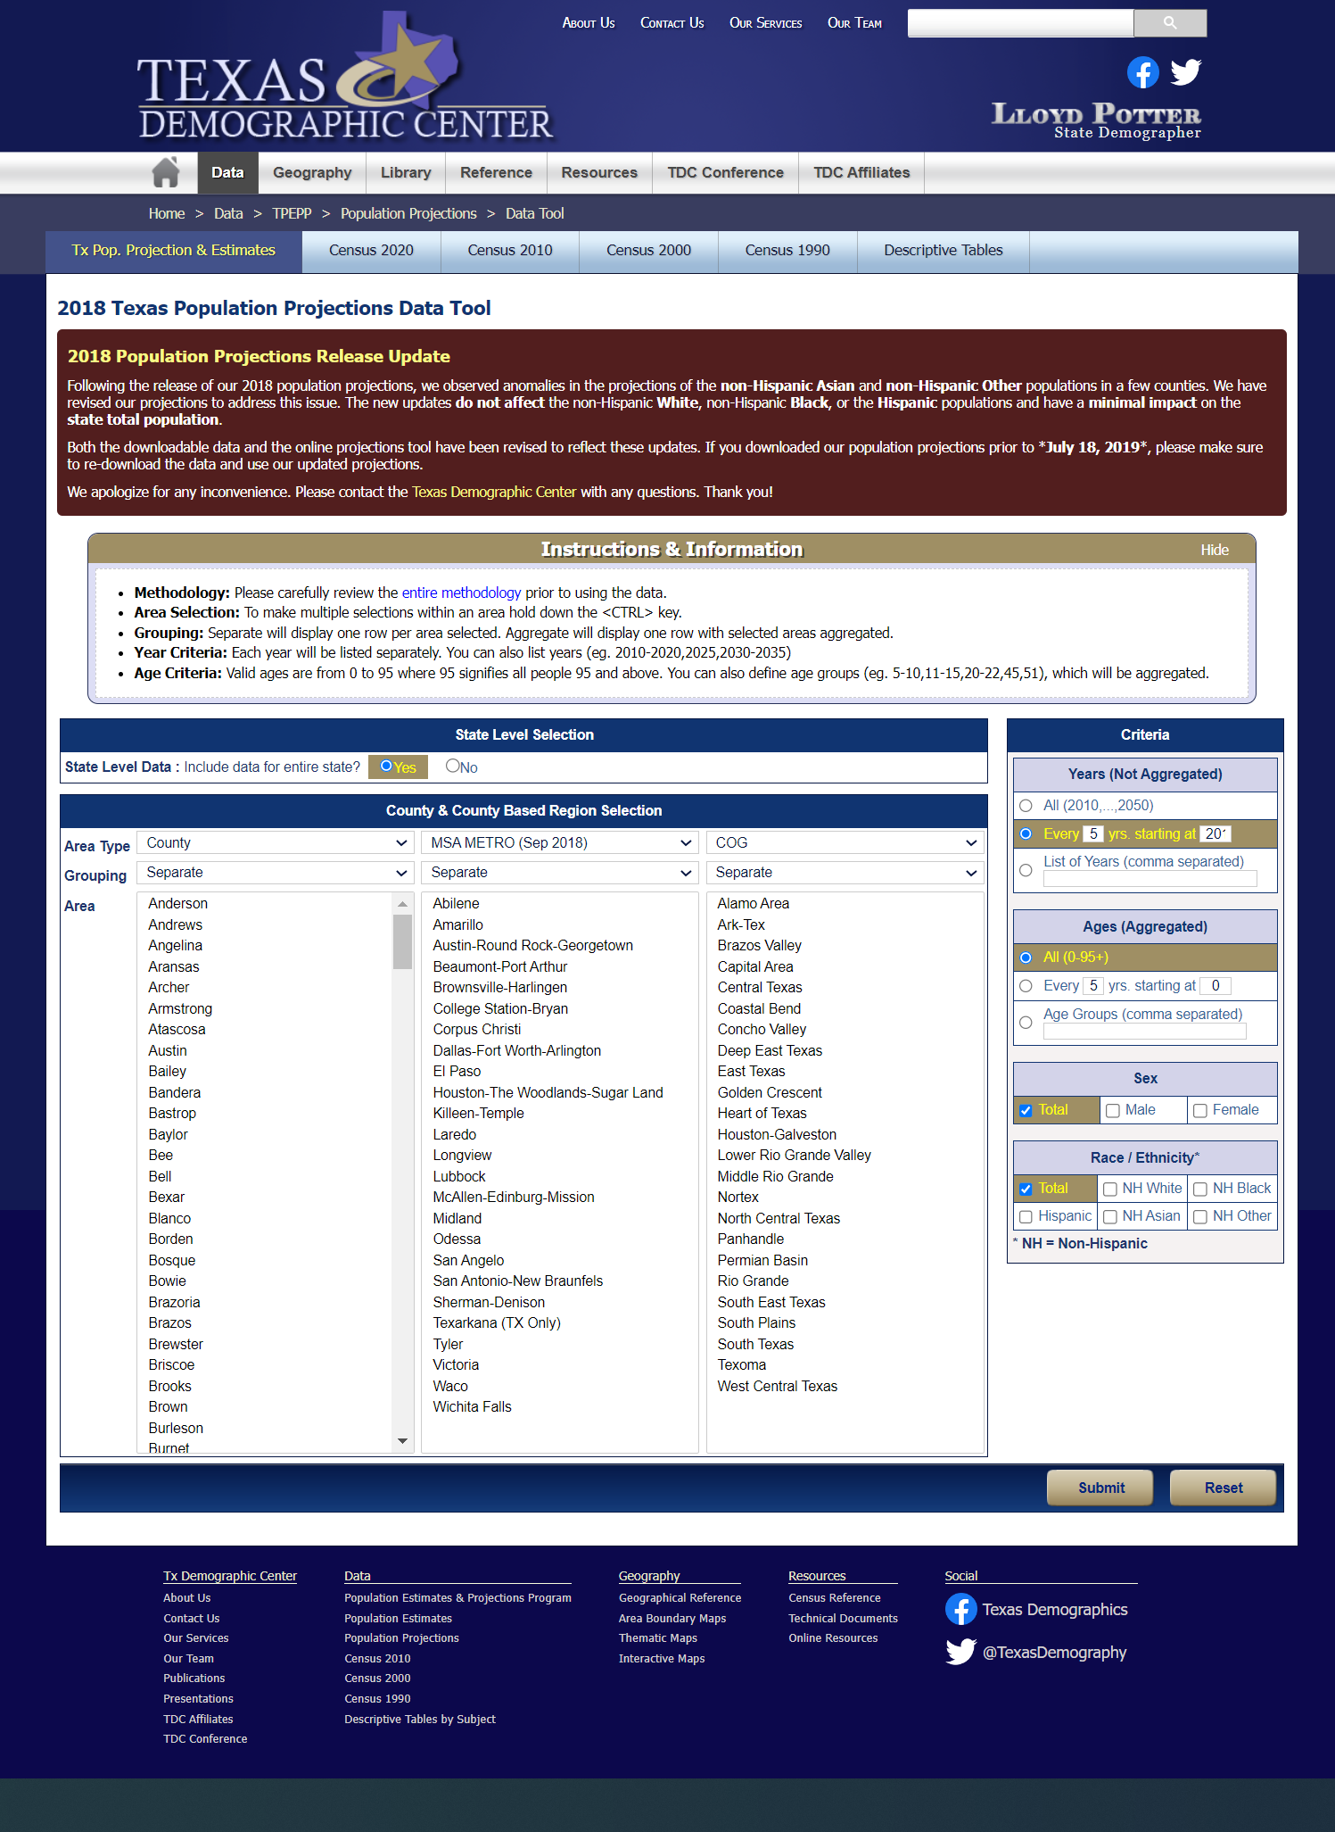
Access TDC Projections Data, V2018 and V2022
Customized tables available for V2018 TDC projections
Source: Texas Demographic. https://idser.maps.arcgis.com/apps/MapSeries/index.html?appid=88493fab762141d7b5a28d3430ab1ca8

Slide 18
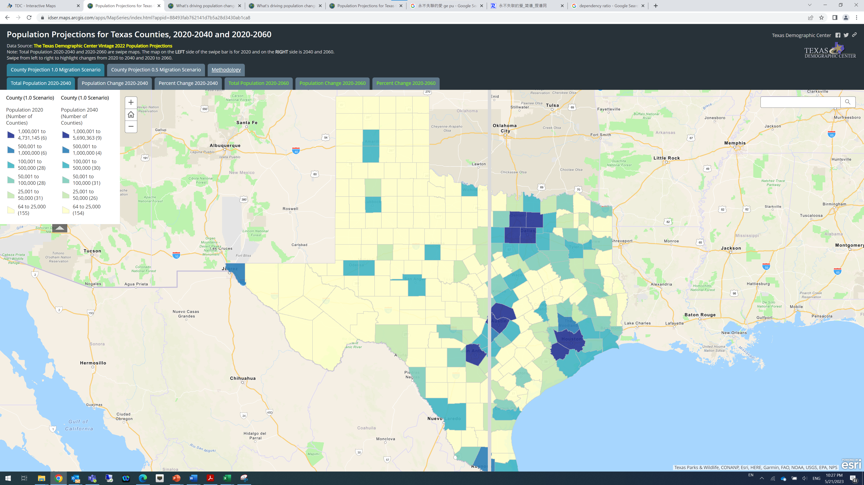
Swipe Maps for TDC Projections
Source: Texas Demographic Center Vintage 2022 Population Projections. https://idser.maps.arcgis.com/apps/MapSeries/index.html?appid=88493fab762141d7b5a28d3430ab1ca8

Slide 19
Frequently Asked Questions
Why is your estimate different from your projection for the same year? Which one should I use?
What are migration scenarios?
Why is the projection for my county lower at 1.0 migration scenario than that at the 0.5 migration scenario?
Why did my county grow in the last decade but projected to decline in the future?
Why is my county projected to grow more slowly than a county that saw similar growth rate with us in the last decade?
….

Slide 20
Challenges in the New Decade
Delays and possible undercounts (for Texas) in the 2020 Decennial Census.
Changes in the public data released by the Census Bureau.
  “Differential privacy (noises)” and the “adaptive design” (varying population threshold for publication);
  “Impossible/improbable” values, parts not adding up to totals, inconsistencies between datasets;
  Base (2020) population for the Census Bureau estimates can change
Challenges in data collections.
Communications and outreach to data users

Slide 21





Helen You, Ph.D.
(210) 458-6530
TDC@UTSA.edu
Demographics.Texas.gov
@TexasDemography

