Slide 1
Population Estimates from the U.S. Census Bureau
Kevin Barragan-Smith
Demographer
Estimates & Projections Area
Population Division
Texas Demographic Conference 2023 Annual Meeting
Austin, TX
May 24, 2023
This presentation is released to inform interested parties of ongoing research and to encourage discussion of work in progress. Any opinions and conclusions expressed herein are those of the author(s) and do not reflect the views of the U.S. Census Bureau.

Slide 2
Overview of Presentation
  What we mean by “estimates”
  Why we disseminate estimates
  How estimates are made
  When estimates products are available
  Where estimates products can be accessed
  Where to learn more
  Questions

Slide 3
What We Mean by “Estimates”
“Estimates” are the official measures of population and housing units between censuses
Population Estimates Program (PEP) estimates are:
  Based on date of the previous decennial census
  Produced primarily using administrative records data on components of change, such as births, deaths, and migration
  Typically made for prior dates with some short-term projections
  Include annual data for July 1 each year
  Include monthly estimates at the national level

Slide 4
Why We Disseminate Estimates
Federal Mandate
(U.S.C. Title 13)
Allocation of
federal funds
Program planning for
public and private
services
Controls for
federal surveys
4

Slide 5
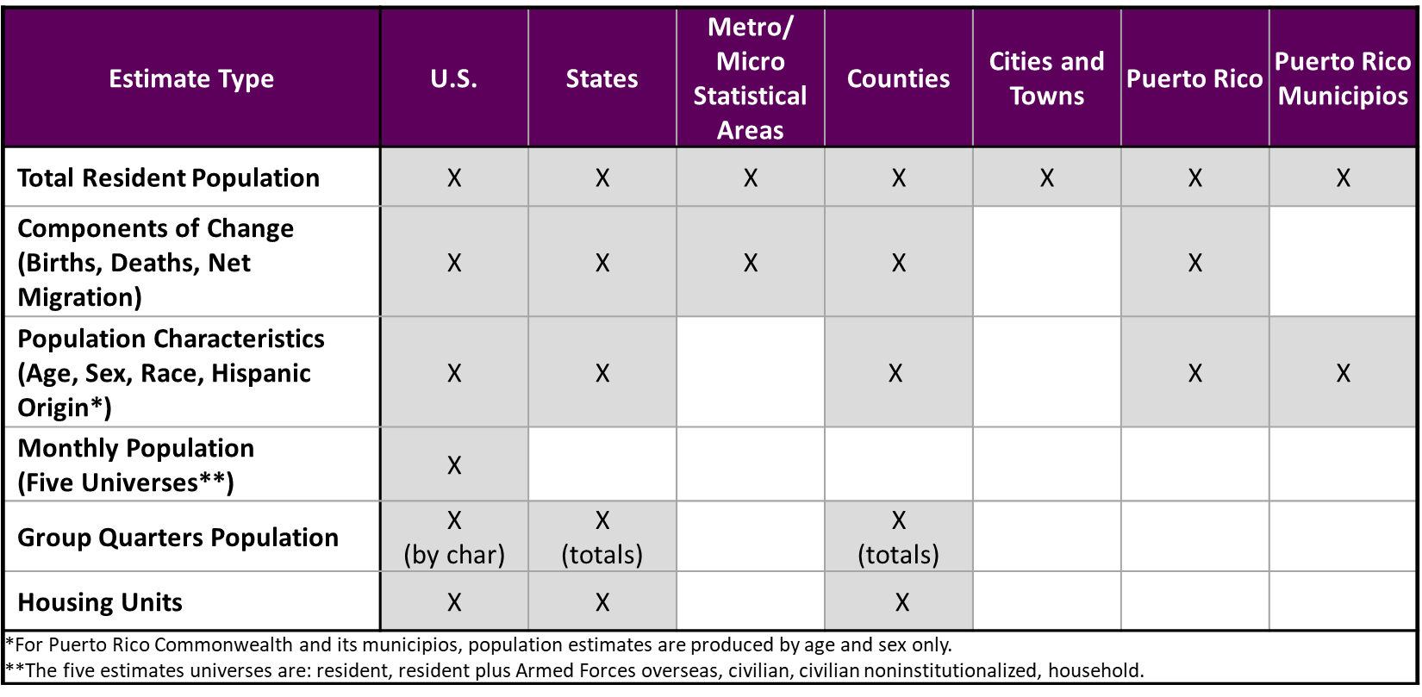
Population and Housing Unit Estimates by Type and Geography

Slide 6
Estimates Methodology
National, state, and county populations
  Cohort-component method
Population Base
Births
Deaths
Net Migration
Population Estimate
Cohort-component method measures population change since the last census using the most current administrative records on births, deaths, and migration
Population base represents the date of the latest decennial census

Slide 7
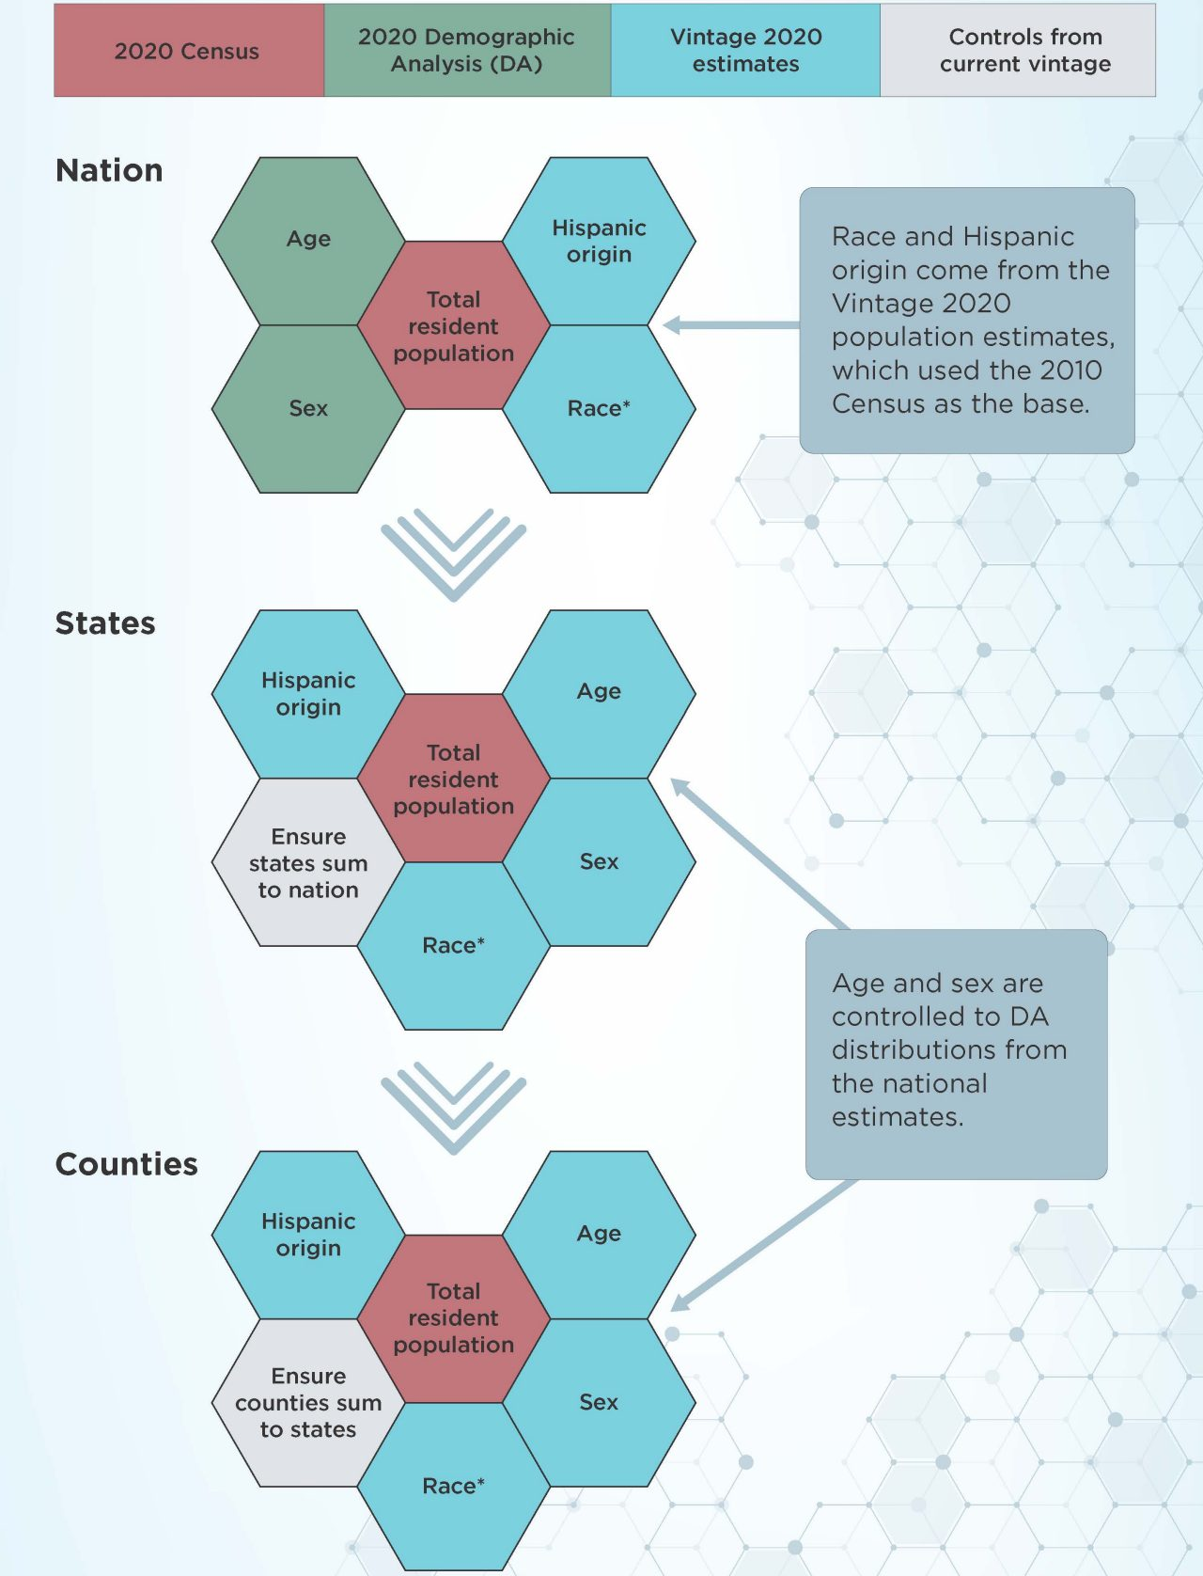
Blended Base Approach

Slide 8
Estimates Methodology (cont.)
Subcounty population (cities and towns)
  Distributive housing unit method
Initial Household Population Estimate
Housing Unit Estimate
Household Population Base (from 2020 Census)
Housing Unit Base (from 2020 Census)
Resident Population Estimate
Initial Household Population Estimate
County Household
Rake Factor
Group Quarters Population

Slide 9
Availability of Vintage 2022 Population and Housing Unit Data Products
census.gov/programs-surveys/popest/about/schedule.html
Release Date | Product | Geography
December 22, 2022 | Population totals, components of change, and voting-age population | Nation, states, and Puerto Rico Commonwealth
March 30, 2023* | Population totals and components of change | Counties, and Puerto Rico municipios
April 13, 2023* | Population by age and sex | Nation
May 18, 2023* | Population totals-- Housing unit totals-- | Cities and towns (incorporated places, minor civil divisions), and metropolitan/micropolitan areas Nation, states, and counties
June 22, 2023* | Population by age, sex, race, and Hispanic origin-- Population by age and sex-- | Nation, states, and counties Puerto Rico Commonwealth and municipios
*Embargoed Release
9

Slide 10
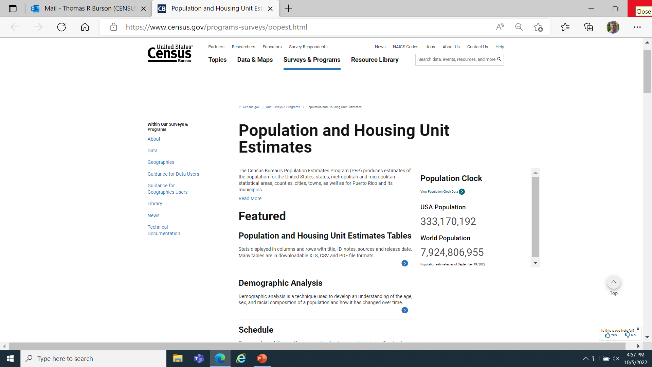
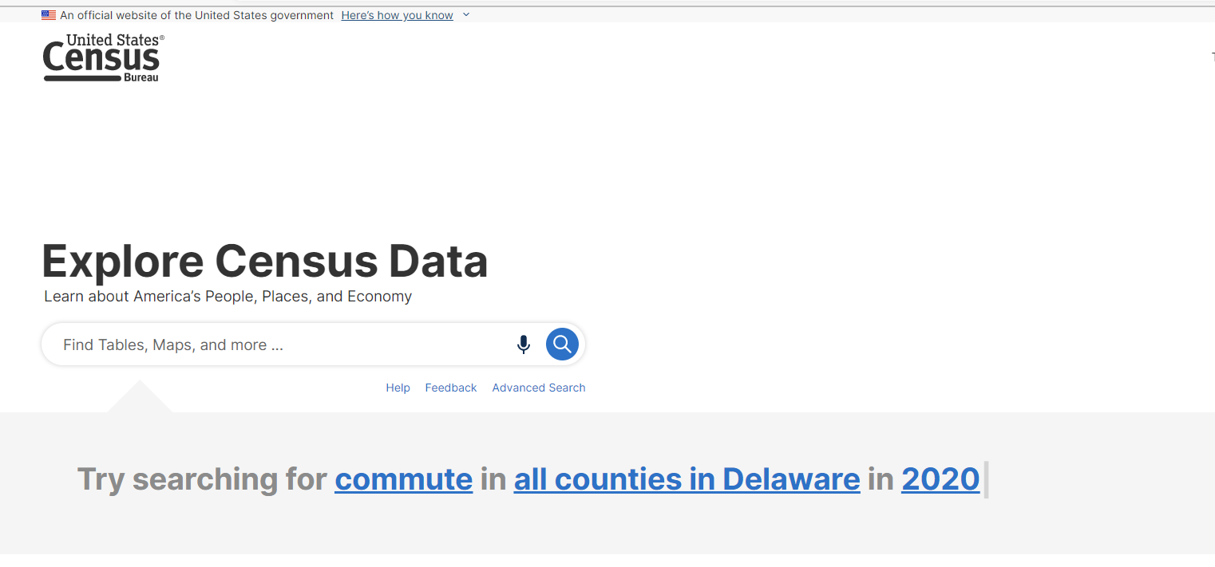
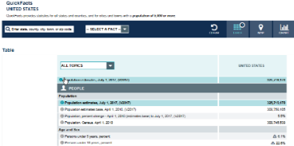
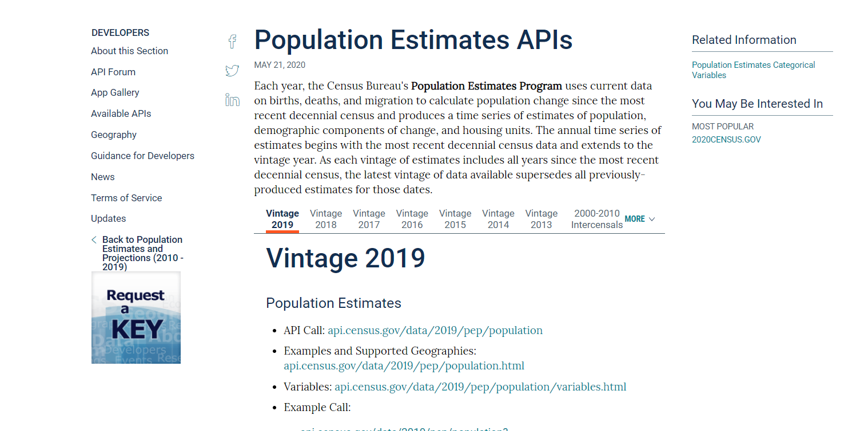
Ways to Access Estimates
PEP Webpage:
census.gov/programs-surveys/popest.html
data.census.gov
QuickFacts
Application Programming Interface (API)

Slide 11
Accessing Vintage 2022 Estimates
census.gov/programs-surveys/popest.html

Slide 12
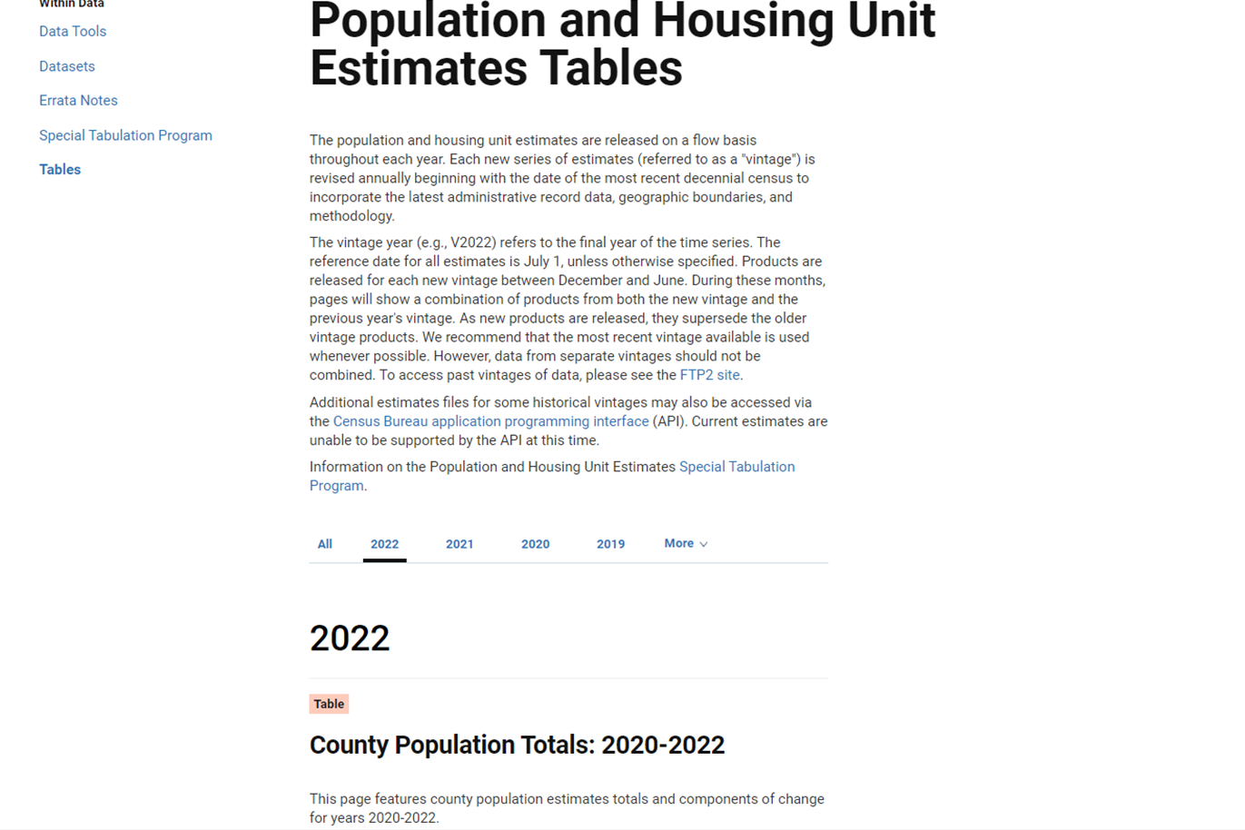
Accessing Vintage 2022 Estimates (cont.)

Slide 13
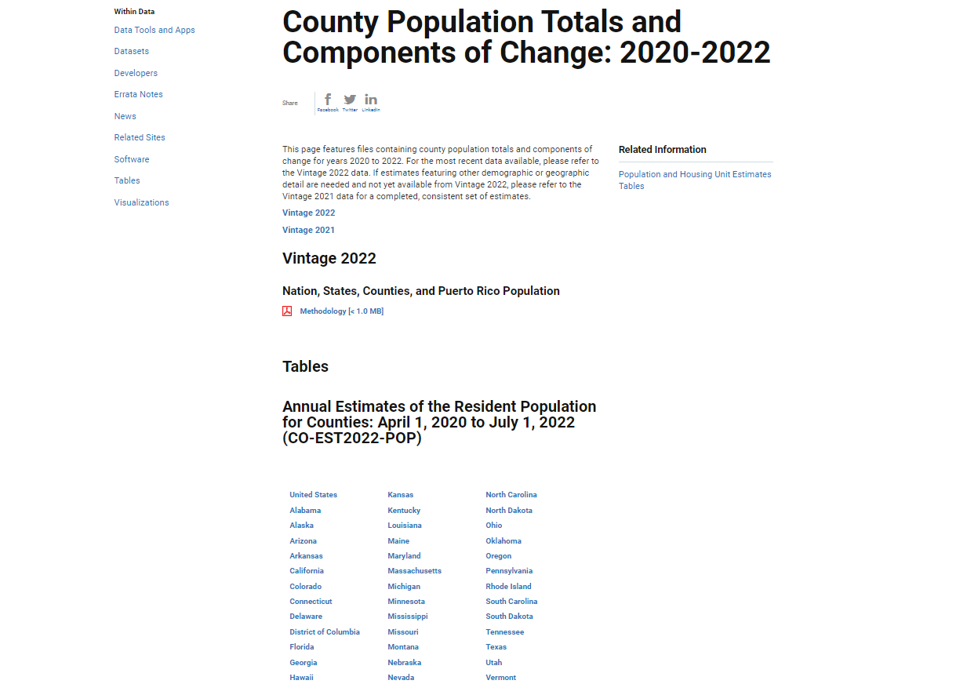
Accessing Vintage 2022 Estimates (cont.)

Slide 14
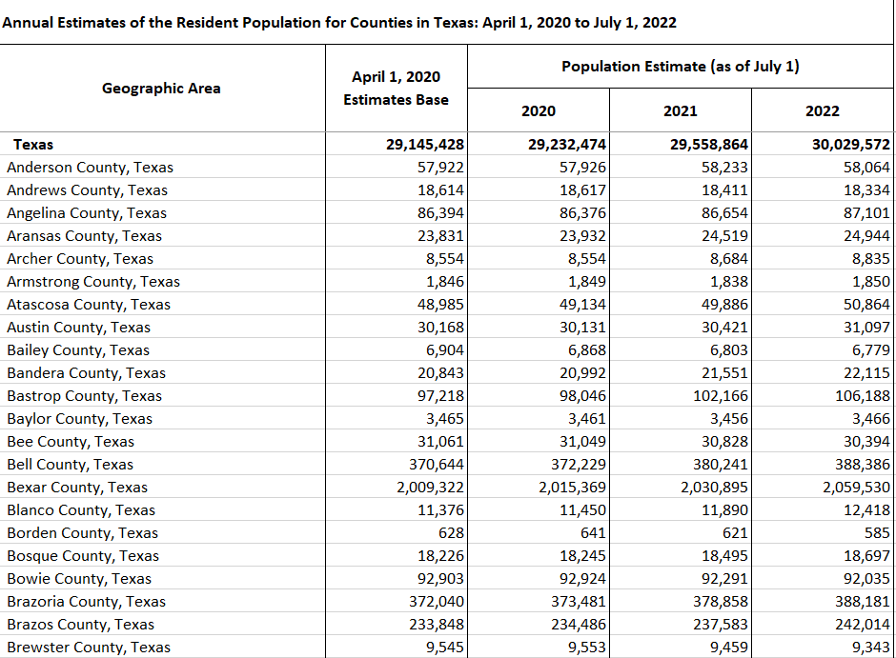
Accessing Vintage 2022 Estimates (cont.)
14

Slide 15
Accessing Vintage 2021 Estimates
census.gov/programs-surveys/popest.html

Slide 16
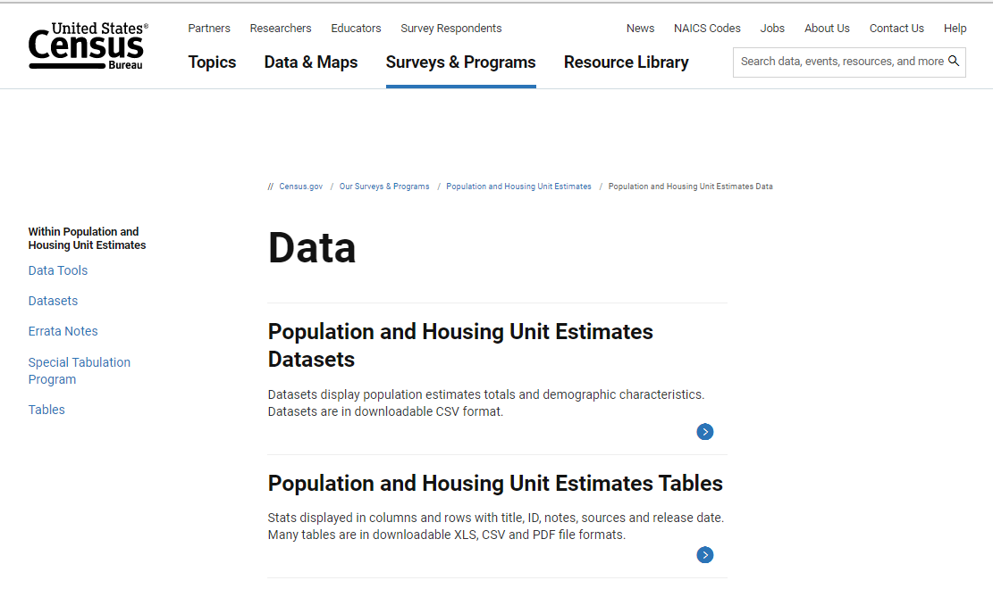
Accessing Vintage 2021 Estimates (cont.)
census.gov/programs-surveys/popest.html

Slide 17
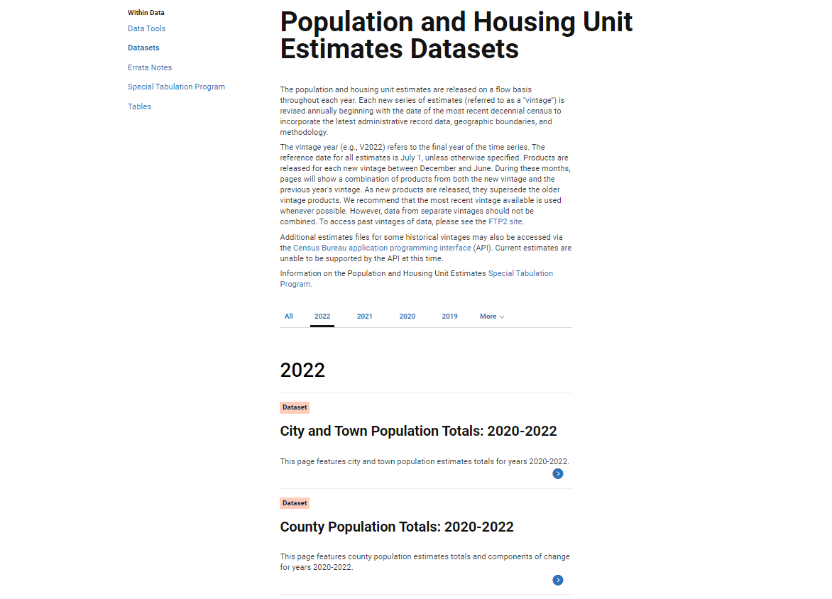
Accessing Vintage 2021 Estimates (cont.)

Slide 18
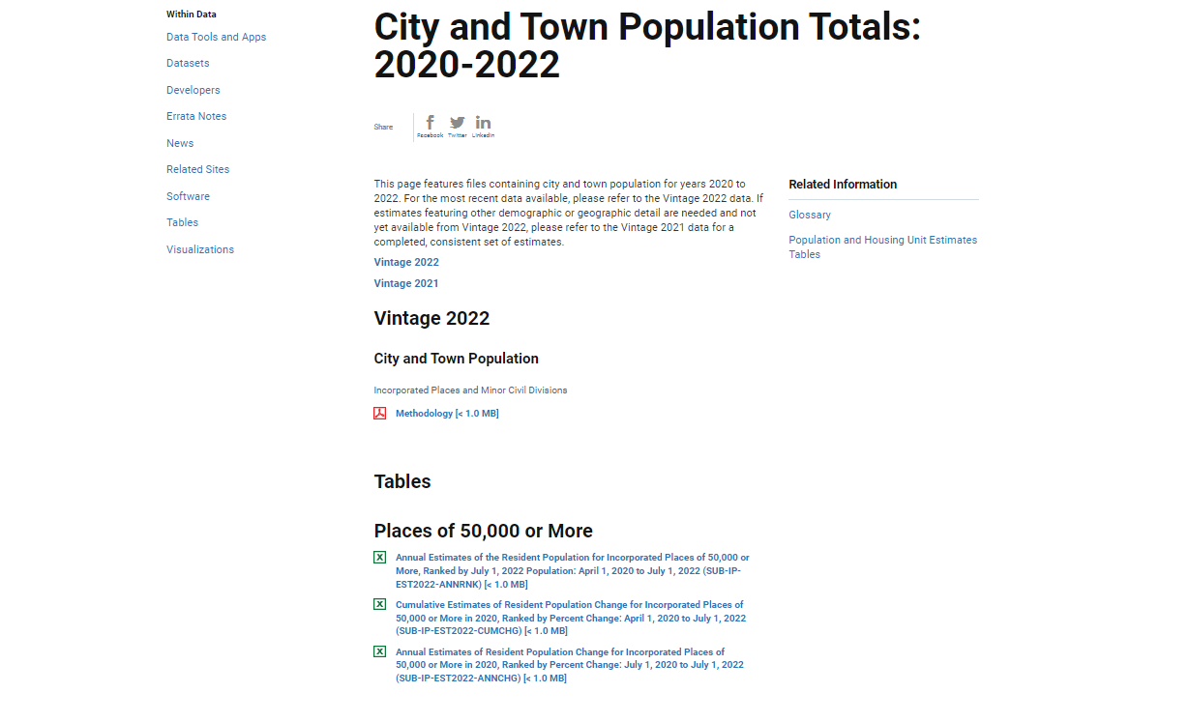
Accessing Vintage 2021 Estimates (cont.)

Slide 19
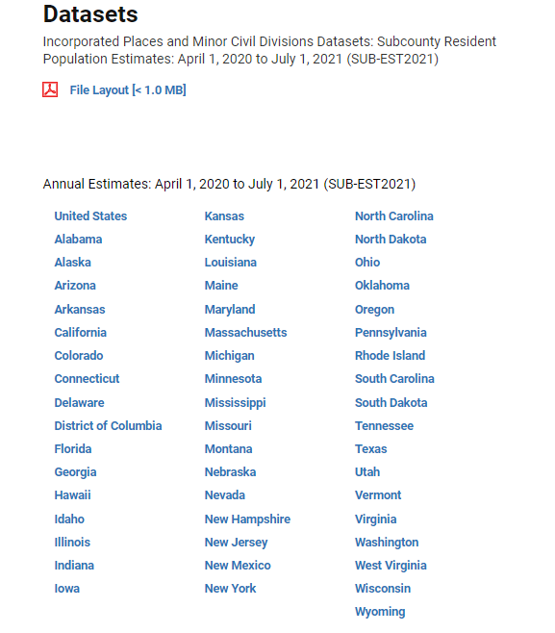
Accessing Vintage 2021 Estimates (cont.)

Slide 20
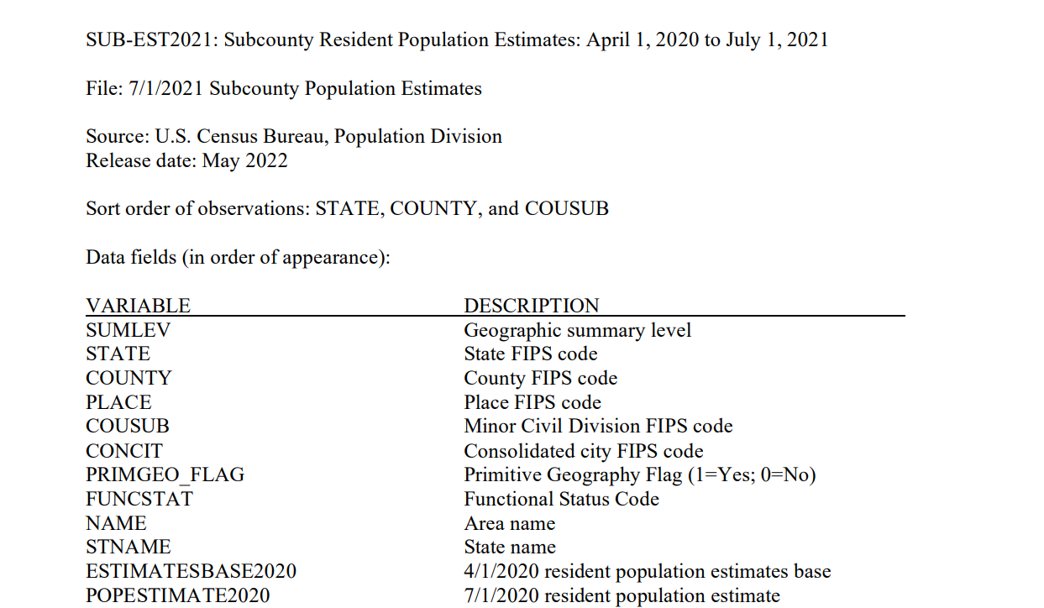
Accessing Vintage 2021 Estimates (cont.)

Slide 21
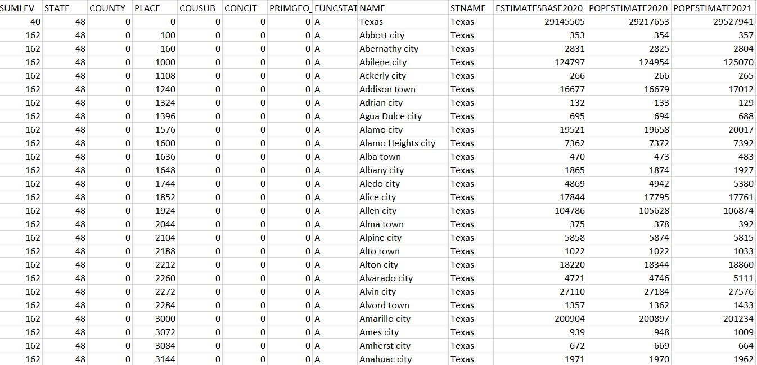
Accessing Vintage 2021 Estimates (cont.)

Slide 22
Accuracy of the Estimates
Average Absolute Percent Differences between Resident Population Estimates and Census Counts: April 1, 2010 and 2020
2010
Nation
0.1%
States
1.0%
Counties
3.1%
Cities and Towns
11.0%
2020
Nation
0.6%
States
1.2%
Counties
2.9%
Cities and Towns
TBD
22

Slide 23
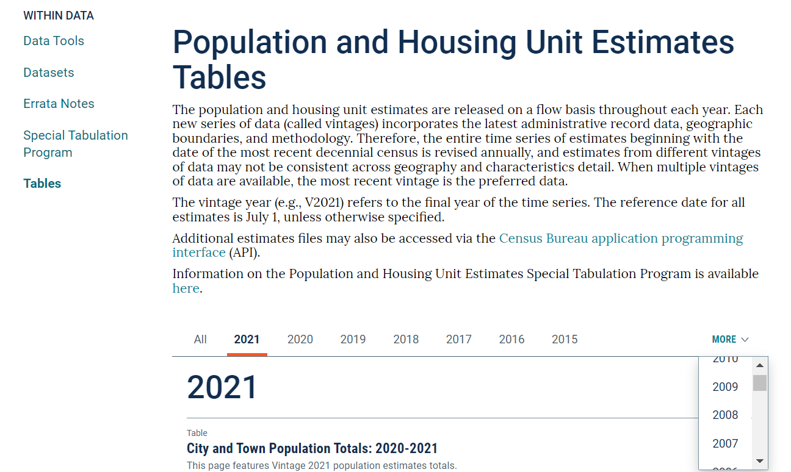
Accessing Intercensal Estimates
23

Slide 24
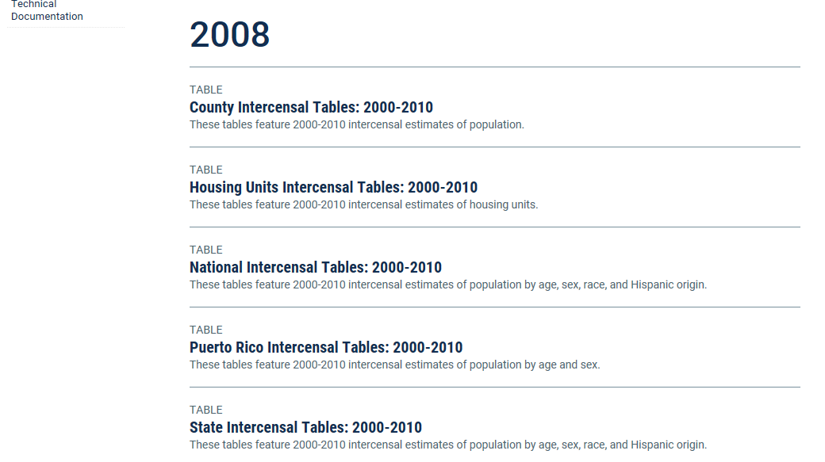
Accessing Intercensal Estimates (cont.)
24

Slide 25
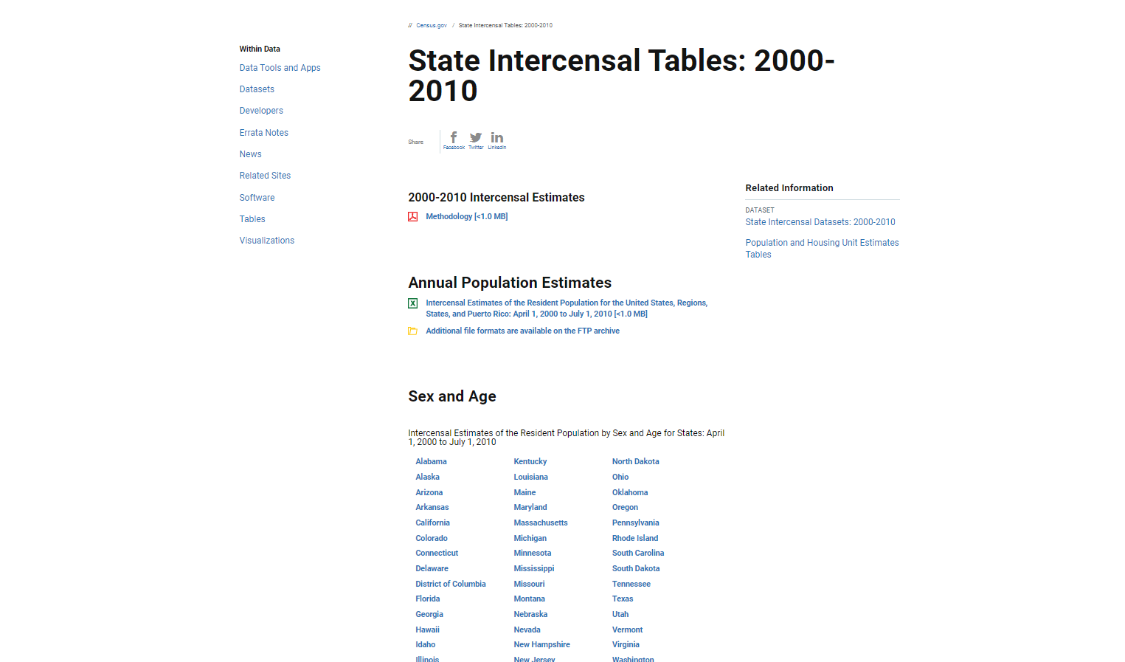

Accessing Intercensal Estimates (cont.)
25

Slide 26
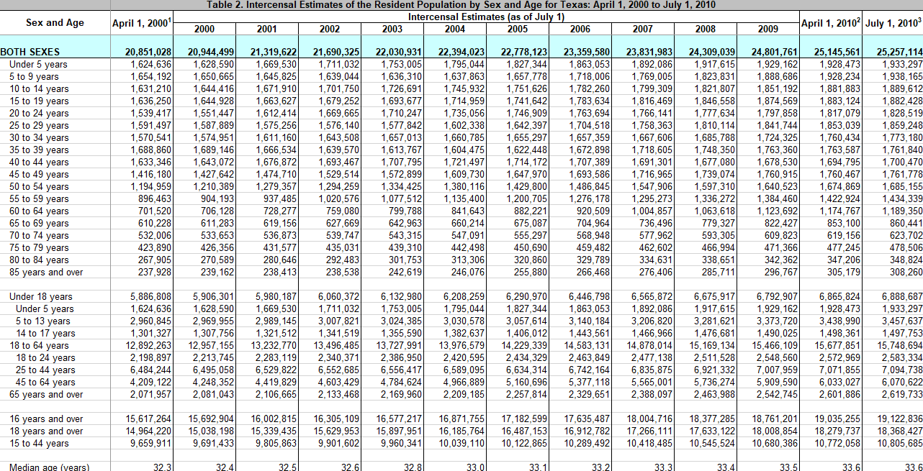
Accessing Intercensal Estimates (cont.)
26

Slide 27
Where to Learn More About Estimates and Projections
Coordination, Dissemination, & Outreach Branch (301-763-2110/pop.cdob@census.gov)
  Catalogue of estimates and projections products
  Product release schedule
  Special tabulations
  Website questions
Population Estimates Branch
  Estimates of total population and components of change
  Estimates of population by age, sex, race, and Hispanic origin
  Estimates of military and group quarters populations
International Migration Branch
  Estimates of international migration
  Puerto Rico estimates

Slide 28
Where to Learn More About Estimates and Projections (cont.)
Local Government Estimates & Migration Processing Branch
  Estimates of population for subcounty places (cities and towns)
  Estimates of housing units
  Estimates of domestic migration
  The Population Estimates Challenge Program (pop.challenge@census.gov)
  Special Census information
Population Evaluation, Analysis, & Projections Branch
  Projections of population and components of change for the U.S.
  Demographic Analysis
  Evaluation Estimates and Modified Race research
Base Evaluation and Research Team (pop.bert@census.gov)
  Changes/improvements to the estimates base
  Feasibility of taking coverage measures from the 2020 Demographic Analysis, 2020 Post-Enumeration Survey, and other administrative records into account in the development of the official population estimates

Slide 29


For More Information Contact
Kevin Barragan-Smith
Demographer
Coordination, Dissemination, and Outreach Branch
Population Division
301-763-5940
kevin.barragan-smith@census.gov

Slide 30

Questions
Thank You!

