Slide 1
An Introduction to the
Texas Open Data Portal
Stacey Lewis
ODP Administrator

Slide 2
Statewide Data Program
Through leadership and collaboration,
the Office of the Chief Data Officer establishes
the statewide data management strategic direction
and best practices for our community of customers.
Data Management
Data
Sharing
Data
Analytics
Open & Closed
Data Portals
Data
Literacy

Slide 3
Evolution of the Texas Open Data Portal
2015
2017
2019
2021
HB 1912​
Statewide Data Coordinator​
SB 79
Public Information Requests, Publicly Accessible Website
SB 819
Chief Data Officer
Central Repository
for Publicly Accessible Electronic Data
SB 475​
Designated Data Management Officer​
Required Publishing on Texas Open Data Portal (ODP)

Slide 4
Defining High Value
  Texas Government Code 2054.1265: 82nd Leg. (R), Senate Bill 701 (2011)
  “…information that can be used to
  increase state agency accountability and responsiveness,
  improve public knowledge of the agency and its operations,
  further the core mission of the agency,
  create economic opportunity, or
  respond to need and demand as identified through public consultation.”

Slide 5
Open Data and the ODP
What is Open Data?
Intended ODP Use
  Information that can be freely used, re-used, and redistributed by anyone
  Excludes sensitive or regulated data
  Public resource offering value:
    Economic: Encourages innovation in products and services​
    Performance: Improving quality and efficiency of government programs​
    Social: Increasing citizen participation in government
  Data sharing platform of open data assets
    High Value Datasets
    Raw
    Tabular
    Structured
    Machine readable formats (.csv, .tsv, .json)
Unintended ODP Use
  Not a document library or archive
    Documents
    Archival information
    Unstructured
    Non-machine-readable formats (.doc, .pdf)

Slide 6


Open Data Sharing Environment
Texas Open Data Portal
(ODP)
Public
Agency Open Data
Self-serve Public Information Requests
Research
Community Engagement

Slide 7
Open Data Portal Usage by Fiscal Year
FY 2023 data current as of 05/01/2023

Slide 8
Publishing Agencies = 31
Office of the Governor
Office of the Texas Attorney General
Public Utility Commission of Texas
Railroad Commission of Texas
Texas Alcoholic Beverage Commission
Texas Bond Review Board
Texas Commission on Environmental Quality
Texas Commission on the Arts
Texas Comptroller of Public Accounts
Texas Department of Agriculture
Texas Department of Banking
Texas Department of Criminal Justice
Texas Department of Family and Protective Services
Texas Department of Housing and Community Affairs
Texas Department of Information Resources
Texas Department of Insurance
Texas Department of Licensing and Regulation
Texas Department of Motor Vehicles
Texas Department of Transportation
Texas Education Agency
Texas Health and Human Services Commission
Texas Historical Commission
Texas Juvenile Justice Department
Texas Lottery Commission
Texas Medical Board
Texas Parks and Wildlife Department
Texas Racing Commission
Texas Real Estate Commission
Texas Secretary of State
Texas Veterans Commission
Texas Workforce Commission
Data as of 05/01/2023

Slide 9
Value and Opportunity FY 2023
Assumptions
State Employee Salary = $48,643 ($23.39/hour)
Time to Complete PIR = 3 hours
Average Cost to Complete PIR= $70
What if 50%, 30% or 10% of visits &
downloads were a result of PIR redirects?
Formulas
$ = (Visits + Downloads) x Hourly Rate x Time x %
Time = (Visits + Downloads) x Time x %
​
Opportunity
In Dollars
50% = $13.2M
30% = $7.9M
10% = $2.7M
In Hours
50% = 565K
30% = 339K
10% = 113K
​
Total Visits and Downloads
376,445
Data as of 05/01/2023

Slide 10
Why the Open Data Portal?
“The benefits of the BRB establishing a presence on the Data Portal include increased availability of state and local debt data to the general public, state leadership, and bond finance community as well as increased communication with customers, decreased agency administrative costs, and improved agency efficiency such that maximum results are produced with a minimum waste of staff resources.”
Justin Groll
Director of Finance
Texas Bond Review Board

Slide 11
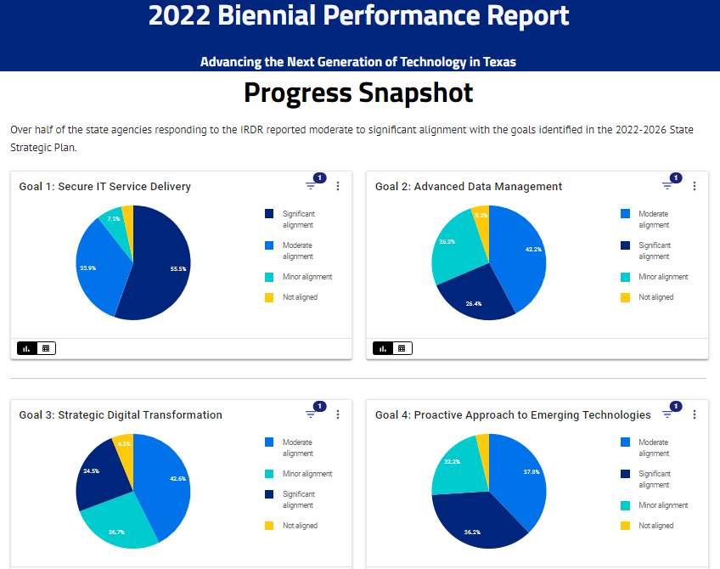
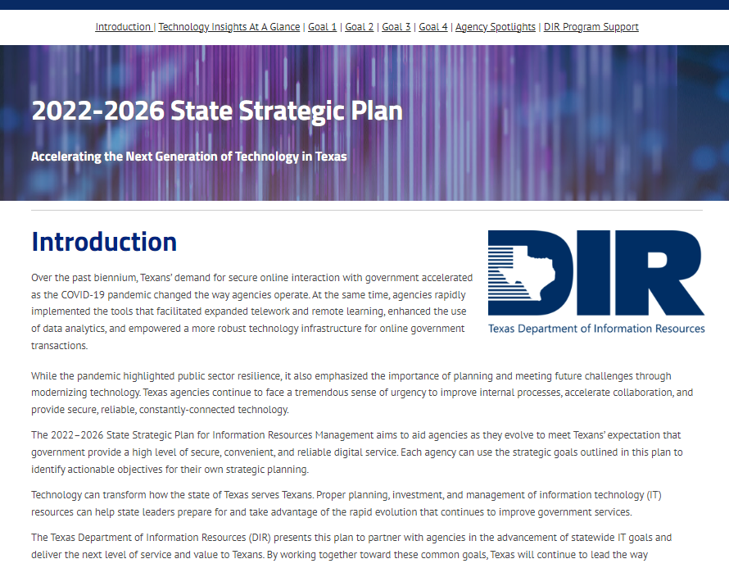
“Using the ODP story pages has transformed the way Texans can access public reports.
We first published the 2020 Biennial Performance Report and liked it so much that we did the same with the Digital Transformation Guide in 2021. It’s nice to be able to quickly navigate to topics of interest, whether using a computer or mobile device, and then drill down further to see the data.
It not only saves on printing costs but provides a better customer experience.”
Elizabeth Cooper, Director
Technology Planning, Policy, & Governance
Department of Information Resources

Slide 12

“Internal customers save time with self-serve, anytime access. Requesters spend less time formulating requests and other staff have fewer data reports they have to provide.
The same benefits apply to the school, state agency, and non-profit partners. Directly accessing data instead of submitting a PIR streamlines their work and gives them access to more data. Partners can be more nimble in their decision making. More data means more options for finding needs and opportunities for community impact.”
Cassandra Delgado-Reyes, Data Analyst
Food and Nutrition Division
Texas Department of Agriculture

Slide 13
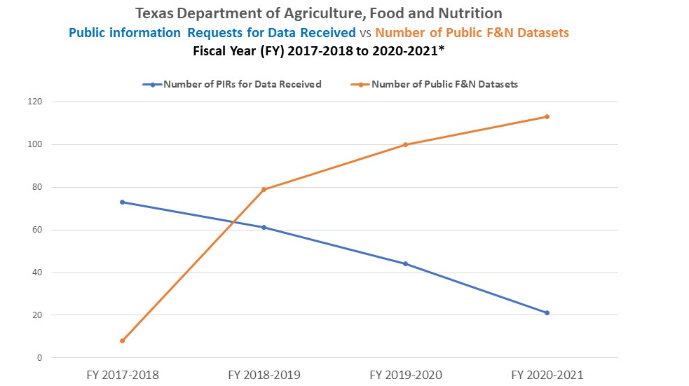

Slide 14
ODP Value = YOUR Opportunity
Data Consumer
Publishing Agency
  Access to Open Data
  On-Demand
  Ability to Establish Account Profile to Save Filtered Views
  Reduction of Public Information Requests
  Insights to Agency
  Open Data Utilization
  Visibility for Executive/
  Management Teams
  Reduction of Public Information Requests

Slide 15
ODP Demonstration

Slide 16



OCDO Resources
Texas Data Portals Resource Guide
data.texas.gov
DIR YouTube Channel
youtube.com/texasdir
OCDO@dir.texas.gov
Email

Slide 17
Thank You
stacey.lewis@dir.texas.gov
OCDO@dir.texas.gov

