Slide 1



Economic Census Overview
Austin, TX
May 2023
Nidaal Jubran– U.S. Census Bureau
Supervisory Survey Statistician, Data User and Trade Outreach Branch
2022 Economic Census Overview

Slide 2

Agenda
Economic Census overview
Response Promotion
Census Data Tools
Census Data and Texas
Q & A
Economic Census Overview | May 2023 | 2
Notes:
Good Afternoon, and thank you for being here with me. Today I am going to provide a Census briefing, which will start with an Economic Census Overview, a discussion on Census Data Tools, Response Promotion, and then we will wrap it up with Q&A.

Slide 3

Economic Census Overview

Slide 4



The Census Bureau measures more than people
Most people know that the U.S. Census Bureau measures the population every 10 years.
But most people don’t know that we also measure the economy.
  In fact, the Census Bureau conducts more than 70 economic surveys each year.
This includes the Economic Census which measures all U.S. businesses every 5 years.
U.S. Census Bureau Partner Briefing | 4
Economic Census Overview | May 2023 | 4
Notes:
So when most people think of the Census, what comes to mind is usually the 10-year population count. While this is very important, it’s just a small part of what we do. We also measure the economy, with more than 70 economic surveys each year.
This includes the Economic Census, which measures all U.S. businesses every 5 years.

Slide 5
The Economic Census
The official measure of U.S. business and the economy
Conducted every five years – for years ending in ”2” and “7”
The 2022 Economic Census is now underway.
  Companies report their 2022 year-end numbers.
Response due date was March 15, 2023 – companies who have not yet responded can file for an extension.
Responses are strictly confidential. Company data is used for statistical purposes only.
  The Census Bureau is required by law to keep information provided private and secure.
Response is required by law.
U.S. Census Bureau Partner Briefing | 5
Economic Census Overview | May 2023 | 5
Notes:
The Economic Census is a mandatory survey that is conducted every 5 years, in the years ending in 2 and 7, and is our most comprehensive source for business data.
Companies report their 2022 year-end numbers
The response due date was March 15, 2023, but it’s not too late to respond to the Census if you’ve received an invitation. You can do so but filing for an extension.
Responses are confidential and data is used for statistical purposes only.

Slide 6
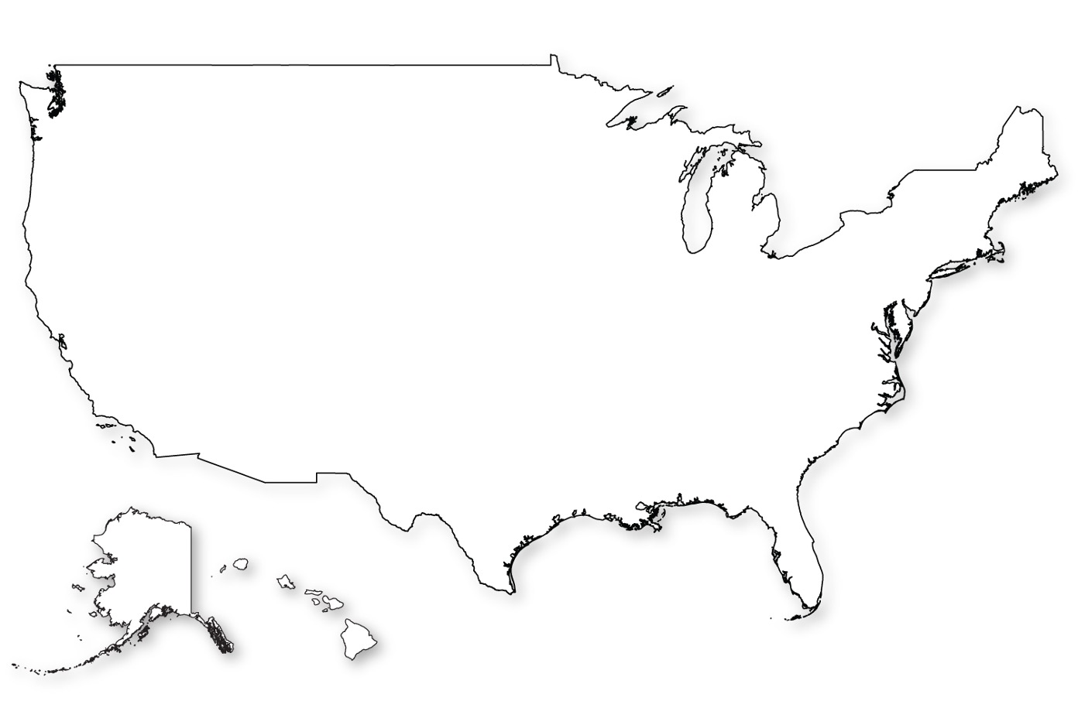
Note: Most companies do not receive the Economic Census
There are more than
~ 30 million businesses in the United States
Only businesses with employees, and
Only a sample of smaller businesses are required to respond.
~ 8 million are employer business establishments
~ 4 million receive the Economic Census
Economic Census Overview | May 2023 | 6
Notes:
I do want to note one thing – not EVERY business in the US will have received the 2022 Economic Census.
The Economic Census only goes to employer businesses, meaning those businesses with paid employees. We have a separate program for statistics for businesses without employees – like independent contractors or people who are self-employed, on a more frequent basis. It is called“Non- Employer Statistics” because they are not employers. And also some industries are excluded from the Economic Census because that data is collected from other federal agencies – for example agriculture and education.
Data from over eight million employer business locations are represented in the Economic Census, but to reduce burden on the business community, not every business is contacted. Approximately four million business locations receive letters requesting their response, and for the remaining four million small businesses, administrative records are used in lieu of direct reporting.

Slide 7
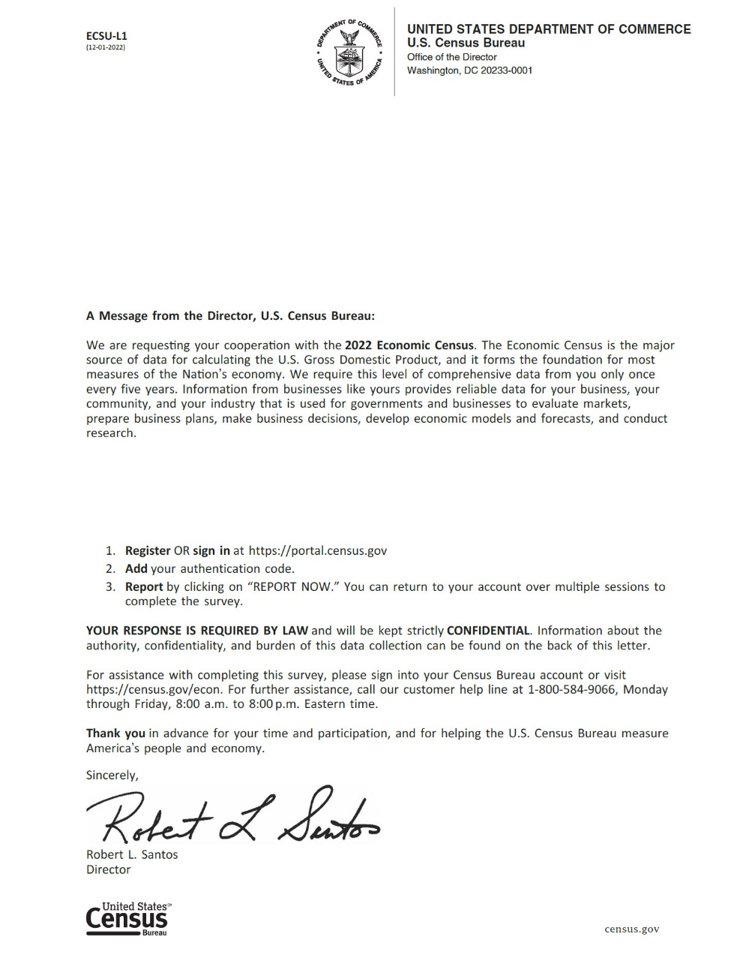
Economic Census Mailout
Official letters were mailed out January 31.
  Letters included unique authentication codes for companies to access survey online.
Respondents are instructed to set up an online account on secure website to complete survey.
  Similar to other online accounts with email username, password, security questions
  Response URL is portal.census.gov
  Businesses can log in to request a time extension.
Help is available online and via telephone.
Due date March 15. Nonresponse follow-up is underway.the Economic Census are free and available to guide business decisions and policy-making
Economic Census Overview | May 2023 | 7
Notes:
Speaking of letters,
The official letters started to mail on January 31st and continued on into the first two weeks of February. These letters contain a one-time use authentication code that is unique to the company to access their survey online. If respondents already have an account to complete Census Bureau economic surveys through our secure website, they can log in and add their authentication code to add this survey to their account. And if respondents don’t already have an account, they will need to create an account. Similar to other online accounts we’ve all been asked to create, with an email username, create a unique password, and set security questions in case the password you created was too unique for you to remember and need to reset it later.
All of this is done by going to portal.census.gov. That is also where businesses can go to grant themselves a time extension. BUT that option is going away soon. Businesses will only be able to get an extension until May 30th, and then at that time they will start receiving our follow-up communications.
Help responding to the survey is available online in the portal (with FAQs and sending a secure message), and within the questionnaire. Help is also available by calling the customer help line phone number on the letter, Monday-Friday 8am-8pm Eastern time.

Slide 8

Information Required
The Economic Census asks for the following information for each business location:
Employer Identification Number
Physical location
Primary business activity
Sales, receipts, or revenue
Employment and payroll
Industry-specific questions
  Different versions of the Census for each industry
Economic Census Overview | March 2023 | 8
Economic Census Overview | May 2023 | 8
Notes:
One of the things that makes the Economic Census different from most other surveys is that it collects information for each business location. This is how we are able to provide summary statistics for counties and even cities. Let’s go through the information that is required.
-An employer identification number, or EIN.
-A physical location if it is different than the mailing address and verify your EIN.
-You will need to select the primary business activity, the sales/receipts or revenue and employment and payroll for each location.
-Primary business activity, or industry
Sales, receipts, or revenue
Employment and payroll
Industry-specific questions, depending on the industry selected

Slide 9
About the Data Provided
The Economic Census provides the most comprehensive data available. It is the only official source of statistics down to the local level.
First data release is planned for early 2024.
Responses from each company are aggregated to create official statistics for all U.S. industries and geographies.
  Information from individual businesses can never shared – Census is required by law to protect confidentiality.
The Economic Census also sets the statistical benchmark for all other economic surveys – making analysis for annual, quarterly and monthly surveys possible.
Results from all Census economic surveys are free and available online for companies to use for business planning.
Economic Census Overview | May 2023 | 9

Slide 10
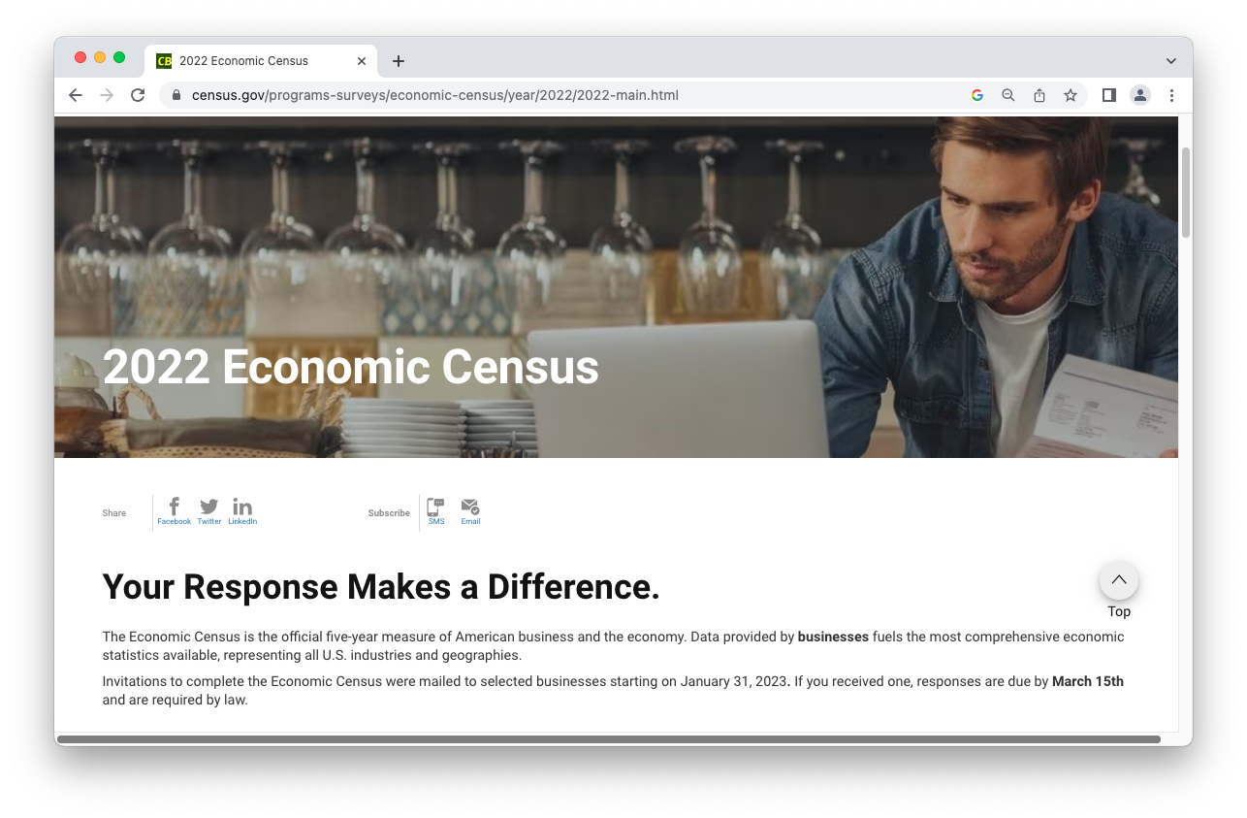
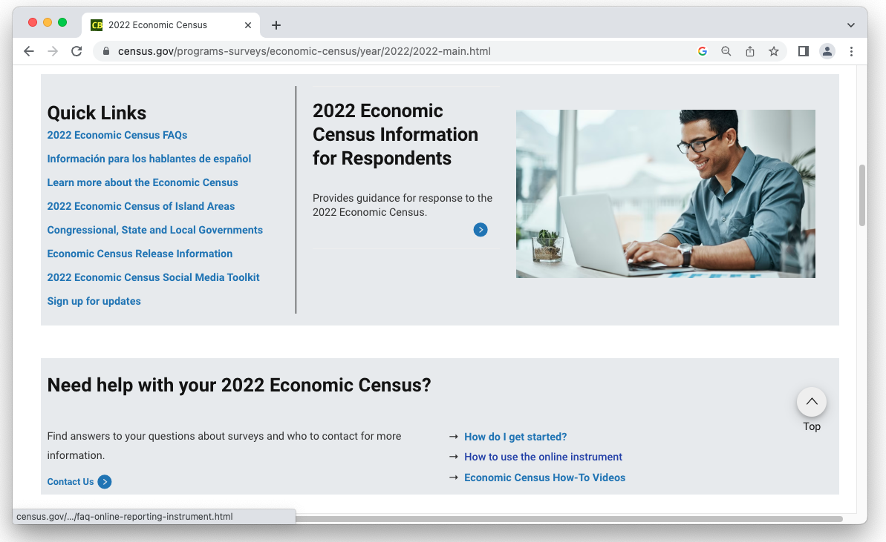
Resources for Respondents at Census.gov/econ
Census.gov/econ
10
Notes:
We also have a variety of resources online to help you get started an answer questions you have up front, and have tried to put the links to what you’re most likely to be looking for together in one place. Start by going to census.gov/econ
You’ll notice we have highlighted the page titled “2022 Economic Census Information for Respondents”. Which as you can probably guess, is a great place to get more information as a respondent. We also have identified the pages that anyone, not just a respondent, might be interested in under Quick Links. Specifically I’d like to mention the link to FAQs and Information for Spanish Speakers pages.
Next I want to go over the links in the help section because I think they can be very useful. First you have “How do I get started”. It goes over in detail how to set up your account and add the authentication code that I mentioned previously. But then it also covers more questions that you may have as you start to use your account.
Next there is “How to use the online instrument” which is a list of FAQs about navigating the survey to report, including the two different ways you can confirm that your responses were submitted.
And finally, How to videos! Here is a collection of videos that walk you through how to accomplish a variety of actions. For example a few things I’ve mentioned already – such as signing into the respondent portal (which also covers setting up an account and adding your authentication code), how to print a preview of your survey, and Review Your Surveys and Submit (which also shows the submission confirmation).

Slide 11

Response Promotion

Slide 12





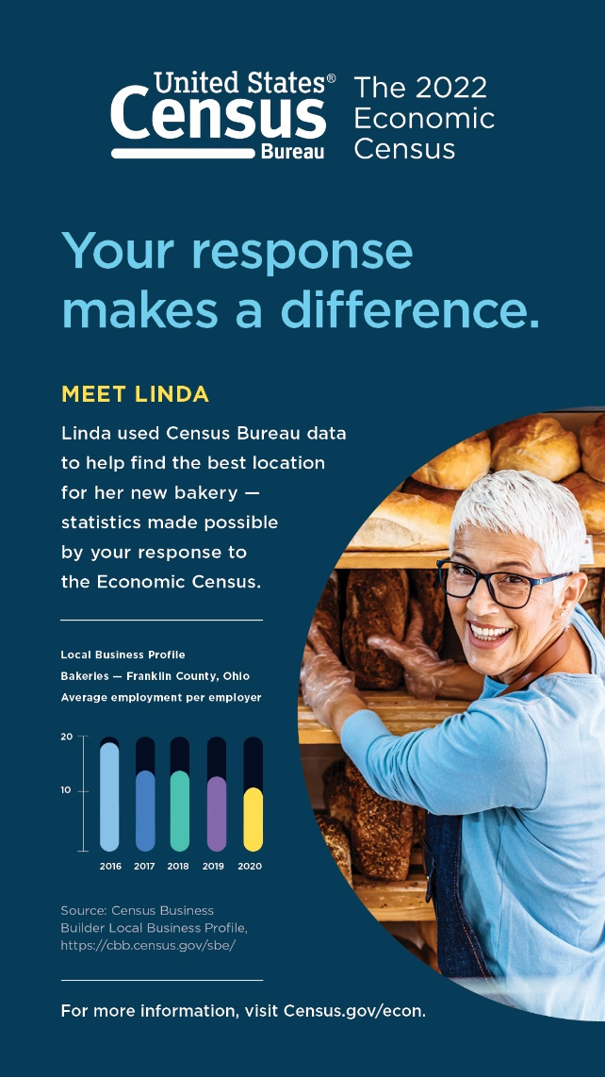
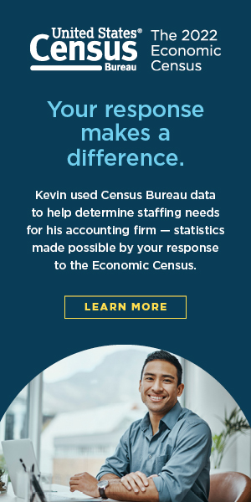

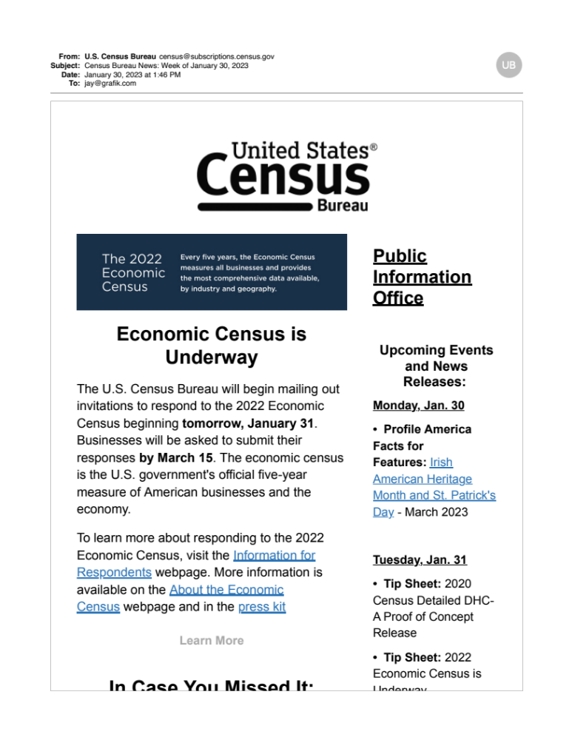
Census Data Stories Campaign -- Advertising
2023 Advertising and Media
Online advertising, print, email, social media, sponsorships, out-of-home
Notes:
these are some of the advertising efforts we've undertaken
we have content in Spanish if you have a need for it
let us know and we will provide you digital images

Slide 13

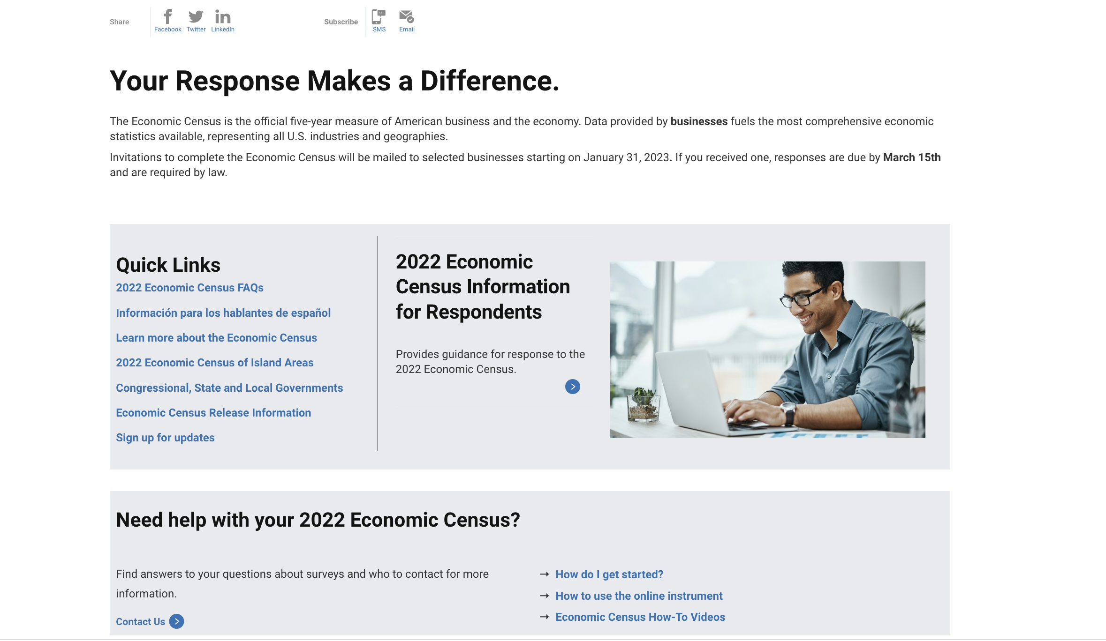
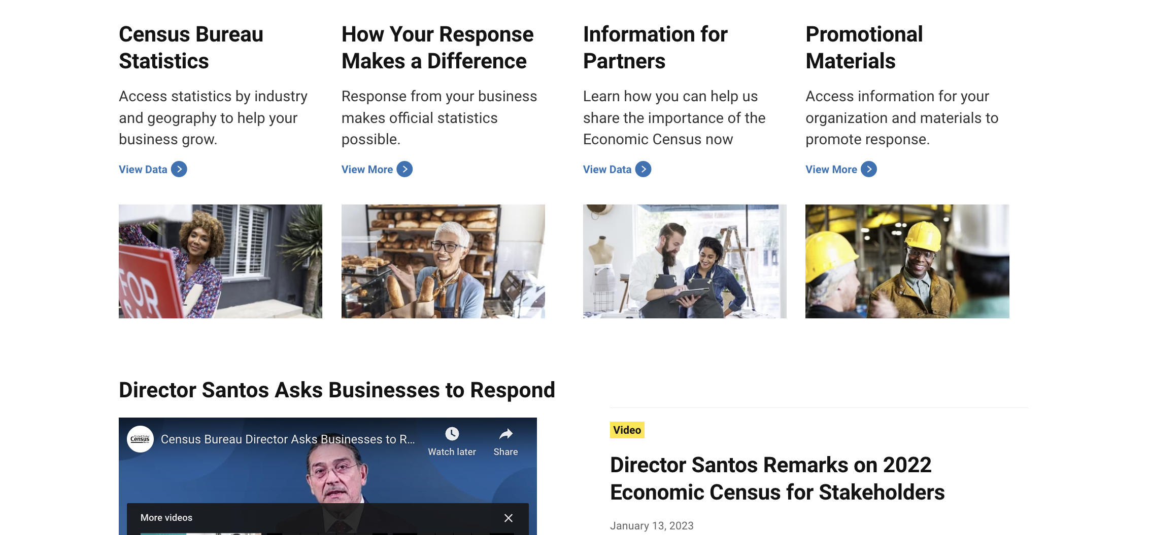

Census Data Stories Campaign - Website
census.gov/econ
Economic Census promotional website: census.gov/econ
  Information for Respondents
  Census Bureau Statistics
  How Your Response Makes a Difference
  Information for Partners
  Promotional Materials
Advertising and promotional materials with are available for your organization
  Digital ads and social media
  Printed brochures
Economic Census Overview | September 2022 | 13

Slide 14
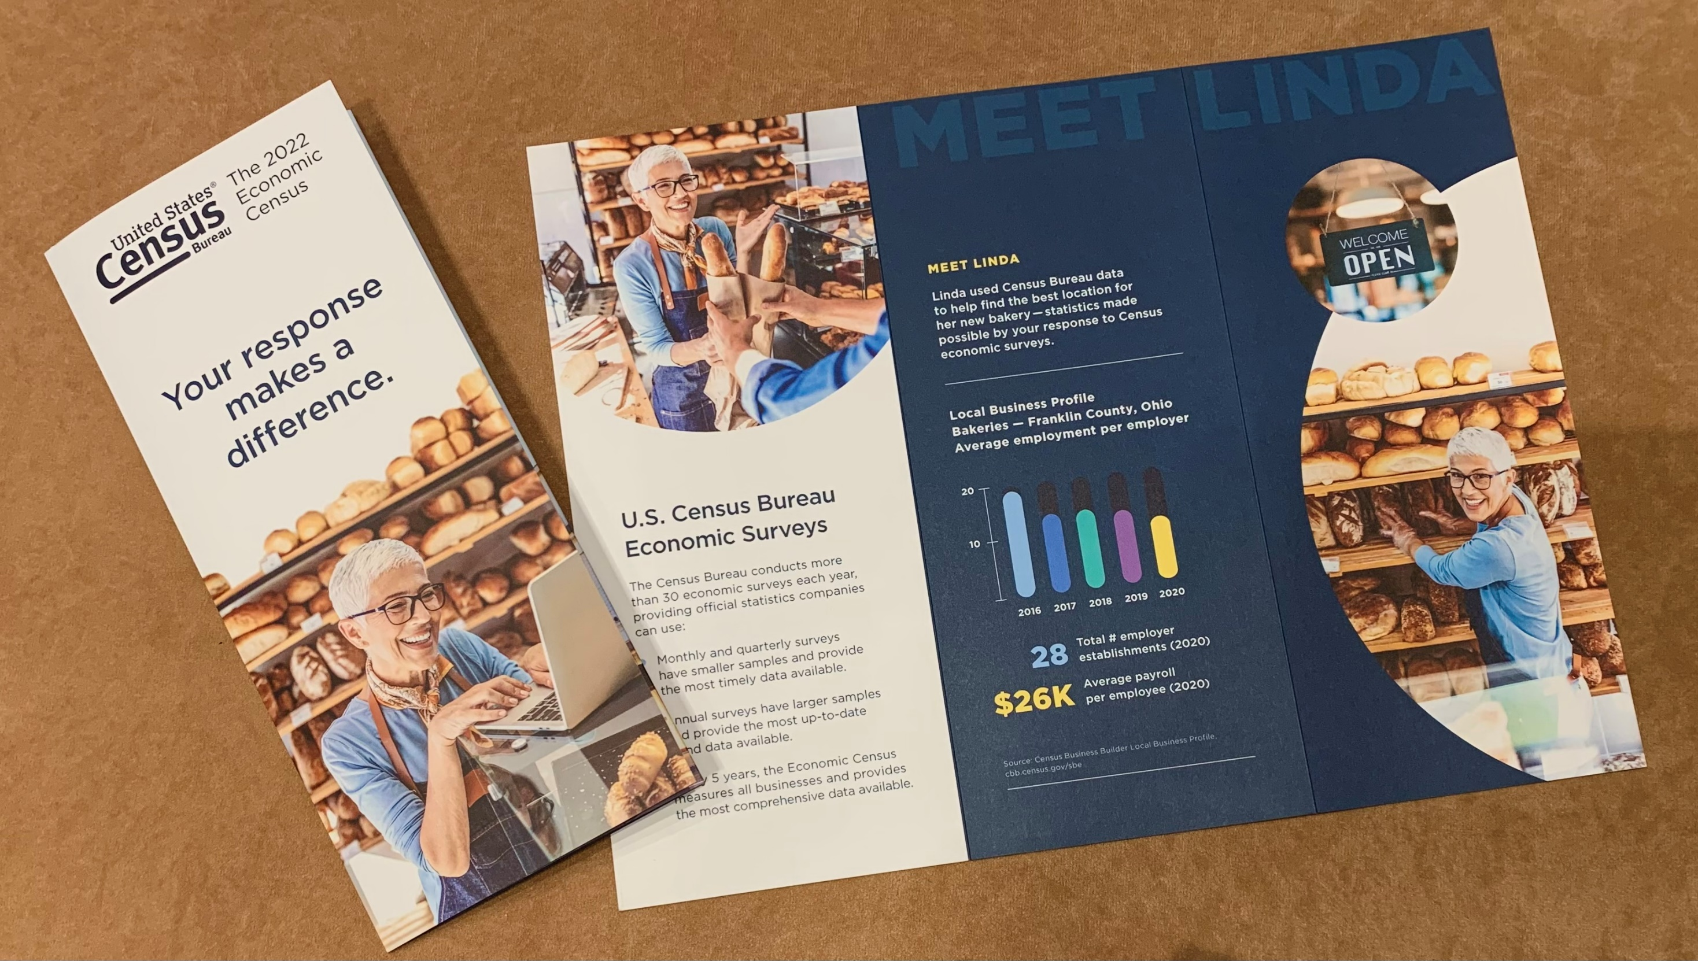
Tri-fold

Slide 15
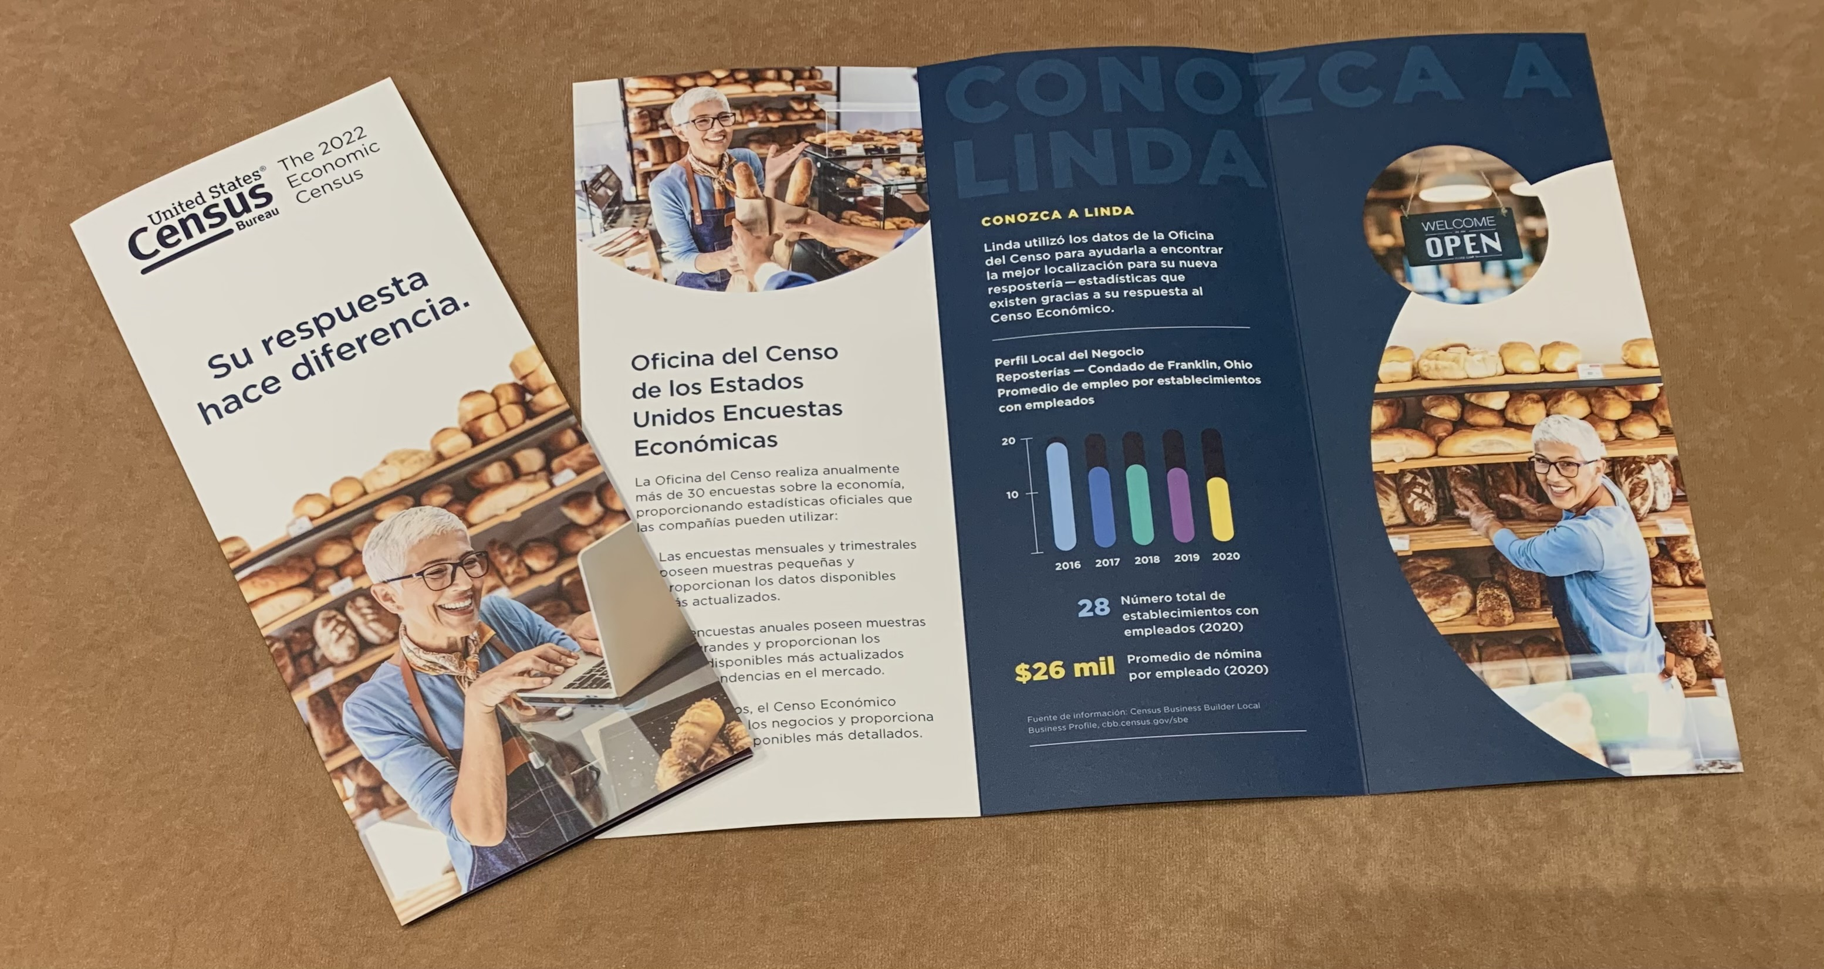
En Español

Slide 16

Census Data Tools
Notes:
The foundation of promoting response to our economic surveys is talking about the data that results from them, so let’s talk about a few of our Census Data Tools.

Slide 17

Longitudinal Employer-Household Dynamics Program (LEHD)
https://lehd.ces.census.gov/
Notes:
First I will be sharing with you a little bit about the Longitudinal Employer-Household Dynamics program and its products.

Slide 18
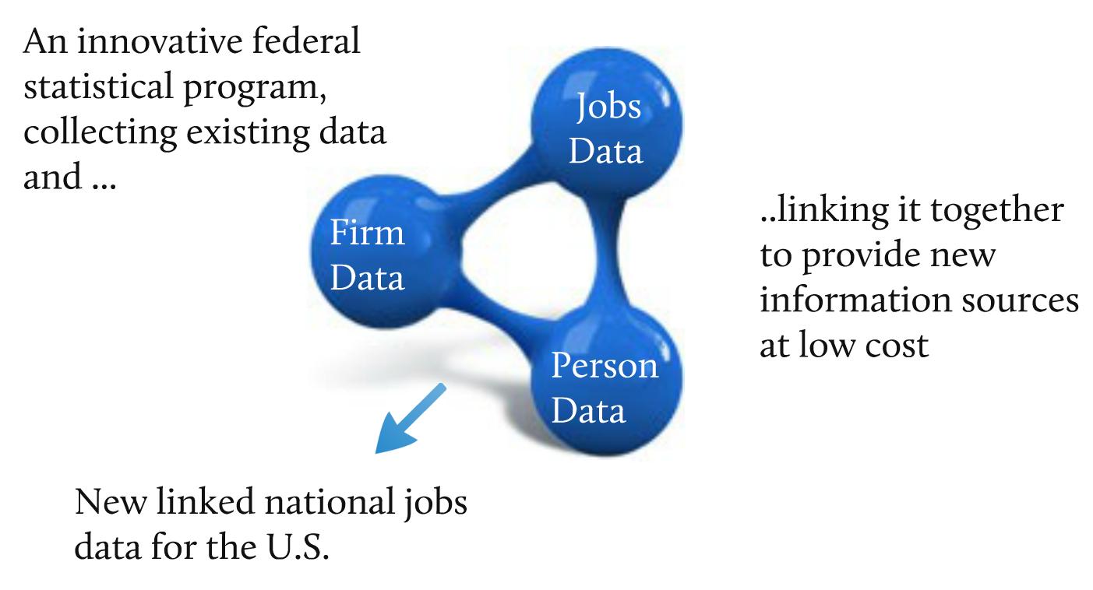

Census data tools –
free and available online
LEHD Data Infrastructure
https://lehd.ces.census.gov/
Economic Census Overview | March 2023 | 18
Notes:
Let’s look at where the data comes from.
LEHD products are different from other Census Data in the fact that our data comes from our Local Employment Dynamics or LED partnership, which is a voluntary federal-state partnership.
Its main purpose is to merge employee data and employer data to produce a collection of enhanced labor market statistics with state-of-the-art confidentiality protection.
Under the partnership, states send their Unemployment Insurance Wage Records and their Quarterly Census of Employment Wage data, which is then combined with censuses and surveys to create this dynamic information on workers to produce public-use data products as well as microdata for research.
The UI records give us jobs data, the QCEW gives us firm data and our person data comes from censuses and surveys.

Slide 19
Census data tools –
free and available online
LEHD Data Products
https://lehd.ces.census.gov/
Data Product | Explore the data, answer questions, or get visualizations | Bulk data for use in analysis process/software | Live queries for building web applications
Quarterly Workforce Indicators (QWI) | QWI Explorer | LED Extraction Tool Raw data download | Census Bureau API
LEHD Origin-Destination Employment Statistics (LODES) | OnTheMap OnTheMap for Emergency Management | Raw data download LED Extraction Tool – Coming in 2023 | Future development
Job-to-Job (J2J) | Job-to-Job Explorer | Raw data download LED Extraction Tool – Coming in 2022 | Future Development
Post-Secondary Employment Outcomes (PSEO) | PSEO Explorer | Raw data download | Census Bureau API
Veteran Employment Outcomes (VEO) | VEO Explorer | Raw data download | Future Development
Economic Census Overview | March 2023 | 19
Notes:
LEHD has three main data sets and two experimental data sets, with seven different data tools for easy access.
Each data set along with each data tool is unique in its own way.

Slide 20
Census data tools –
free and available online
LEHD Data Products
https://lehd.ces.census.gov/
Quarterly Workforce Indicators (QWI)
Employment: Hires, separations, turnovers, earnings
LEHD Origin-Destination Employment Statistics (LODES)
Employment data for detailed and customized geographic levels
Data Tools: OnTheMap, or OnTheMap for Emergency Management
Economic Census Overview | March 2023 | 20
Notes:
If you are curious about employment----hires---- separations----turnovers---- and earnings, you would look at the Quarterly Workforce Indicators or QWI, utilizing the QWI Explorer or the LED Extraction Tool.
If you want to look at employment for detailed and customized geography, you would look at the LODES data, using the OnTheMap or OnTheMap for Emergency Management data tools
OnTheMap for Emergency Management is the only data tool that’s part of the LEHD suite of tools that has population data, along with data from other federal agencies.

Slide 21
Census data tools –
free and available online
LEHD Data Products
https://lehd.ces.census.gov/
Job-to-Job (J2J)
Statistics on job mobility across state boundaries or industries
Transitions between jobs by timing and firm or worker characteristics
Earning changes due to job changes
Post-Secondary Employment Outcomes (PSEO)
Experimental data set that reports earnings by
  institution, degree field, degree level, and graduation cohort for 1, 5 and 10 years after graduation
Accessible through the PSEO Explorer
Economic Census Overview | March 2023 | 21
Notes:
If you want to look at statistics on job mobility across state boundaries or industries, transitions between jobs by timing and firm or worker characteristics, or earning changes due to job changes you would use our Job-to-Job or J2J Flows data, using the J2J One of our newer data sets is the Post-Secondary Employment Outcomes or PSEO.
This experimental data set reports earnings by institution------ degree field------ degree level------ and graduation cohort for 1, 5, and 10 years after graduation and is accessible through the PSEO Explorer.

Slide 22
Census data tools –
free and available online
LEHD Data Products
https://lehd.ces.census.gov/
Veteran Employment Outcomes (VEO)
Experimental data set that reports earnings and employment outcomes for U.S. Army veterans 1, 5 and 10 years after discharge by:
  Military occupation, rank, demographics, industry, geography of employment
  Accessible through the VEO Explorer
Raw data downloads are also available, along with LEHD microdata, for approved projects through our secure Census Research Data Centers
Economic Census Overview | March 2023 | 22
Notes:
Finally, we have another experimental data set called the Veteran Employment Outcomes or VEO.
This new experimental data set reports earnings and employment outcomes for U.S. Army veterans one, five, and 10 years after discharge by military occupation, rank-----demographics------- industry --------and geography of employment. This is also accessible through our VEO Explorer
In addition to the data tools, raw data downloads are available, along with LEHD microdata for approved projects through our secure Census Research Data Centers.

Slide 23
Census Business Builder
cbb.census.gov
Economic Census Overview | May 2023 | 23
Notes:
The first tool is Census Business Builder, or CBB.

Slide 24
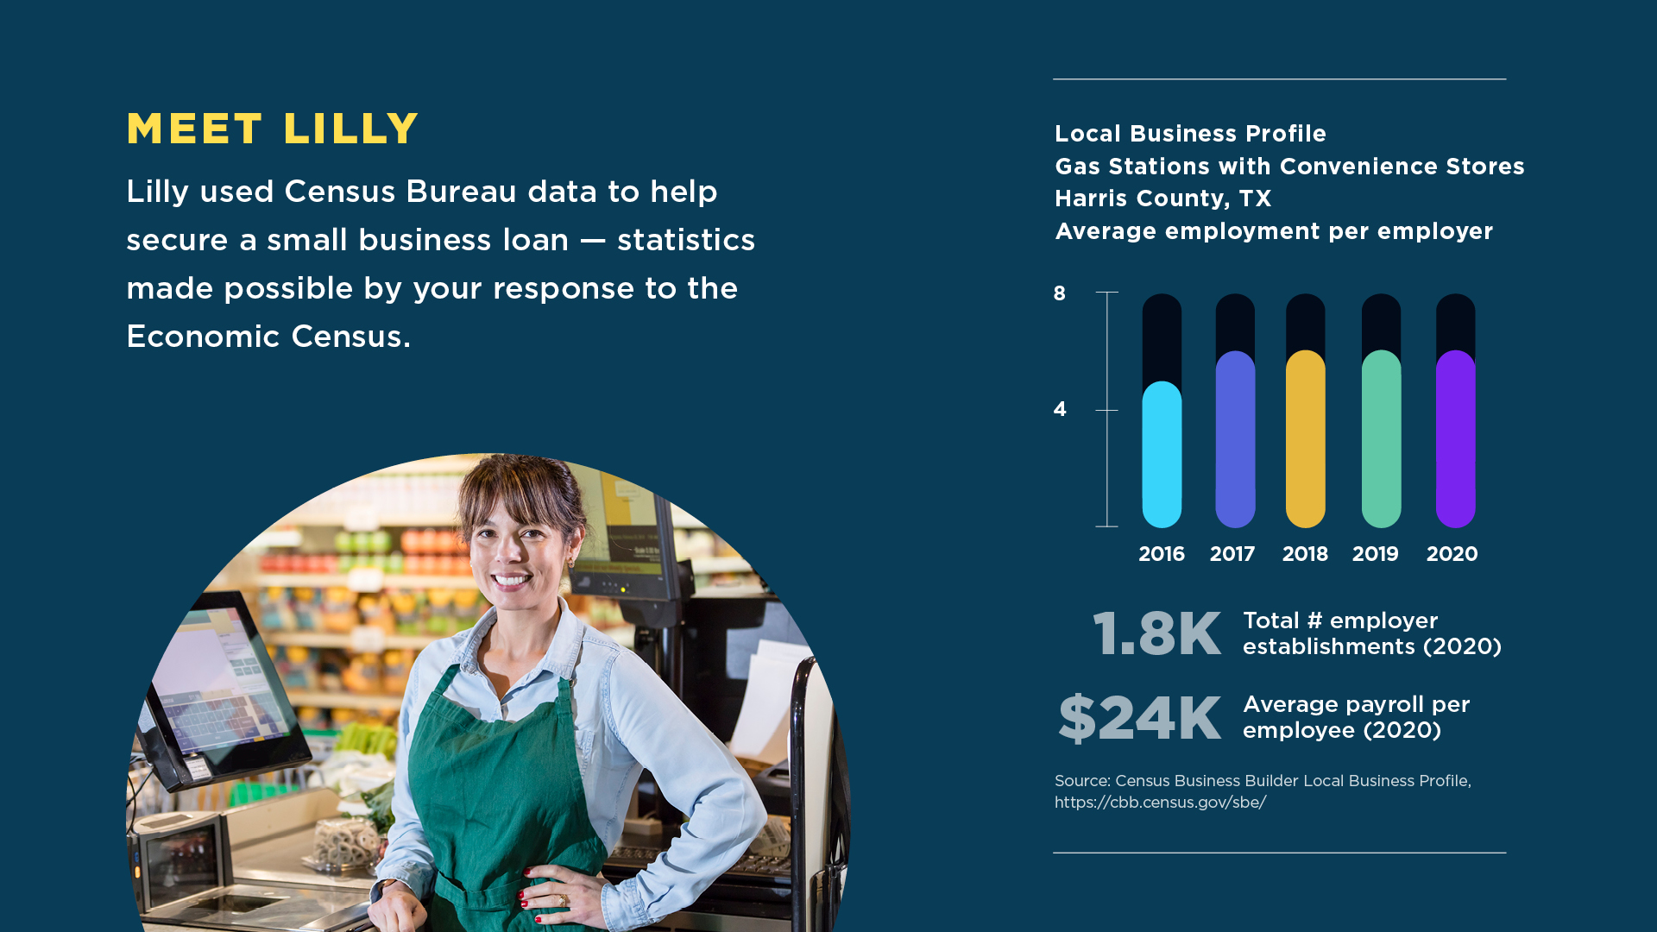

Your Response Makes a Difference
24
Notes:
For the 2022 Economic Census, we created a Census Data Stories campaign with a dozen data stories using actual data and how it can be used.
One story we story we told was that of Lilly, who used Census Bureau data to secure a small business loan for her gas station with convenience store in Harris County.
If people you are talking to want to open a business, this graphic shows how many people on average work at gas stations with convenience stores in Harris Count.
These statistics are made possible by response to the EC. Notice her story is paired with actual data from our Census Business Builder using Harris County.

Slide 25
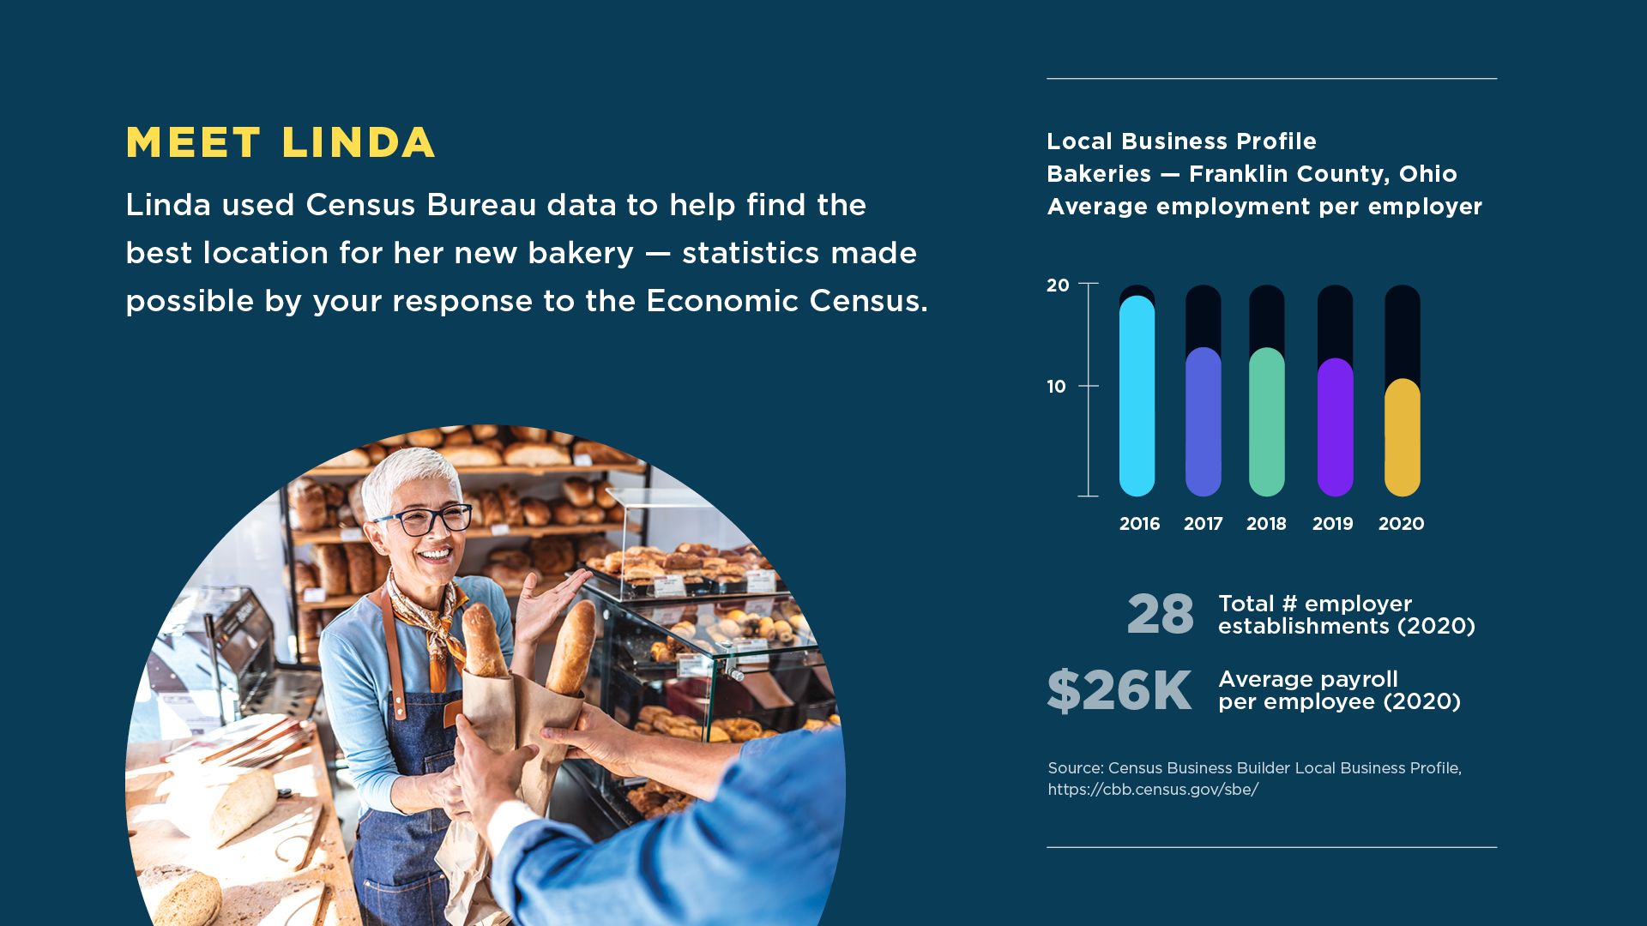
Your Response Makes a Difference
Notes:
And here’s Linda, who used Census Bureau data to help find the best location for her new bakery – statistics made possible by your response to the Econ Census. Notice this source statement, this data for bakeries in Franklin County, OH is directly from CBB. Let’s take a look.

Slide 26
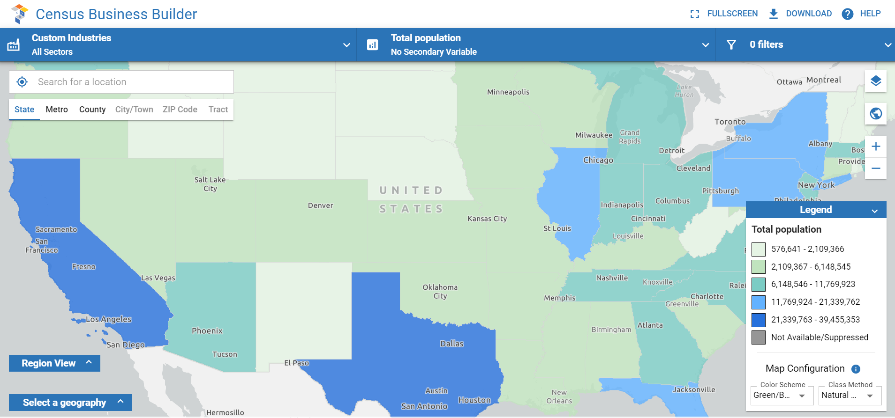
Census data tools –
free and available online
Census Business Builder
cbb.census.gov
CBB STARTS WITH
UNITED STATES

Slide 27
Census data tools –
free and available online
Census Business Builder
cbb.census.gov
SELECT LOCATION
FRANKLIN COUNTY, OHIO

Slide 28
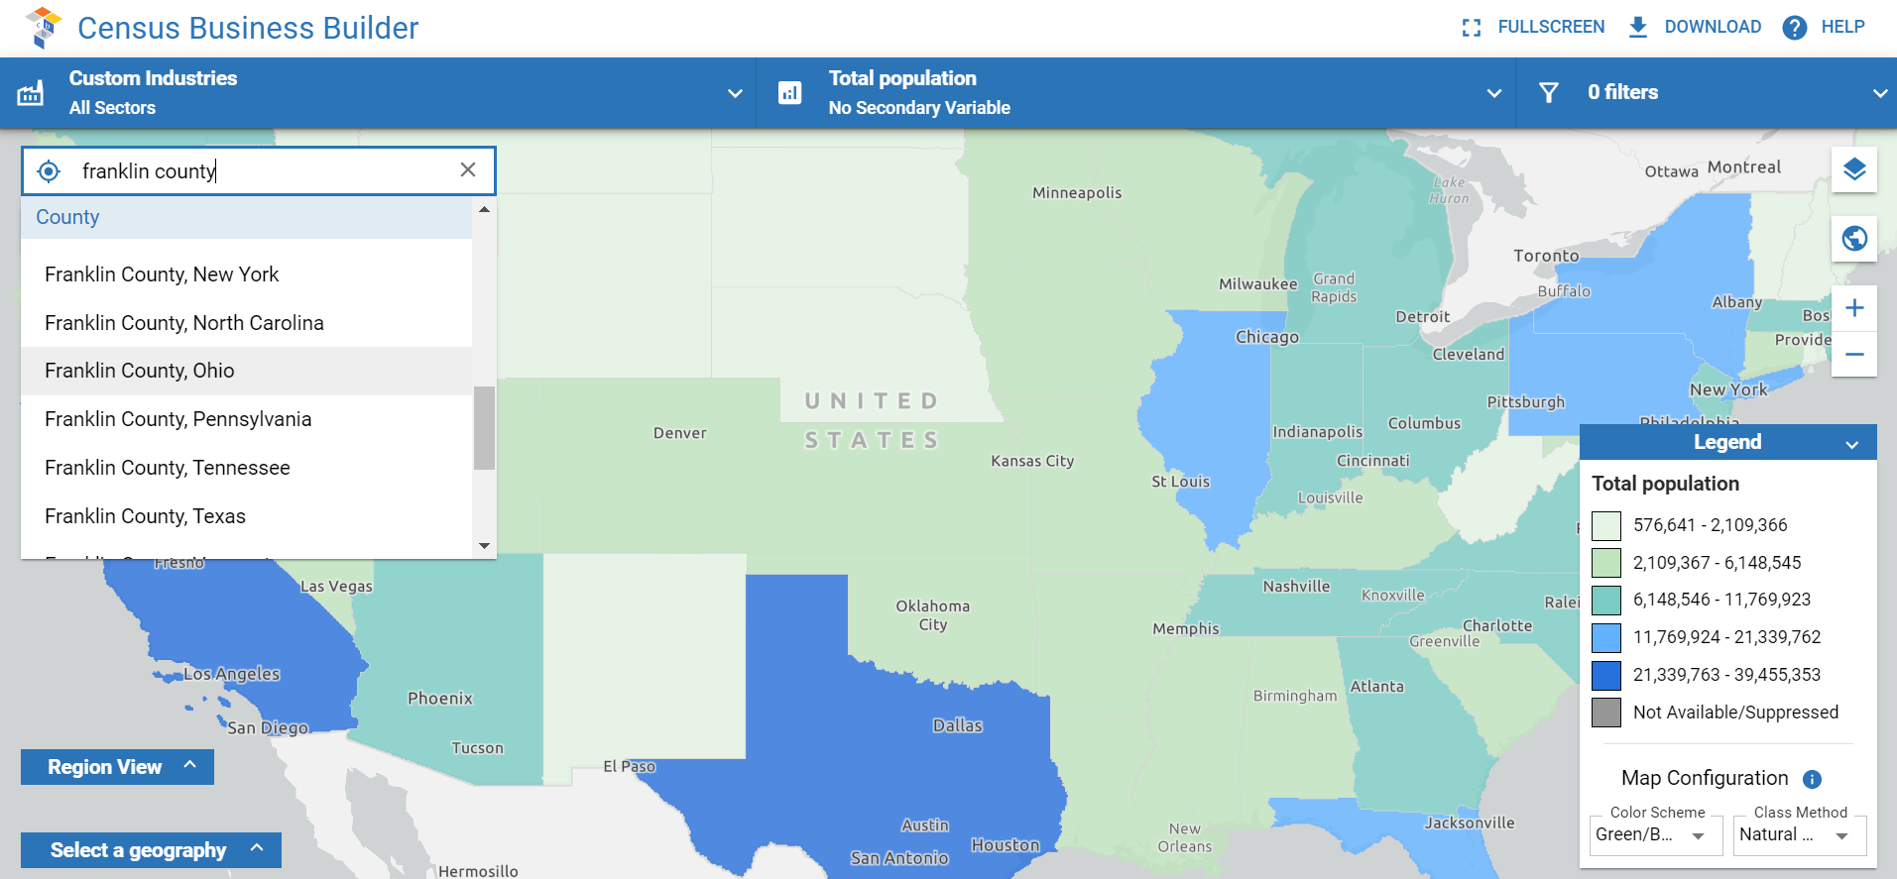

Census data tools –
free and available online
Census Business Builder
cbb.census.gov
SELECT LOCATION
FRANKLIN COUNTY, OHIO

Slide 29
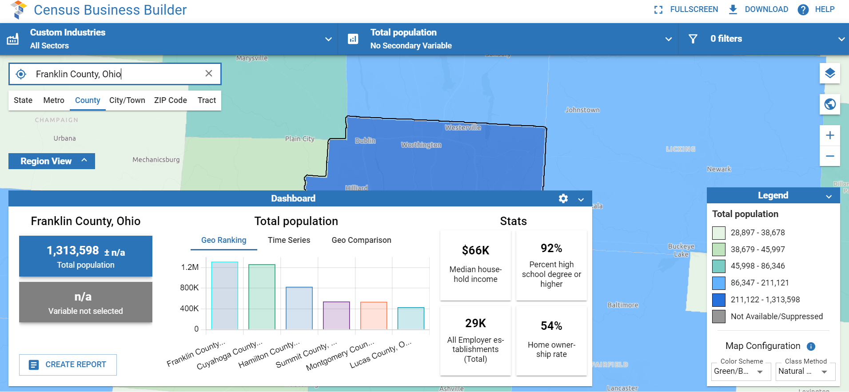
Census data tools –
free and available online
Census Business Builder
cbb.census.gov
SELECT INDUSTRY
RETAIL BAKERIES

Slide 30
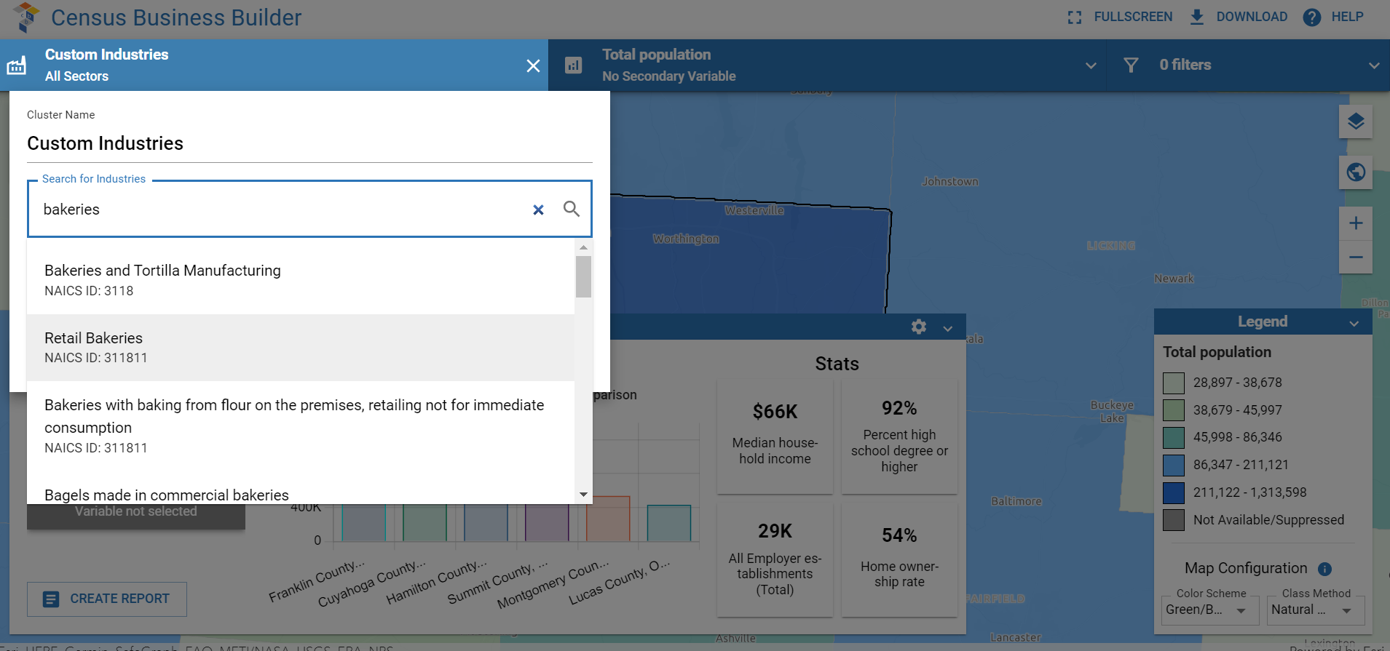
Census data tools –
free and available online
Census Business Builder
cbb.census.gov
SELECT INDUSTRY
RETAIL BAKERIES

Slide 31

Census data tools –
free and available online
Census Business Builder
cbb.census.gov
GENERATE CUSTOM REPORT
RETAIL BAKERIES
IN FRANKLIN COUNTY OHIO

Slide 32
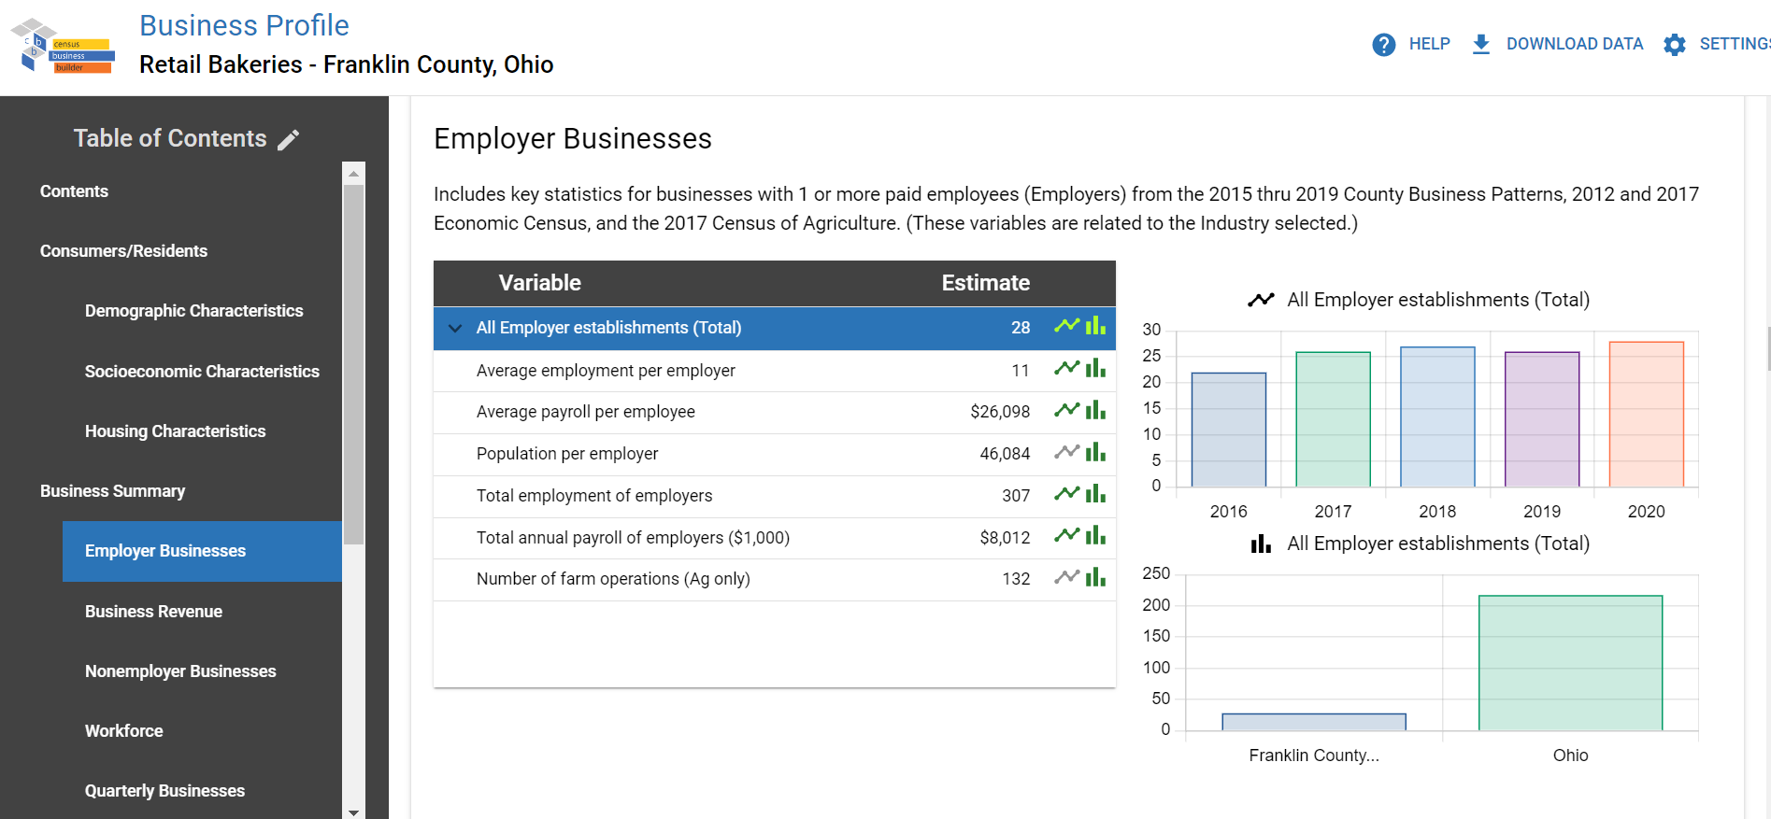
Census data tools –
free and available online
Census Business Builder
cbb.census.gov

Slide 33
Census Data and Texas
Notes:
Now we will demonstrate how we can use Census Data, and specifically, Census Business Builder, to identify data points and trends for Texas.

Slide 34
Census Data and Texas
You can use Economic Census data to identify:
Economic trends in Texas
Industry growth/decline
Small business information
Employment, revenue, payroll information.
Economic Census Overview | May 2023 | 34

Slide 35
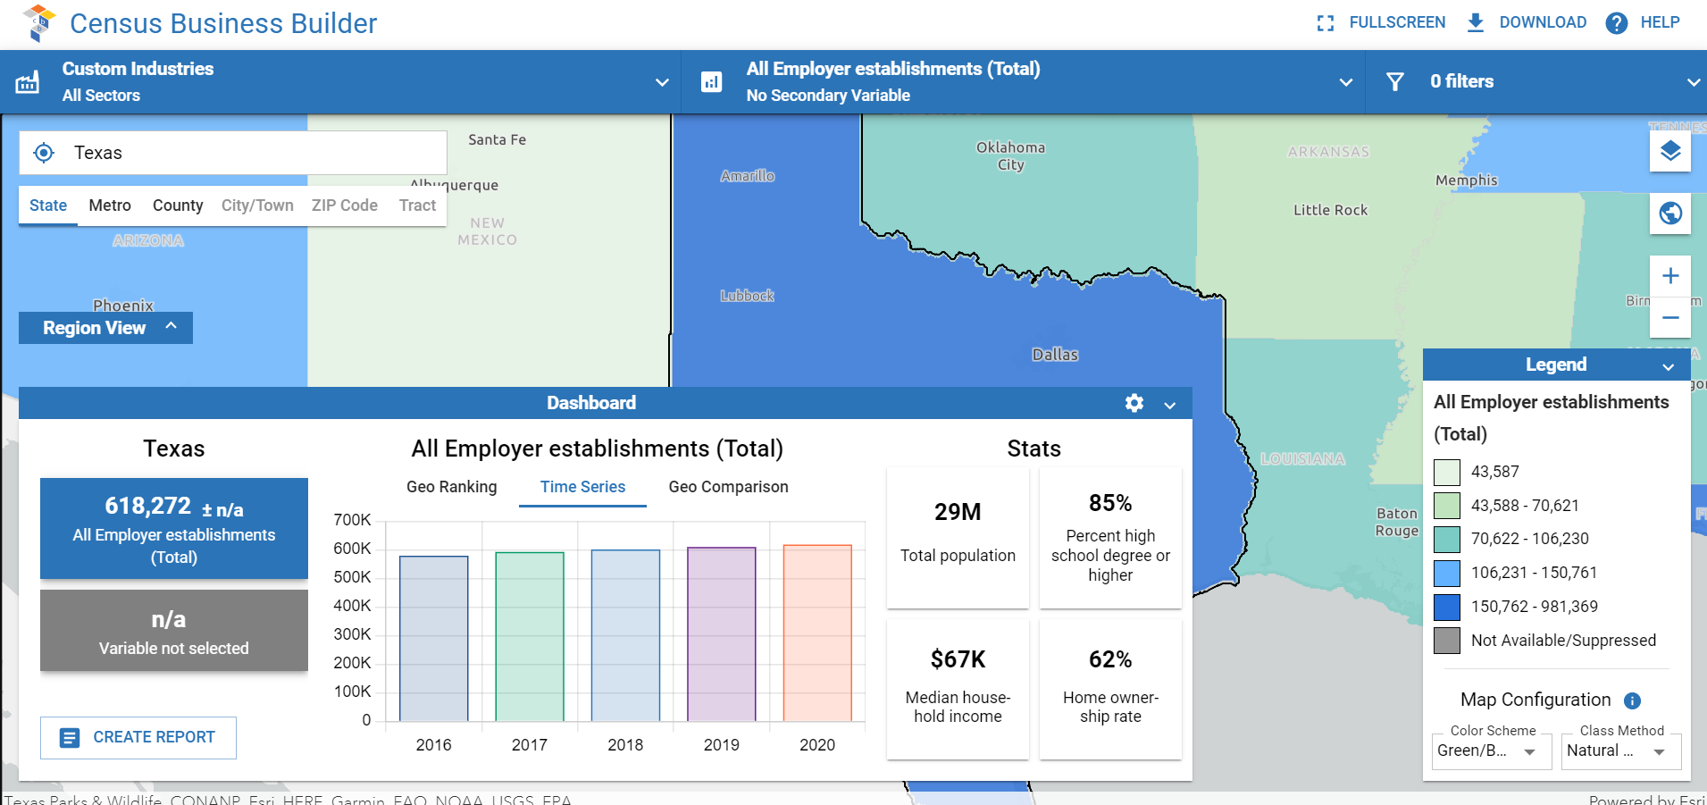
Census data tools –
free and available online
Economic Trends in Texas
cbb.census.gov
Time-series Analysis for Economic Data

Slide 36
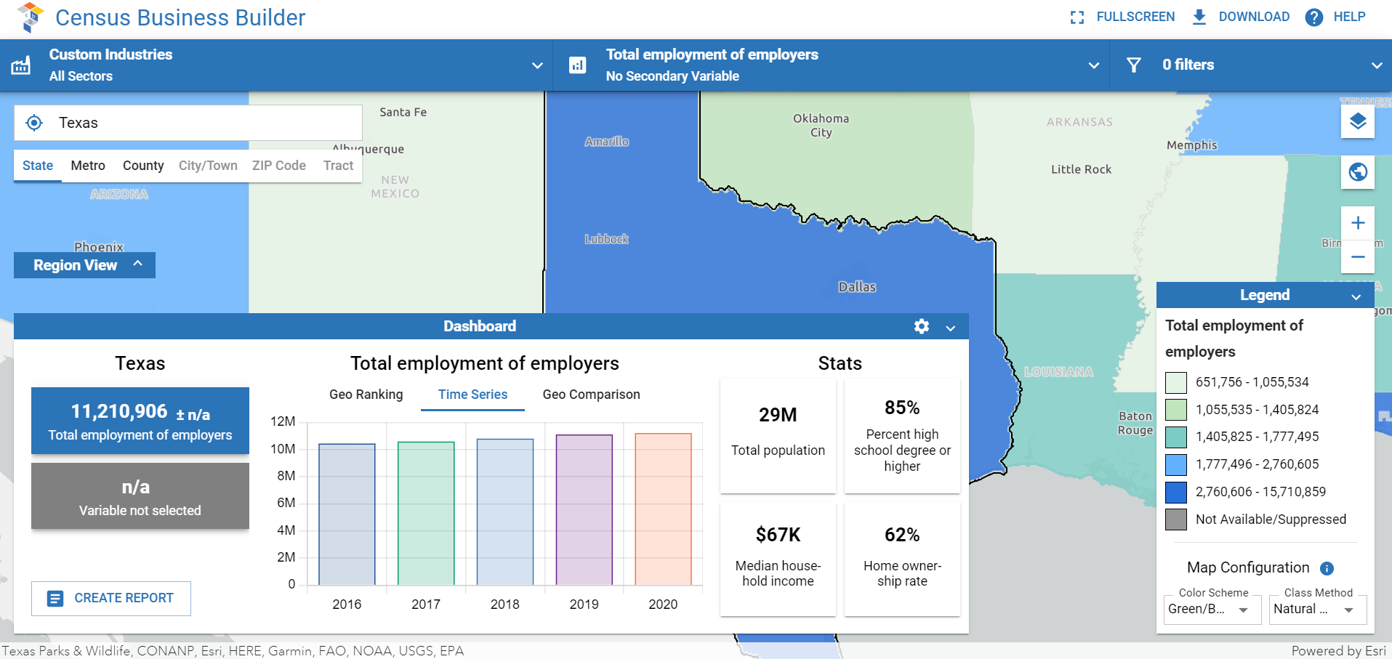
Census data tools –
free and available online
Economic Trends in Texas
cbb.census.gov
Time-series Analysis for Economic Data

Slide 37
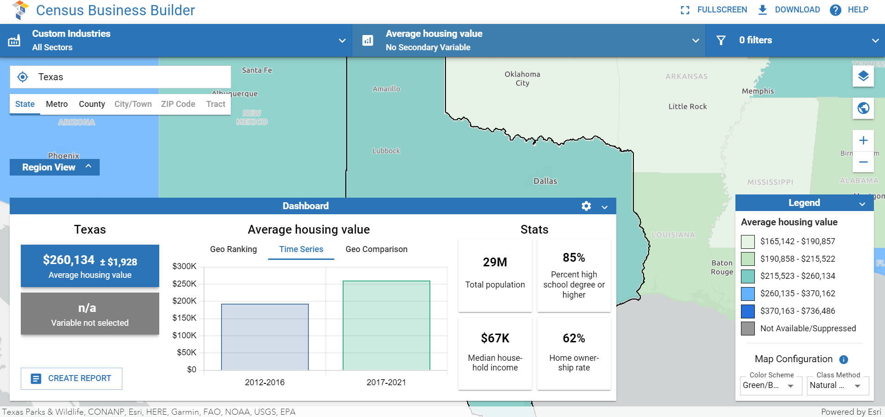
Census data tools –
free and available online
Economic Trends in Texas
cbb.census.gov
Time-series Analysis for Economic Data

Slide 38
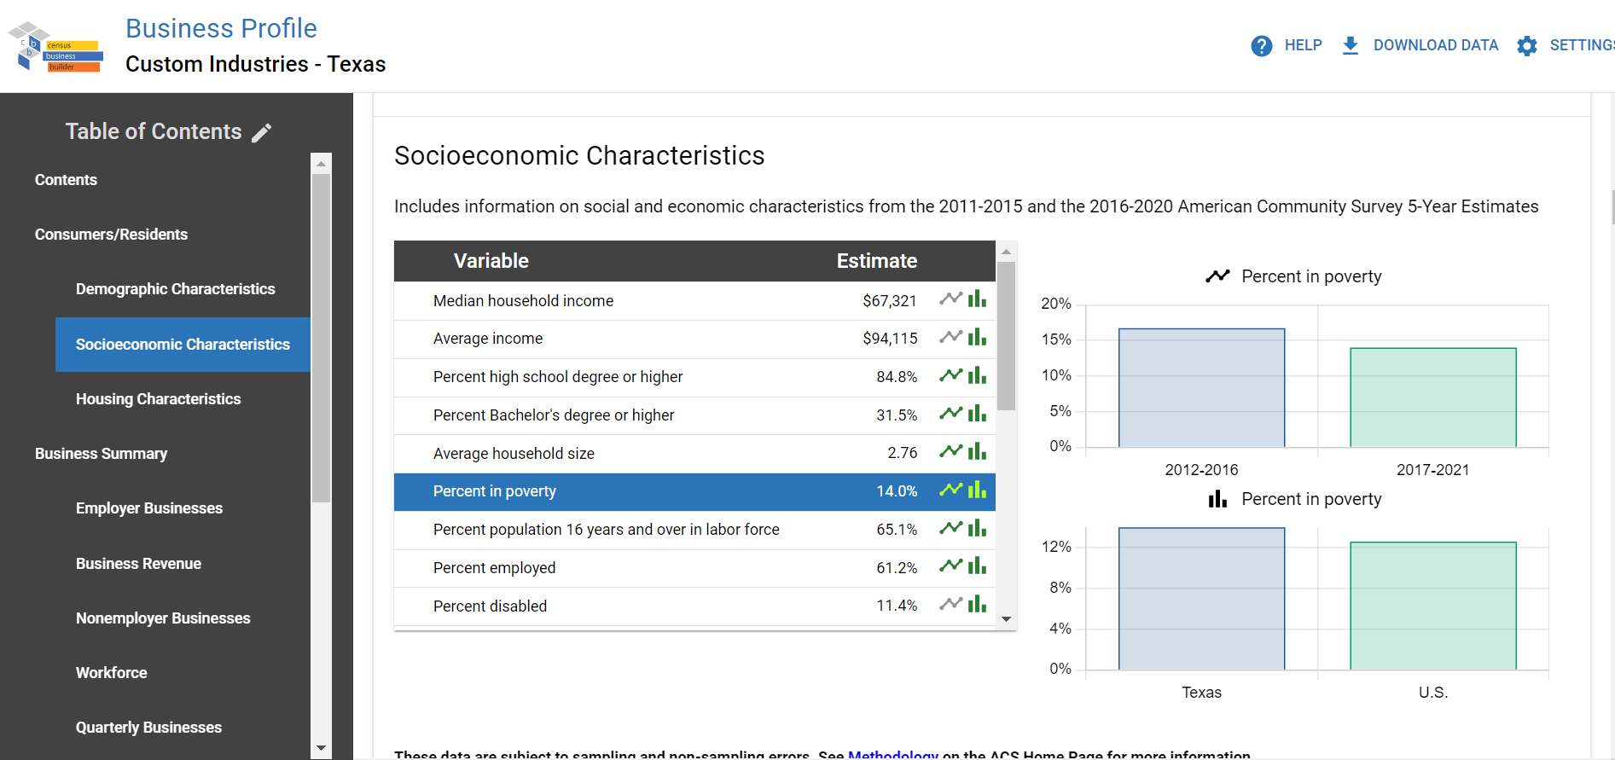
Census data tools –
free and available online
Economic Trends in Texas
cbb.census.gov
Business Profile for Texas

Slide 39
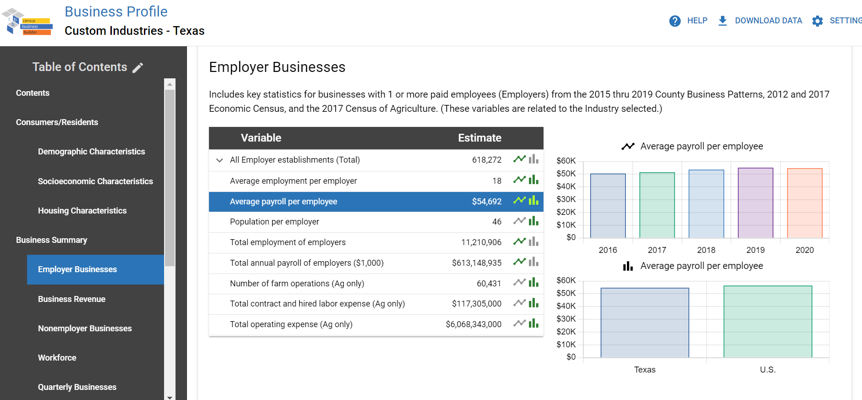
Census data tools –
free and available online
Economic Trends in Texas
cbb.census.gov
Business Profile for Texas

Slide 40
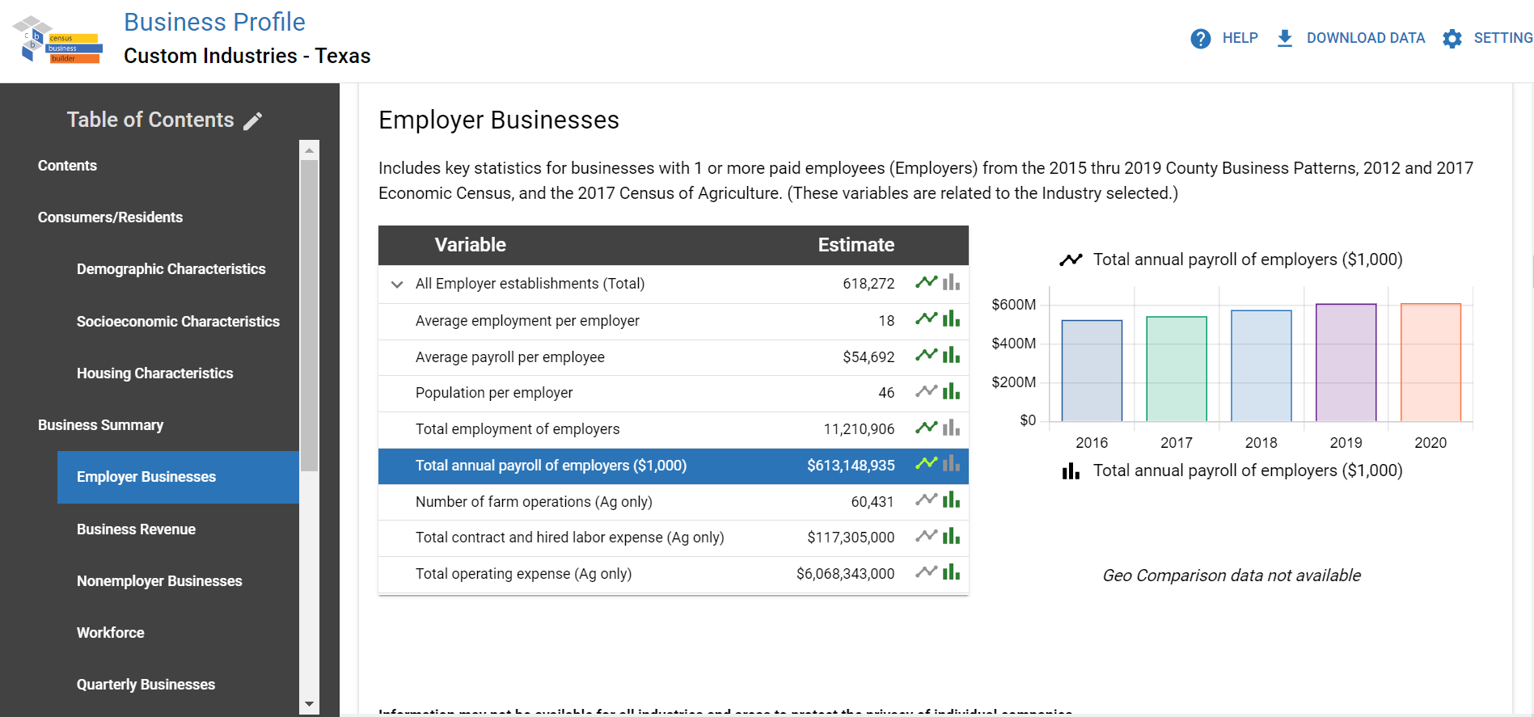
Census data tools –
free and available online
Economic Trends in Texas
cbb.census.gov
Business Profile for Texas

Slide 41
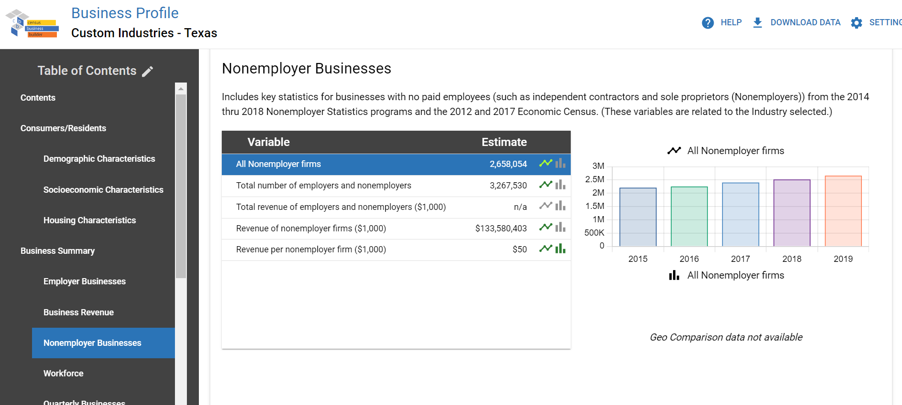
Census data tools –
free and available online
Economic Trends in Texas
cbb.census.gov
Business Profile for Texas

Slide 42
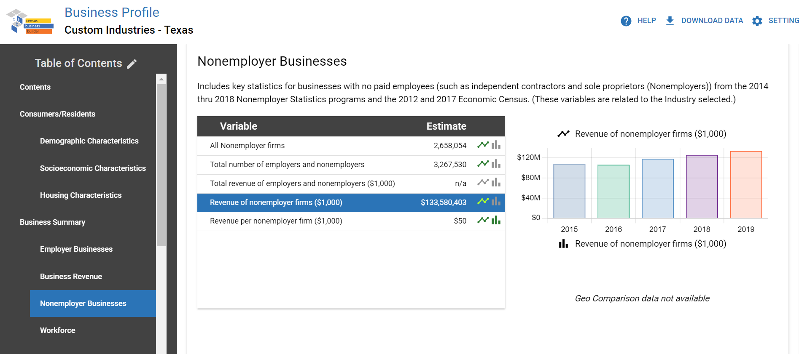
Census data tools –
free and available online
Economic Trends in Texas
cbb.census.gov
Business Profile for Texas

Slide 43
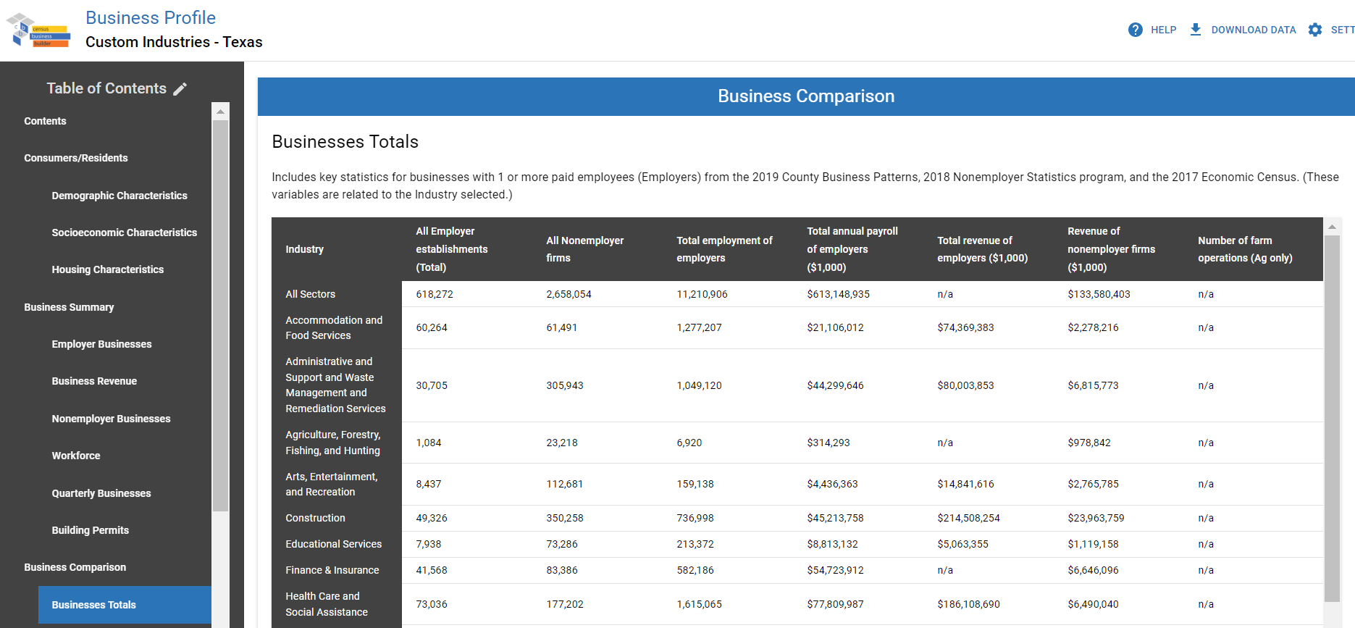
Census data tools –
free and available online
Economic Trends in Texas
cbb.census.gov
Business Profile for Texas

Slide 44
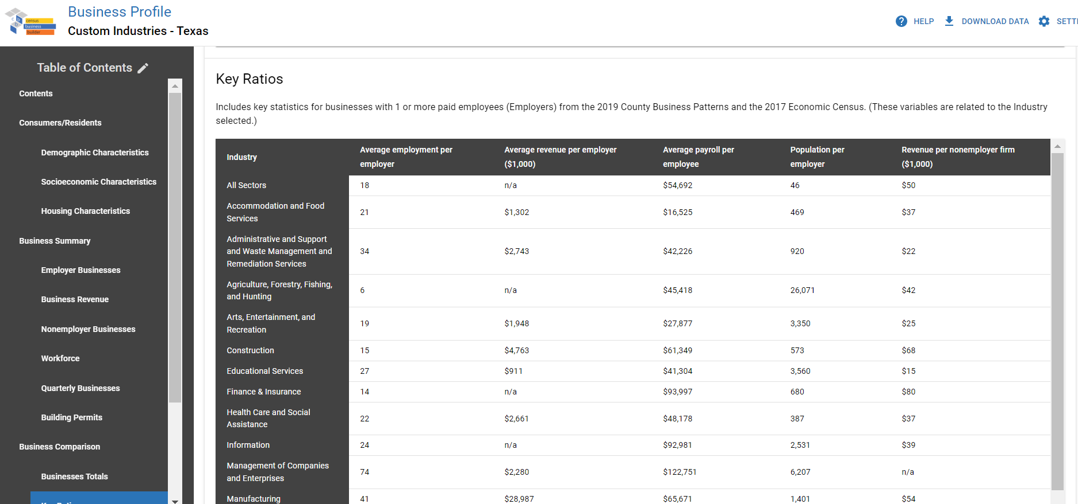
Census data tools –
free and available online
Economic Trends in Texas
cbb.census.gov
Business Profile for Texas

Slide 45
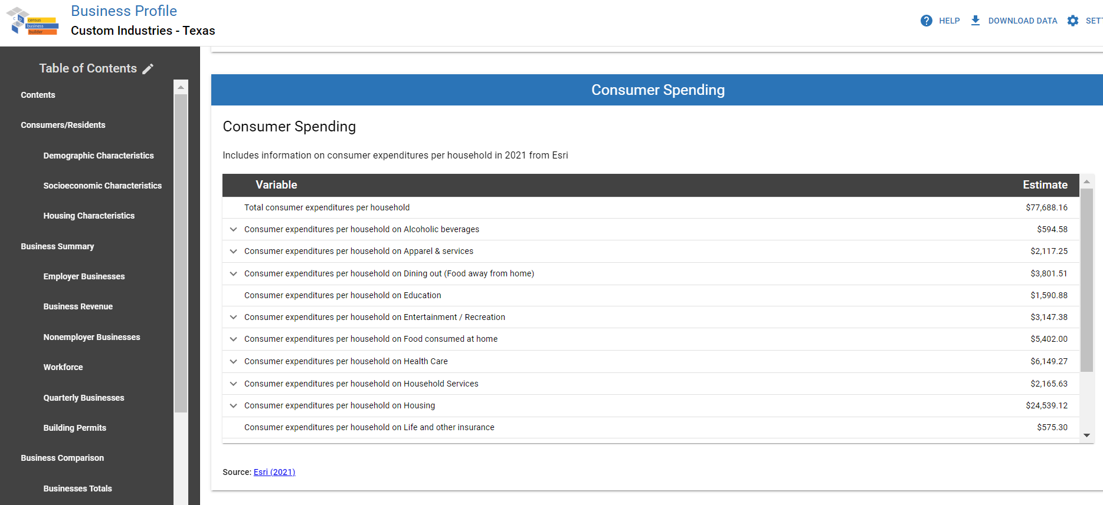
Census data tools –
free and available online
Economic Trends in Texas
cbb.census.gov
Business Profile for Texas

Slide 46

Important takeaways to help support response
Not every company receives the Economic Census.
The Economic Census due date was March 15, 2023, but businesses may request an extension.
Responses are held confidential and are required by law (Title 13, U.S. Code).
Respondent help line number is on each invitation to respond.
Results are free and available online.
Find support at census.gov/econ.
Economic Census Overview | May 2023 | 46

Slide 47

Q & A
Nidaal Jubran
Nidaal.jubran@census.gov
(301) 763-7686
Economic Census Overview | May 2023 | 47

