Slide 1

Aging, Dementia, and the Care Gap How population trends are shaping the demand for care and delivery systems
Jacqueline L. Angel, PhD
The University of Texas at Austin
Presented
2026 Texas Demographic Conference
May 21, 2026

Slide 2
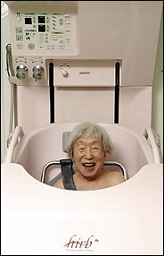
Who Should Take Care of the Elderly Living with Dementia?
Family
The “State”
Market (Employer)
Elderly Individual
Technology
2024 Michigan Poll Results Who Should Pay for Caregiving of Individuals 65 and Over
Government |  | 45%
Elderly Recipient |  | 27%
Family or Friends |  | 18%
Other Sources |  | 10%
Source: University of Michigan National Poll on Healthy Aging, 2024 Angel et l. 2021. The Gerontologist.

Slide 3
Dementia in Texas: The Numbers
400,000 → 500,000+
Texans with Alzheimer’s (by 2030)
$20.6B / $3.9B
Families (annual) / Texas Medicaid
1 Million
Unpaid caregivers
1.5 Billion hours
Unpaid care each year
$23.9 Billion
Value of unpaid care
#3 / #2
U.S. rank: cases / deaths
Texas Department of State Health Services (DSHS), Texas Alzheimer’s Disease Facts & Figures (2020–2025); Alzheimer’s Association, Alzheimer’s Disease Facts and Figures (2025);Texas A&M Center for Community Health & Aging.

Slide 4
Prevalence of Cognitive Impairment and Dementia in Mexico and U.S.
Percent
Highest proportion of older adult (65+) with cognitive impairment and dementia among U.S. Hispanics
Source: 2025, Rosa García-Chanes, Mariana López-Ortega, Jacqueline Angel, Alfonso Rojas, Emma Aguila
Data source: Health and Retirement Study and Mexican Health and Aging Study

Slide 5
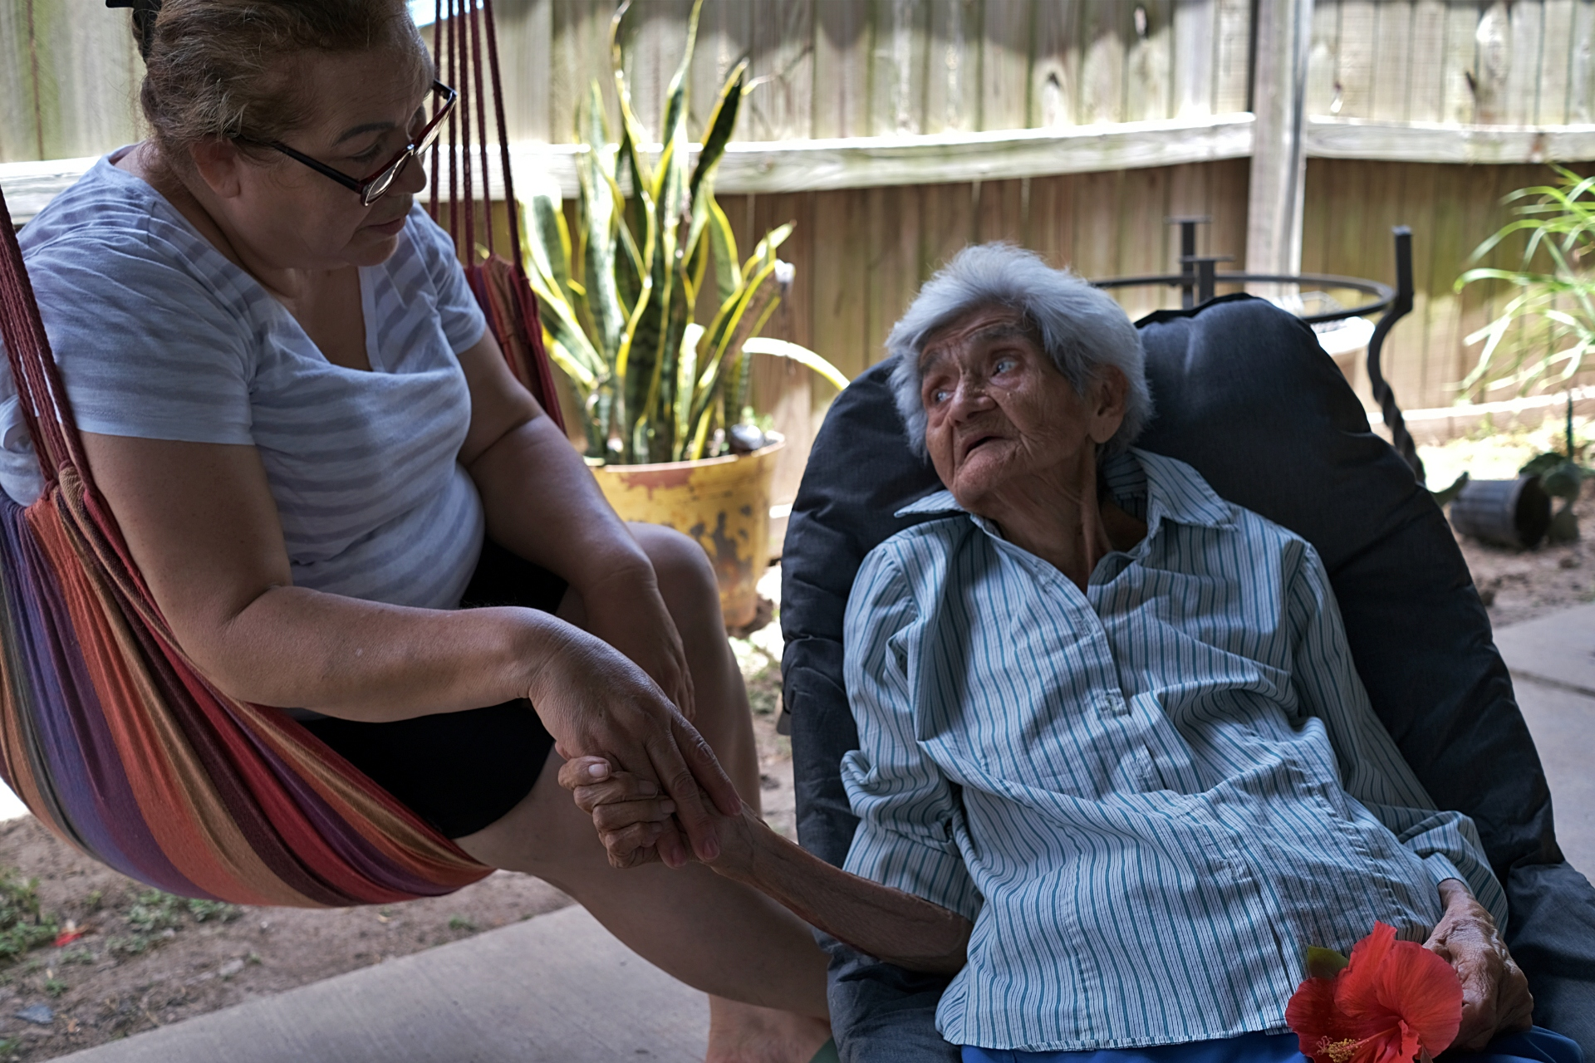
U.S. Trends in Increasing Life Spans
Maria Alanis holds the hand of her mother, Isabel, in their backyard in Brownsville, Texas. Maria was a full-time dementia caregiver for her mother until she died last month. Credit: Miguel Roberts/MyRGV.com
Source: U.S. Census Bureau, 2020. https://www.census.gov/content/dam/Census/library/publications/2020/demo/p25-1145.pdf

Slide 6
Life Expectancy at Age 65 and Percent with Likely Dementia
Late-Life migrant women will spend 8.6 years (44%) living with dementia.
Source: H-EPESE Wave 9

Slide 7
Cognitive Impairment Reflects Life Course Challenges
Low Education
Limited Insurance
Neighborhood Disadvantage
Socioeconomic Exclusion

Slide 8
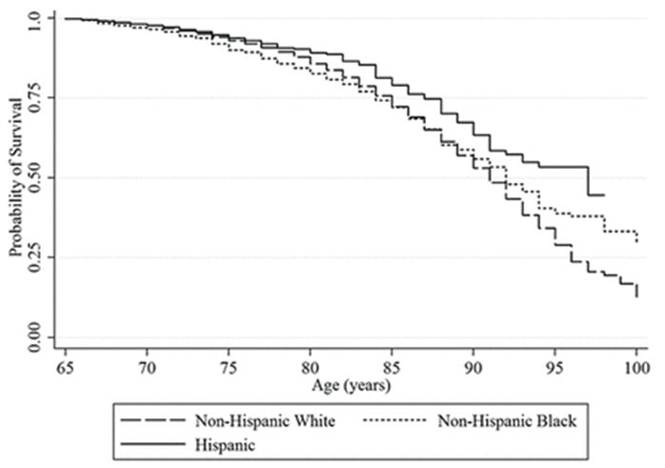
Probability of Remaining in the Community by Age
Ka18,952) (plan-Meier Survival Estimates for Entering Nursing Homes after Age 65 by Race/Ethnicity (N = Adjusted for birth year and gender)
Source: Health and Retirement Study (1998-2010)
N = 20,253; Thomeer, Mudrazija, and Angel. “How and Why Does Nursing Home Use Differ by Race and Ethnicity?,” The Journals of Gerontology: Series B, Volume 73, Issue 4, May 2018, Pages e11–e12, https://doi.org/10.1093/geronb/gbv056

Slide 9
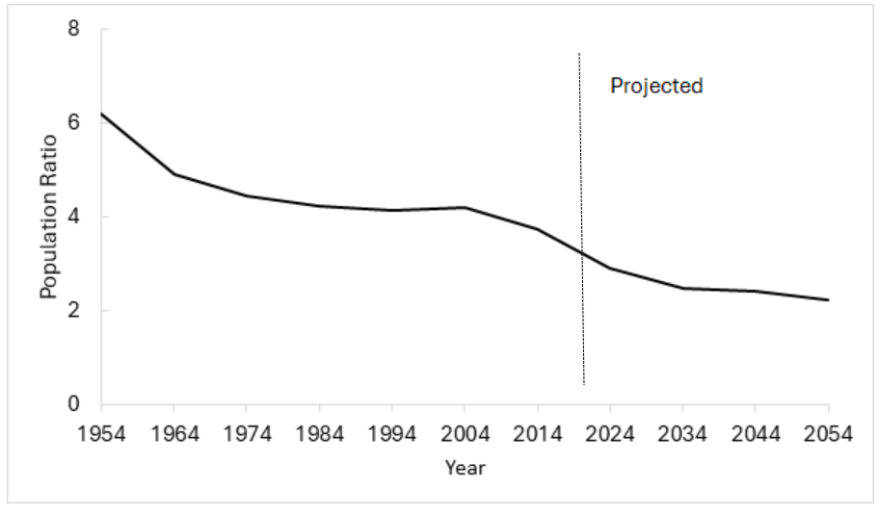
Why the Gap Is Growing?
Source: Congressional Budget Office, 2025.

Slide 10
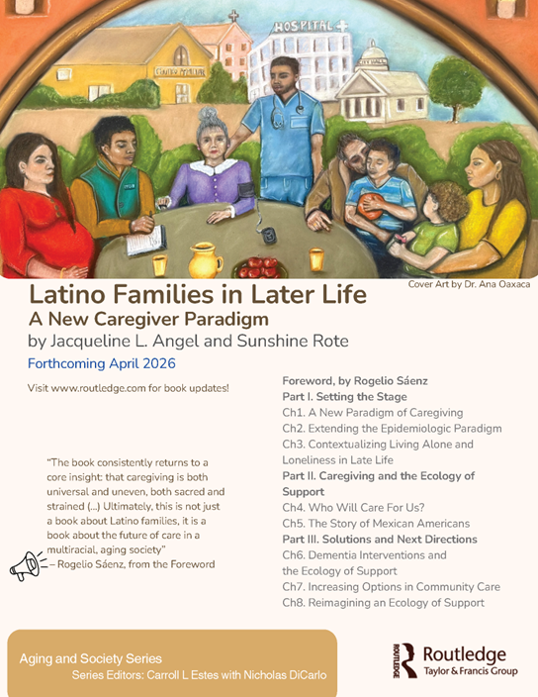
Data and Methods
Hispanic Established Epidemiologic Studies of the Elderly (HEPESE)
3,050 individuals 65 and older 1993-94
902 new cohort added in 2004-05 75+ (wave 5)
925 Mexican American-Caregivers Dyads (wave 7)
Vital status at the follow up in 2020-21 (wave 10)
  68% dead (n=2701)
  32% survived (1,254)
  Source: ICPSR/NACDA

Slide 11
Defining Dementia in the HEPESE
Mini Mental Status Examination (MMSE)
18 and under and at least one IADL disability, report of Alzheimer's disease, or proxy report of dementia
Cognitive Impairment, No Dementia (CIND)
MMSE 18 and under; no IADL disability
No Dementia
MMSE above 18

Slide 12
Living Arrangements Among Elderly Mexican-Americans 80 and Over: 2010
Source: Cantu and Angel, 2017

Slide 13
Growing Dependency
Living Arrangement Changes Between 1993-94 and 2010-11
Source: HEPESE

Slide 14
Multinomial Logistic Regression Predicting Transition, ref Living Alone
 |  | Transition to Others
 |  | HEPESE
Female |  | 0.98
Age |  | 1.01
Living Alone |  | 0.03***
Dementia |  | 1.69**
Poverty |  | 1.06
Number of Living Kids |  | 0.97
No Education |  | 0.95
1-6 Years |  | 1.01
 |  | Death
 |  | HEPESE
Female |  | 0.89
Age |  | 1.12***
Living Alone |  | 0.11***
Dementia |  | 3.07***
Poverty |  | 1.15
Number of Living Kids |  | 0.99
No Education |  | 1.22
1-6 Years |  | 1.37
Dementia Predicts Transitions to Living with Others
Source: HEPESE

Slide 15
Probability of Transitioning from Living Alone to Living with Others by Gender and Dementia
Source: HEPESE

Slide 16
Caregiving Intensity and Complexity
Source: 2015 NSOC-2016 and H-EPESE

Slide 17
Use of Formal Services by Dual-Eligibility
Source: HEPESE, Wave 9

Slide 18
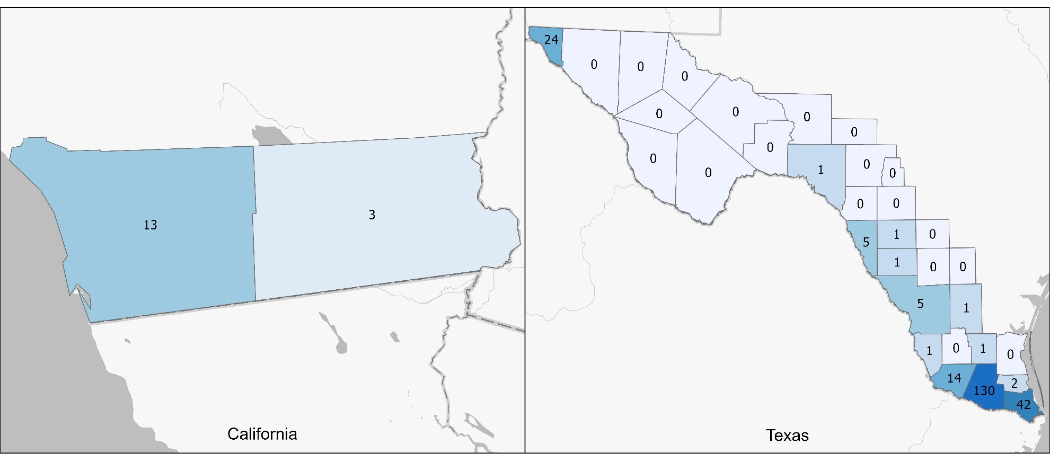
Adult Day Center Use
Compared to California, Texas has a state Medicaid plan that entitles participants to adult day health care services. Despite restrictive participation rules, (2019 $771 a monthly individual income and $2000 asset limit), higher proportion of extreme poor reside in Texas.

Slide 19
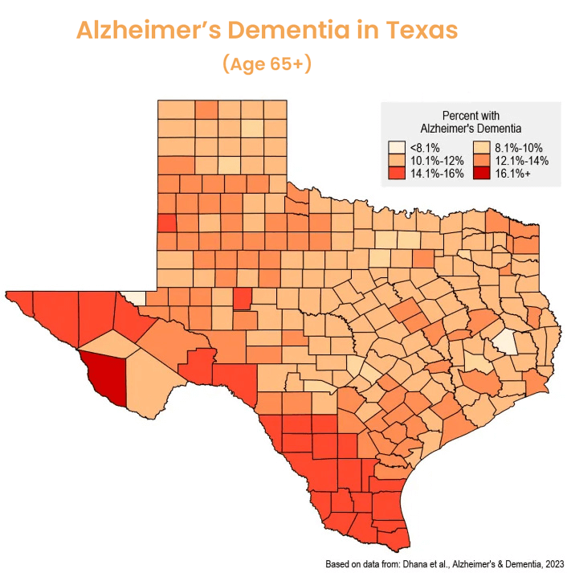
Source: Dementia Prevention Research Institute of Texas (DPRIT) - Texas Medical Center https://www.hhs.texas.gov/sites/default/files/documents/texas-statewide-interagency-aging-services-strategic-plan-sf2025-2030.pdf

Slide 20

Intergenerational Day Centers
Strengthen families and systems
Case Example- Varcity- Texas A&M
City of Austin- Res. #84- Strengthen intergenerational programs; Austin Parks and Recreation IDC pilot proposal
Source-
Varcity Announces New Intergenerational Senior Living Project on Campus of Texas A&M University - Senior Housing News
AFA Presentation

Slide 21
Acknowledgments
National Institute on Aging: R03 AG063183-01
Texas RCMAR: P30AG059301
H-EPESE: R01 AG010939-25
MHAS: R01-AG018016
NIA T-32 Postdoctoral Training Grant 5T32AG000270-21
1R03AG063183-01
PRC/CAPS P30AG066614
Collaborators: Sunshine Rote and ICAA Team https://sites.utexas.edu/caa/

