Slide 1
Demographic Trends and Characteristics in Texas and Williamson County
Presented to
Georgetown Health Foundation
June 15, 2026

Slide 2




About the Texas Demographic Center
Major Function
Produce annual population estimates and biennial population projections
Other Services
Disseminate demographic and socioeconomic information from the Census Bureau and other reliable sources.
Provide training and technical expertise.
Custom data analyses.
State Demographer
Lloyd B. Potter, PhD
Affiliated with
The University of Texas at San Antonio
Institute for Demographic and Socioeconomic Research (IDSER)
Partnerships
U.S. Census Bureau
TDC Affiliates

Slide 3
Population Growth and the Drivers of Growth

Slide 4

New 2025 Estimates Show Texas Growth but at Slower Rate
Newly Released Data
Texas Total Population 2025
31.7M
391K
1.2%
Numeric increase
Percent increase
Growth from 2024
New Census Bureau data shows Texas’ population reached 31.7 million in July 2025 — a 1.2% increase from 2024 to 2025, more than 2X the 0.5% national growth rate. Though growth slowed compared to recent years, TX still led the nation in numeric gains, adding over 391K residents.

Slide 5
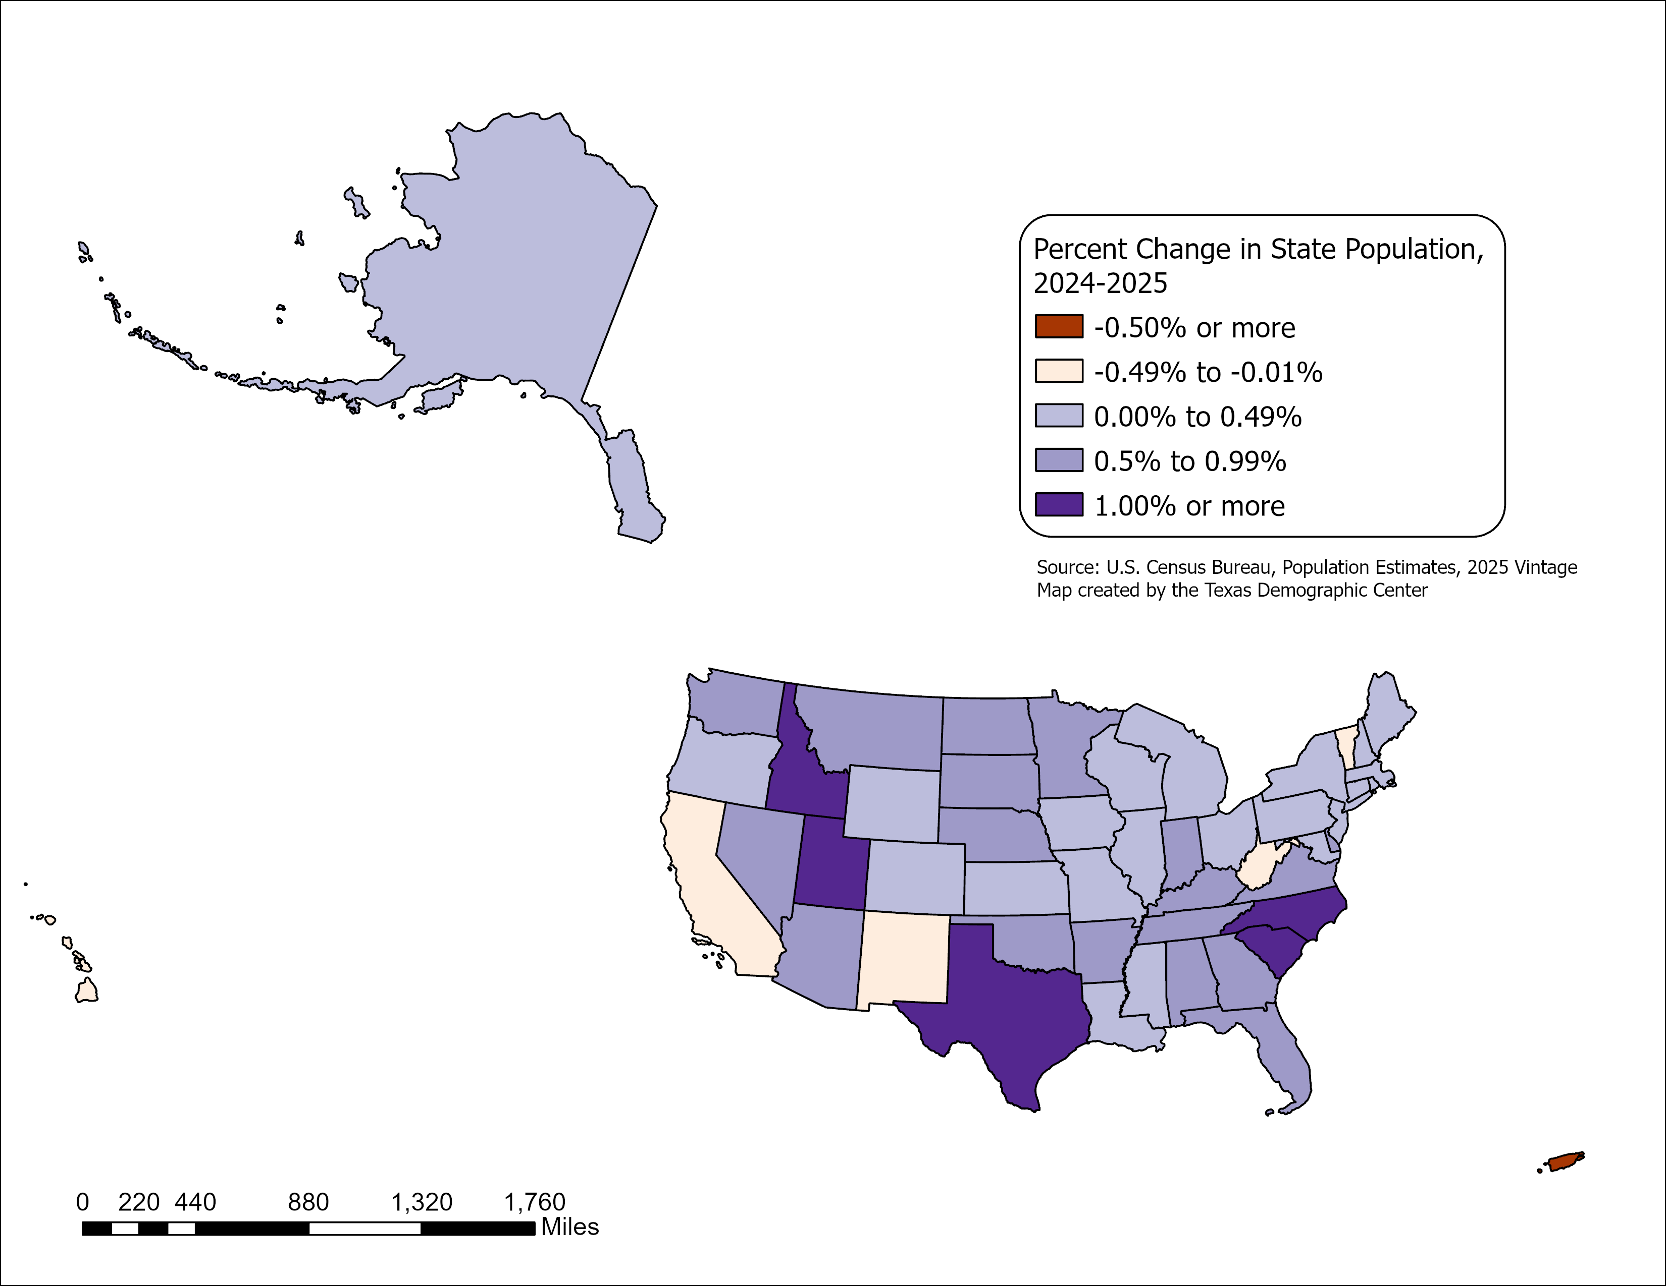
State Highlights
Top 5 States with percent change
  South Carolina
  North Carolina
  Idaho
  Utah
  Texas
All but five U.S. states grew between July 2024 and July 2025
- CA, HI, NM, VT, and WV.
Source: U.S. Census Bureau, Vintage 2025 Population Estimates

Slide 6
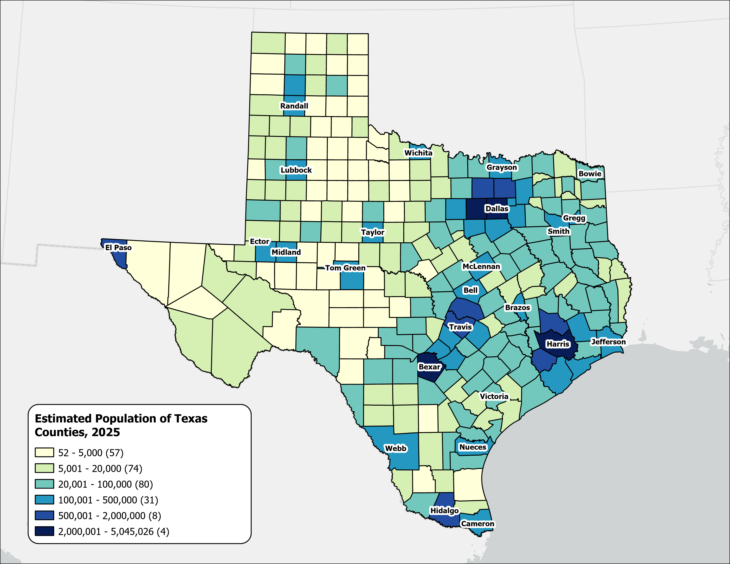
Estimated Population,
Texas Counties, 2025
Texas population is highly concentrated within the metropolitan triangle formed by Dallas–Fort Worth, Austin, San Antonio, and Houston.
The 120 counties on and east of the I‑35 corridor are home to 27.3 million residents—approximately 87.3% of the state’s total population.
87%
Source: U.S. Census Bureau, Vintage 2025 Population Estimates

Slide 7
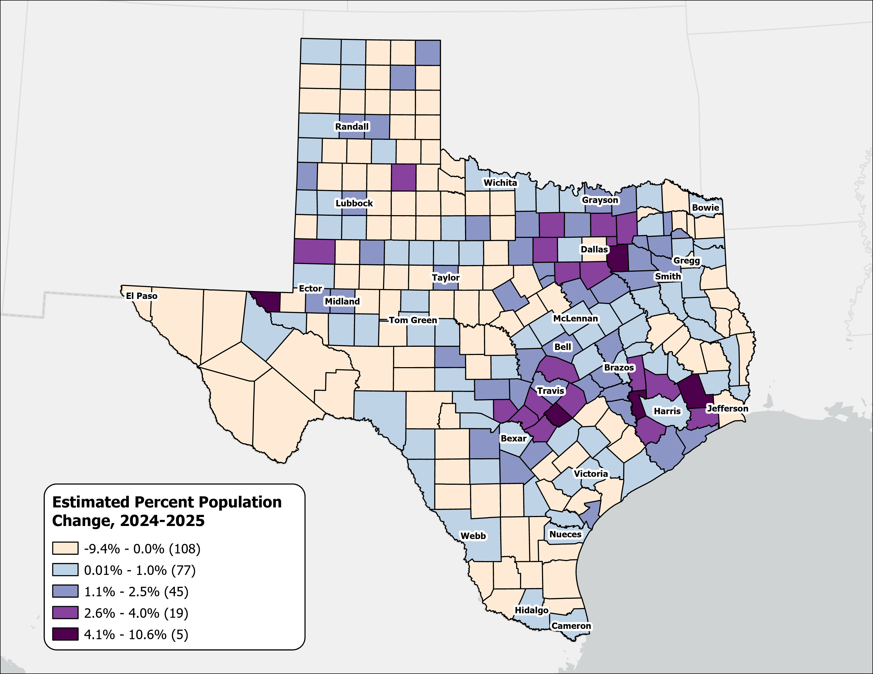
Estimated Percent Population Change, Texas Counties, 2024-2025
Rapid growth was concentrated in counties at the suburban and exurban edges of the Texas metropolitan triangle.
Source: U.S. Census Bureau, Vintage 2025 Population Estimates

Slide 8
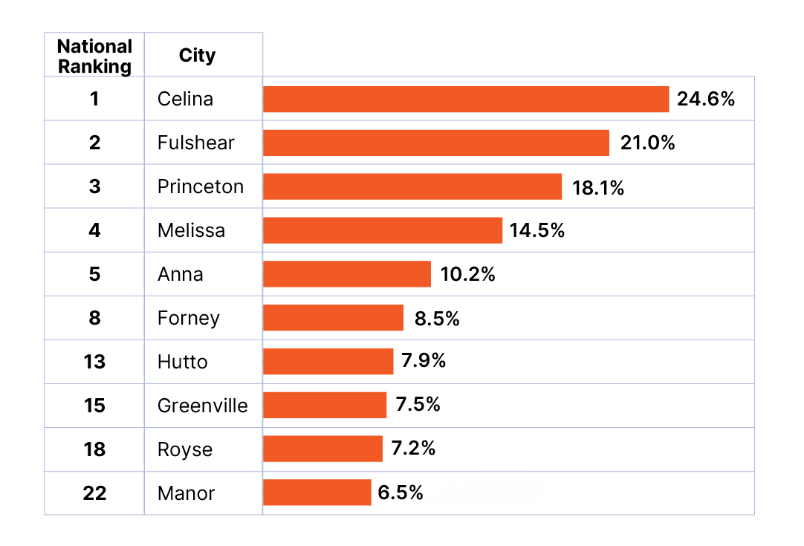
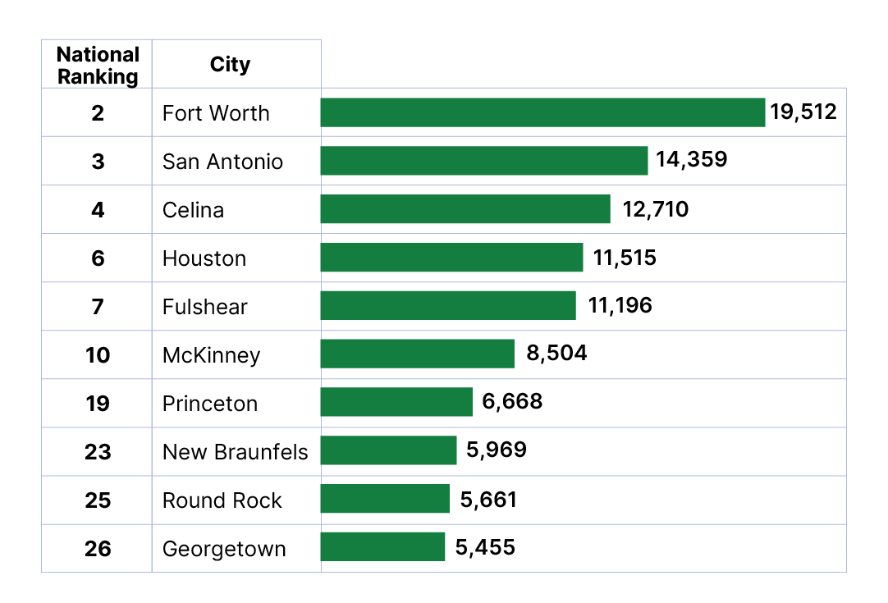
Top Growth Texas Cities and Towns
Top 10 Cities by Percent Growth in Texas
From July 1, 2024 to July 1, 2025
Top 10 Cities by Numeric Growth in Texas
From July 1, 2024 to July 1, 2025
Source: U.S. Census Bureau, Vintage 2025 Population Estimates. Ranked among incorporated places with a population of 20,000 or more.

Slide 9
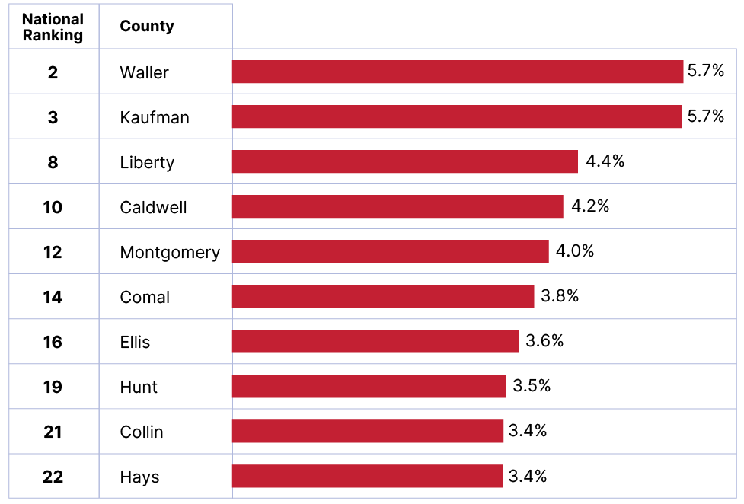
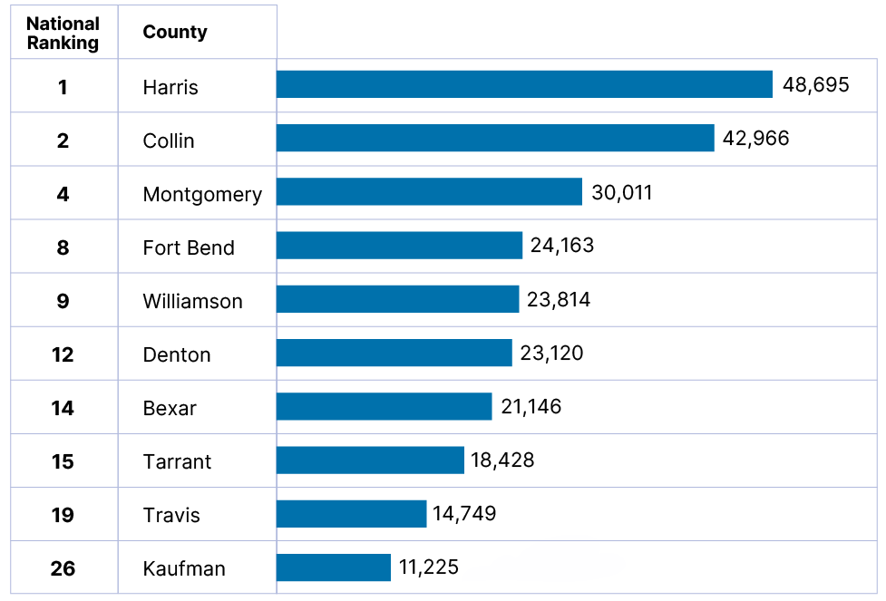
Top Growth Texas Counties
Top 10 Counties by Percent Growth in Texas
From July 1, 2024 to July 1, 2025
Top 10 Counties by Numeric Growth in Texas
From July 1, 2024 to July 1, 2025
Source: U.S. Census Bureau, Vintage 2025 Population Estimates

Slide 10
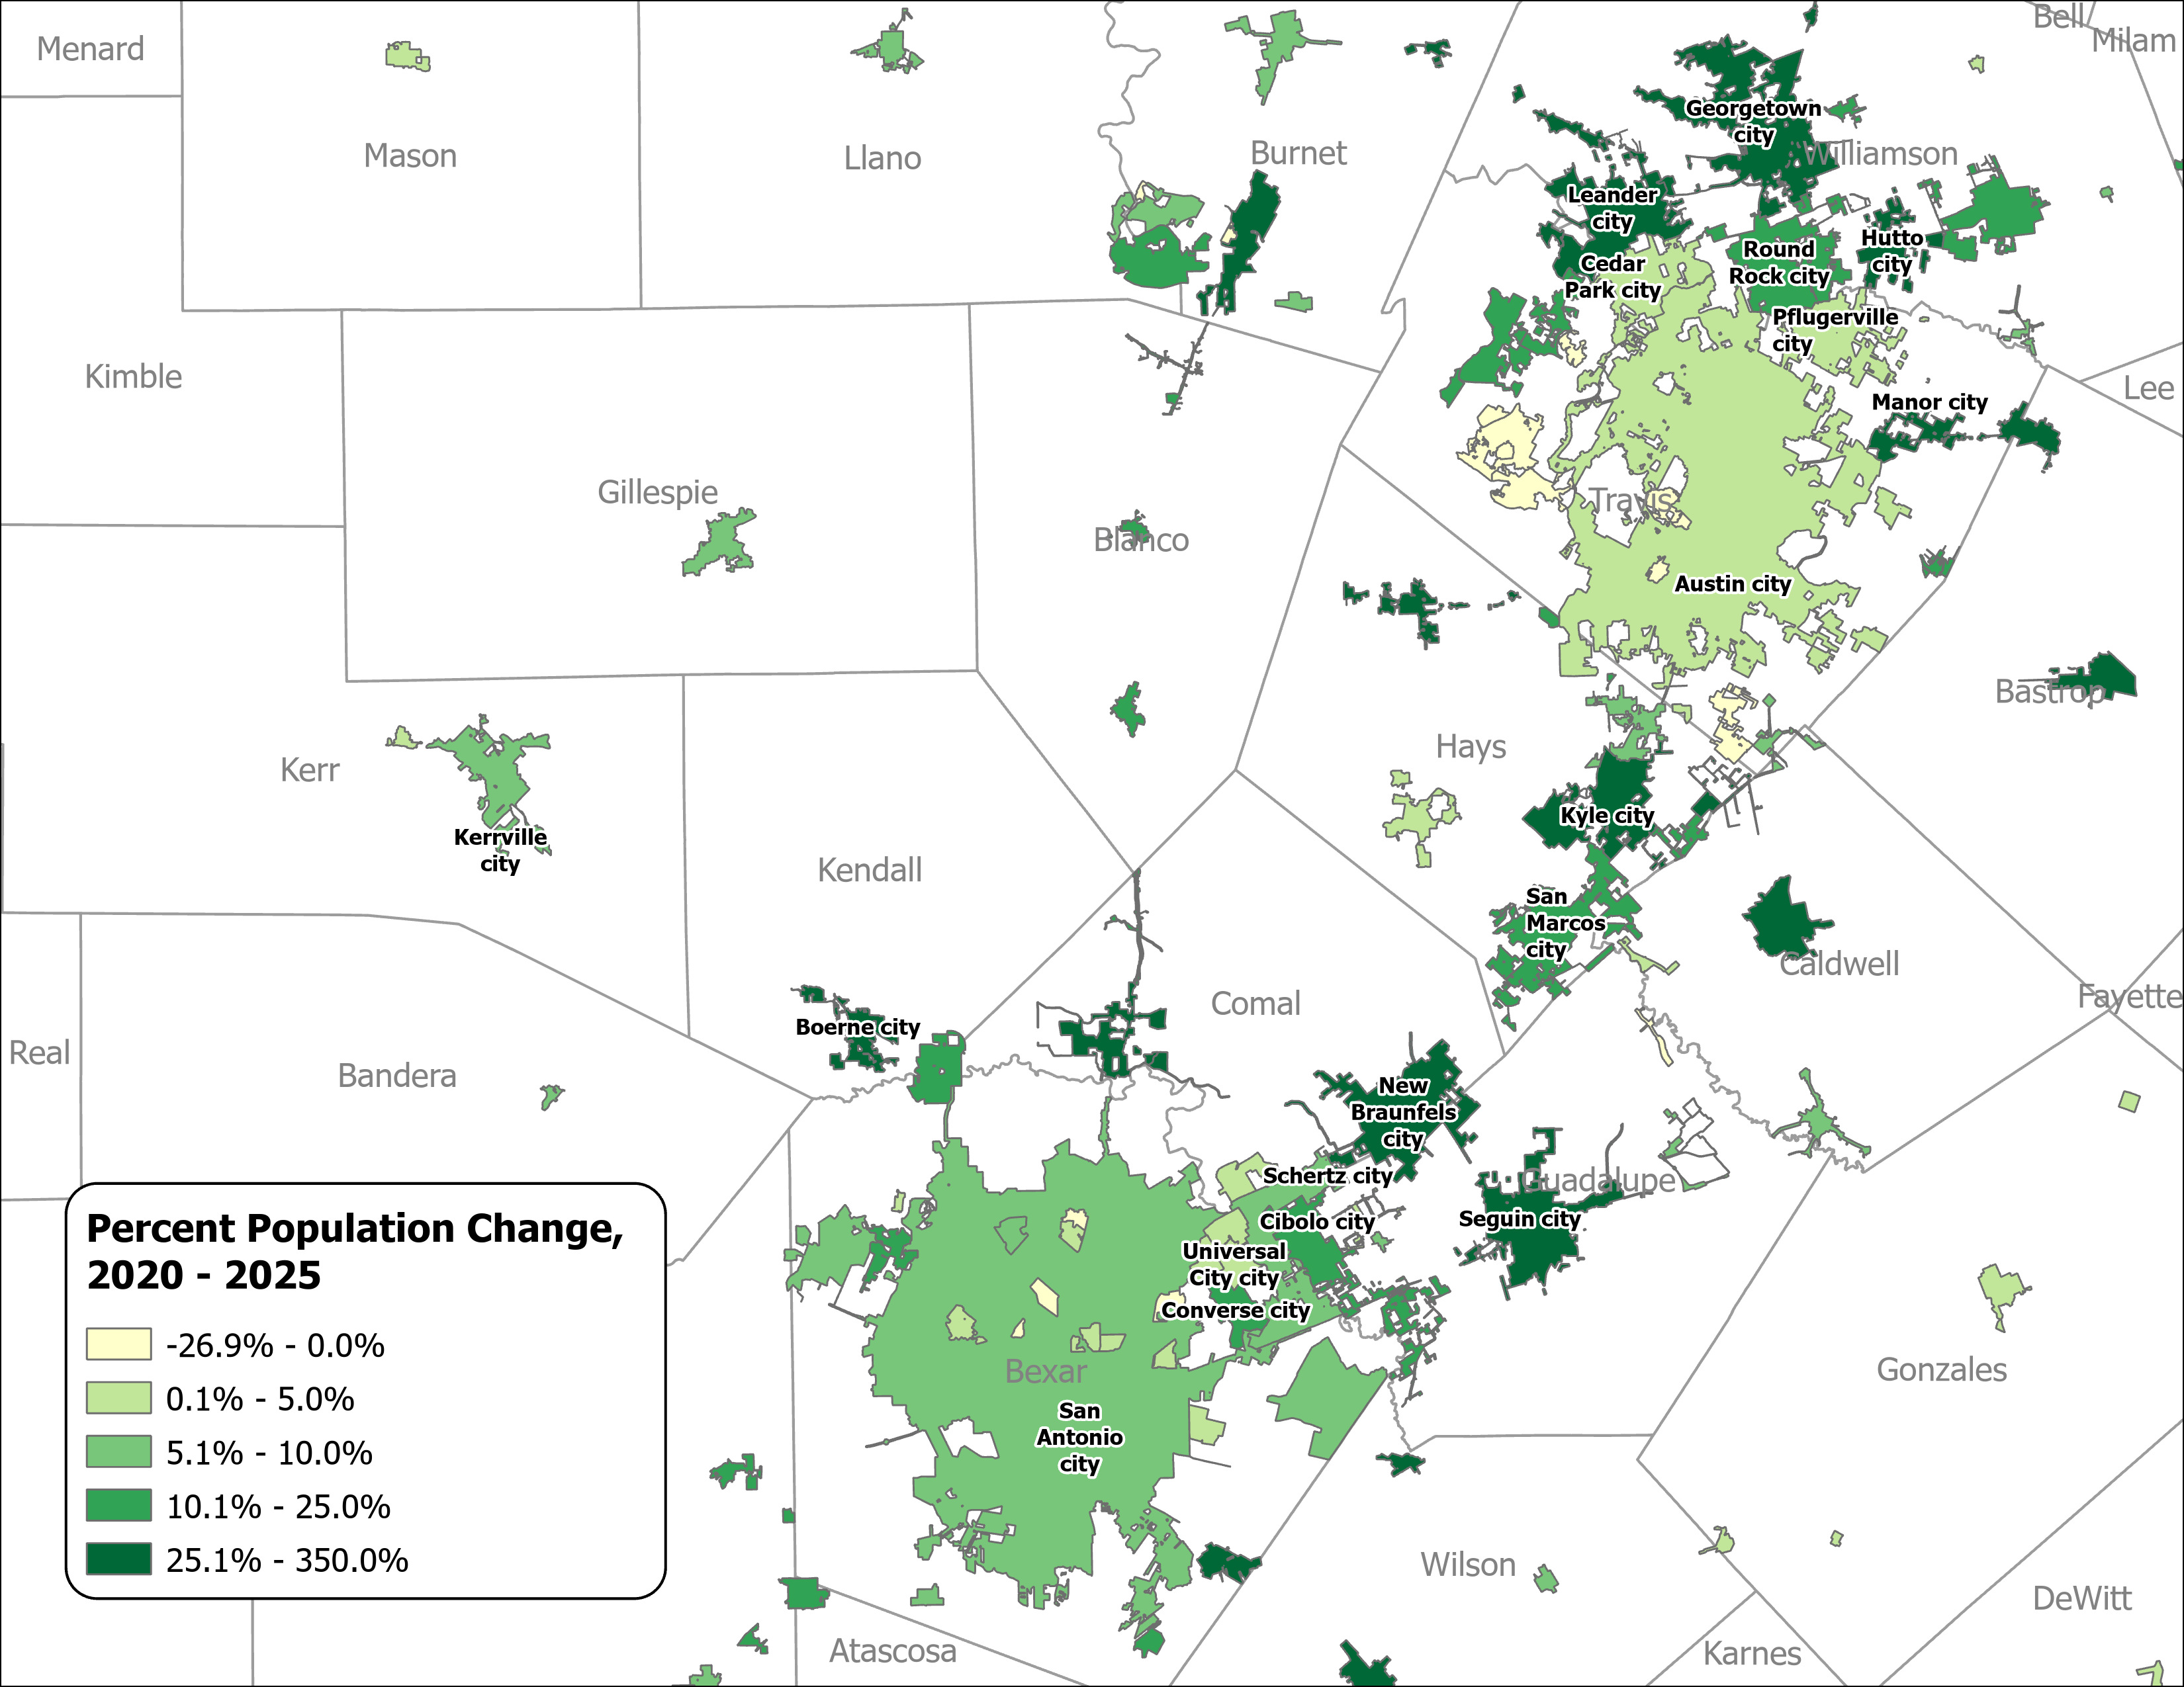
Percent Population Change for Incorporated Places, 2020-2025
Austin and San Antonio Area
Growth in major urban centers slowed considerably.
Small and midsized suburban and exurban cities within the Triangle region experienced the most rapid expansion.
Source: U.S. Census Bureau, Vintage 2025 Population Estimates

Slide 11

Median Household Income and Home Value in Texas, 2013-2023
Median
Home
Value
Median
Household
Income
$
$
$
Source: U.S. Census Bureau, American Community Survey, 1-Year, 2013, 2018, and 2023.
Note: 2023 Inflation-Adjusted Dollars.

Slide 12
Drivers of Population Growth

Slide 13
Texas Daily Population Growth and Components of Change, 2020-2025
Reduced international and domestic migration drove the decline, while natural increase made up 40% of growth, up from about 25% since 2020.
917 | 1,494 | 1,647 | 1,642 | 1,072 | Daily Average Population Change
Source: U.S. Census Bureau, Vintage 2025 Population Estimates
Note: Components of change may not add to the total population change due to the minor residual components in the Census Bureau’s Population Estimates

Slide 14
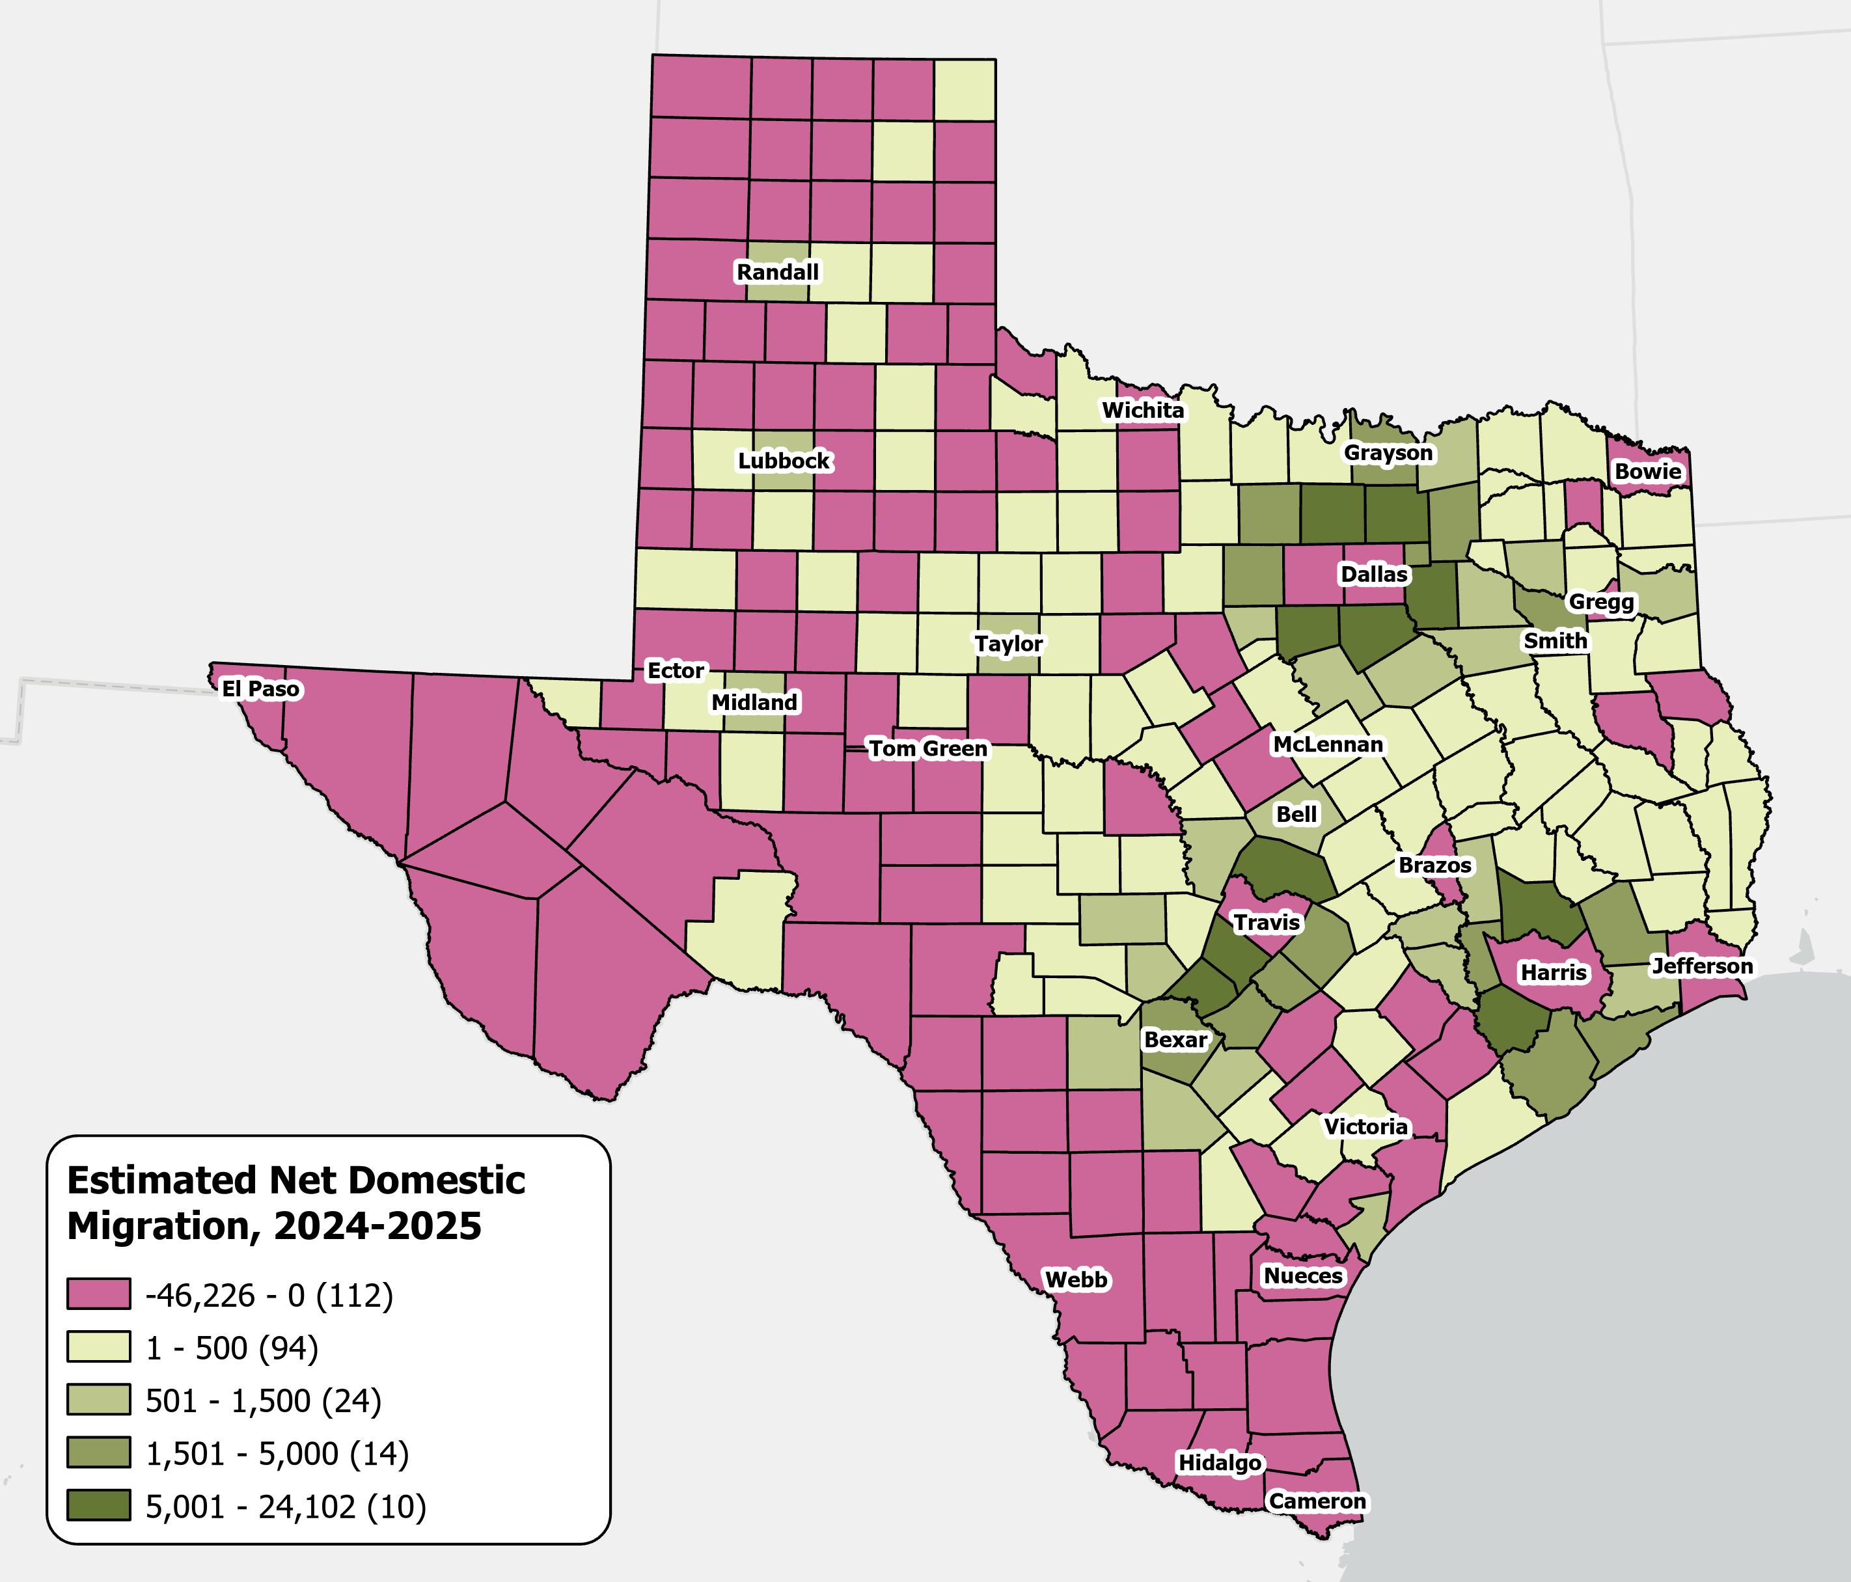
Estimates Net Domestic Migration Across Texas Counties
From July 1, 2024 to
July 1, 2025
High net domestic migration persists in suburban counties
Texas saw its
lowest domestic migration
in over a decade.
Source: U.S. Census Bureau, Vintage 2025 Population Estimates

Slide 15
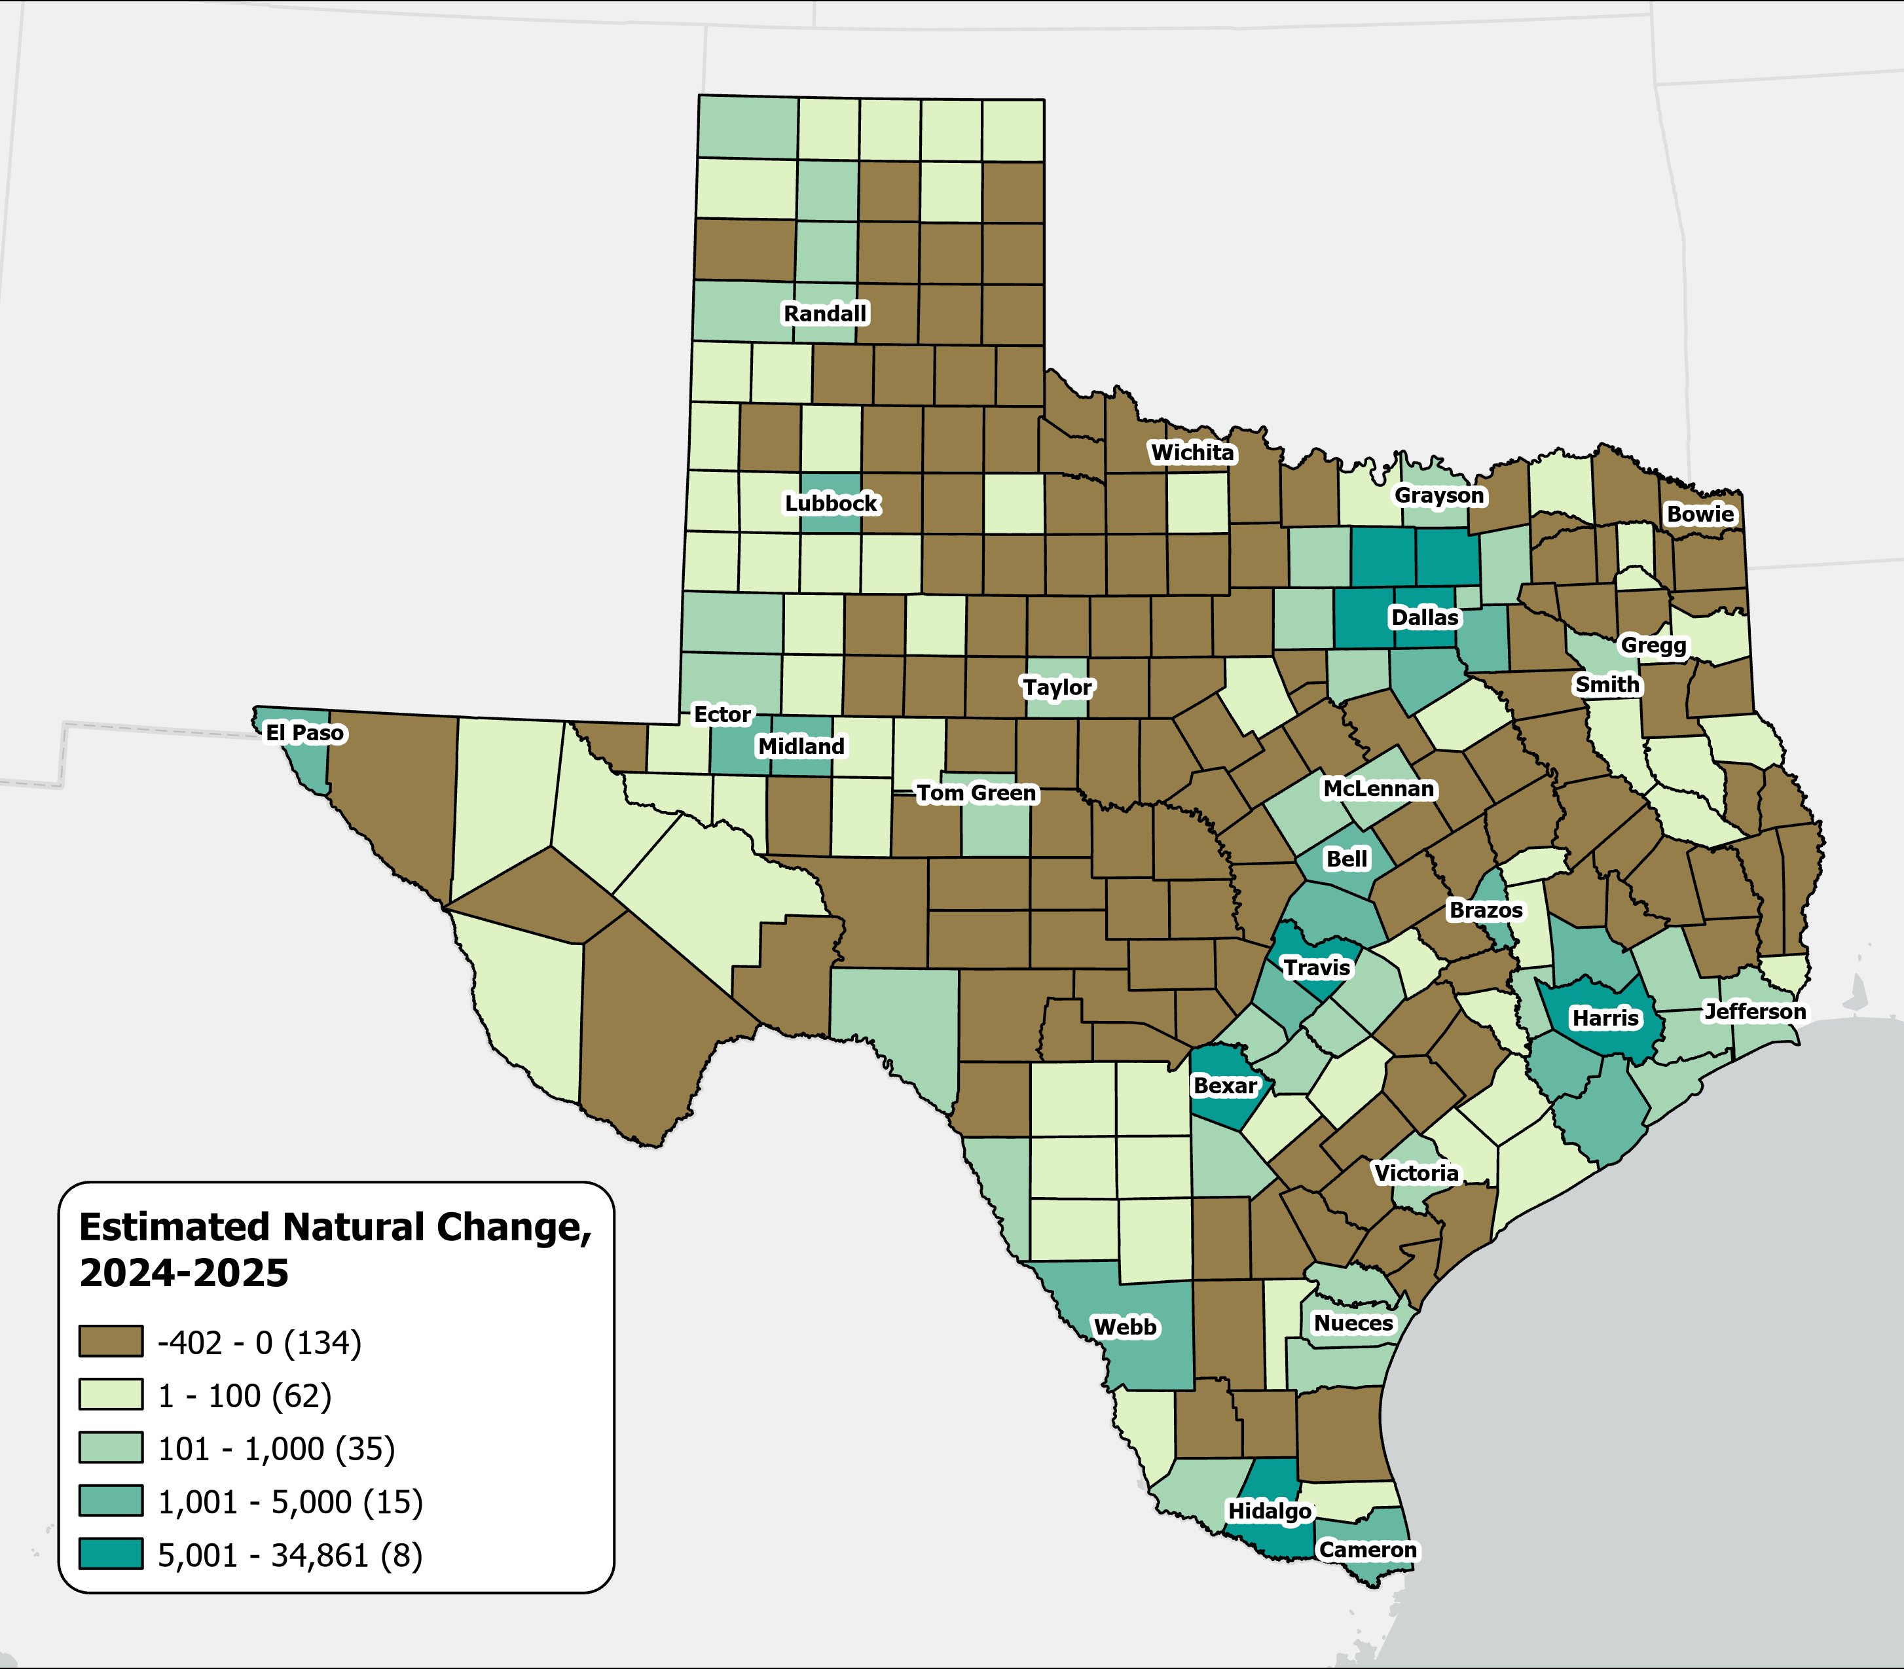
A majority of Texas counties saw more deaths than births
Estimates Natural Change Across Texas Counties
From July 2024 to July 2025
134
counties experienced natural population decline, with most located in rural areas.
Source: U.S. Census Bureau, Vintage 2025 Population Estimates

Slide 16
Texas Fertility Rates, 2007-2024
Births per 1,000 women aged 15-44
Source: Centers for Disease Control and Prevention, National Center for Health Statistics. Natality on CDC WONDER Online Database, 2007-2024.

Slide 17
Texas Fertility Rates by Age Group of Mothers, 2009 and 2024
Note: Birth rate is expressed as births per 1,000 women ages 15–44 during the calendar year.
Source: Centers for Disease Control and Prevention, National Center for Health Statistics.

Slide 18
Social and Economic Characteristics
Williamson County

Slide 19
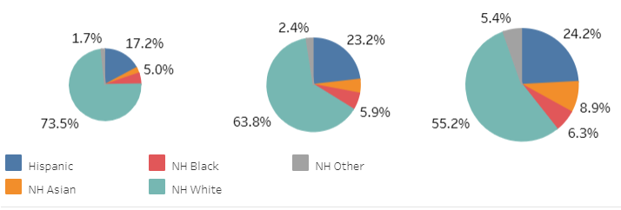
Williamson County 2000-2020
2000
Pop. 249,967
2010
Pop. 422,679
2020
Pop. 609,017
2025 Pop. 752,827
23.6% increase from 2020
Source: U.S. Census Bureau, Decennial Census P.L. 94-171 Redistricting Data, Vintage 2025 Population Estimates

Slide 20
Components of Population Change, 2024-2025,
Williamson County, TX
23,814 new residents between 2024-2025
65 new residents per day
Source: US Census Bureau, 2025 Vintage Population Estimates
1 Total population change includes a residual. This residual represents the change in population that cannot be attributed to any specific demographic component. See Population Estimates Terms and Definitions at https://www.census.gov/programs-surveys/popest/about/glossary.html.

Slide 21
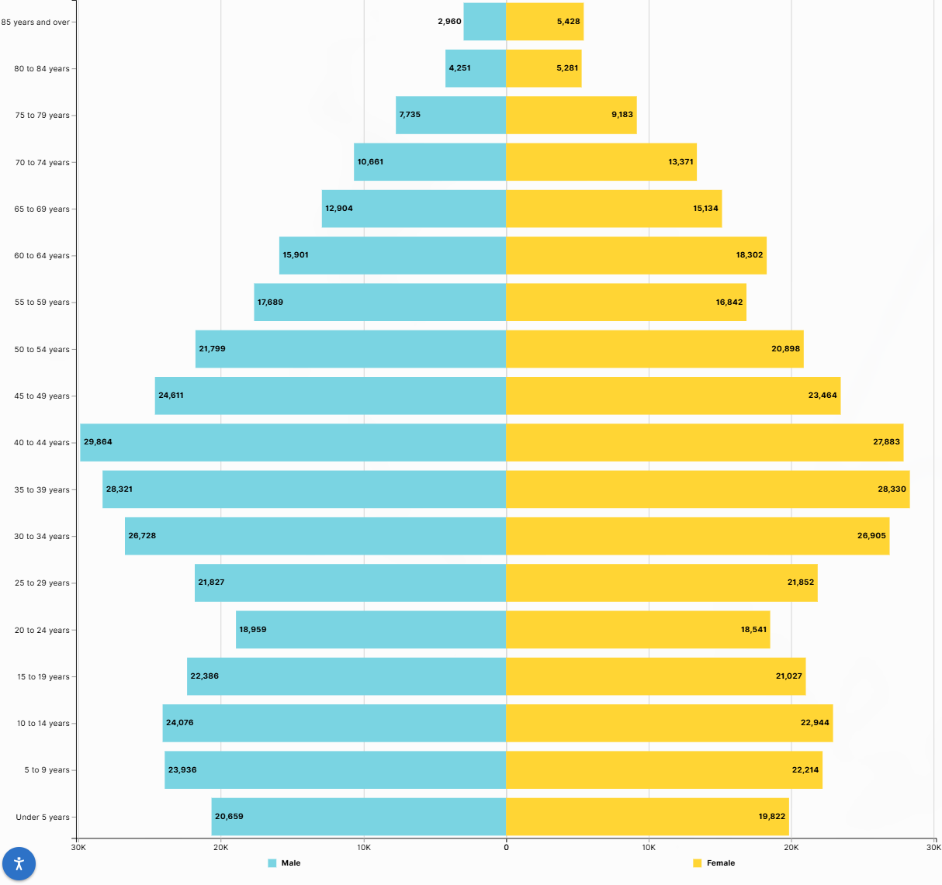
Williamson County
Population Pyramid
Largest age group is between 35-44 years
Small population under 5 years
Source: U.S. Census Bureau, 2024 ACS 5-year Estimates

Slide 22
Percentage of Families Whose Income in the Past 12 Months is Below the Poverty Level, Williamson County
All families | 3.90%
With related children under 18 years | 4.90%
With related children under 5 years only | 8.70%
Married couple families | 2.20%
With related children under 18 years | 2.10%
With related children under 5 years only | 2.60%
Families with female householder, no spouse present | 12.80%
With related children under 18 years | 17.70%
With related children under 5 years only | 62.10%
Source: U.S. Census Bureau, ACS 2024 1-year Estimates

Slide 23
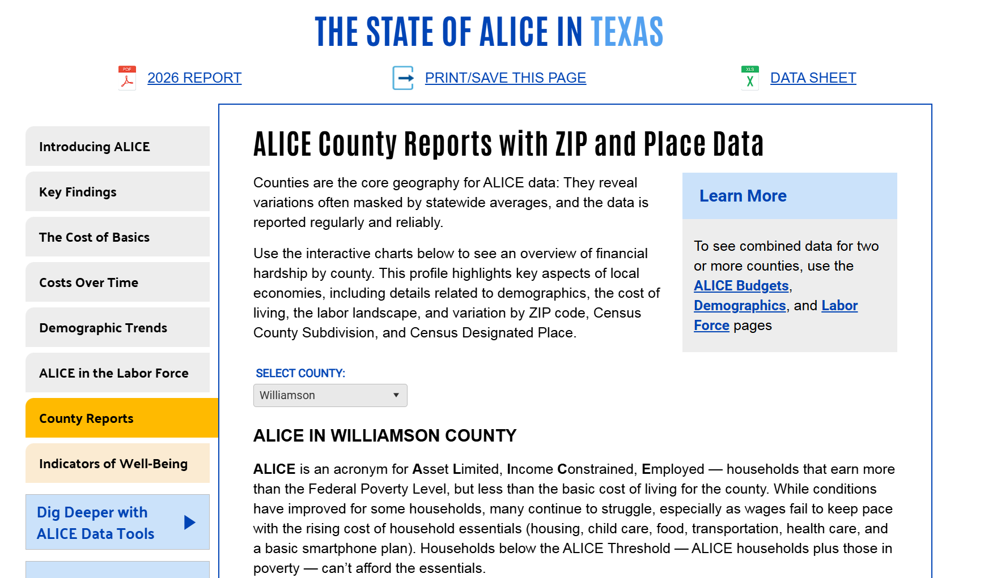
The State of Alice in Texas
Source: Texas | UnitedForALICE

Slide 24
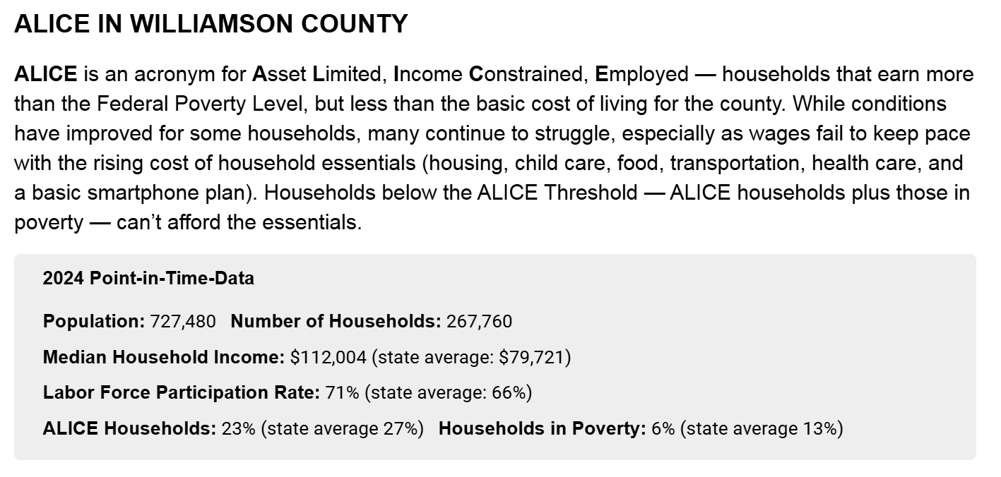
Alice in Williamson County
Source: The State of ALICE in Texas, 2024 Report Texas | UnitedForALICE

Slide 25
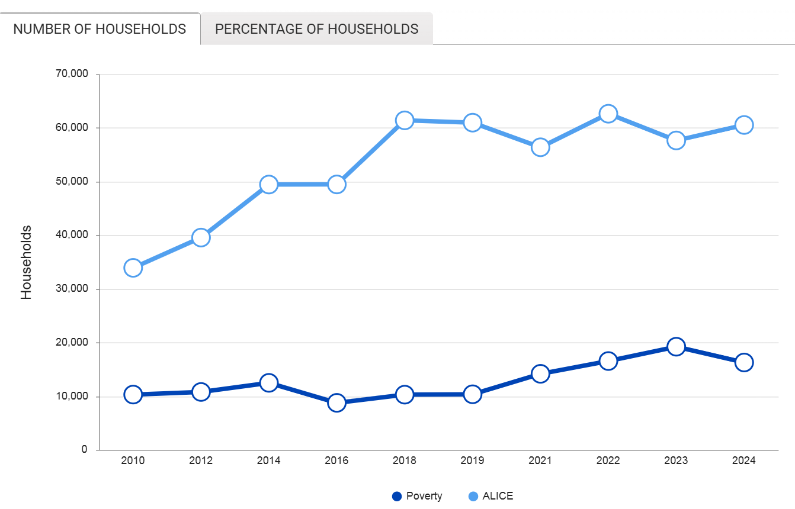
Financial Hardship Has Changed Over Time in Williamson County
2010 - 2024
2024
ALICE Threshold: 60,478
(29% of all HH)
Poverty: 16,257
Source: The State of ALICE in Texas, 2024 Report Texas | UnitedForALICE

Slide 26
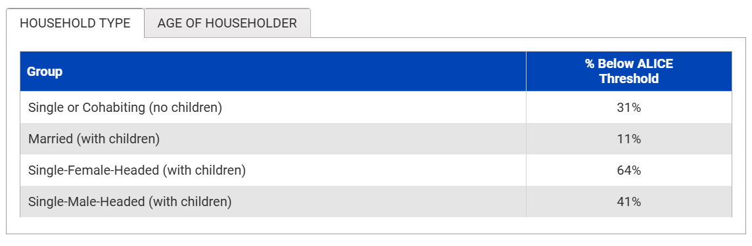
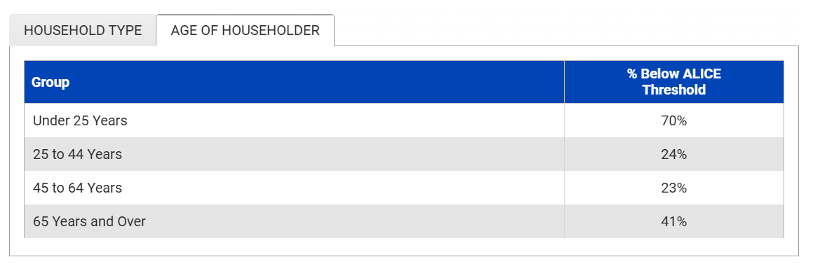
Financial Hardship by Household Type and Age
Williamson County, TX
Source: The State of ALICE in Texas, 2024 Report Texas | UnitedForALICE

Slide 27
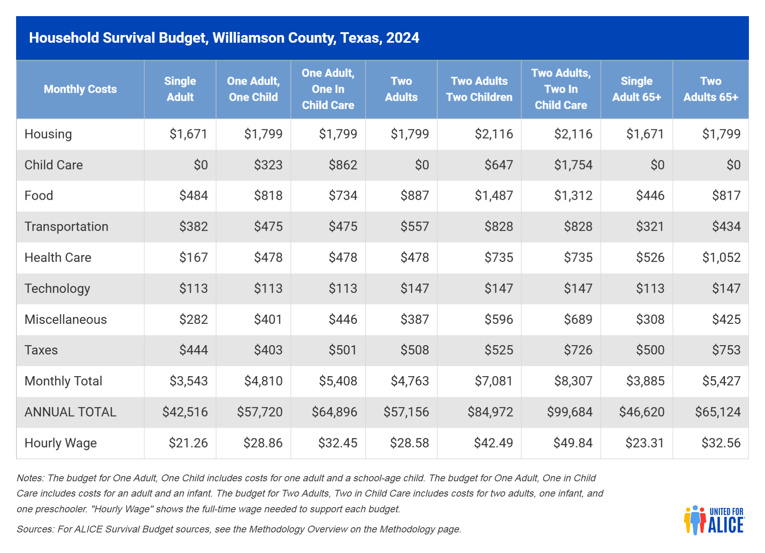
Household Survival Budget, Williamson County, Texas, 2024

Slide 28
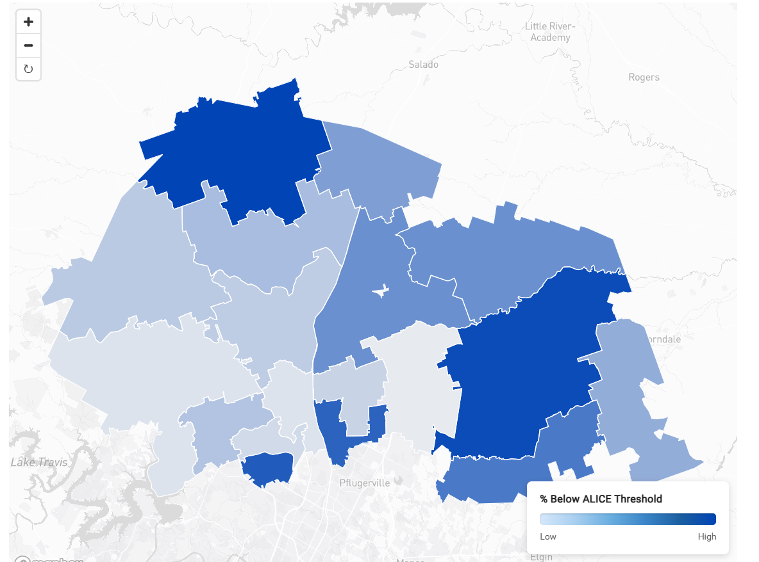
Financial Hardship by Zip Code
Williamson County, TX
Zipcode 76527: 45% Households are below the ALICE Threshold
Zipcode 76574: 44 % Households are below the ALICE Threshold
76527
76574
Source: The State of ALICE in Texas, 2024 Report Texas | UnitedForALICE

Slide 29
Median Income by Types of Families
Williamson County
Source: U.S. Census Bureau, 2024 ACS 1-year Estimates

Slide 30
Educational Attainment, 25 years and Older
Bachelor’s Degree or Higher by Race/Ethnicity
Williamson County, 2024
Source: U.S. Census Bureau, 2024 ACS 1-year Estimates

Slide 31

Housing Characteristics
Williamson County, 2024
Median Home Value | $464,900
Median Monthly Homeowner Cost | $2,609
Percent of Homeowners Cost-Burdened | 27%
Median Monthly Renter Cost | $1,854
Percent of Renters Cost-Burdened | 46%
63% HH Homeowners
37% HH Renters
Source: U.S. Census Bureau, 2024 ACS 1-year Estimates

Slide 32
Travis County

Slide 33
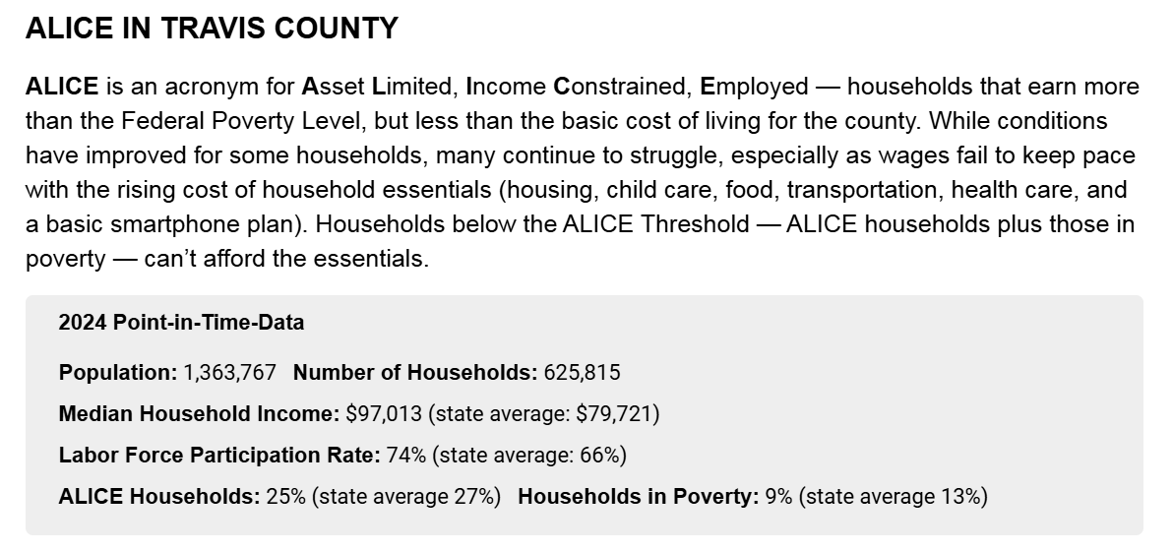
Alice in Travis County
Source: The State of ALICE in Texas, 2024 Report Texas | UnitedForALICE

Slide 34
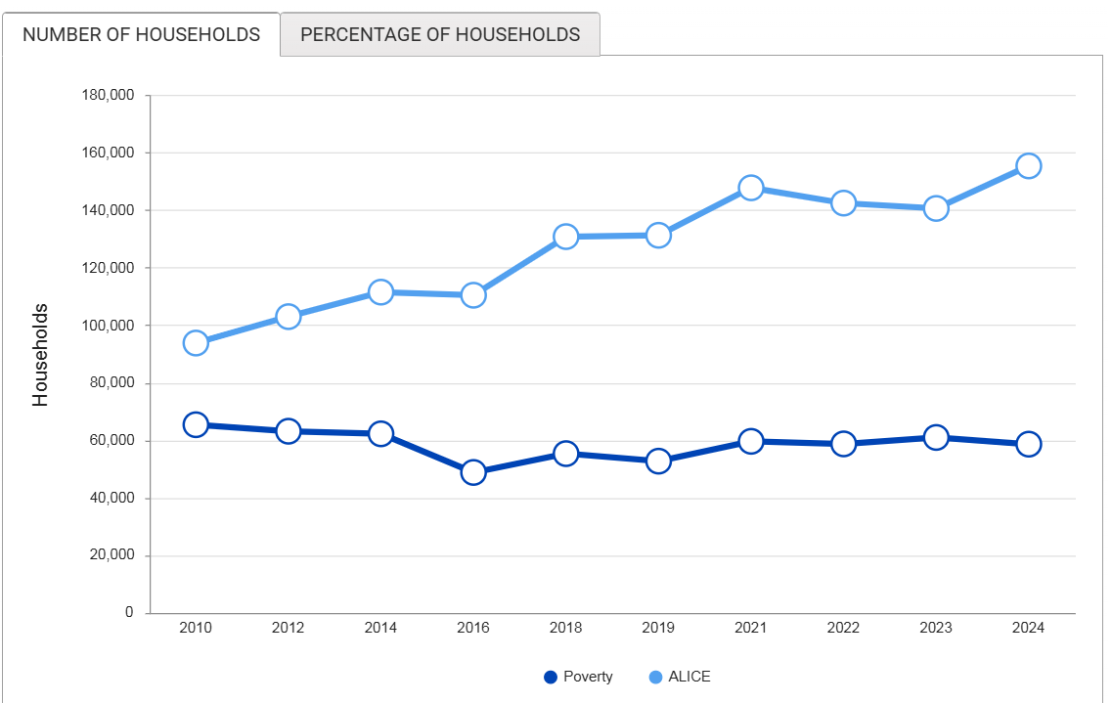
Financial Hardship Has Changed Over Time in Travis County
2010 - 2024
2024
ALICE Threshold: 155,306
(25% of all HH)
Poverty: 58,663
Source: The State of ALICE in Texas, 2024 Report Texas | UnitedForALICE

Slide 35
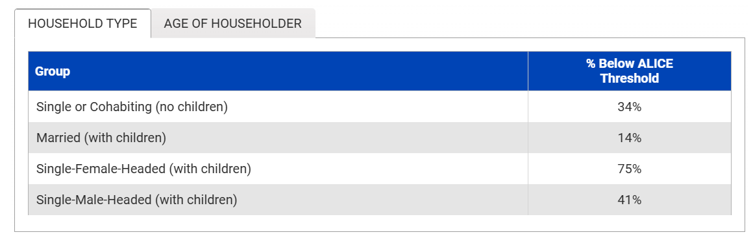
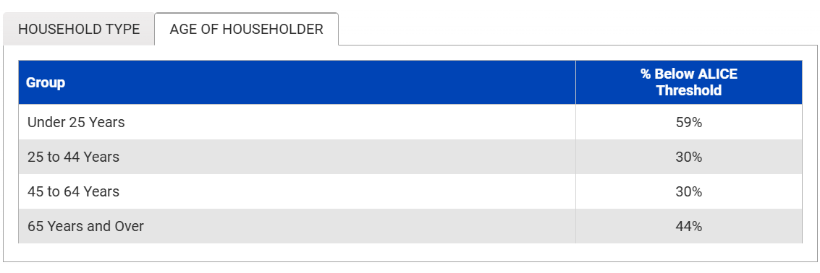
Financial Hardship by Household Type and Age
Travis County, TX
Source: The State of ALICE in Texas, 2024 Report Texas | UnitedForALICE

Slide 36
Percentage of Families Whose Income in the Past 12 Months is Below the Poverty Level, Travis County
All families | 6.7%
With related children under 18 years | 10.1%
With related children under 5 years only | 11.8%
Married couple families | 3.3%
With related children under 18 years | 3.4%
With related children under 5 years only | 2.0%
Families with female householder, no spouse present | 24.5%
With related children under 18 years | 36.5%
With related children under 5 years only | 71.0%
Source: U.S. Census Bureau, ACS 2024 1-year Estimates

Slide 37
A Look into the Future of Texas

Slide 38
Projected Population Growth, Selected Counties
2020-2060
1.3 M
Source: Texas Demographic Center, 2024 Vintage Population Projections

Slide 39
Texas is expected to keep growing significantly.
Projected Population Growth in Texas with Various Migration Scenarios
42.6 million
in 2060.
(Mid-migration Scenario)
Source: Texas Demographic Center, Vintage 2024 Population Projections

Slide 40
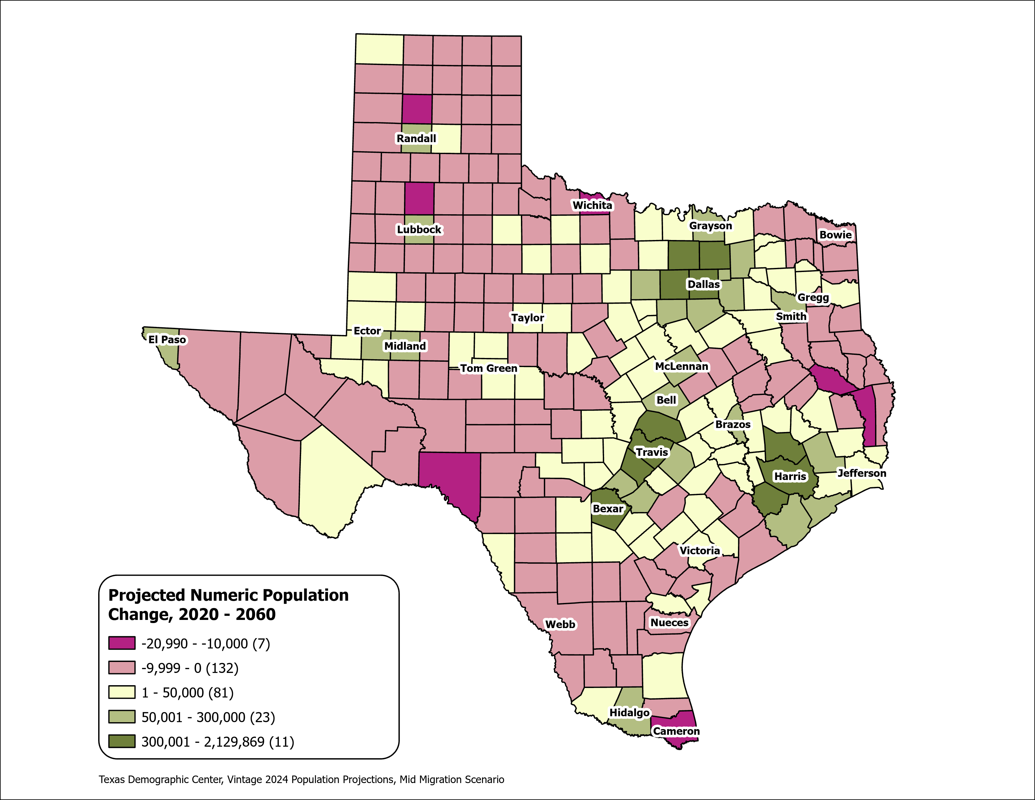
Texas Counties
Projected Population Numeric Change 2020-2060
Mid Migration Scenario
139 Counties are projected to lose population
Current MSA counties will account for 99% of the state’s growth from 2020 to 2060
The four MSAs within the TX Triangle will increase their share of population from 67% to 74%
Source: Texas Demographic Center, Vintage 2024 Population Projections, Mid Migration Scenario

Slide 41
Projected Population by Age
2020, 2040, and 2060
Mid Migration Scenario
22%
18%
Texas will continue to age in the next few decades.
The 65+ group will grow fastest.
Growth among those under 18 will slow and begin to decline.
The working-age population will grow and maintain a stable share of the total population.
13%
60%
60%
62%
Total Population
29.1M
37.1M
42.6M
Source: Texas Demographic Center, Vintage 2024 Population Projections, Mid Migration Scenario

Slide 42


Visit our website
demographics.texas.gov

Slide 43




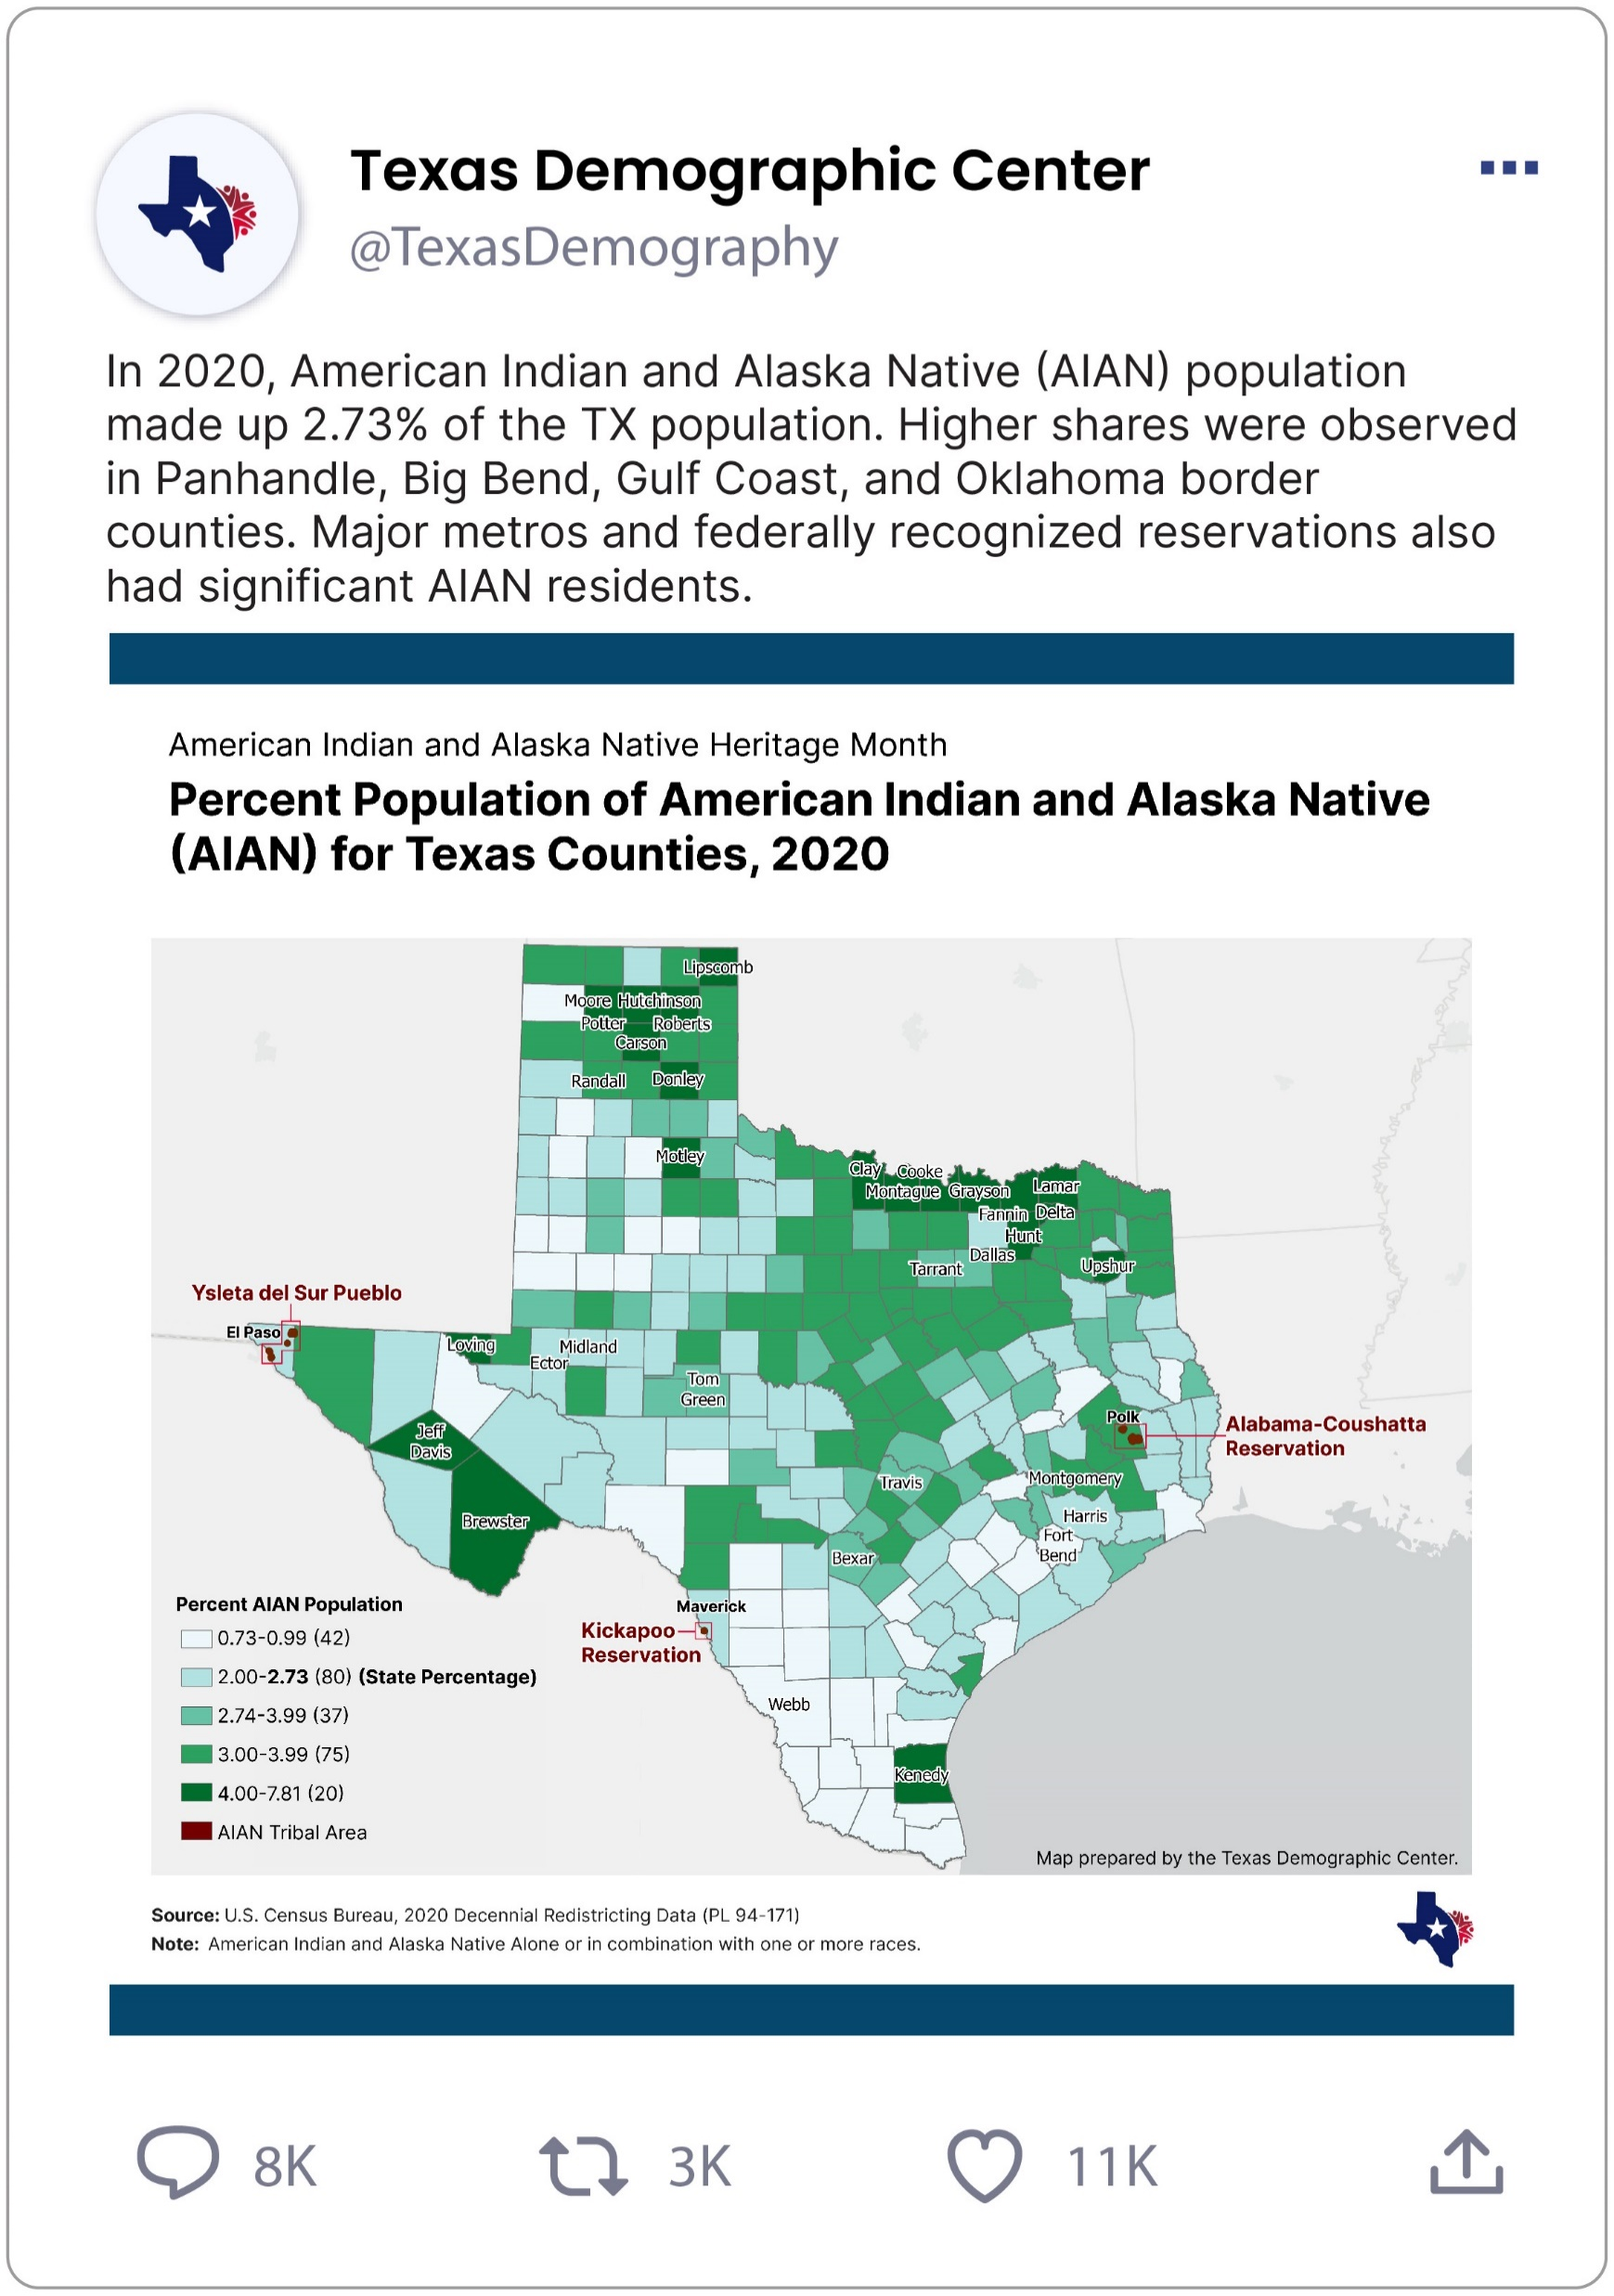
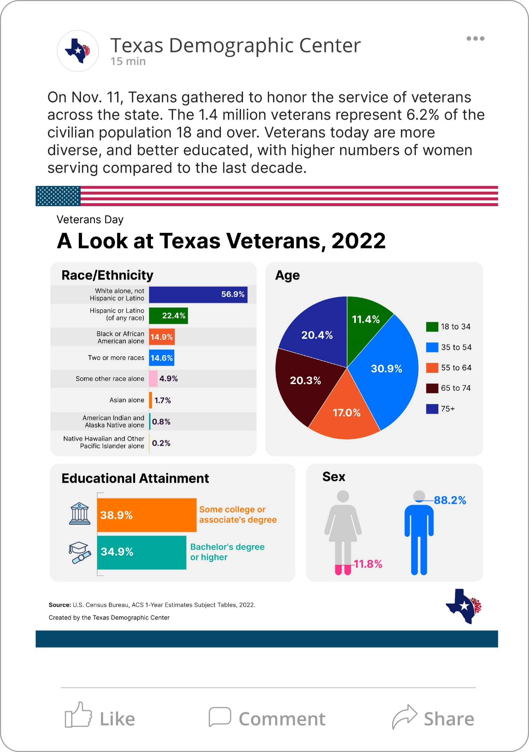
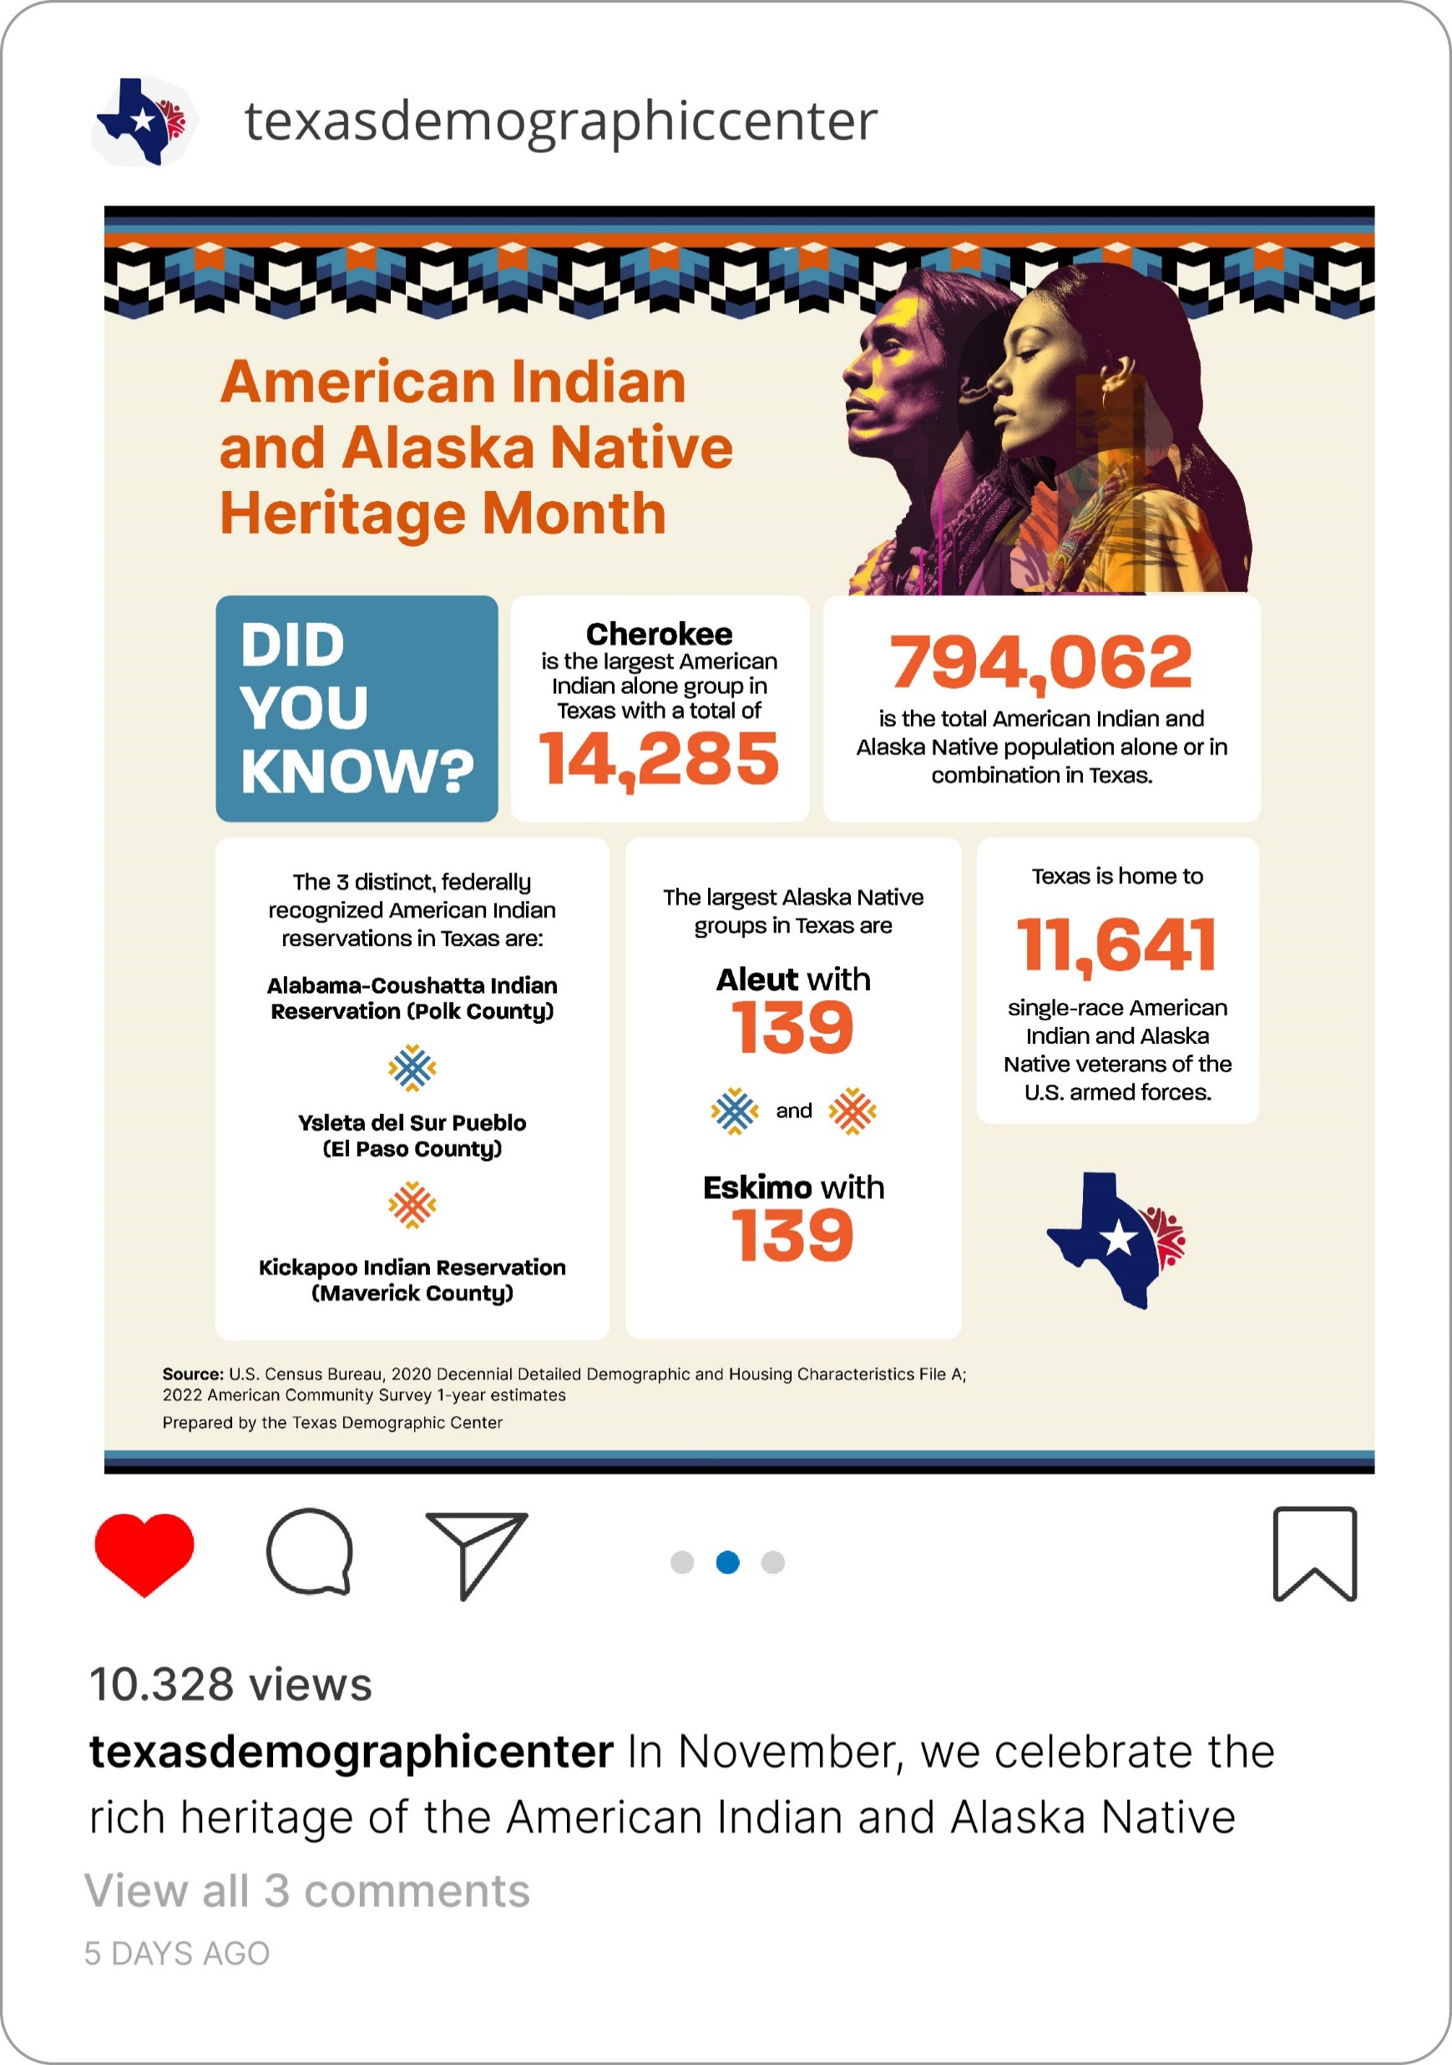
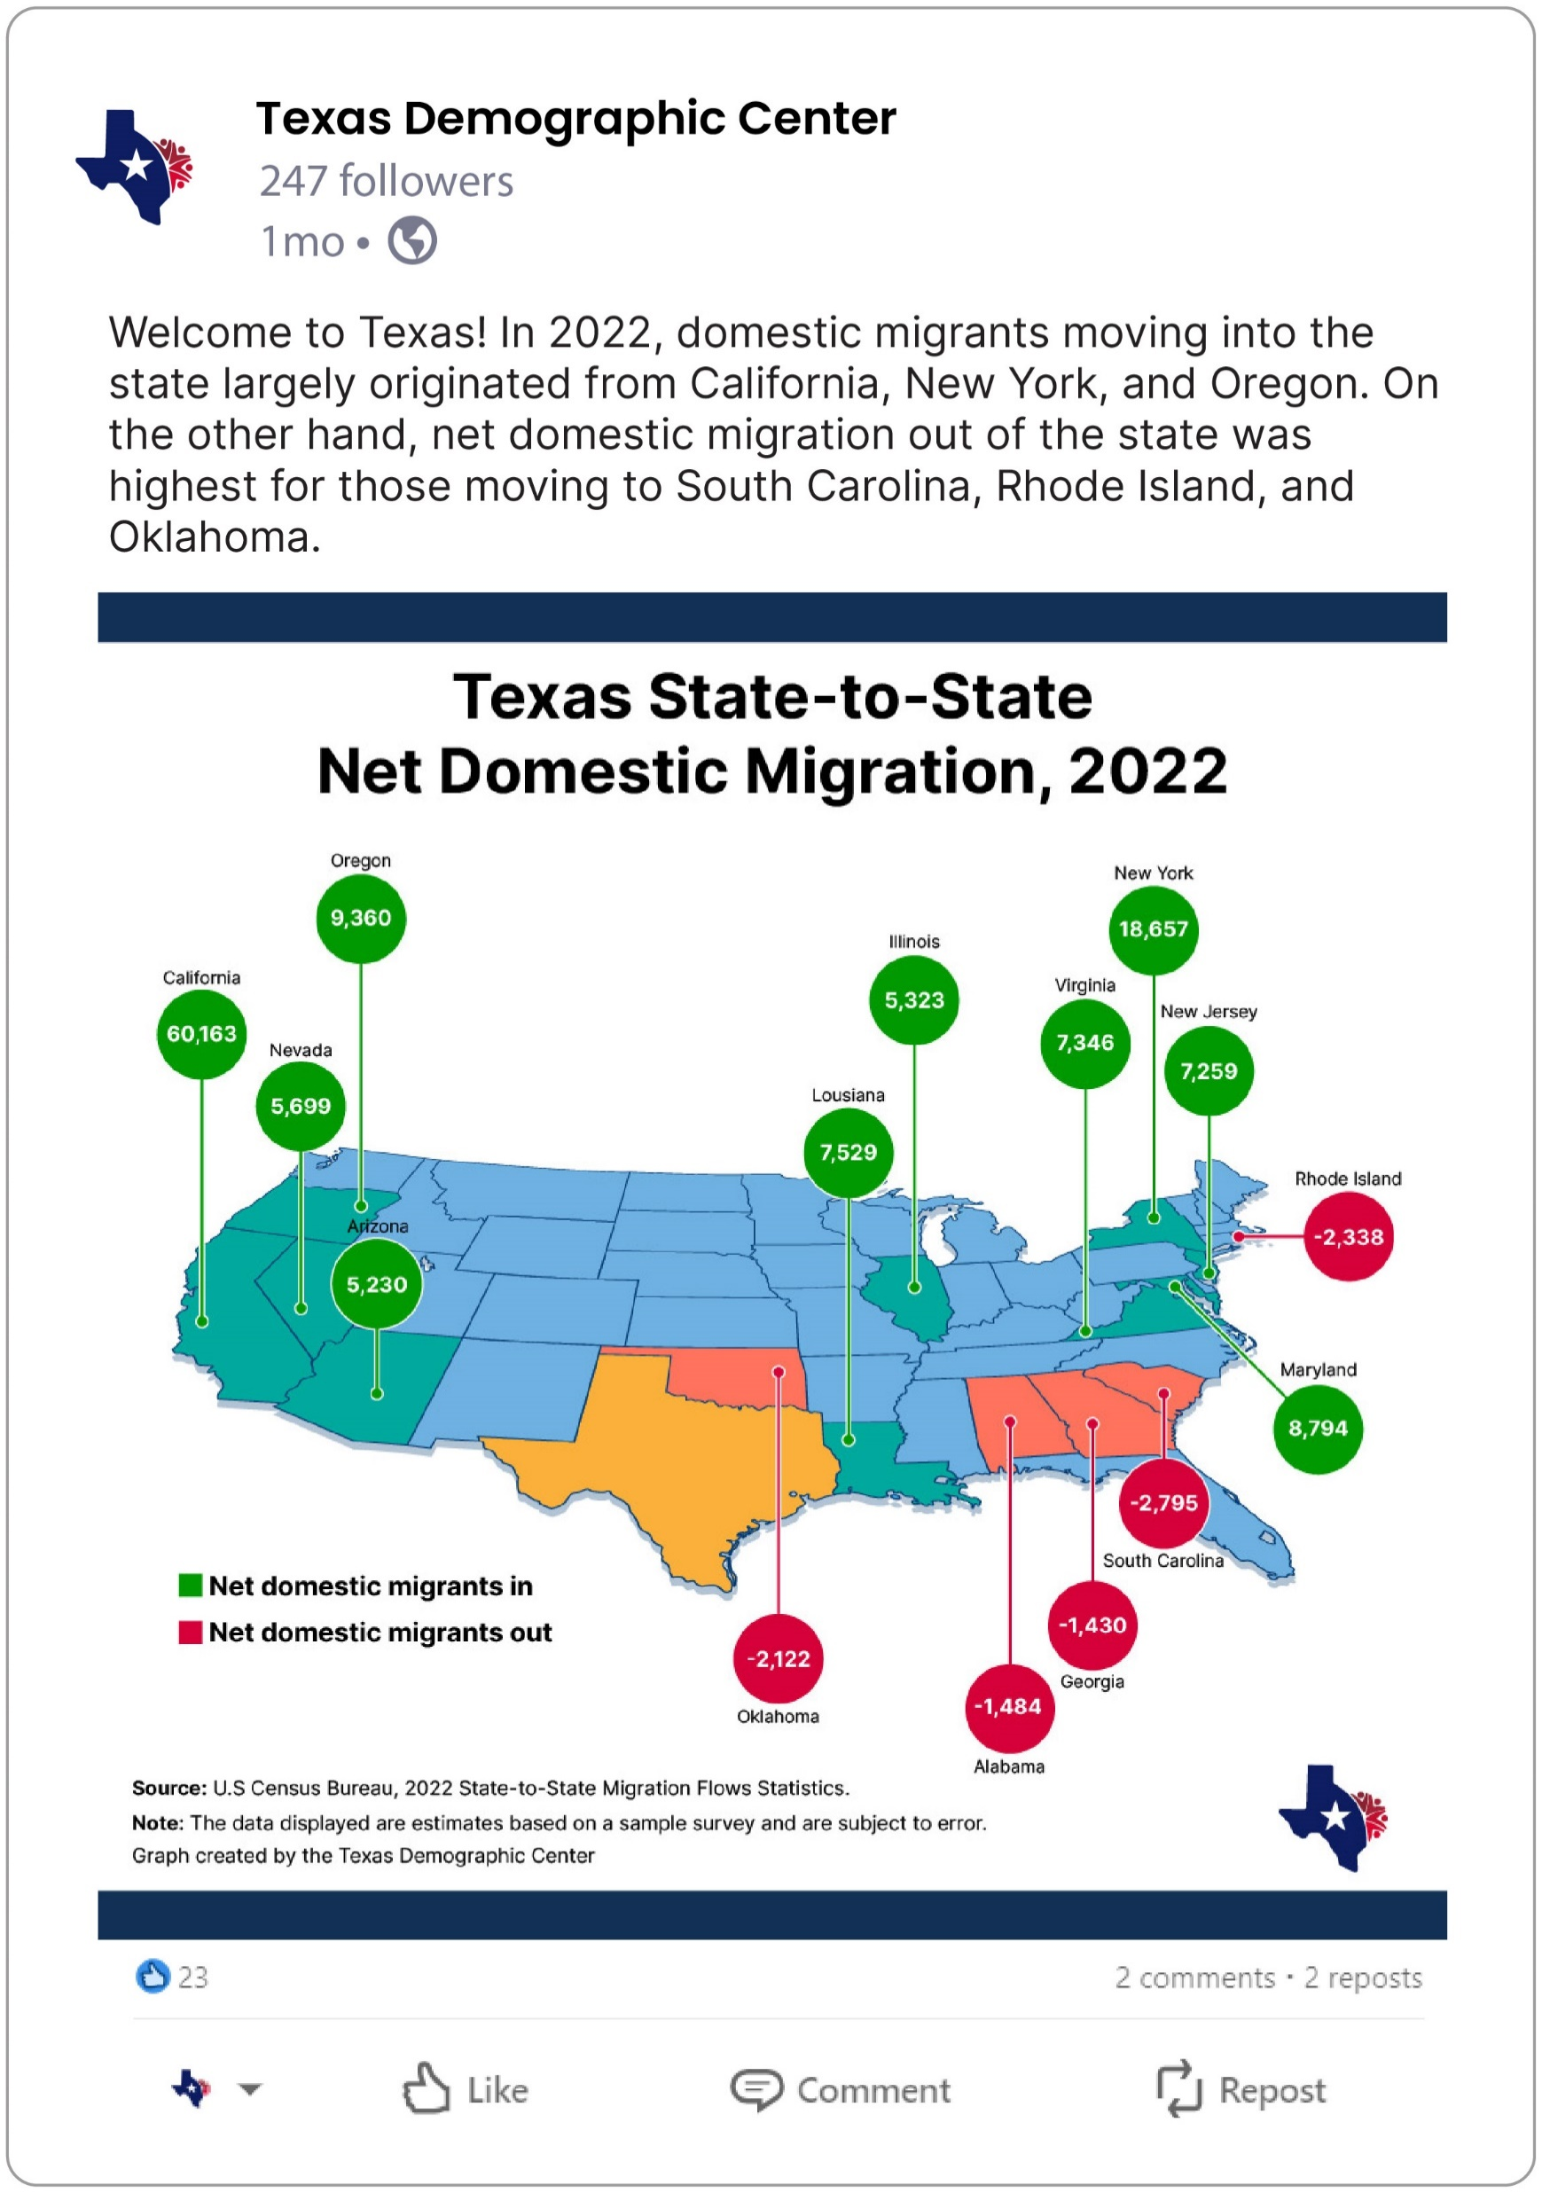
Follow us on social media!
@TexasDemography
Texas Demographic Center
texasdemographiccenter
Texas Demographic Center

Slide 44
Stay in Touch
Monica Cruz, Ph.D.
(210) 458-6543
TDC@UTSA.edu
demographics.texas.gov/

