Slide 1
Demographic Trends and Characteristics in Texas and Heart of Texas COG
Presented to
Heart of Texas Council of Governments
July 23, 2026

Slide 2




About the Texas Demographic Center
Major Function
Produce annual population estimates and biennial population projections
Other Services
Disseminate demographic and socioeconomic information from the Census Bureau and other reliable sources.
Provide training and technical expertise.
Custom data analyses.
State Demographer
Lloyd B. Potter, PhD
Affiliated with
The University of Texas at San Antonio
Institute for Demographic and Socioeconomic Research (IDSER)
Partnerships
U.S. Census Bureau
TDC Affiliates

Slide 3

New 2025 Estimates Show Texas Growth but at Slower Rate
Newly Released Data
Texas Total Population 2025
31.7M
391K
1.2%
Numeric increase
Percent increase
Growth from 2024
New Census Bureau data shows Texas’ population reached 31.7 million in July 2025 — a 1.2% increase from 2024 to 2025, more than 2X the 0.5% national growth rate. Though growth slowed compared to recent years, TX still led the nation in numeric gains, adding over 391K residents.

Slide 4
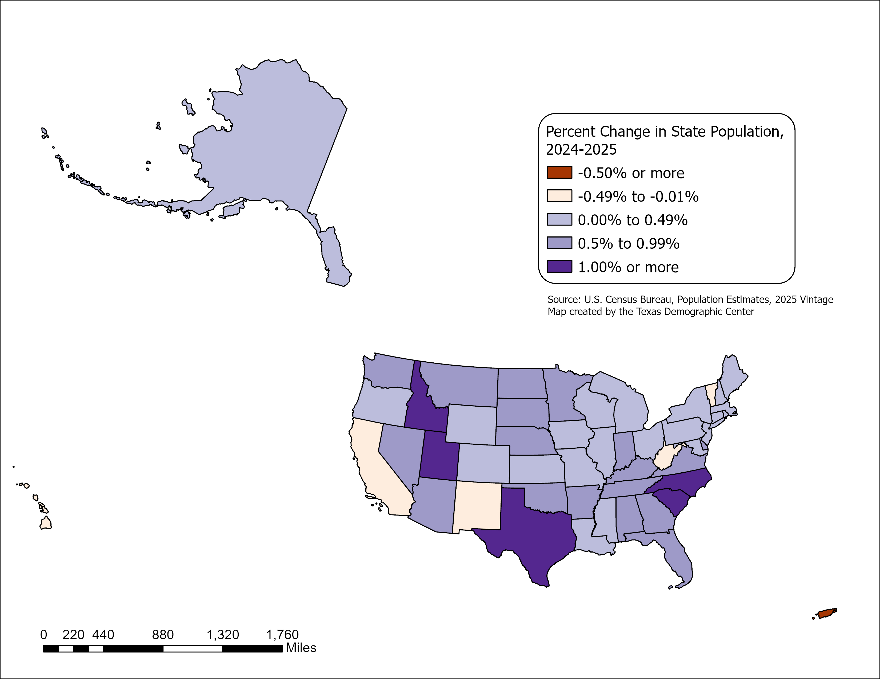
State Highlights
2024-2025
Top 5 States with percent change
  South Carolina
  North Carolina
  Idaho
  Utah
  Texas
All but five U.S. states grew between July 2024 and July 2025
- CA, HI, NM, VT, and WV.
Source: U.S. Census Bureau, Vintage 2025 Population Estimates

Slide 5
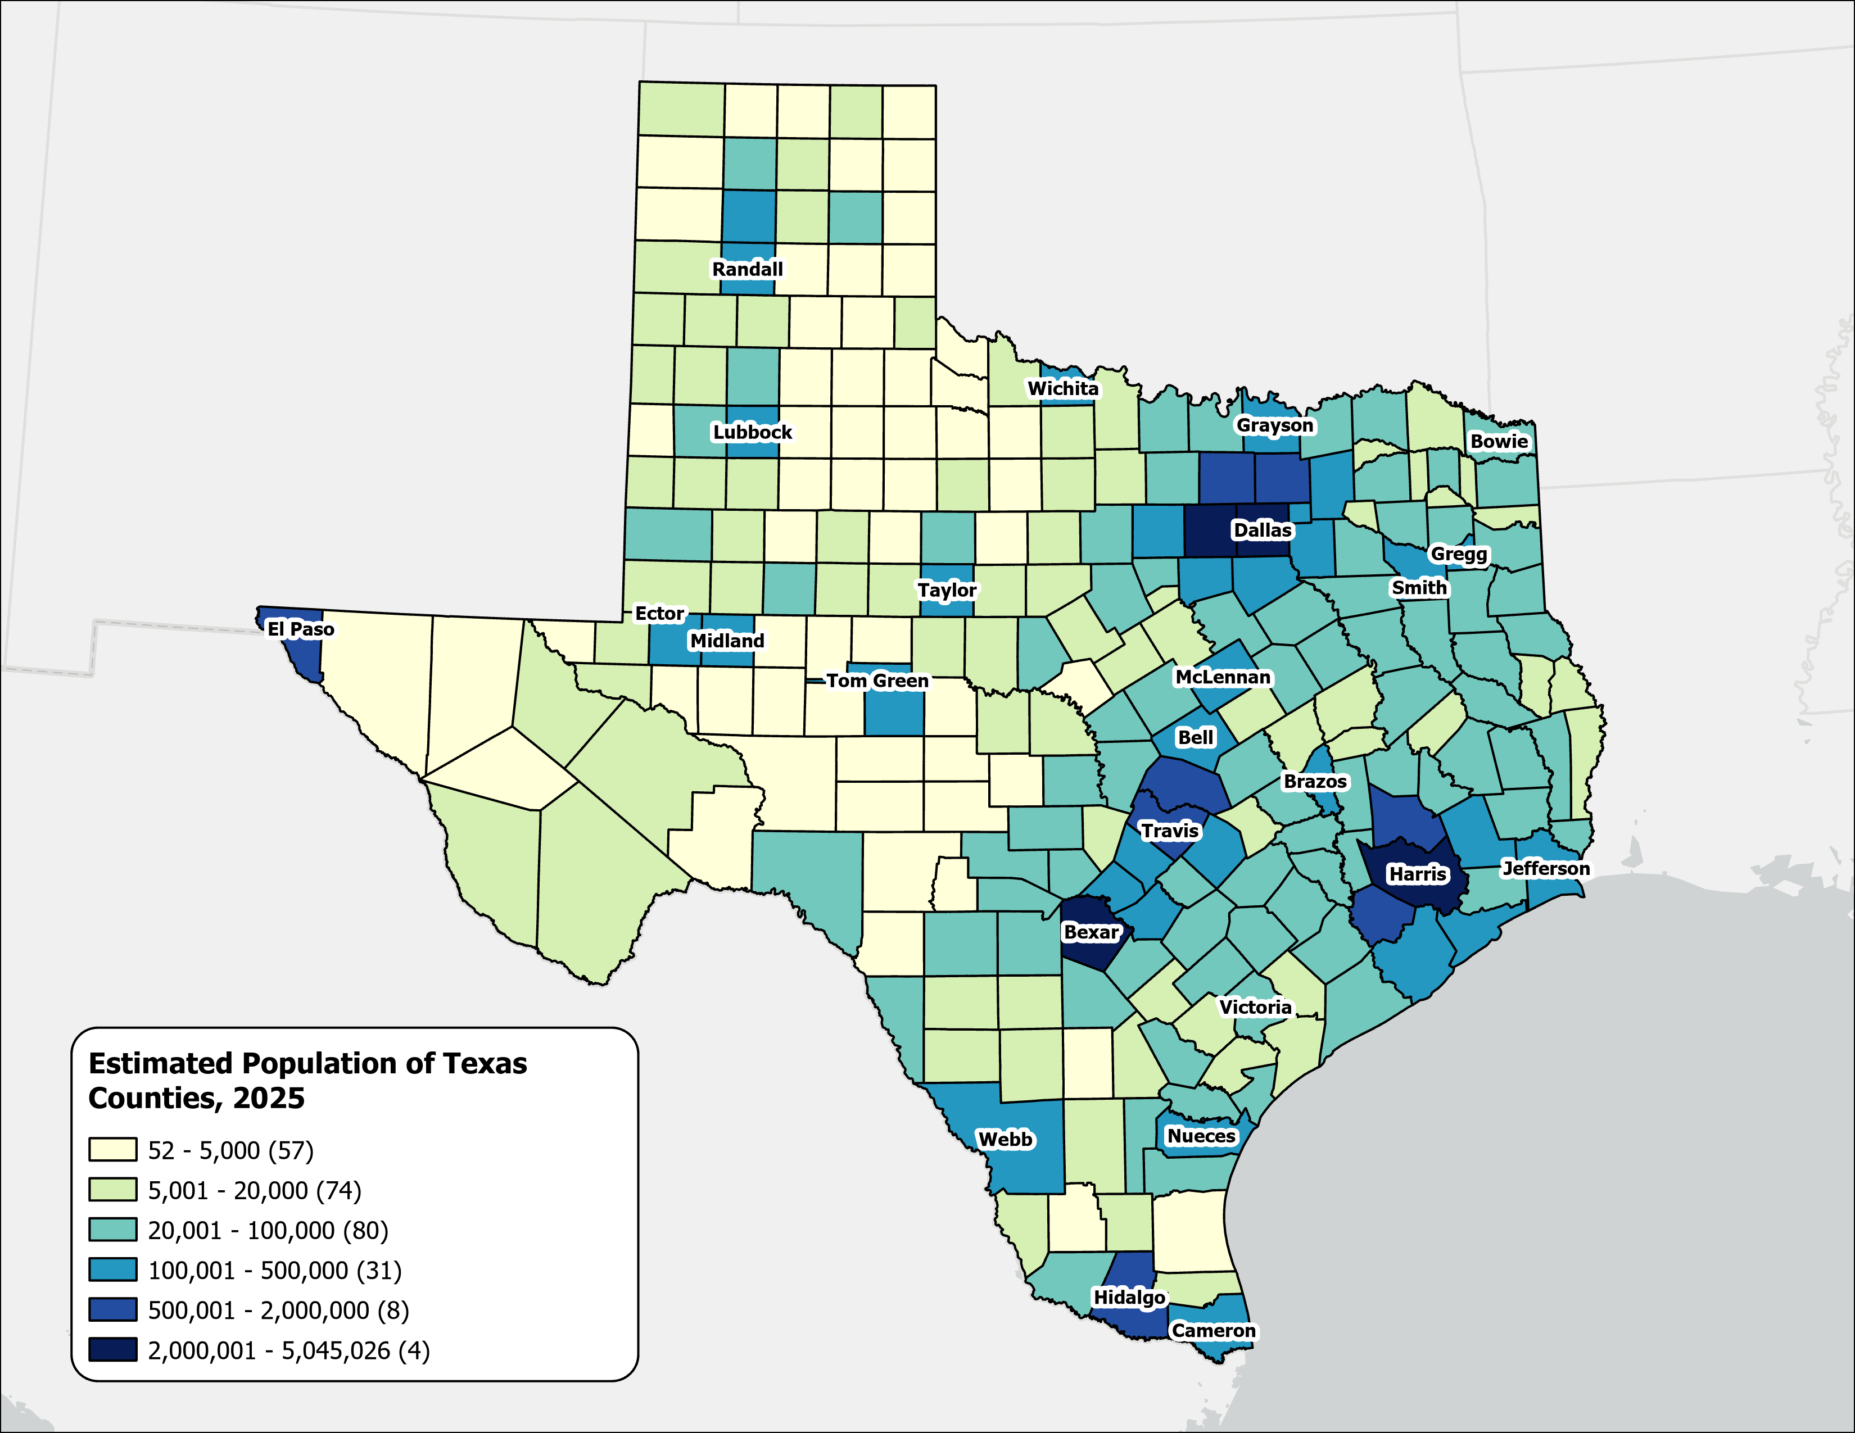
Estimated Population,
Texas Counties, 2025
Texas population is highly concentrated within the metropolitan triangle formed by Dallas–Fort Worth, Austin, San Antonio, and Houston.
The 120 counties on and east of the I‑35 corridor are home to 27.3 million residents—approximately 87.3% of the state’s total population.
87%
Source: U.S. Census Bureau, Vintage 2025 Population Estimates

Slide 6
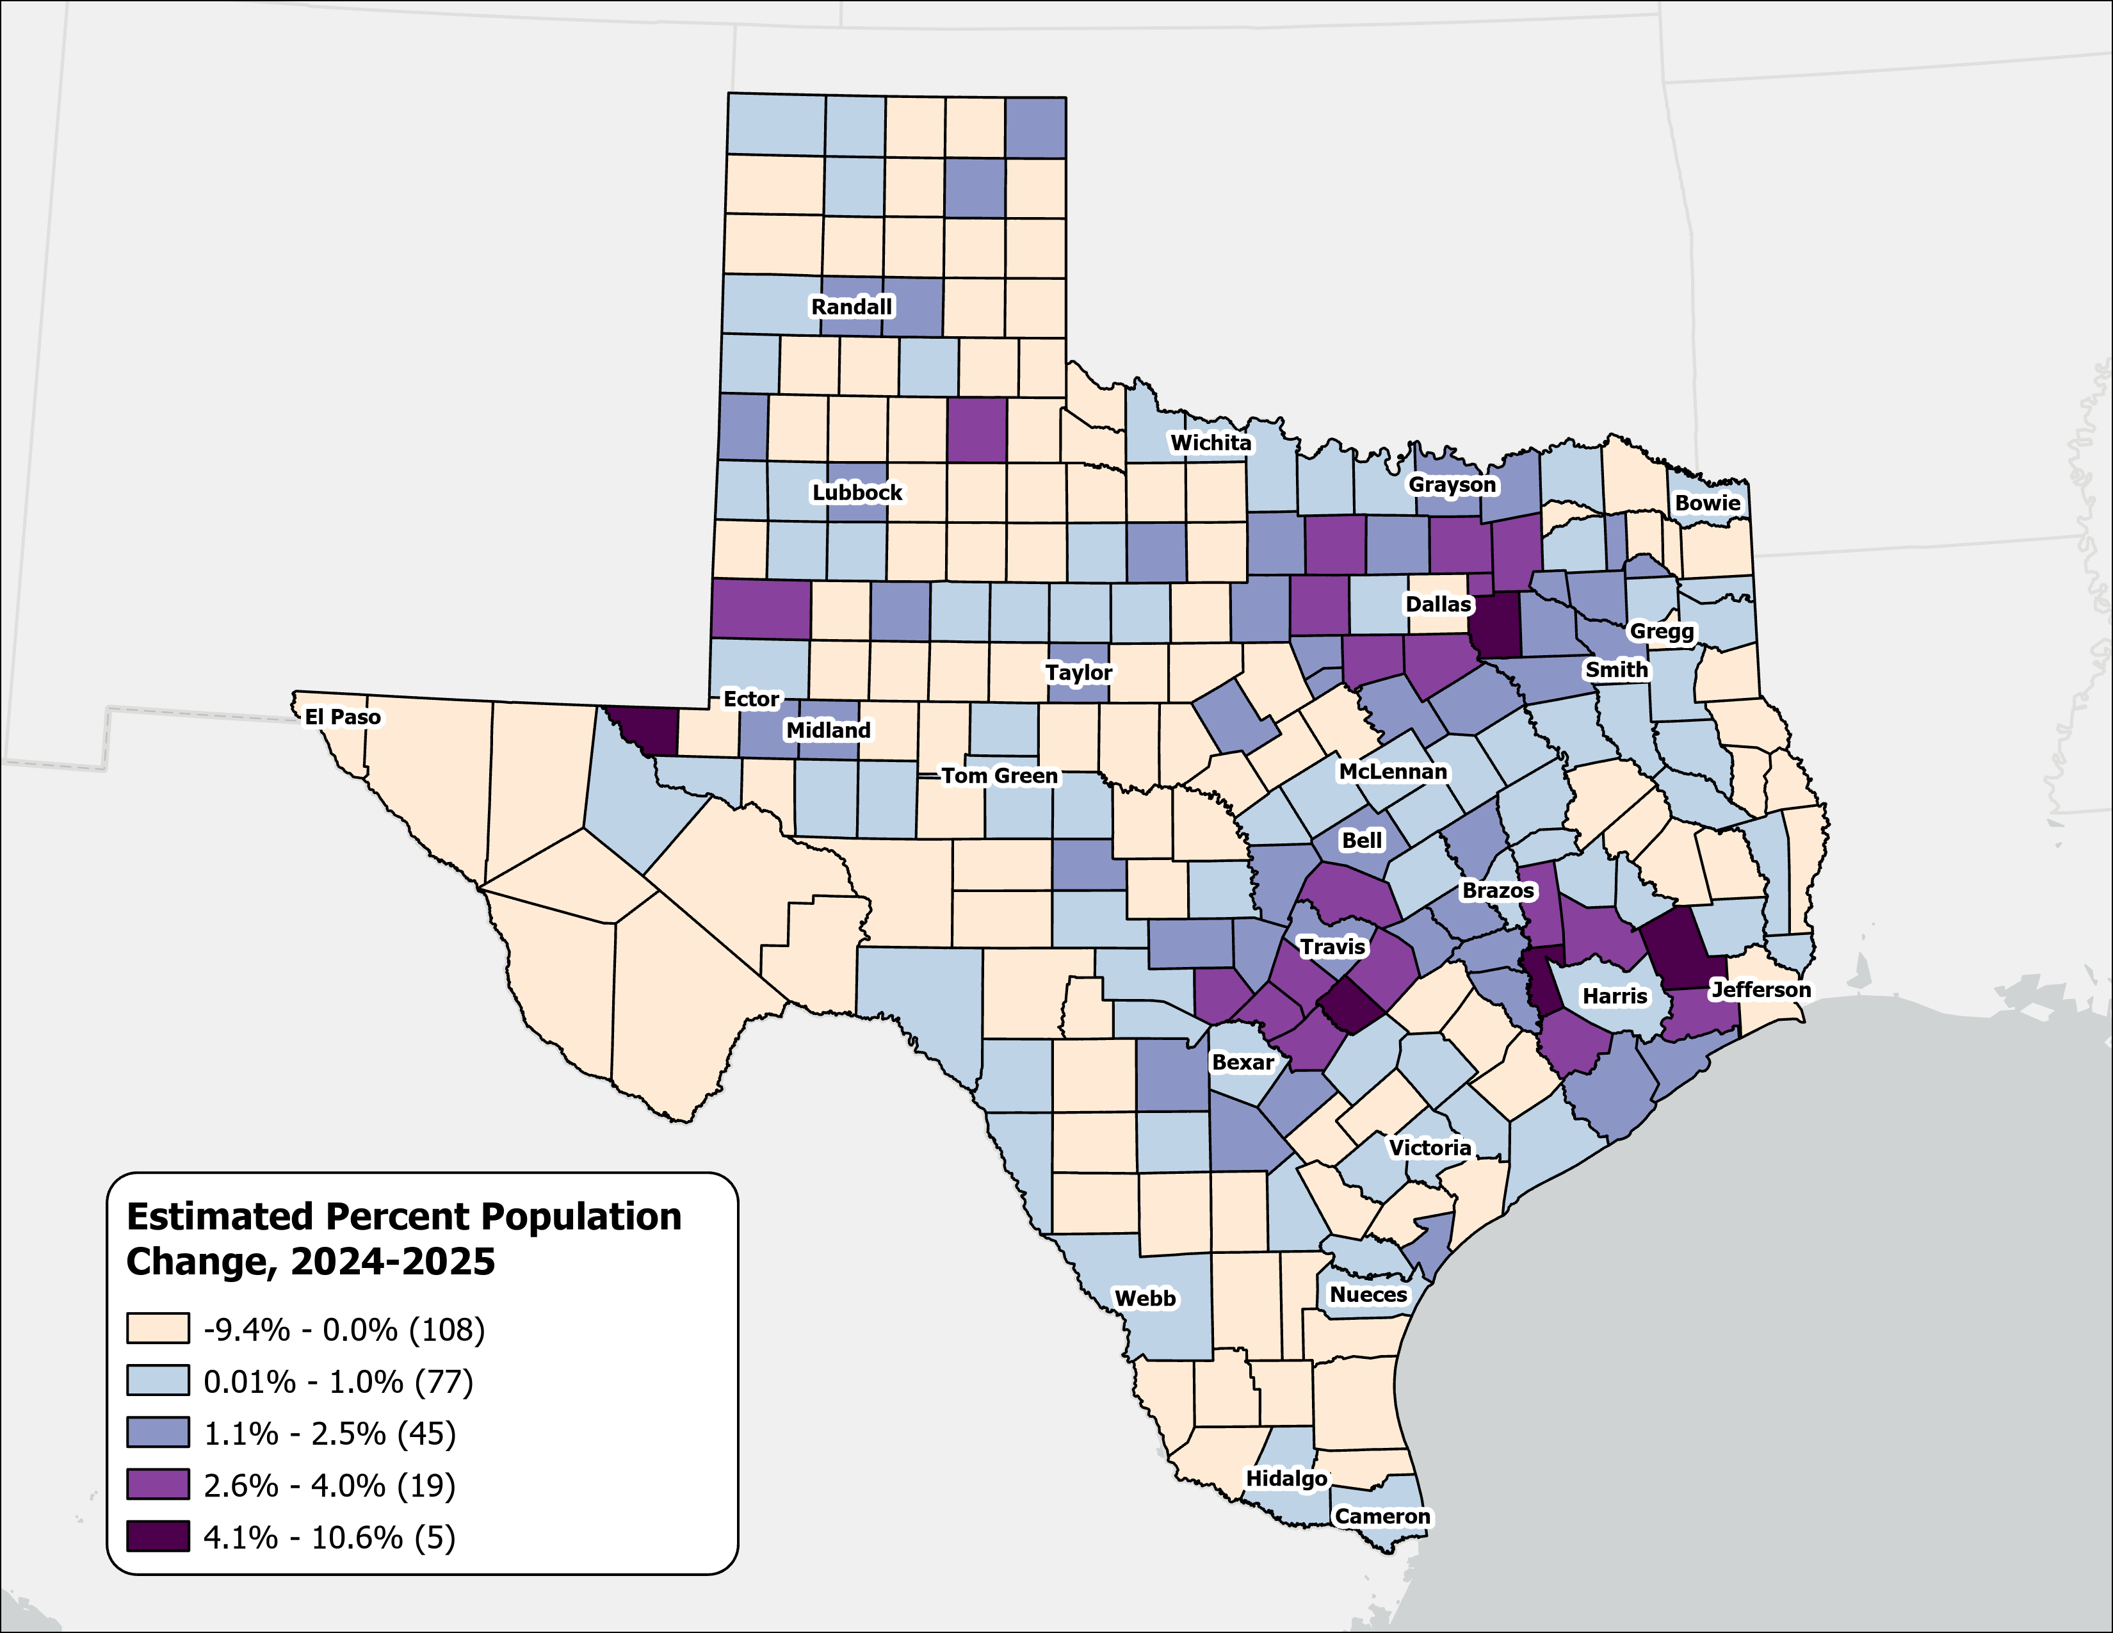
Estimated Percent Population Change, Texas Counties, 2024-2025
Rapid growth was concentrated in counties at the suburban and exurban edges of the Texas metropolitan triangle.
Source: U.S. Census Bureau, Vintage 2025 Population Estimates

Slide 7
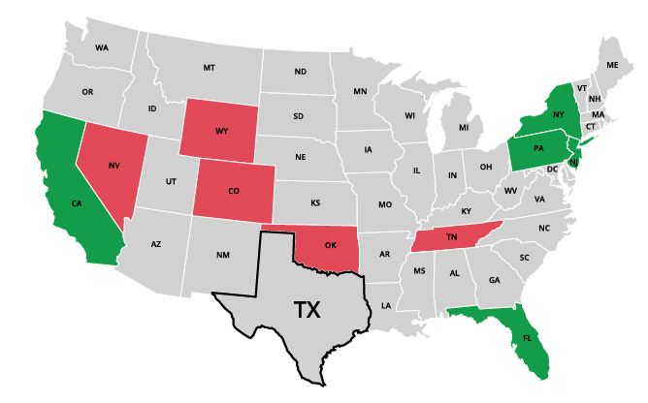
Top Net Migration To and From Texas: Leading States in 2024
Moving to Texas
California | 31,714
2. New York | 11,909
3. New Jersey | 8,148
4. Florida | 6,960
5. Pennsylvania | 5,730
Leaving Texas
1. Oklahoma | -9,495
2. Tennessee | -5,210
3. Colorado | -4,588
4. Wyoming | -2,342
5. Nevada | -2,180
Source: U.S. Census Bureau, 2024 State-to-State Migration Flows Statistics.
Notes:
Note: Data displayed are estimates based on a sample survey and are subject to error.
Caption: Latest U.S. Census Bureau Data: Around 550K domestic migrants moved to Texas in 2024, while 480K left for other states. Texas saw the largest net inflows of migrants from California, New York, and New Jersey and net outflows to Oklahoma, Tennessee, and Colorado.

Slide 8
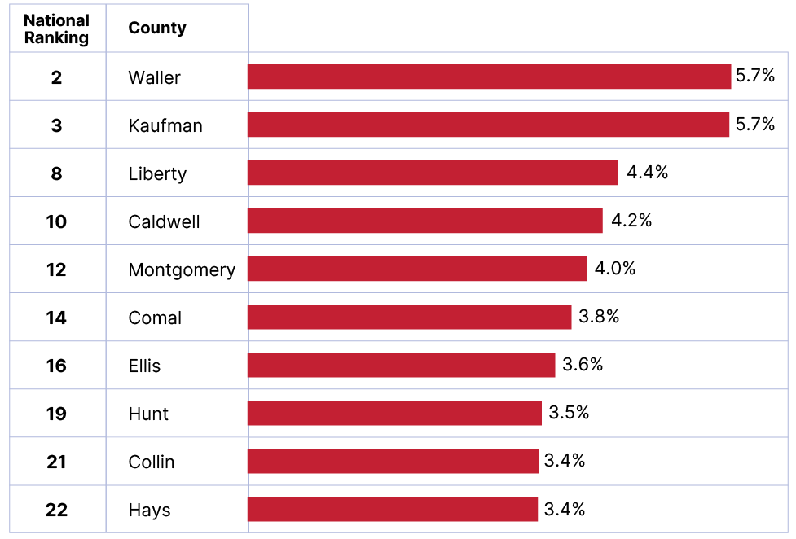
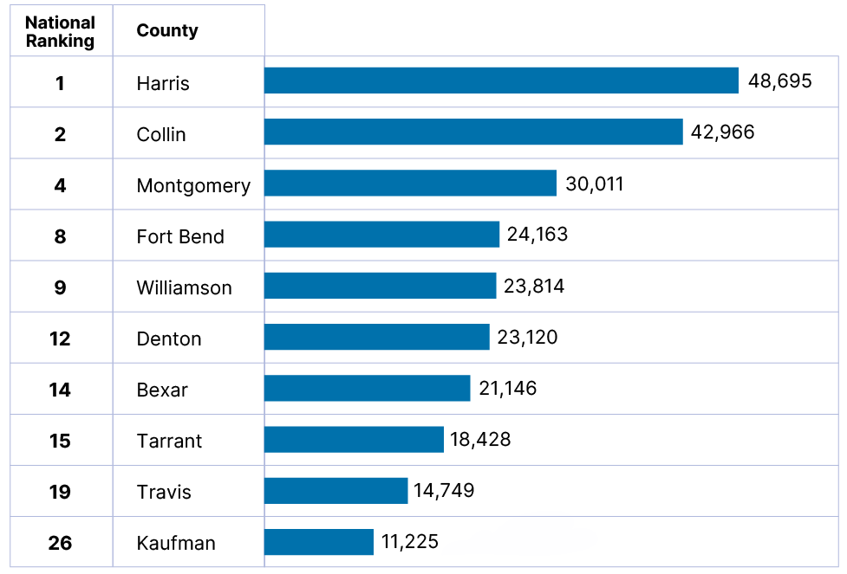
Top Growth Texas Counties
Top 10 Counties by Percent Growth in Texas
From July 1, 2024 to July 1, 2025
Top 10 Counties by Numeric Growth in Texas
From July 1, 2024 to July 1, 2025
Source: U.S. Census Bureau, Vintage 2025 Population Estimates

Slide 9
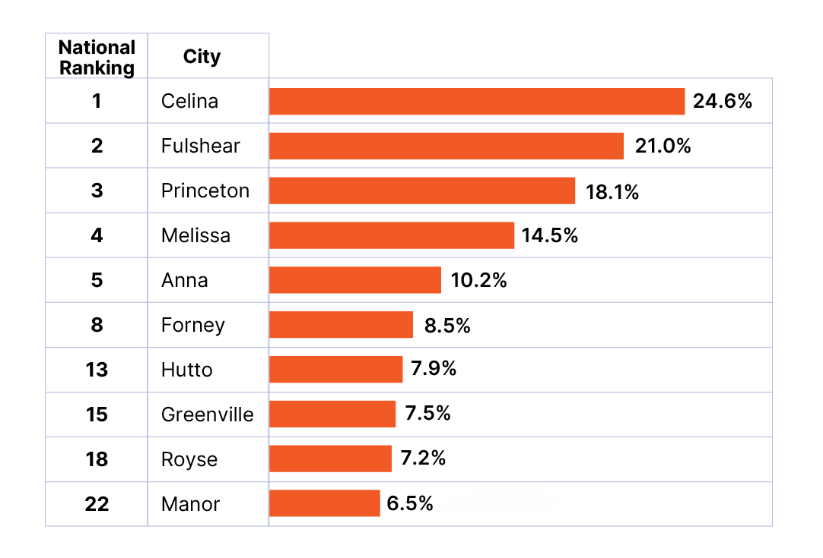
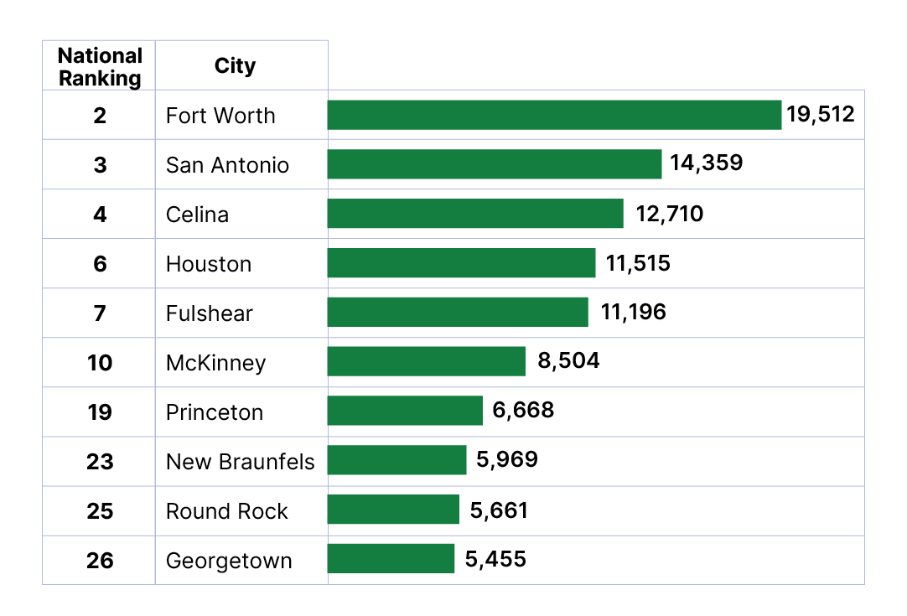
Top Growth Texas Cities and Towns
Top 10 Cities by Percent Growth in Texas
From July 1, 2024 to July 1, 2025
Top 10 Cities by Numeric Growth in Texas
From July 1, 2024 to July 1, 2025
Source: U.S. Census Bureau, Vintage 2025 Population Estimates. Ranked among incorporated places with a population of 20,000 or more.

Slide 10
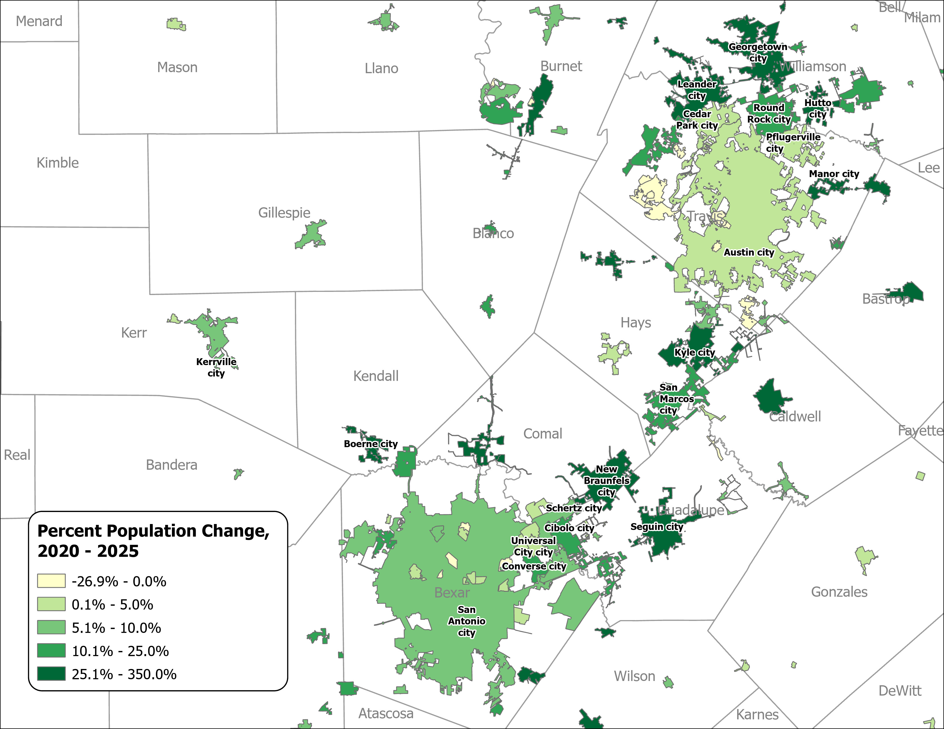
Percent Population Change for Incorporated Places, 2020-2025
Austin and San Antonio Area
Growth in major urban centers slowed considerably.
Small and midsized suburban and exurban cities within the Triangle region experienced the most rapid expansion.
Source: U.S. Census Bureau, Vintage 2025 Population Estimates

Slide 11
Drivers of Population Growth

Slide 12
Texas Daily Population Growth and Components of Change, 2020-2025
Reduced international and domestic migration drove the decline, while natural increase made up 40% of growth, up from about 25% since 2020.
917 | 1,494 | 1,647 | 1,642 | 1,072 | Daily Average Population Change
Source: U.S. Census Bureau, Vintage 2025 Population Estimates
Note: Components of change may not add to the total population change due to the minor residual components in the Census Bureau’s Population Estimates

Slide 13
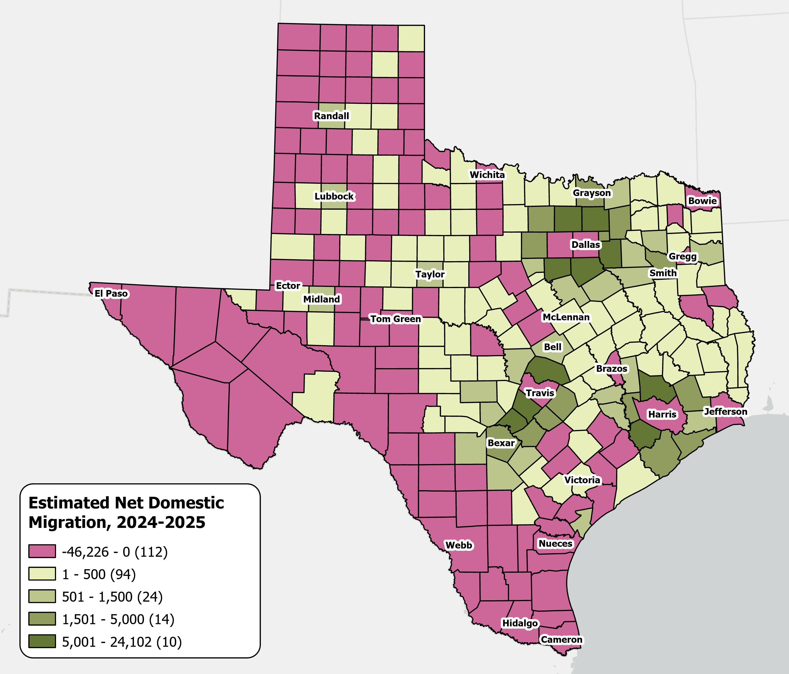
Estimates Net Domestic Migration Across Texas Counties
From July 1, 2024 to
July 1, 2025
High net domestic migration persists in suburban counties
Texas saw its
lowest domestic migration
in over a decade.
Source: U.S. Census Bureau, Vintage 2025 Population Estimates

Slide 14
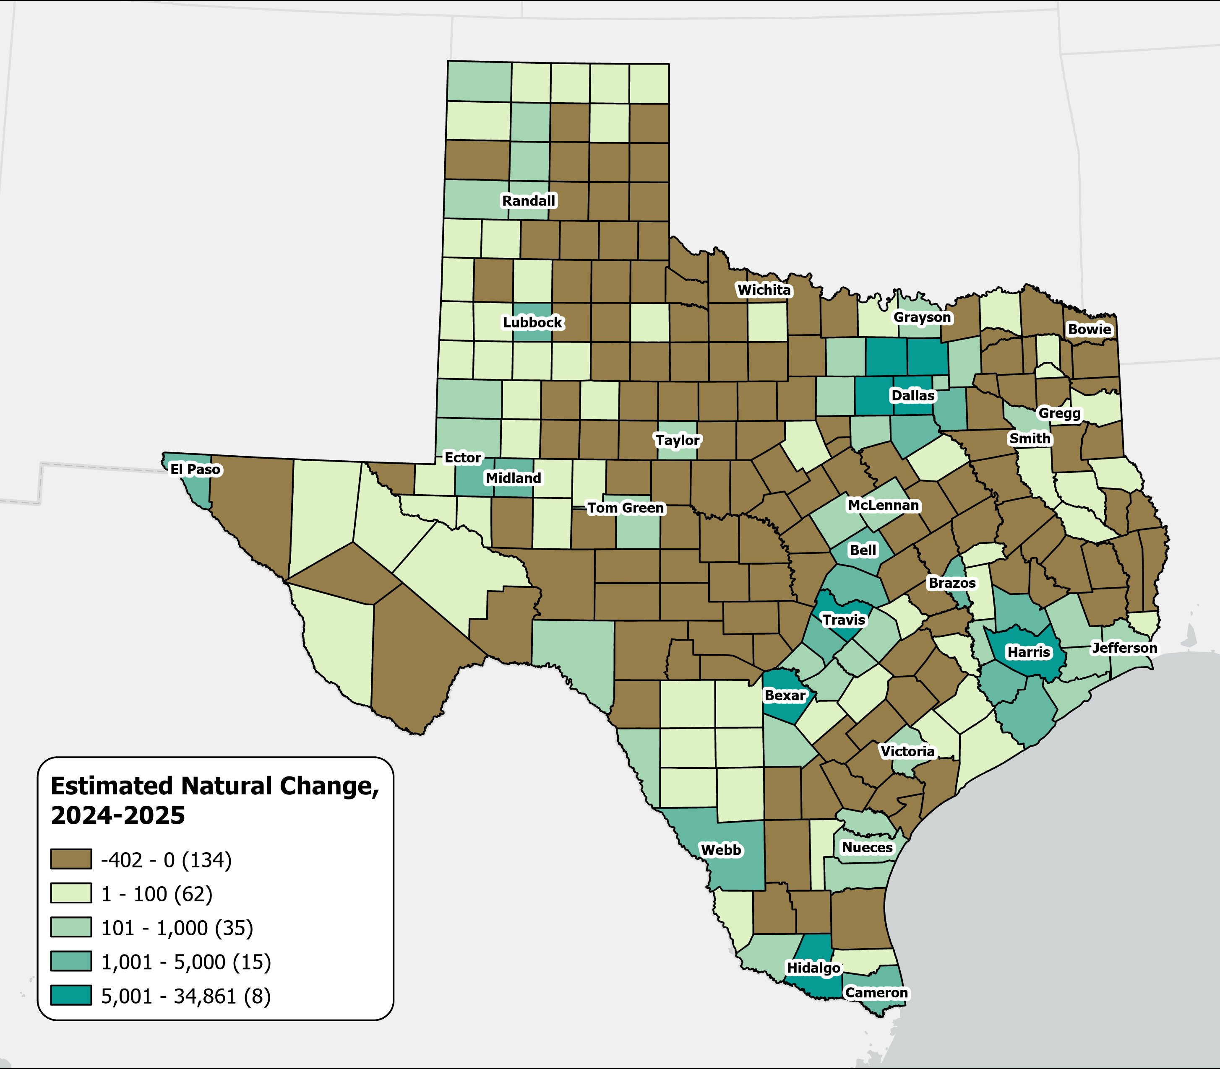
A majority of Texas counties saw more deaths than births
Estimates Natural Change Across Texas Counties
From July 2024 to July 2025
134
counties experienced natural population decline, with most located in rural areas.
Source: U.S. Census Bureau, Vintage 2025 Population Estimates

Slide 15
Texas Fertility Rates, 2007-2024
Births per 1,000 women aged 15-44
Source: Centers for Disease Control and Prevention, National Center for Health Statistics. Natality on CDC WONDER Online Database, 2007-2024.

Slide 16
Texas Fertility Rates by Age Group of Mothers, 2009 and 2024
Note: Birth rate is expressed as births per 1,000 women ages 15–44 during the calendar year.
Source: Centers for Disease Control and Prevention, National Center for Health Statistics.

Slide 17
Selected Socioeconomic Characteristics in Texas

Slide 18

Median Household Income and Home Value in Texas, 2013-2023
Median
Home
Value
Median
Household
Income
$
$
$
Source: U.S. Census Bureau, American Community Survey, 1-Year, 2013, 2018, and 2023.
Note: 2023 Inflation-Adjusted Dollars.

Slide 19
Distribution of Monthly Homeownership
Costs in Texas, 2021 and 2024
Source: U.S. Census Bureau, American Community Survey, 1-Year, 2021–2024.

Slide 20
Percent Uninsured by Race/Ethnicity, Texas 2024
16.7% of Texans are without health insurance
TX has the highest uninsured rate in the US
Source: U.S. Census Bureau, American Community Survey, 2024 1-year estimates

Slide 21
Undergraduate College Enrollment in Texas and Selected States, 2014 and 2024
California
New York
Florida
Illinois
Utah
Texas
Source: U.S. Census Bureau, American Community Survey Estimates, 1-Year, 2014 and 2024

Slide 22

Top Five Commodity Exports in Texas, 2024
Texas Ranking | Commodities | Annual Earnings (million U.S. dollars)
1 | Beef and veal | $1,272
2 | Cotton | $1,130
3 | Other plant products | $1,016
4 | Dairy products | $642
5 | Feeds and other feed grains | $379
Source: USDA Economic Research Service, 2024 Annual State Agricultural Exports

Slide 23
Social and Economic Characteristics
Heart of Texas COG

Slide 24
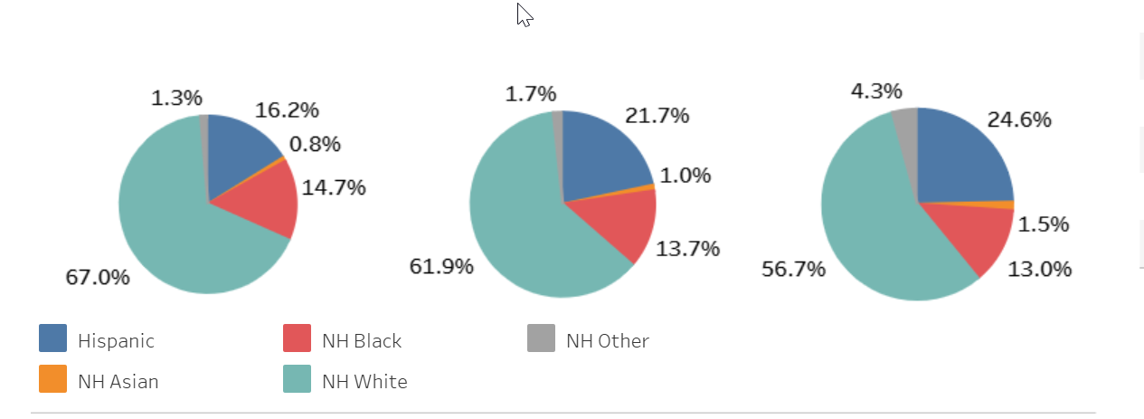
Heart of Texas COG Counties 2000-2020
2000
Pop. 321,536
2010
Pop. 349,273
2020
Pop. 373,237
2025 Pop. 389,934
4.5% increase from 2020
Source: U.S. Census Bureau, Decennial Census P.L. 94-171 Redistricting Data, Vintage 2025 Population Estimates

Slide 25
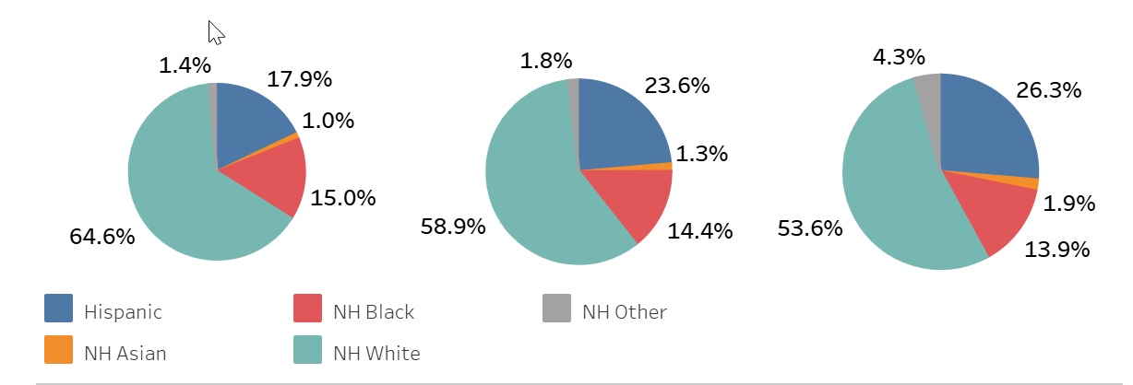
McLennan County 2000-2020
2000
Pop. 213,517
2010
Pop. 234,906
2020
Pop. 260,579
2025 Pop. 272,020
4.4% increase from 2020
Source: U.S. Census Bureau, Decennial Census P.L. 94-171 Redistricting Data, Vintage 2025 Population Estimates

Slide 26
Heart of Texas COG, Selected Demographic Indicators
County | Median Household Income | Percent HH on Food Stamp/SNAP benefits | Percent with no health insurance | Percent with income below poverty level | Median Age | Percent under age 18 | Percent age 65 and older
Bosque | $68,914 | 10.4 | 17.6 | 9.3 | 46.2 | 20.8 | 25.6
Falls | $57,247 | 13.2 | 16.9 | 14.7 | 40.6 | 21.0 | 19.3
Freestone | $59,960 | 14.8 | 12.6 | 12.3 | 41.1 | 22.6 | 20.1
Hill | $64,591 | 11.1 | 18.6 | 14.7 | 41.0 | 23.1 | 20.4
Limestone | $60,573 | 16.6 | 17.7 | 17.1 | 41.9 | 22.4 | 20.9
McLennan | $68,446 | 12.1 | 14.3 | 17.0 | 33.8 | 24.0 | 15.3
Heart of Texas Region |  | 13.0 | 16.3 | 14.2 |  | 22.3 | 20.3
TEXAS | $79,721 | 11.4 | 16.7 | 13.4 | 35.9 | 25.0 | 13.4
Source: U.S. Census Bureau, 2024 ACS 5-Year Estimates Data Profiles

Slide 27
Population Projections of Heart of Texas COG Counties, 2020-2060
Name | 2020 April | 2030 July | 2040 July | 2050 July | 2060 July | Change 2020-2060 | %Change 2020-2060
Bosque | 18,235 | 19,190 | 19,299 | 19,243 | 19,334 | 1,099 | 6.0%
Falls | 16,968 | 17,106 | 15,912 | 14,705 | 13,656 | -3,312 | -19.5%
Freestone | 19,435 | 20,504 | 20,073 | 19,301 | 18,501 | -934 | -4.8%
Hill | 35,874 | 39,839 | 41,057 | 41,559 | 42,019 | 6,145 | 17.1%
Limestone | 22,146 | 22,030 | 20,935 | 19,818 | 19,027 | -3,119 | -14.1%
McLennan | 260,579 | 283,691 | 303,752 | 320,275 | 333,808 | 73,229 | 28.1%
Source: Texas Demographic Center, Vintage 2024 Projections

Slide 28
Population Projections Heart of Texas COG Counties, 2020-2060
Source: Texas Demographic Center, Vintage 2024 Projections

Slide 29
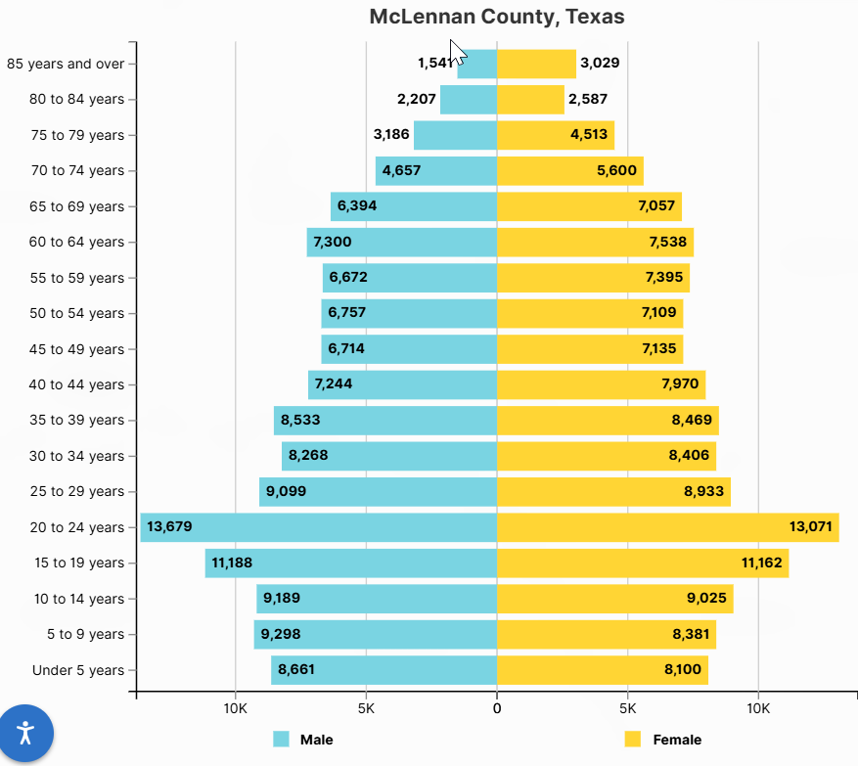
McLennan County
Population Pyramid
Largest age group is between 20-24 years
Source: U.S. Census Bureau, 2024 ACS 5-year Estimates

Slide 30
Preparing Texas for the 2030 Census

Slide 31
A Look Back at 2020
Between 2010- 2020 Texas ranked #1 in numeric growth adding 3.9 million new Texans
YET 2020 Census: Texas was one of 6 states with an undercount (approximately 500K people)
Undercounting the population costs us billions in lost funding for infrastructure, health care, social services

Slide 32
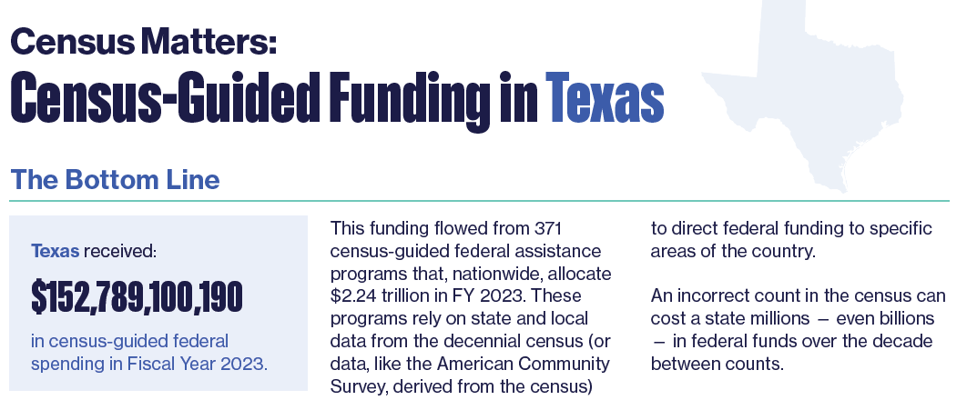
Why Good Population Data Matters
Texas received over
$152 Billion
in Census-guided federal assistance in 2023
Project on Government Oversight report
Source: Census Matters: Why an Accurate Count is Essential to Funding Our Communities | Project On Government Oversight

Slide 33
Local Update of Census Addresses (LUCA)
An Important Step for Local Governments
LUCA (Local Update of Census Address) is a voluntary, once-a-decade, opportunity for tribal, state, and local governments to review and update the Census Bureau’s residential address list before the decennial census.
This residential address list is what the Census Bureau will use for its Master Address File to disseminate the 2030 Census survey.
The LUCA operation is the most direct method local governments can provide updated residential addresses to the Census Bureau before the 2030 Census.
Participation in LUCA is voluntary but highly recommended for an accurate Census count for your community in 2030.
Notes:
Census Address List Improvement Act of 1994 (Public Law 103-430)
Title XIII Confidentiality

Slide 34
Who Can Participate in LUCA?
Highest Elected Officials from eligible governments include:
States, Counties, Cities (incorporated places), Townships (minor civil divisions)
Federally recognized Tribal Nations with a reservation and/or off-reservation trust lands
Highest elected/appointed officials can designate LUCA participants for their jurisdiction. This may include direct employees, interns, contractors, or designating alternate reviewers, such as county, state data center, or regional planning agency.
Notes:
Census Address List Improvement Act of 1994 (Public Law 103-430)
Title XIII Confidentiality

Slide 35
LUCA Timeline 2027-2028
May- August 2027 (Prep Phase)
Highest Elected Officials will receive notification from the Census Bureau about LUCA operations in the April 2027.
LUCA participants may access the Census Bureau’s address inventory to review the address block count list for their geographic jurisdiction.
October 2027- March 31, 2028 (Review and official submission)
LUCA participants officially submit their updates to the Census Bureau via a digital portal.
March 31, 2028 (Deadline)
*Dates subject to change upon final notice from the Census Bureau
Source: U.S. Census Bureau, Local Update of Census Addresses (LUCA) Operation
Notes:
Census Address List Improvement Act of 1994 (Public Law 103-430)
Title XIII Confidentiality

Slide 36
What Local Governments Can Do Now
Visit the Census Bureau’s 2030 LUCA website to learn more about the operation and helpful resources.
Obtain data on residential addresses (E-911 addresses, residential addresses from local government sources, commercial contractors, etc.)
Identify staff members or contractors who have technical skills to utilize the Census Bureau’s Address Count Listing to review housing count units and compare with your own data.
If needed, plan for budget allocation to ensure participation in 2027 (staff or consultants).
Notes:
Census Address List Improvement Act of 1994 (Public Law 103-430)
Title XIII Confidentiality

Slide 37
A Look into the Future of Texas

Slide 38
Texas is expected to keep growing significantly.
Projected Population Growth in Texas with Various Migration Scenarios
42.6 million
in 2060.
(Mid-migration Scenario)
Source: Texas Demographic Center, Vintage 2024 Population Projections

Slide 39
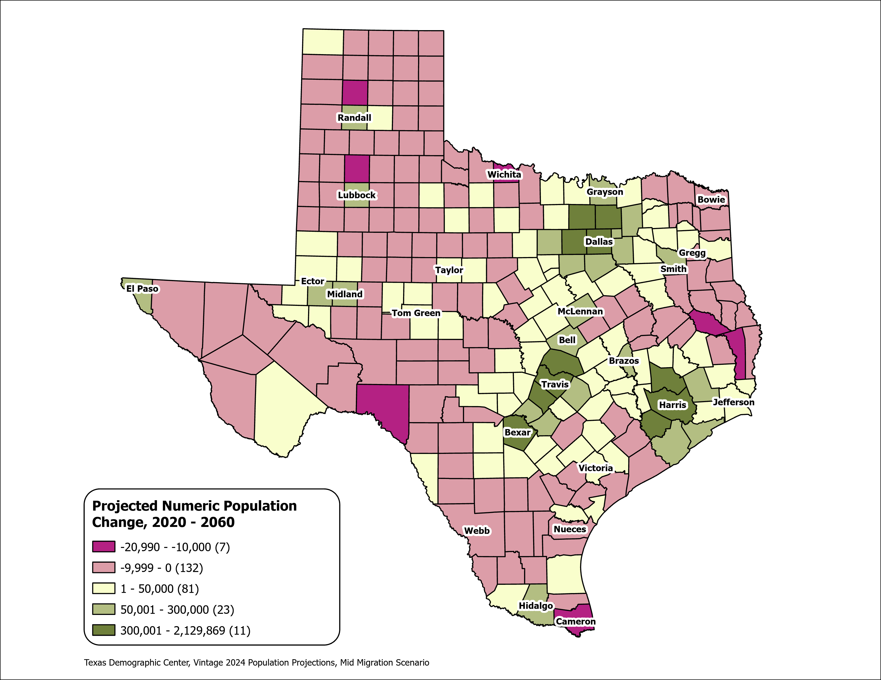
Texas Counties
Projected Population Numeric Change 2020-2060
Mid Migration Scenario
139 Counties are projected to lose population
Current MSA counties will account for 99% of the state’s growth from 2020 to 2060
The four MSAs within the TX Triangle will increase their share of population from 67% to 74%
Source: Texas Demographic Center, Vintage 2024 Population Projections, Mid Migration Scenario

Slide 40
Projected Population by Age
2020, 2040, and 2060
Mid Migration Scenario
22%
18%
Texas will continue to age in the next few decades.
The 65+ group will grow fastest.
Growth among those under 18 will slow and begin to decline.
The working-age population will grow and maintain a stable share of the total population.
13%
60%
60%
62%
Total Population
29.1M
37.1M
42.6M
Source: Texas Demographic Center, Vintage 2024 Population Projections, Mid Migration Scenario

Slide 41


Visit our website
demographics.texas.gov

Slide 42




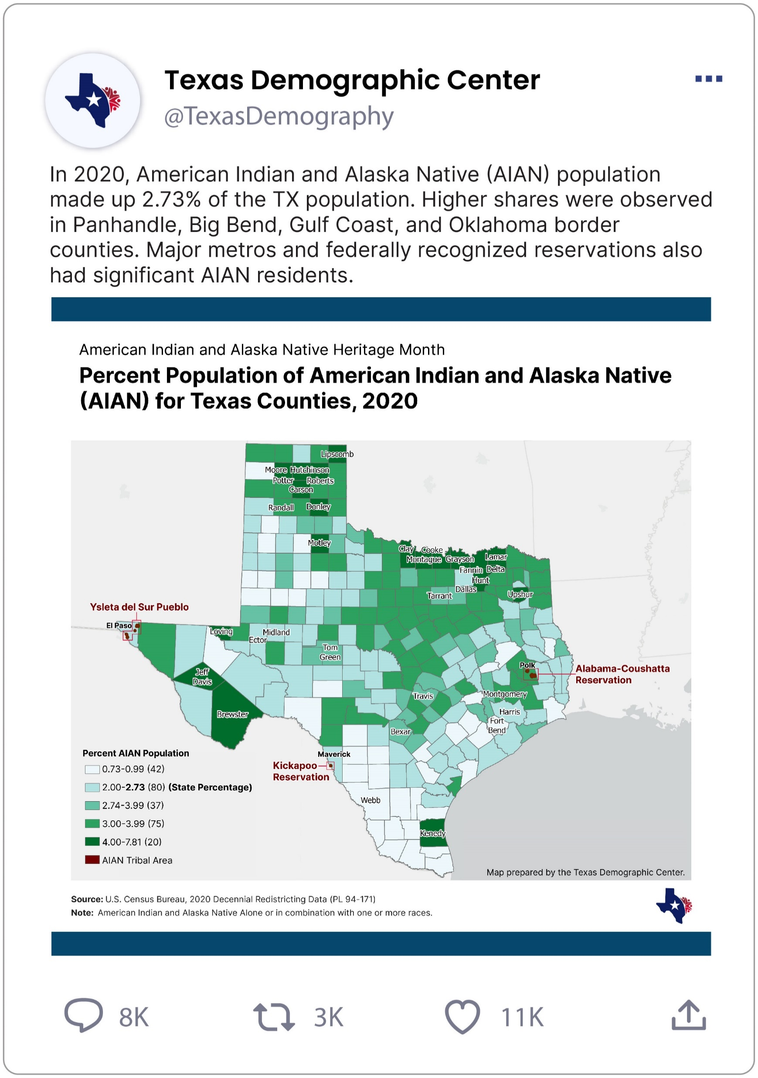
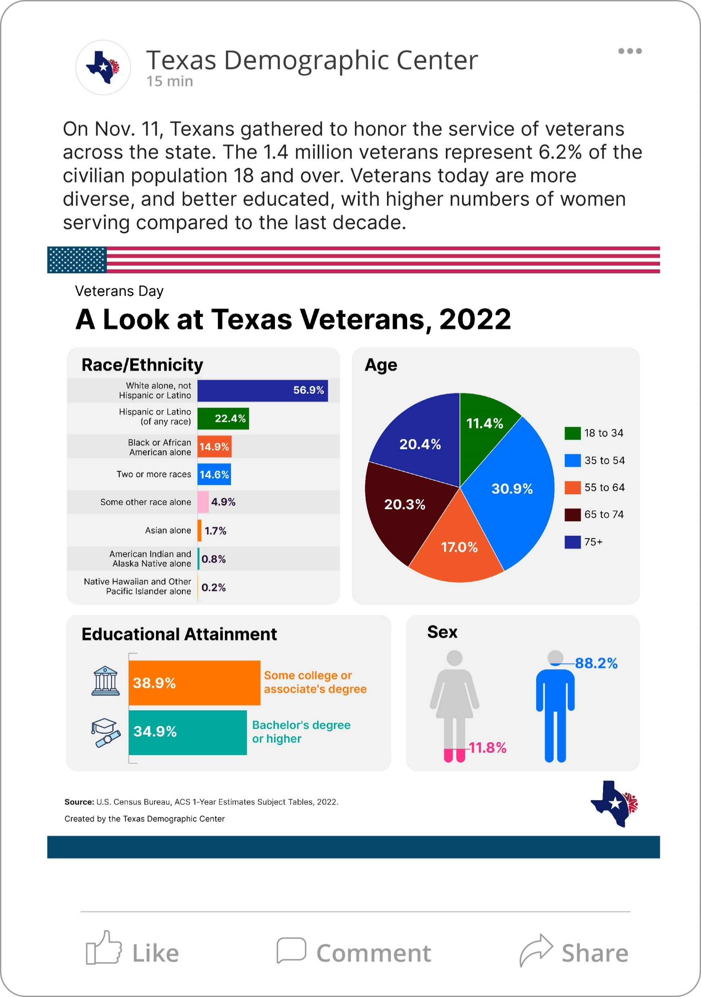

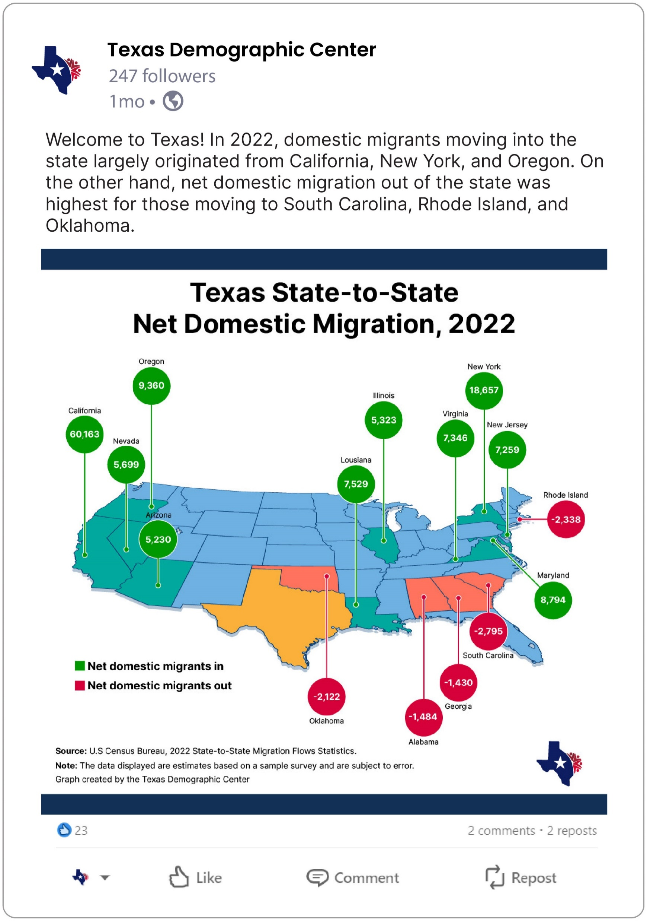
Follow us on social media!
@TexasDemography
Texas Demographic Center
texasdemographiccenter
Texas Demographic Center

Slide 43
Stay in Touch
Monica Cruz, Ph.D.
(210) 458-6543
TDC@UTSA.edu
demographics.texas.gov/

