Slide 1
Texas Population: Trends and Characteristics
Texas Department of Transportation - Congestion Relief Task Force
April 29, 2026

Slide 2

New 2025 Estimates Show Texas Growth but at Slower Rate
Newly Released Data
Texas Total Population 2025
31.7M
391K
1.2%
Numeric increase
Percent increase
Growth from 2024
New Census Bureau data shows Texas’ population reached 31.7 million in July 2025 — a 1.2% increase from 2024 to 2025, more than 2X the 0.5% national growth rate. Though growth slowed compared to recent years, TX still led the nation in numeric gains, adding over 391K residents.

Slide 3
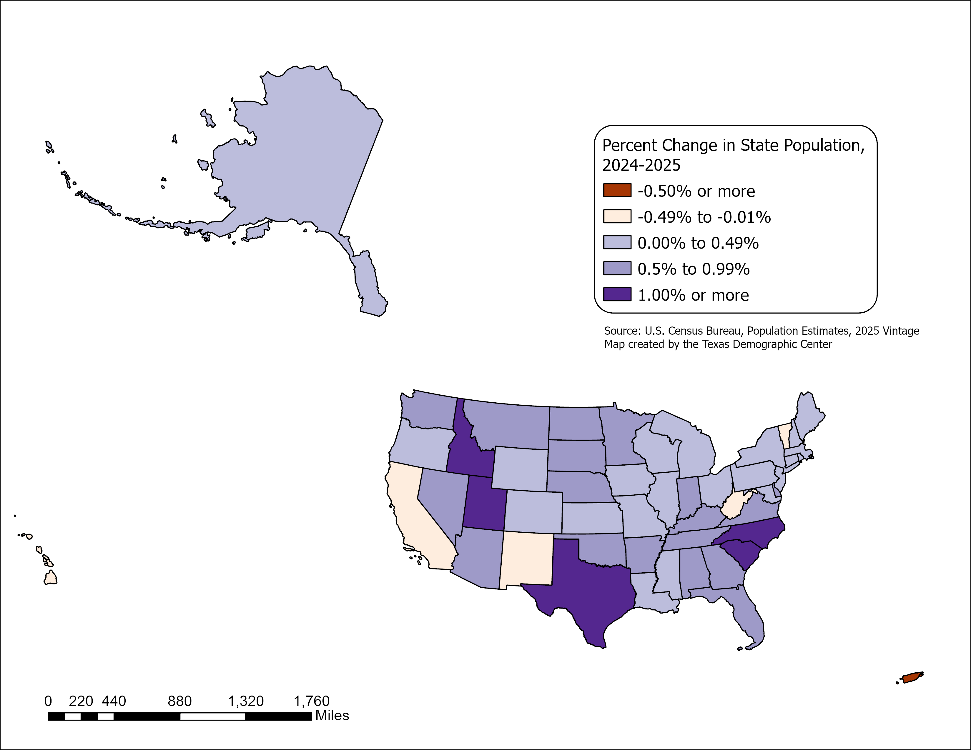
State Highlights
All but five U.S. states grew between July 2024 and July 2025
- CA, HI, NM, VT, and WV.
Top 5 States with percent change
-SC, ID, NC, TX, UT.
Top 5 States with numeric change
-TX, FL, NC, GA, SC.
Source: U.S. Census Bureau, Vintage 2025 Population Estimates

Slide 4
Texas Daily Population Growth and
Components of Change 2020-2025
917
1,494
1,647
1,642
1,072
Daily Average Population Change
Source: U.S. Census Bureau, Vintage 2025 Population Estimates

Slide 5
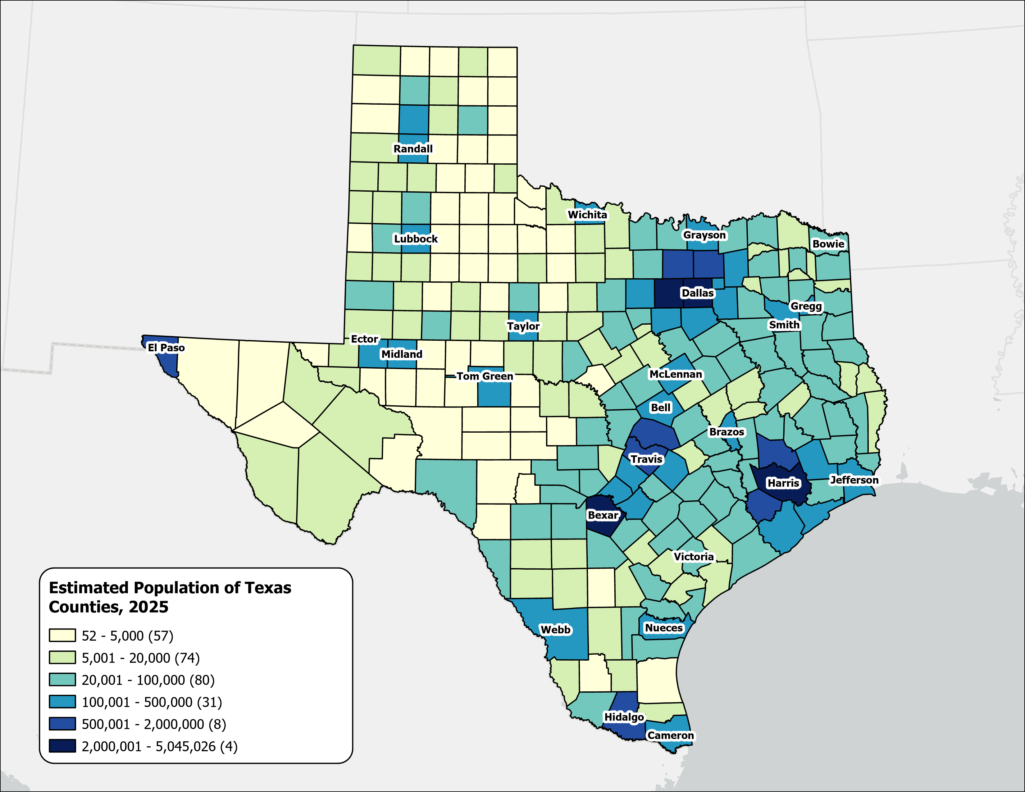
Estimated Population,
Texas Counties, 2025
Texas population is highly concentrated within the metropolitan triangle formed by Dallas–Fort Worth, Austin, San Antonio, and Houston.
The 120 counties on and east of the I‑35 corridor are home to 27.3 million residents—approximately 87.3% of the state’s total population.
87%
Source: U.S. Census Bureau, Vintage 2025 Population Estimates

Slide 6
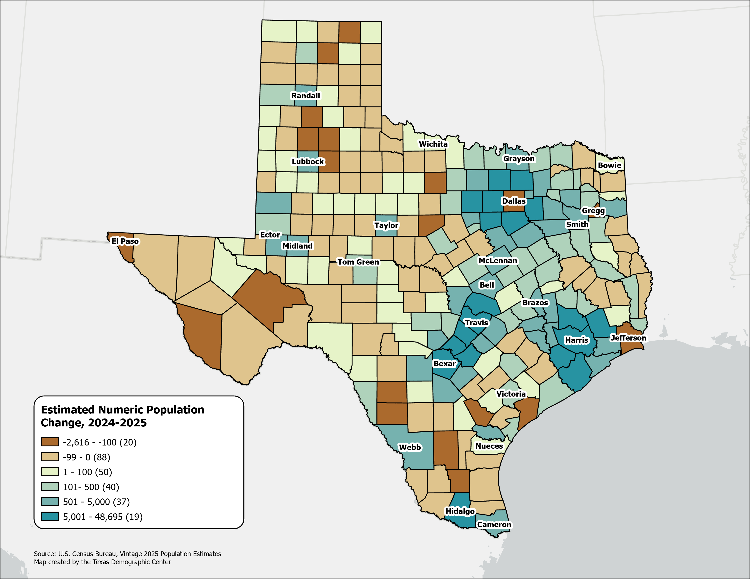
Estimated Numeric Population Change, Texas Counties, 2024-2025
Population declined in 108 Texas counties, primarily in rural areas.
Dallas experienced the largest numeric population loss, along with several border counties.
Source: U.S. Census Bureau, Vintage 2025 Population Estimates

Slide 7
Top Counties for Numeric Growth in Texas, 2024-2025
County | US Rank | 2025 Population Estimate | Population Change 2024-2025 | Change from Natural Increase | Change from International Migration | Change from Domestic Migration
Harris | 1 | 5,045,026 | 48,695 | 72% | 118% | -89%
Collin | 2 | 1,297,179 | 42,966 | 17% | 27% | 56%
Montgomery | 4 | 781,194 | 30,011 | 14% | 12% | 76%
Fort Bend | 8 | 975,191 | 24,163 | 20% | 37% | 43%
Williamson | 9 | 752,827 | 23,814 | 19% | 19% | 62%
Denton | 12 | 1,069,346 | 23,120 | 28% | 22% | 50%
Bexar | 14 | 2,160,088 | 21,146 | 47% | 40% | 12%
Tarrant | 15 | 2,248,466 | 18,428 | 68% | 69% | -38%
Travis | 19 | 1,389,670 | 14,749 | 63% | 81% | -45%
Kaufman | 26 | 209,235 | 11,225 | 15% | 1% | 85%
Hays | 32 | 304,390 | 10,051 | 18% | 8% | 75%
Ellis | 40 | 240,867 | 8,413 | 16% | 0% | 85%
Hidalgo | 45 | 921,549 | 7,937 | 111% | 3% | -16%
Comal | 50 | 209,166 | 7,680 | 4% | 1% | 97%
Source: U.S. Census Bureau, Vintage 2025 Population Estimates

Slide 8
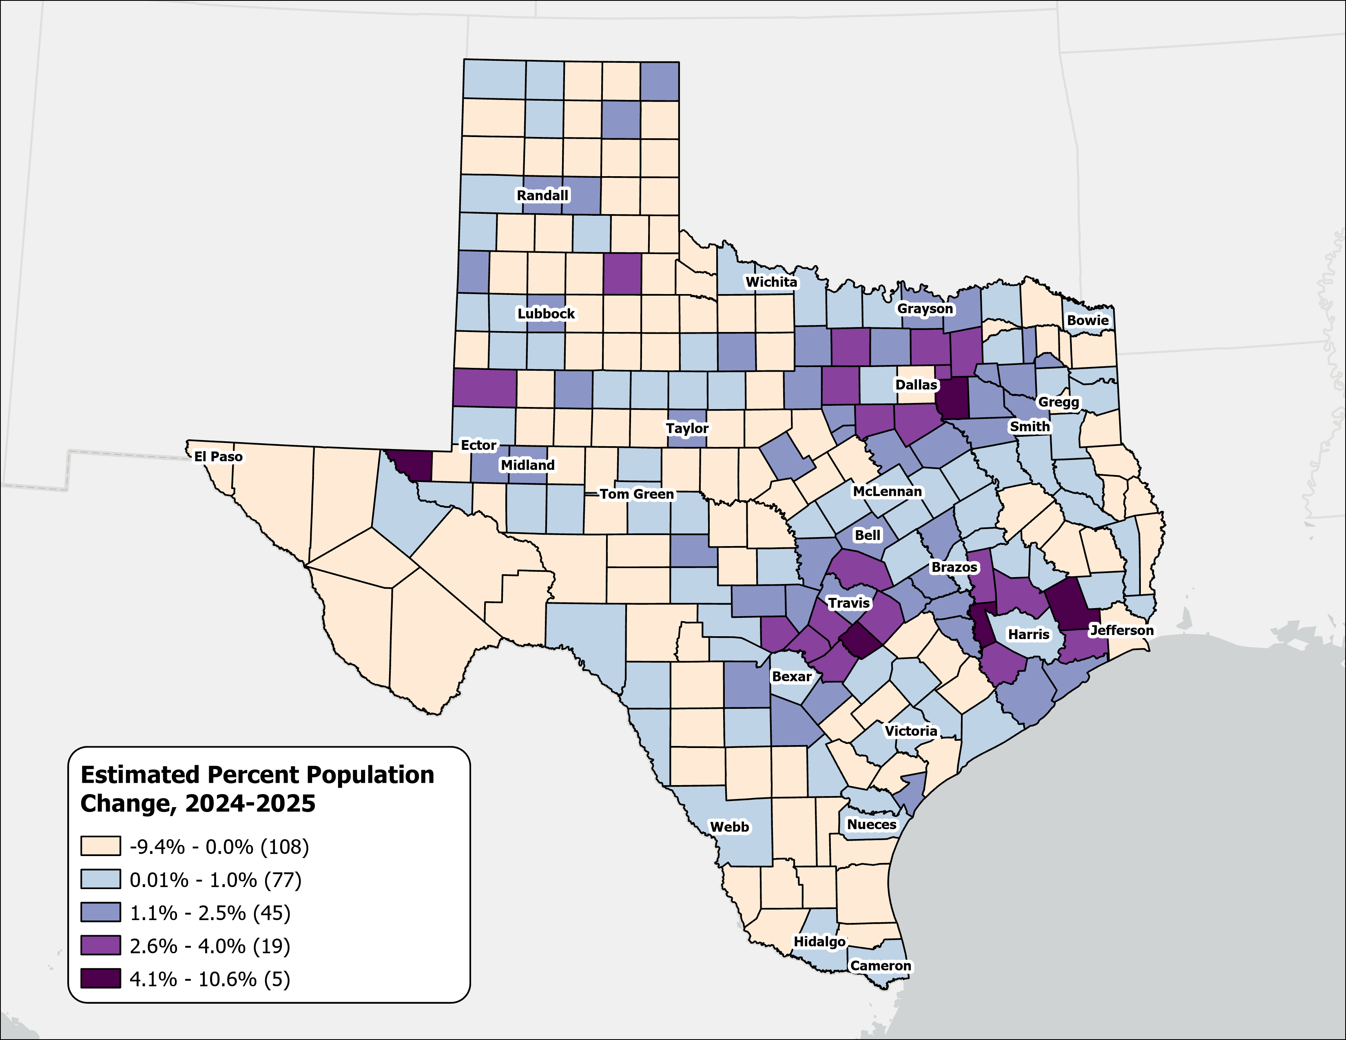
Estimated Percent Population Change, Texas Counties, 2024-2025
Rapid growth was concentrated in counties at the suburban and exurban edges of the Texas metropolitan triangle.
Source: U.S. Census Bureau, Vintage 2025 Population Estimates

Slide 9
Top Counties for Percent Growth in Texas, 2024-2025
County | US Rank | 2025 Population Estimate | Population Change 2024-2025 | Percent Population Change 2024-2025 | Percent of Population Change from Natural Increase | Percent of Population Change from International Migration | Percent of Population Change from Domestic Migration
Waller | 1 | 69,858 | 3,761 | 6% | 13% | 8% | 80%
Kaufman | 2 | 209,235 | 11,225 | 6% | 15% | 1% | 85%
Liberty | 6 | 121,364 | 5,073 | 4% | 15% | 3% | 84%
Caldwell | 7 | 55,150 | 2,211 | 4% | 13% | 3% | 85%
Montgomery | 8 | 781,194 | 30,011 | 4% | 14% | 12% | 76%
Comal | 10 | 209,166 | 7,680 | 4% | 4% | 1% | 97%
Ellis | 11 | 240,867 | 8,413 | 4% | 16% | 0% | 85%
Hunt | 13 | 123,336 | 4,126 | 3% | 12% | 7% | 81%
Collin | 15 | 1,297,179 | 42,966 | 3% | 17% | 27% | 56%
Hays | 16 | 304,390 | 10,051 | 3% | 18% | 8% | 75%
Williamson | 19 | 752,827 | 23,814 | 3% | 19% | 19% | 62%
Wise | 26 | 83,778 | 2,486 | 3% | 6% | 0% | 96%
Johnson | 28 | 218,048 | 6,458 | 3% | 11% | 3% | 86%
Chambers | 34 | 57,594 | 1,606 | 3% | 22% | 2% | 77%
*Among counties with populations of 50,000 or more in 2025
Source: U.S. Census Bureau, Vintage 2025 Population Estimates

Slide 10
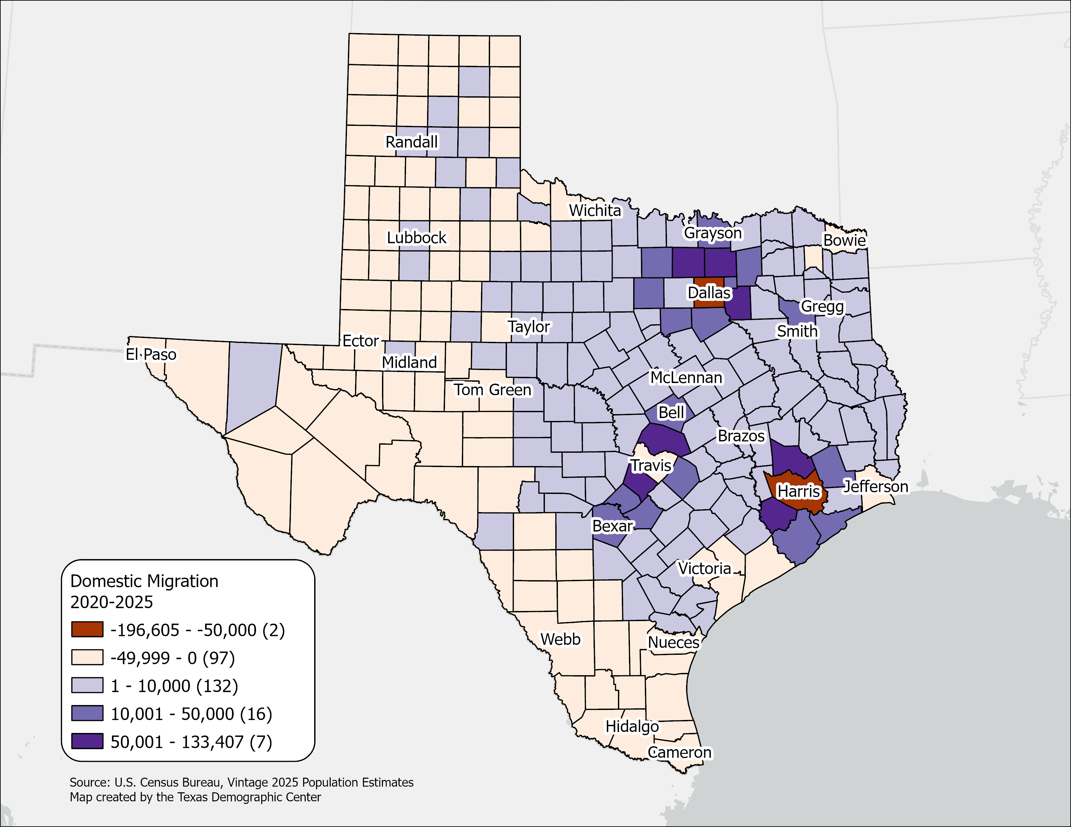
Estimated Net Domestic Migration between 2020 and 2025,
Texas Counties
Ninety‑nine counties, primarily in West Texas, South Texas, and the Panhandle, experienced net domestic migration losses or minimal gains.
The Texas Triangle continues to be the primary destination for domestic migrants in the state.
Central‑city counties within the Texas Triangle saw the largest numeric migration losses, largely reflecting population movement to surrounding suburban counties.
Source: U.S. Census Bureau, Vintage 2025 Population Estimates.

Slide 11
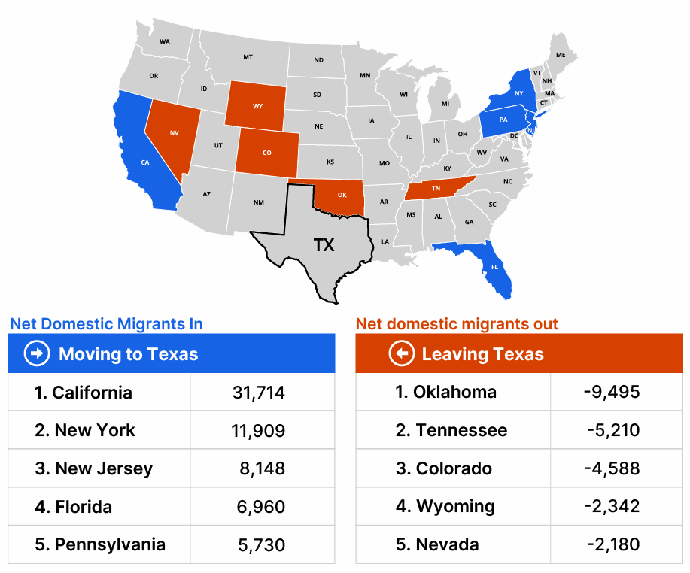
Texas State-to-State Net Domestic Migration, 2024
In 2024, approximately 550,000 domestic migrants moved to Texas, while about 480,000 left for other states.
Texas experienced its largest net domestic inflows from California, New York, and New Jersey, and net outflows to Oklahoma, Tennessee, and Colorado.
Note: Data displayed are estimates based on a sample survey and are subject to error.
Source: U.S. Census Bureau, 2024 State-to-State Migration Flows Statistics
Notes:
Caption: U.S. Census Bureau State-to-State Migration Data 2024: Around 550K domestic migrants moved to Texas in 2024, while 480K left for other states. Texas saw the largest net inflows of migrants from California, New York, and New Jersey and net outflows to Oklahoma, Tennessee, and Colorado.

Slide 12
Texas Fertility Rates, 2007-2024
Births per 1,000 women aged 15-44
Source: Centers for Disease Control and Prevention, National Center for Health Statistics. Natality on CDC WONDER Online Database, 2007-2024.

Slide 13
Texas Fertility Rates by Age Group of Mothers, 2009 and 2024
Note: Birth rate is expressed as births per 1,000 women ages 15–44 during the calendar year.
Source: Centers for Disease Control and Prevention, National Center for Health Statistics.

Slide 14
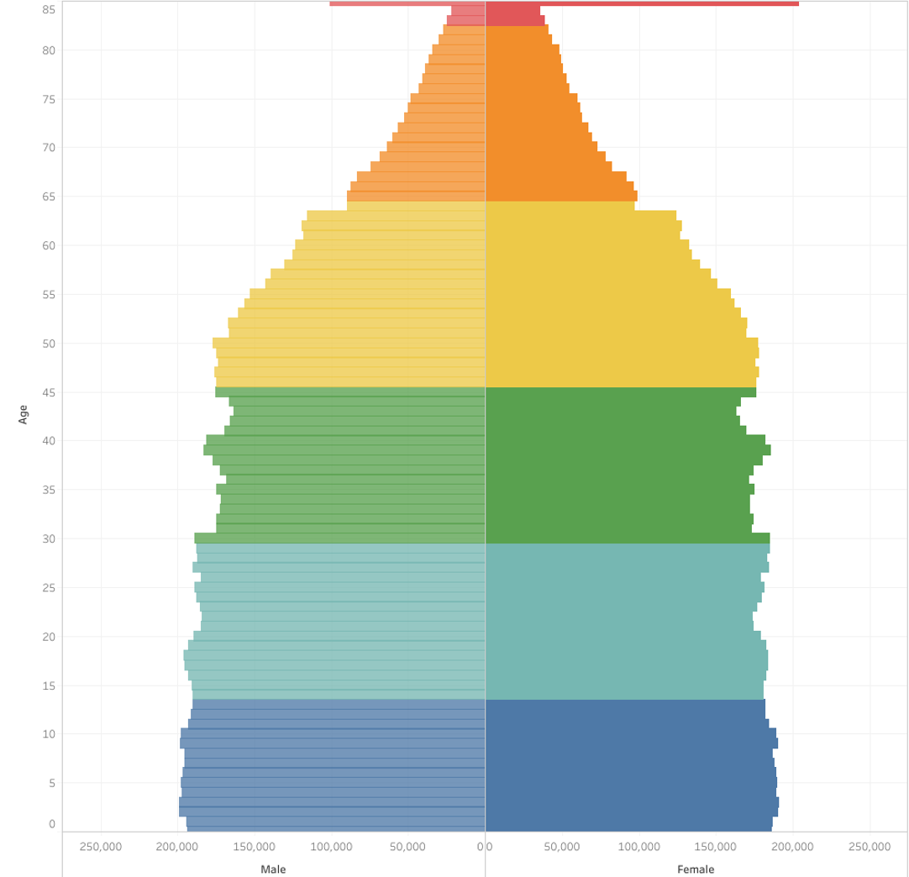
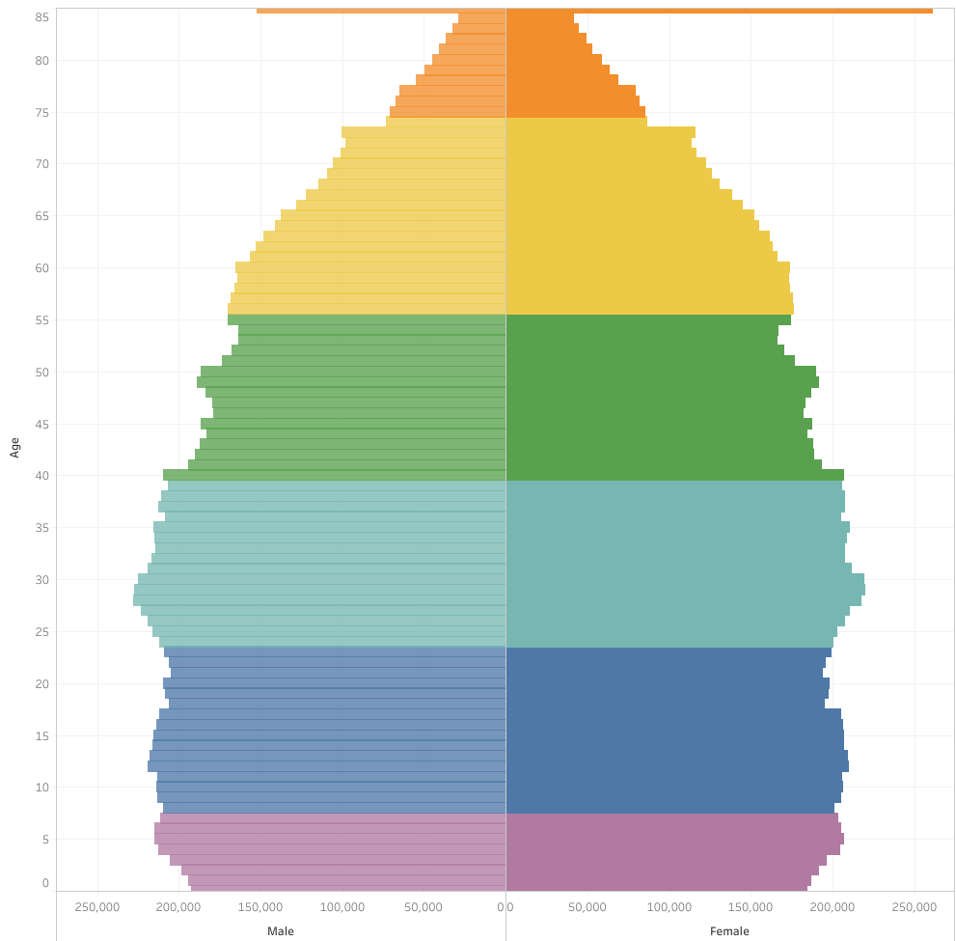
Generational Population Pyramids, Texas, 2010 and 2020
2010
2020
Generation
Greatest Generation (1901-1927)
Silent Generation (1928-1945)
Baby Boomers (1946-1964)
Generation X (1965-1980)
Millennials (1981-1996)
Generation Z (1997-2012)
Generation Alpha (2013-)
Source: U.S. Census Bureau. 2010 and 2020 Vintage Population Estimates

Slide 15
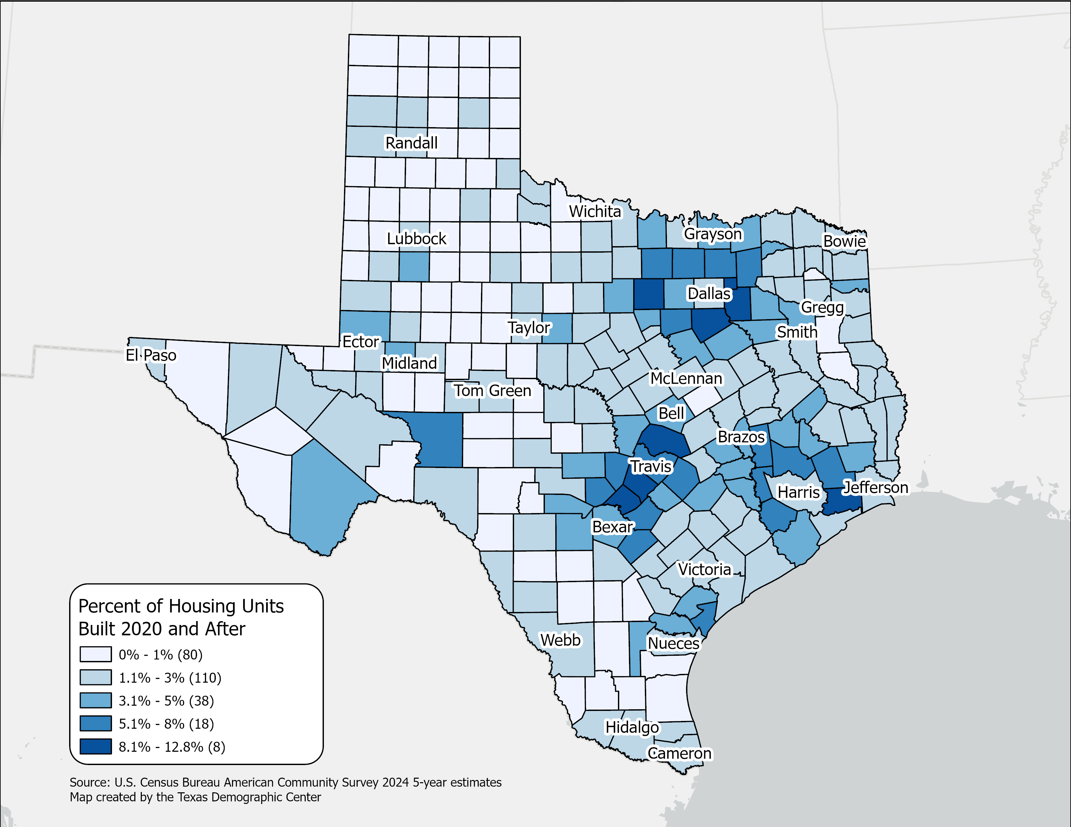
Percent of the housing units built in 2020 and after
Texas Counties
New housing is concentrated in suburban counties within the Texas Triangle.
Highest shares of post‑2020 housing are around major metros (DFW, Houston, Austin, San Antonio).
Rural counties show limited recent construction, often below 1%.
Source: U.S. Census Bureau, American Community Survey, 2024 5-year estimates

Slide 16
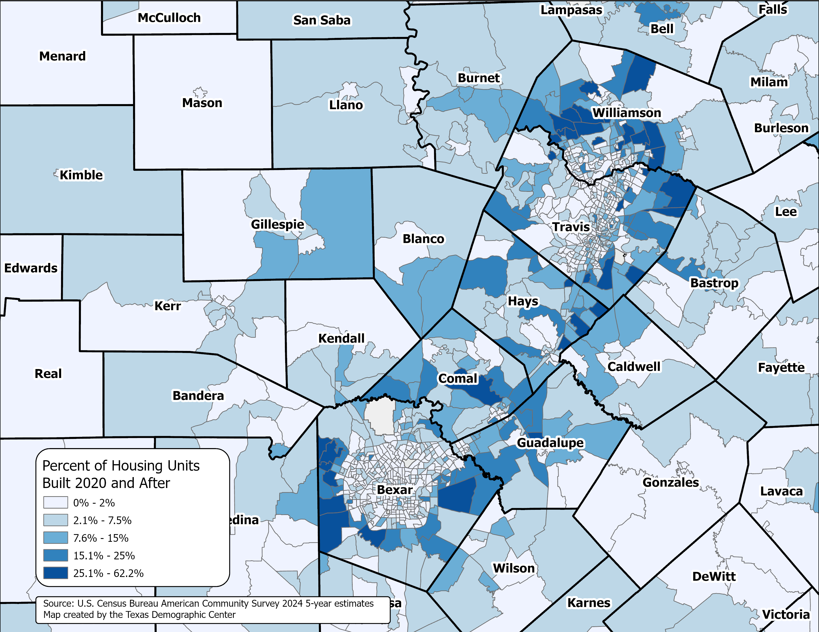
Percent of the housing units built in 2020 and after
Texas Census Tracts
San Antonio and Austin Area
Source: U.S. Census Bureau, American Community Survey, 2024 5-year estimates

Slide 17
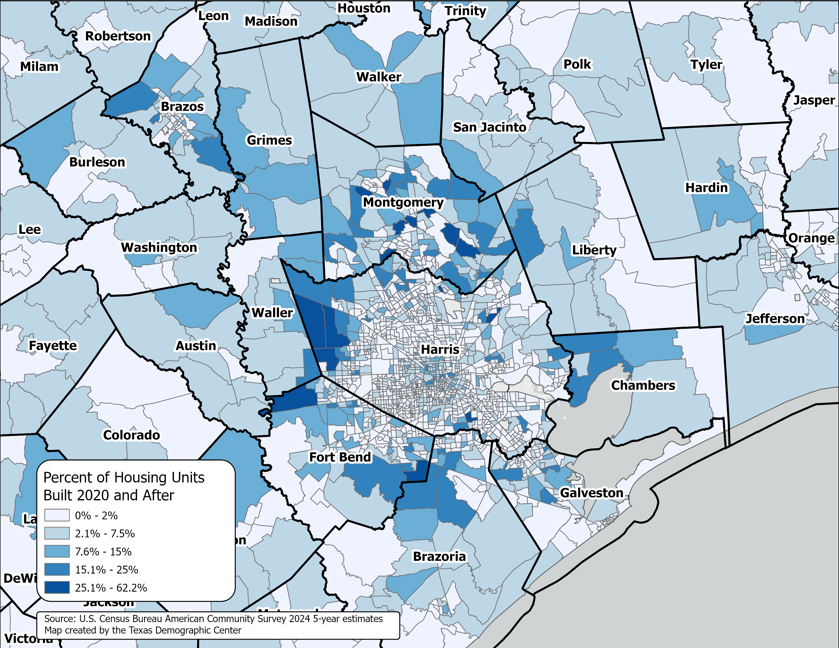
Percent of the housing units built in 2020 and after
Texas Census Tracts
Houston Area
Source: U.S. Census Bureau, American Community Survey, 2024 5-year estimates

Slide 18
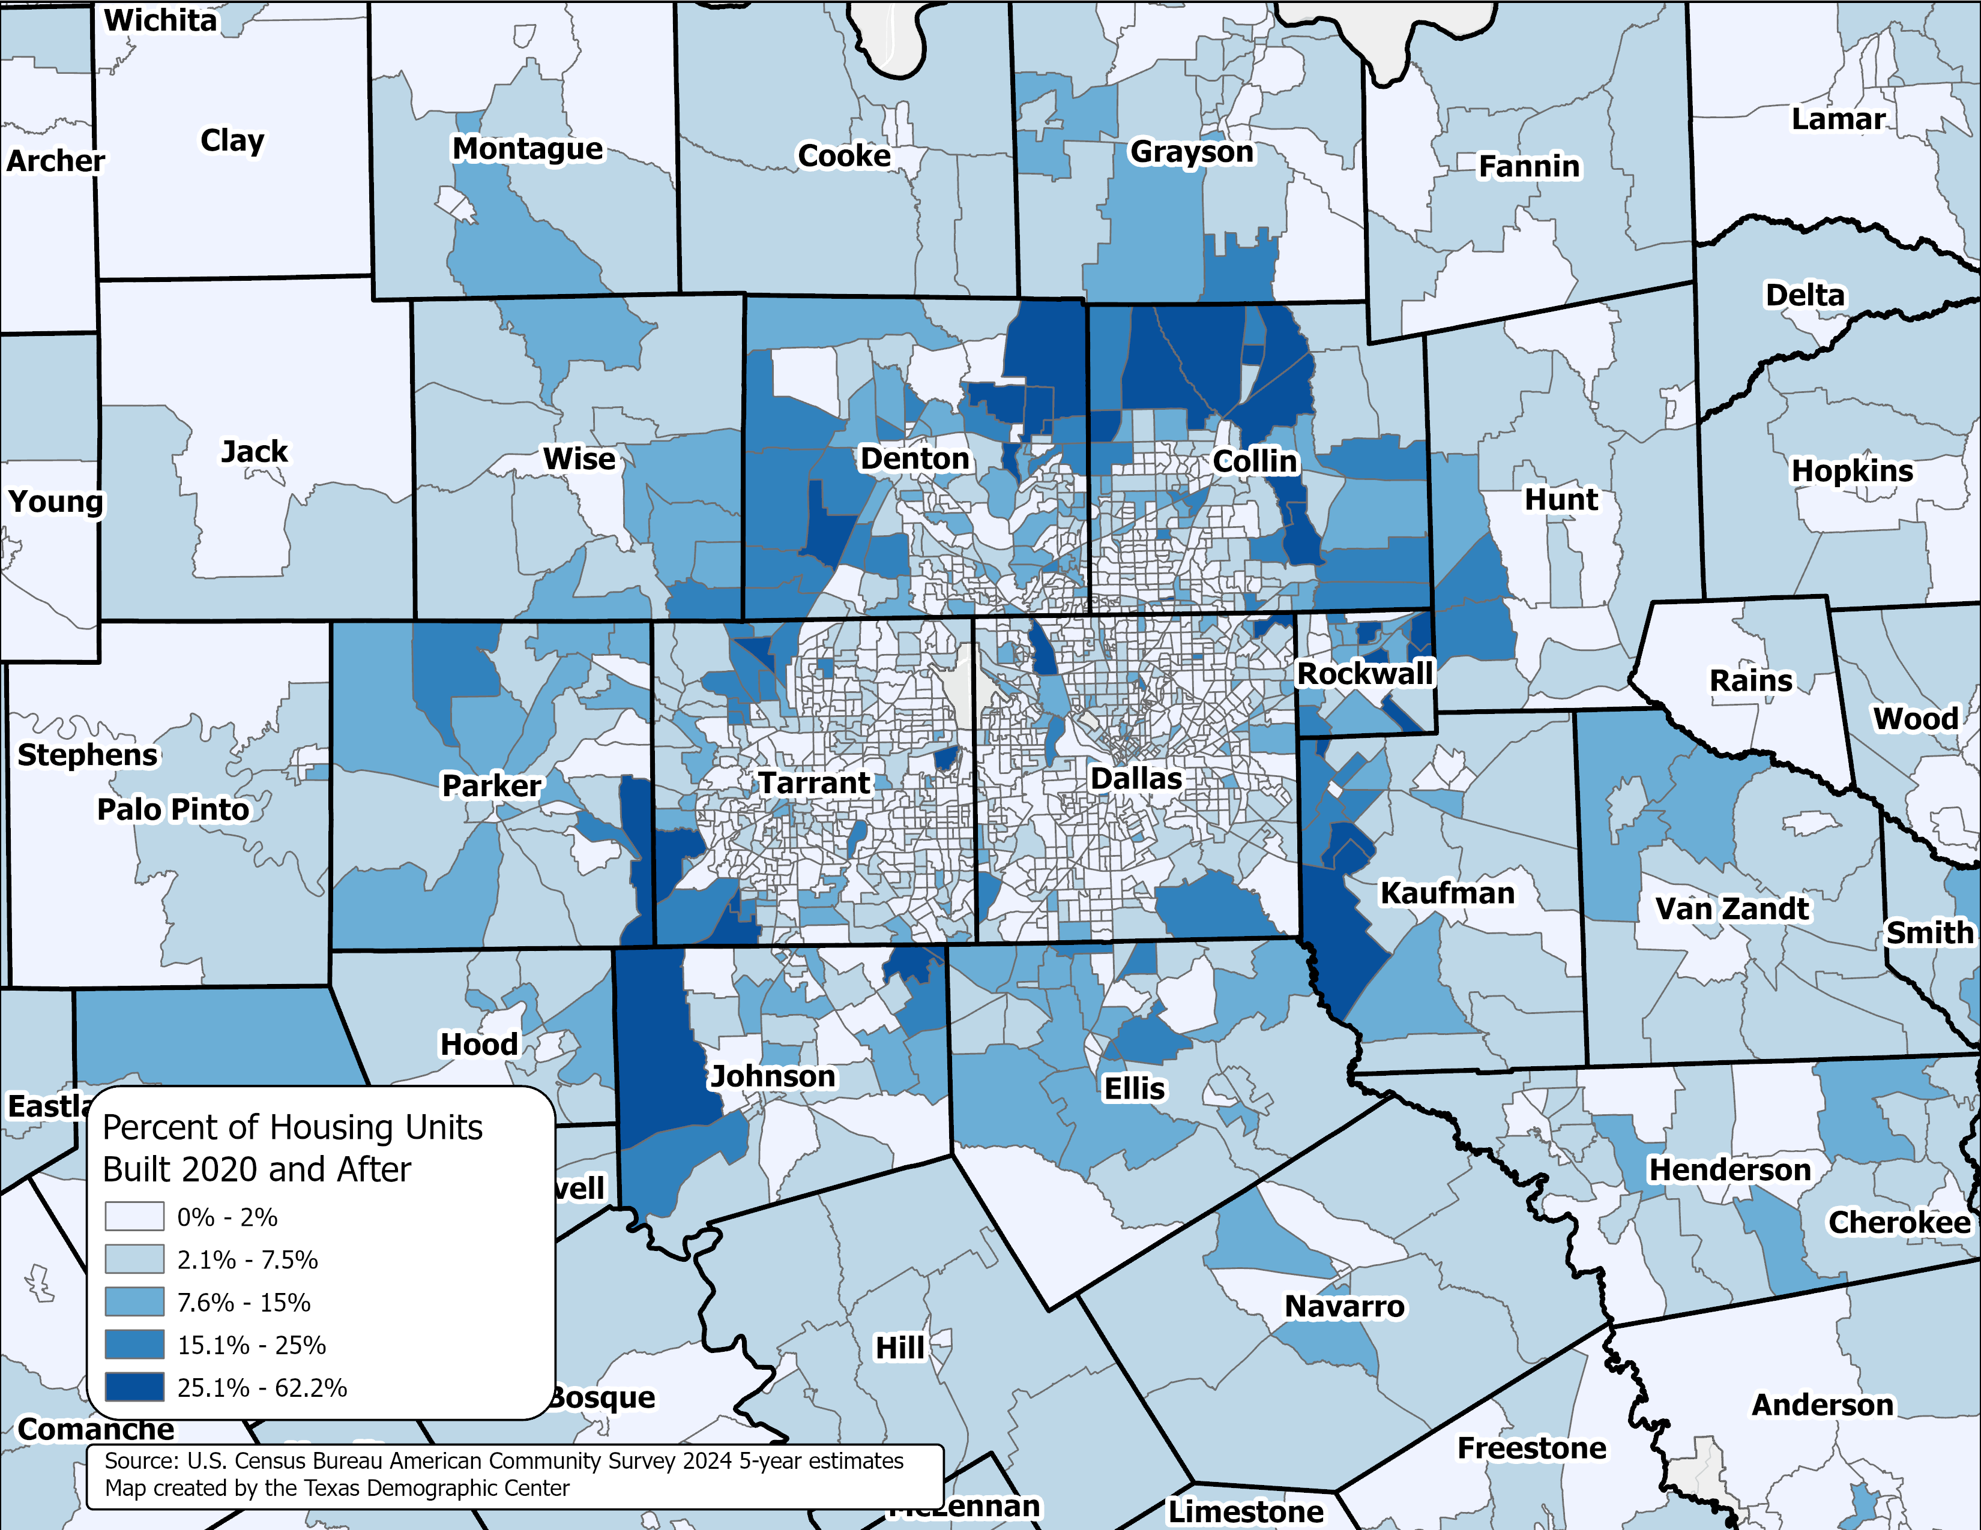
Percent of the housing units built in 2020 and after
Texas Census Tracts
Dallas-Fort Worth Area
Source: U.S. Census Bureau, American Community Survey, 2024 5-year estimates

Slide 19
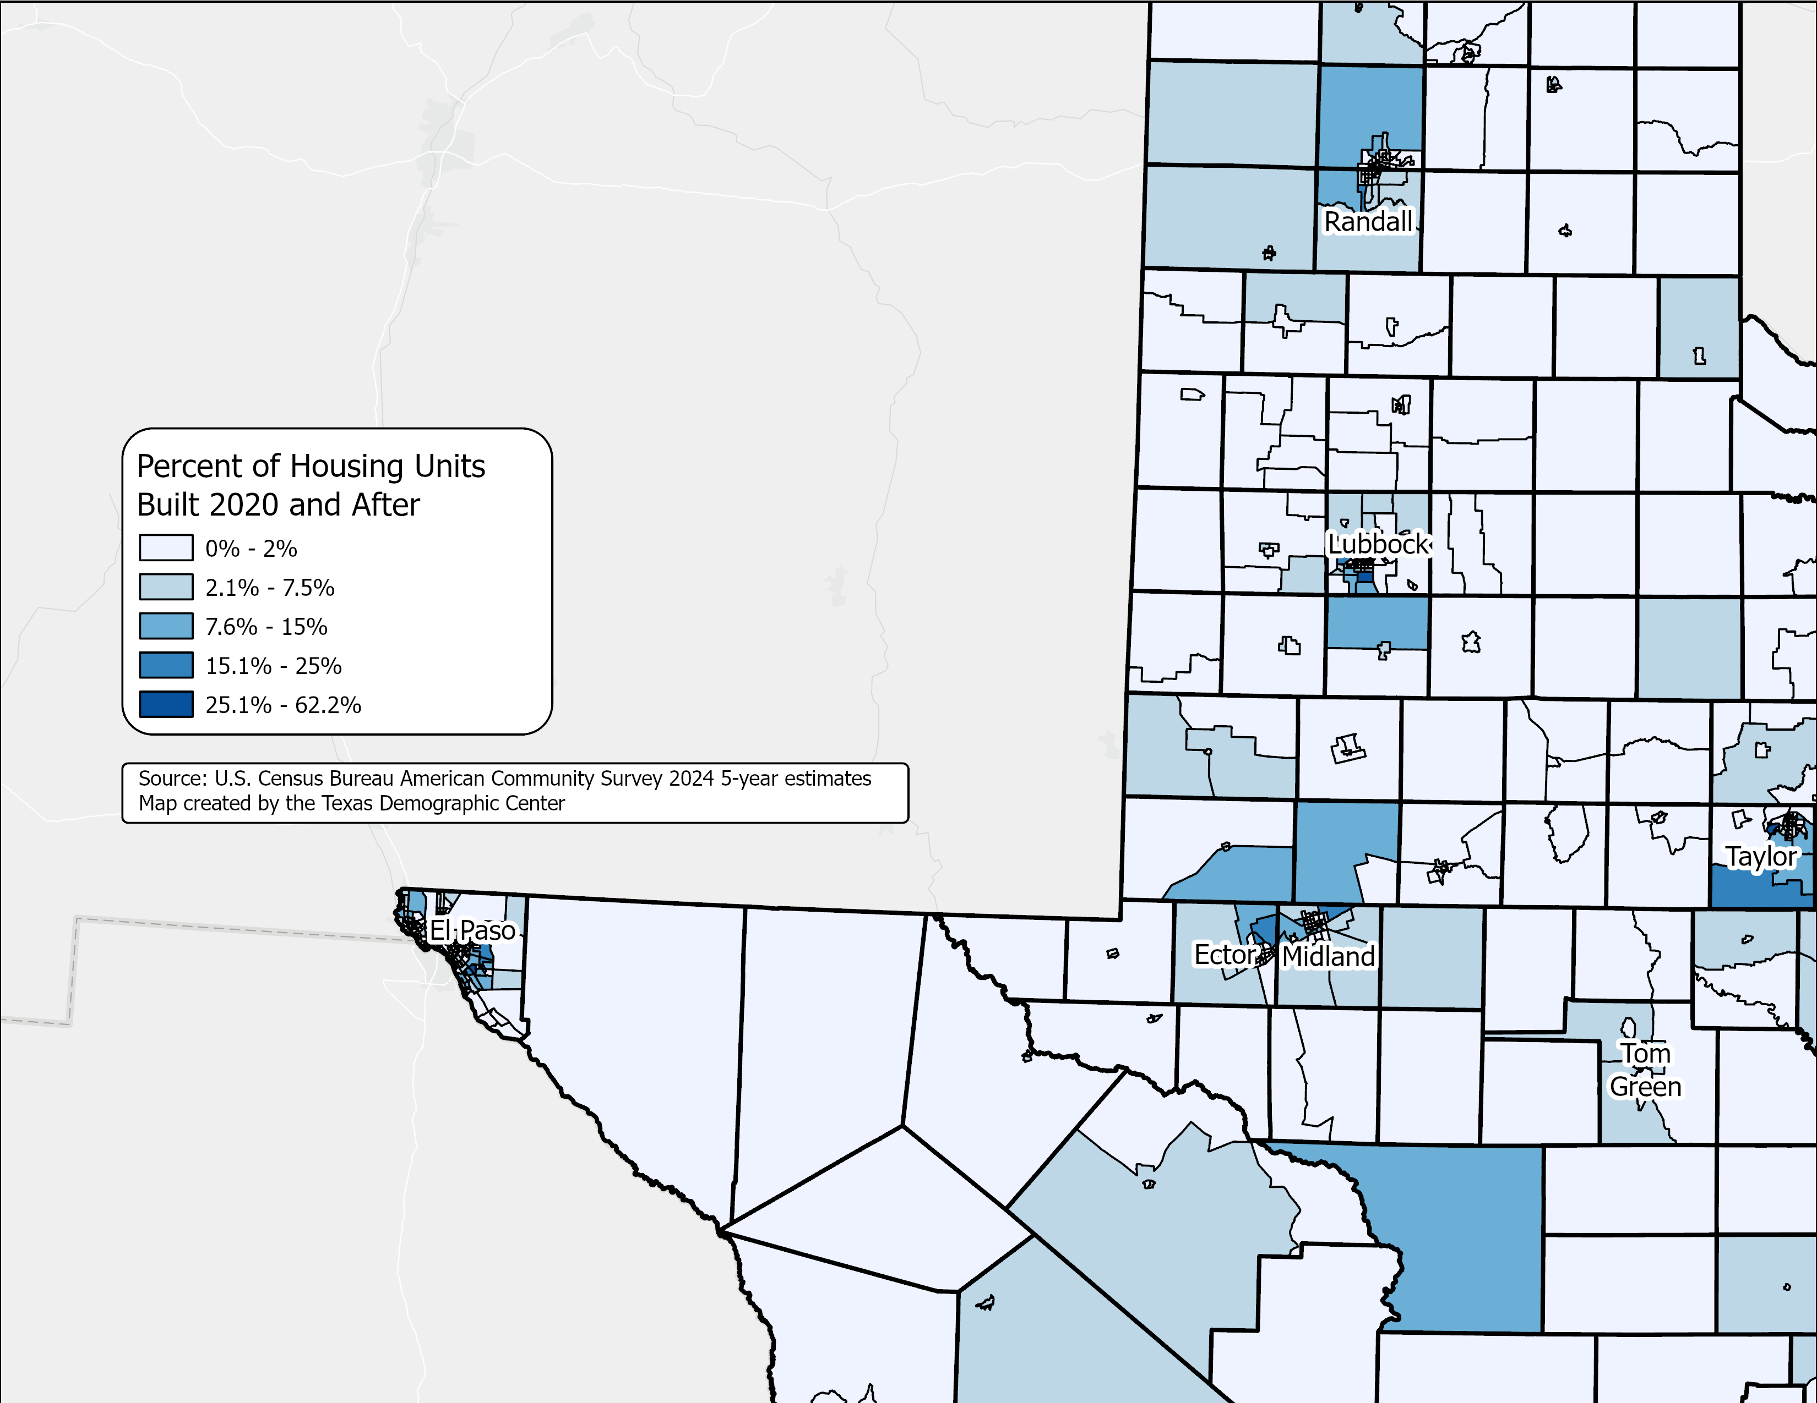
Percent of the housing units built in 2020 and after
Texas Census Tracts
Lubbock, El Paso, and Permian Basin Area
Source: U.S. Census Bureau, American Community Survey, 2024 5-year estimates

Slide 20
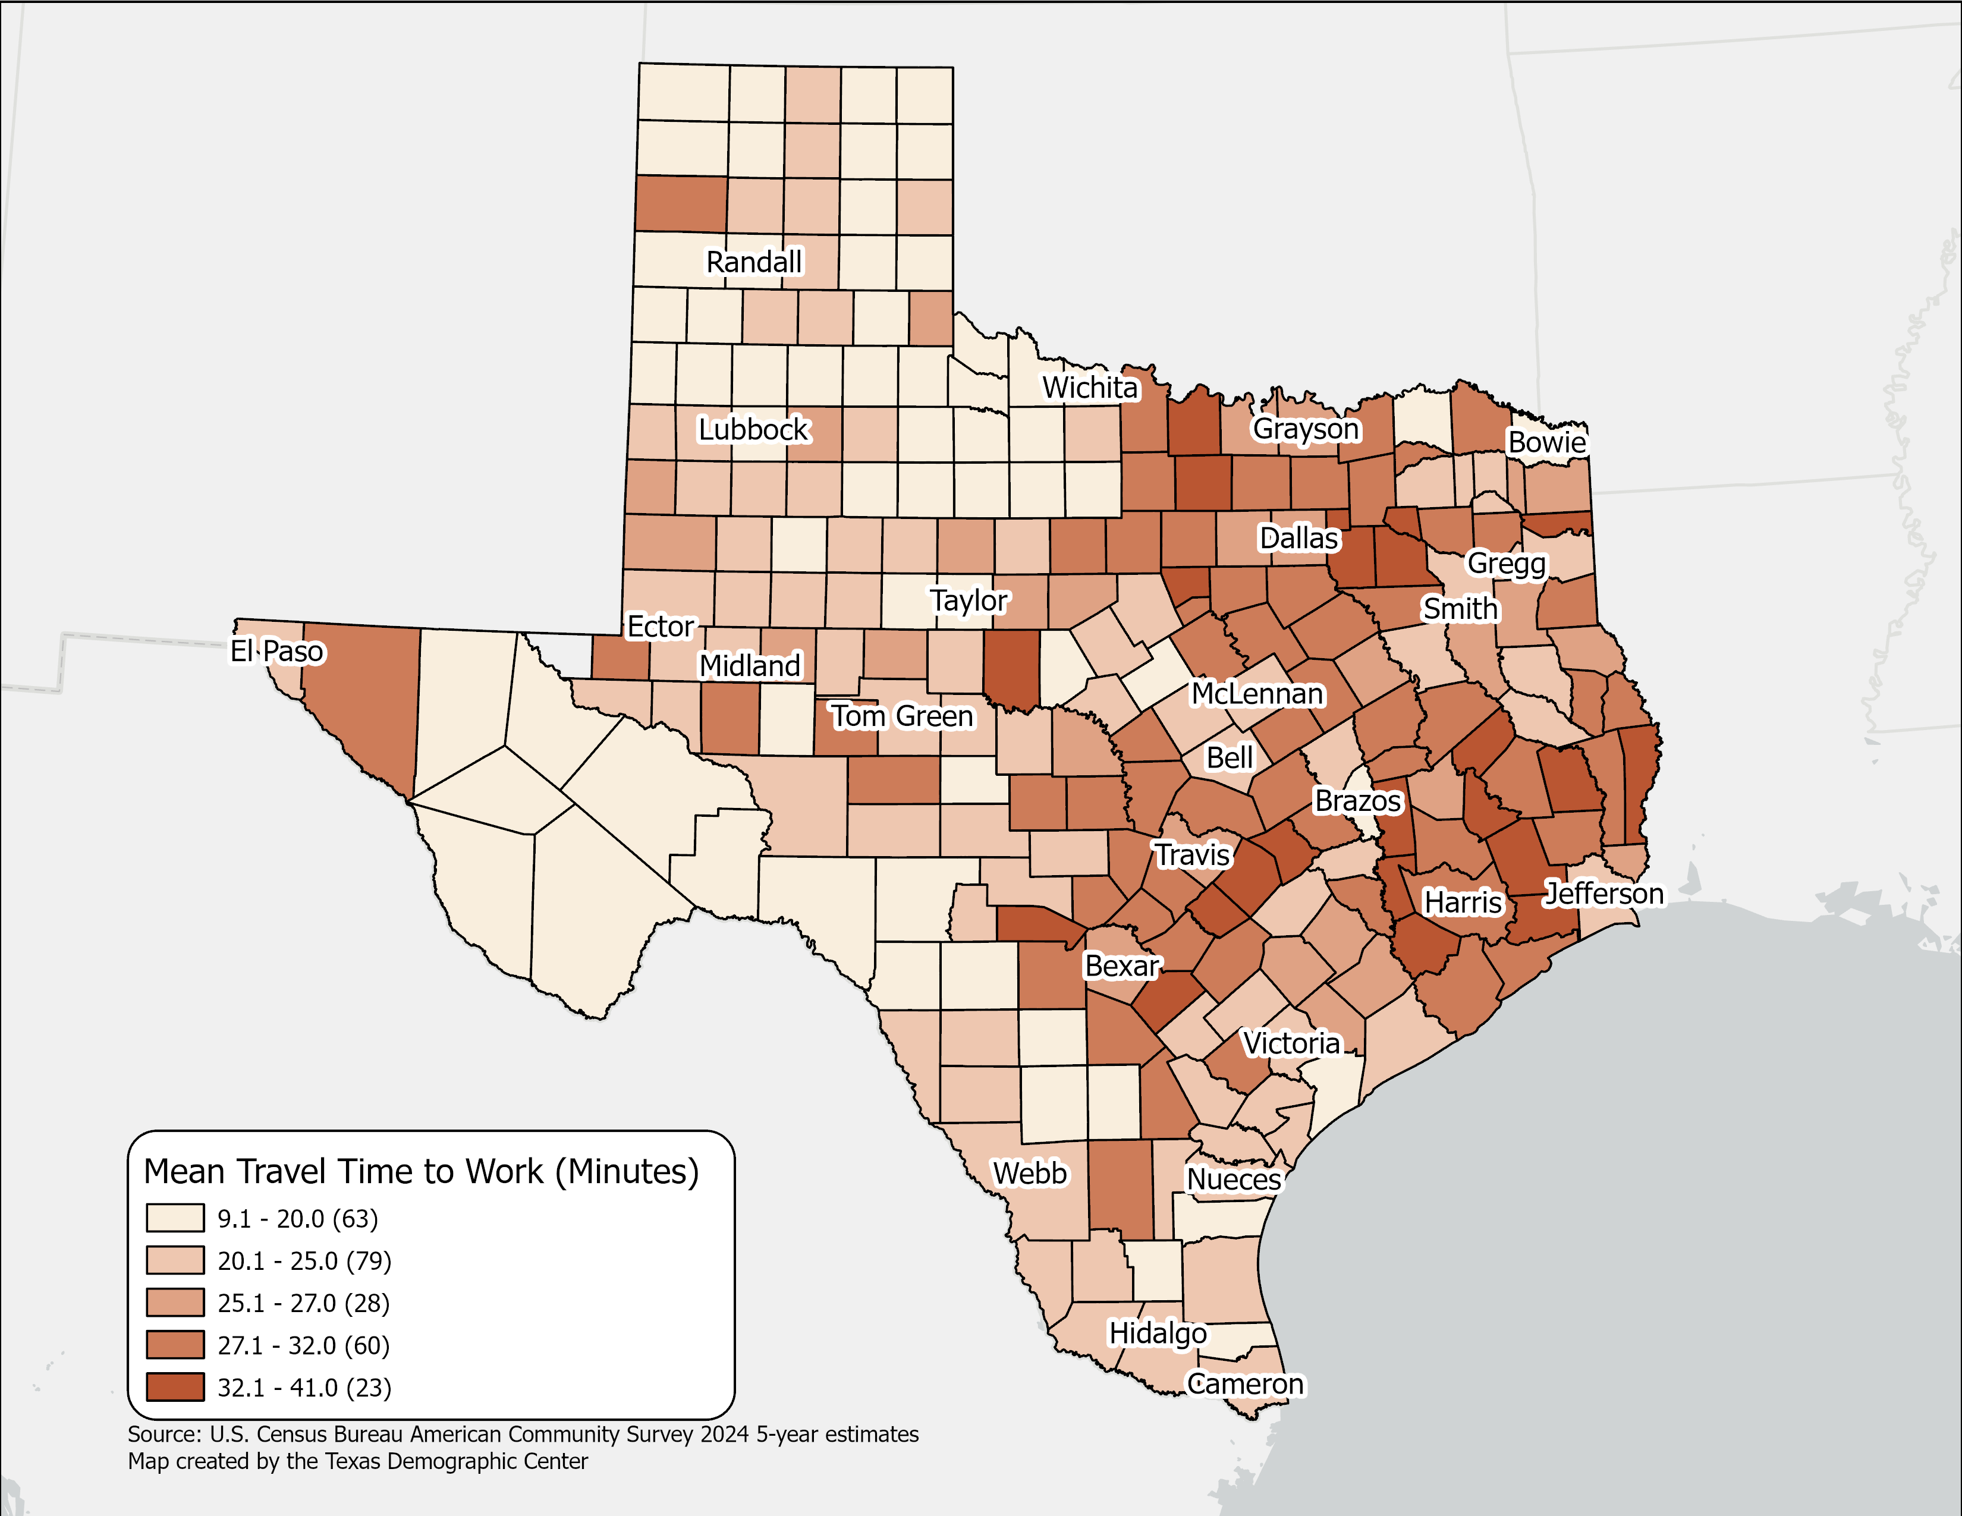
Mean Travel Time to Work(minutes),
Texas Counties, 2024
Mean Travel time for Texas:
  26.7 (2024 5-year)
  25.2 (2014 5-year)
Geographic variation across Texas counties reflects higher travel times in large metropolitan and suburban areas.
Source: U.S. Census Bureau, American Community Survey, 2024 5-year estimates

Slide 21
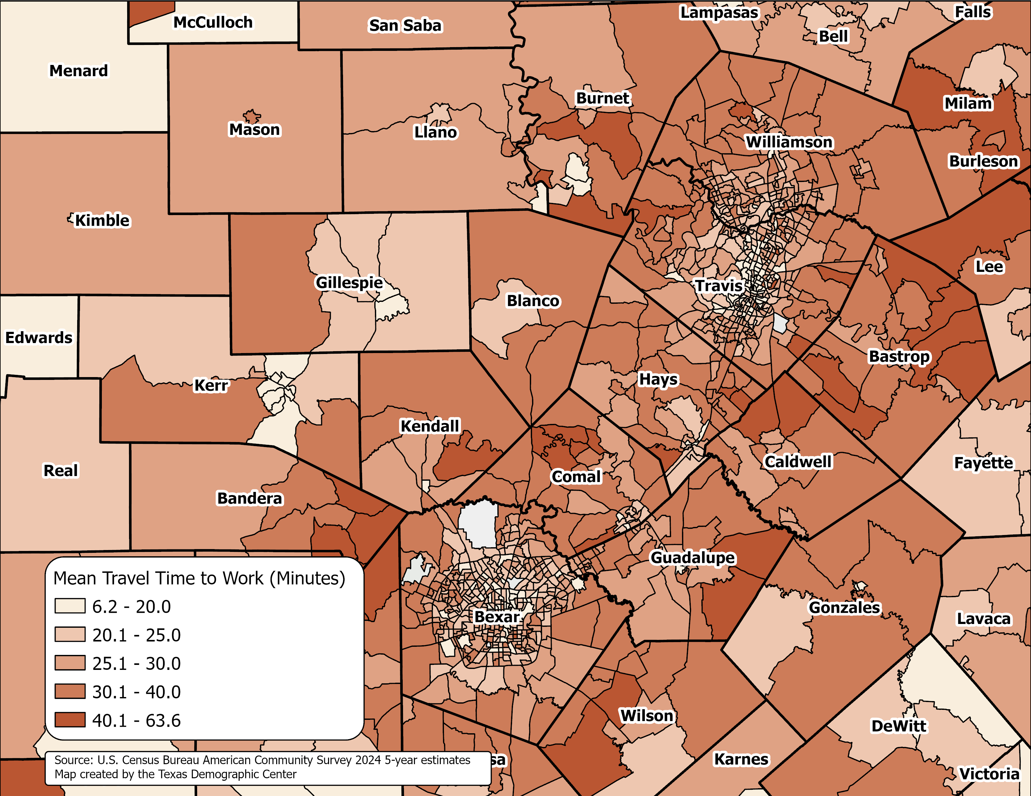
Mean Travel Time to Work(minutes), Texas Census Tracts
Austin and San Antonio Area, 2024
Source: U.S. Census Bureau, American Community Survey, 2024 5-year estimates

Slide 22
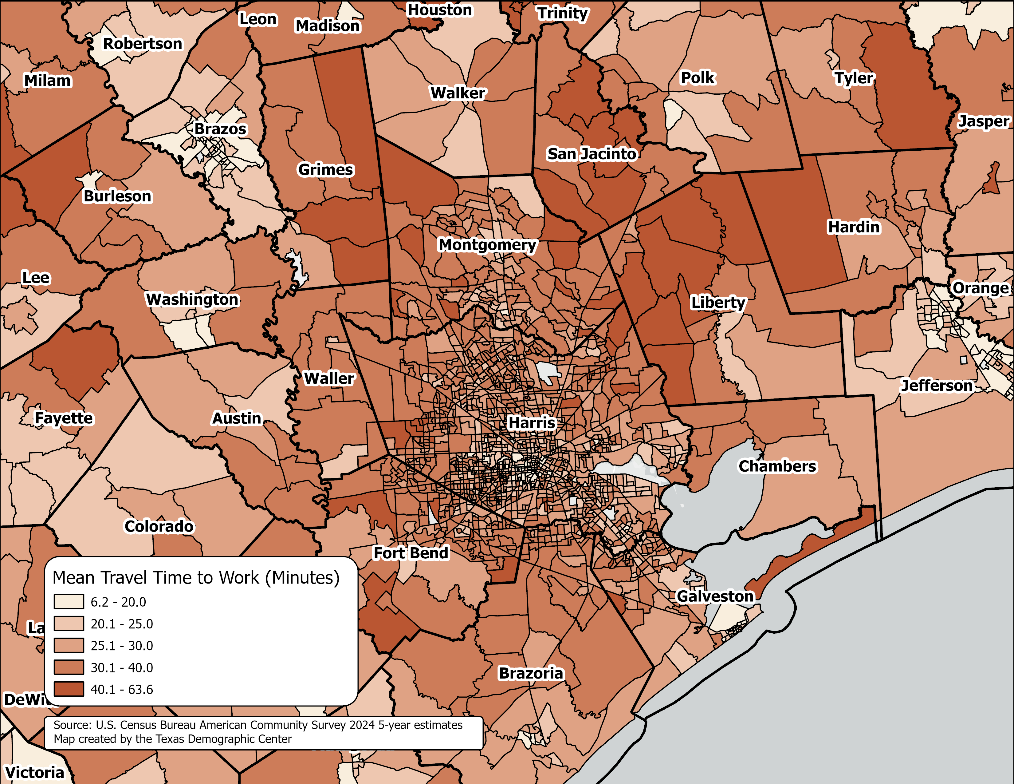
Mean Travel Time to Work(minutes), Texas Census Tracts
Houston Area, 2024
Source: U.S. Census Bureau, American Community Survey, 2024 5-year estimates

Slide 23
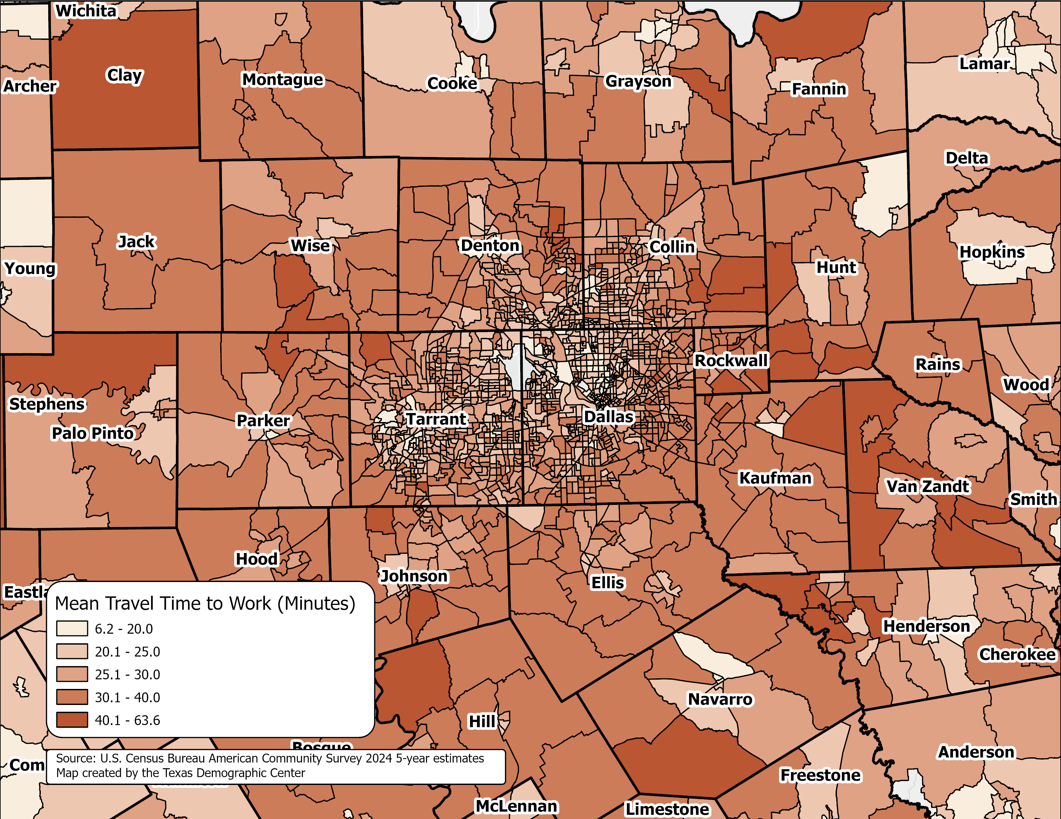
Mean Travel Time to Work(minutes), Texas Census Tracts
Dallas-Fort Worth Area, 2024
Source: U.S. Census Bureau, American Community Survey, 2024 5-year estimates

Slide 24
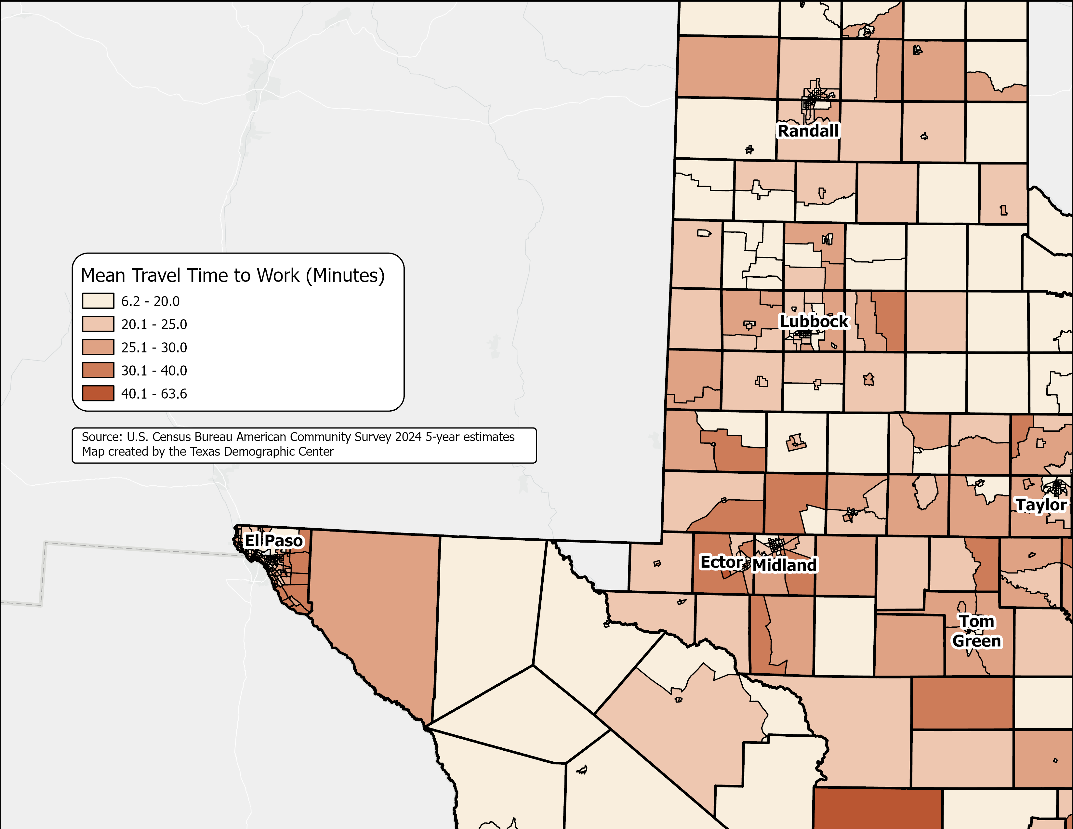
Mean Travel Time to Work(minutes), Texas Census Tracts
Lubbock, El Paso, and Permian Basin Area, 2024
Source: U.S. Census Bureau, American Community Survey, 2024 5-year estimates

Slide 25
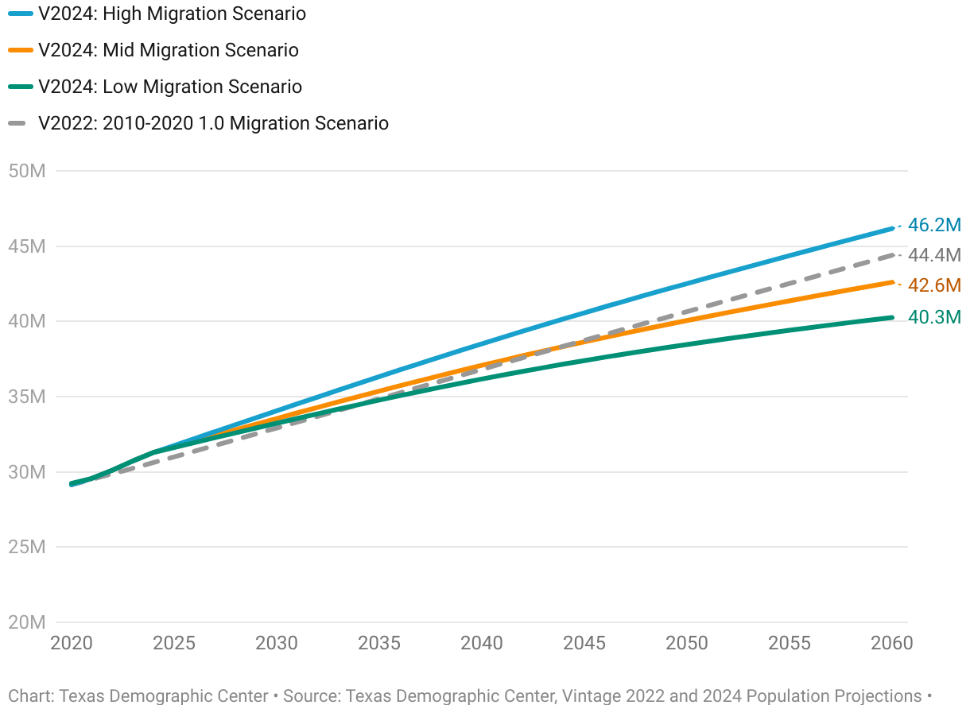
Projected Population Growth in Texas with Various Migration Scenarios

Slide 26
Projected Components of Change under the Mid Migration Scenario
Source: Texas Demographic Center, Vintage 2024 Population Projections

Slide 27
Projected Population by Race/Ethnicity
2020-2060
Mid Migration Scenario
All race/ethnic groups are projected to grow in size except for the non-Hispanic White.
Hispanics will gain the most population, while NH Asians will experience the fastest growth
Source: Texas Demographic Center, Vintage 2024 Population Projections, Mid Migration Scenario

Slide 28
Projected Population by Age
2020, 2040, and 2060
Mid Migration Scenario
22%
18%
Texas will continue to age in the next few decades.
The 65+ group will grow fastest.
Growth among those under 18 will slow and begin to decline.
The working-age population will grow and maintain a stable share of the total population.
13%
60%
60%
62%
Total Population
29.1M
37.1M
42.6M
Source: Texas Demographic Center, Vintage 2024 Population Projections, Mid Migration Scenario

Slide 29
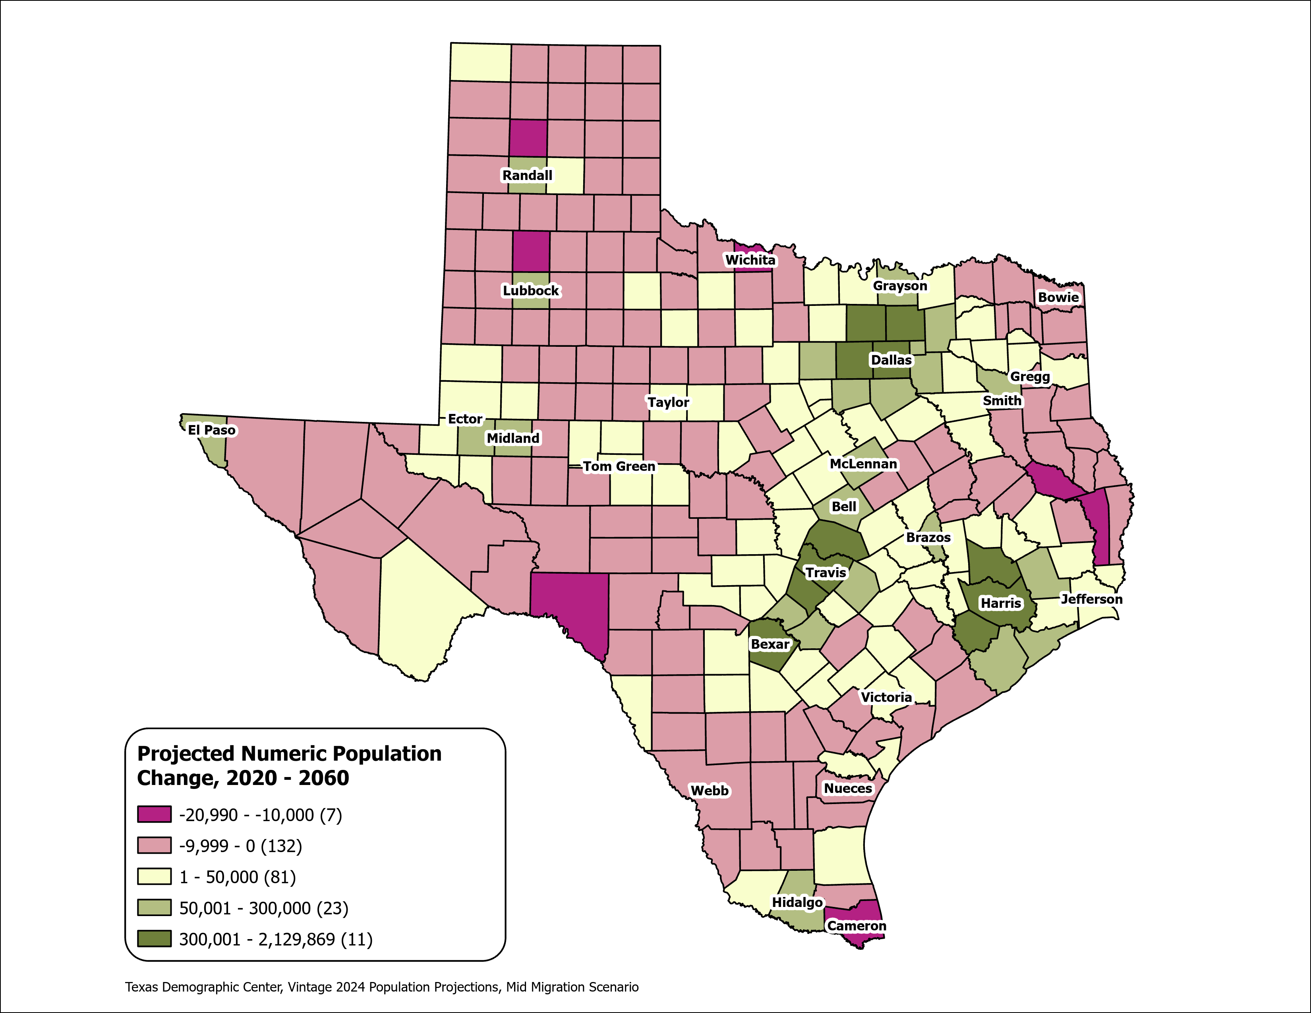
Texas Counties
Projected Population Numeric Change 2020-2060
Mid Migration Scenario
139 Counties are projected to lose population
Current MSA counties will account for 99% of the state’s growth from 2020 to 2060
The four MSAs within the TX Triangle will increase their share of population from 67% to 74%
Source: Texas Demographic Center, Vintage 2024 Population Projections, Mid Migration Scenario

Slide 30
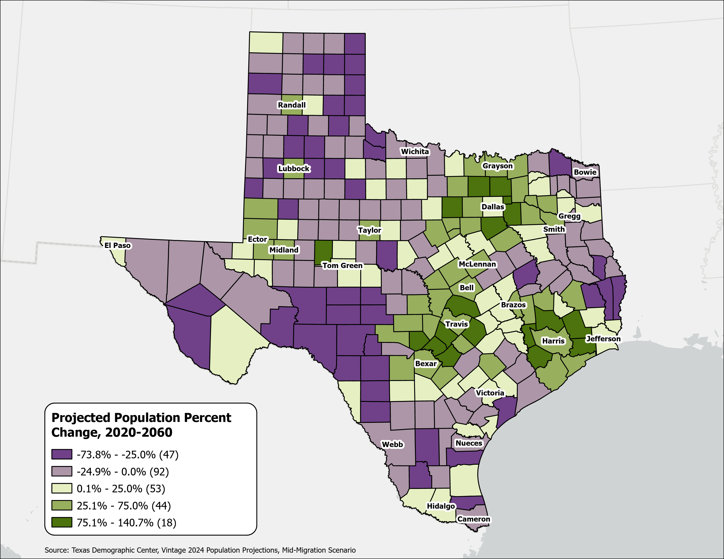
Texas Counties
Projected Population Percent Change 2020-2060
Mid Migration Scenario
Suburban ring counties in the triangle area will see the fastest growth rates.
Source: Texas Demographic Center, Vintage 2024 Population Projections, Mid Migration Scenario

Slide 31
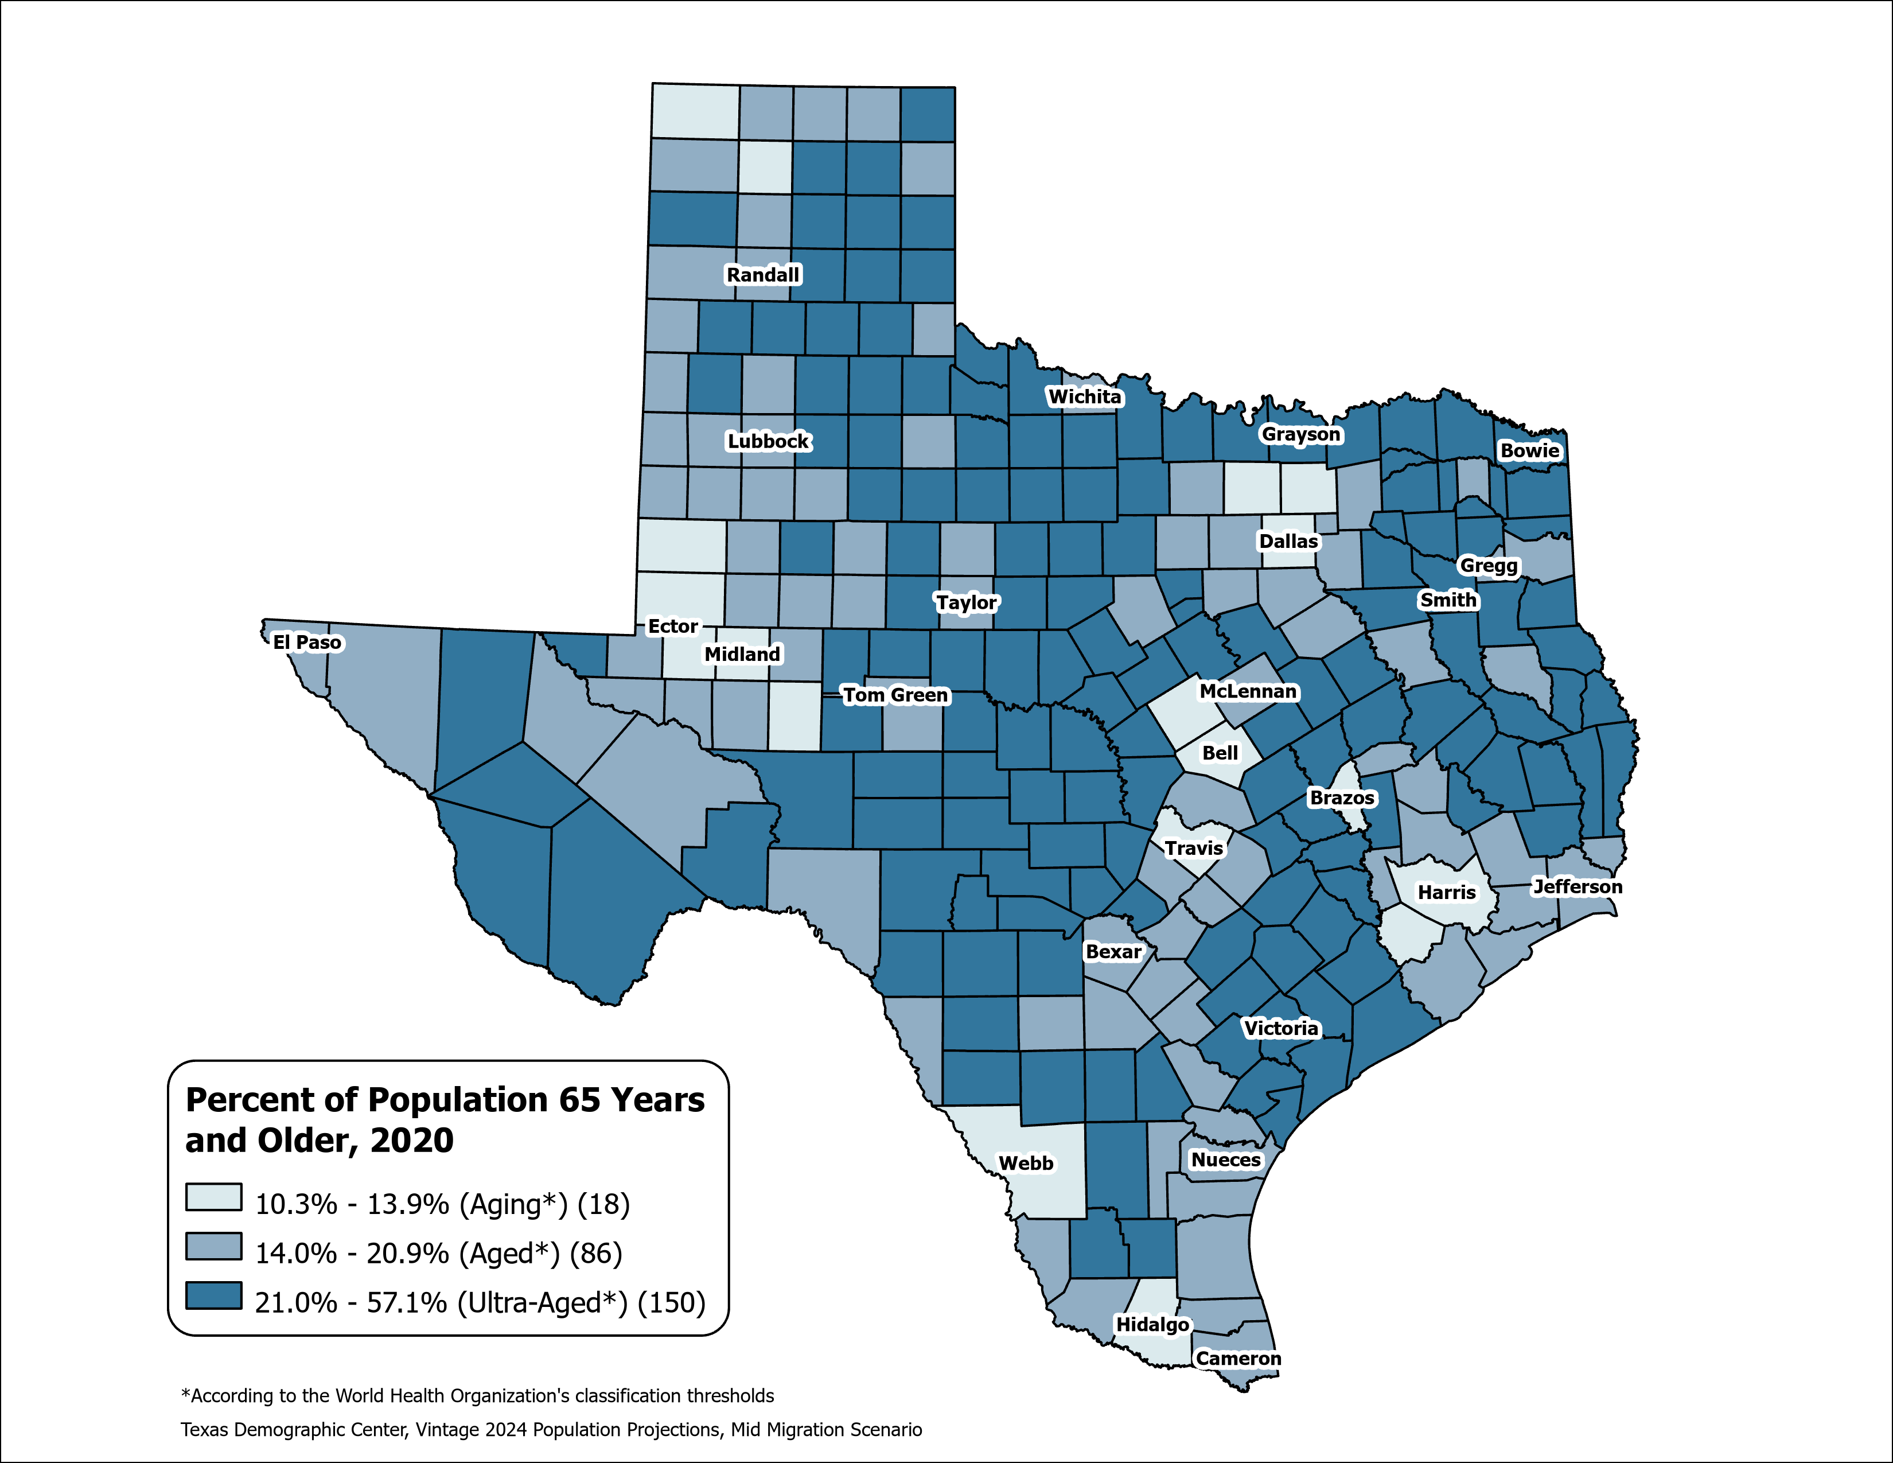
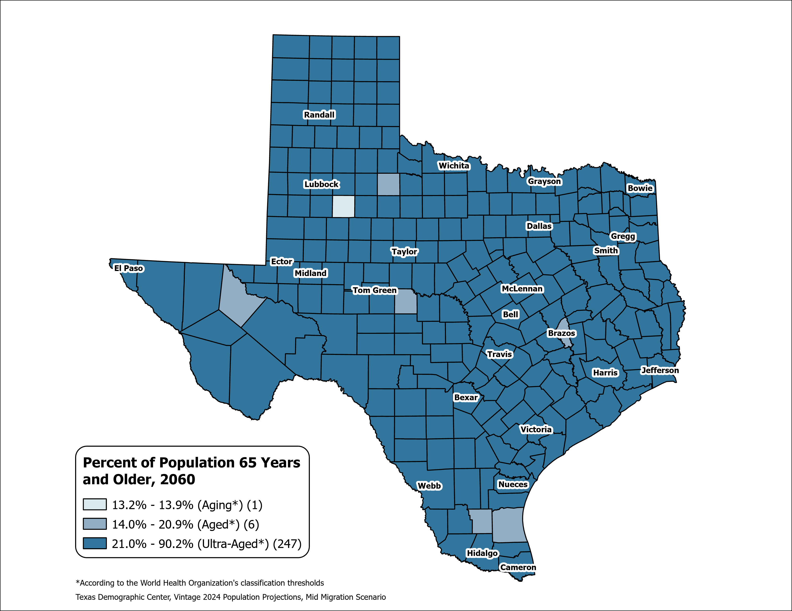
County Aging Map – Using the % of 65+ to Measure
Texas 2020: Aging (13.5%)
Texas 2060: Ultra-Aged (21.7%)
Source: Texas Demographic Center, Vintage 2024 Population Projections, Mid-Migration Scenario

Slide 32
About Presenter
Helen You, Ph.D.
(210) 458-6530
tdc@utsa.edu
demographics.texas.gov/

