Slide 1
Texas Population:
Trends and Characteristics
Tex-21
June 26, 2026

Slide 2




About our organization
Major Function
Produce annual population estimates and biennial population projections
Other Services
Disseminate demographic and socioeconomic information from the Census Bureau and other reliable sources.
Provide training and technical expertise.
Custom data analyses.
State Demographer
Lloyd B. Potter, Ph.D.
Affiliated with
The University of Texas at San Antonio
Partnerships
U.S. Census Bureau
TDC Affiliates

Slide 3
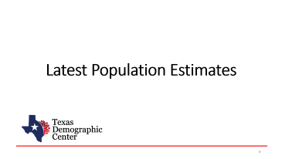

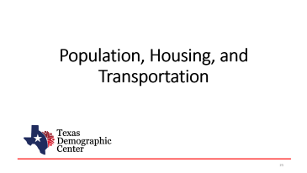
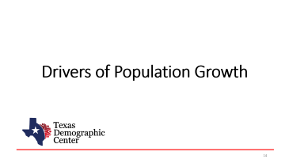
Table of Contents

Slide 4
Latest Population Estimates
Notes:
Let's start with the latest population estimates. This section covers newly released data from the Census Bureau's Vintage 2025 Population Estimates program.
These numbers give us the most current picture of how Texas's population is growing, where that growth is happening, and how Texas compares to other states.

Slide 5


New 2025 Estimates Show Texas Growth but at Slower Rate
Newly Released Data
Texas Total Population 2025
31.7M
391K
1.2%
Numeric increase
Percent increase
Growth from 2024
New Census Bureau data shows Texas’ population reached 31.7 million in July 2025 — a 1.2% increase from 2024 to 2025, more than 2X the 0.5% national growth rate. Though growth slowed compared to recent years, TX still led the nation in numeric gains, adding over 391K residents.

Slide 6
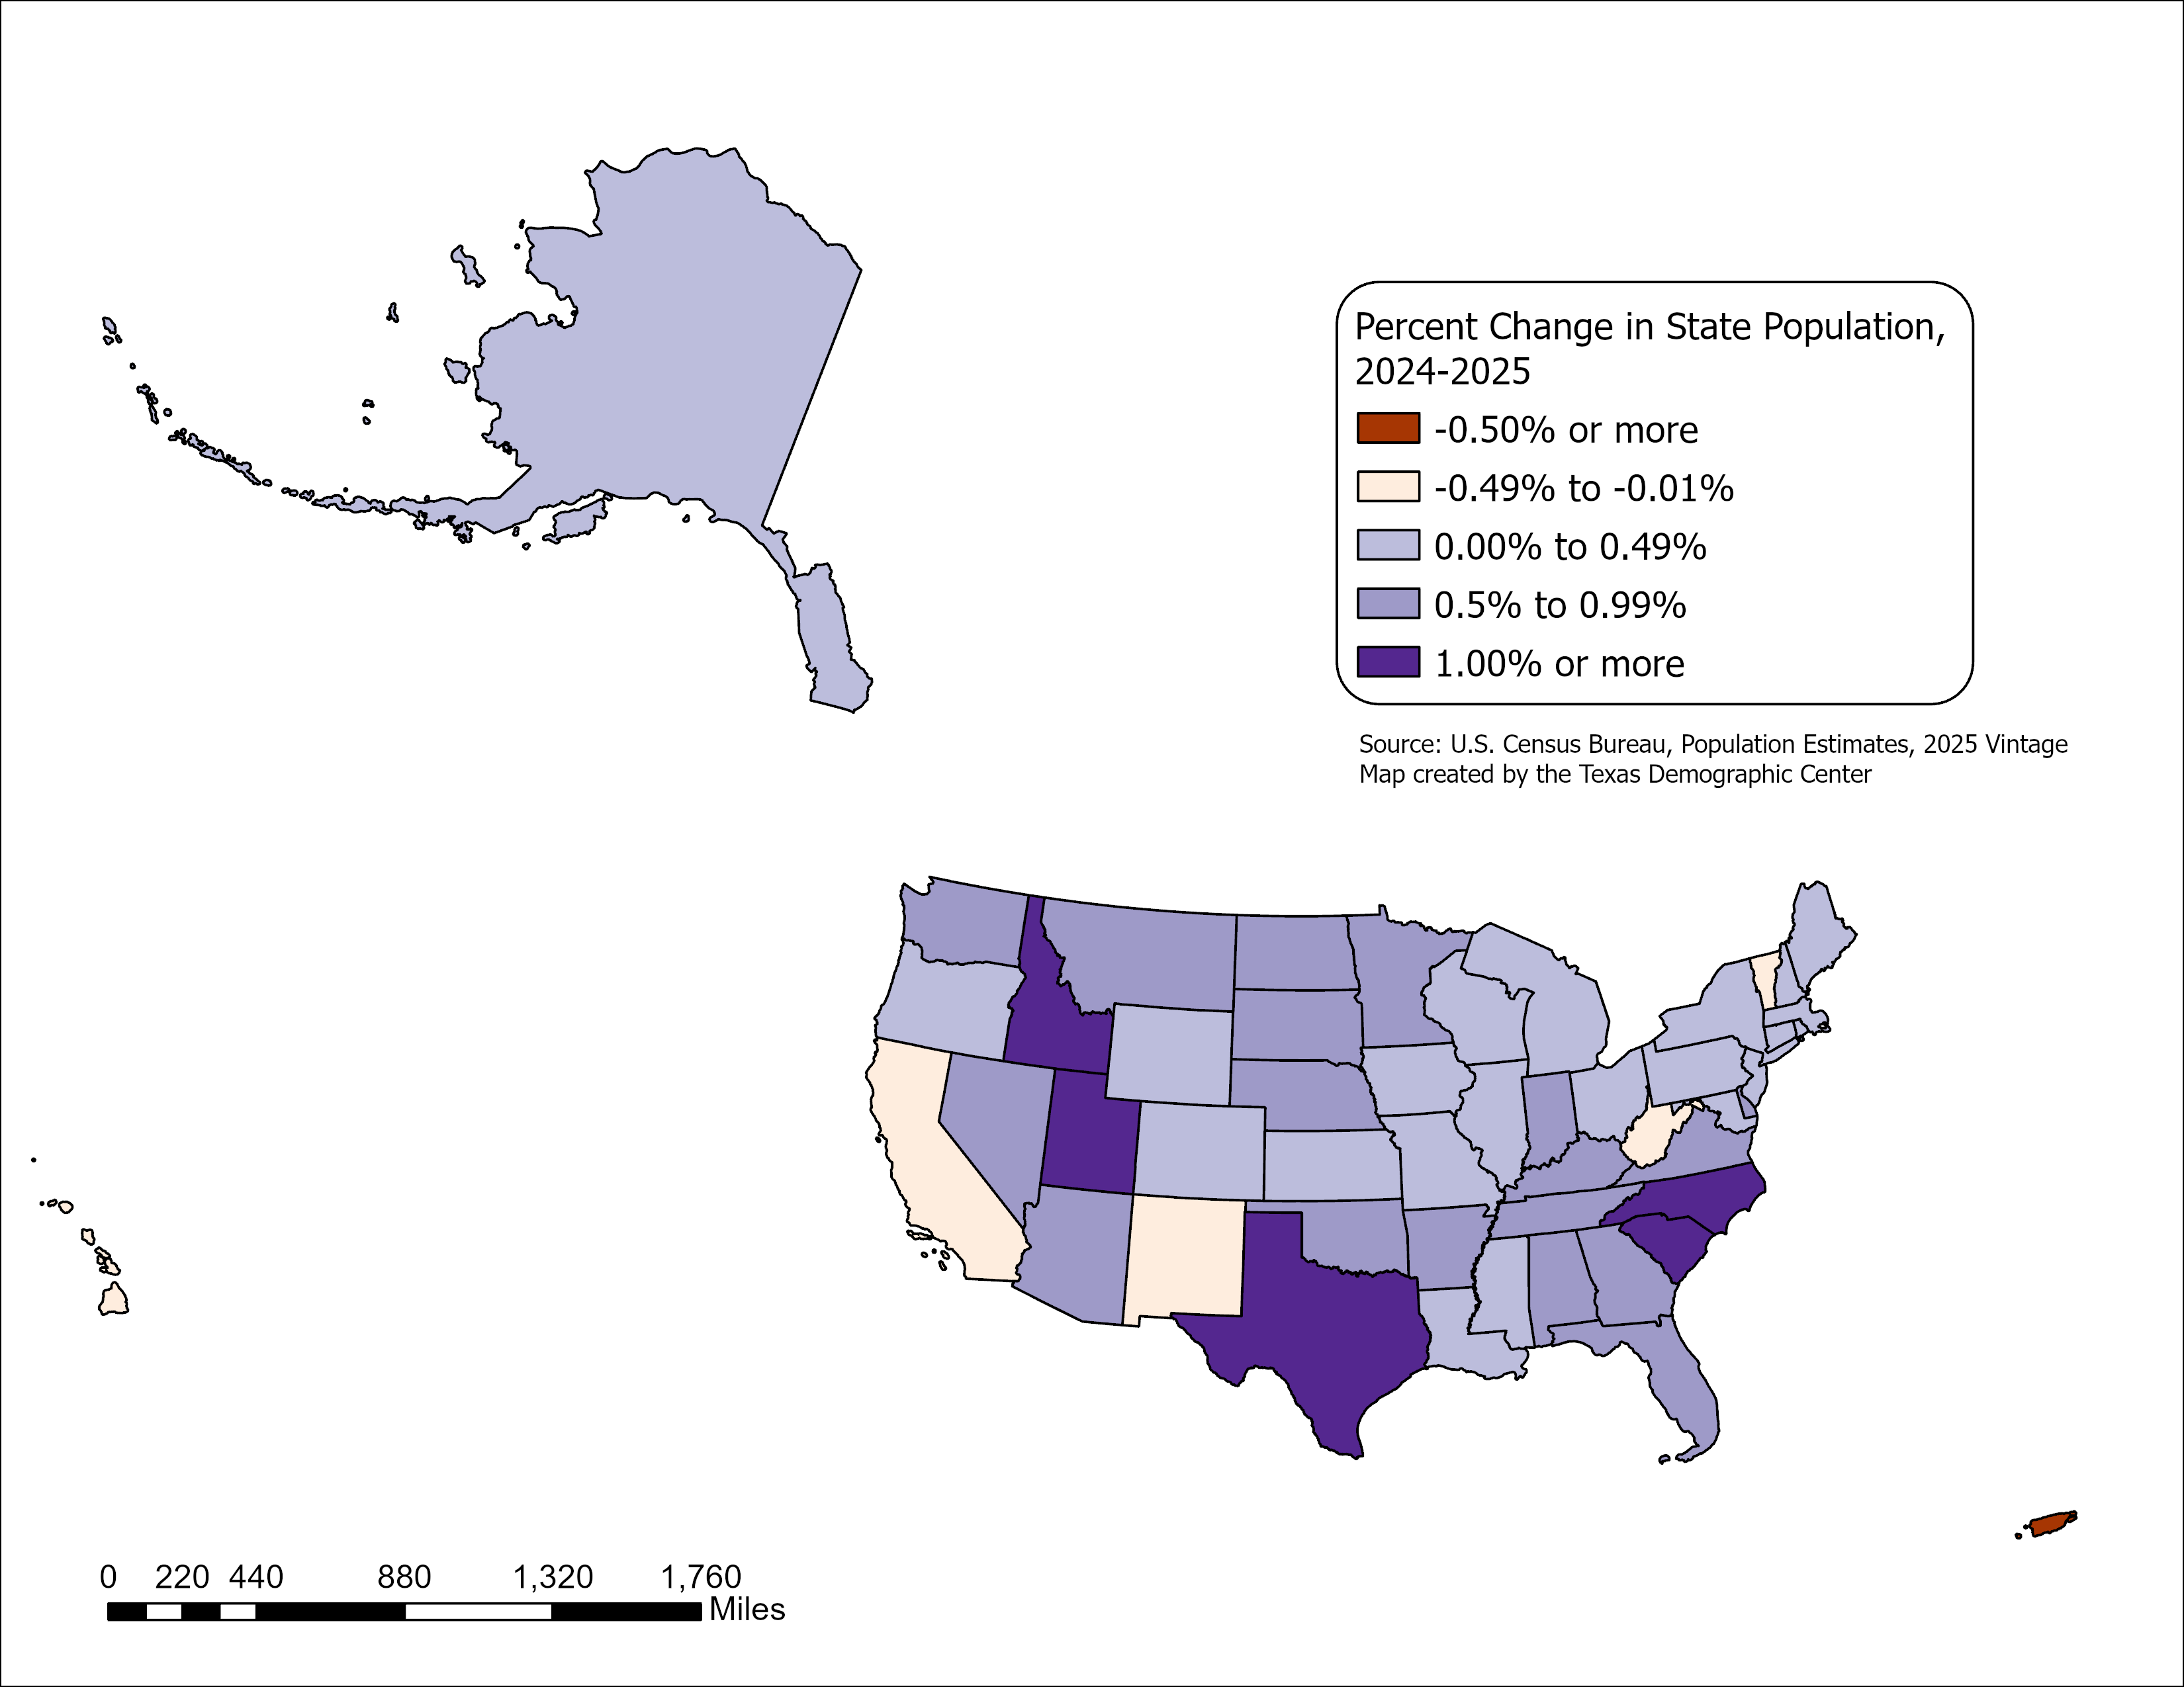
State Highlights
All but five U.S. states grew between July 2024 and July 2025
- CA, HI, NM, VT, and WV.
Top 5 States with percent change
-SC, ID, NC, TX, UT.
Top 5 States with numeric change
-TX, FL, NC, GA, SC.
Source: U.S. Census Bureau, Vintage 2025 Population Estimates

Slide 7
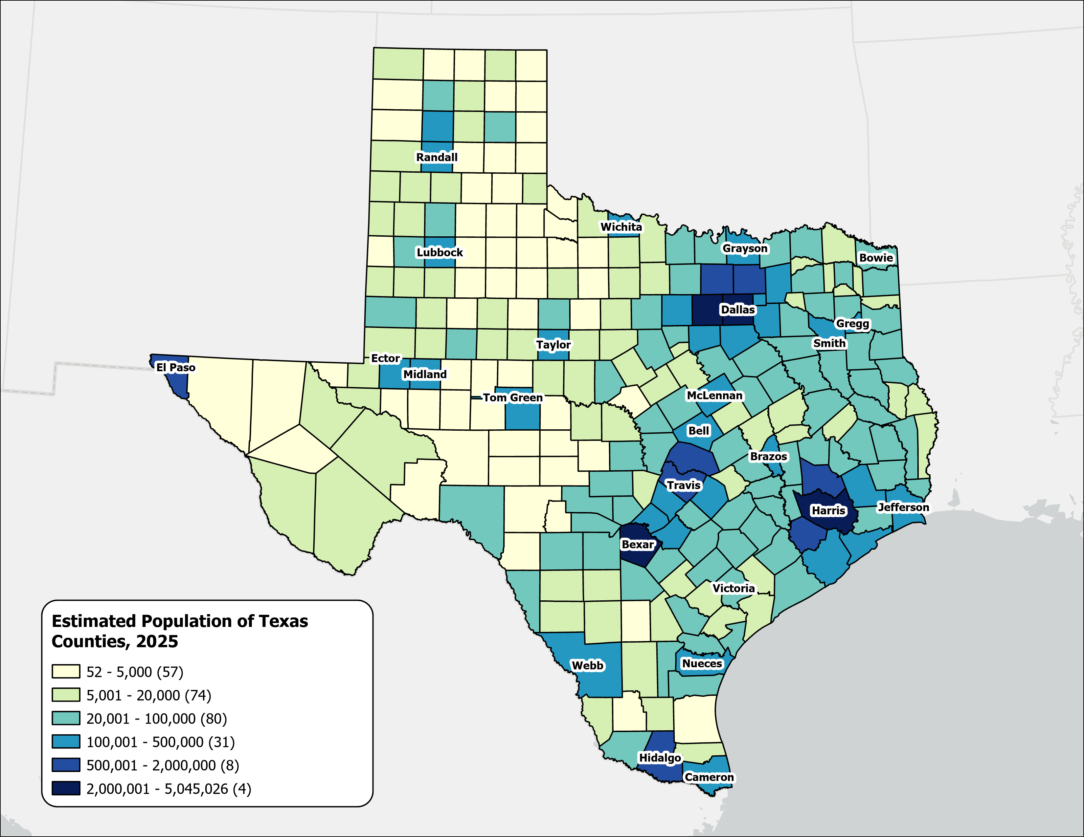
Estimated Population,
Texas Counties, 2025
Texas population is highly concentrated within the metropolitan triangle formed by Dallas–Fort Worth, Austin, San Antonio, and Houston.
The 120 counties on and east of the I‑35 corridor are home to 27.3 million residents—approximately 87.3% of the state’s total population.
87%
Source: U.S. Census Bureau, Vintage 2025 Population Estimates

Slide 8
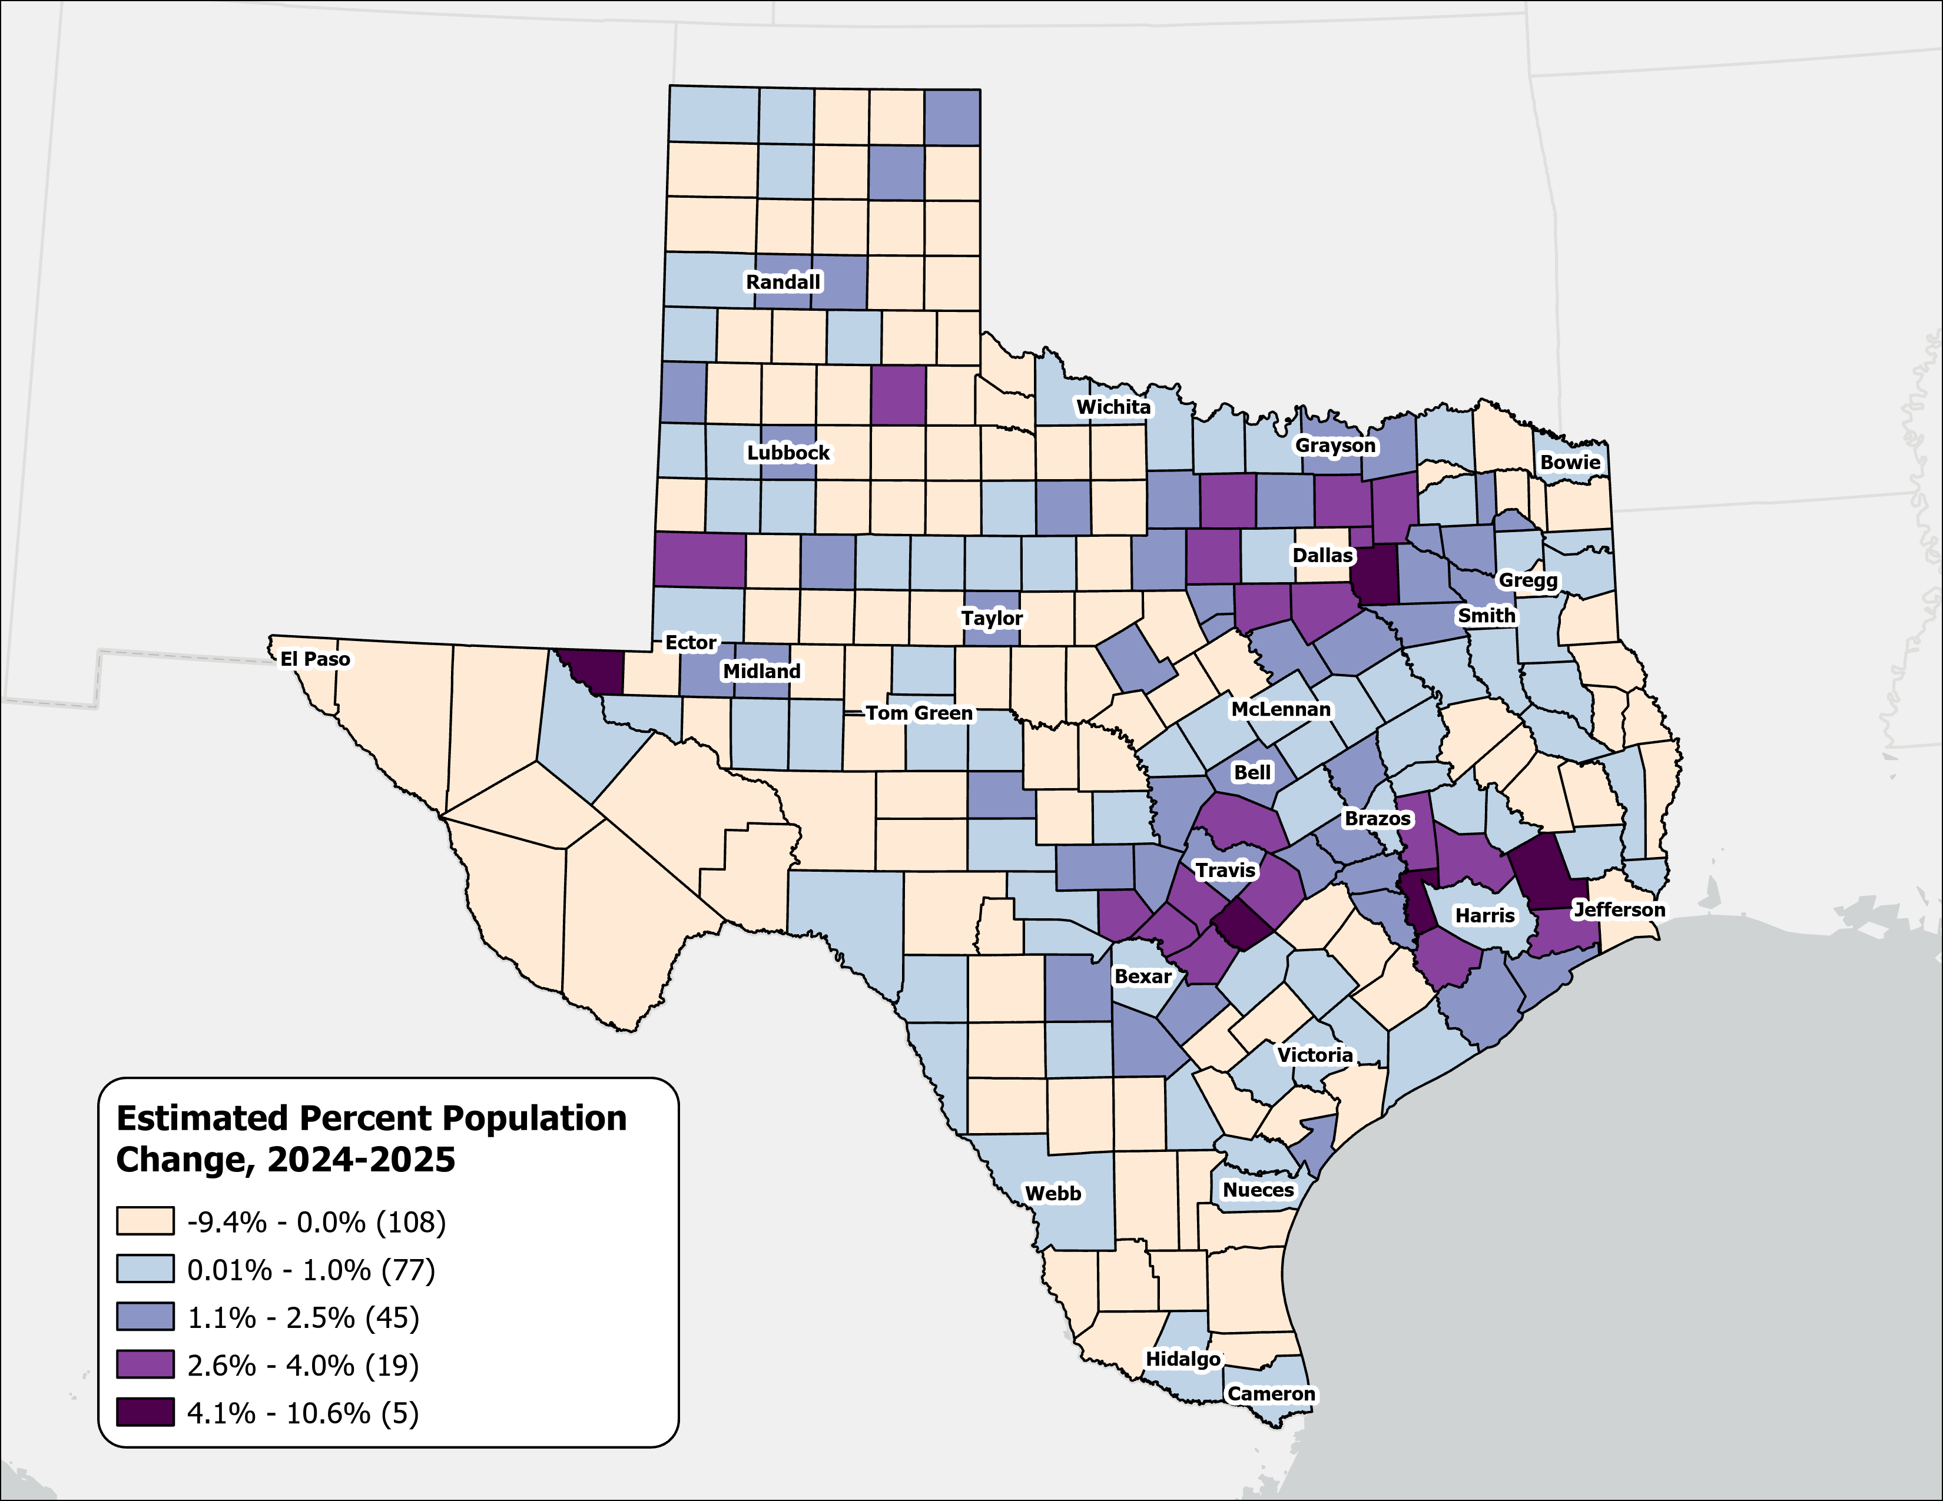
Estimated Percent Population Change, Texas Counties, 2024-2025
Rapid growth was concentrated in counties at the suburban and exurban edges of the Texas metropolitan triangle.
Source: U.S. Census Bureau, Vintage 2025 Population Estimates

Slide 9
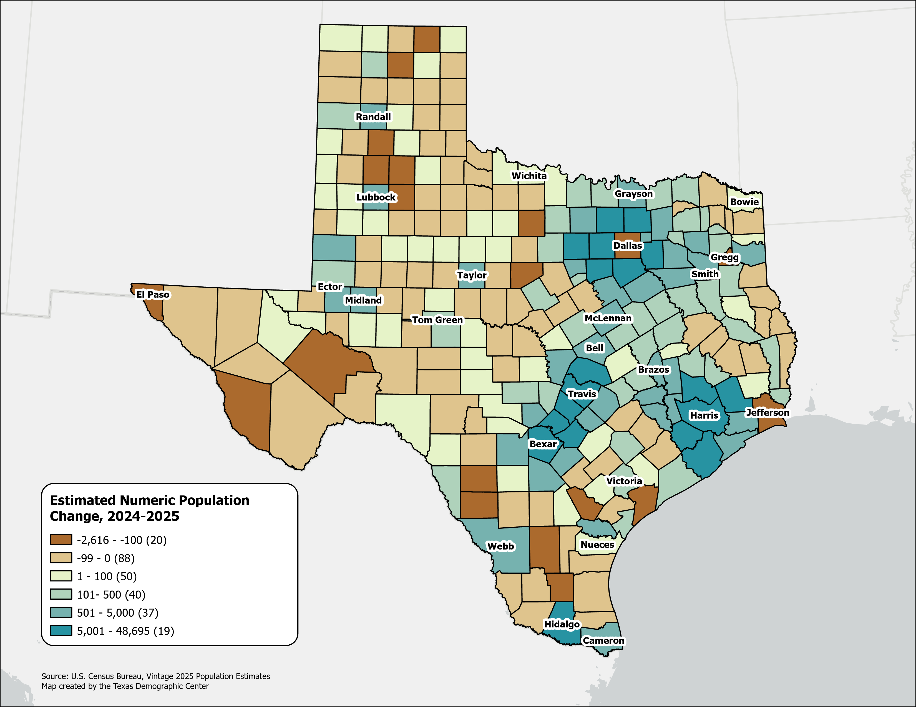
Estimated Numeric Population Change, Texas Counties, 2024-2025
Population declined in 108 Texas counties, primarily in rural areas.
Dallas experienced the largest numeric population loss, along with several border counties.
Source: U.S. Census Bureau, Vintage 2025 Population Estimates

Slide 10
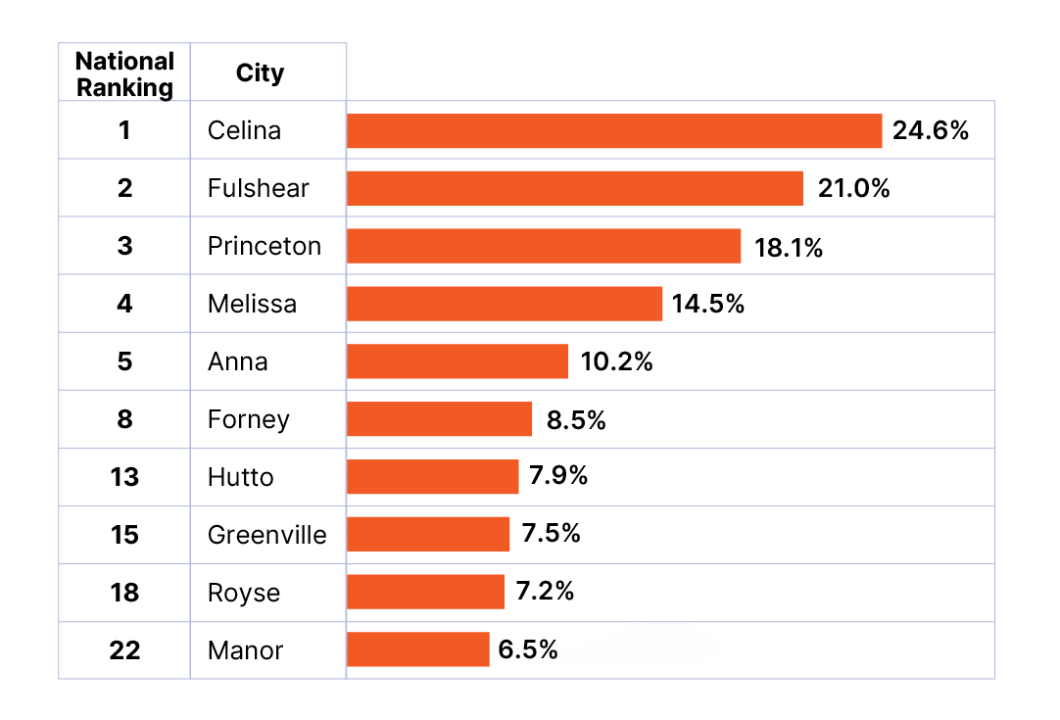
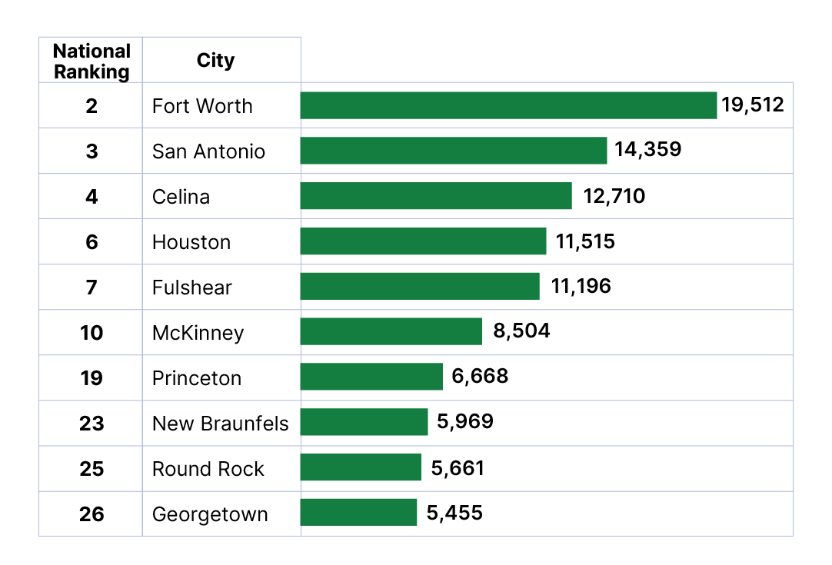
Top Growth Texas Cities and Towns
Top 10 Cities by Percent Growth in Texas
From July 1, 2024 to July 1, 2025
Top 10 Cities by Numeric Growth in Texas
From July 1, 2024 to July 1, 2025
Source: U.S. Census Bureau, Vintage 2025 Population Estimates. Ranked among incorporated places with a population of 20,000 or more.

Slide 11
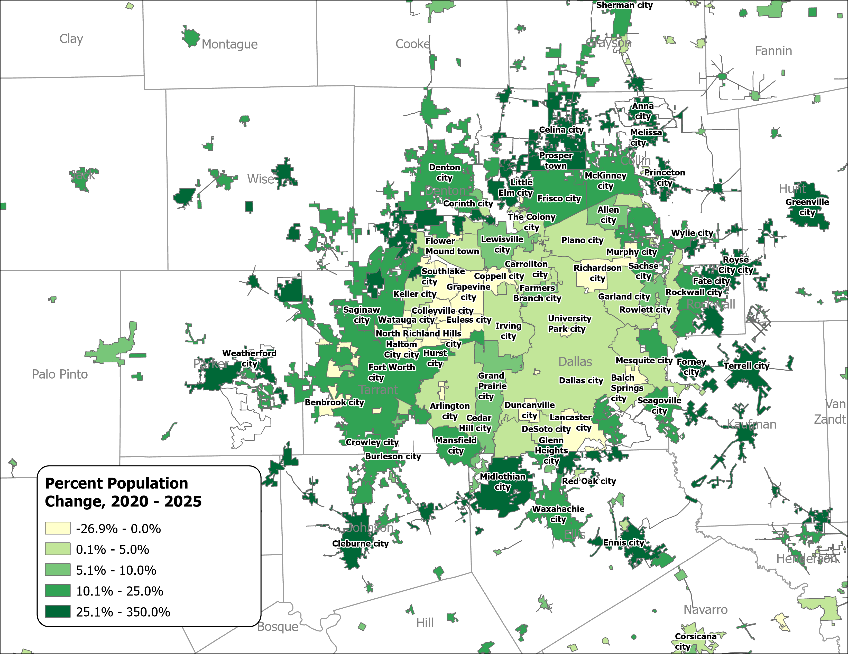
Percent Population Change for Incorporated Places, 2020-2025
Dallas-Fort Worth Area
Growth in major urban centers slowed considerably.
Small and midsized suburban and exurban cities within the Triangle region experienced the most rapid expansion.
Source: U.S. Census Bureau, Vintage 2025 Population Estimates

Slide 12
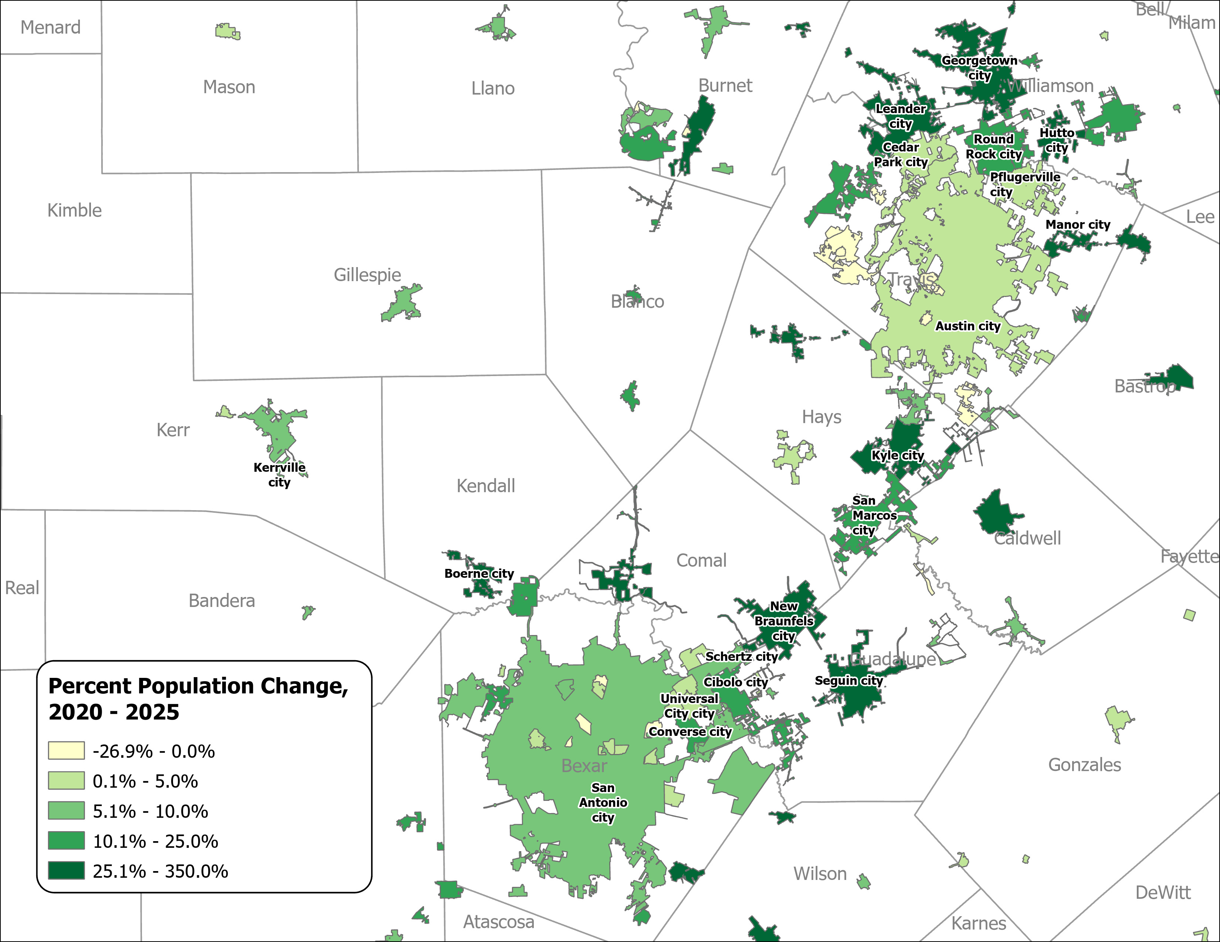
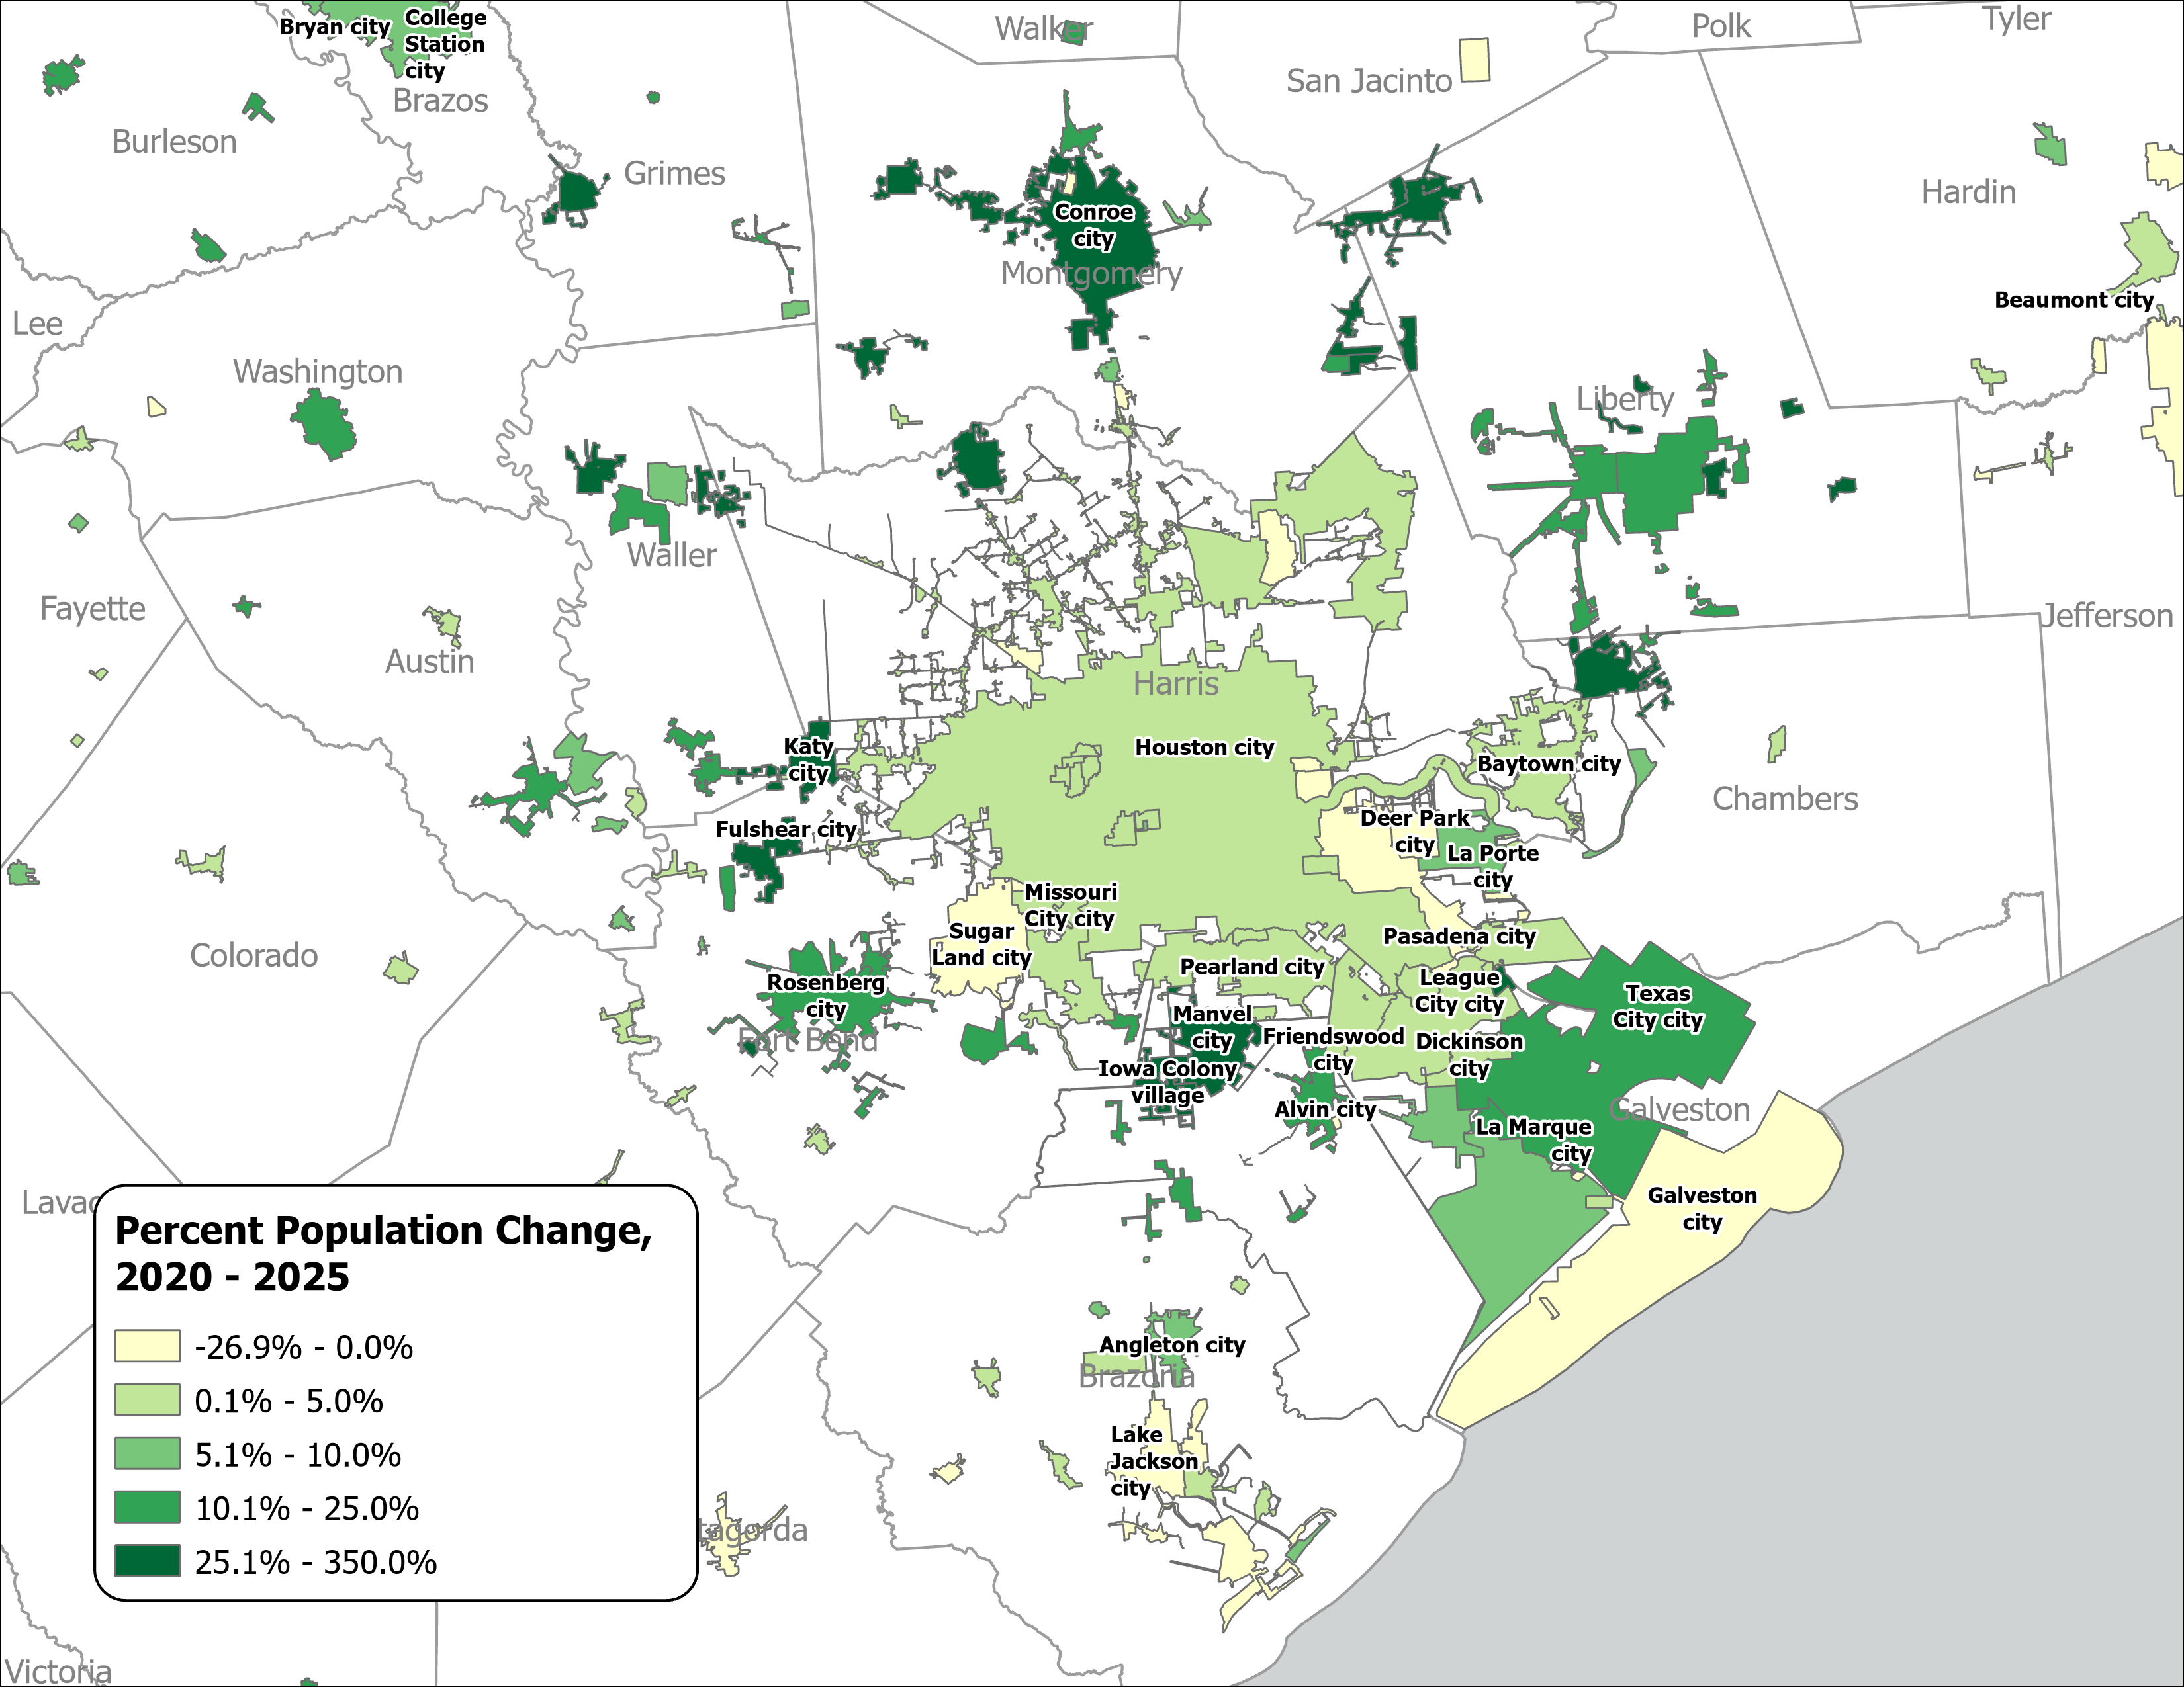
Percent Population Change for Incorporated Places, 2020-2025
(Austin, San Antonio, Houston)
Austin and San Antonio Area
Houston Area
Source: U.S. Census Bureau, Vintage 2025 Population Estimates

Slide 13
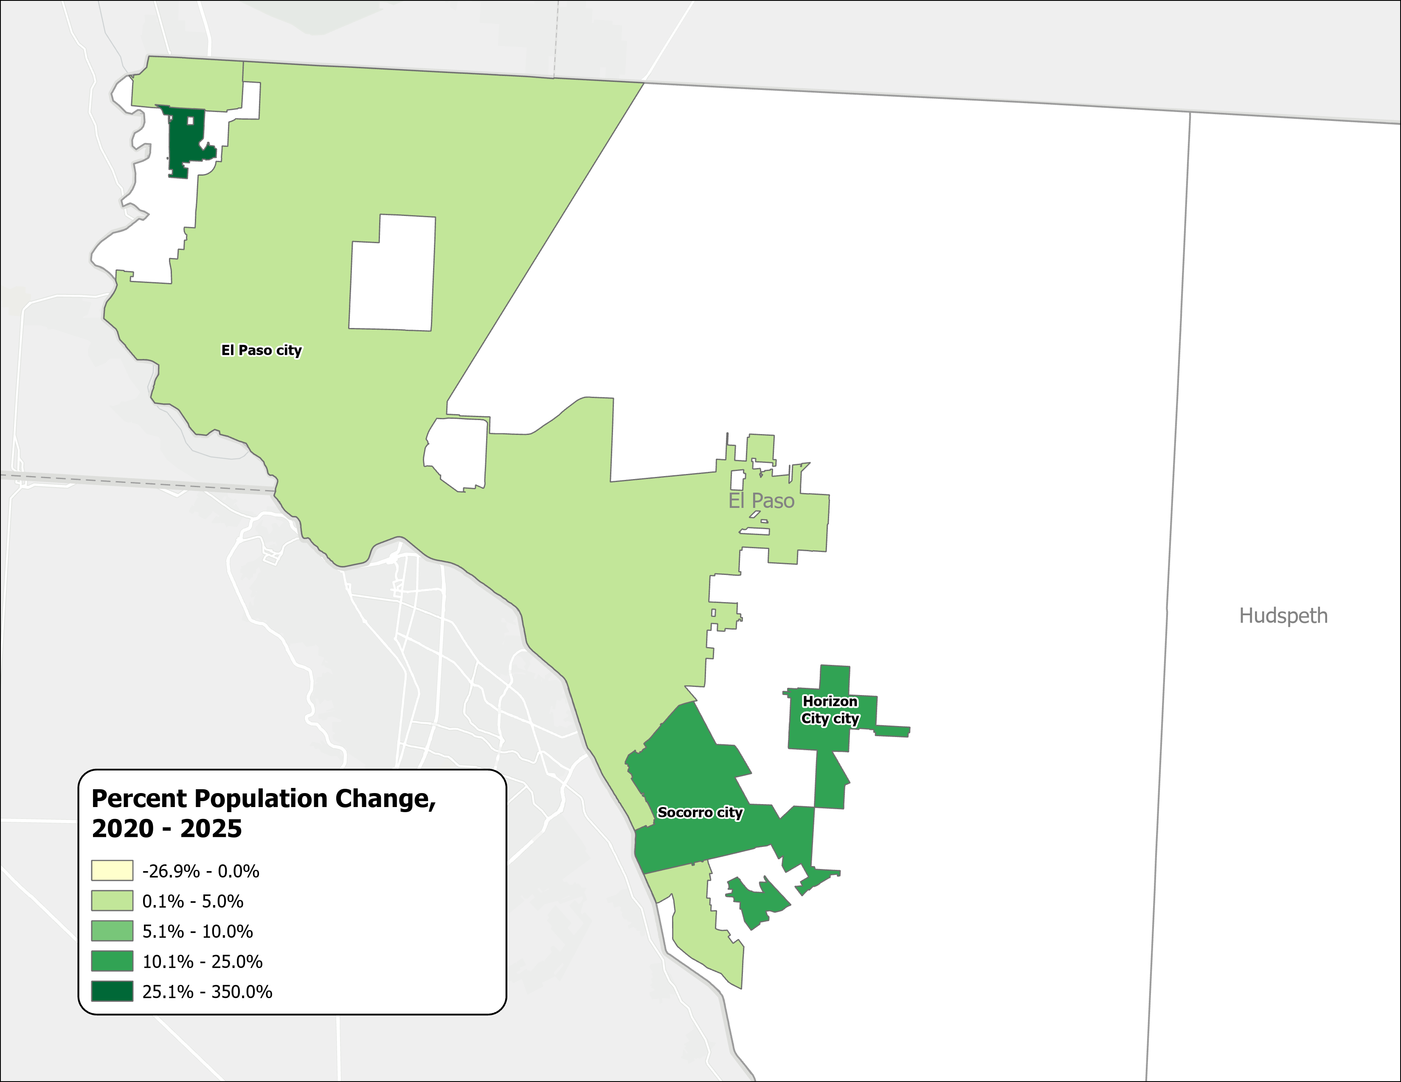
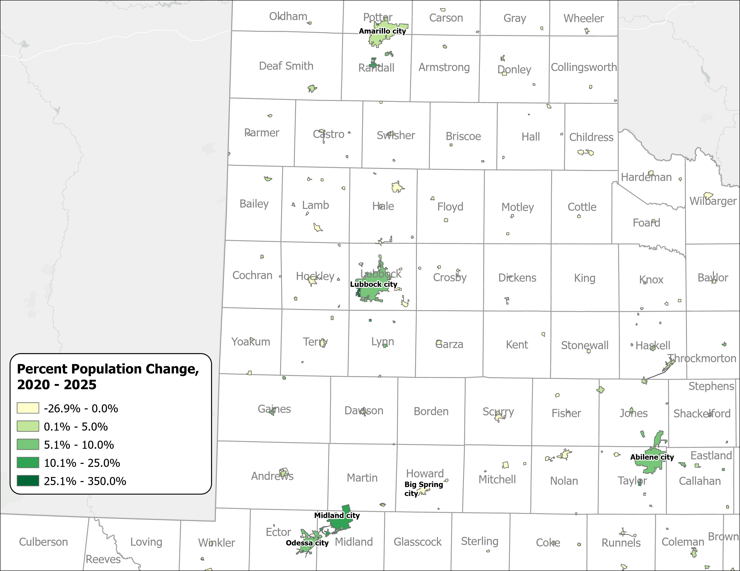
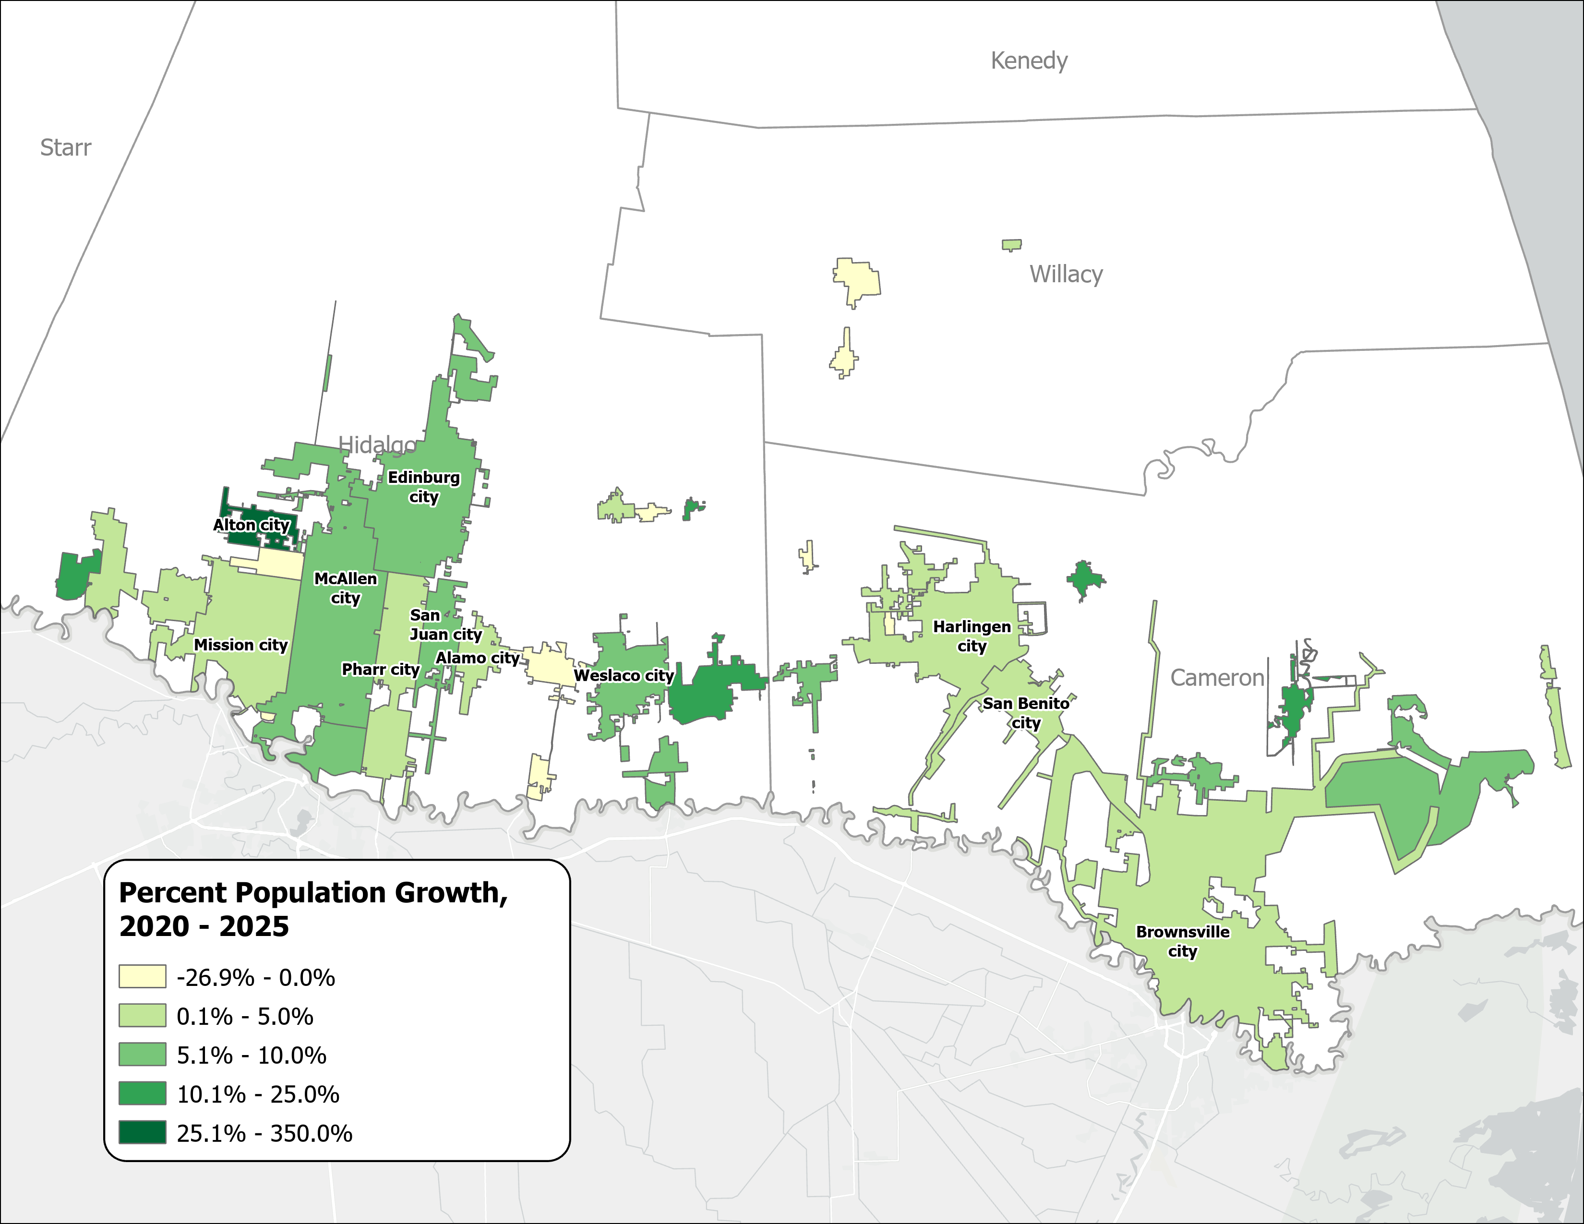
Percent Population Change for Incorporated Places, 2020-2025
(El Paso, Panhandle and West Texas, and Rio Grande Valley)
El Paso Area
Panhandle and West Texas
Rio Grande Valley
Source: U.S. Census Bureau, Vintage 2025 Population Estimates

Slide 14
Drivers of Population Growth
Notes:
Now let's shift to the drivers behind these population trends. This is a topic that I know many of you at this conference follow closely.
Understanding why Texas is growing — and why that growth is changing — requires looking at three components: natural increase, which is births minus deaths; domestic migration, which is people moving within the United States; and international migration. Each of these has shifted significantly in recent years, and the interplay between them tells a more nuanced story than the headline growth numbers alone.

Slide 15
Texas Daily Population Growth and Components of Change, 2020-2025
Reduced international and domestic migration drove the decline, while natural increase made up 40% of growth, up from about 25% since 2020.
917 | 1,494 | 1,647 | 1,642 | 1,072 | Daily Average Population Change
Source: U.S. Census Bureau, Vintage 2025 Population Estimates
Note: Components of change may not add to the total population change due to the minor residual components in the Census Bureau’s Population Estimates

Slide 16
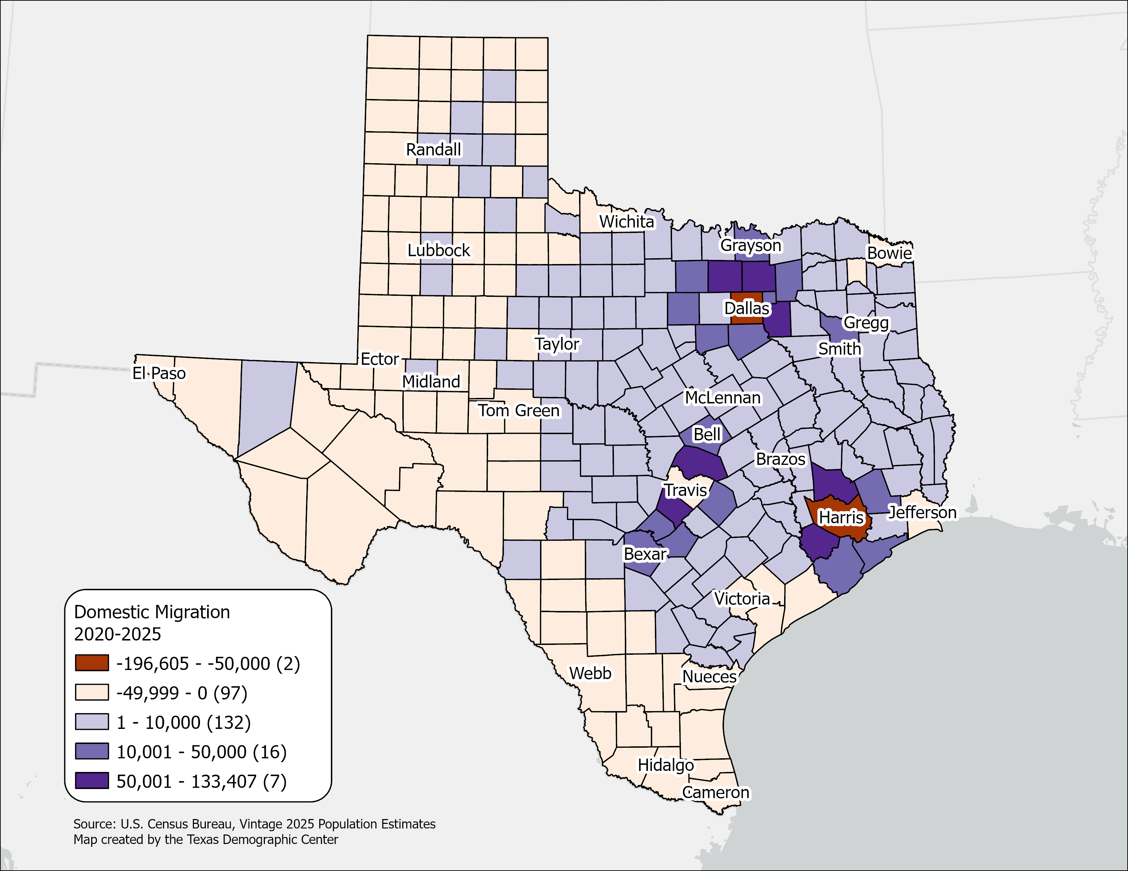
Estimated Net Domestic Migration between 2020 and 2025,
Texas Counties
Ninety‑nine counties, primarily in West Texas, South Texas, and the Panhandle, experienced net domestic migration losses or minimal gains.
The Texas Triangle continues to be the primary destination for domestic migrants in the state.
Central‑city counties within the Texas Triangle saw the largest numeric migration losses, largely reflecting population movement to surrounding suburban counties.
Source: U.S. Census Bureau, Vintage 2025 Population Estimates.

Slide 17
Top 10 Texas Counties for Net International Migration
 | International Migration 2020-2025 | % Share
Texas | 1,017,836 | 100%
Harris | 308,470 | 30%
Dallas | 155,526 | 15%
Travis | 73,742 | 7%
Tarrant | 70,644 | 7%
Collin | 63,163 | 6%
Bexar | 58,857 | 6%
Fort Bend | 42,287 | 4%
Denton | 30,861 | 3%
Williamson | 22,604 | 2%
Montgomery | 21,212 | 2%
Source: U.S. Census Bureau, Vintage 2025 Population Estimates

Slide 18
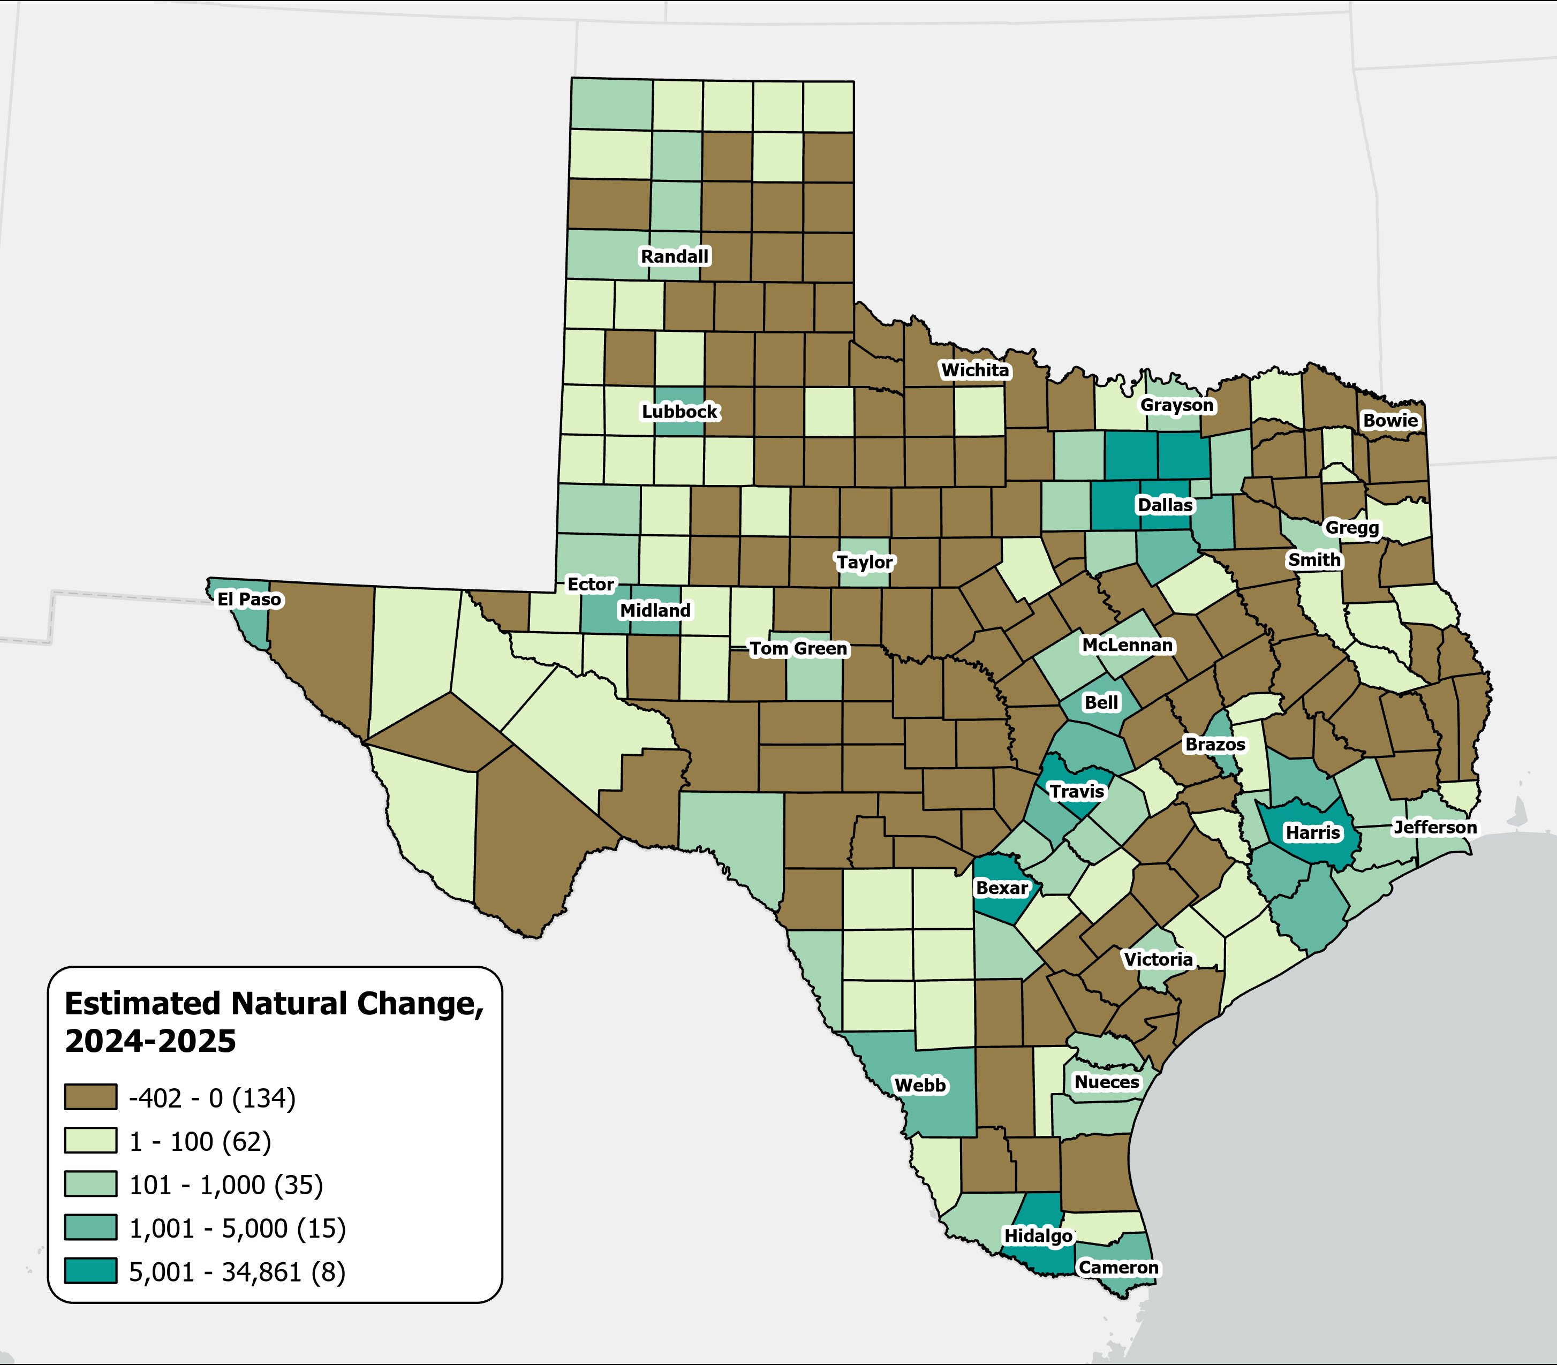
A majority of Texas counties saw more deaths than births
Estimates Natural Change Across Texas Counties
From July 2024 to July 2025
134
counties experienced natural population decline, with most located in rural areas.
Source: U.S. Census Bureau, Vintage 2025 Population Estimates

Slide 19
Texas Fertility Rates, 2007-2024
Births per 1,000 women aged 15-44
Source: Centers for Disease Control and Prevention, National Center for Health Statistics. Natality on CDC WONDER Online Database, 2007-2024.

Slide 20
Texas Fertility Rates by Age Group of Mothers, 2009 and 2024
Note: Birth rate is expressed as births per 1,000 women ages 15–44 during the calendar year.
Source: Centers for Disease Control and Prevention, National Center for Health Statistics.

Slide 21
Population, Housing, and Transportation
Notes:
Now let's go beyond the pure demographic numbers and look at some of the real-world impacts and implications of these population trends. This section connects demographics to the issues that many of you work on every day and that will be featured in conference sessions throughout the day — housing affordability, commuting and transportation, water resources, education, labor force participation, disability, rural population dynamics, and healthcare access.
The data here underscores why demographic analysis matters for policy and planning.

Slide 22
The Formation of the Golden Triangle
Growth accelerated after the mid-1950s, when the Interstate Highway System began linking these counties to regional markets.
(I-35, I-45, I-10, I-37)
Source: U.S. Census Bureau, American Community Survey, 2024 5-year estimates

Slide 23
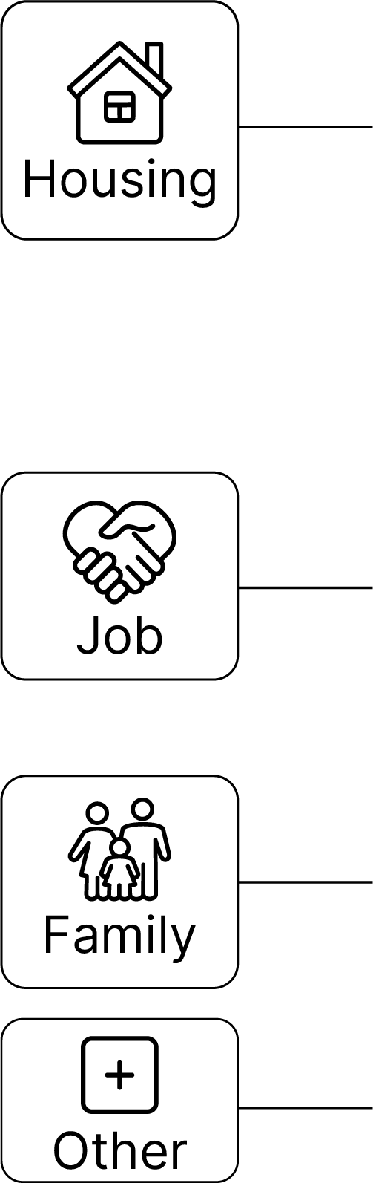
Why Texans Move, 2022-2023
Between 2024 and 2025, people moved within Texas or from elsewhere to Texas primarily for housing reasons.
Why Texans Move?
Top Detailed Reasons ?
2020
Housing | wanted new or better house/apartment | 14%
Housing | to establish own household | 12%
Job | new job or job transfer | 11%
2025
Job | new job or job transfer | 12%
Housing | wanted new or better house/apartment | 11%
Housing | cheaper housing | 11%
Source: U.S. Census Bureau, Current Population Survey Annual Social and Economic Supplement (ASEC) Supplement (March 2023).

Slide 24

Median Household Income and Home Value Gap Widens in Texas, 2013-2023
Housing costs outpace income for many Texans
Median
Home
Value
Median
Household
Income
$
$
$
Source: U.S. Census Bureau, American Community Survey, 1-Year, 2013, 2018, and 2023.
Note: Data represented in 2023 inflation-adjusted dollars.

Slide 25
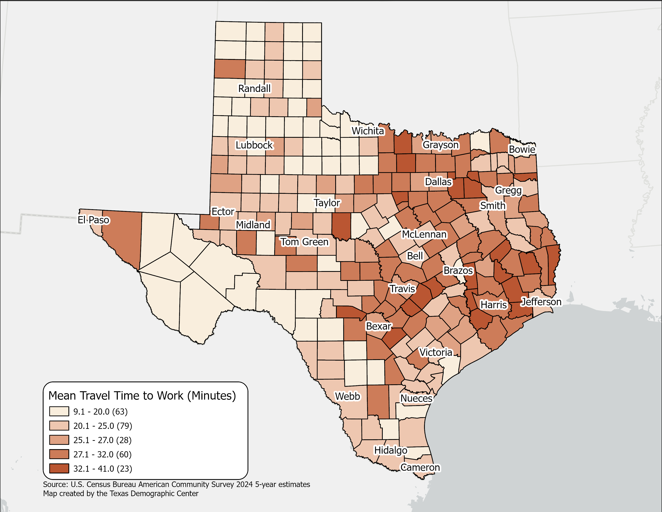
Mean Travel Time to Work(minutes),
Texas Counties, 2024
Mean Travel time for Texas:
  26.7 (2024 5-year)
  25.2 (2014 5-year)
Geographic variation across Texas counties reflects higher travel times in large metropolitan and suburban areas.
Source: U.S. Census Bureau, American Community Survey, 2024 5-year estimates

Slide 26
Means of Transportation to Work in Texas
Source: U.S. Census Bureau, American Community Survey, 2024 1-year estimates

Slide 27
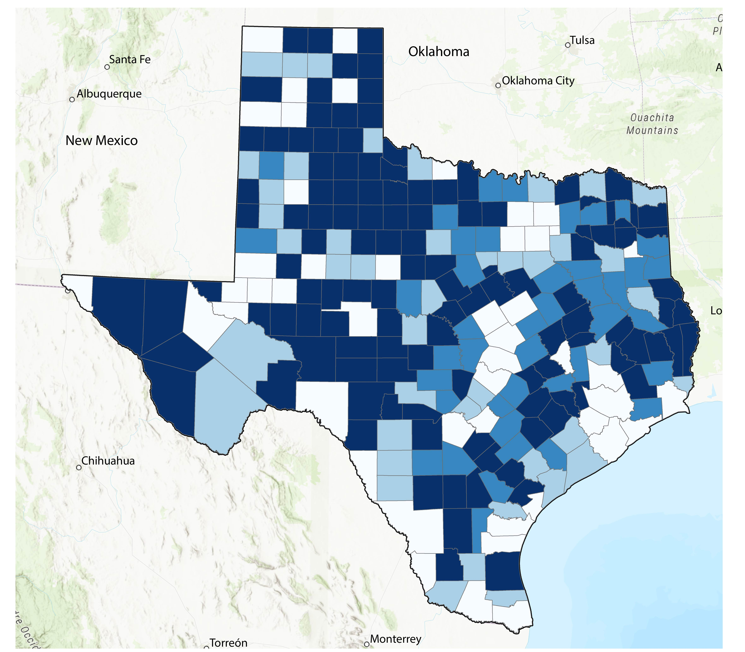
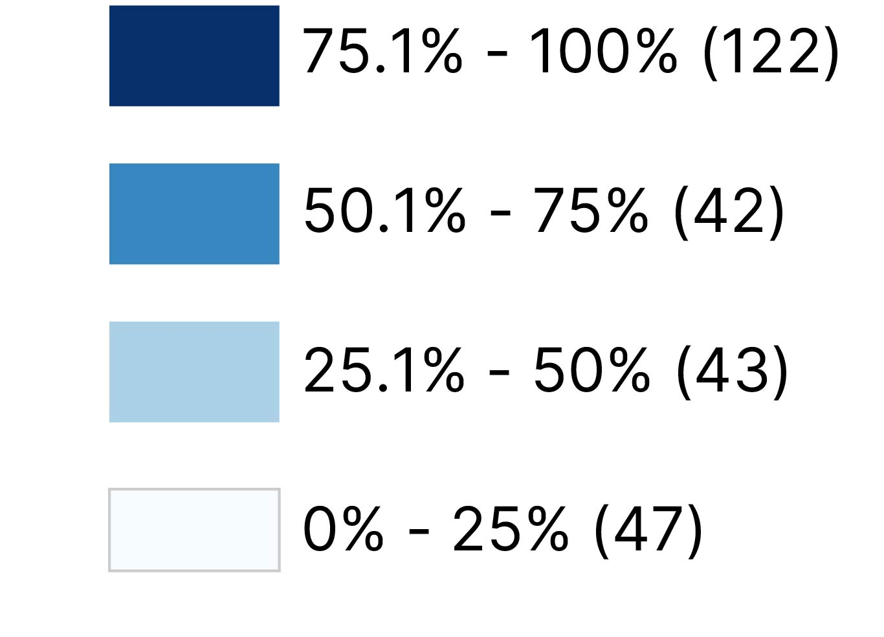
Texas is home to the largest rural population in the U.S.
Percent of Rural Population by County
4,744,808 or 16%
of Texans live outside the urban areas defined by the Census Bureau.
Source: U.S. Census Bureau, 2020 Decennial Census Demographic and Housing Characteristics (DHC) File

Slide 28
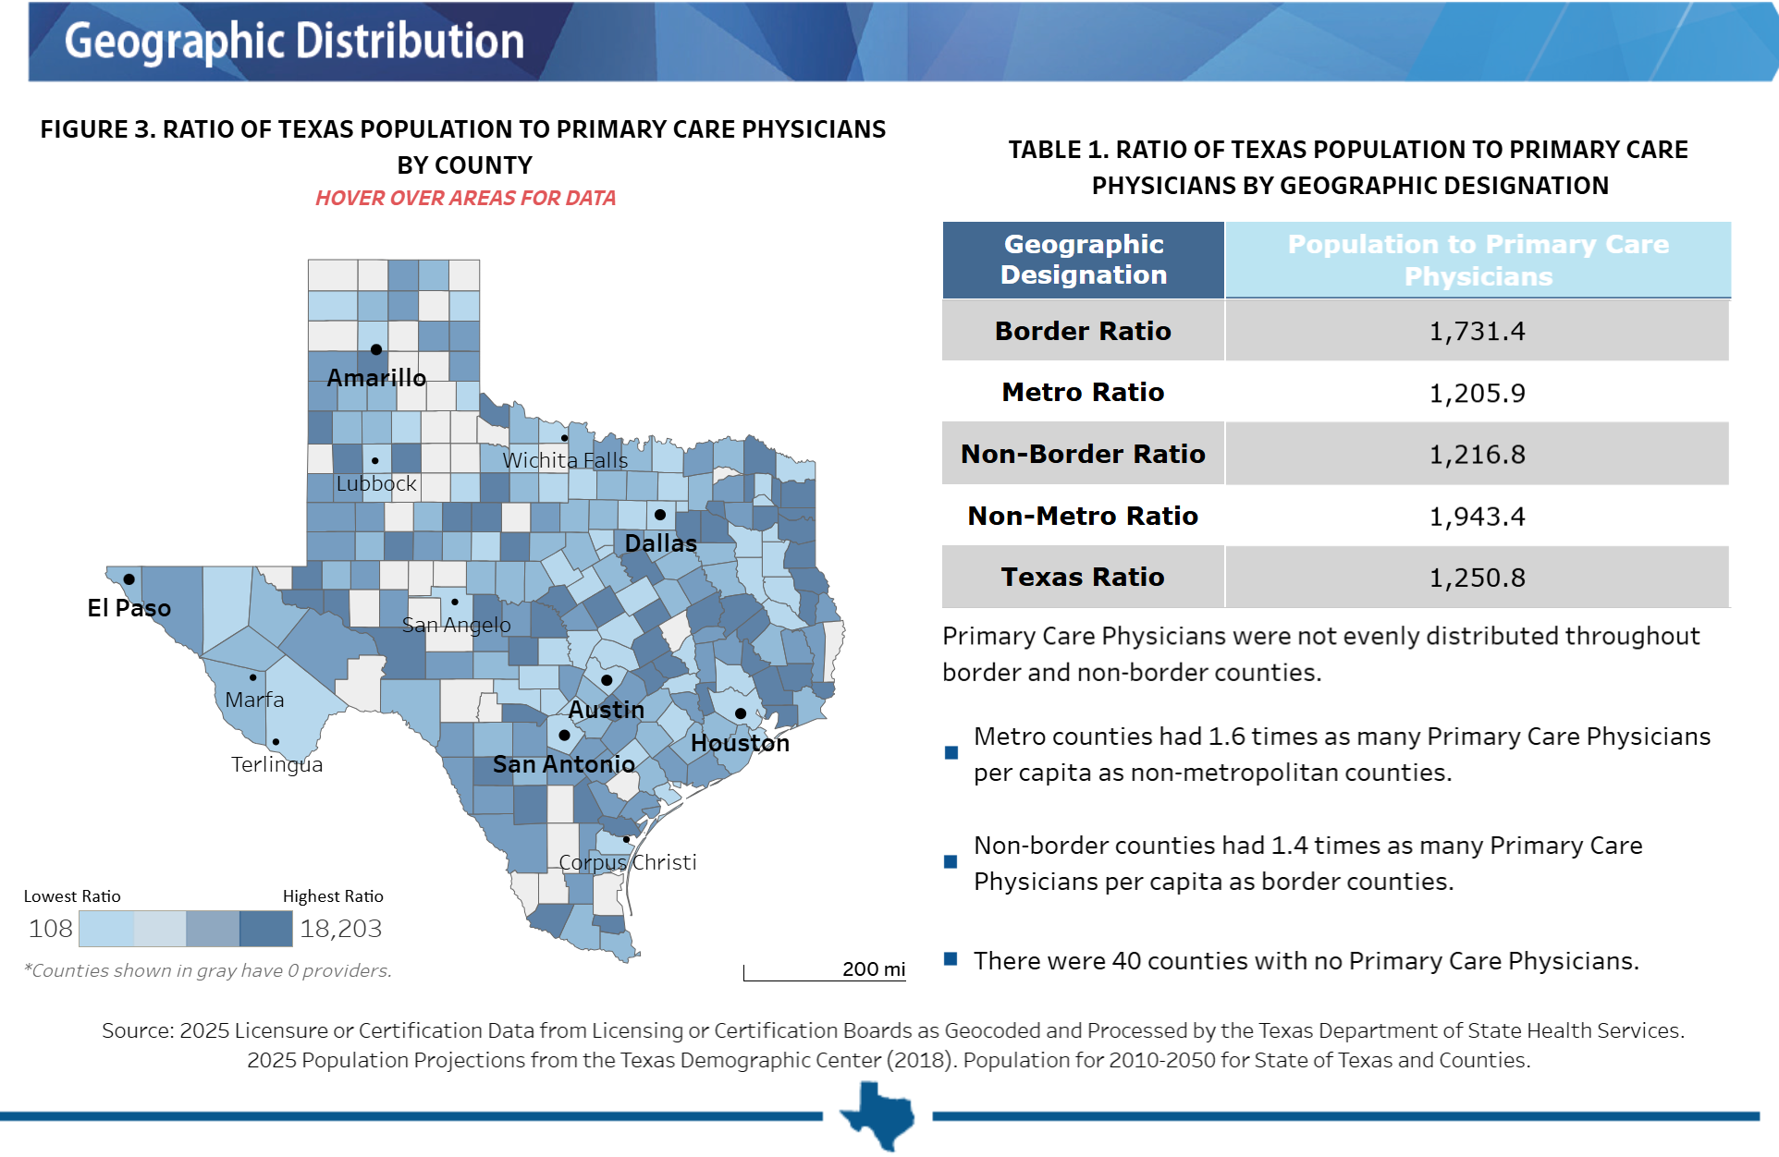
Primary Care Geographic Distribution in Texas, 2025
Source: Texas Department of State Health Services. https://healthdata.dshs.texas.gov/dashboard/health-care-workforce/hprc/health-profession-fact-sheets

Slide 29
Looking into the Future

Slide 30
Texas is expected to keep growing significantly.
Projected Population Growth in Texas with Various Migration Scenarios
42.6 million
in 2060.
(Mid-migration Scenario)
Source: Texas Demographic Center, Vintage 2024 Population Projections

Slide 31
Projected Population by Age
2020, 2040, and 2060
Mid Migration Scenario
22%
18%
Texas will continue to age in the next few decades.
The 65+ group will grow fastest.
Growth among those under 18 will slow and begin to decline.
The working-age population will grow and maintain a stable share of the total population.
13%
60%
60%
62%
Total Population
29.1M
37.1M
42.6M
Source: Texas Demographic Center, Vintage 2024 Population Projections, Mid Migration Scenario

Slide 32
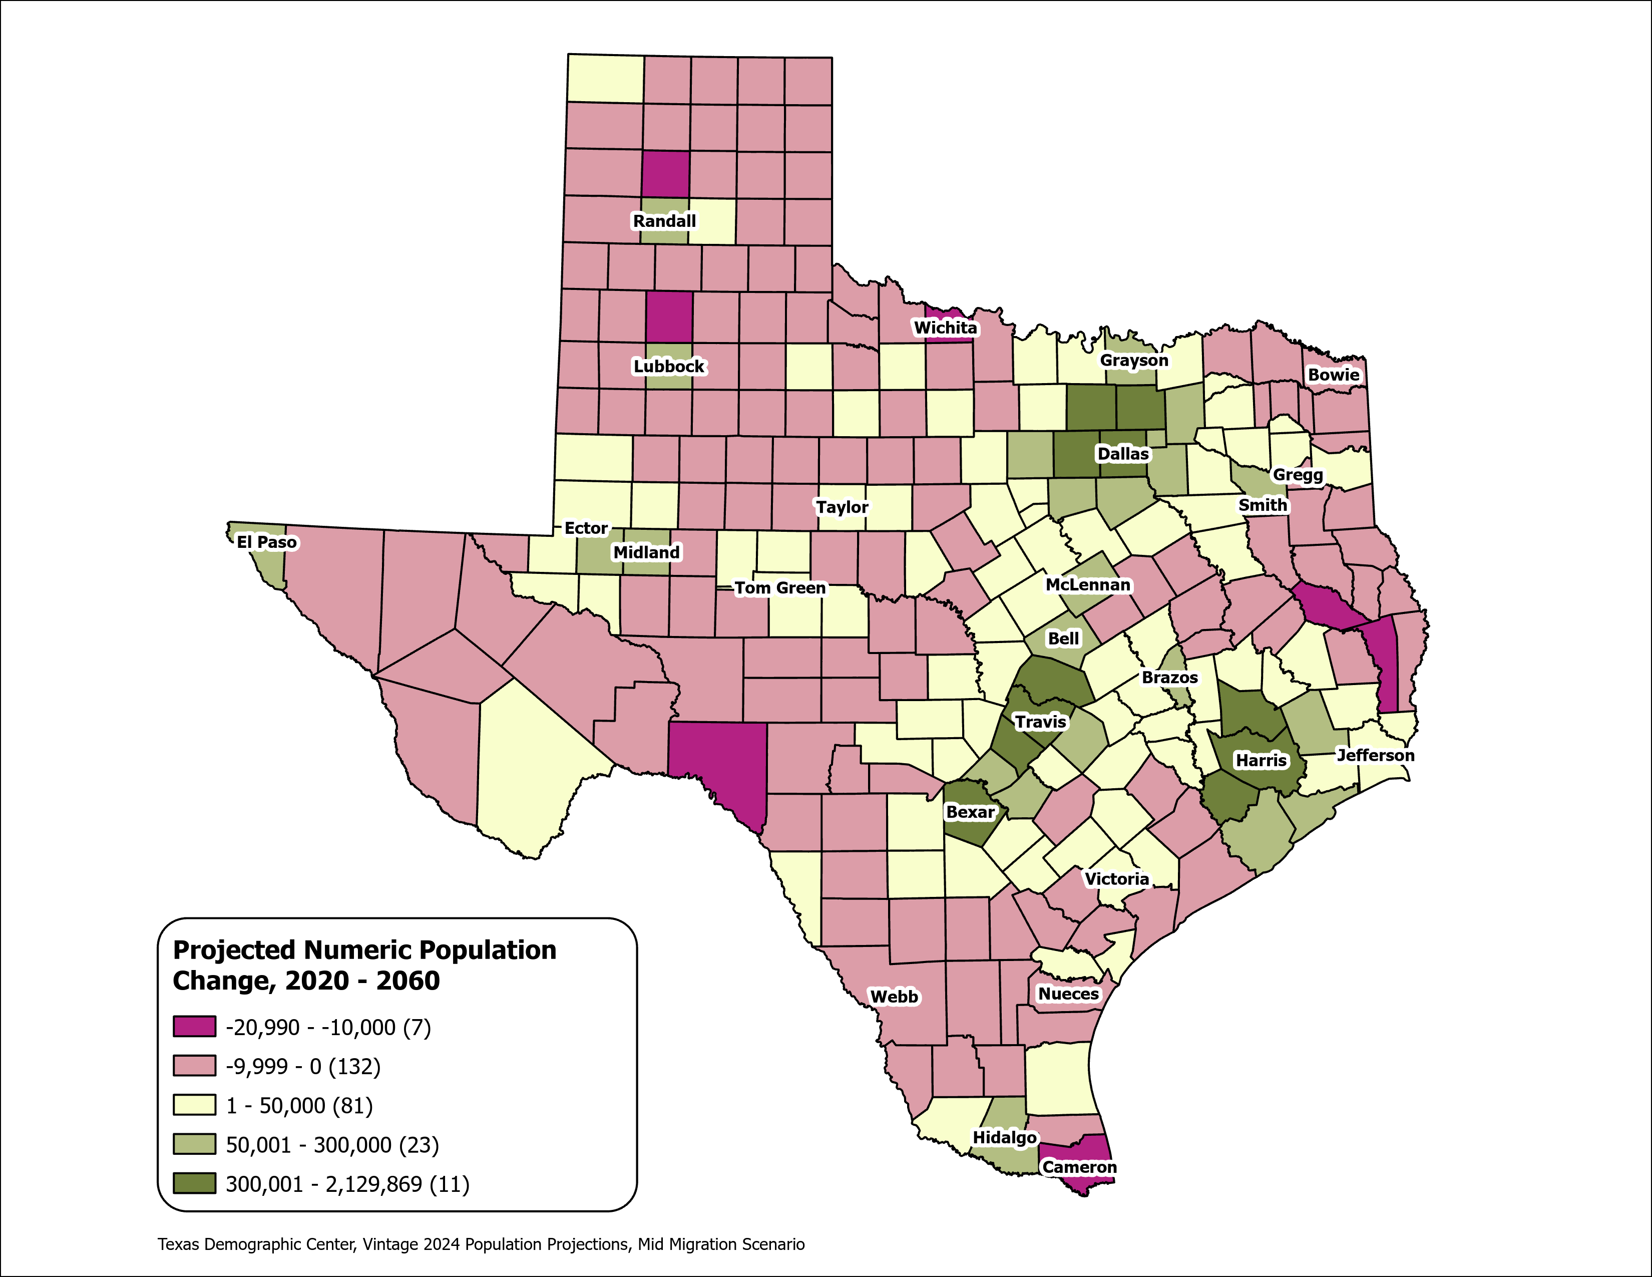
Texas Counties
Projected Population Numeric Change 2020-2060
Mid Migration Scenario
139 Counties are projected to lose population
Current MSA counties will account for 99% of the state’s growth from 2020 to 2060
The four MSAs within the TX Triangle will increase their share of population from 67% to 74%
Source: Texas Demographic Center, Vintage 2024 Population Projections, Mid Migration Scenario

Slide 33
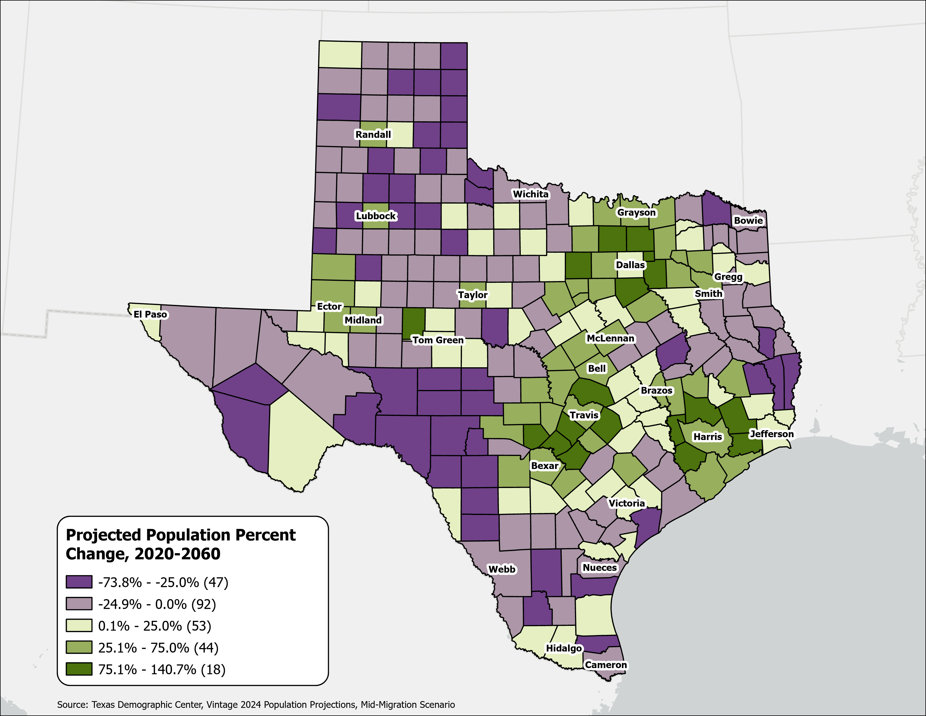
Texas Counties
Projected Population Percent Change 2020-2060
Mid Migration Scenario
Suburban ring counties in the triangle area will see the fastest growth rates.
Source: Texas Demographic Center, Vintage 2024 Population Projections, Mid Migration Scenario

Slide 34
How Growth and Transportation Are Reshaping Texas
Key Takeaways from Texas Demographic Data
Trends
Slower growth nationwide
Growth concentrated in the suburban and exurban areas of the Texas Triangle, expanding outward along major highway corridors
Rural counties losing population and aging
Domestic migration at its lowest in a decade; natural increase now 40% of growth
Fertility rates declining; baby boomers driving rapid aging
Challenges
Growing pains: as metros grow, commutes lengthen and most workers still drive alone
Road and transit capacity strains to keep pace with rapid suburban growth
Rural and border counties face the longest trips to jobs, services, and care
Opportunities
Reaching 42.6 million by 2060 will drive strong demand for new transportation infrastructure.
A robust, smart transportation system fuels a sustained economic boom as the population and workforce keep expanding.
Connecting regions through new transportation links opens opportunities for new development.
Data-driven planning that aligns transportation, housing, and infrastructure with where Texans are moving is essential for ensuring Texas's future prosperity

Slide 35
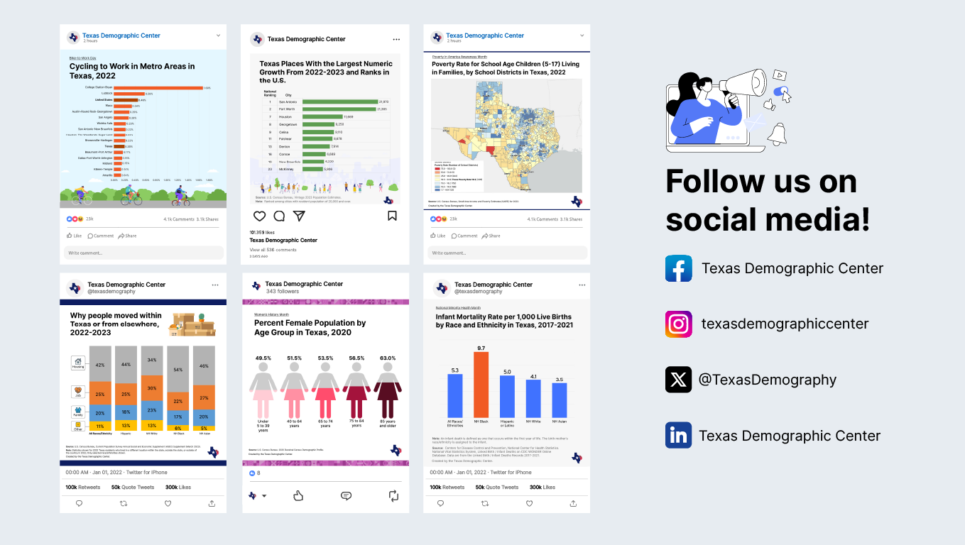
Follow us on social media

Slide 36
About Presenter
Helen You, Ph.D.
(210) 458-6530
tdc@utsa.edu
demographics.texas.gov/

